Slide 1
Optimization in R

Slide 2
Historically
R had very limited options for optimization
  There was nls
  There was optim
  There was nothing else
Both would work, but;
  Sensitive to starting values
  Convergence was a hope and a prayer in tricky problems

Slide 3
Now
From CRAN Optimization task view
_x0016_What follows is an attempt to provide a by-subject overview of packages. The full name of the subject as well as the corresponding MSC code (if available) are given in brackets.
LP (Linear programming, 90C05): boot, glpk, limSolve, linprog, lpSolve, lpSolveAPI, rcdd, Rcplex, Rglpk, Rsymphony, quantreg
GO (Global Optimization): Rdonlp2
SPLP (Special problems of linear programming like transportation, multi-index, etc., 90C08): clue, lpSolve, lpSolveAPI, optmatch, quantreg, TSP
BP (Boolean programming, 90C09): glpk, Rglpk, lpSolve, lpSolveAPI, Rcplex
IP (Integer programming, 90C10): glpk, lpSolve, lpSolveAPI, Rcplex, Rglpk, Rsymphony
MIP (Mixed integer programming and its variants MILP for LP and MIQP for QP, 90C11): glpk, lpSolve, lpSolveAPI, Rcplex, Rglpk, Rsymphony
SP (Stochastic programming, 90C15): stoprog
QP (Quadratic programming, 90C20): kernlab, limSolve, LowRankQP, quadprog, Rcplex
SDP (Semidefinite programming, 90C22): Rcsdp
MOP (Multi-objective and goal programming, 90C29): goalprog, mco
NLP (Nonlinear programming, 90C30): Rdonlp2, Rsolnp
GRAPH (Programming involving graphs or networks, 90C35): igraph, sna
IPM (Interior-point methods, 90C51): kernlab, glpk, LowRankQP, quantreg, Rcplex
RGA (Methods of reduced gradient type, 90C52): stats ( optim()), gsl
QN (Methods of quasi-Newton type, 90C53): stats ( optim()), gsl, ucminf
DF (Derivative-free methods, 90C56): minqa

Slide 4
Convex Optimization
Maximum likelihood is usually a smooth, convex, well defined problem
Many other statistical loss functions are designed to be well behaved, such as least squares.
Non convex optimization problems are harder to talk about and solve in 10 min.

Slide 5
An example
Many data sources will have common problems
  Data missing
  Data subject to lower (upper) limits of detection
  Data censored
In the face of these problems one may still need to estimate statistical quantities, like a correlation coefficient.

Slide 6
Likelihood for the correlation
We have to consider 4 cases:
  Y₁ and Y₂ Both observed, Called l₁
  Y₁ observed, Y₂ truncated, Called l₁
  Y₁ truncated, Y₂ observed, Called l₃
  Y₁ truncated, Y₂ truncated, Called l₄
  The likelihood is prod(L₁x L₂x L₃x L₄ )
  And has 5 parameters, only one of interest, ρ
  Details in Lyles et al (2001) Biometrics 57: 1238-1244

Slide 7
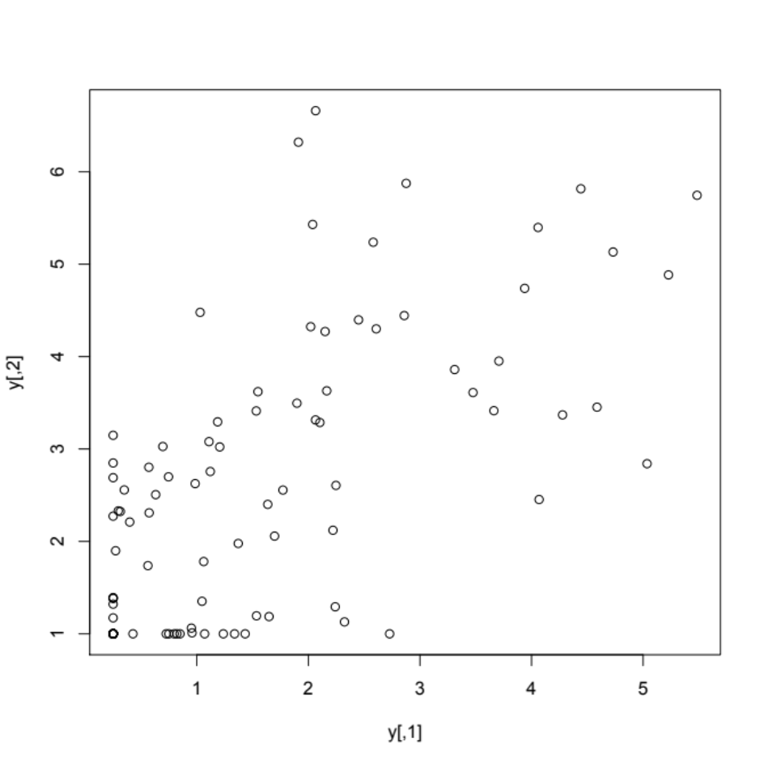
Sample data
Generate some truncated data
library(mvtnorm)
y<-rmvnorm(100,c(1,2),sigma=matrix(c(4,3,3,4),nr=2))
y[y[,1]<.25,1]<-.25
y[y[,2]<.25,2]<-1

Slide 8
Maximize function
myCensCorMle(y[,1],y[,2],start=rep(1,5))
[1] -209.629729 -36.250019 -29.423872 -2.631578
[1] -209.629820 -36.249818 -29.424006 -2.631555
[1] -209.629954 -36.249716 -29.423954 -2.631575
Save results from method L-BFGS-B
Assemble the answers
Sort results
$optans
par fvalues
1 1.9570621, 3.1099548, 1.3524671, 1.4210937, 0.3786403 285.5024
2 1.6705174, 2.6889463, 1.5077538, 1.6717092, 0.5619592 277.9352
method fns grs itns conv KKT1 KKT2 xtimes
1 bobyqa 23 NA NULL 0 FALSE TRUE 0.014
2 L-BFGS-B 13 13 NULL 0 TRUE TRUE 0.121
$start
[1] 1.9696264 3.1099548 1.3518358 1.4204625 0.5316266
Note: optimization function is optimx, and uses multiple optimizers

Slide 9
Conclusions
R has come a long way with optimization
New frameworks allow use of mltiple optimizers with little fuss

