Slide 1
Bayes methods
Using R & Openbugs
San Jose February 2015
Professor Chris Barker, Ph.D.
Consultant
www.barkerstats.com
Feb 2017 – San Jose
Chris Barker Statistical Planning and Analysis Services www.barkerstats.com

Slide 2
Bayes in R
Possible using “openbugs”
Openbugs generates Markov Chain Monte Carlo “MCMC” simulations for a very broad spectrum of Bayesian Models
Openbugs replaces “winbugs” (Spiegelhalter no longer updates winbugs)
Install from website
Feb 2017 – San Jose
Chris Barker Statistical Planning and Analysis Services www.barkerstats.com

Slide 3
Today’s talk
install/download openbugs
Install from cran: R2OpenBUGS
Install from cran: codea
invoke from R
generate bayes output and diagnostics
Nice tutorial
http://www.r-tutor.com/bayesian-statistics/openbugs
Feb 2017 – San Jose
Chris Barker Statistical Planning and Analysis Services www.barkerstats.com

Slide 4
library(R2OpenBUGS) ; library(MASS) ;library(coda)
  model <- function() {
  # Prior
  p ~ dbeta(1, 1)
  # Likelihood
  y ~ dbin(p, N) }
  model.file <- file.path("c:\\stats\\bayesopenbugs\\model.txt") ;model.file
  write.model(model, model.file)
  tbl <- table(survey$Smoke)
  N <- as.numeric(sum(tbl)); N ; y <- N - as.numeric(tbl["Never"]); y
  data <- list("N", "y");data
  params <- c("p");params
  inits <- function() { list(p=0.5) } ; inits
  out <- bugs(data, inits, params, codaPkg=TRUE, model.file, n.iter=10000)
  out.coda <- read.bugs(out)
Feb 2017 – San Jose
Chris Barker Statistical Planning and Analysis Services www.barkerstats.com

Slide 5
Openbugs output in R
> out
Inference for Bugs model at "c:\stats\bayesopenbugs\model.txt",
Current: 3 chains, each with 100 iterations (first 50 discarded)
Cumulative: n.sims = 150 iterations saved
mean sd 2.5% 25% 50% 75% 97.5% Rhat n.eff
p 0.2 0.0 0.2 0.2 0.2 0.2 0.3 1 150
deviance 6.4 1.3 5.5 5.6 5.9 6.8 10.0 1 150
For each parameter, n.eff is a crude measure of effective sample size,
and Rhat is the potential scale reduction factor (at convergence, Rhat=1).
DIC info (using the rule, pD = Dbar-Dhat)
pD = 0.9 and DIC = 7.4
DIC is an estimate of expected predictive error (lower deviance is better).
>
Feb 2017 – San Jose
Chris Barker Statistical Planning and Analysis Services www.barkerstats.com

Slide 6
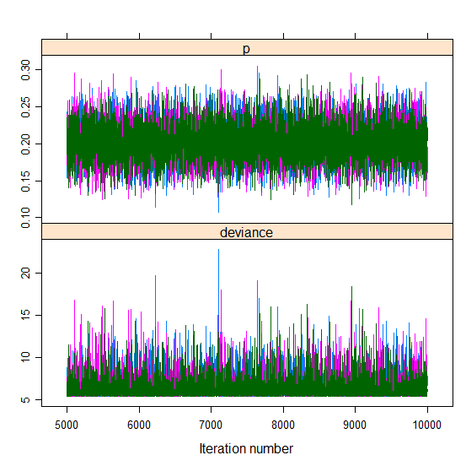
xyplot(out.coda)
Feb 2017 – San Jose
Chris Barker Statistical Planning and Analysis Services www.barkerstats.com

Slide 7
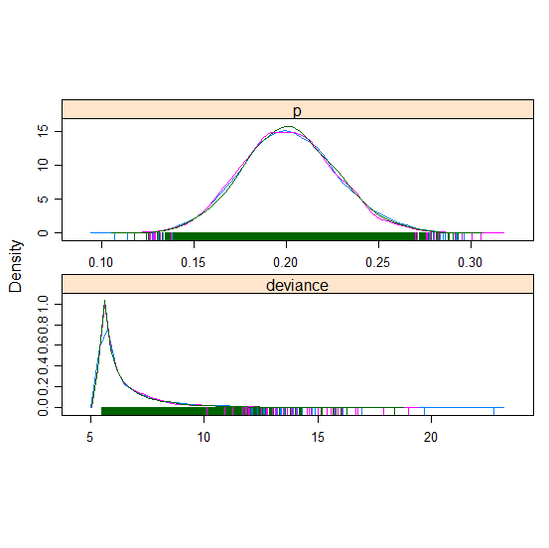
densityplot(out.coda)
Feb 2017 – San Jose
Chris Barker Statistical Planning and Analysis Services www.barkerstats.com

Slide 8
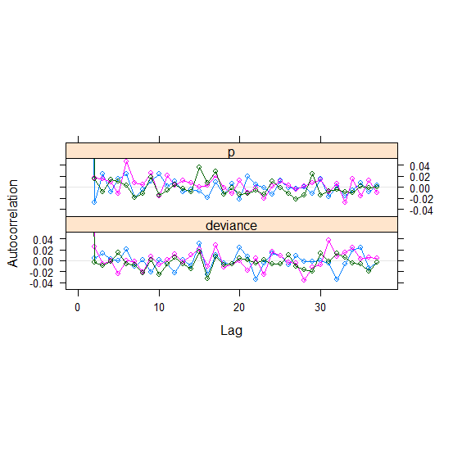
Autocorrelation acfplot(out.coda)
Feb 2017 – San Jose
Chris Barker Statistical Planning and Analysis Services www.barkerstats.com

Slide 9
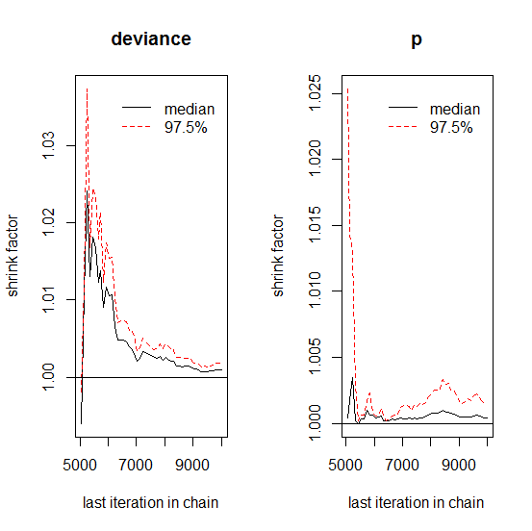
Gelman-Rubin-Brooks plot for visual confirmation of the shrink factor convergence as well.
> gelman.plot(out.coda)
Feb 2017 – San Jose
Chris Barker Statistical Planning and Analysis Services www.barkerstats.com

Slide 10
Credible intervals for P
out.summary <- summary(out.coda, q=c(0.025, 0.975))
out.summary$stat["p",]
Mean SD Naive SE Time-series SE
0.2014755467 0.0257468417 0.0002102221 0.0002153910
> out.summary$q["p", ]
2.5% 97.5%
0.1531 0.2545
Feb 2017 – San Jose
Chris Barker Statistical Planning and Analysis Services www.barkerstats.com

Slide 11
Questions
Feb 2017 – San Jose
Chris Barker Statistical Planning and Analysis Services www.barkerstats.com

