Slide 1
Generalization
Krishna Pillutla

Slide 2
References
Wilson, Ashia C., Rebecca Roelofs, Mitchell Stern, Nathan Srebro, and Benjamin Recht. "The Marginal Value of Adaptive Gradient Methods in Machine Learning." arXiv preprint arXiv:1705.08292 (2017).
Keskar, Nitish Shirish, Dheevatsa Mudigere, Jorge Nocedal, Mikhail Smelyanskiy, and Ping Tak Peter Tang. "On large-batch training for deep learning: Generalization gap and sharp minima." arXiv preprint arXiv:1609.04836 (2016).

Slide 3

Roadmap
Generalization: What? Why?
Generalization: How?
Choice of optimization algorithm
Choice of batch size
Tuning SGD step lengths

Slide 4
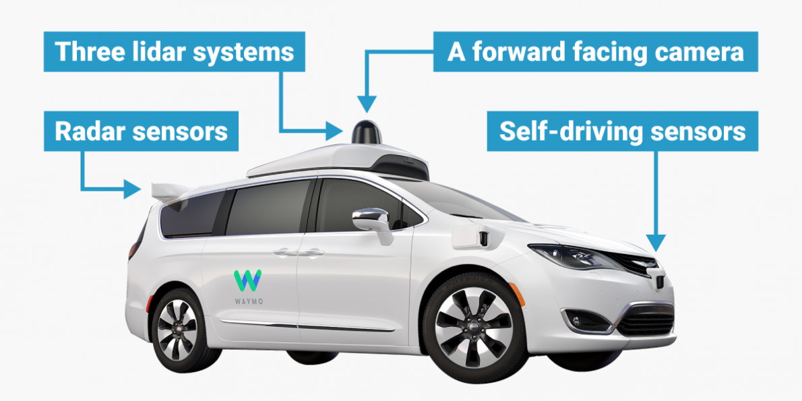
Generalization
Measures how accurately an algorithm is able to predict outcome values for previously unseen data
Good performance on training set does not necessarily translate to good out-of-sample-error

Slide 5
Choice of Algorithm and Generalization

Slide 6
Choice of Algorithm and Generalization
Non-adaptive algorithms:
SGD
SGD + momentum / Heavy Ball (HB)
Adaptive algorithms:
Adam
RMSprop
Adagrad, etc
When #parameters > #datapoints, choice of algorithm influences set of minima found

Slide 7
Choice of Algorithm and Generalization
Adaptive methods generalize significantly worse, even when they achieve better training performance!
Adaptive methods often display faster initial progress
Moral of the story: SGD/HB generalize better, potentially take longer

Slide 8
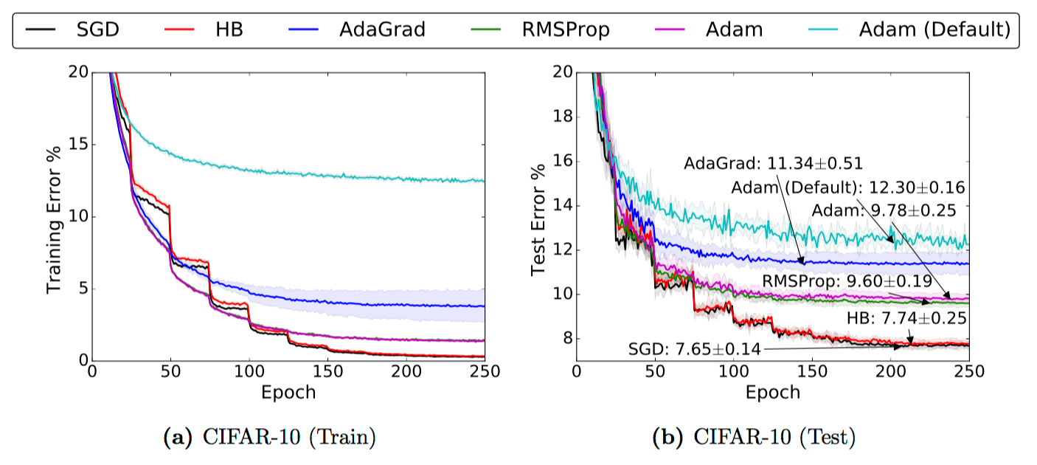
CNN on CIFAR10
Notes:
http://torch.ch/blog/2015/07/30/cifar.html
VGGnet

Slide 9
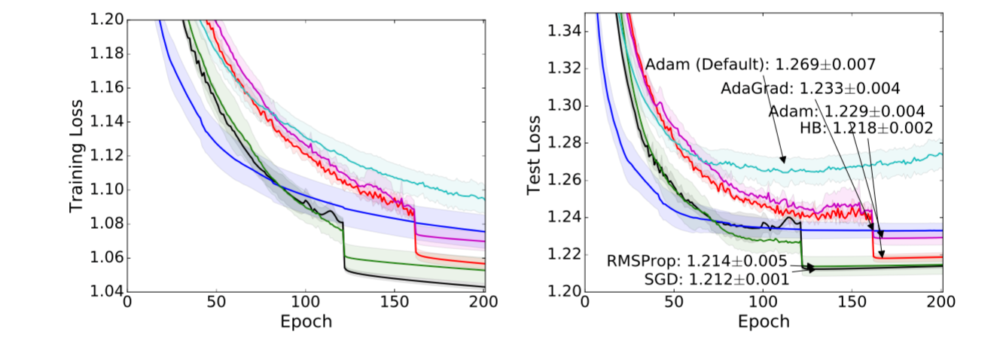
Character Level Language Modeling
Notes:
War and Peace,

Slide 10
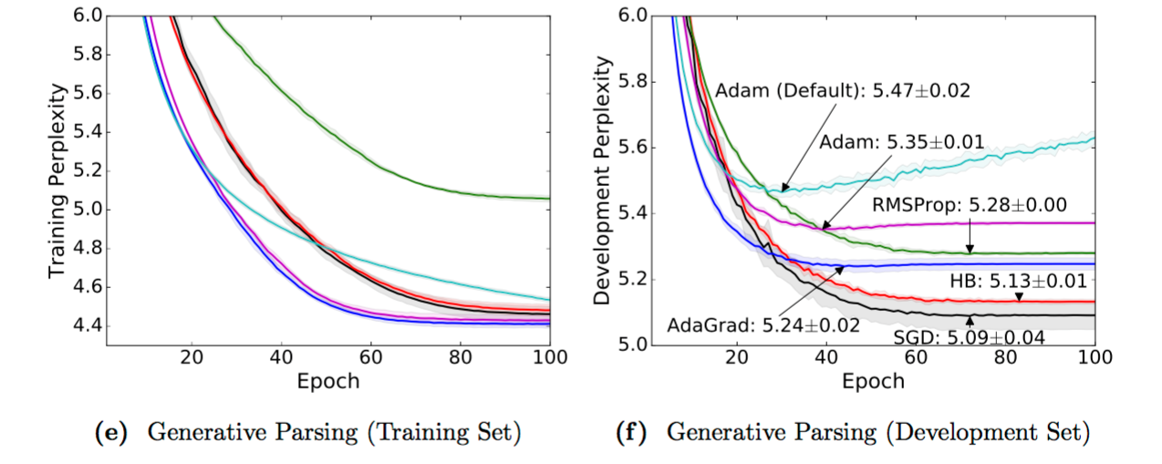
Generative Constituency Parsing
Notes:
Predict hierarchical structure of a sentence
Cast as language modeling problem with trees represented by depth-first traversal. Dataset: PTB. from Choe and Charniak
High correlation between perplexity and f1 dev score

Slide 11
Batch Size and Generalization

Slide 12
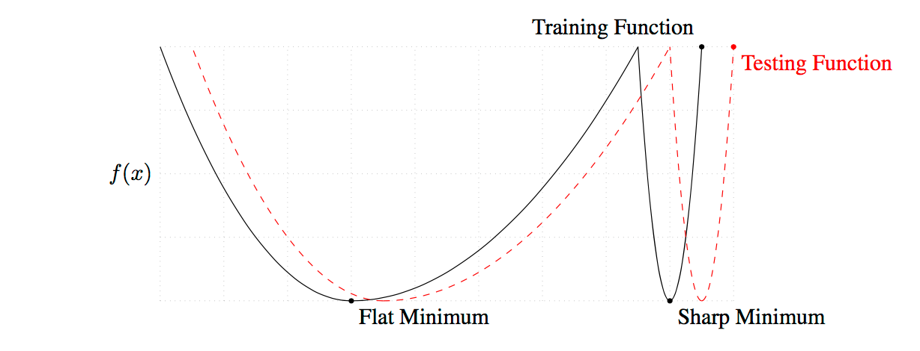
Sharp and Flat minima

Slide 13
Batch size and Generalization
Observation: Small batch sizes have better out-of-sample error
Example: CIFAR-10 on AlexNet (C1) and VGG (C2)

Slide 14
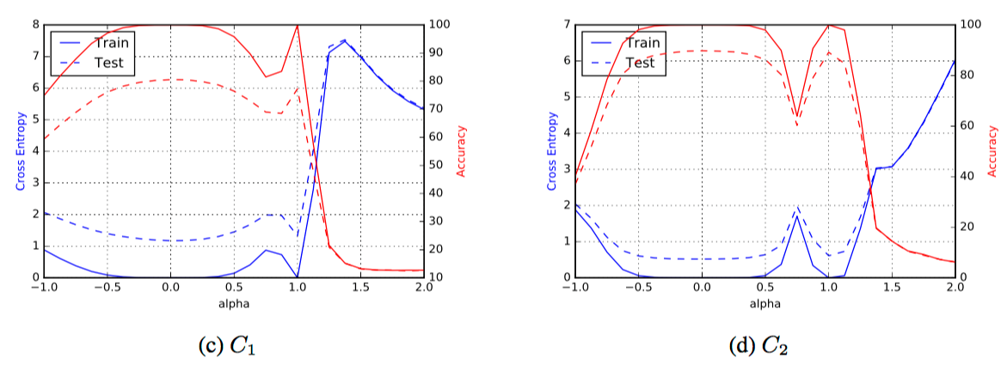
Sharpness
Notes:
Line joining SB (0.0) and LB (1.0)

Slide 15
SGD step sizes

Slide 16
Tuning SGD step sizes
Grid search: infeasible
Alternate procedure:
Find divergent step length
Start with slightly smaller step length
Cut step length by a factor if progress stalls (on a dev set)

Slide 17
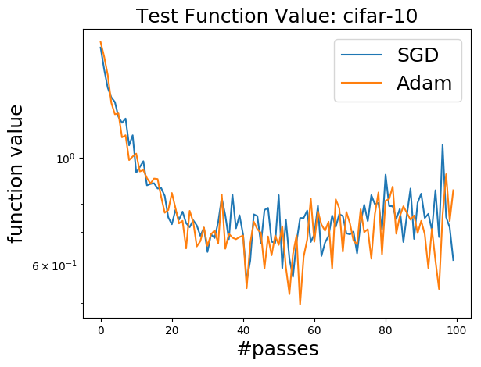
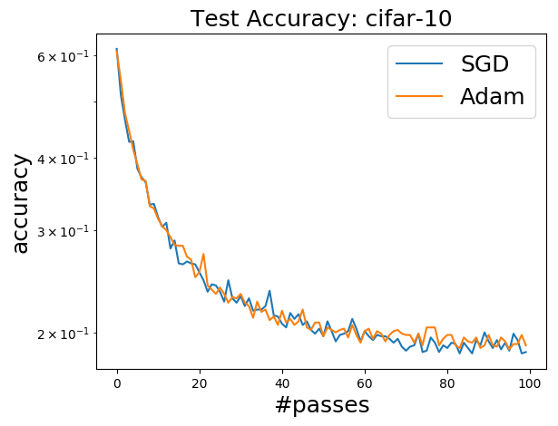
SGD vs Adam on CIFAR-10

Slide 18
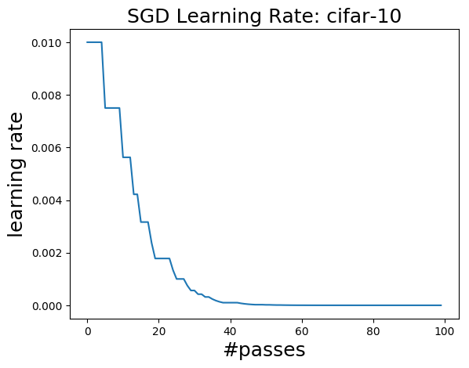
SGD step sizes CIFAR-10

Slide 19
Demo

