Slide 1
2023 CWE’s TOP TEN MOST DANGEROUS SOFTWARE WEAKNESSES

Slide 2
Key Terminology and Important Concepts
Weakness: General flaws/issues in a system that, if left unaddressed, may lead to vulnerabilities
Vulnerabilities: Known weaknesses in a system that can be exploited by attackers, resulting in a security risk
Exploits: Techniques or actions that take advantage of weaknesses to compromise a system's security
CWE (Common Weakness Enumeration): Community-developed list of software & hardware weaknesses
CVE (Common Vulnerabilities and Exposures): List of publicly disclosed computer security flaws in real world products

Slide 3
CWE-787: Out-of-bounds Write
Occurs in programs that writes data beyond the boundaries of an allocated memory buffer
Doesn’t necessary require an input from a user; the program itself could be faulty due to incorrect memory management
This could potentially lead to corruption of data, a crash (segmentation fault, etc.) or arbitrary code execution (stack-based buffer overflow aka CWE121)

Slide 4
CWE-787 (continued)
Prevention –
Bound checking
Input validation (in the case when the user input is used)
Utilize programming languages with built in memory safety features
Prevalent in C & C++ where manual memory management is used

Slide 5
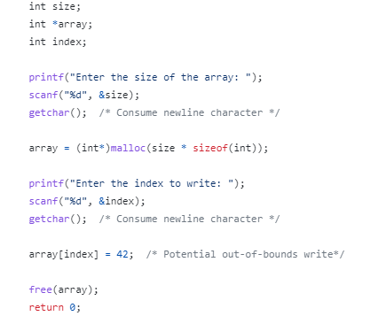
CWE-787: Example Code
The memory for the array is allocated based on the ‘size’ provided by the user.
But the user could potentially give an ‘index’ greater than the ‘size’ they gave.
This leads to an out-of-bounds write

Slide 6
CWE-125: Out-of-bounds Read
Occurs in programs that reads data beyond the boundaries of an allocated memory buffer
Like CWE-787, it doesn’t necessary require an input from a user; the program itself could be faulty due to incorrect memory management
This could allow an attacker to read sensitive information from other memory locations or cause a crash (from a segmentation fault)

Slide 7
CWE-125 (continued)
Prevention –
Bound checking
Input validation (in the case when the user inputs data)
Use safe functions that automatically handle bound checking such as strncpy, snprintf, etc.
Prevalent in C & C++ where manual memory management is used

Slide 8
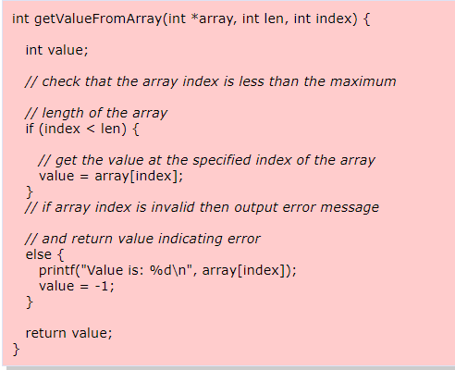
CWE-125: Example Code
Program lets a user access elements of an array. User inputs an index to see the data present of the array of that index
Program doesn’t check for negative values
An attacker could read potentially sensitive information past the beginning of the buffer

Slide 9
CWE-416: Use After Free
Occurs when a program tries to reference memory (using pointers) after it has been deallocated or freed
In complex programs, multiple parts of the code may interact with the same memory, leading to confusion about which part is responsible for freeing it. As a result, the memory may be mistakenly used after it has already been freed.
Prevalent in C & C++ where manual memory management is used

Slide 10
CWE-416 (continued)
Consequences -
Crashes: Accessing the freed memory could led to a segmentation fault
Returning unexpected values: The data at the freed memory location might be overwritten with new data
Execution of arbitrary code
Prevention –
After freeing the allocated memory, ensure that the pointers that used to point to the allocated memory are set to NULL

Slide 11
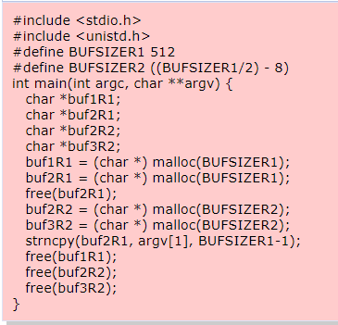
CWE-416 : Example Code
Allocated memory to buf2R1
Freed memory allocated to it
Still tried to reference its allocated memory as seen in the strncpy function

Slide 12
CWE-20: Improper Input Validation
Occurs in applications which take an input from the user
This weakness arises when the application fails to properly validate or fails to validate user-supplied input that can affect the flow of a program
Consequences –
An attacker could potentially provide unexpected values that could lead to a program crash
An attacker could use malicious input to modify data or possibly alter control flow in unexpected ways, including arbitrary command execution.

Slide 13
CWE-20 (continued)
Prevention –
Employ proper input validation techniques such as whitelisting.
Do not rely exclusively on looking for malicious or malformed inputs. This is likely to miss at least one undesirable input, especially if the code's environment changes.
Not language/application specific

Slide 14
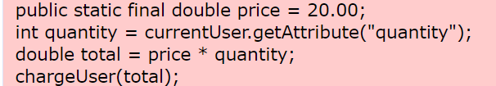
CWE-20: Example Code
If an attacker provided a negative value, then the user would have their account credited instead of debited.

Slide 15
CWE-89: Improper Neutralization of Special Elements used in an SQL Command (SQL Injection)
Occurs in applications that allows users to supply an SQL command/part of a SQL command to access its server’s database
This weakness occurs when the application fails to neutralize or incorrectly neutralizes special elements in the user supplied SQL command
special elements refers to SQL operators (AND, OR, etc.), SQL comments, etc.
This could allow an attacker to inject malicious SQL code into input fields, allowing them to manipulate the SQL queries and potentially access, modify, or delete data they should not have access to.

Slide 16
CWE-89 (continued)
Prevention –
Properly Sanitize & Validate User Input
Utilize “prepared statements”
Simply put it’s a more efficient way to securely handle user input when constructing SQL queries
Not language specific -> Nowadays, most programming languages have libraries or modules that allow developers to interact with databases using SQL queries
Mostly associated with database servers -> SQL commands are primary used for interacting with databases

Slide 17
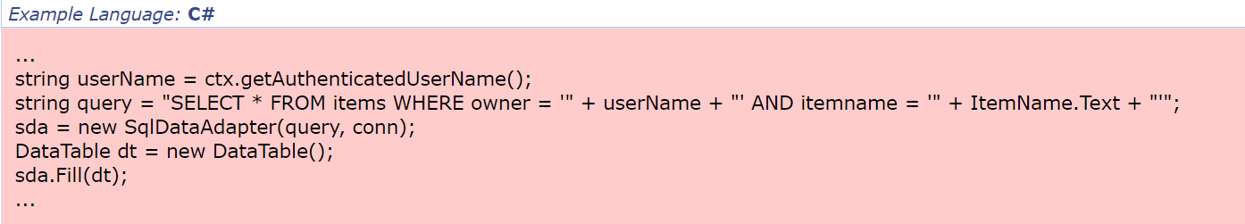


CWE-89: Example Code
This SQL query searches for items matching a specific name & “restricts” to display items only belonging to the currently authenticated user
User could input this as an item name
Query results to
Query is essentially equivalent to
So, the query now returns all entries stored in the items table, regardless of their specified owner

Slide 18
CWE-78: Improper Neutralization of Special Elements used in an OS Command ('OS Command Injection')
Occurs in applications that allows for the user to input an OS command/part of an OS command
This weakness arises when the application fails to cleanse special elements of the provided input
Special elements like wildcard characters (*,?), input/output redirection (>,<) , shell metacharacters (; , &)
This could potentially lead to the execution of malicious commands on the application server
Unauthorized access to sensitive information
Denial of Service

Slide 19
CWE-78 (continued)
Can be fixed by proper input validation of the provided command
Validating that the input only contains alphanumeric characters, no other syntax or whitespace
Whitelisting
Not language/application specific

Slide 20
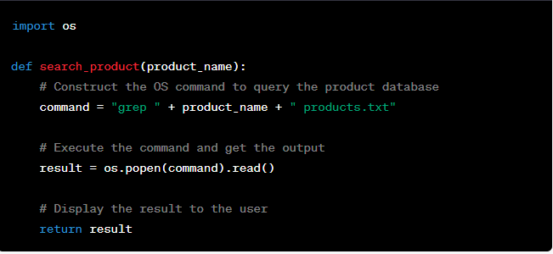


CWE-78: Example Code
Input (bottom left) results in 3 commands being executed (bottom right); one of which is a malicious command which deletes all the files in the root directory

Slide 21
CWE-22: Improper Limitation of a Pathname to a Restricted Directory ('Path Traversal')
Occurs in application which allows users to access permitted directories/files in its server by inputting a pathname
This weakness arises when the application fails to cleanse special elements of the provided pathname
Special elements may include the following: .. (parent directory), / (root directory), etc.
Improper handling of these pathnames may allow access and control over unauthorized directories/files in the server, leading to potential deletion or modification by an attacker

Slide 22
CWE-22 (continued)
Can be fixed by proper input validation of the provided pathname
Sanitization
Whitelisting
Not language/application specific

Slide 23
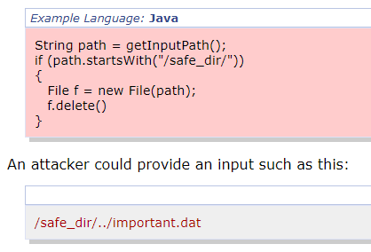
CWE22: Example Code

Slide 24
CWE-434 : Unrestricted Upload of File with Dangerous Type
Occurs in applications which allows users to upload files to its server
This weakness arises when the application fails to properly check/validate the files uploaded by users. (This can be corrected by validation done on the server side as well client side)
Actions an attacker can take to exploit the application-
Providing a malicious file extension/double extensions
Embedding malicious content in a file with a permitted file extension
Providing a massive file that is beyond the server's handling capabilities

Slide 25
CWE-434 (continued)
Consequences-
Results in a malicious file present in the server which could lead to things like Remote Code Execution (server could potentially run malicious uploaded file) or Denial-of-Service (essentially just overworking the server)
Prevention-
File Type Validation: Implement robust file type validation
File Size Limitations: Enforce reasonable file size limitations for uploaded files (to prevent DoS attacks)
Content Inspection: Use antivirus scanning or other content inspection techniques to detect and block harmful files.

Slide 26
CWE-434 (continued)
Most often found in PHP/ASP.NET based web applications -> hence web servers are more often vulnerable to CWE-434
ASP.NET & PHP are web server-side scripting languages which are used to create web applications. Due to the configuration of such servers, files with a .php or .asp may be executed automatically.
Assume the application was intended to take in a pdf file but fails to validate whether the type of the file is indeed a pdf.
This can be misused by an attacker to provide a harmful/malicious php file instead.
When such a php file is received, the server will simply execute it, because the server executes all php files. This will cause the harmful action to occur.
The fix for this problem is to validate the filename input at the server/client to check that is indeed an intended file type (such as pdf)

Slide 27
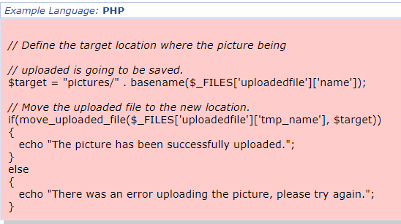
CWE-434 : Example Code
This code uploads a file to a server but doesn’t check the file itself.
The if statement just checks to see if the upload was successful and doesn’t check the file content
$_FILES['uploadedfile']['tmp_name'] is a reference to the temporary location of the uploaded file on the server
$_FILES['uploadedfile']['name'] represents the original name of the file on the client's machine before being
uploaded to the server.

Slide 28
CWE-79: Improper Neutralization of Input During Web Page Generation ('Cross-site Scripting’/ XSS)
Occurs in applications that permit users to input data, subsequently utilized to create a web page containing the provided input. This page is then made available for access by other users.
This weakness arises when the applications fails to neutralize the malicious user input before incorporating it into a generated web page accessible to others
Malicious input may mean scripts, HTML tags, HTML attributes, CSS, URLs, etc.

Slide 29
CWE-79: A more detailed explanation (1)
An application allows users to input data
This potentially malicious input triggers an initial request that is transmitted from the client to the server.
Subsequently, the server handles the request (which contains the input) and creates a response sent to the client.
The client then generates a web page from what the server sent
During this whole process, both the client nor server fail to prevent the input from containing content that is executable by a web browser, such as JavaScript, HTML tags, HTML attributes, etc.

Slide 30
CWE-79: A more detailed explanation (2)
A victim somehow visits the generated web page (unaware that it contains malicious input) through their web browser
Since the script comes from a web page that was sent by the web server, the victim's web browser executes the malicious input in the context of the web server's domain.
This effectively violates the intention of the web browser's same-origin policy, which states that scripts in one domain should not be able to access resources or run code in a different domain.
A domain refers to the main part of a web address (URL) that identifies a specific website or web application on the internet. It's a human-readable name that corresponds to a unique numeric IP address.
XSS attacks don't directly target the domain itself, but rather exploits the way the web application handles and displays user input, leading to the execution of unauthorized scripts within the context of the web page

Slide 31
CWE-79: Stored XSS attack
An attacker submits malicious data that gets stored on the server. When other users access a page that contains the stored malicious data, it executes in their browsers
While the malicious script is indeed present in the comment's content, it will not execute in the attacker's browser. This is due to the browser's same-origin policy, which prevents scripts from one domain (the attacker's origin) from accessing or running code on a different domain (the video platform's domain).

Slide 32
CWE-79: Reflected XSS attack (1)
An attacker tricks a user into clicking a specially crafted link (containing a script)
The victim’s web server receives the request, including the malicious input (script), as part of the URL or request parameters
The malicious input within the URL is treated as input from the user; the server cannot tell that the link was created by an attacker
The server generates the web page's content, which includes the malicious script as part of the response.

Slide 33
CWE-79: Reflected XSS attack (2)
The web server delivers the generated response back to the victim's web browser which ends up rendering the web page’s content, including the malicious script
The malicious script is executed within the context of the victim's browser as the browser believes it to have been generated by the web server
The executed script can perform various actions within the victim's browser such as performing actions on the victim's behalf or even redirecting the victim to a different malicious website.

Slide 34
CWE-79 (continued)
The key issue in XSS attacks is that the web server doesn't necessarily differentiate between legitimate and malicious input when generating the response. So, the web server may process and incorporate the malicious input into the response content without properly recognizing the potential danger of the input. This can lead to the malicious input being "ignored" in the sense that the server doesn't treat it as harmful or take appropriate measures to prevent its execution.
Not language specific
Cross-Site Scripting (XSS) is primarily associated with web applications because they involve manipulating the rendering of content in a victim's web browser.

Slide 35
CWE-79 (continued)
Consequences –
Some cross-site scripting vulnerabilities can be exploited to manipulate or steal cookies, create requests that can be mistaken for those of a valid user, compromise confidential information, or execute malicious code on the end user systems for a variety of nefarious purposes.
Other damaging attacks include the disclosure of end user files, installation of Trojan horse programs, redirecting the user to some other page or site, running "Active X" controls (under Microsoft Internet Explorer) from sites that a user perceives as trustworthy, and modifying presentation of content.
In some circumstances it may be possible to run arbitrary code on a victim's computer when cross-site scripting is combined with other flaws.
Prevention (mainly done on the server; client-side protection doesn’t hurt) –
Input Validation & Sanitation
Implement firewalls to detect such attacks

Slide 36
CWE-79: Theory Example (Stored XSS)
Think of a site which allows users to leave comments on articles. This site displays these comments to other users who also visit these webpages.
However, the site doesn’t properly validate or sanitize the user-submitted comments before displaying them.
An attacker could comment: “<script>alert('XSS Attack');</script>”
This just triggers an alert box to pop up in a web browser
When a user visits the same article webpage with the comments, the site reflects the attacker's comment without proper validation and encoding.

Slide 37
CWE-352: Cross-Site Request Forgery (CSRF)
CWE352 is a weakness which arises when an attacker tries a user into unknowingly make an unwanted request to a web application’s server
If the user is authenticated to the vulnerable web application, the attacker's request could potentially be executed on their behalf, leading to actions that the user did not intend to perform.
Key Terms & Concepts: Session & Session Cookies

Slide 38
CWE-352: step by step explanation (1)
User logs in to a vulnerable web page (Website A) and the client receives a session cookie (which is stored locally) which authenticates the user
While logged in to website A, the user also simultaneously opens malicious website B
Website B contains a script (hidden to the user). When the victim’s web browser opens the website B, this script will trigger an HTTP request to Site A on behalf of the user
The script can simulate user actions on the vulnerable website (Website A). For example, the script might programmatically click on buttons, submit forms, or perform other actions that trigger specific requests on Website A.

Slide 39
CWE-352: step by step explanation (2)
Since the victim is authenticated on site A, the server processes the malicious requests as if they were initiated by the victim
This effectively performs unintended actions without the user being aware
So, the weakness arises from the fact that the server was not able to identify that an external attacker was the one who initiated the request and thereby causes the web server to carry out the malicious request

Slide 40
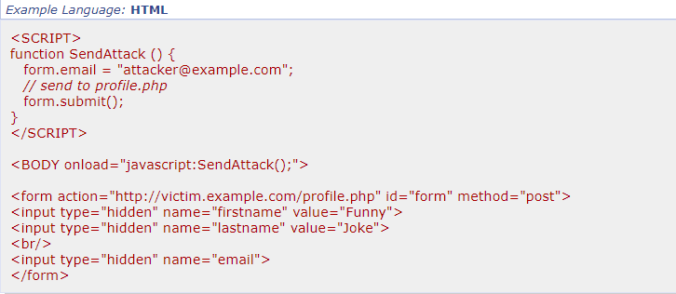
CWE-352: Malicious Script Code
Because SendAttack() is defined in the body's onload attribute, it will be automatically called when the victim loads the web page.
Assuming that the user is already logged in to victim.example.com, profile.php will see that a valid user session has been established, then update the email address to the attacker's own address.
At this stage, the user's identity has been compromised, and messages sent through this profile could be sent to the attacker's address.

Slide 41
CWE-352 (continued)
Malicious actions that the attacker might perform once the request has been sent –
Unauthorized Data Modification: The attacker can modify or delete data on the targeted website. For example, if the website is a social media platform, the attacker can post malicious content, delete posts, or edit user profile information.
Unauthorized Transactions: In websites that involve financial transactions, the attacker can initiate unauthorized money transfers, purchases, or withdrawals without the user's consent.
Fixes –

Slide 42
CWE-352
Prevalent in web applications due to the nature of how web browsers handle and transmit user authentication and session information

