Slide 1
Fast Convergence Page Rank in Hadoop
Geet Varma – gmv33
Joseph Bernard – jkb243
Sudharsan Premkumar – sc2466

Slide 2
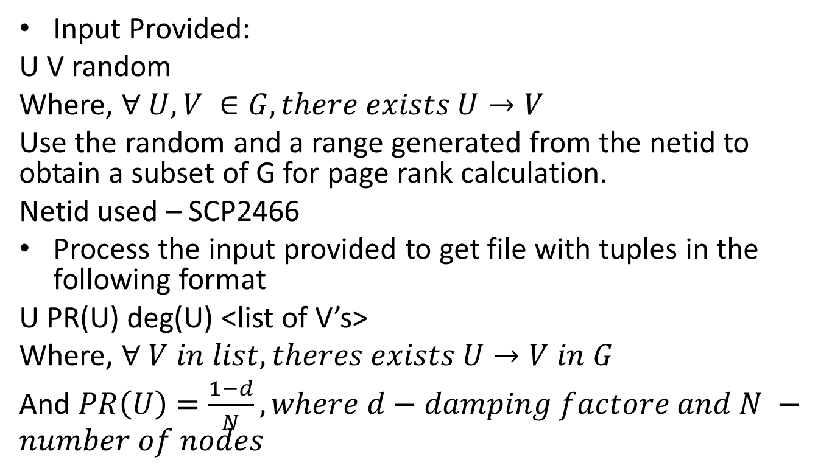
Mapper Input
Input Provided:
U V random
Where, $∀ U,V ∈G, there exists U→V$
Use the random and a range generated from the netid to obtain a subset of G for page rank calculation.
Netid used – SCP2466
Process the input provided to get file with tuples in the following format
U PR(U) deg(U) <list of V’s>
Where, $∀ V in list, theres exists U→V in G$
And $PR\left(U\right)=\frac{1−d}{N}, where d−damping factore and N −number of nodes$

Slide 3
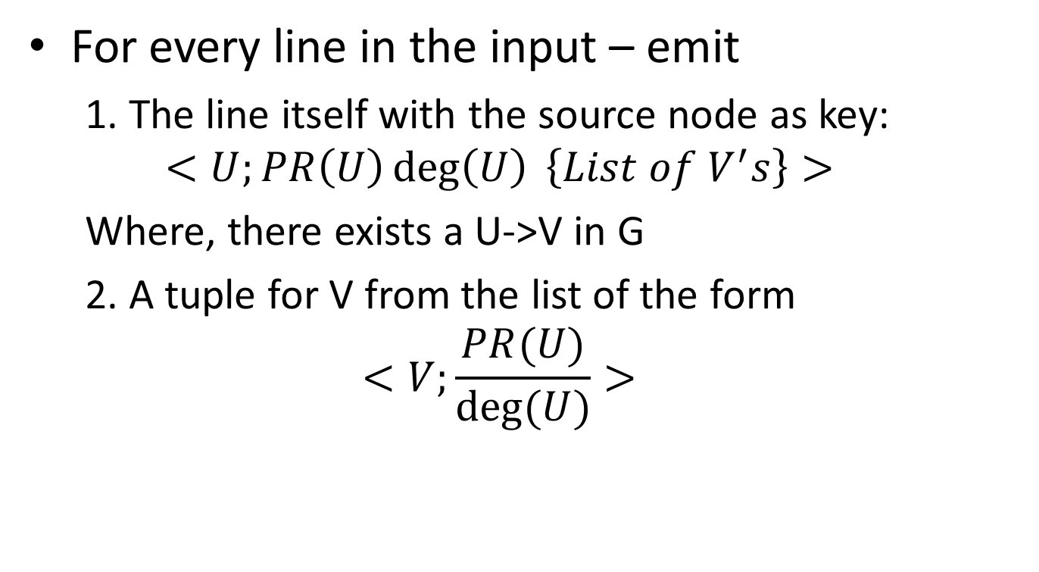
Mapper - Unblocked
For every line in the input – emit
1. The line itself with the source node as key:
$$<U;PR\left(U\right)\deg\left(U\right) \left\{List of V^{′}s\right\}>$$
Where, there exists a U->V in G
2. A tuple for V from the list of the form
$$<V;\frac{PR(U)}{deg⁡(U)}>$$

Slide 4
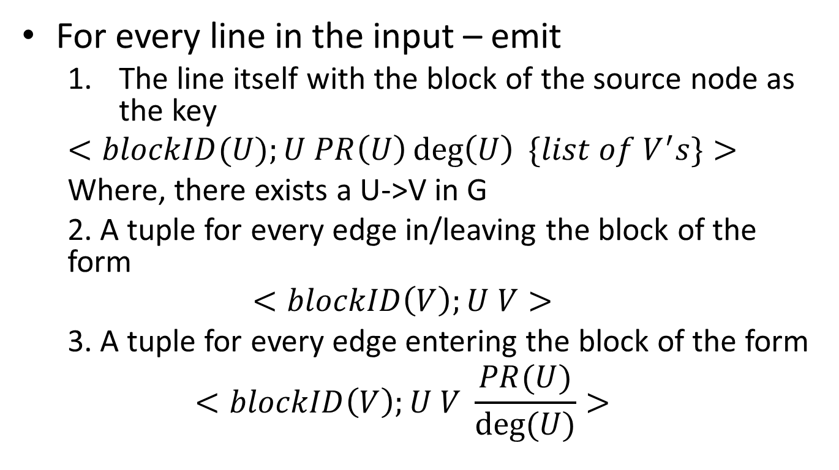
Mapper - Blocked
For every line in the input – emit
The line itself with the block of the source node as the key
$$<blockID(U);U PR\left(U\right)\deg\left(U\right) \{list of V^{′}s\}>$$
Where, there exists a U->V in G
2. A tuple for every edge in/leaving the block of the form
$$<blockID\left(V\right);U V>$$
3. A tuple for every edge entering the block of the form
$$<blockID\left(V\right);U V \frac{PR(U)}{deg⁡(U)}>$$

Slide 5
Global Convergence
Checked for in the driver
Unblocked:
The reducer at each pass end stores the residual for the node in counter
Blocked:
The reducer stores the sum of the residuals of all nodes in that block in a counter.

Slide 6
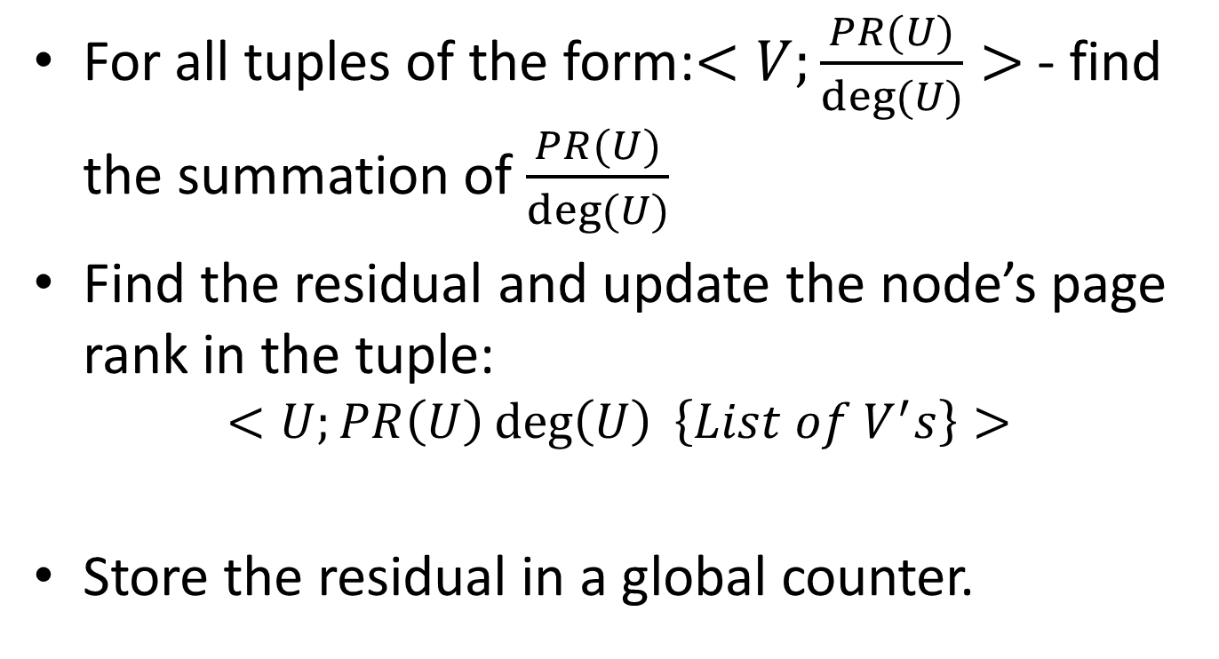
Reducer - Unblocked
For all tuples of the form:$<V;\frac{PR(U)}{deg⁡(U)}>$ - find the summation of $\frac{PR(U)}{deg⁡(U)}$
Find the residual and update the node’s page rank in the tuple:
$$<U;PR\left(U\right)\deg\left(U\right) \left\{List of V^{′}s\right\}>$$
Store the residual in a global counter.

Slide 7
Reducer Blocked - Input and outputs
Inputs
<;v, PR(v), deg(v), [u1, u2, …] >
<u,v> - BE edges
<u,v,r> - BC edges
Emit
<v; PR(v), deg(v), [u1, u2, ….] >

Slide 8
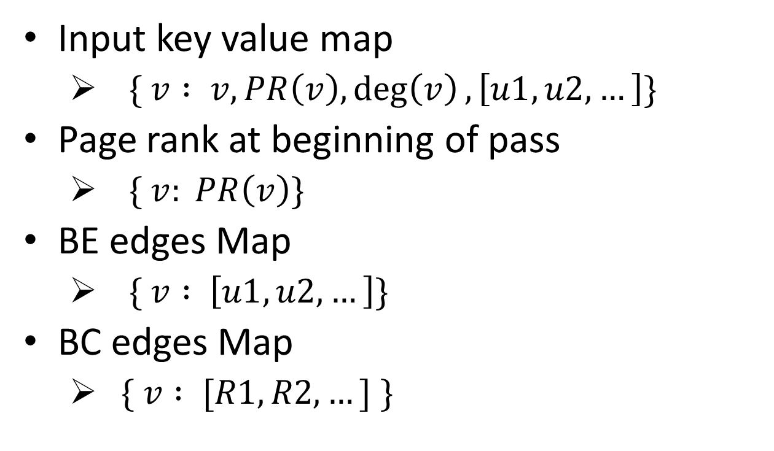
Reducer Blocked - Data Structures
Input key value map
$\{ v : v, PR\left(v\right),\deg\left(v\right), \left[u1, u2,…\right]\}$
Page rank at beginning of pass
$\{ v: PR\left(v\right)\}$
BE edges Map
$\{ v : \left[u1, u2,…\right]\}$
BC edges Map
$\{ v : [R1, R2,…] \}$

Slide 9
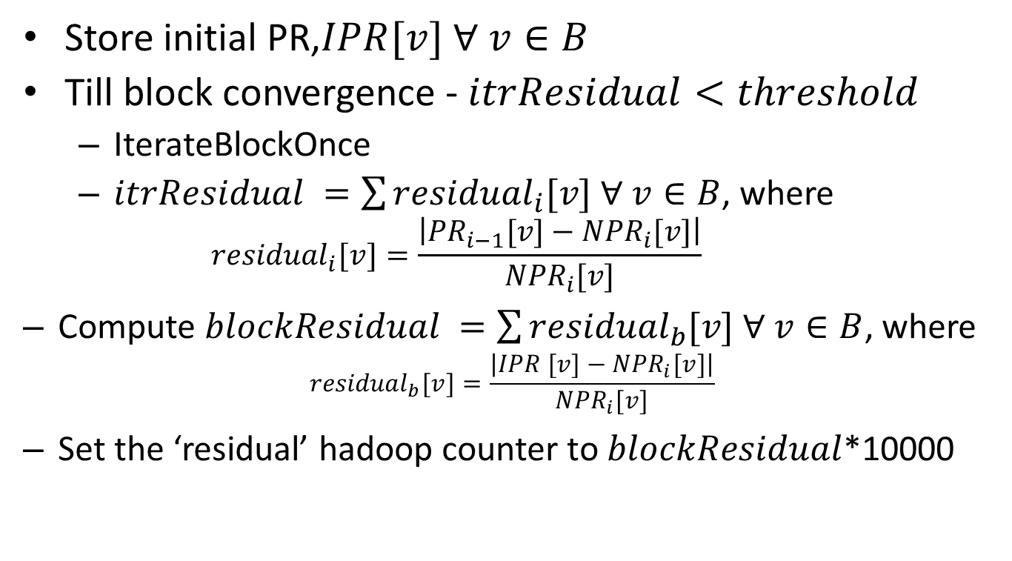
Reducer Blocked - Pseudocode
Store initial PR,$IPR[v] ∀ v∈B$
Till block convergence - $itrResidual<threshold$
IterateBlockOnce
$itrResidual =\sum{{residual}_{i}[v] ∀ v∈B}$, where
$${residual}_{i}[v]=\frac{\left|{PR}_{i−1}[v]−{NPR}_{i}[v]\right|}{{NPR}_{i}[v]}$$
Compute $blockResidual =\sum{{residual}_{b}[v] ∀ v∈B}$, where
$${residual}_{b}[v]=\frac{\left|IPR [v]−{NPR}_{i}[v]\right|}{{NPR}_{i}[v]}$$
Set the ‘residual’ hadoop counter to $blockResidual$*10000

Slide 10
Results
Unblocked:
Residual value after 5 iterations - 0.0423
Stdout on EMR
Blocked:
Using block.txt – 8 pass convergence
Page ranks

Slide 11
Blocked Results
residual-->0.4215 number of passes-->1 Average block iterations-->12.691176470588236 residual-->0.0214 number of passes-->2 Average block iterations-->4.661764705882353 residual-->0.0111 number of passes-->3 Average block iterations-->3.6323529411764706 residual-->0.0057 number of passes-->4 Average block iterations-->2.75 residual-->0.0032 number of passes-->5 Average block iterations-->2.1029411764705883 residual-->0.0018 number of passes-->6 Average block iterations-->1.6764705882352942 residual-->0.0012 number of passes-->7 Average block iterations-->1.3970588235294117 residual-->8.0E-4 number of passes-->8 Average block iterations-->1.2058823529411764

Slide 12
Extra Credit
Random Block Partition
Using node%RANDOM for block partition
For RANDOM = 100, convergence in 24 passes

