Slide 1
Raceline Optimization with DQN and DDQN (Attempt)

Slide 2
Initial Proposal: Race Line Optimization as MDP
Racing Line is the path a driver takes to go around a track.
➥ There can be infinite number of Racing Lines – Which one is optimal?
Existing Challenges:
Supervised learning requires large datasets of labeled racing lines under various conditions (Track Profile/Weather/Car Performance/etc.) – Not publicly available
Driving tasks are relatively easy to simulate but difficult to model explicitly
Why RL?
Agents learn directly from environment-interactions (bypass need for labeled datasets)
Quickly generate/simulate synthetic track scenarios with diverse conditions
Transfer learned Policy towards driver-in-loop simulators (Driver Development Programs/Academies)

Slide 3
Initial Proposal: Race Line Optimization as MDP
Simplified Starting Point
State Space:
Car position on track (𝒙, 𝒚)
Car Velocity (𝒗_{𝒙} , 𝒗_{𝒚})
Car Orientation (θ)
Car Angular momentum (ω)
Absolute distances to Left and Right track limits
Action Space:
Throttle/Acceleration 𝑎∈{−1,0,1} (brake, lift, throttle)
Steering Angle Δθ∈{−1,0,1} (full left, neutral, full right)
Goal: Complete the track in the lowest amount of time, carrying & maintaining maximum possible speed around corners without exceeding track limits
Proposed Reward Function:
- 𝑇 + αΔ𝒗_{max} - β𝑶
Where:
𝑇 is the lap time
Δ𝒗_{max} mean max. speed changes over a run
𝑶 is the number of track excursions
α, β are weight hyperparameters

Slide 4
Brief Recap: Q-Learning
Q values Q(S, A) - estimate of how good is it to take the action A at the state S
Estimate Q(S,A) at every step using TD Update:
where α is the learning rate, γ is the discount factor, S′ is the next state, and a is a possible action
Store estimates in a Q-Table
Disadvantages:
Q-Table memory storage impracticality
Large State Space Inefficiency (requires explicitly visiting every state-action pair to accurately estimate Q(S,A))
Possible Solution: Deep Q-Network
Notes:
Model-Free Algorithm: does not require prior knowledge of the environment's dynamics (transition probabilities or reward function) Q-Table memory impracticality: impractical for problems with large or continuous state spaces because the number of state-action pairs grows exponentially Large State Space Inefficiency: requires explicitly visiting every state-action pair to accurately estimate Q(S,A), cannot generalize/make inference based on history

Slide 5

Deep Q-Learning: Deep Q Network (DQN)
Leveraging Neural Network for Q value prediction
Maintain a Replay Buffer, store actions and states, for network update
Network Update:
Sample a batch from the Replay Buffer
Make Q prediction for next state
Perform gradient descend on:
Advantages:
Memory usage efficient
Performance boosting
Agent doesn’t have to go through all state-action pairs to compute Q since model generalize and learn the pattern from data
Disadvantages:
Overestimation bias
Agent learned the noise in environment leading to overestimating the Q value of certain actions
Result in optimal action missed.
Notes:
Mention that in our implementation, we use hyperparameter search and epsilon greedy for action selection
Briefly mentioned we use Huber method for difference calculation

Slide 6
Deep Q-Learning: Double Deep-Q Network (DDQN)
Extension of DQN that take inspiration from Double Q-Learning Algorithm
Introduce another network, Target network.
Network update:
Maintains a Replay Buffer (like DQN)
Action is selected using CURRENT Network
Use TARGET Network to evaluate
Overestimation Bias begone! But how?!
If one of the policy overestimates, the other is unlikely to overestimate the same action.
When evaluating one using the other, any overestimation is balanced out.

Slide 7
Roadblock: Environment
Initial Environment Choice: Gymnasium’s Car Racing Environment
Roadblock & Challenges:
Catastrophic Bug: Environment crashes on discrete actions
Required not-insignificant work to identify, fix bug
Severely underestimated work required to adapt/modify environment to suit our problem
Decision: Test algorithm implementation on a suitable alternative environment

Slide 8
Alternate Test Environment: Cartpole
Gymnasium’s Cartpole Environment
State Space:
Cart’s position
Cart velocity
Pole Angle
Pole Angular momentum
Action Space:
Push Cart Left
Push Cart Right
Goal: Control cart to keep pole upright-balanced for as long as possible
Reward:
+1 for every episode pole is balanced
Suitable alternative because:
Similar State-space representations
Similar underlying Physics formulation for Racing Car Control (apply actions mid-corner to prevent spin-out and track-limit violations)

Slide 9
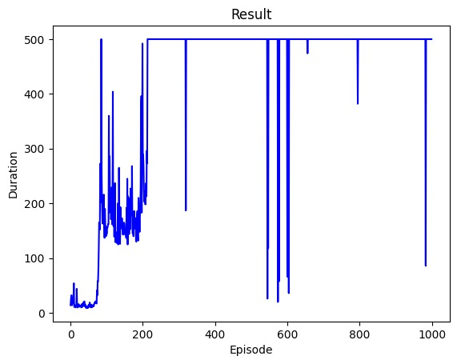
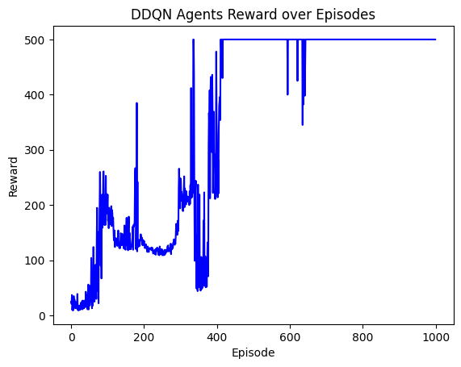
Results
DQN reward over episodes
DDQN reward over episodes
Notes:
> We can see that implementation works, it is learning

Slide 10
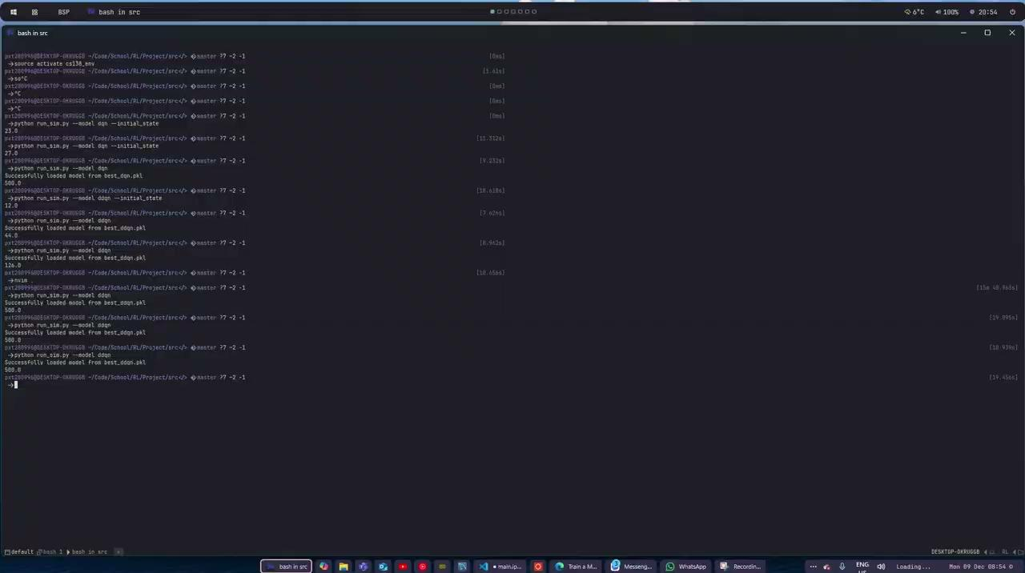
Demo - DQN

Slide 11
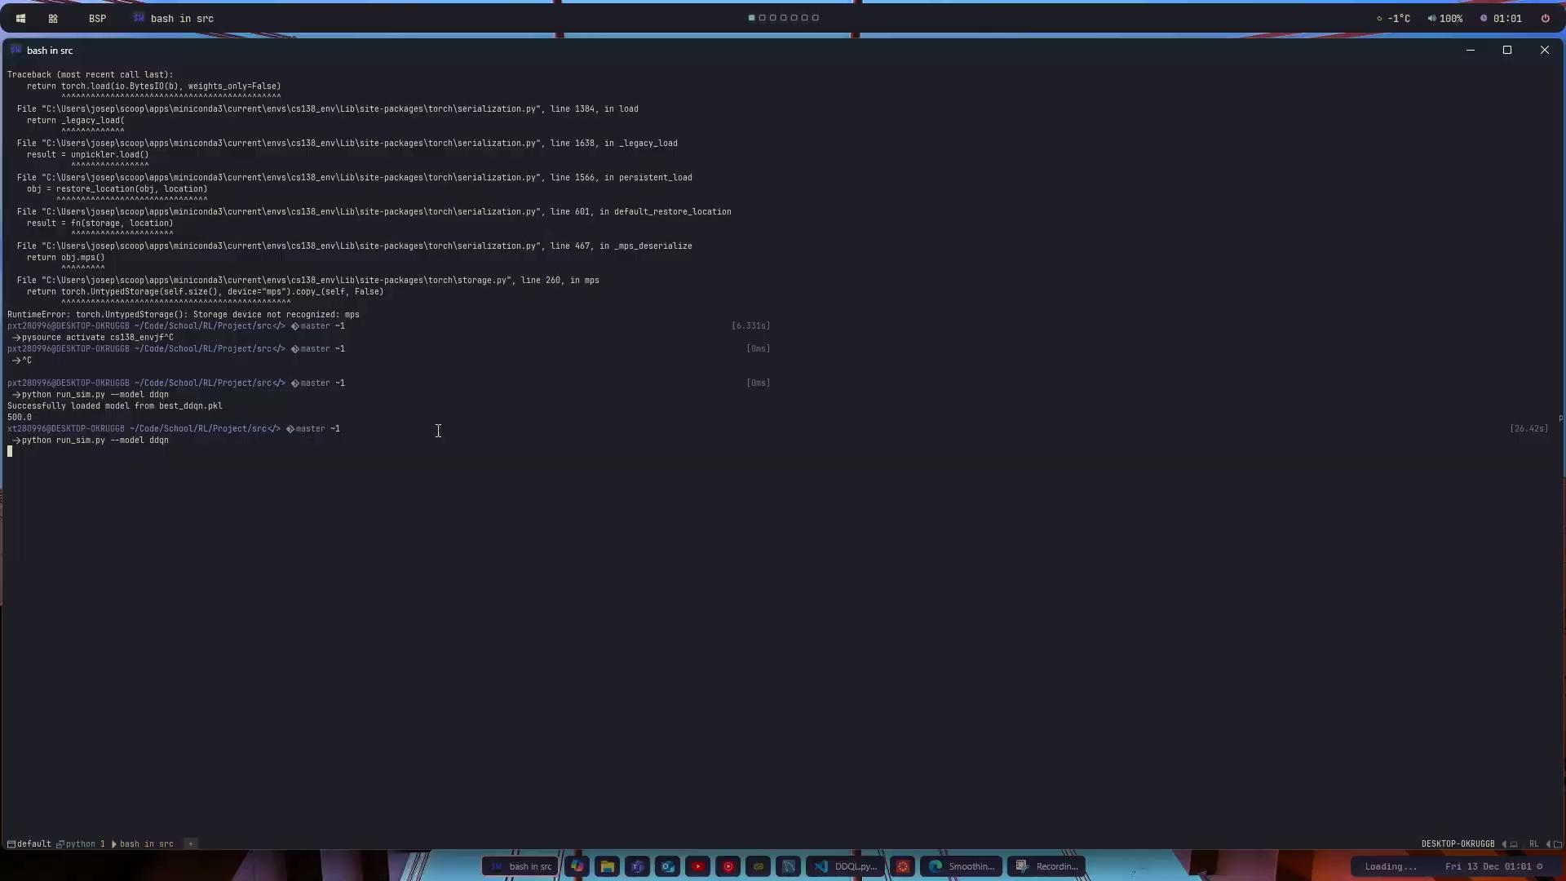
Demo - DDQN

Slide 12
Future Work
Implement proper race-simulation environment
Explore Transfer-Learning of learned policy, possibly integrating into driver-in-loop simulators
Extend Environment to continuous space and attempt solving with suitable algorithms (e.g. DDPG)

Slide 13
Thank You

