Slide 1
Reinforcement Learning for Raceline Estimation

Slide 2
What is a Racing Line?
Racing Line is the path a driver takes to go around a track. ➥ There can be infinite number of Racing Lines – Which one is optimal?

Slide 3
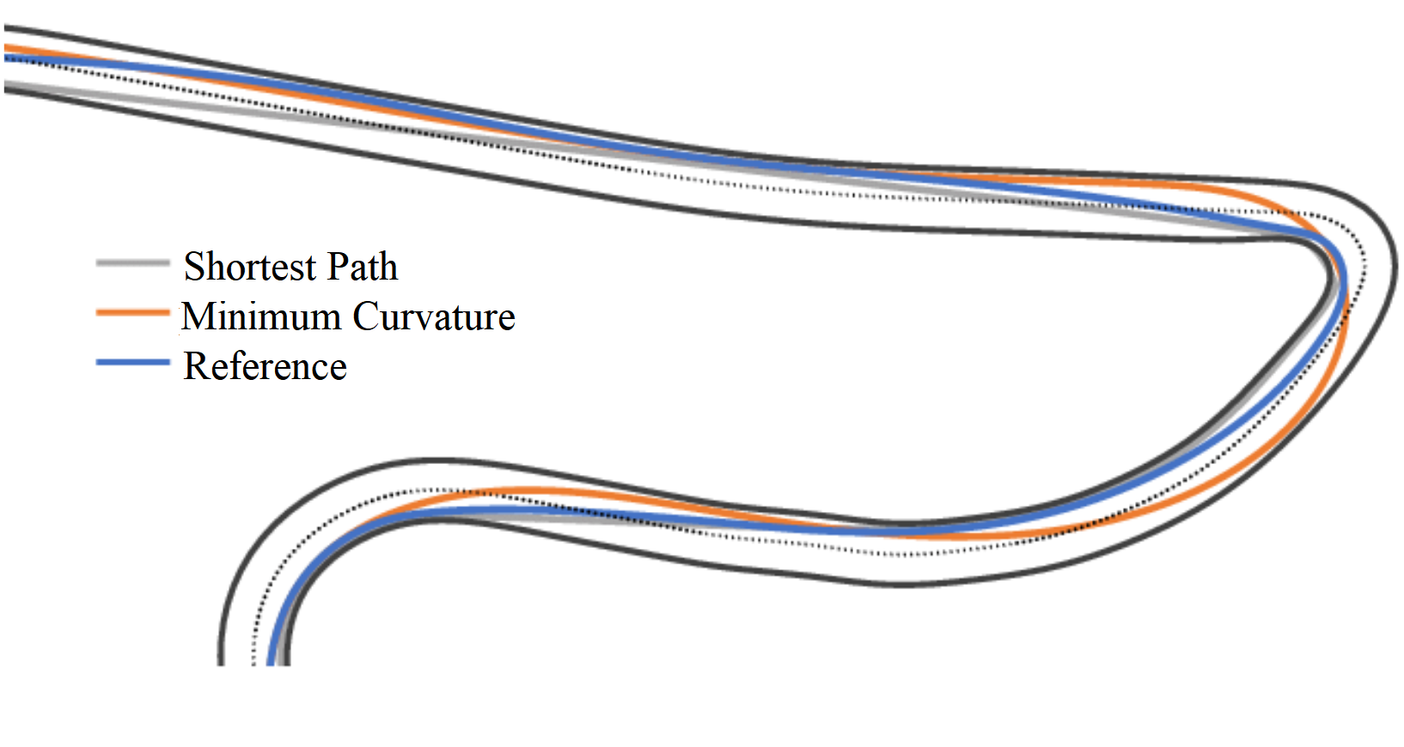
How do Drivers view Racing Lines?
➥ Shortest Path approach ➥ Minimum Curvature approach (Generally inversely proportional to each other)

Slide 4
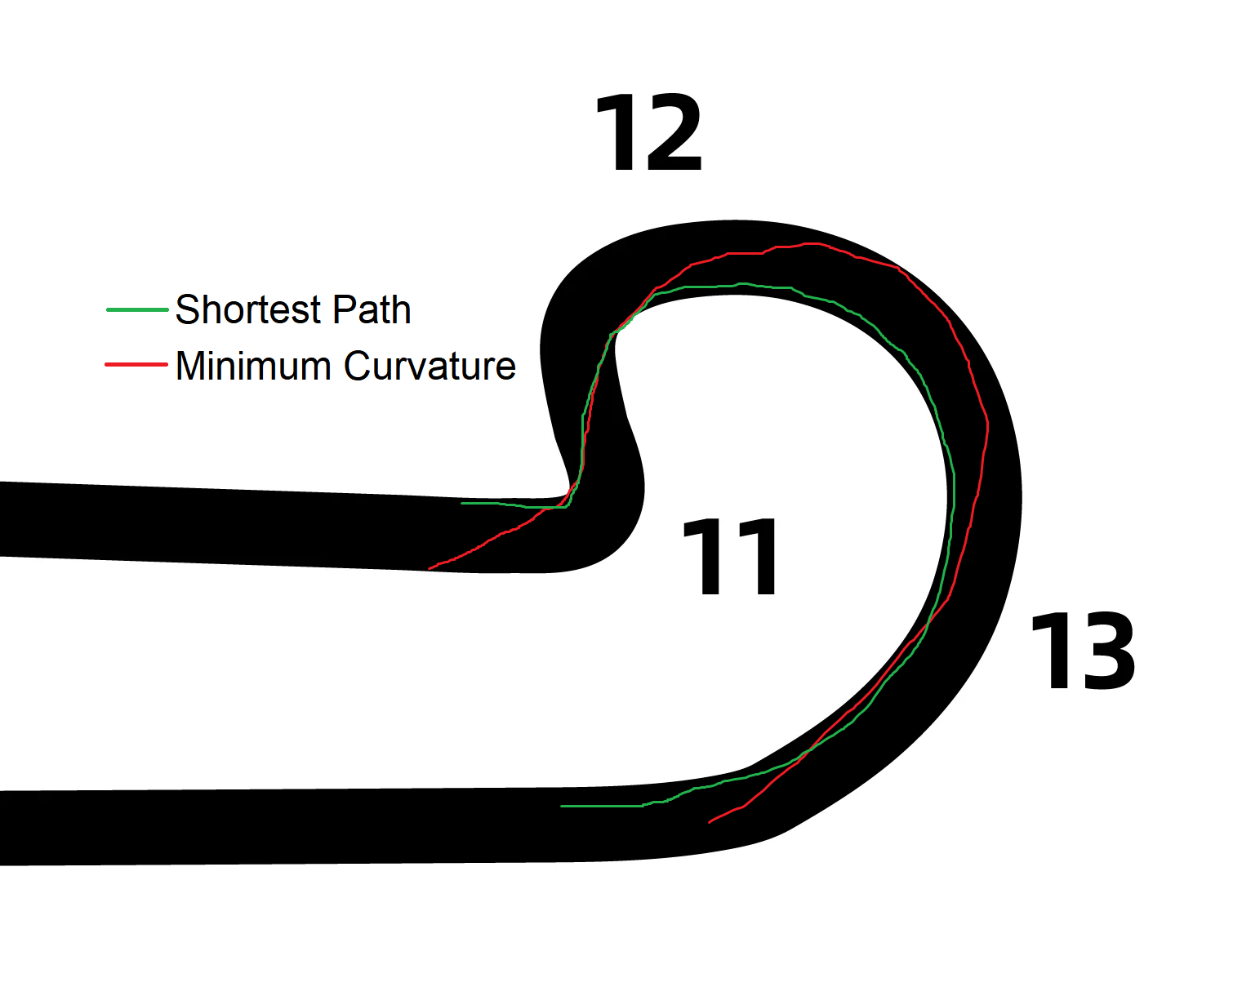
Environmental Considerations
Track Profile (Varying Radius Turn)

Slide 5
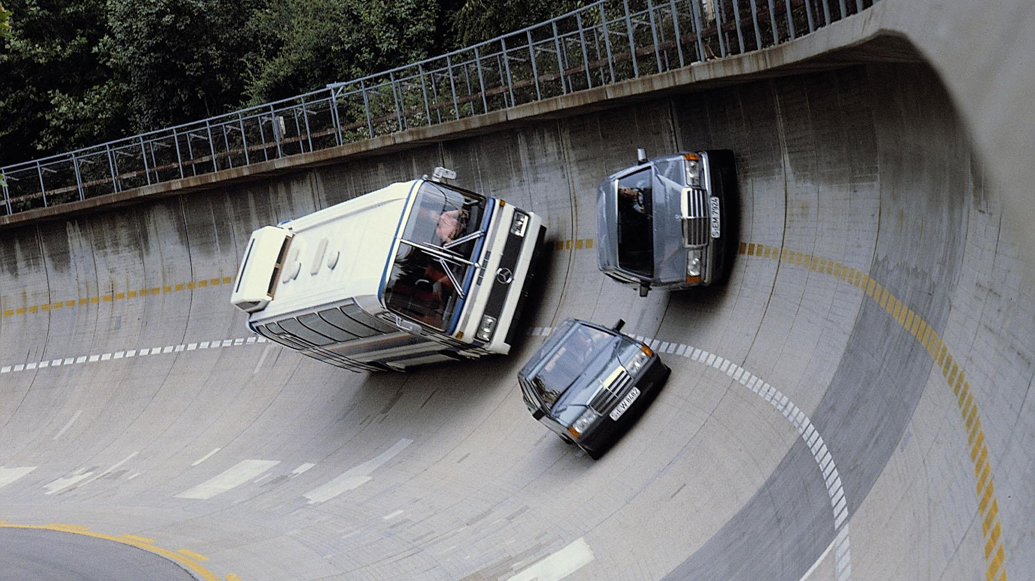
Environmental Considerations
Track Profile (Varying Radius Turn)
Terrain Elevation/Banking
Longer Path: Carry more speed & momentum Shorter Path: Sacrifice speed & momentum

Slide 6
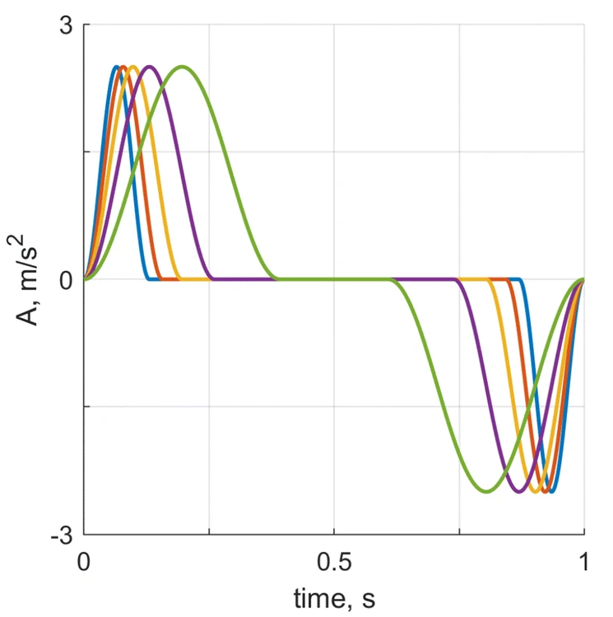
Environmental Considerations
Track Profile (Varying Radius Turn)
Terrain Elevation/Banking
Engine Characteristics (Acceleration, Engine Braking, etc.)
Good Acceleration: More biassed to Shortest Path Poor Acceleration: More biassed to Min. Curvature

Slide 7

Environmental Considerations
Track Profile (Varying Radius Turn)
Terrain Elevation/Banking
Engine Characteristics (Acceleration, Engine Braking, etc.)
Grip Levels, Wind Direction, and many more…

Slide 8

Initial Proposal
Baseline: Simple, Single Agent Environment Fixed Acceleration, Top Speed and Deceleration Profile Simple, Real Racing Circuit (Indianapolis, Monza, Red Bull Ring) Ignore Terrain & Elevation, Fixed Width Ignore other Factors (Grip Level/Tyre degradation, Wind speed & direction, etc.)
Agent is rewarded based on the Time taken to complete sectors of the Circuit Agent penalized if out of bounds
Compare across Multiple RL methods & algorithms: Off-Policy: Q-Learning, Deep Q-Network (DQN), Deep Deterministic Policy Gradient (DDPG)* On-Policy: SARSA, Proximal Policy Optimization (PPO)*
Monza Autodromo
* Subject to Project Progress

Slide 9
Possible Extensions**
** Time and Resources permitting
Multi-Agent Race Environment Modify Reward: Include # of agents passed, # of sectors/time spent in the lead.
Increased Environment Complexity Introduce Wind on corners (Probability of sudden acceleration increase in Wind-axis direction)
Try Human Reinforcement Incorporate TAMER framework by feeding it historical race records to train the reward function.

Slide 10
Thank you

Slide 11
