Slide 1
Cocktail Shaker Sorting Algorithm
By
Alexander Blake and Andrew Lindsley
Notes:
Andrew: “What is the algorithm”, “step by step explanation”, “our implementation(explaining the code)”
Alex: “background of algorithm”, “our implementation(show test cases)”, “benchmark”, “pros and cons”

Slide 2
What is the algorithm?
Problem it solves: sorting a list of numbers
One application is a program that tracks the height of all animals and the program needs to track animal information from shortest height to tallest height.
Another example is organizing names(if it’s modified to track alphabetical instead of numerical order).
Goes from front to back of list, sorting elements on the way

Slide 3
Background of algorithm
Also known as ripple sort, shaker sort, and shuttle sort
Has similarities to Bubble Sort
No official creator
Notes:
Cocktail Shaker sort is very similar to the bubble sorting algorithm, which is not surprising since Cocktail Shaker sort is actually a bidirectional variation of bubble sort.

Slide 4
Step by step explanation
Starts at first element and iterates towards end of list
Swaps elements along the way similarly to bubble sort
Reaches last element and iterates towards start of list
Swaps elements along the way similarly to bubble sort
Process repeated until list is sorted

Slide 5
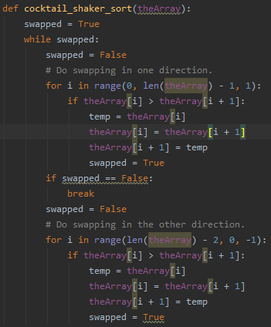
Our implementation

Slide 6
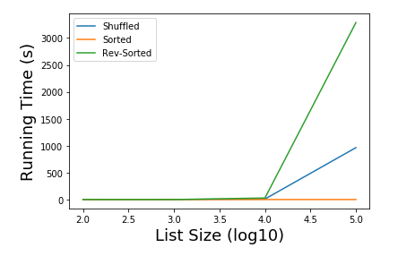
Result of benchmark
Sorted completed immediately
Shuffle completed in around 1000s
Reverse sorted completed with time
over 3000s
Benchmark took approximately
12 hours to fully run all trials

Slide 7
Pros and cons
Time complexity
Best case: O(n)
Average/worst case: O(n²)
Worst-Case Space complexity: O(1)
Bubble Sort complexity
Best case: O(n)
Average/worst case: O(n²)
Worst-Case Space Complexity: O(n)
Pros
Sorts through elements slightly faster than bubble sort
Better space complexity than bubble sort
Cons
Still slow with larger n lists

Slide 8
Questions?

