Slide 1
Medical records database
Joseph Kovack
Kathleen Sweeney
Kristina Krokosz
Dylan Knuth

Slide 2
Project overview
Project is being built for Doctor Bob.
Purpose is to be able to view patients medical records and their health care providers.
Database contains records of: individuals, health care providers, hospitals, and employees
Main use is for Hospitals employees which would have the ability to recall the information for review or edit.
Functional webpage designed to add, edit, view, and drop information about users.

Slide 3
Status
Working Database
Working Log in
Working admin page
In-progress Home page

Slide 4
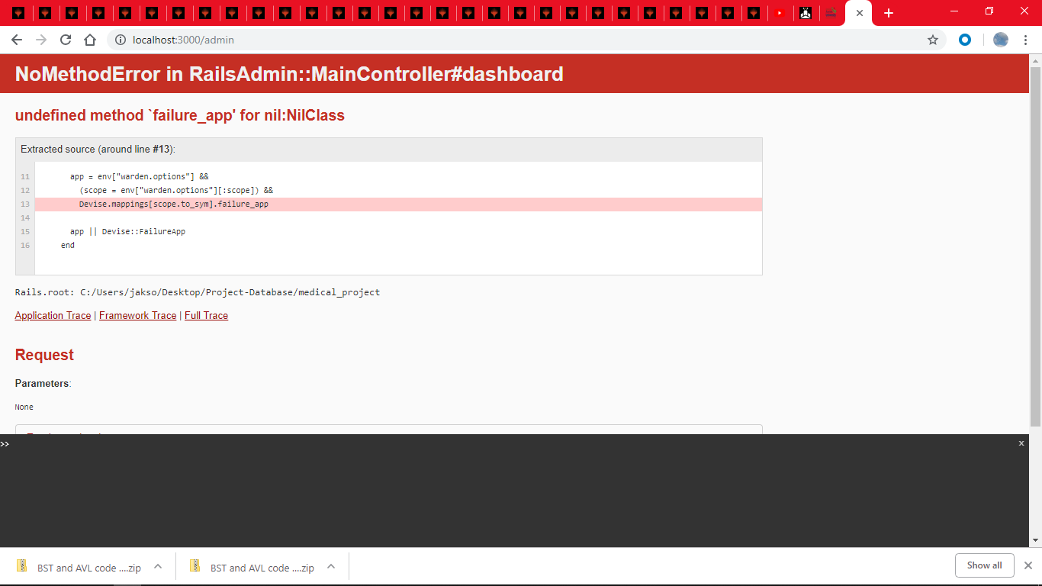

Slide 5
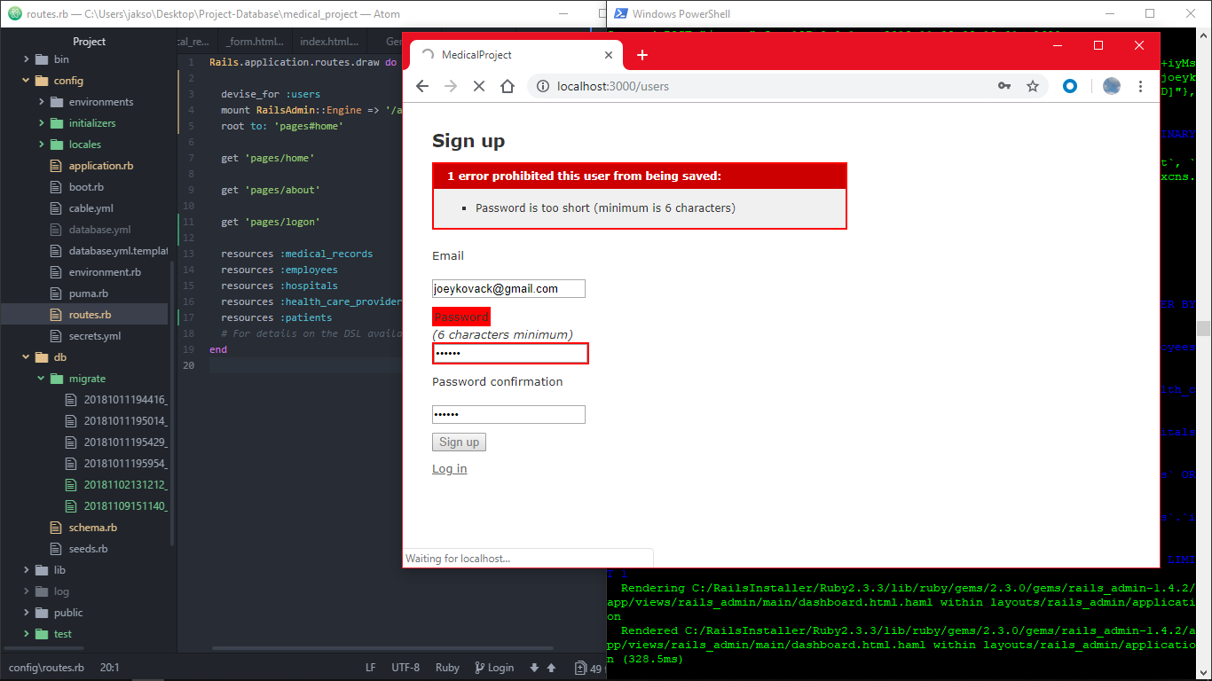

Slide 6
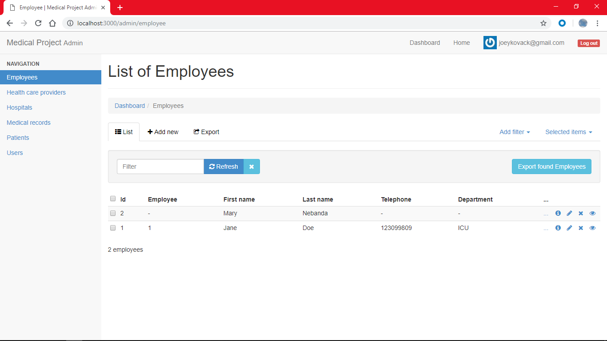

Slide 7
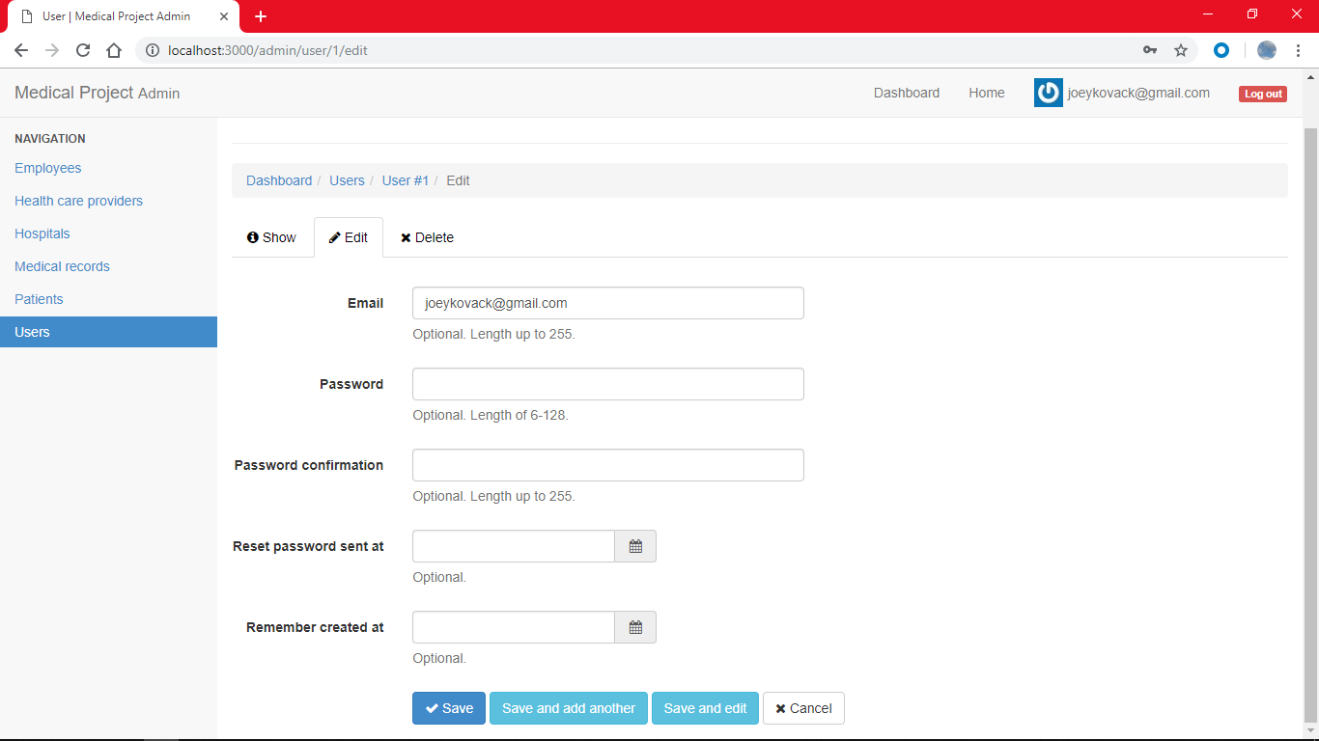

Slide 8
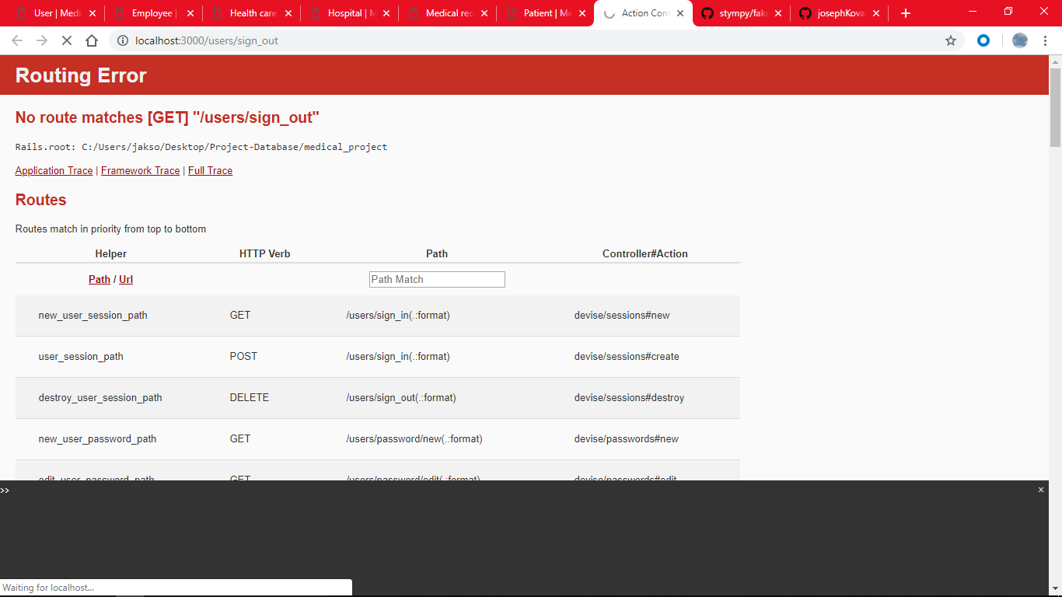

Slide 9
Future steps
Create a scaffolding
Create working directory
Link database to web page
Create git hub repository
Create a Login
Create a user and admin
Work on hosting the site
Create pages to run complex queries.
Re-create Foreign keys in the database
Implement bootstrap
Implement triggers

Slide 10
End

