Slide 1
BEE 208
Laboratory Access
Control System
A C++ terminal application for verified, traceable laboratory entry
GROUP 1.11
Mid-Semester Practical Project Examination

Slide 2
Manual records leave accountability gaps
02
The laboratory may know that access happened—without knowing enough to explain it later.
The software produces a clear decision report and a persistent access record.
WHO?
WHEN?
WHY?
Who requested entry and what ID did they provide?
When was permission granted or refused?
Was the person authorised, and how many attempts were used?
BEE 208 • GROUP 1.11

Slide 3
One workflow verifies, limits, and records access
03
01
02
03
VERIFY
DECIDE
RECORD
Collect a non-empty name, ID, role, and access code.
Grant access on the correct code or deny after three failures.
Display the outcome and append successful access to the log.
Visitors who pass verification are explicitly marked: SUPERVISION REQUIRED.
BEE 208 • GROUP 1.11

Slide 4
Every request follows the same controlled path
04
01
02
03
04
05
USER DETAILS
ROLE
CODE
REPORT
LOG
Enter a valid name and ID
Choose Student, Lecturer, Technician or Visitor
Verify BEE208LAB within three attempts
Display granted or denied status
Save successful access only
Correct code → Access Granted | Three failed attempts → Access Denied
BEE 208 • GROUP 1.11

Slide 5
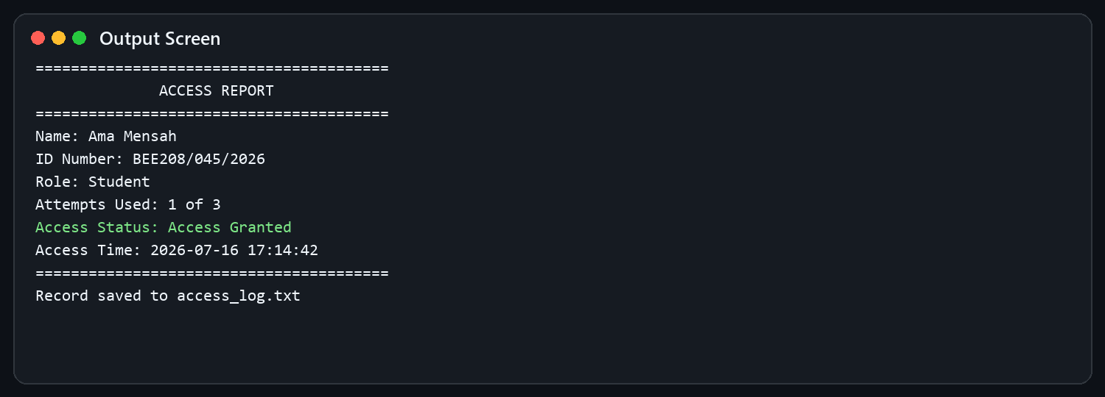
A successful request produces a timestamped report
05
DEMO INPUT
Name
Ama Mensah
ID
BEE208/045/2026
Role
Student
Code
BEE208LAB
The record is saved only after access is granted.
BEE 208 • GROUP 1.11

Slide 6
The AccessUser class keeps each request self-contained
06
COLLECT
VERIFY
REPORT
setUserDetails()
validateRole()
verifyAccessCode()
displayAccessStatus()
saveAccessLog()
Captures name, ID and role using reusable validation helpers.
Counts attempts, compares with BEE208LAB and records the successful time.
Shows the decision and appends only authorised records.
Private data: fullName • userID • userRole • accessGranted • attemptsUsed • accessTime
BEE 208 • GROUP 1.11

Slide 7
The implementation demonstrates the required C++ concepts
07
01
02
03
04
INPUT / OUTPUT
DATA TYPES
CONDITIONS
LOOPS
getline, cout, cerr
string, int, bool, time
grant, deny, visitor rule
validation and 3 attempts
05
06
07
08
FUNCTIONS
CLASS / OBJECT
VECTOR
FILE HANDLING
focused reusable operations
AccessUser per request
four supported roles
append to access_log.txt
BEE 208 • GROUP 1.11

Slide 8
One repository contains the full submission evidence
08
Repository/
├── main.cpp
├── README.md
├── algorithm.md
├── pseudocode.md
├── flowchart.png
├── report.md
├── test-data.md
├── access_log.txt
├── group-contribution.md
└── screenshots/
LIVE REPOSITORY
github.com/josephasamoah/
BEE208-Laboratory-Access-
Control-System
Why GitHub matters
• One source of truth
• Complete submission structure
• Visible collaboration
• Version history and accountability
BEE 208 • GROUP 1.11

Slide 9
Testing confirms both the happy path and failure paths
09
Scenario | Expected behaviour | Result
Valid student | Grant on attempt 1 and save | PASS
Third-attempt success | Grant on attempt 3 and save | PASS
Three wrong codes | Deny and do not save | PASS
Visitor | Grant with supervision flag | PASS
Invalid input | Reject and re-prompt safely | PASS
Multiple users | Process both in one session | PASS
Denied users never appear in the successful-access log.
BEE 208 • GROUP 1.11

Slide 10
The challenges improved reliability and shaped future work
10
CHALLENGES & LESSONS
FUTURE IMPROVEMENTS
Safe input handling
Read whole lines, then parse choices.
Whitespace validation
Trim before accepting names and IDs.
Visitor policy
Make supervision explicit in reports and logs.
• Hide code entry while typing
• Store a secure hash instead of plain text
• Add role-specific permissions
• Record denied attempts in a security log
• Replace the text file with a database
• Integrate ID cards or biometrics
Simple enough to defend today—structured enough to extend tomorrow.
BEE 208 • GROUP 1.11

Slide 11
CONCLUSION
The system turns access decisions into accountable records.
VERIFY IDENTITY
LIMIT ATTEMPTS
PRESERVE EVIDENCE
Questions & demonstration
GROUP 1.11

