Slide 1


Slide 2
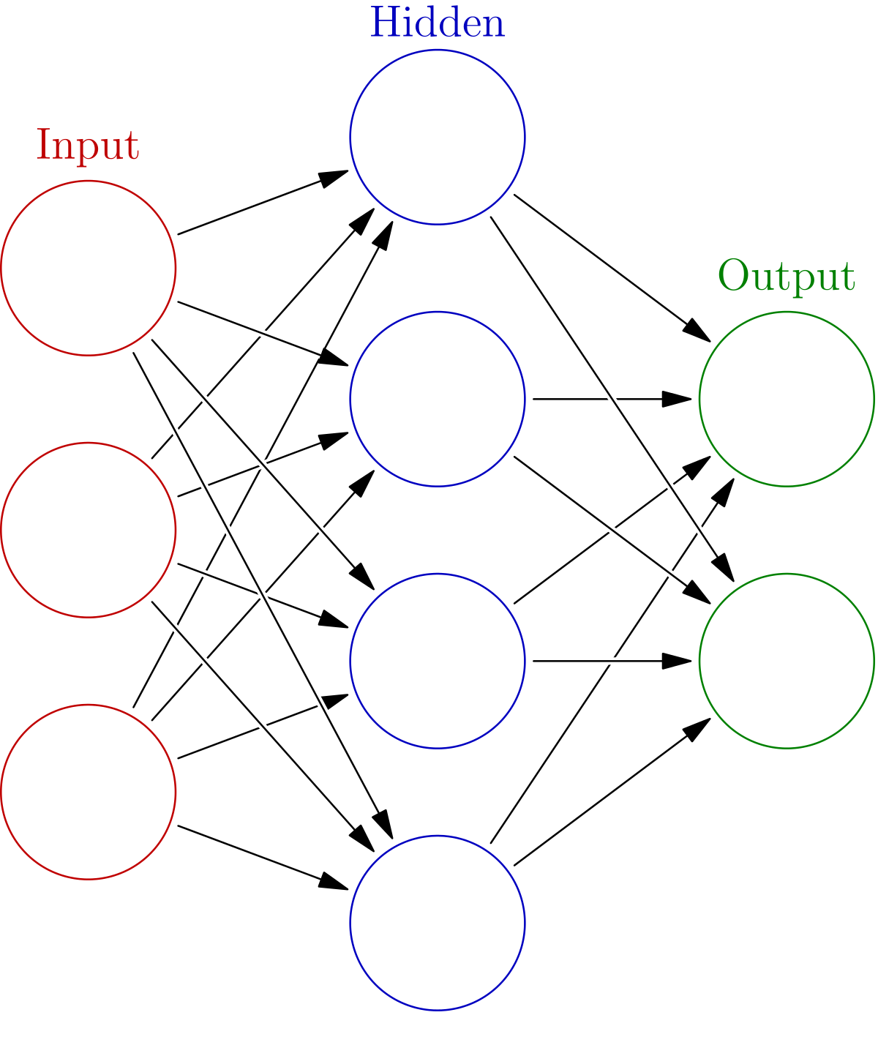


Presented By: Joseph Attieh Clara Akiki

Slide 3
Objective and Tools
Learn how to construct a multilayer neural network from scratch, train it and test it
JAVA is the programming language used in our project
With the help of java (javafx) and css in order to create GUIs

Slide 4
Overview
Build an artificial network based on characteristics entered by user: number of inputs, number of outputs, number of hidden layers and number of inputs per hidden layer
Train perceptron based on a data set containing multiple training pairs
Test perceptron using a specific input or using one of the three validation methods

Slide 5
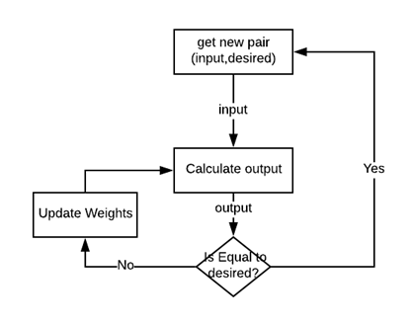
Procedure

Slide 6
Data sets for training

