Slide 1

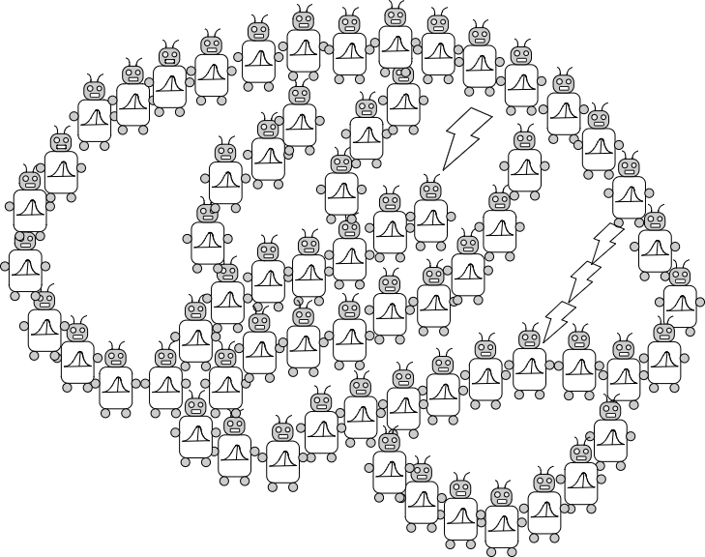
GitHub Primer
Joseph Austerweil
UW-Madison
Dept of Psychology
March 05, 2020
alab.psych.wisc.edu

Slide 2
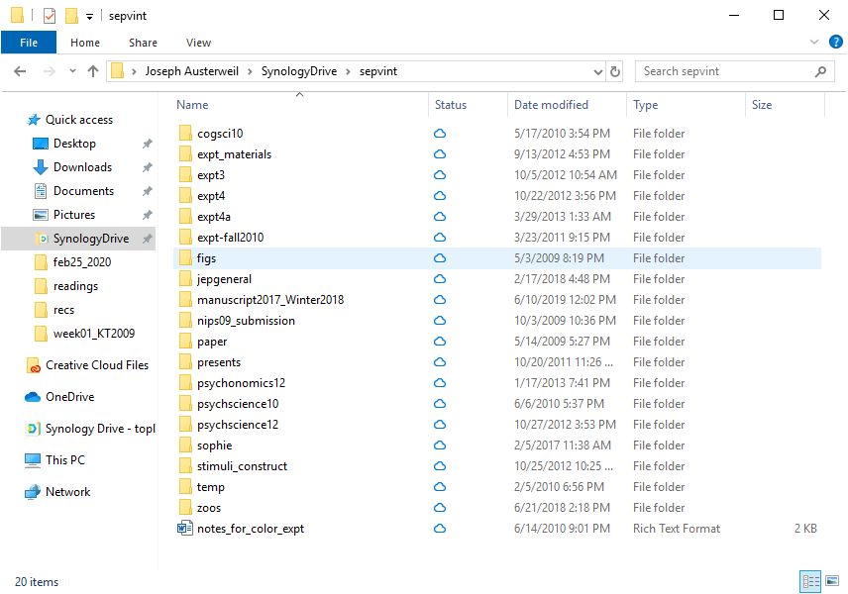

Slide 3
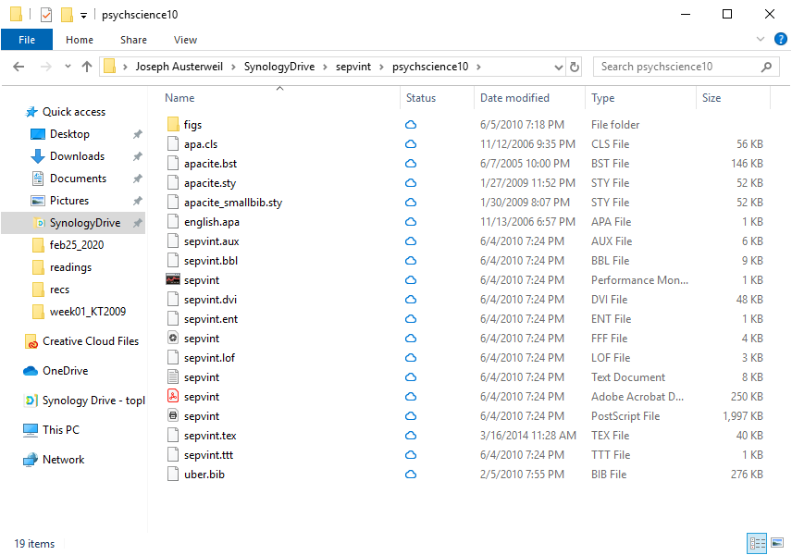

Slide 5
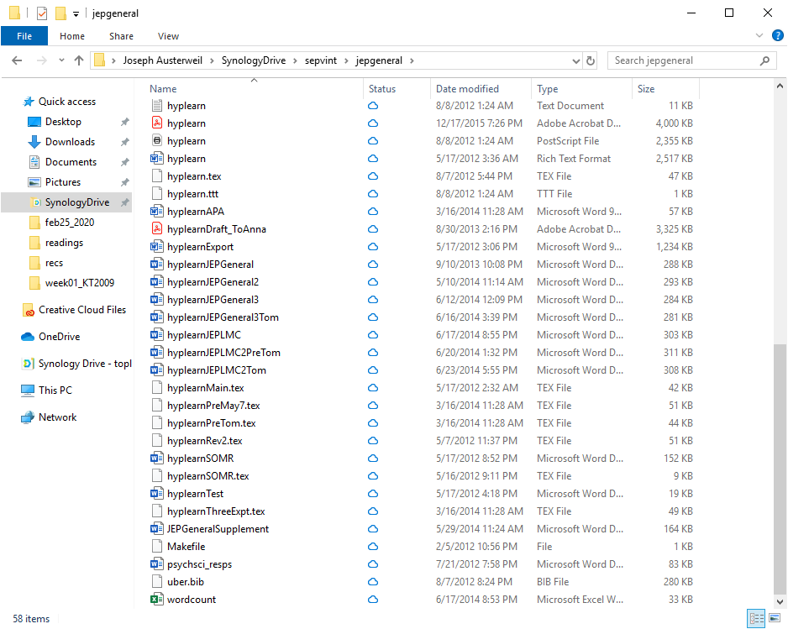

Slide 7
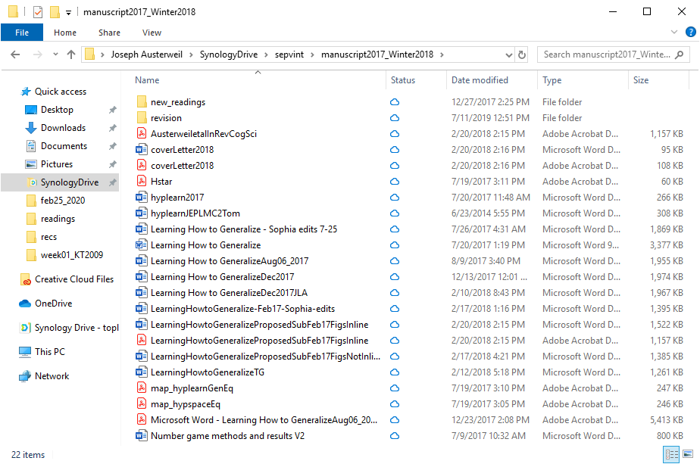

Slide 8
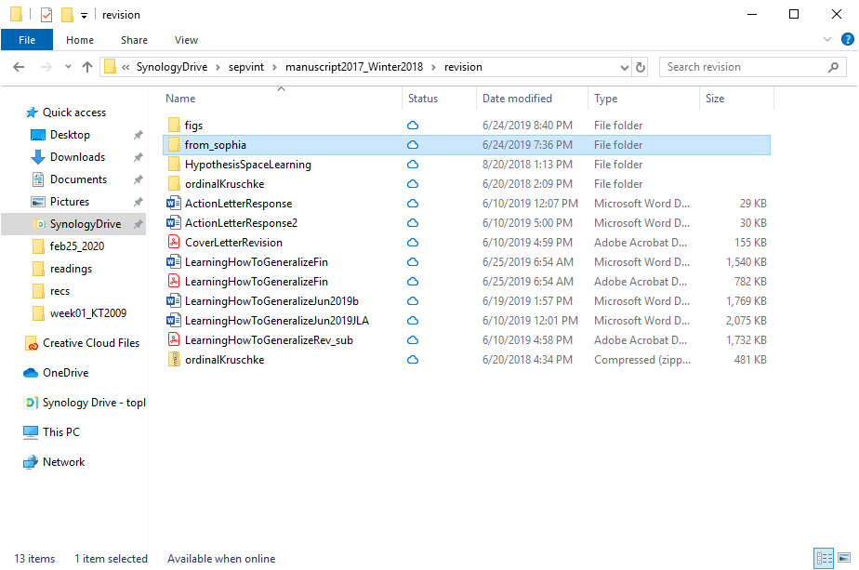

Slide 9
Outline for Today
Why use version control?
What is version control, Git, and GitHub?
Our first Git version control project with Rstudio
More Git demo

Slide 10
Problems and Takeaways
Unorganized versions can lead to confusion
Journals, different authors, myself over time
Where are the analyses?
Where are the figures?
Where are the data?
Where is the experiment?
Many places for error -> reproducibility issues
What we need:
Keep track of how projects develop.
Standardization of project files and folders.

Slide 11
git, GitHub, and Friends
git is a decentralized version control system for managing projects.
Decentralized: Full local versions of project
Version control: Keeps track of text, file, and other changes
Project: A folder with all non-ignored files (called repositories).
Records changes from the current files to the official record.
Notes:
Decentralized: local versions, “easy” to create a whole new copy of the project that can be reintegrated into the original one
GitHub: owned by microsoft

Slide 12
git workflow
Local Working Directory
Staging Area
Local git Repository
add/remove files
commit changes
Files on your computer as you change them.
Latest version of the project stored in git.
checkout/revert to previous version
Commit, add, and remove changes git repository.
pull new version

Slide 13
git, GitHub, and Friends
git is a decentralized version control system for managing projects.
Decentralized: Full local versions of project
Version control: Keeps track of text, file, and other changes
Project: A folder with all non-ignored files (called repositories).
Records changes from the current files to the official record.
GitHub is an online storage for repositories.
Another layer of official record that is globally accessible.
GitLab, BitBucket, …
GUIs/IDEs ease use (Fork, GitKraken, …)
Notes:
GitHub:

Slide 14
git workflow with GitHub
Local Working Directory
Staging Area
Local git Repository
Global git Repository
(GitHub)
add/remove files
commit changes
Files on your computer as you change them.
Latest version of the project stored in git.
checkout previous version
Commit, add, and remove changes git repository.
pull new version
push update
pull/checkout new version

Slide 15
Outline for Today
Why use version control?
What is version control, Git, and GitHub?
Our first Git version control project with Rstudio
More Git demo

Slide 16
Outline for Today
Why use version control?
What is version control, Git, and GitHub?
Our first Git version control project with Rstudio
More Git demo

Slide 17
Creating a new repository on GitHub

Slide 18
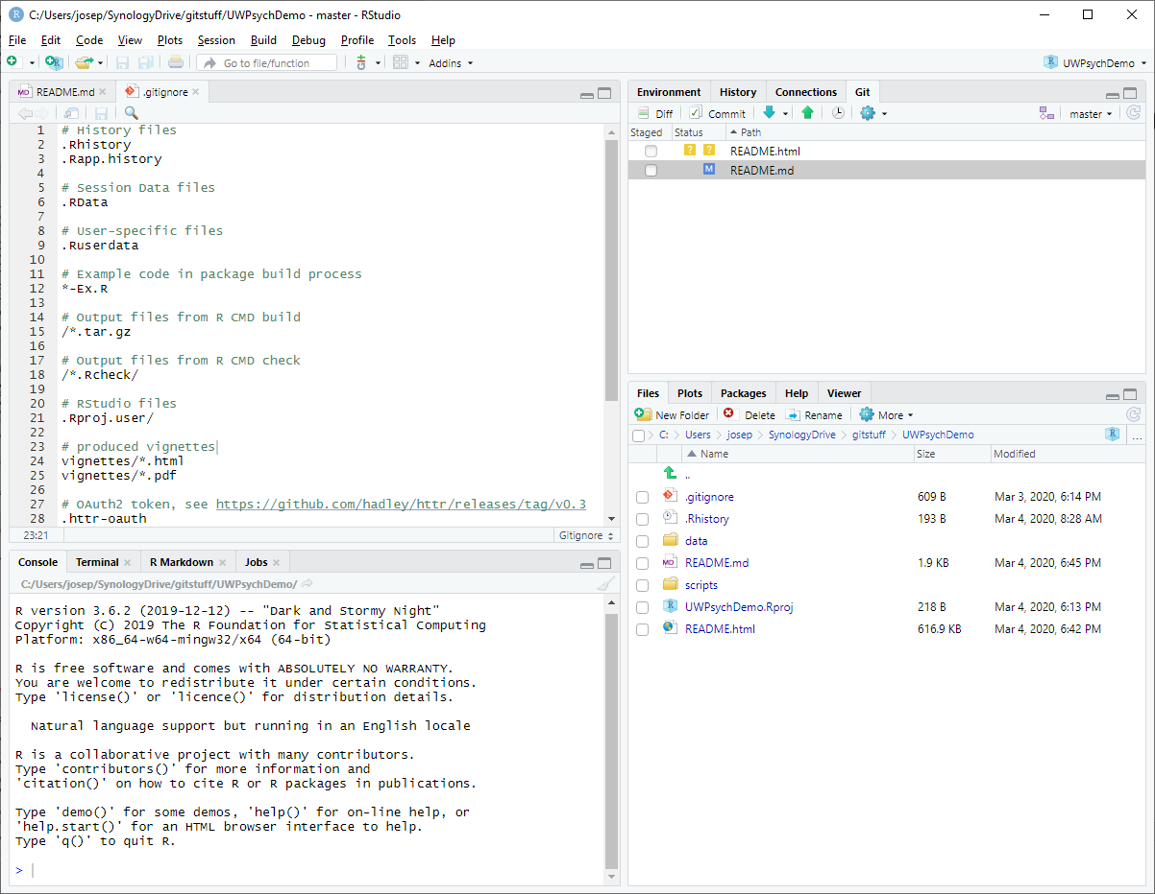
git(Hub) through RStudio
Notes:
Barebones in functionality but useable. For example, can create a local git repository, but can’t then make that also a global one through GitHub
If you want to share through GitHub, you need to first

Slide 19
Your first git commands
clone Copy a repository into your current folder
add Tell git you want to add files
commit Tell git you want to make changes to files
push Have git update your repository with current changes
REMEMBER TO SAVE BEFOREHAND.
Changes within files are only tracked for “raw text” files.

Slide 20
RStudio demo
Create the repository on GitHub first.
You can create a local git repository with a new R project, but you cannot “push” that repository to GitHub.*
*Within RStudio. It is possible, but is beyond beginner git.

Slide 21
Public vs. Private Repositories
Public repositories are visible and accessible by anyone.
Private repositories are only visible and accessible by the owner (and/or group in the case of group repositories).
OSF and GitHub integrate.
My lab has a private group -> public repository workflow.
It also integrates into Slack.

Slide 22
Reverting a mistake

Slide 23
Inviting a collaborator

Slide 24
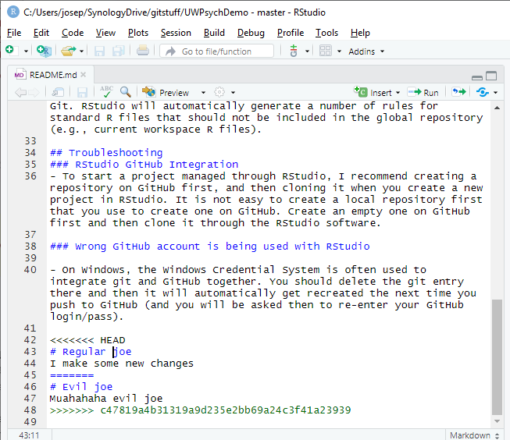
Conflicts
Notes:
Rstudio makes it hard to do – there’s many ways to do it, here’s one

Slide 25
Stay calm
When errors and issues arise with committing, pushing, pulling, etc., look online for help.
I included more resources in the GitHub Readme page.

