Slide 1


GitHub Primer
Joseph Austerweil
UW-Madison
Dept of Psychology
March 05, 2020
alab.psych.wisc.edu

Slide 2
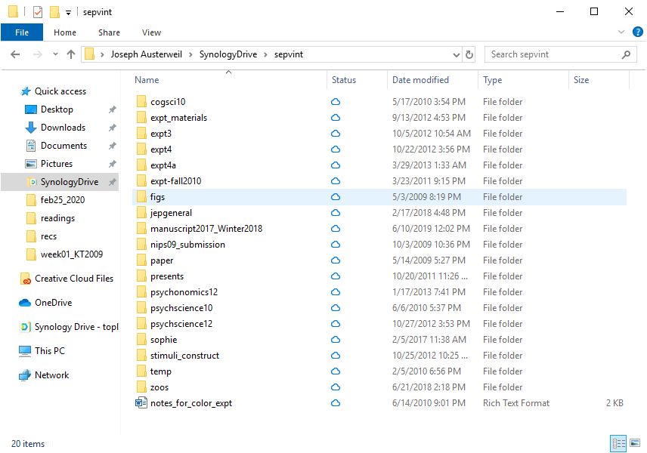

Slide 3
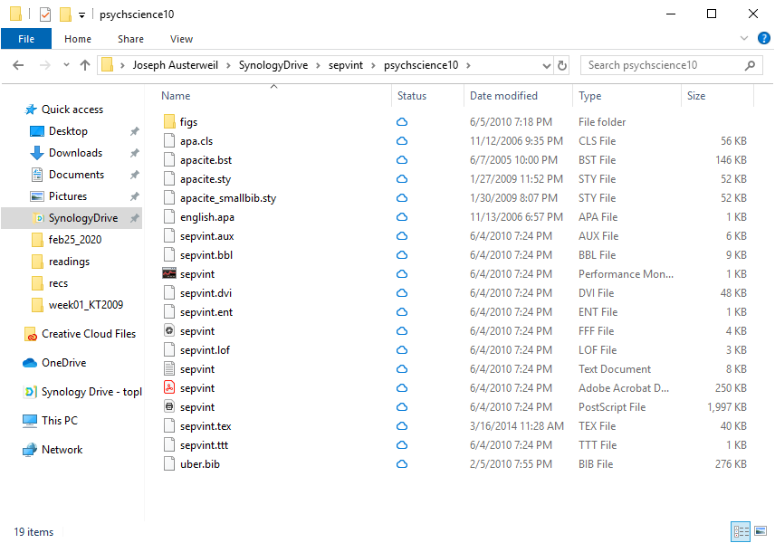

Slide 5
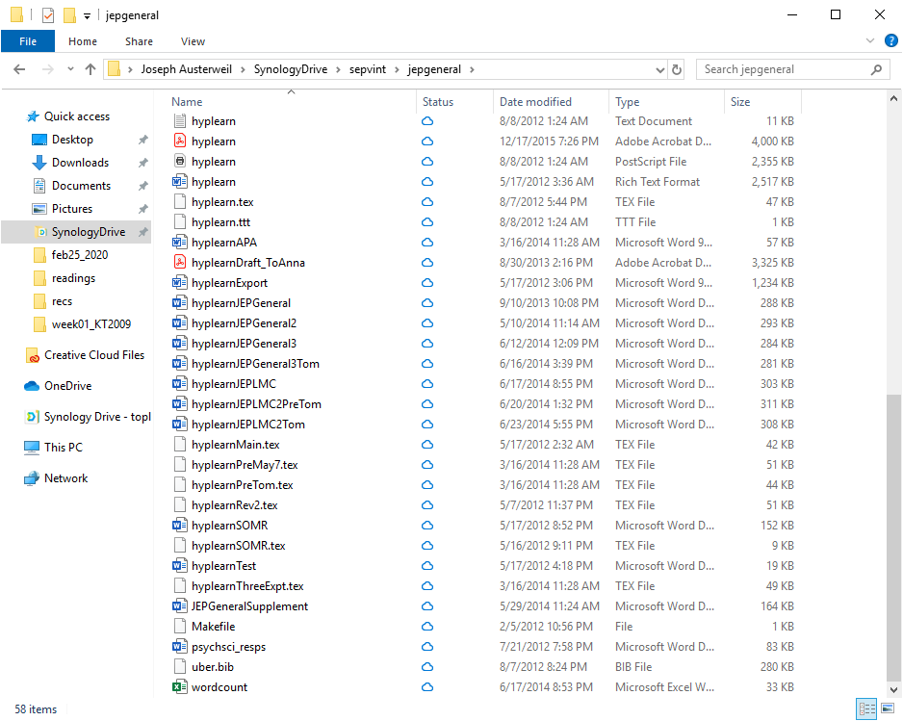

Slide 7
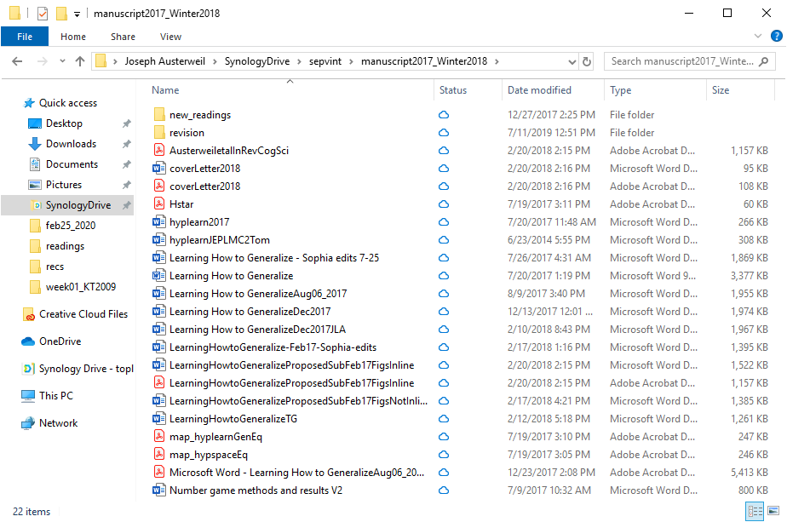

Slide 8
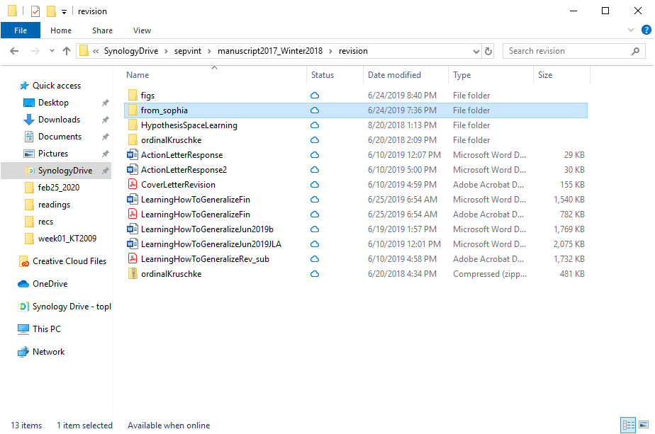

Slide 9
Outline for Today
Why use version control?
What is version control, Git, and GitHub?
Our first Git version control project with Rstudio
More Git

Slide 10
Problems and Takeaways
Unorganized versions can lead to confusion
Journals, different authors, myself over time
Where are the analyses?
Where are the figures?
Where are the data?
Where is the experiment?
Many places for error -> reproducibility issues
What we need:
Keep track of how projects develop.
Standardization of project files and folders.

Slide 11
git, GitHub, and Friends
git is a decentralized version control system for managing projects.
Decentralized: Full local versions of project
Version control: Keeps track of text, file, and other changes
Project: A folder with all non-ignored files (called repositories).
Records changes from the current files to the official record.
GitHub is an online storage for repositories.
Another layer of official record that is globally accessible.
GitLab, BitBucket, …
Notes:
GitHub:

Slide 12
git workflow
Local Working Directory
Staging Area
Local git Repository
push update
add/remove files
commit changes
Files on your computer as you change them.
Latest version of the project stored in git.
checkout previous version
Commit, add, and remove changes git repository.
pull new version

Slide 13
git, GitHub, and Friends
git is a decentralized version control system for managing projects.
Decentralized: Full local versions of project
Version control: Keeps track of text, file, and other changes
Project: A folder with all non-ignored files (called repositories).
Records changes from the current files to the official record.
GitHub is an online storage for repositories.
Another layer of official record that is globally accessible.
GitLab, BitBucket, …
GUIs/IDEs ease use (Fork, GitKraken, …)
Notes:
GitHub:

Slide 14
Creating a new repository on GitHub

Slide 15
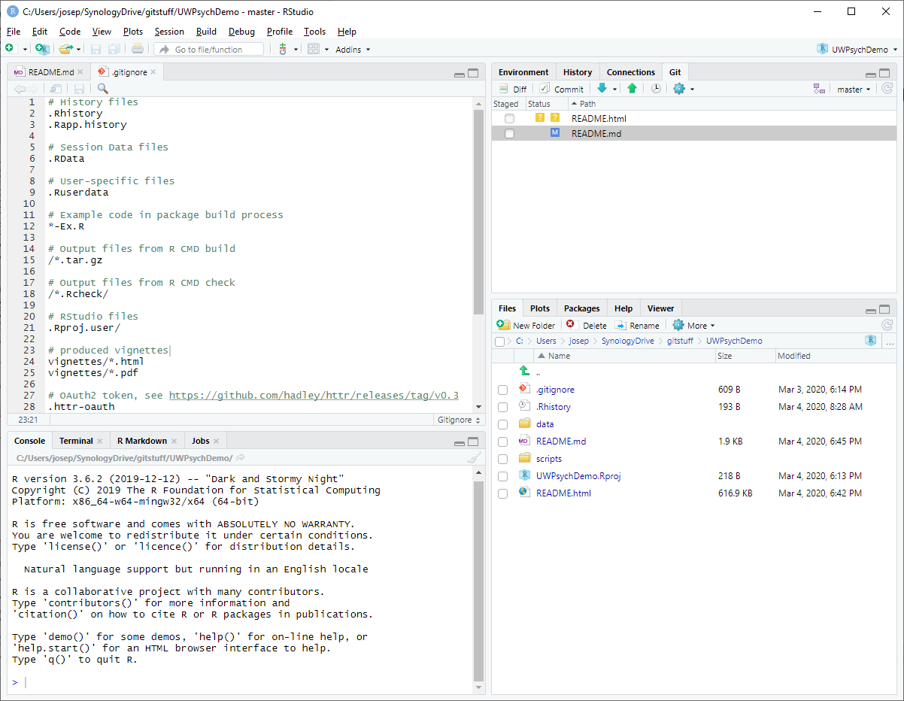
git(Hub) through RStudio
Notes:
Barebones in functionality but useable. For example, can create a local git repository, but can’t then make that also a global one through GitHub
If you want to share through GitHub, you need to first

Slide 16
Your first git commands
clone Copy a repository into your current folder
add Tell git you want to add files
commit Tell git you want to make changes to files
push Have git update your repository with current changes
REMEMBER TO SAVE BEFOREHAND.

Slide 17
RStudio demo

Slide 18
Public vs. Private Repositories
Public repositories are visible and accessible by anyone.
Private repositories are only visible and accessible by the owner (and/or group in the case of group repositories).
OSF and GitHub integrate.
My lab has a private group -> public repository workflow.

Slide 19
Reverting a mistake

Slide 20
Inviting a collaborator

Slide 21
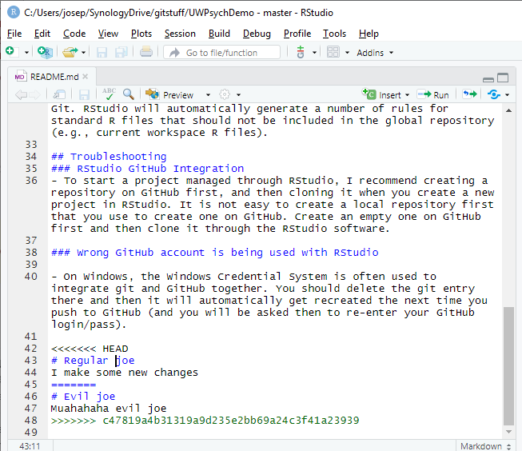
Conflicts
Notes:
Rstudio makes it hard to do – there’s many ways to do it, here’s one

