Slide 1

Machine Learning in Biology: Predicting Heart Failure based on Patient Medical History and Blood Chemistry
Prepared by: Joseph Matthew R. Azanza
Notes:
Hi everyone, good morning. I’m here to present my project, Machine Learning in Biology: Predicting Heart Failure based on Patient Medical History and Blood Chemistry
Coming from a molecular biology background, I was really excited to apply my ML1 learnings to biological problems. However, in conceptualizing a problem to solve, I encountered three recurring problems:

Slide 2
Problems Encountered
Public datasets are too complex for traditional ML models
Small sample sizes (tens to hundreds)
Need to collaborate with scientists
Notes:
First, publicly available datasets are too complex for traditional ML models as most require Deep Learning or advanced Image Processing
Second, public datasets that can be handled by traditional ML models have small sample sizes, typically in the tens to hundreds range, but rarely in thousands
Third, datasets with large sample sizes that can be handled by traditional ML models are not available publicly and are most likely being processed for publication.
To address these problems, I can either wait for next term, where Deep Learning and Image Processing will be discussed, or I can contact some labs for potential collaboration, but both will take time

Slide 3
Learning Goals
How to handle public datasets with small sample sizes
How ML models can be interpreted in a biological context
Notes:
This led me to the question, “how can we handle public datasets with small sample sizes?“
And now for my project, I am going to demonstrate how do that and how ML models can be interpreted in a biological context

Slide 4
Dataset
Obtained from Ahmad, et al. (2017):
Survival analysis of heart failure patients: A case study
299 Pakistani patients with 12 variables, predicting mortality (299x13)
Patient info: age, sex, smoker, time
Medical history: anemic, blood pressure, diabetic
Blood chemistry: creatinine phosphokinase, blood creatinine,
blood sodium, ejection fraction, platelets,
Notes:
The dataset I used in this study was obtained from Ahmad et al.’s research published in 2017.
The dataset has 299 Pakistani patients, with 12 variables identified by the researchers as relevant factors contributing to heart failure.
They identified 3 data categories such as patient information, medical history, and blood chemistry.

Slide 5
Data Processing and EDA
Classification via Train-test split (8 models)
Classification Leave One Out CV (8 models)
Compare and Interpret
Performed Methodology
Notes:
The methodology I used is as follows. I processed the data, then I did a run of classifier models with the standard train-test split, and then I performed a parallel run using the Leave One Out Cross Validation method, and then I compared the results of the two runs

Slide 6
Leave One Out Cross Validation
Extreme version of k-fold cross validation using all
but one data point as train set; left out = test set
Advantage: more robust model performance and no randomness
Disadvantage: variability of model performance and computation cost
We can use LOOCV to handle small datasets
Notes:
But what is Leave One Out Cross Validation (LOOCV)?
It is an extreme version of the k-fold cross validation, wherein all but one is used as the learning set. So for this study, the LOO method produced 299 models per algorithm and 299 accuracy values were calculated. To get the final accuracy, the 299 accuracies were averaged.
The advantage of using LOO is the more robust estimation of the model's performance. Since we're using the whole dataset, bias is minimized, and overestimation of error is reduced. Randomness due to data splitting is also removed. In fact, LOO is usually preferred over the usual train-test split when the dataset is small or when robustness of accuracy is preferred over computational costs.
So to answer my initial question of how can we handle small datasets, we can use the LOO method to produce robust results.

Slide 7
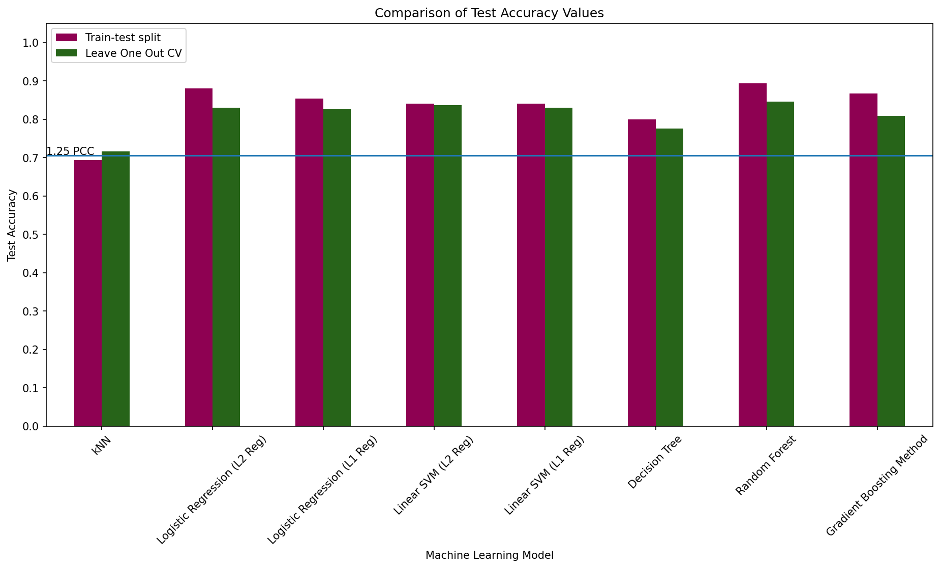
Results
Notes:
Looking at the results of parallel runs,, we can see that only kNN has a higher LOO test accuracy compared to the train-test split method. The other test accuracies are lower, but still within a comparable range. These results are as expected.
In terms of total runtime, the train-test split method for 8 algorithms only took about 2 seconds while it took around 4 mins for the LOO method.
In terms of model selection for predicting heart failure, we want the accuracy to be robust. Following this, it is preferable to pick the models produced via LOO compared to the train-test split. The calculated test accuracies via LOO are also higher than the 1.25 PCC , meaning all of them can predict better than chance.

Slide 8
Interpreting ML
in a Biological Problem
Best Model: Random Forest Classifier, 85% Accuracy
Skepticism on applying model to non-Pakistani People
Value: ML model used to augment decision making
Notes:
Moving forward, let's say we picked the Random Forest classifier as our model of choice, how do we proceed?
First, I want to highlight that even though we have an accuracy of 85%, we still need to be skeptical when we use this model for non-Pakistani people. The study and the data was done in a Pakistani context and applying the model to non-Pakistani people can include some context changes on a molecular level that even ML models might not account for.
The value of this model when applied to a different context is that it can provide us with a base expectation of what might happen. However, it's still the responsibility of the researchers to use their domain knowledge for decision making. In short, the ML model is used to augment decision making, not replace the decision maker.

Slide 9
Summary
We can use the Leave One Out Cross Validation method
to handle small datasets
Application and interpretation of ML in a biological problem
is highly context dependent
The value ML gives is the augmentation of decision making
Notes:
In summary:
We can use the Leave One Out Cross Validation method to handle datasets with small samples as the calculated test accuracies are more robust than the train-test split method
Application and interpretation of ML in a biological problem is highly context dependent. While I was able to create a model with 85% accuracy, applying this model non-Pakistani people should be handled with skepticism. There are some context changes on a molecular level that even traditional machine learning models might not account for.
The value that the ML model with 85% accuracy gives when we applied in a different context is that it can provide us with a base expectation of what can happen. The ML model is used to augment decision making but not replace the decision makers.

Slide 10
Appendix

Slide 11
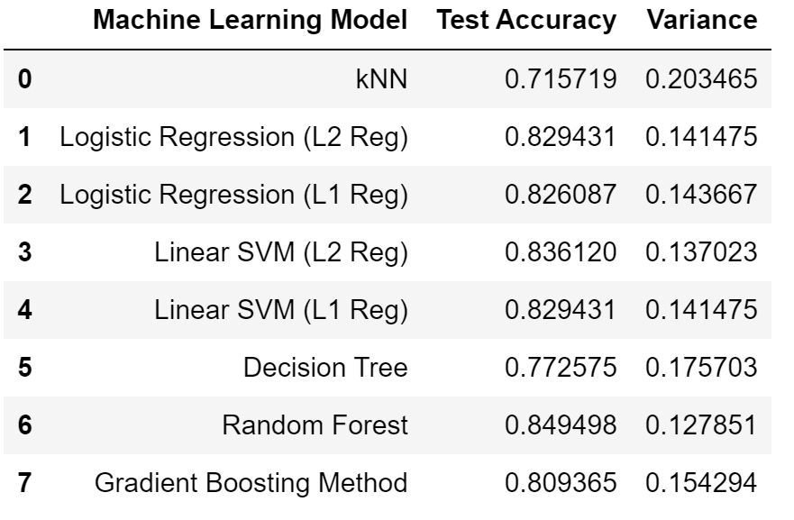
LOOCV Calculated Variance

