Slide 1

Composing Final Fantasy Original Sound Tracks via Neural Networks
by Joseph Matthew R. Azanza
Notes:
Hi everyone, good afternoon. I’m here to present my project titled “Composing Final Fantasy OSTs via Neural Networks”

Slide 2
Why focus on music (OSTs)?
INTRODUCTION
Based on experience, OSTs are very important for the experience and can make or break the game
Music is on par with story, graphics, and game mechanics
Published research on importance of music in video games:
Ganiti, et al., (2017): Music invokes emotional engagement from players, resulting in better experience
Zhang and Fu (2015): “Music makes gamers be easily absorbed in the gameplay and forget the time passing, leading to more serious time distortion”
Notes:
This is a passion project. I’ve been playing games since I was 5 years old and I’ve had my fair share of Role-playing games. From my experience, video game music is very important for immersion. And to be honest, it can make or break the experience.
I also found that music is on par with the story, graphics, and the game mechanics in identifying how good or bad a game is.
Published research also supports my perceived importance of music, where good music results in players having a better experience to the point of experiencing time distortion

Slide 3

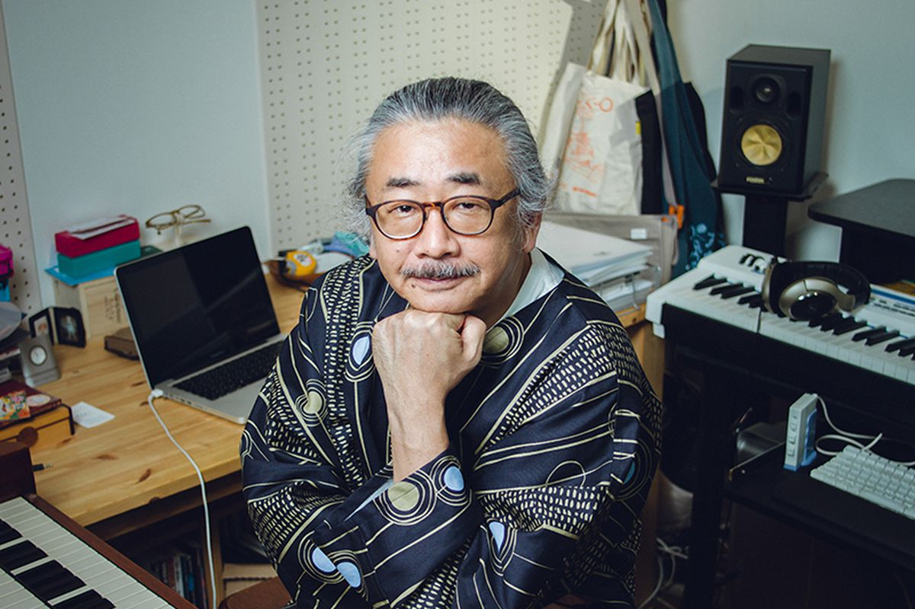
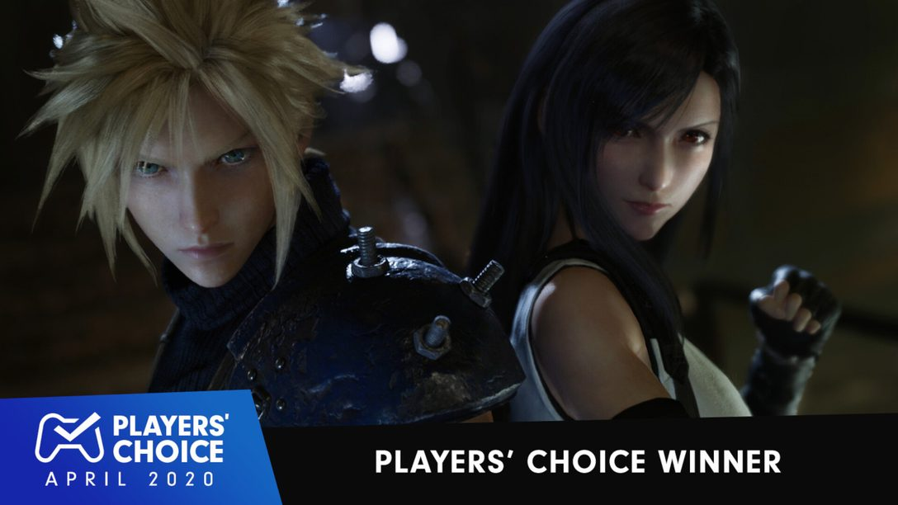
But why Final Fantasy?
INTRODUCTION
Nobuo Uematsu (Main Composer)
Preference
Popularity
Legacy
Notes:
But out of all the games and franchises out there, why am I focusing on the Final Fantasy franchise?
I picked Final Fantasy because of personal preference, the popularity, and the legacy of the music. Final Fantasy OSTs vary widely, from light-hearted to very emotional ones.
It is also famous to the point that concerts are being held outside of Japan.
It is also responsible for changing the course of classical music by inspiring a new generation of classical music lovers and composers

Slide 4
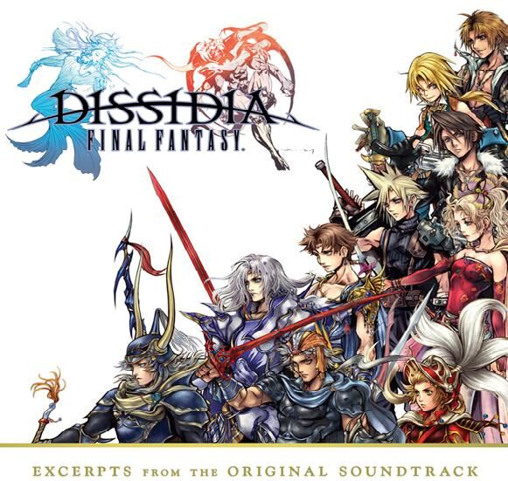
How can I apply our ML2 learnings in composing OSTs?
Notes:
Now, given the very rich background of the Final Fantasy franchise, my goal in this project, is simply to apply our ML2 learnings, and figure out how to compose OSTs using neural networks.

Slide 5

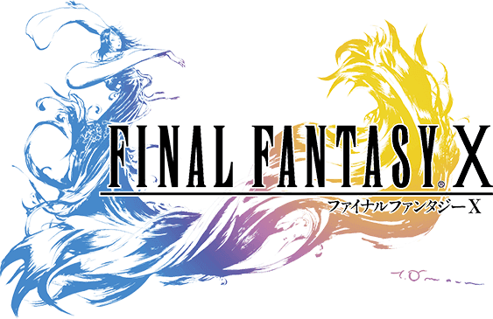
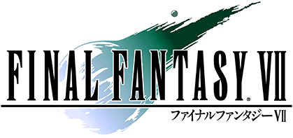
DATA SET
Classics Era
PlayStation Era
Collaboration Era
100 handpicked MIDI Files
Inclusions: Character Themes, Boss Themes, World and Area Themes
Exclusions: Opening / Crystal Theme, Battle Theme, Victory Fanfare, Chocobo Theme
Notes:
The dataset I used are 100 handpicked MIDI files across three Final Fantasy games that represent certain eras of the franchise: the classics, the playstation, and the collaboration era
The midi files are handpicked in the sense that I only included certain tracks because of their high variability.
I also excluded tracks that are structured the same across the franchise

Slide 6
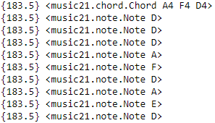

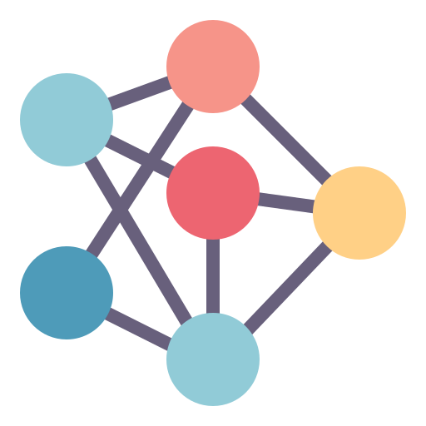
TRAINING THE NETWORK
15 | 4 | 13 | 7 | 10
Extracting Piano
Notes and Chords
Number Representation
of Notes and Chords
Sequence of 128 notes
Sequence-based Training
of Neural Network
(75-25 train-test split)
Notes:
Now, I’ll present to you the intuition behind my methodology.
For the training part, I first read the MIDI files via the music21 library, and I extracted only the piano notes and chord sequences per midi file, for simplicity.
Then, I transformed these sequences into numerical representations, so that a neural network can process them. Once transformed, my neural network will train on a given length of sequential notes, predicting the next note or chord.

Slide 7
SONG GENERATION
15 | 4 | 13 | 7 | 10
4 | 13 | 7 | 10 | 12
Random Sequence of
128 notes as “seed”
Fully
Trained Network
Predict Next Note,
Drop First Note of seed
Predict until target
number of notes is achieved
Notes:
For the OST generation, I used a random sequence of 128 notes as seed input into the trained network since the network can only predict given an initial sequence.
With the initial 128 notes, the network will predict the next note, and then I will slide the 128-note window to drop the first note and factor in the newly predicted note.
This process will be repeated until a sequence of 500 notes or a 1.5-minute track has been generated

Slide 8
NETWORK ARCHITECTURE AND METRICS
LSTM
LSTM
LSTM
Normalization
Dropout
Dense
Normalization
Dropout
Dense
Total params: 5, 455, 633
Trainable params: 5, 454, 097 (99.97%)
Number of Output Labels: 273
Training time: 8 hours via Google Colab
Final layer activation: Softmax
Loss function: Categorical Cross-entropy
Optimizer: RMS Prop
Epoch | Val Acc | Val Loss
42 | 0.6708 | 1.55726
118 | 0.7489 | 1.9412
Notes:
The architecture of my best network is comprised of three LSTM layers followed by two sets of a Batch Normalization layer, a Dropout layer, and a Dense layer.
Since this is a multiclass, single classification problem, softmax and categorical cross-entropy were used as the final activation function and loss function respectively,
During training, I checkpointed two versions of the weights, one for max validation accuracy and one for minimum validation loss.
Between the two, I picked the max validation accuracy weights because I want my network to generalize better.

Slide 9

ORIGINAL VS GENERATED SONGS
Collaboration Era
AI-generated
Notes:
After all is said and done, let us listen to an OST composed by Uematsu-san and an AI-generated OST.
With this, I can say that I was successful in figuring out how to compose OSTs using neural networks.

Slide 10
Key Learnings
Perfect is the enemy of good
Advantage of Domain Knowledge
Having fun and enjoying the process
Notes:
So, what are my key learnings in doing this project?
First, is that perfect is the enemy of good. Is the AI-generated song perfect? Unfortunately, no. But I think the network and the output is good enough to stand on its own.
Which brings me to my second learning, the advantage of domain knowledge. At my current state, I lack music theory knowledge to further enhance the network. If I have that, I will include more components such as Different Note Durations, Rests, and more instruments.
And lastly, my third learning, having fun and enjoying the process. Doing this project felt similar to clearing the final dungeon of a game. I found that enjoying the process made work feel like play. And given the difficult term that we are in, I think it’s important to take a step back and enjoy what we can.
With that I’m open to your questions. Thank you!

Slide 11
Appendix

Slide 12
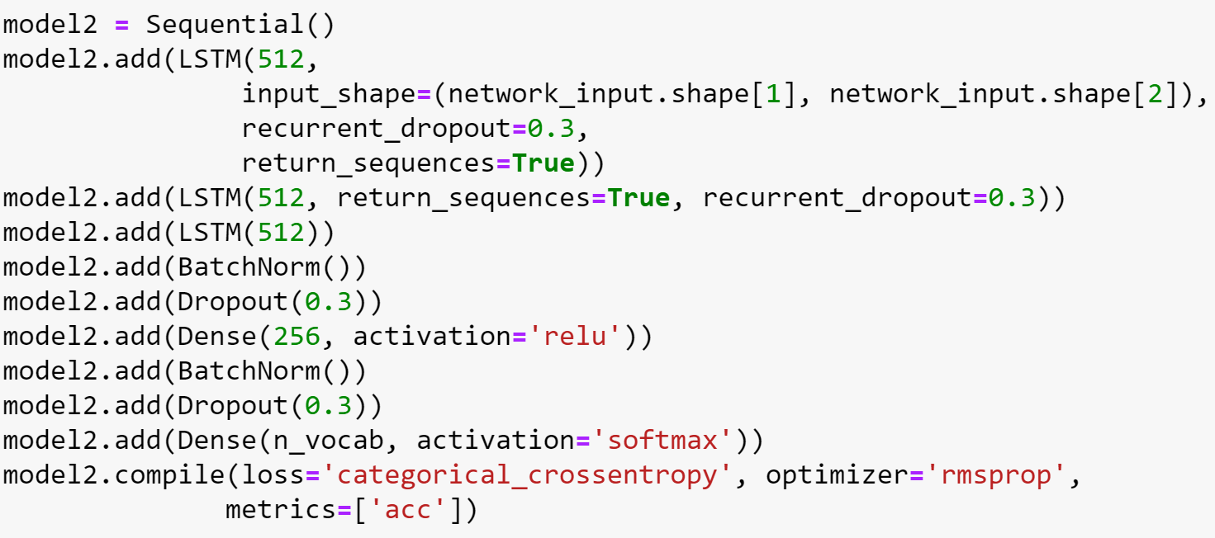
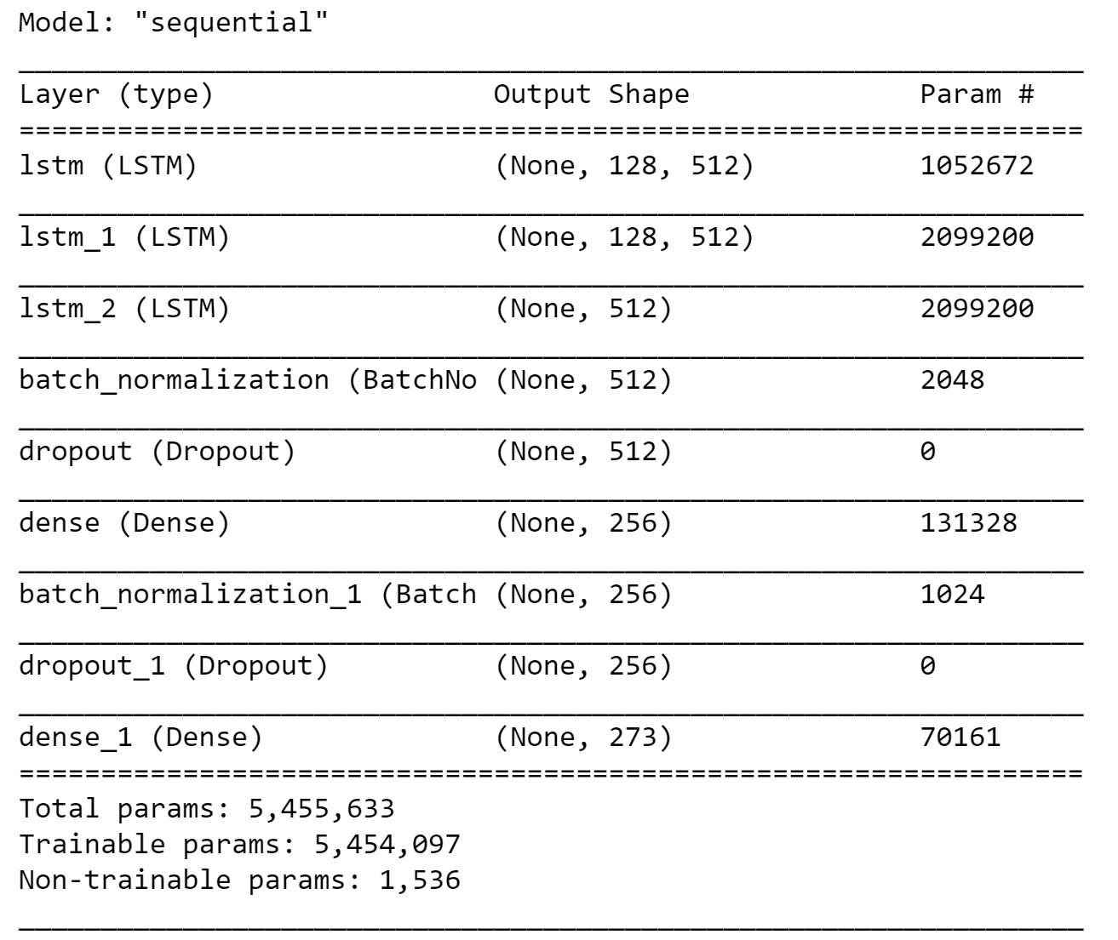
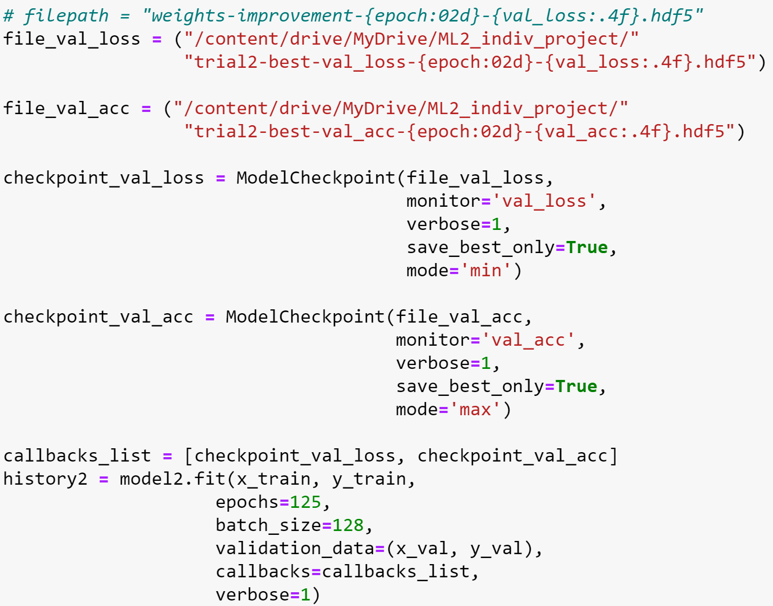

Slide 13
