Slide 1
Title
Student 1 name Student 2 name

Slide 2
Summary of your idea / project
What is your project about

Slide 3
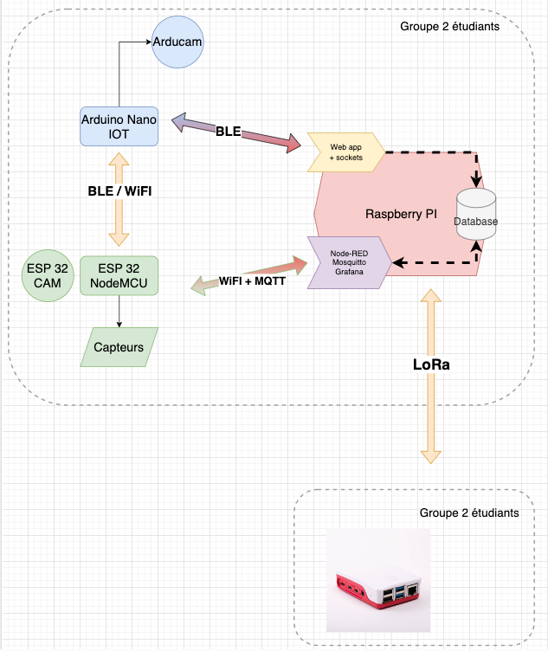
Architecture
Example architecture
You have to show how
Components are interacting with
Each others
Tell if you are using an RPI or
Your PC (IoTStack or Docker Compose)

Slide 4
Sensors / Collected data
Ex:
ESP32 ⇒ Temp sensor ⇒ DHT 11
Arduino nano ⇒ Accelerometer axis x,y z
Etc

Slide 5
Storage
How are you saving the data? Where?

Slide 6
Processing
Screenshot of your NodeRed flows
If you are doing processing on NodeJS or Android, please mention this here

Slide 7
Visualisation
Screenshots of your graphs (Grafana and other)

