Slide 1
MINERvA OmniFold
Research catch-up with Ben
Joseph Bailey
2D validation, higher-dimensional inference, and full-event learning
10 October 2026
Notes:
Target 56 seconds; elapsed 0–56 seconds
Ben, I want to bring you up to date on the whole project and separate what we have established from what still needs work. The original goal was to reproduce MINERvA’s inclusive muon-neutrino cross section using OmniFold, then use the same event-based method to add hadronic information. That expanded into two research directions: scalar observables, meaning one numerical value per event for each chosen quantity, and a learned representation of the particles and detector deposits in an event. I will show the successful reproduction first, then explain why uncertainty validation has become the central issue. I have kept the details of individual campaigns in backup slides so we can follow whichever part you want to discuss.
SOURCES
Repository /Users/josephbailey/local-research/MINERvA-OmniFold/docs/analysis-note/main_note.tex
Repository /Users/josephbailey/local-research/MINERvA-OmniFold/docs/publication/submission/PACKAGE-MANIFEST-20261006.md
Evidence snapshot: f6dc46e6afef9efa8722d01b43c3f2b379b41314, 2026-10-10. Presenter paraphrase of committed records.

Slide 2
The project now has three distinct outcomes
2D reproduction
Validated central result and a rebuilt uncertainty construction
3D to 5D scalar studies
Validated finite closure tests and conditional generator inference
Full-event PET studies
Better recovery in simulation, but no eligible uncertainty procedure
02
Notes:
Target 57 seconds; elapsed 56–113 seconds
There are three outcomes to keep separate. The two-dimensional reproduction gives a stable central cross section close to the published result. Its uncertainty construction has been repaired, although the newest statistical band still needs a coverage re-test. The scalar extensions add up to five recorded observables and pass specific consistency and closure tests. A separate campaign gives conditional generator-test results, but did not qualify a five-dimensional cross-section measurement with total uncertainties. Finally, the point-cloud studies substantially improve recovery of some simulated distortions. Their uncertainty procedure fails calibration, so they remain method development. A central estimate is the fitted spectrum. An uncertainty procedure is the rule that assigns its error bars. Success of one does not automatically establish the other.
SOURCES
Repository /Users/josephbailey/local-research/MINERvA-OmniFold/2d-unfolding/2D_OMNIFOLD_STUDY_STATUS.md
Repository /Users/josephbailey/local-research/MINERvA-OmniFold/3d-unfolding/3D_OMNIFOLD_STATUS.md
Repository /Users/josephbailey/local-research/MINERvA-OmniFold/docs/orchestration/DELIVERY-20261006-s5p-campaign-terminal.md
Repository /Users/josephbailey/local-research/MINERvA-OmniFold/nd-unfolding/pet/final_design/DECISION_RECORD-pet-final-design.md
Evidence snapshot: f6dc46e6afef9efa8722d01b43c3f2b379b41314, 2026-10-10. Presenter paraphrase of committed records.

Slide 3
The data and the measurement
Sample
Medium-energy neutrino mode, about 6 GeV. 4.12 million selected events
Signal
Muon-neutrino charged-current interactions in the tracker
Reference domain
Muon angle < 20°, 1.5 < p∥ < 60 GeV/c, pT < 4.5 GeV/c
Detector
MINERvA measures activity. Downstream MINOS measures the muon
03
Notes:
Target 59 seconds; elapsed 113–172 seconds
We use the same medium-energy neutrino-mode exposure as the published inclusive measurement: about 1.057 times ten to the twenty-one protons on target, leaving about 4.12 million selected events. Protons on target measures the accelerator exposure. Charged-current means the neutrino produces a charged lepton, here a muon. Inclusive means we do not require a particular hadronic final state. The fiducial volume is the selected interior region of the tracker. The reference cross section also restricts the muon angle and momentum as shown. MINERvA measures the interaction and recoil activity, while the downstream magnetized MINOS detector provides muon momentum and charge. Here p transverse and p parallel are momentum components relative to the beam. Simulation supplies paired records of the generated interaction and its detector reconstruction.
SOURCES
Repository /Users/josephbailey/local-research/MINERvA-OmniFold/docs/analysis-note/sec_experiment.tex
Repository /Users/josephbailey/local-research/MINERvA-OmniFold/2d-unfolding/2D_OMNIFOLD_REFERENCE.md
Evidence snapshot: f6dc46e6afef9efa8722d01b43c3f2b379b41314, 2026-10-10. Presenter paraphrase of committed records.

Slide 4
OmniFold learns event weights in two spaces
01
02
03
Detector space
Paired simulation
Truth space
Compare data with reconstructed simulation
Carry that weight to its truth record
Learn a smooth truth-level reweighting
Fit a weight for each simulated event
Estimate weights for missed events
Repeat with the updated simulation
After five iterations, histogram the weighted truth events in the desired observables
04
Notes:
Target 82 seconds; elapsed 172–254 seconds
Unfolding estimates the particle-level distribution that could have produced the detector-level observations. Truth means the simulated interaction before detector effects, not something directly known for the data. OmniFold does this through event weights. In the detector step, a classifier learns to distinguish data from reconstructed simulation. A classifier is a function trained to separate labeled examples. With the appropriate class normalization, its probability gives a density ratio through p divided by one minus p. That ratio says where simulation needs more or less weight. We transfer the weights through the paired simulated events to truth. A regressor, meaning a learned prediction of a numerical quantity, supplies weights for truth events without a selected reconstructed partner. The second classifier smooths the reweighting in truth space. Repeating these steps defines an iteration. The scalar analyses use boosted decision trees: an ensemble of small decision rules fitted successively. The final product is a weighted truth ensemble, so we can choose reporting histograms afterward. The number of iterations and the learner’s capacity limit how much structure the fit can recover.
SOURCES
Repository /Users/josephbailey/local-research/MINERvA-OmniFold/docs/analysis-note/sec_method.tex
Evidence snapshot: f6dc46e6afef9efa8722d01b43c3f2b379b41314, 2026-10-10. Presenter paraphrase of committed records.

Slide 5
Three different tests of an unfolding result
Closure
Create simulated data with known truth and test recovery
Dimensional anchor
Integrate an added observable and compare with the earlier result
Coverage
Repeat simulated experiments and count how often intervals contain truth
A closure pass applies to the tested deformation and detector response
05
Notes:
Target 65 seconds; elapsed 254–319 seconds
These terms recur throughout the talk. A closure test creates pseudo-data, or simulated data, whose underlying truth we know. We change that truth, unfold, and ask whether we recover it. A dimensional anchor integrates away an added observable and compares with the earlier lower-dimensional result. That checks consistency, especially normalization, but does not prove every shape agrees. Coverage asks a different question: if we repeated the experiment many times, how often would a stated interval contain the fixed truth? A nominal 95 percent interval should do so roughly 95 percent of the time under the tested model. A method can recover one injected bump and still have poorly calibrated intervals or miss a different distortion. The one-dimensional binned study served as an equivalence and debugging cross-check. It is complete and is not a separate publication result.
SOURCES
Repository /Users/josephbailey/local-research/MINERvA-OmniFold/docs/analysis-note/sec_validation.tex
Repository /Users/josephbailey/local-research/MINERvA-OmniFold/docs/analysis-note/sec_3d.tex
Evidence snapshot: f6dc46e6afef9efa8722d01b43c3f2b379b41314, 2026-10-10. Presenter paraphrase of committed records.

Slide 6
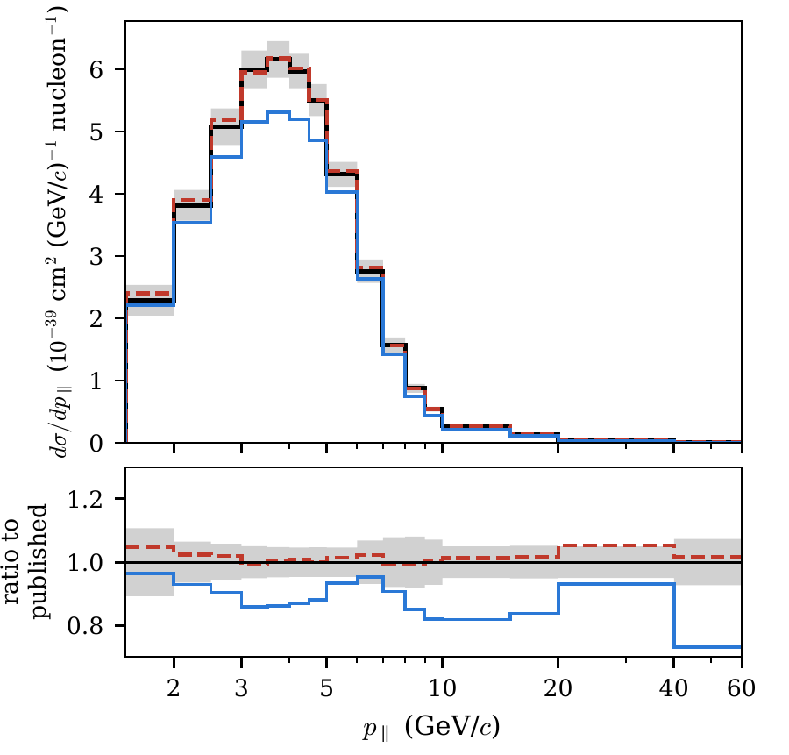
The 2D cross section reproduces the published scale
3.073 × 10⁻³⁸ cm²/nucleon
1.11% above the published total
205 reported bins. Five iterations
Same data and shared systematics
Black: published Red dashed: OmniFold Blue: tuned prior
Projection of the validated 2D central result. This is a reproduction, not an independent measurement
06
Notes:
Target 61 seconds; elapsed 319–380 seconds
This figure compares the two-dimensional extraction with the published result. The bin ratios show shape agreement, while the integrated comparison checks normalization. The integrated result is 3.073 times ten to the minus thirty-eight square centimeters per nucleon, 1.11 percent above the published total. Across the 205 reported bins, about 94 percent are within ten percent of the published values. This is a meaningful reproduction of the extraction and normalization using a different unfolding method. It uses the same data and many of the same systematic ingredients, so it is not an independent measurement of the physics. There is also a backend distinction: the published central estimate uses scikit-learn’s exact-split trees, while the uncertainty ensembles use LightGBM, another boosted-tree implementation. The central estimator and covariance are not strictly matched.
SOURCES
Repository /Users/josephbailey/local-research/MINERvA-OmniFold/2d-unfolding/2D_OMNIFOLD_STUDY_STATUS.md
Repository /Users/josephbailey/local-research/MINERvA-OmniFold/docs/analysis-note/figures/MEFHC_5iter_xsec_proj_pt.pdf
Repository /Users/josephbailey/local-research/MINERvA-OmniFold/docs/analysis-note/sec_method.tex
Repository /Users/josephbailey/local-research/MINERvA-OmniFold/docs/analysis-note/figures/paper_fig1_validation.pdf
Evidence snapshot: f6dc46e6afef9efa8722d01b43c3f2b379b41314, 2026-10-10. Presenter paraphrase of committed records.

Slide 7
The 2D controls test recovery and bookkeeping
Injected shapes
Truth reweights and alternative-universe tests pass their declared thresholds
Missed events
Truth records define the full signal denominator
Iteration controls
Five iterations form the frozen production choice
Known limit
A large hidden response deformation exceeds the closure threshold
07
Notes:
Target 64 seconds; elapsed 380–444 seconds
Several controls support that result. Injected truth shapes and selected alternative systematic-universe tests pass their declared thresholds. A universe here means a simulated variation of an uncertain model or detector parameter. We also repaired and checked the signal bookkeeping: truth records define the denominator, and an event that fails reconstruction remains present as a missed event. That prevents an apparently successful unfold from silently losing part of the signal. Five iterations are the frozen production choice, supported by the existing iteration checks. The validation has a visible boundary. In a hidden-variable test, a sufficiently large distortion in a detector-resolution variable exceeds the closure threshold. That matters because agreement on the training observables cannot guarantee correctness for every unobserved feature or detector response. I would describe these as targeted validation successes, with their tested scope attached.
SOURCES
Repository /Users/josephbailey/local-research/MINERvA-OmniFold/docs/analysis-note/sec_validation.tex
Repository /Users/josephbailey/local-research/MINERvA-OmniFold/docs/analysis-note/sec_method.tex
Repository /Users/josephbailey/local-research/MINERvA-OmniFold/2d-unfolding/2D_OMNIFOLD_REFERENCE.md
Evidence snapshot: f6dc46e6afef9efa8722d01b43c3f2b379b41314, 2026-10-10. Presenter paraphrase of committed records.

Slide 8
The rebuilt uncertainty recipe still needs a coverage test
Construction
187 systematic universes + statistics + training variation
Current budget
6.87% median relative uncertainty per reported bin
Old statistical band
Two-standard-deviation containment: 91.21%. Failed its window
Repair
Adopted VL170 band, rebuilt in VL172. Coverage not re-tested
The 6.87% is a median bin uncertainty, not the uncertainty on the integrated cross section
08
Notes:
Target 77 seconds; elapsed 444–521 seconds
A covariance matrix describes both individual bin variances and how bins move together. The two-dimensional construction combines 187 systematic universes with statistical resampling and training variation. Flux means the number of incident neutrinos per area. Applying each universe’s flux normalization correctly was essential. The current construction follows the MINERvA Analysis Toolkit prescription and gives a median relative bin uncertainty of 6.87 percent. That number is not the error on the integral. A recent fixed-truth test found that the old statistical band contained truth within two standard deviations only 91.21 percent of the time, below its predeclared acceptable window. The repair removed a spurious fluctuating completeness normalization from the replicas. I adopted the rebuilt statistical band, and the combined products were rebuilt. The printed total median barely changed because other sources dominate. The new band has not been coverage re-tested. Adding our covariance to the published one double-counts shared systematics, so I do not use the resulting small chi-square as the main validation claim.
SOURCES
Repository /Users/josephbailey/local-research/MINERvA-OmniFold/VALIDATION_LEDGER.md: VL169–VL172
Repository /Users/josephbailey/local-research/MINERvA-OmniFold/docs/analysis-note/sec_systematics.tex
Repository /Users/josephbailey/local-research/MINERvA-OmniFold/docs/analysis-note/sec_validation.tex
Repository /Users/josephbailey/local-research/MINERvA-OmniFold/KNOWN_ISSUES.md: 84–85
Evidence snapshot: f6dc46e6afef9efa8722d01b43c3f2b379b41314, 2026-10-10. Presenter paraphrase of committed records.

Slide 9
Each added observable asks a physics question
2D: pT, p∥
Muon kinematics anchor the published measurement
3D: add Eavail
Visible hadronic energy resolves recoil structure
4D: add q3
Magnitude of momentum transfer adds interaction information
5D: add W
An inferred hadronic mass separates regions of the spectrum
“5D” counts recorded observables. It does not imply five independent degrees of freedom
09
Notes:
Target 70 seconds; elapsed 521–591 seconds
The progression follows the physics. Available energy, E avail, is a species-dependent measure of visible hadronic energy. It is not the total energy transfer, because neutrons and other excluded particles do not contribute to its truth definition. The fourth observable, q three, is the magnitude of the three-momentum transferred to the hadronic system. At reconstruction level it uses muon kinematics and a calorimetric estimate of energy transfer. The fifth, W, is an experimenter’s inferred hadronic invariant mass. It helps separate the quasielastic region, where scattering resembles a nucleon knockout, from resonance production and the high-mass deep-inelastic region. These variables are correlated and partly derived, so five dimensions means five recorded coordinates, not five independent degrees of freedom. Adding an input avoids building a huge explicit response matrix, but it still increases demands on simulation support, training and validation. The exact energy convention matters, and I give it in backup.
SOURCES
Repository /Users/josephbailey/local-research/MINERvA-OmniFold/docs/analysis-note/sec_3d.tex
Repository /Users/josephbailey/local-research/MINERvA-OmniFold/docs/analysis-note/sec_eavailw.tex
Evidence snapshot: f6dc46e6afef9efa8722d01b43c3f2b379b41314, 2026-10-10. Presenter paraphrase of committed records.

Slide 10
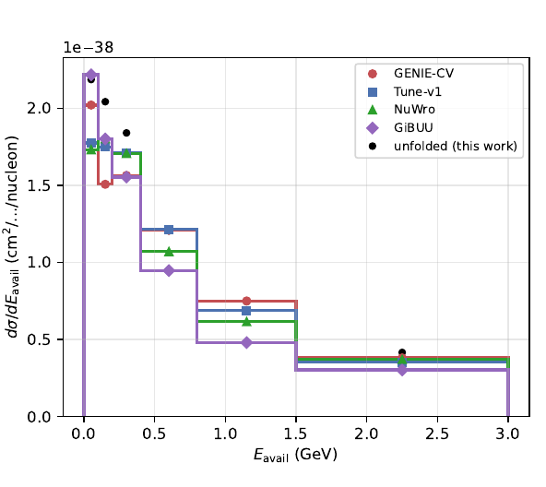
Hadronic energy reveals model differences
3D normalization anchors to 2D
The tested Eavail injection closes
Valencia 2p2h fills 52% of the gap at Eavail ≤ 0.4 GeV
Central-value comparison only
Generator predictions use repaired samples. Historical covariance significances stay unquoted
10
Notes:
Target 74 seconds; elapsed 591–665 seconds
The three-dimensional result preserves the overall normalization of the two-dimensional anchor and recovers the tested injected available-energy shape. Here the spectrum shows how generator predictions separate once we examine the hadronic energy. Monte Carlo means simulation using random sampling. A generator is a Monte Carlo model of the neutrino interaction and final-state particles. GENIE, NuWro and GiBUU implement different physics assumptions, while MINERvA Tune v1 applies experiment-specific weights to the reference GENIE simulation. The low-energy deficit is related to the familiar two-particle–two-hole contribution, abbreviated two p two h: an interaction involving a pair of nucleons that leaves two holes in the nuclear state. Adding the Valencia model fills 52 percent of the gap below 0.4 GeV in this comparison. That is descriptive evidence about the central spectra, not proof of a unique mechanism or a significance. The older three-dimensional covariance-derived significances are quarantined. The energy definition also differs from some published low-recoil measurements, which limits direct comparisons.
SOURCES
Repository /Users/josephbailey/local-research/MINERvA-OmniFold/3d-unfolding/3D_OMNIFOLD_STATUS.md
Repository /Users/josephbailey/local-research/MINERvA-OmniFold/VALIDATION_LEDGER.md: VL159–VL160
Repository /Users/josephbailey/local-research/MINERvA-OmniFold/docs/analysis-note/figures/generators_vs_unfolded_band_central.pdf
Evidence snapshot: f6dc46e6afef9efa8722d01b43c3f2b379b41314, 2026-10-10. Presenter paraphrase of committed records.

Slide 11
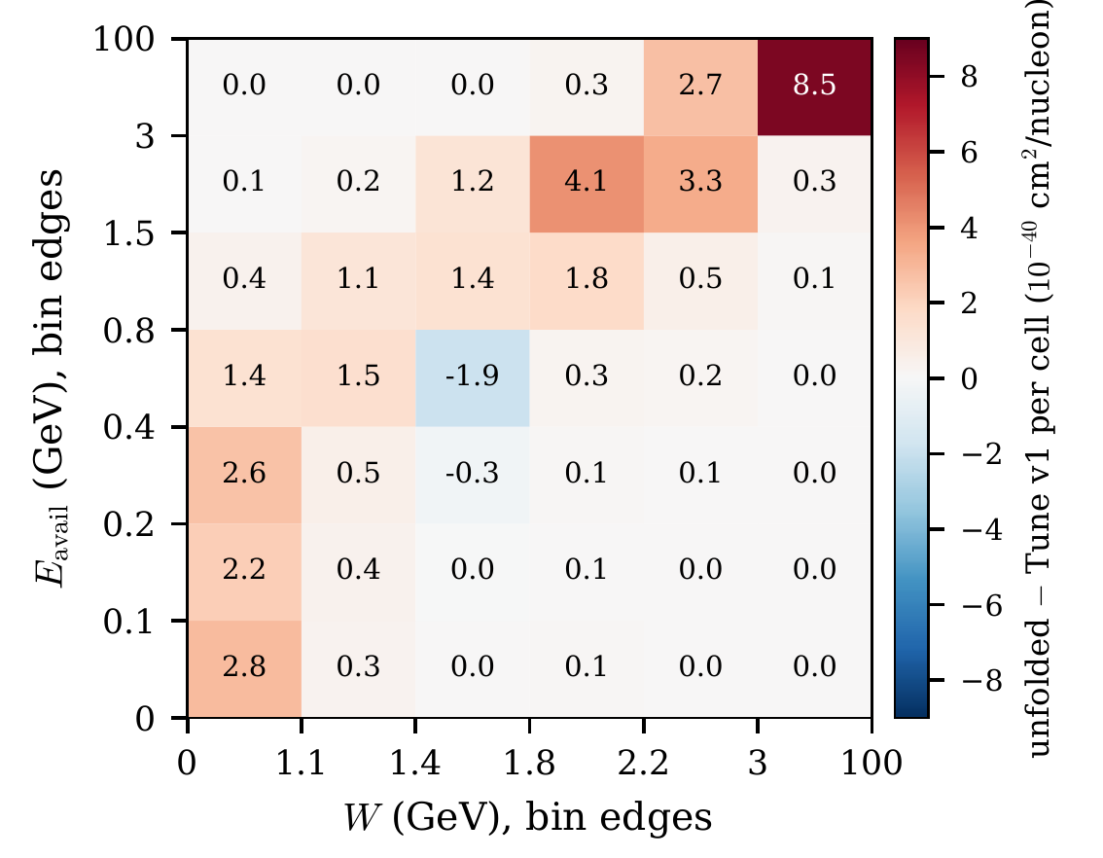
The 5D projection locates a high-energy difference
Added-axis anchors pass
The nominal result exceeds the tuned prior at high Eavail and W
Regularization and detector response limit interpretation
Descriptive central values under the nominal response. The map does not establish a localized significance
11
Notes:
Target 63 seconds; elapsed 665–728 seconds
Projecting the five-coordinate result onto available energy and W shows where the nominal unfolded spectrum differs from the tuned prior. A projection means integrating or summing over the other coordinates. The prior is the simulated distribution we start from. Much of the positive difference lies at high available energy and high inferred hadronic mass. That is an interesting place to investigate deep-inelastic modeling, but I would not claim that the map identifies the physical cause. This is also where later tests found large regularization effects. Regularization is the restriction imposed by finite iteration count and learner capacity: it stabilizes the inverse problem while potentially retaining dependence on the starting model. The dimensional anchors and earlier closures still stand, but they do not establish an uncertainty or a local significance for this feature.
SOURCES
Repository /Users/josephbailey/local-research/MINERvA-OmniFold/docs/analysis-note/sec_eavailw.tex
Repository /Users/josephbailey/local-research/MINERvA-OmniFold/docs/analysis-note/figures/paper_fig2_joint.pdf
Repository /Users/josephbailey/local-research/MINERvA-OmniFold/VALIDATION_LEDGER.md: VL149–VL152
Evidence snapshot: f6dc46e6afef9efa8722d01b43c3f2b379b41314, 2026-10-10. Presenter paraphrase of committed records.

Slide 12
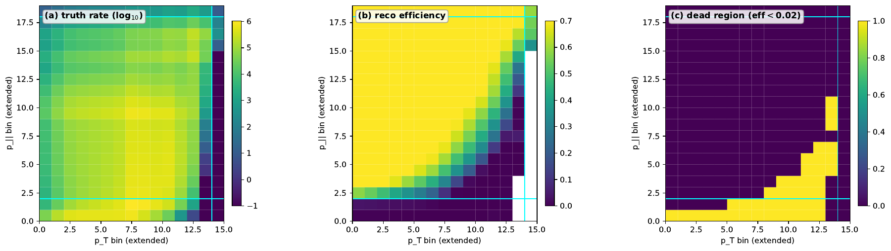
Extending the domain increases reliance on simulation
Remove truth-muon kinematic cuts
Keep the reconstructed MINOS selection
27.7% of truth rate lies where efficiency < 2%
Central-value and prior tests only
Extended fiducial domain. No corrected covariance for this extension
12
Notes:
Target 65 seconds; elapsed 728–793 seconds
The extended-fiducial study asks what happens if we remove the truth-level muon kinematic restrictions while keeping the reconstructed selection. It is still an interaction in the tracker volume, not unrestricted neutrino phase space. Efficiency is the fraction of true events that become selected reconstructed events. The map shows a substantial region where that fraction is nearly zero. About 27.7 percent of the weighted true rate lies below two percent efficiency. In those regions the result relies heavily on extrapolating the missed-event weights from simulation. The published subdomain remains well anchored, and finite closure and three-prior comparisons provide useful diagnostics. But three priors do not bound all possible model dependence. One historical NuWro-shaped prior also predates the flux repair. There is no corrected covariance for this enlarged domain, so its result is preliminary central-value and validation information.
SOURCES
Repository /Users/josephbailey/local-research/MINERvA-OmniFold/docs/analysis-note/sec_fps.tex
Repository /Users/josephbailey/local-research/MINERvA-OmniFold/docs/analysis-note/figures/fps_acceptance_MEFHC.pdf
Evidence snapshot: f6dc46e6afef9efa8722d01b43c3f2b379b41314, 2026-10-10. Presenter paraphrase of committed records.

Slide 13
The adopted 5D covariance carries four measurements
1. Seed sensitivity
6.145% projected-width movement versus a 5% bound
2. Tested ensemble sizes
6.02%, 6.02%, 6.145% at N = 40, 80, 160. One seed pair
3. Unprobed bands
Five seed-pinned bands: 6.75% of trace. Direction of missing effect unknown
4. Central shifts
Up to 6.02% of projected uncertainty. Up to 49.8% in individual 5D bins
Digest 3d7465f6… adopted under a byte-specific exception. Product fields remain NON-PASSING / adoptable: false
13
Notes:
Target 89 seconds; elapsed 793–882 seconds
I adopted one specific five-dimensional covariance product under an explicit exception. That decision carries four measurements, which are part of the result. A seed fixes a pseudo-random sequence used by training. First, changing the estimator’s random seed moves a projected uncertainty width by as much as 6.145 percent, above the five percent limit. This statistic measures changes in square roots of projected variances, including correlations. Second, the effect remains about six percent across the tested 40, 80 and 160 throws. The smaller samples are nested subsets of one ensemble at one seed pair. Larger ensembles and the distribution over seed pairs remain unmeasured. In contrast, the resampling control falls from 20.91 to 7.57 percent between 40 and 80. Third, five bands keep a fixed seed. They account for 6.75 percent of the covariance trace, the sum of bin variances, or 26 percent of its square-root trace scale. Their unmeasured contribution could move the result either way. Fourth, the seed also moves central values: at most 6.02 percent of the projected uncertainty, but as much as 49.8 percent for individual five-dimensional bins. Adoption did not convert the product’s failed criteria into passes.
Expanded measurements for slide 13 (reference, not additional timed speech):
M1: The maximum fractional change in a declared projected uncertainty width is s_proj = 6.145%, above the 5% bound. The aggregate and median diagnostics are 0.471% and 0.485%. The comparison products are different from the adopted digest.
M2: s_proj is 6.02%, 6.02% and 6.145% on nested N = 40, 80 and 160 subsets at one seed pair. The same-seed resampling control falls from 20.91% to 7.57% between 40 and 80. The quoted 6.04% ± 0.39% summarizes subset scatter, not the width over seed pairs. Larger N and seed-pair width remain unmeasured.
M3: BeamAngleX, BeamAngleY, MuonResolution, Muon_Energy_MINERvA and Muon_Energy_MINOS remain at literal seed 42. These five of 45 bands carry 6.75% of covariance trace, or 26.0% of the square-root trace scale, and contribute zero seed movement by construction. Releasing their seeds could change the total statistic in either direction.
M4: On 43 projection functionals, central relative shifts have median 0.104% and maximum 0.761%, compared with median relative uncertainty 10.1%. In units of their own uncertainties the shifts have median 1.06%, maximum 6.02%, and total-rate movement 1.13%. Per individual 5D bin, median is 3.77%, 90th percentile 13.6%, maximum 49.8% of uncertainty. The same-seed control is 9.4e-13.
SOURCES
Repository /Users/josephbailey/local-research/MINERvA-OmniFold/docs/orchestration/DECISION-20260920-joseph-adopts-z-cv-under-the-6.4-exception.md: §4
Repository /Users/josephbailey/local-research/MINERvA-OmniFold/docs/orchestration/CORRECTION-20260921-seed-effect-larger-ensemble-corollary-withdrawn.md
Repository /Users/josephbailey/local-research/MINERvA-OmniFold/docs/orchestration/CORRECTION-20260920-lower-bound-inference-withdrawn.md
Evidence snapshot: f6dc46e6afef9efa8722d01b43c3f2b379b41314, 2026-10-10. Presenter paraphrase of committed records.

Slide 14
The scalar campaigns exposed two distinct biases
Background treatment
Purity subtraction biases the highest-W column by about 4% in nominal toys
Truth departures
Generator-sized deformations leave residuals up to 74% in tested cells
Targeted repair
More refinement-classifier capacity repairs nominal background bias
Remaining failure
Candidate R fails real-data numerical stability. No estimator adoption
14
Notes:
Target 82 seconds; elapsed 882–964 seconds
The later scalar campaigns are important because they test things the early injected-feature closures did not. The s5c study found a bias from the binned purity background treatment in nominal pseudo-experiments, meaning a systematic displacement of the estimate from truth, reaching about four percent in the highest-W column. Purity is the estimated signal fraction in a detector bin, used to downweight data. The s5n study explored a refined alternative based on signed background subtraction. It improved that problem but exposed a much larger issue under generator-sized truth changes: residuals reached about 74 percent in some tested cells, and signal-only controls reproduced the departure failure. The s5e diagnosis identified insufficient refinement-classifier capacity as a cause of the remaining nominal background bias. Increasing that capacity produced candidate R and repaired that specific bias on fresh tests. It did not fix the large truth-departure residuals, and R failed its real-data numerical-stability criterion. These are measured simulation failures and method sensitivities, not measurements of the real data’s bias. None of these campaigns adopted a replacement estimator or total covariance.
SOURCES
Repository /Users/josephbailey/local-research/MINERvA-OmniFold/VALIDATION_LEDGER.md: VL149–VL152
Repository /Users/josephbailey/local-research/MINERvA-OmniFold/docs/orchestration/OUTCOME-20260926-s5e-oi192-diagnosis-and-candidate.md
Evidence snapshot: f6dc46e6afef9efa8722d01b43c3f2b379b41314, 2026-10-10. Presenter paraphrase of committed records.

Slide 15
A calibrated model test answers a narrower question
01
02
03
Assume a generator truth
Simulate repeated experiments
Compare the observed statistic
Specify the fine-grid cross section and sub-grid model
Apply the declared nuisance variations and the estimator
Count simulated tests at least as extreme
This defines the null hypothesis
Measure its behavior under that null
Correct for the ten comparisons
s5p measurement branch: NOT ADMITTED. The separate inference branch supplies no new reportable uncertainty
15
Notes:
Target 81 seconds; elapsed 964–1045 seconds
The next campaign, s5p, tested whether any permitted reporting choice could provide a useful five-dimensional measurement with defensible total uncertainties. That measurement branch was not admitted. Instead, a separately authorized inference branch asked a narrower question. Suppose a particular generator’s fine-grid cross section were true, with specified assumptions below that grid and for the detector. How often would the complete estimation procedure produce a discrepancy as large as the observed one? That assumption is the null hypothesis. Here the hybrid null combines the generator’s fine-cell rates and finite-sample fluctuations with MINERvA Tune’s shapes below the grid. We simulate pseudo-experiments under it, including the declared nuisance variations. A nuisance parameter describes an uncertain ingredient such as an energy response or interaction-model parameter. We then calibrate the comparison statistic empirically. The p-value is the probability, under that specific null, of a statistic at least as extreme as observed. It is not the probability that the generator is true. This route can account for an estimator’s modeled bias without turning its output into a qualified cross-section measurement.
SOURCES
Repository /Users/josephbailey/local-research/MINERvA-OmniFold/docs/orchestration/DELIVERY-20261006-s5p-campaign-terminal.md
Repository /Users/josephbailey/local-research/MINERvA-OmniFold/docs/orchestration/RECORD-20260927-s5p-stage2-exit.md
Repository /Users/josephbailey/local-research/MINERvA-OmniFold/docs/orchestration/RECORD-20261005-s5p-joint-5d-inference-result.md
Evidence snapshot: f6dc46e6afef9efa8722d01b43c3f2b379b41314, 2026-10-10. Presenter paraphrase of committed records.

Slide 16
All ten tests reject their specified hybrid nulls
Five predictions × total and shape, familywise α = 0.05
1
Sub-grid shape is model-imposed. Refinement has not converged
2
Declared detector bands only. No recoil-energy-scale band
3
34 interaction-model bands. Two negative-weight variations clipped
4
Half-MC toys versus full-MC data fit. Shift assessed and included
5
GiBUU has no Eν > 20 GeV. All predictions stop at 100 GeV
6
Generator finite-sample uncertainty enters the metric and draws
Conditional inference with candidate R, not a measured cross section. Independent recomputation agrees on the calculation
16
Notes:
Target 81 seconds; elapsed 1045–1126 seconds
Under these six conditions, all ten tests reject their specified nulls: five predictions, each tested for total rate and shape. Shape means comparing distributions after removing their overall normalization. The predictions are MINERvA Tune v1, GENIE 2.12.10 with and without the Valencia two-nucleon component, NuWro 21.09 and GiBUU 2019. The familywise five percent threshold controls the chance of at least one false rejection across the declared family, under the calibration assumptions. Holm’s procedure adjusts the thresholds for the multiple comparisons. The conditions stay attached to that claim. The null assumes sub-grid shapes that have not converged under refinement. Detector coverage is incomplete, especially for recoil energy. Interaction-model variations use the declared bands and clipping. The toys use less simulation than the data fit, with a measured correction variant. GiBUU has a restricted energy domain. All generators have finite simulation uncertainty. Independent recomputation agrees with the calculation, not the adequacy of every assumption. Recovered time-limited draws leave the decisions unchanged, with their margins disclosed. Monte Carlo p-values have finite resolution and are never zero.
Expanded conditions for slide 16 (reference, not additional timed speech):
1. The fine-grid null uses generator G's cross section, with MnvTune shapes and G's finite-MC fine-cell fluctuations below it. Refinement has not converged. The 0.50–0.86 comparison is the L2 norm of per-cell relative changes. The frozen kappa = 2 variants and the report-only kappa = 3 check follow the last refinement shift. The true sub-fine residual remains unmeasured and potentially material.
2. Detector calibration assumes the simulated per-event response beyond the drawn MinosEfficiency and GEANT neutron, pion and proton bands at plus or minus one standard deviation, together with the linear surrogate for five lateral bands. There is no recoil-energy-scale band. Hadronic-response completeness is not established.
3. Every pseudo-experiment draws all 34 vertical interaction-model bands. Negative LowQ2_1 and HighQ2_1 weights are clipped per universe under the recorded exception, at no more than 0.35% of a band's shift in the covariance-standardized norm.
4. Toys unfold with half the MC, whereas the data use the full MC. The shift measured in 16 pairs has median absolute size 0.02–0.075% per cell. Along the null's bias direction it is not always consistent with zero, but is at most about 0.05 null standard deviations. A bias-aligned upper-bound variant enters the rule.
5. GiBUU lacks neutrino energy above 20 GeV. Its truth outside p_parallel < 6 GeV/c still migrates into the tested domain under that energy truncation. All generator samples lack neutrino energy above 100 GeV; the record treats that tail as negligible.
6. Each prediction's finite simulation enters both as a diagonal variance term in the comparison metric and as a sampled residual. Independent recomputation establishes arithmetic agreement under these choices, not calibration adequacy.
SOURCES
Repository /Users/josephbailey/local-research/MINERvA-OmniFold/docs/orchestration/RECORD-20261005-s5p-joint-5d-inference-result.md: §3
Repository /Users/josephbailey/local-research/MINERvA-OmniFold/docs/orchestration/DELIVERY-20261006-s5p-campaign-terminal.md: §1
Repository /Users/josephbailey/local-research/MINERvA-OmniFold/docs/publication/CLAIMS-20261005-claim-to-evidence.md: §§E–F
Evidence snapshot: f6dc46e6afef9efa8722d01b43c3f2b379b41314, 2026-10-10. Presenter paraphrase of committed records.

Slide 17
The inference has useful, measured limits
Grid sensitivity
All decisions remain determinate to κ ≈ 5.25 along one tested shift direction
Response sensitivity
Exploratory ±4% data-side scale does not remove the rejections
Dimensional comparison
No qualified claim of extra power beyond matched coarse projections
Unresolved
The sub-grid residual and full hadronic-response uncertainty remain unmeasured
17
Notes:
Target 67 seconds; elapsed 1126–1193 seconds
Several follow-ups tell us how far to take that inference. Kappa multiplies the change measured in the last grid-refinement step. Along that one direction, all ten decisions remain determinate to about 5.25 in the frozen ensembles. This is a sensitivity scan, not a measurement or bound on the actual unresolved sub-grid error. An exploratory coherent four percent shift of the data-side hadronic energy also does not remove the rejections. It does not vary the null response or cover species dependence, resolution, or larger changes. A matched lower-dimensional comparison does not support a qualified claim that the joint test adds power beyond its coarse projections. In particular, the matched muon-only projection does not reject GENIE CV, so hadronic information matters for that comparison. The conditions on the preceding slide remain in force. Neither these tests nor independent arithmetic checks establish complete hadronic-response modeling.
SOURCES
Repository /Users/josephbailey/local-research/MINERvA-OmniFold/publication/kappa/RECORD-20261008-kappa-breakdown.md
Repository /Users/josephbailey/local-research/MINERvA-OmniFold/publication/w2/W2B-REPORT-20261006.md
Repository /Users/josephbailey/local-research/MINERvA-OmniFold/docs/publication/CLAIMS-20261005-claim-to-evidence.md: §§D–F
Evidence snapshot: f6dc46e6afef9efa8722d01b43c3f2b379b41314, 2026-10-10. Presenter paraphrase of committed records.

Slide 18
PET gives OmniFold a set of objects per event
Detector objects
Truth particles
Energy deposits in scintillator views
Four-momenta and particle identity
Muon event features condition the network
Attention learns object relationships; stored clouds retain at most 12 tokens
Historical recoil-only PET and the later full-event candidate have different input contracts
18
Notes:
Target 71 seconds; elapsed 1193–1264 seconds
The other major direction is PET, the point-cloud transformer used in OmniLearn. Instead of summarizing each event only by a few scalar quantities, it receives a set of detector deposits or simulated particles. A token is one object’s numerical representation. Attention is the learned operation that lets each object use information from the other objects. A point cloud is an unordered set, so the representation should not depend on an arbitrary input ordering. The historical recoil-only cross-check omitted the muon from classifier inputs. The later full-event candidate adds a distinguished muon event input that conditions the transformer. These are different estimators. The stored clouds are energy-ranked and truncated to twelve objects. Detector events often contain far more deposits, so this discards meaningful information. That observation motivated detector energy summaries and comparisons of pooled versus individual object representations. The schematic is a representation diagram, not a display of one measured event.
SOURCES
Repository /Users/josephbailey/local-research/MINERvA-OmniFold/docs/analysis-note/sec_pet.tex
Evidence snapshot: f6dc46e6afef9efa8722d01b43c3f2b379b41314, 2026-10-10. Presenter paraphrase of committed records.

Slide 19
The earlier PET covariance did not qualify
Central/statistical pairing
Declined in August. A 50-member covariance exists but remains unverified
Observed anomaly
Nominal result lies outside its bootstrap family. Mechanism unresolved
Training variation
No full-event machine-learning covariance constructed. Gate 6 blocked
Scientific scope
Diagnostic and method development throughout
19
Notes:
Target 66 seconds; elapsed 1264–1330 seconds
The full-event covariance work reached an important stopping point in August. A fifty-member partial statistical covariance exists, but the independent construction check and central pairing were not established. I declined the pairing and demoted PET to diagnostic work. The nominal point estimate lies outside its bootstrap family in a spatially organized way. A bootstrap repeats an analysis after randomly resampling the events, to estimate sampling variation. The observed mismatch is real, but the named bootstrap-centering and bias explanations were not established as its mechanism. The machine-learning covariance, meaning the covariance associated with training variability, was also not constructed, and its gate remains blocked. The later PET studies therefore start from a method-development question. They cannot inherit a publication uncertainty claim from the existence of that earlier artifact. Reconsidering the pairing would require estimator equivalence and separate coverage evidence.
SOURCES
Repository /Users/josephbailey/local-research/MINERvA-OmniFold/docs/analysis-note/sec_pet.tex
Repository /Users/josephbailey/local-research/MINERvA-OmniFold/VALIDATION_LEDGER.md: VL132
Repository /Users/josephbailey/local-research/MINERvA-OmniFold/docs/OPEN_ITEMS.md: OI-126
Repository /Users/josephbailey/local-research/MINERvA-OmniFold/docs/orchestration/state/gate6-member-trajectories-result-56847059.json
Evidence snapshot: f6dc46e6afef9efa8722d01b43c3f2b379b41314, 2026-10-10. Presenter paraphrase of committed records.

Slide 20
PET recovery improved substantially in simulation
Fraction of injected Eavail tilt recovered
Historical control
0.306
Compact hybrid finalist
0.895
Larger hybrid finalist
0.863
0
1 = exact recovery
Final-bank Eavail tilt, 60 draws. R = 1 is exact recovery, R = 0 retains the prior discrepancy
20
Notes:
Target 71 seconds; elapsed 1330–1401 seconds
The September studies asked whether representation and training changes could improve recovery. We score normalized histograms using one minus the absolute distance between unfolded and target distributions divided by the prior’s distance from that target. That is R: one is exact recovery, zero means no improvement on the prior, and a negative value means moving farther away. The initial improvement study found gains from detector summaries, categorical particle identity and an efficiency-corrected truth step, but no frozen configuration passed both accuracy and stress requirements. The final-design study added longer truth-step training and better seed stability. On sixty final-bank draws of the available-energy tilt, the compact hybrid reaches 0.895 and the larger hybrid 0.863, versus 0.306 for the historical control. Those are substantial point-estimate gains. The banks are fixed finite simulation samples, and the study is signal-only. These results do not establish a universal architecture ranking, real-data performance or calibrated uncertainty.
SOURCES
Repository /Users/josephbailey/local-research/MINERvA-OmniFold/nd-unfolding/pet/final_design/DECISION_RECORD-pet-final-design.md
Repository /Users/josephbailey/local-research/MINERvA-OmniFold/docs/analysis-note/sec_pet_campaigns.tex
Repository /Users/josephbailey/local-research/MINERvA-OmniFold/VALIDATION_LEDGER.md: VL164–VL167
Evidence snapshot: f6dc46e6afef9efa8722d01b43c3f2b379b41314, 2026-10-10. Presenter paraphrase of committed records.

Slide 21
PET intervals fail differently across acceptance regions
Region | Nominal 68% | Nominal 95%
Aggregate Eavail | 89.6% | 99.0%
Low acceptance | 25.7% | 78.9%
Moderate acceptance | 70.1% | 96.4%
Good acceptance | 92.9% | 99.8%
Too wide in aggregate, too narrow at low acceptance
Compact finalist, 120 simulated draws, six bootstrap members per estimate. No eligible design or selected default
21
Notes:
Target 76 seconds; elapsed 1401–1477 seconds
The uncertainty test changes the conclusion. Each compact-finalist estimate averages six bootstrap members, and the declared interval uses their spread. On 120 final-bank simulated draws, intervals labeled 68 percent contain truth 89.6 percent of the time in the aggregate available-energy histogram. Those aggregate intervals are too wide under the frozen criterion. But in the low-acceptance region, the same nominal 68 percent intervals cover only 25.7 percent, and nominal 95 percent intervals cover 78.9 percent. So this is not uniform conservatism. Acceptance is the probability that an event enters the selected sample, and the weakly observed region behaves very differently. The compact point estimator passes its accuracy, robustness and stability rules, but its interval construction fails calibration. The larger finalist fails a separate neutron-distortion point rule, with an unresolved statistical comparison around the threshold. The terminal outcome is no eligible design and no selected default. It does not mean neither point estimator is useful, and it does not authorize another round of repair.
SOURCES
Repository /Users/josephbailey/local-research/MINERvA-OmniFold/nd-unfolding/pet/final_design/DECISION_RECORD-pet-final-design.md
Repository /Users/josephbailey/local-research/MINERvA-OmniFold/docs/analysis-note/sec_pet_campaigns.tex
Evidence snapshot: f6dc46e6afef9efa8722d01b43c3f2b379b41314, 2026-10-10. Presenter paraphrase of committed records.

Slide 22
The paired PET–tree comparison depends on the distortion
Available-energy tilt
PET gains +0.102 and +0.070 in recovery over the matched tree comparator
Generator reweightings
Trees recover the three tested generator departures better
Hadron content
Some PET gains depend on the tree iteration choice
Scope
Exploratory point estimates on the same events. No uncertainty comparison
22
Notes:
Target 74 seconds; elapsed 1477–1551 seconds
We also fitted a scalar histogram-gradient-boosting comparator to the same event samples, targets and distortions. Pairing means comparing methods on identical draws, which removes much of the variation from using different pseudo-data. PET does better on the available-energy tilt, with recovery gains of 0.102 and 0.070 for the two finalists. The broader distortion library changes the ordering: the tree method performs better on all three tested generator reweightings and on a narrow energy bump. Some proton-content differences shrink or reverse when the tree iteration count changes. Those generator tests reweight a fixed detector simulation; they are not independent detector simulations. This comparison is exploratory because the PET final results had already been examined, and its intervals are not adjusted for the number of comparisons. There is no tree uncertainty procedure to compare, and PET’s own procedure failed. The useful conclusion is that representation helps some departures and loses on others, rather than that one method wins generally.
SOURCES
Repository /Users/josephbailey/local-research/MINERvA-OmniFold/docs/analysis-note/sec_pet_campaigns.tex
Repository /Users/josephbailey/local-research/MINERvA-OmniFold/VALIDATION_LEDGER.md: VL168
Evidence snapshot: f6dc46e6afef9efa8722d01b43c3f2b379b41314, 2026-10-10. Presenter paraphrase of committed records.

Slide 23
Reproducibility became part of the research
Execution integrity
An import-path defect could run another checkout’s code despite matching file hashes
Scientific verification
Independent recomputation checks the calculation. It cannot validate every assumption
Stopping rules
Closed failed studies preserve useful limits and prevent retrospective selection
Deliverables
Note, primer, article and replay materials now separate claims by scope
23
Notes:
Target 66 seconds; elapsed 1551–1617 seconds
One contribution that is easy to miss in the note’s physics narrative is the infrastructure needed to trust these results. We found that a hardcoded import path could execute modules from a different checkout even while the pinned files passed hash comparisons. That is why guarded execution checks actual provenance, not just a job’s successful exit. A hash identifies file bytes; it does not establish which code ran or whether a scientific criterion is adequate. Similarly, independent numerical recomputation is stronger than two workers repeating a shared summary, but it still checks a defined calculation. The bounded campaigns also taught us to preserve a terminal failure instead of selecting a better-looking iteration after inspection. We now have the note, primer, article and scoped replay materials. Replaying saved sufficient products is distinct from regenerating the full training and pseudo-experiment pipeline.
SOURCES
Repository /Users/josephbailey/local-research/MINERvA-OmniFold/docs/OPEN_ITEMS.md: OI-136
Repository /Users/josephbailey/local-research/MINERvA-OmniFold/docs/orchestration/CAMPAIGN-REVIEW-20260929.md
Repository /Users/josephbailey/local-research/MINERvA-OmniFold/docs/publication/submission/PACKAGE-MANIFEST-20261006.md
Repository /Users/josephbailey/local-research/MINERvA-OmniFold/reproduction/s5p/README.md
Evidence snapshot: f6dc46e6afef9efa8722d01b43c3f2b379b41314, 2026-10-10. Presenter paraphrase of committed records.

Slide 24
Discussion with Ben
Article
Package assembled for review. Nothing submitted, deposited or sent
Measurement priority
Resolve the matched 2D estimator and uncertainty question before new production
Method development
PET recovery and interval calibration are separate next decisions
Scope decision
Which result should lead, and which validation is most valuable next?
24
Notes:
Target 63 seconds; elapsed 1617–1680 seconds
The article package is assembled for review, with the validation results and limits stated explicitly. It has not been submitted, deposited or sent to coauthors. Its readiness is assessed separately from s5p’s unmet precision-measurement objective. The reviewed successor proposal recommends stopping immediate measurement production and first checking whether the existing two-dimensional central estimator and uncertainty recipe can be made consistently matched. Narrowing the measurement scope would itself need a scientific decision. For PET, the point-estimate improvements are worth understanding, while interval calibration is a separate problem. The questions I would like to discuss are which scientific result should lead the paper and which next validation would most improve its credibility. My preference is to resolve those questions before committing to another large campaign. [Pause here for two minutes of discussion.]
SOURCES
Repository /Users/josephbailey/local-research/MINERvA-OmniFold/docs/publication/submission/PACKAGE-MANIFEST-20261006.md
Repository /Users/josephbailey/local-research/MINERvA-OmniFold/docs/orchestration/PROPOSAL-20261005-scalar-measurement-successor.md
Evidence snapshot: f6dc46e6afef9efa8722d01b43c3f2b379b41314, 2026-10-10. Presenter paraphrase of committed records.

Slide 25
Backup: exact available-energy convention
Truth
Protons: E − 938.27 MeV. Charged pions: E − 135 MeV
Truth continued
Neutral pions and photons: total energy. All other species contribute zero
Reconstruction
1.17 × (tracker + ECAL blob energy after muon-fuzz subtraction)
Comparison limit
The inherited charged-pion constant and species exclusions differ from some published definitions
B1
Notes:
Backup, outside the timed talk
ECAL means electromagnetic calorimeter. A blob is a reconstructed aggregate of detector energy. Muon fuzz is energy associated with the muon’s nearby deposits and subtracted from the recoil estimate. No final nonnegative clamp is applied to the reconstructed quantity. The truth definition excludes secondary electrons, neutrons, kaons and other species not explicitly listed. The charged-pion subtraction uses 135 MeV rather than about 139.57 MeV. The effect has been measured, but its materiality against the adopted 5D projection is not established. There is no universal published available-energy convention. Do not describe this implementation as generically matching all low-recoil publications.
SOURCES
Repository /Users/josephbailey/local-research/MINERvA-OmniFold/docs/analysis-note/sec_3d.tex: operational definition
Evidence snapshot: f6dc46e6afef9efa8722d01b43c3f2b379b41314, 2026-10-10. Presenter paraphrase of committed records.

Slide 26
Backup: q3 and W are inferred kinematic quantities
q0
Energy transfer: neutrino energy minus muon energy at truth level
Q²
Positive spacelike four-momentum-transfer variable
q3
Magnitude of momentum transfer: q3² = Q² + q0²
W
Experimenter’s mass: W² = M² + 2M q0 − Q²
B2
Notes:
Backup, outside the timed talk
At reconstruction level q zero comes from calorimetry and Q squared combines that energy estimate with the muon kinematics. M is the nucleon mass used in the estimator. These expressions motivate the variables, but nuclear motion and reconstruction mean W is an operational experimenter’s quantity, not a complete measurement of every final-state particle’s invariant mass. Quasielastic scattering, baryon resonances and deep-inelastic interactions populate different regions without forming perfectly separated event classes. The quantities are correlated and change under lateral systematics, which shift event coordinates rather than only their weights.
SOURCES
Repository /Users/josephbailey/local-research/MINERvA-OmniFold/docs/analysis-note/sec_3d.tex: fourth axis
Repository /Users/josephbailey/local-research/MINERvA-OmniFold/docs/analysis-note/sec_eavailw.tex: W as a fifth axis
Evidence snapshot: f6dc46e6afef9efa8722d01b43c3f2b379b41314, 2026-10-10. Presenter paraphrase of committed records.

Slide 27
Backup: the adopted covariance’s exact boundary
Identity
z-cv.npz, SHA-256 prefix 3d7465f6, 890,500,272 bytes
Four measurements
M1–M4 on slide 13 travel with every use of this product
Unresolved criterion
Cause 3 remains predeclared and not computed for this digest
Decision meaning
Exception covers these bytes only. No inherited adoption for other candidates
B3
Notes:
Backup, outside the timed talk
The full digest is 3d7465f66fbe66b0dfcf09b6fc51249f227fb33e97ae40bc78dda90275e918c5. The projection digest begins 835828bf. Identity verification establishes which covariance was projected, not its statistical adequacy. The predeclaration ordering defect is ratified by exception, not cured, and no declared cause-3 boundary was evaluated by production. The paired measurement products used for the seed comparison are different digests and are not separately adopted. Five pinned bands are BeamAngleX, BeamAngleY, MuonResolution, Muon_Energy_MINERvA and Muon_Energy_MINOS. Their seed effect is unprobed in either direction. See slide 13 for the mandatory numerical measurements and their finite-ensemble scope.
SOURCES
Repository /Users/josephbailey/local-research/MINERvA-OmniFold/docs/orchestration/DECISION-20260920-joseph-adopts-z-cv-under-the-6.4-exception.md
Repository /Users/josephbailey/local-research/MINERvA-OmniFold/docs/orchestration/OPERATIVE-SHEET-scalar5d.md
Evidence snapshot: f6dc46e6afef9efa8722d01b43c3f2b379b41314, 2026-10-10. Presenter paraphrase of committed records.

Slide 28
Backup: reading the conditional p-values
Finite simulation
p = (k + 1) / (B + 1), with k exceedances in B toys
Resolution
B = 1,343–1,751. Never report p = 0 or turn it into a Gaussian significance
Test domain
109 supported joint cells. 72 for GiBUU with p∥ < 6 GeV/c
Missing draws
224 calibration + 53 power draws recovered. Frozen decisions unchanged
B4
Notes:
Backup, outside the timed talk
These statistics belong only to the hybrid-null construction and the six conditions on slide 16. The frozen family has zero exceedances in nine tests and one in NuWro shape. Clopper–Pearson intervals are exact binomial confidence intervals for the exceedance probability. Determinacy requires those Monte Carlo intervals to resolve the decision relative to the multiple-testing threshold. The lost-draw recovery is report-only. Four nulls would have stopped one batch earlier with complete batches, with the same decisions. The closest recovered margin is 4.6 statistic units for GENIE plus MEC shape at kappa three. Independent checks cover the frozen-shift reading; the union reading is a same-code consistency replay. A small conditional p-value does not identify a nuclear mechanism or localize a discrepancy.
SOURCES
Repository /Users/josephbailey/local-research/MINERvA-OmniFold/docs/orchestration/DELIVERY-20261006-s5p-campaign-terminal.md
Repository /Users/josephbailey/local-research/MINERvA-OmniFold/docs/orchestration/RECORD-20261005-s5p-joint-5d-inference-result.md
Evidence snapshot: f6dc46e6afef9efa8722d01b43c3f2b379b41314, 2026-10-10. Presenter paraphrase of committed records.

Slide 29
Backup: the PET representation studies
Pooling versus individual objects
Synthetic routing comparison found no resolved accuracy difference
Production cloud
The top-12 cap removes substantial reconstructed activity
Improvement campaign
No frozen ten-iteration candidate passed adequacy plus stress
Final design and pretraining
No tested PET2 recipe passed every development screen
B5
Notes:
Backup, outside the timed talk
Pooling summarizes several objects into one representation. Individual routing gives each object its own attention token. The synthetic comparison used a small fixed object fixture and cannot settle production-multiplicity performance. The production cap acts on generic calorimeter clusters, not simply a thin typed-object tail. Later hybrid designs use energy summaries to recover some omitted information. PDG is the particle-identity code assigned by the Particle Data Group. One-hot encoding represents identity with separate category indicators rather than treating the code as a continuous number. PET2 is a tested pretrained model family. Pretraining means learning on another sample before this task. Its failure here applies to the tested recipes, not all possible pretraining. CPU–GPU optimizer differences were also investigated; numerical reproducibility does not establish physical accuracy.
SOURCES
Repository /Users/josephbailey/local-research/MINERvA-OmniFold/nd-unfolding/pet/direct_token_comparison/REPORT_FOR_BEN.md
Repository /Users/josephbailey/local-research/MINERvA-OmniFold/nd-unfolding/pet/direct_token_comparison/GO_NO_GO-20260918.md
Repository /Users/josephbailey/local-research/MINERvA-OmniFold/docs/analysis-note/sec_pet_campaigns.tex
Evidence snapshot: f6dc46e6afef9efa8722d01b43c3f2b379b41314, 2026-10-10. Presenter paraphrase of committed records.

Slide 30
Backup: the closed scalar sequence
s5c
Futility stop. Nominal purity-background bias confirmed
s5n
Refined subtraction improves nominal behavior. Departure failure persists
s5e
Diagnosed refinement underfitting. Candidate R fails fresh assessment
s5p
Measurement not admitted. Conditional inference completes with no new uncertainty
B6
Notes:
Backup, outside the timed talk
These labels identify successive bounded campaigns, not distinct published measurements. They are all terminal. The background repair is a causal diagnosis for one nominal-bias component. The physical truth-departure failure remains without a single established cause. Reopening a closed study would require a new decision and contract. R is a targeted refinement change, not the production central-value estimator. A nominal-truth calibration check cannot establish performance over every alternative truth, and a pooled calibration result can hide individual functionals with poor coverage. A functional is any declared quantity extracted from the distribution, such as a bin, integral or projection.
SOURCES
Repository /Users/josephbailey/local-research/MINERvA-OmniFold/VALIDATION_LEDGER.md: VL149–VL155
Repository /Users/josephbailey/local-research/MINERvA-OmniFold/docs/orchestration/OUTCOME-20260926-s5e-oi192-diagnosis-and-candidate.md
Repository /Users/josephbailey/local-research/MINERvA-OmniFold/docs/orchestration/DELIVERY-20261006-s5p-campaign-terminal.md
Evidence snapshot: f6dc46e6afef9efa8722d01b43c3f2b379b41314, 2026-10-10. Presenter paraphrase of committed records.

Slide 31
Backup: what the release can reproduce
Available
Article sources, analysis note, primer and saved inference inputs
Replay
Recompute conditional inference from sufficient products
Different task
Regenerate training and calibration pseudo-experiments end to end
Release limits
Several closure, uncertainty and sensitivity results remain outside RC4 replay
B7
Notes:
Backup, outside the timed talk
Sufficient products are the stored quantities needed to recompute the reported inference without regenerating every event or training run. RC4 is a local release candidate, not a public deposit. Its scope excludes reproducing the 2D uncertainty, closure, bias, low-recoil, W2 and covariance-status numbers, as listed in its README. Those results retain their own evidence routes. The article still needs author decisions and external-release actions, including coauthor review, deposit and submission. None of those acts is authorized by preparing this talk.
SOURCES
Repository /Users/josephbailey/local-research/MINERvA-OmniFold/docs/publication/submission/PACKAGE-MANIFEST-20261006.md
Repository /Users/josephbailey/local-research/MINERvA-OmniFold/docs/publication/release/RC4-README.md
Repository /Users/josephbailey/local-research/MINERvA-OmniFold/reproduction/s5p/README.md
Evidence snapshot: f6dc46e6afef9efa8722d01b43c3f2b379b41314, 2026-10-10. Presenter paraphrase of committed records.

