Slide 1
MINERvA OmniFold
Research discussion with Ben
Joseph Bailey
2D validation, higher-dimensional inference, and full-event learning
11 October 2026
Notes:
0–28 seconds (28 s)
Ben, this is the current state of the OmniFold analysis: a reproduced two-dimensional central result, higher-dimensional inference and validation limits, and full-event PET development. I will separate what the data show from what the uncertainty and calibration studies justify.
SOURCES
docs/analysis-note/main_note.tex
docs/publication/submission/PACKAGE-MANIFEST-20261006.md
Main evidence: 3892e769043cddebfd58ec19e1ab1a567eb01784; XR interim evidence: 9be8bfb4d4acace2ec64273970130d6404f1813c.

Slide 2
Reproduction, conditional inference and PET development
2D central result
Published muon cross section reproduced. XR now reproduces both LightGBM reference centrals.
Joint 5D inference
Ten specified generator hypotheses rejected under a calibrated hybrid model. Measurement branch did not qualify.
Full-event PET
Recovery improves for some truth changes. Tested intervals still fail in low-acceptance regions.
Reproduction, model rejection and a calibrated measurement are different achievements.
XR interim snapshot: 11 October, 11:20 UTC. Covariance transfer and corrected-band coverage remain open.
02
Notes:
28–79 seconds (51 s)
The two-dimensional central result reproduces the published muon measurement. XR has now regenerated the LightGBM reference centrals at both seeds, which closes specific reproducibility questions. It does not yet establish that those error bars describe the quoted exact-tree central. The higher-dimensional program reveals hadronic structure and supports a conditional generator test, but did not qualify a joint-five-dimensional measurement. PET improves recovery of some simulated departures while its tested intervals remain miscalibrated. These are different scientific outcomes, and the plots will show both the achievements and the limits.
SOURCES
2d-unfolding/2D_OMNIFOLD_STUDY_STATUS.md
3d-unfolding/3D_OMNIFOLD_STATUS.md
docs/orchestration/DELIVERY-20261006-s5p-campaign-terminal.md
nd-unfolding/pet/final_design/DECISION_RECORD-pet-final-design.md
docs/orchestration/ASSESSMENT-20261008-2d-estimator-pairing.md
9be8bfb4d4acace2ec64273970130d6404f1813c:docs/orchestration/state/next-preparation-20261009/xr-linux/REPORT.md
9be8bfb4d4acace2ec64273970130d6404f1813c:docs/orchestration/state/next-preparation-20261009/xr-linux/logs/compare-interim-L1.json
Main evidence: 3892e769043cddebfd58ec19e1ab1a567eb01784; XR interim evidence: 9be8bfb4d4acace2ec64273970130d6404f1813c.

Slide 3
The selected neutrino sample and its truth domain
Sample
Medium-energy neutrino mode, about 6 GeV. 4.12 million selected events
Signal
Muon-neutrino charged-current interactions in the tracker
Reference domain
Muon angle < 20°, 1.5 < p∥ < 60 GeV/c, pT < 4.5 GeV/c
Detector
MINERvA measures activity. Downstream MINOS measures the muon
Truth-only events remain in the signal denominator even when reconstruction misses them.
03
Notes:
79–130 seconds (51 s)
We use about 4.12 million selected events from the twelve medium-energy neutrino-mode playlists. The signal is inclusive muon-neutrino charged-current scattering in the tracker. The reference truth domain has a forward muon within the published momentum cuts, and selected reconstruction includes a downstream MINOS match. Those are distinct definitions: a truth signal event can miss reconstructed selection. The extended-fiducial PET studies keep the reconstructed selection while enlarging the truth domain. The September PET selection studies are signal-only simulations on fixed banks, rather than a complete real-data background analysis.
SOURCES
docs/analysis-note/sec_experiment.tex
2d-unfolding/2D_OMNIFOLD_REFERENCE.md
Main evidence: 3892e769043cddebfd58ec19e1ab1a567eb01784; XR interim evidence: 9be8bfb4d4acace2ec64273970130d6404f1813c.

Slide 4
Closure, dimensional anchors and coverage
Closure
Create simulated data with known truth and test recovery
Dimensional anchor
Integrate an added observable and compare with the earlier result
Coverage
Repeat simulated experiments and count how often intervals contain truth
A closure pass applies to the tested deformation and detector response
04
Notes:
130–201 seconds (71 s)
Your shorthand is useful: closure primarily tests the point-estimation procedure, and coverage tests the interval procedure. In closure we know the simulated truth, optionally deform it away from the starting simulation, then ask how accurately unfolding recovers it. A dimensional anchor instead integrates away an added observable and checks consistency with the earlier result. Coverage counts repeated experiments whose intervals contain the target bin value. It is not event classification. Bias in the central estimate can also spoil coverage, so the two tests are connected. Passing a few closures cannot establish coverage, and wide intervals can cover even a biased estimate. Every verdict needs its target, simulated response, departures and sample construction. The one-dimensional binned study was a completed equivalence and debugging check, not a separate publication result.
SOURCES
docs/analysis-note/sec_validation.tex
docs/analysis-note/sec_3d.tex
Main evidence: 3892e769043cddebfd58ec19e1ab1a567eb01784; XR interim evidence: 9be8bfb4d4acace2ec64273970130d6404f1813c.

Slide 5
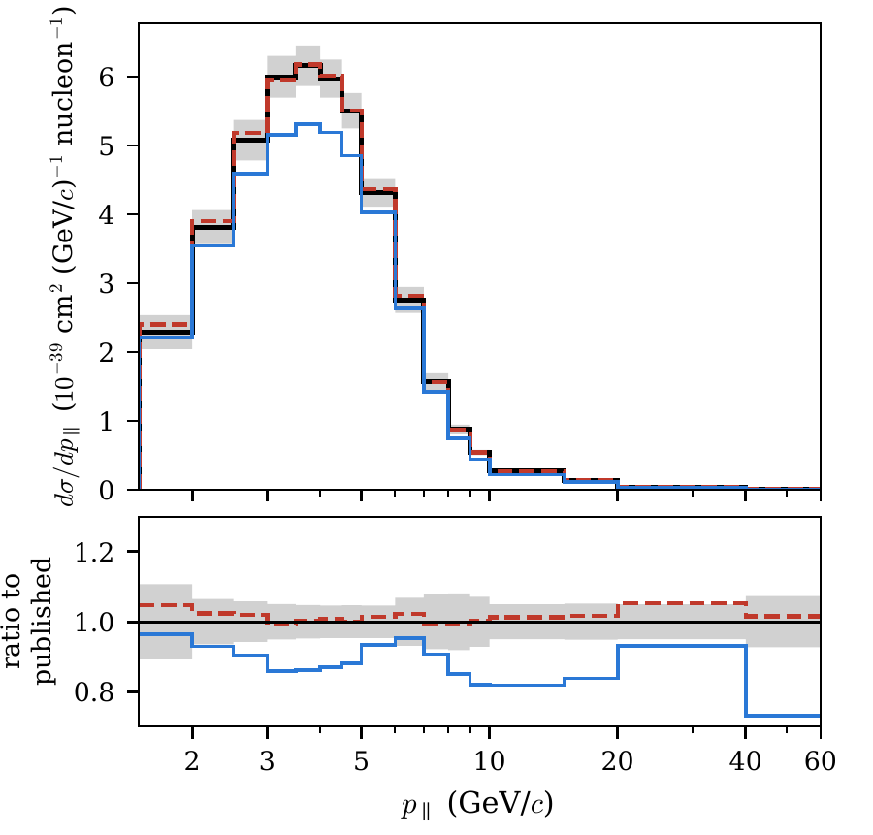
The 2D central result reproduces the published scale
3.073 × 10⁻³⁸ cm²/nucleon
1.11% above the published total
205 reported bins. Five iterations
Same data and shared systematics
Black: published Red dashed: OmniFold Blue: tuned prior
Projection of the validated 2D central result. This is a reproduction, not an independent measurement
05
Notes:
201–252 seconds (51 s)
The central result reproduces the published scale: the integrated cross section is 3.073 times ten to the minus 38 square centimetres per nucleon, 1.11 percent above the published total. This figure also shows the bin-by-bin agreement. It uses the same data and shares systematic sources with the publication, so this is a reproduction, not an independent measurement. The quoted central uses exact-split scikit-learn trees; the uncertainty ensembles use LightGBM. XR has now reproduced the LightGBM references, but their uncertainty transfer to the exact central remains unmeasured.
SOURCES
2d-unfolding/2D_OMNIFOLD_STUDY_STATUS.md
docs/analysis-note/figures/MEFHC_5iter_xsec_proj_pt.pdf
docs/analysis-note/sec_method.tex
docs/analysis-note/figures/paper_fig1_validation.pdf
Main evidence: 3892e769043cddebfd58ec19e1ab1a567eb01784; XR interim evidence: 9be8bfb4d4acace2ec64273970130d6404f1813c.

Slide 6
Most iteration movement occurs before five iterations
1.54% at k = 5
Exact-tree shape difference from its k = 10 reference.
Reported total change from 5 to 10: 0.026%.
Five iterations capture most of the movement. Residual shape evolution remains.
Playlist 1A. Each curve uses its own k = 10 reference, whose zero is automatic. Tabulated archived scan.
06
Notes:
252–307 seconds (55 s)
This is the archived playlist-1A iteration scan, with each tree estimator compared to its own ten-iteration result. The exact-tree shape RMS falls from 5 percent at one iteration to 1.54 percent at five and 0.55 percent at eight. The histogram-tree version reaches 0.86 percent at five. Ten is the reference, so its zero is automatic. This supports five as a practical stopping choice, not proof that every bin has reached an unbiased limit. The reported five-to-ten total-cross-section change is only 0.026 percent. Iteration stability and closure ask different questions: a stable answer can still be biased.
SOURCES
docs/analysis-note/sec_validation.tex
docs/analysis-note/sec_method.tex
2d-unfolding/2D_OMNIFOLD_REFERENCE.md
evidence/prepublication-2026-08-20-0b329e8a:2d-unfolding/2D_OMNIFOLD_RUN_LOG_ARCHIVE.md
2d-unfolding/2D_OMNIFOLD_STUDY_STATUS.md
Main evidence: 3892e769043cddebfd58ec19e1ab1a567eb01784; XR interim evidence: 9be8bfb4d4acace2ec64273970130d6404f1813c.

Slide 7
Closure passes depend on what the test changes
Changed truth shape
Changed hidden resolution
Easy shapes close. A hidden-resolution departure exceeds its limit at amplitude 0.30.
1A, LightGBM, 5 iterations. Hidden variable: ΔpT = reco pT − truth pT, absent from the classifier inputs.
07
Notes:
307–360 seconds (53 s)
The easy truth deformations close very well: median residuals are 0.046 and 0.013 percent against a 1.5 percent limit. The more revealing test changes a hidden resolution variable, reconstructed minus truth transverse momentum. Its residual rises with the deformation, reaching 3.43 percent at amplitude 0.30 and exceeding the 3 percent criterion. These are playlist-1A, LightGBM, five-iteration tests. They validate the tested situations, not arbitrary detector errors. Missed events are a separate bookkeeping requirement: retaining truth events without selected reconstruction preserves the signal denominator, but cannot create data constraints in zero-acceptance regions.
SOURCES
2d-unfolding/2D_OMNIFOLD_STUDY_STATUS.md
docs/analysis-note/sec_validation.tex
docs/analysis-note/sec_method.tex
Main evidence: 3892e769043cddebfd58ec19e1ab1a567eb01784; XR interim evidence: 9be8bfb4d4acace2ec64273970130d6404f1813c.

Slide 8
XR reproduces both LightGBM reference centrals
All 205 cells pass
Seed 1: 2.41 × 10⁻¹²
Seed 42 July: 9.81 × 10⁻¹³
Seed 42 sweep: 1.38 × 10⁻¹¹
Criterion: 10⁻⁸
Reference reproduction is established for LightGBM. Transfer to the exact-tree central remains unmeasured.
Committed interim XR results, 9be8bfb4. Exact-tree comparisons incomplete at 11:20 UTC; final campaign review pending.
08
Notes:
360–423 seconds (63 s)
The newer XR record changes the previous presentation. The seed-42 run agrees with the systematic-sweep central to a maximum relative bin difference of 1.38 times ten to the minus eleven. Against the July background-aware central the difference is 9.81 times ten to the minus thirteen. The seed-one run reproduces its reference to 2.41 times ten to the minus twelve. All are below the frozen ten-to-the-minus-eight criterion in 205 cells. These are committed interim results, not the completed campaign review. The exact-tree reproduction and one-seed comparisons remain incomplete in that snapshot. Reproducing the LightGBM references establishes their provenance and reproducibility; it does not measure covariance transfer between LightGBM and the quoted exact-tree central.
SOURCES
9be8bfb4d4acace2ec64273970130d6404f1813c:docs/orchestration/state/next-preparation-20261009/xr-linux/REPORT.md
9be8bfb4d4acace2ec64273970130d6404f1813c:docs/orchestration/state/next-preparation-20261009/xr-linux/logs/compare-interim-L1.json
Main evidence: 3892e769043cddebfd58ec19e1ab1a567eb01784; XR interim evidence: 9be8bfb4d4acace2ec64273970130d6404f1813c.

Slide 9
The repaired 2D band still needs a coverage test
Old band: nominal 95.45% containment
91.21%
89%
91%
93%
95%
97%
99%
Acceptable window 92.81–97.22%
99.5% confidence interval: 90.65–91.79%
VL170 repaired completeness. Its independent coverage re-test is still outstanding.
Old VL162 band, 100 fixed-truth toys. XR tests reproducibility. The later split-sample design establishes only conditional width agreement.
09
Notes:
423–482 seconds (59 s)
The old statistical band contained truth only 91.21 percent of the time for its nominal 95.45 percent intervals. Its 99.5 percent confidence interval lies wholly below the predeclared acceptable window, so this is a statistical failure rather than a demand for exactly 95 percent. Completeness was repaired in the adopted VL170 band, but that replacement has not received an independent coverage re-test. The October diagnostic supports under-scattering of same-event toys; it does not certify the real-data band. The later split-sample design supports conditional width agreement only, and finds the original objective infeasible under the current inputs. XR addresses reproduction, not this coverage question.
SOURCES
VALIDATION_LEDGER.md: VL169–VL172
docs/analysis-note/sec_systematics.tex
docs/analysis-note/sec_validation.tex
KNOWN_ISSUES.md: 84–85
docs/orchestration/ASSESSMENT-20261008-2d-estimator-pairing.md
docs/orchestration/state/ki85-diag-20261006/ki85_result.json
docs/orchestration/DELIVERY-20261008-uncertainty-preparation.md
docs/orchestration/state/next-preparation-20261009/two-d-path/REPORT.md
docs/orchestration/state/next-preparation-20261009/two-d-followup/REPORT.md
9be8bfb4d4acace2ec64273970130d6404f1813c:docs/orchestration/state/next-preparation-20261009/xr-linux/REPORT.md
9be8bfb4d4acace2ec64273970130d6404f1813c:docs/orchestration/state/next-preparation-20261009/xr-linux/logs/compare-interim-L1.json
Main evidence: 3892e769043cddebfd58ec19e1ab1a567eb01784; XR interim evidence: 9be8bfb4d4acace2ec64273970130d6404f1813c.

Slide 10
Added coordinates expose hadronic structure
Muon kinematics
Visible hadronic energy
Calorimetric transfer
pT and p∥ anchor the published result.
Eavail records selected visible energy, with a species-defined sum.
q0 supplies recoil information used to derive q3 and W.
2D
+ Eavail
+ q3, W
Hadronic observables reveal structure hidden by muon-only projections.
Eavail differs from q0. Outgoing neutrinos and neutrons contribute zero to the implemented Eavail sum.
10
Notes:
482–534 seconds (52 s)
The muon variables reproduce the established two-dimensional result. Available energy adds a species-defined visible-energy measurement, and the calorimetric energy transfer q-zero supplies additional reconstructed information. The derived variables q-three and W then express those inputs in useful interaction coordinates. Available energy excludes invisible outgoing neutrinos and also omits neutrons under the implemented convention; the incoming neutrino supplies energy rather than being an outgoing deposit. The key distinction is between a useful coordinate and a new independent observation. Five scalar inputs do not automatically mean five independent degrees of freedom.
SOURCES
docs/analysis-note/sec_3d.tex
docs/analysis-note/sec_eavailw.tex
MINERvA101/MINERvA-101-Cross-Section/event/CVUniverse.h
Main evidence: 3892e769043cddebfd58ec19e1ab1a567eb01784; XR interim evidence: 9be8bfb4d4acace2ec64273970130d6404f1813c.

Slide 11
Reconstructed q3 and W share the same event inputs
Measured inputs: muon energy / direction and calorimetric q0
Eν = Eμ + q0
Q² = 2Eν(Eμ − pμ cos θμ) − mμ²
q3² = Q² + q0²
W² = M² + 2Mq0 − Q²
W adds a useful physics coordinate, but no independent reconstructed input once muon kinematics and q3 are given.
q0: full calorimetric transfer. M: average nucleon mass. Physical interior, q0 ≥ 0. Code clips Q² and W² at zero.
11
Notes:
534–599 seconds (65 s)
Both quantities use the muon energy and direction and the same calorimetric q-zero. The neutrino-energy estimate is muon energy plus q-zero. From that we calculate Q-squared, then q-three and W using the displayed equations. In the physical interior, muon kinematics and q-three already determine q-zero, so adding reconstructed W supplies no independent detector measurement. It can still organize the interaction physics and help a finite learner by presenting a useful nonlinear transformation. That is why it is too strong to say we should expect nothing useful. Truth W uses a struck-nucleon mass and its own generator convention; exact identities between stored truth coordinates need those conventions checked. Clipping at the reconstruction boundaries can also break invertibility.
SOURCES
MINERvA101/MINERvA-101-Cross-Section/event/CVUniverse.h
docs/analysis-note/sec_eavailw.tex
Main evidence: 3892e769043cddebfd58ec19e1ab1a567eb01784; XR interim evidence: 9be8bfb4d4acace2ec64273970130d6404f1813c.

Slide 12
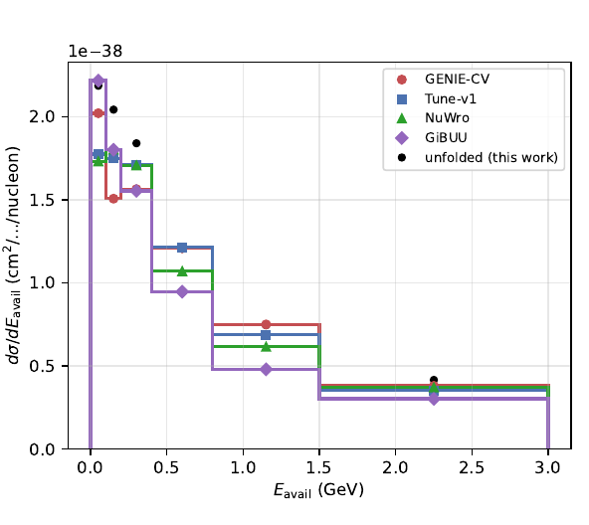
Hadronic energy reveals model differences
3D normalization anchors to 2D
The tested Eavail injection closes
Valencia 2p2h fills 52% of the gap at Eavail ≤ 0.4 GeV
Central-value comparison only
Generator predictions use repaired samples. Historical covariance significances stay unquoted
12
Notes:
599–646 seconds (47 s)
Adding available energy preserves the lower-dimensional normalization and closes the injected available-energy shape. It also exposes model differences hidden by the muon projection. The measured spectrum is harder than several generator predictions. Valencia two-particle–two-hole strength fills 52 percent of the low-energy gap in this comparison, but that observation does not uniquely identify an interaction mechanism. These are central-value comparisons. The historical three-dimensional covariance significances remain withheld; the conditional joint-five-dimensional test later in the talk is a separate result.
SOURCES
3d-unfolding/3D_OMNIFOLD_STATUS.md
VALIDATION_LEDGER.md: VL159–VL160
docs/analysis-note/figures/generators_vs_unfolded_band_central.pdf
Main evidence: 3892e769043cddebfd58ec19e1ab1a567eb01784; XR interim evidence: 9be8bfb4d4acace2ec64273970130d6404f1813c.

Slide 13
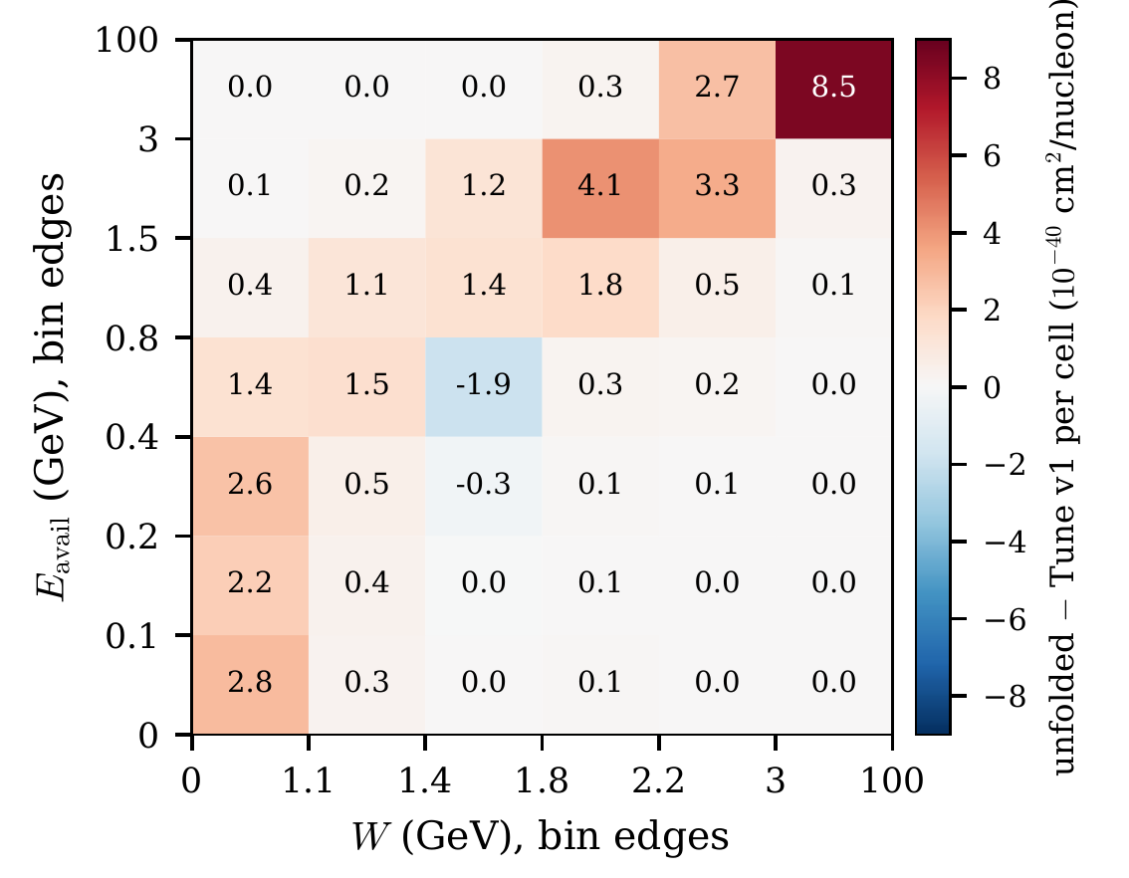
The excess concentrates at high Eavail and high W
67% of positive excess at Eavail ≥ 0.8 GeV
83% of that at W ≥ 1.8 GeV
Largest cell: 22% of this map’s positive excess
Cell-integrated central differences from MINERvA Tune v1. No ranking of significance across observables.
13
Notes:
646–698 seconds (52 s)
The E-avail versus W map localizes the difference from the MINERvA Tune prediction. Sixty-seven percent of this map’s positive excess lies above 0.8 GeV available energy, and 83 percent of that lies above W of 1.8 GeV. The largest cell contains 22 percent of the positive excess, partly because it spans a broad region. This is not a ranking of significance or fractional discrepancy across all variables. It suggests hadronic physics questions but does not isolate a cause; prior support, regularization and detector modelling can also affect the result.
SOURCES
docs/analysis-note/sec_eavailw.tex
docs/analysis-note/figures/paper_fig2_joint.pdf
VALIDATION_LEDGER.md: VL149–VL152
Main evidence: 3892e769043cddebfd58ec19e1ab1a567eb01784; XR interim evidence: 9be8bfb4d4acace2ec64273970130d6404f1813c.

Slide 14
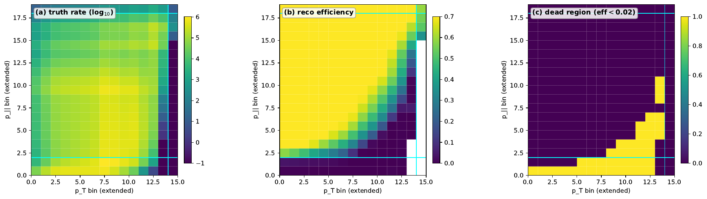
Extending truth acceptance increases extrapolation
Remove truth-muon kinematic cuts
Keep the reconstructed MINOS selection
27.7% of truth rate lies where efficiency < 2%
Central-value and prior tests only
Extended fiducial domain. No corrected covariance for this extension
14
Notes:
698–742 seconds (44 s)
Removing the truth-level muon cuts enlarges the signal domain while retaining reconstructed selection. The efficiency plot shows the consequence: about 27.7 percent of the weighted truth rate lies below two percent efficiency. Those regions rely heavily on simulation and extrapolation through missed events. The dimensional anchors and available-energy closure still pass, and the muon marginal is recovered, but these are central-value and prior tests. No corrected covariance was adopted for this extended-domain result.
SOURCES
docs/analysis-note/sec_fps.tex
docs/analysis-note/figures/fps_acceptance_MEFHC.pdf
Main evidence: 3892e769043cddebfd58ec19e1ab1a567eb01784; XR interim evidence: 9be8bfb4d4acace2ec64273970130d6404f1813c.

Slide 15
The 5% bound limits seed-induced movement of error bars
For independent Gaussian throws
Width for a projection u
SE(s) / σ ≈ 1 / √[2(N − 1)]
σ(u) = √(uᵀ C u)
N = 160: about 5.61%
max |σnew(u) / σref(u) − 1|
Chosen tolerance δ = 5%
Measured: 6.145% > 5%
Seed-invariant ideal: 0%
6.145% is movement of an error-bar width when the estimator seed changes, with nuisance throws held fixed.
5% is a declared stability tolerance, motivated by sampling precision. It is not a p-value or a simultaneous confidence bound.
15
Notes:
742–820 seconds (78 s)
The bound was a declared numerical-stability tolerance, motivated by the precision of a 160-throw estimate of a standard deviation. For independent Gaussian throws, the approximate relative standard error of a sample standard deviation is one over the square root of twice N minus one. At 160 this is about 5.61 percent. Five percent was chosen as a direct movement tolerance of roughly that scale. It is not a derived confidence threshold for a maximum over correlated projections. We compare the same nuisance throws under different estimator seeds and calculate each projected standard deviation. The largest relative width change is 6.145 percent, above five. If a reference width were ten units, that magnitude would mean a change of 0.6145 units, not a 6.145 percent shift in the cross section. A perfectly seed-invariant estimator would give zero; the tolerated value is at most five percent.
SOURCES
docs/orchestration/AUTHORIZATION-20260918-d-resource-required-deliverable-path.md
nd-unfolding/z_statistics.py
docs/orchestration/DECISION-20260920-joseph-adopts-z-cv-under-the-6.4-exception.md
Main evidence: 3892e769043cddebfd58ec19e1ab1a567eb01784; XR interim evidence: 9be8bfb4d4acace2ec64273970130d6404f1813c.

Slide 16
Four measurements accompany the adopted 5D covariance
M1 / M2: exceeds 5% throughout this tested range
M3: five seed-pinned bands
6.75% of covariance trace. Their seed effect is unprobed in either direction.
M4: central values also move
Up to 6.02% of projected σ.
Up to 49.8% of individual-bin σ.
At one seed pair, width movement stays near 6%. The same-seed resampling floor falls from 20.91% at N = 40 to 7.57% at N = 80.
Nested subsets of 160, one seed pair. Larger N unmeasured. Adopted 3d7465f6… remains NON-PASSING; its production C3 was not computed.
16
Notes:
820–880 seconds (60 s)
These four measurements travel with the adopted covariance. First, the largest projected-width movement is 6.145 percent against the five percent bound. Second, it stays near six percent across nested 40, 80 and 160 throw subsets at one seed pair, while the same-seed resampling floor falls. Larger ensembles and other seed pairs remain unmeasured. Third, five fixed-seed bands carry 6.75 percent of the trace; their seed effect is unprobed in either direction. Fourth, central values move by up to 6.02 percent of projected uncertainty and 49.8 percent of individual-bin uncertainty. The exception adopts specific bytes without changing their NON-PASSING status or computing the missing production criterion.
Expanded measurements for slide 16 (reference, not additional timed speech):
M1: The maximum fractional change in a declared projected uncertainty width is s_proj = 6.145%, above the 5% bound. The aggregate and median diagnostics are 0.471% and 0.485%. The comparison products are different from the adopted digest.
M2: s_proj is 6.02%, 6.02% and 6.145% on nested N = 40, 80 and 160 subsets at one seed pair. The same-seed resampling control falls from 20.91% to 7.57% between 40 and 80. The quoted 6.04% ± 0.39% summarizes subset scatter, not the width over seed pairs. Larger N and seed-pair width remain unmeasured.
M3: BeamAngleX, BeamAngleY, MuonResolution, Muon_Energy_MINERvA and Muon_Energy_MINOS remain at literal seed 42. These five of 45 bands carry 6.75% of covariance trace, or 26.0% of the square-root trace scale, and contribute zero seed movement by construction. Releasing their seeds could change the total statistic in either direction.
M4: On 43 projection functionals, central relative shifts have median 0.104% and maximum 0.761%, compared with median relative uncertainty 10.1%. In units of their own uncertainties the shifts have median 1.06%, maximum 6.02%, and total-rate movement 1.13%. Per individual 5D bin, median is 3.77%, 90th percentile 13.6%, maximum 49.8% of uncertainty. The same-seed control is 9.4e-13.
Criterion scope: the 5% bound was approved with the roughly 5.6% finite-ensemble width precision as motivation. The seed comparison grades comparison products; the adopted digest did not evaluate C3 in its own production. Adoption does not change that history.
SOURCES
docs/orchestration/DECISION-20260920-joseph-adopts-z-cv-under-the-6.4-exception.md: §4
docs/orchestration/CORRECTION-20260921-seed-effect-larger-ensemble-corollary-withdrawn.md
docs/orchestration/CORRECTION-20260920-lower-bound-inference-withdrawn.md
docs/orchestration/AUTHORIZATION-20260918-d-resource-required-deliverable-path.md
docs/orchestration/PREREGISTRATION-20260919-cause3-two-member-campaign.md
Main evidence: 3892e769043cddebfd58ec19e1ab1a567eb01784; XR interim evidence: 9be8bfb4d4acace2ec64273970130d6404f1813c.

Slide 17
Purity weights and negative-weight subtraction
Example: D = (50, 50), B = (20, 0)
Standard 2D / scalar 5D chain
wdata = max(0, 1 − Bb/Db)
Same weight within each reco bin.
Comparison and later diagnostics
Data weight +1, background weight −wB. Positive refinement precedes the later candidate’s fit.
Both totals are 80. Their within-bin shapes differ unless B/D is constant.
Illustration only. Raw signed training, positive refinement, and clipping negative GENIE systematic weights are distinct operations.
17
Notes:
880–951 seconds (71 s)
The standard two-dimensional and scalar five-dimensional production chains use binned purity weights: all data events in a reconstructed bin receive the same nonnegative background correction. Negative-weight injection instead appends simulated background with negative weight and leaves data at positive one. The two constructions share bin totals when the floor is inactive, but they generally differ within bins. A synthetic example shows why: purity preserves the data shape, while pointwise subtraction removes the background shape. Signed injection is a comparison method, not the adopted standard chain. The later scalar diagnostic and inference candidates use a learned positive-weight refinement of the signed target, rather than feeding raw signed weights to the final classifier. The refinement can itself underfit. Clipped negative GENIE systematic weights in the inference calibration are a different operation.
SOURCES
docs/analysis-note/app_negweight.tex
docs/analysis-note/sec_method.tex
docs/orchestration/OUTCOME-20260926-s5e-oi192-diagnosis-and-candidate.md
docs/orchestration/RECORD-20261005-s5p-joint-5d-inference-result.md
Main evidence: 3892e769043cddebfd58ec19e1ab1a567eb01784; XR interim evidence: 9be8bfb4d4acace2ec64273970130d6404f1813c.

Slide 18
Repairing background bias did not repair truth recovery
Background bias ↓
More than 80% reduction in every worst cell.
The truth-departure residual barely changes.
Refinement capacity repairs nominal background bias. It does not resolve the truth-recovery failure.
s5e candidate R, tested Eavail departure. Residuals persist with signal only. Candidate also failed real-data numerical stability; no adoption.
18
Notes:
951–1016 seconds (65 s)
The nominal background bias was traced to an underpowered positive-weight refinement classifier. Increasing it from 100 trees and eight leaves to 400 trees and 31 leaves reduced that paired bias by more than 80 percent in every worst cell, with a median reduction of 93 percent. But the physical truth-departure residuals barely changed: the largest E-avail residual remained about 74 percent. They also persist in signal-only tests, so negative weights cannot explain the entire failure. Candidate R subsequently failed the real-data numerical-stability criterion. These studies identify one repairable approximation and a distinct unresolved recovery limitation. They do not show that correct background subtraction is intrinsically biased or establish the generator as the unique source of the discrepancy.
SOURCES
VALIDATION_LEDGER.md: VL149–VL152
docs/orchestration/OUTCOME-20260926-s5e-oi192-diagnosis-and-candidate.md
docs/orchestration/state/next-preparation-20261009/d-id/REPORT.md
Main evidence: 3892e769043cddebfd58ec19e1ab1a567eb01784; XR interim evidence: 9be8bfb4d4acace2ec64273970130d6404f1813c.

Slide 19
A separate test asks whether specified models fit the data
Specify a hybrid null
Repeat experiments
Compare with the data
Generator fine-cell rates
+ within-cell shape
+ detector and nuisance model
Apply the same estimator and calculate the chosen statistic.
Calibrate a Monte Carlo p-value. Correct the family of ten tests.
Unbinned event unfolding
Finite-grid hypothesis and test
The joint-5D measurement did not qualify. A separately calibrated model test answers a narrower question.
Binning makes the hypothesis and calibration explicit. An unbinned test would require its own statistic and calibration.
19
Notes:
1016–1068 seconds (52 s)
The joint-five-dimensional measurement branch did not qualify, so a separately authorized branch tested specified generator hypotheses. Each null includes generator fine-cell rates, an imposed within-cell distribution, and a detector and nuisance model. Repeated simulated experiments calibrate the same test statistic used on data. The unfolding still uses unbinned events; the hypothesis and statistic use a finite grid to make the null and calibration explicit. An unbinned test is possible in principle, but would need its own calibration. This inference supplies neither a new measured cross section nor a reportable uncertainty.
SOURCES
docs/orchestration/DELIVERY-20261006-s5p-campaign-terminal.md
docs/orchestration/RECORD-20260927-s5p-stage2-exit.md
docs/orchestration/RECORD-20261005-s5p-joint-5d-inference-result.md
Main evidence: 3892e769043cddebfd58ec19e1ab1a567eb01784; XR interim evidence: 9be8bfb4d4acace2ec64273970130d6404f1813c.

Slide 20
All ten specified joint-5D null hypotheses are rejected
Prediction
Total
Shape
Conditions carried by each rejection
GENIE CV
Reject
Reject
Fine-grid rates, imposed within-cell shape
MINERvA Tune v1
Reject
Reject
Declared detector bands; no recoil scale
34 interaction bands; two clipped weights
GENIE + Valencia MEC
Reject
Reject
Half-MC toys, full-MC fit; shift included
NuWro
Reject
Reject
GiBUU Eν ≤ 20 GeV; all ≤ 100 GeV
GiBUU
Reject
Reject
Generator MC statistics in metric and draws
Holm familywise α = 0.05. Rejection concerns the full specified null, not a uniquely identified generator defect.
s5p conditional inference with candidate R. No new measured cross section or uncertainty. Independent recomputation agrees on the calculation.
20
Notes:
1068–1124 seconds (56 s)
All five predictions are rejected in both total and shape tests after Holm correction across the ten hypotheses. Total retains normalization; shape removes it. The familywise five percent level controls false rejections across this stated family. That is the same multiple-opportunity principle as the look-elsewhere effect, though this is a fixed family rather than a continuous bump scan. The rejection applies to the full hybrid null. The six conditions displayed alongside it restrict its interpretation. Independent recomputation agrees on the calculation; it does not establish every calibration assumption. Monte Carlo p-values have finite resolution and are never zero.
Expanded conditions for slide 20 (reference, not additional timed speech):
1. The fine-grid null uses generator G's cross section, with MnvTune shapes and G's finite-MC fine-cell fluctuations below it. Refinement has not converged. The 0.50–0.86 comparison is the L2 norm of per-cell relative changes. The frozen kappa = 2 variants and the report-only kappa = 3 check follow the last refinement shift. The true sub-fine residual remains unmeasured and potentially material.
2. Detector calibration assumes the simulated per-event response beyond the drawn MinosEfficiency and GEANT neutron, pion and proton bands at plus or minus one standard deviation, together with the linear surrogate for five lateral bands. There is no recoil-energy-scale band. Hadronic-response completeness is not established.
3. Every pseudo-experiment draws all 34 vertical interaction-model bands. Negative LowQ2_1 and HighQ2_1 weights are clipped per universe under the recorded exception, at no more than 0.35% of a band's shift in the covariance-standardized norm.
4. Toys unfold with half the MC, whereas the data use the full MC. The shift measured in 16 pairs has median absolute size 0.02–0.075% per cell. Along the null's bias direction it is not always consistent with zero, but is at most about 0.05 null standard deviations. A bias-aligned upper-bound variant enters the rule.
5. GiBUU lacks neutrino energy above 20 GeV. Its truth outside p_parallel < 6 GeV/c still migrates into the tested domain under that energy truncation. All generator samples lack neutrino energy above 100 GeV; the record treats that tail as negligible.
6. Each prediction's finite simulation enters both as a diagonal variance term in the comparison metric and as a sampled residual. Independent recomputation establishes arithmetic agreement under these choices, not calibration adequacy.
SOURCES
docs/orchestration/RECORD-20261005-s5p-joint-5d-inference-result.md: §3
docs/orchestration/DELIVERY-20261006-s5p-campaign-terminal.md: §1
docs/publication/CLAIMS-20261005-claim-to-evidence.md: §§E–F
Main evidence: 3892e769043cddebfd58ec19e1ab1a567eb01784; XR interim evidence: 9be8bfb4d4acace2ec64273970130d6404f1813c.

Slide 21
The rejection survives a bounded refinement stress test
κ multiplies the last change seen when splitting truth cells more finely.
1: last observed
refinement shift
2: primary
test
3: robustness
check
≈5.25: first loss of
determinate rejection
The matched coarse muon-only test does not reject GENIE CV. The added joint coordinates reveal a disagreement.
Refinement has not converged. κ is a stress scale, not a confidence level. Recovered draws shift the first-loss value to ≈5.17. Muon check is post hoc.
21
Notes:
1124–1178 seconds (54 s)
Refinement splits truth cells to test sensitivity to the imposed within-cell shape. Kappa scales the last observed change: two is the primary test and three the robustness check. There is no universal typical kappa or confidence-level interpretation. In frozen ensembles, the first loss of determinate rejection is around 5.25; recovered draws shift it to about 5.17. That is not determinate acceptance, and the grid has not converged. The matched coarse muon-only comparison does not reject GENIE CV. This post-hoc comparison supports the relevance of joint hadronic information without establishing a universal power advantage.
SOURCES
publication/kappa/RECORD-20261008-kappa-breakdown.md
publication/w2/W2B-REPORT-20261006.md
docs/publication/CLAIMS-20261005-claim-to-evidence.md: §§D–F
Main evidence: 3892e769043cddebfd58ec19e1ab1a567eb01784; XR interim evidence: 9be8bfb4d4acace2ec64273970130d6404f1813c.

Slide 22
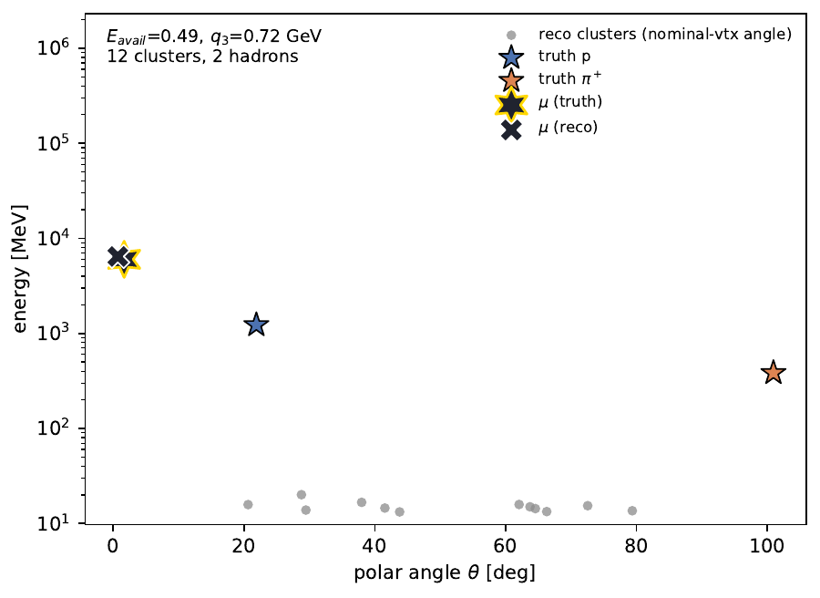
PET uses particle and detector-object structure
Objects carry structure
Many detector clusters can come from one hadron.
Muon information remains available separately.
PET learns relationships among objects. The detector cloud is not a list of reconstructed truth particles.
Archived recoil-cloud example. Cluster angle uses a nominal vertex for display; PET inputs use stored view/position features.
22
Notes:
1178–1234 seconds (56 s)
PET receives sets of objects rather than only scalar summaries. This archived event display places truth hadrons, reconstructed recoil clusters and the muon on a common energy-angle plane. Detector clusters are not individual reconstructed hadrons: a single particle can produce many deposits. The original recoil-cloud representation gives the muon separately as event-level features; the later full-event models incorporate aligned event scalars. The plot uses a nominal vertex to illustrate cluster angle, while the model consumes the stored view and position features. PET can learn relationships among objects, but more tokens do not automatically produce more independently measurable physics.
SOURCES
docs/analysis-note/sec_pet.tex
docs/analysis-note/figures/pet_event_displays_energy_angle.pdf
Main evidence: 3892e769043cddebfd58ec19e1ab1a567eb01784; XR interim evidence: 9be8bfb4d4acace2ec64273970130d6404f1813c.

Slide 23
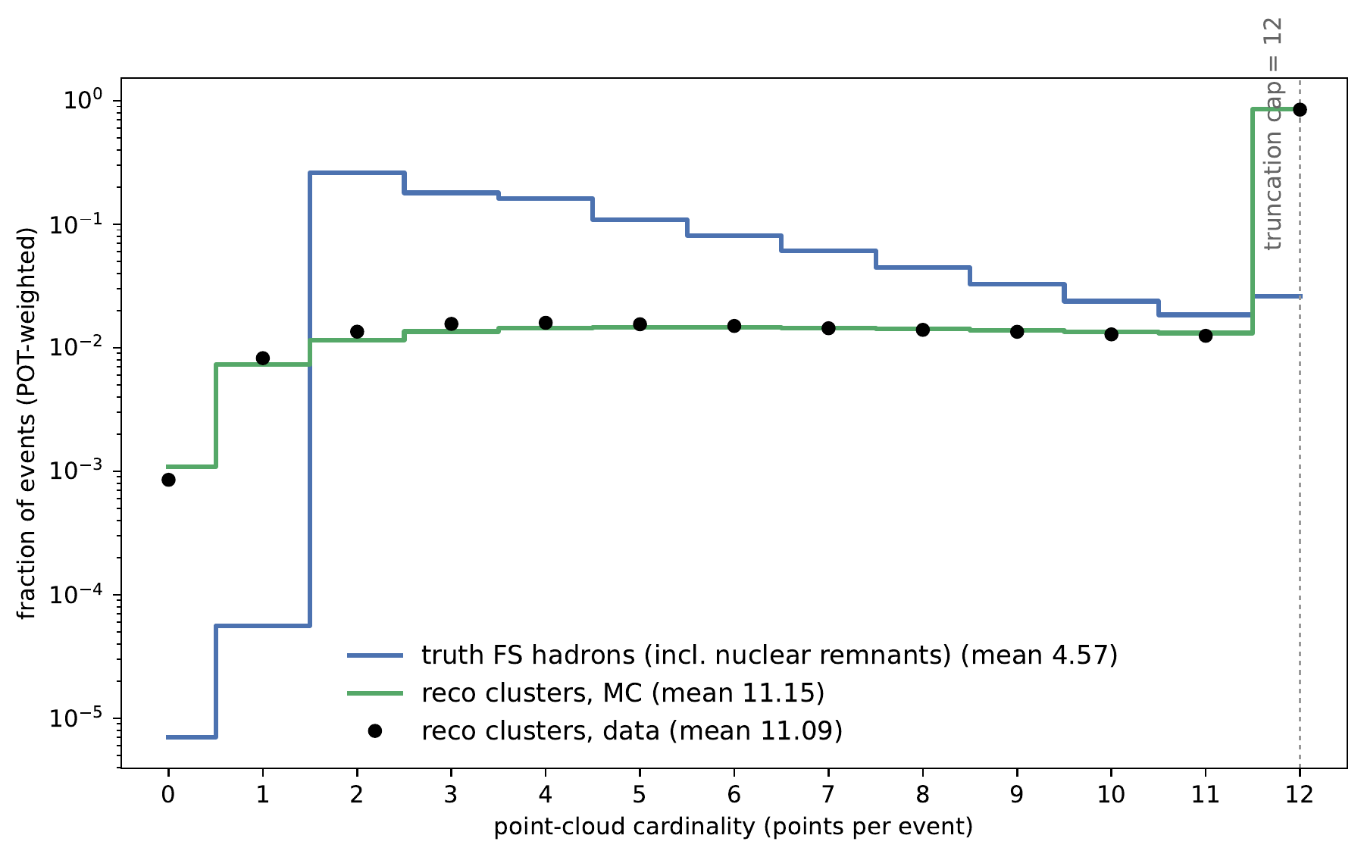
The 12-token cap truncates reco clouds much more often
Reco hits the cap
Truth: 2.31% reach 12.
The 12th truth object carries 0.09% of retained energy on average.
Twelve limits compute and memory. A controlled cap scan has not established that it is optimal.
0.09% is not the total discarded energy or lost-information fraction. This post-truncation plot cannot show the uncapped reco tail.
23
Notes:
1234–1299 seconds (65 s)
This is the actual cardinality distribution after truncation. Truth clouds are relatively sparse, with mean 4.57 including nuclear-remnant bookkeeping particles. Only 2.31 percent reach twelve. Reconstructed clusters pile up strongly at the cap, because a hadron can leave many deposits. The twelfth truth constituent carries 0.09 percent of retained truth energy on average, but that is neither the total discarded energy nor a bound on lost reconstruction information. Twelve was a compute and memory choice, not the winner of a controlled cap scan. Attention pair costs grow roughly quadratically with token count, although total training cost has other terms. The correct conclusion is that the optimal cap and the effect of discarded structure remain unmeasured.
SOURCES
docs/analysis-note/sec_pet.tex
docs/analysis-note/figures/pet_cardinality_withremnant.pdf
Main evidence: 3892e769043cddebfd58ec19e1ab1a567eb01784; XR interim evidence: 9be8bfb4d4acace2ec64273970130d6404f1813c.

Slide 24
The earlier PET central disagrees with its bootstrap family
Localized mismatch
63 of 257 cells have central / mean > 1.5.
In 44 of those, central is above every one of 50 replicas.
The central/statistical pairing was declined. The mechanism remains unresolved.
Corrected same-domain, bin-width-weighted comparison. Covariance exists but is unverified. No adopted PET total covariance or ML block.
24
Notes:
1299–1348 seconds (49 s)
The earlier PET nominal and its bootstrap family disagree locally. On 257 common cells, the width-weighted total ratio is 1.1027, while the median cell ratio is only 1.0003. Sixty-three cells have nominal-to-mean ratio above 1.5; in 44 of those, nominal is above all fifty replicas. This localized anomaly motivated declining the central/statistical pairing. Its mechanism remains unresolved, and the covariance construction lacks independent verification. No full-event PET total covariance or ML covariance was adopted. The later PET studies therefore focus on method development.
SOURCES
docs/analysis-note/sec_pet.tex
VALIDATION_LEDGER.md: VL132
docs/OPEN_ITEMS.md: OI-126
docs/orchestration/state/gate6-member-trajectories-result-56847059.json
docs/orchestration/state/RECEIPT-20260815-cstat-tail-geometry-and-weighting-correction.json
Main evidence: 3892e769043cddebfd58ec19e1ab1a567eb01784; XR interim evidence: 9be8bfb4d4acace2ec64273970130d6404f1813c.

Slide 25
PET recovers more of the tested Eavail tilt
Fraction of injected Eavail tilt recovered
Historical control
0.306
Compact hybrid finalist
0.895
Larger hybrid finalist
0.863
0
1 = exact recovery
Final-bank Eavail tilt, 60 draws. R = 1 is exact recovery, R = 0 retains the prior discrepancy
25
Notes:
1348–1395 seconds (47 s)
The final-bank available-energy tilt measures recovery with R: one means the injected change is recovered, and zero means the prior discrepancy remains. The historical control reaches 0.306, the compact hybrid 0.895, and the larger hybrid 0.863. These are substantial improvements on that tested departure. The full selection study also required accuracy and stress performance, and no design passed every requirement. It used signal-only simulated banks. This plot establishes neither a universal architecture ranking nor a calibrated real-data cross-section measurement.
SOURCES
nd-unfolding/pet/final_design/DECISION_RECORD-pet-final-design.md
docs/analysis-note/sec_pet_campaigns.tex
VALIDATION_LEDGER.md: VL164–VL167
Main evidence: 3892e769043cddebfd58ec19e1ab1a567eb01784; XR interim evidence: 9be8bfb4d4acace2ec64273970130d6404f1813c.

Slide 26
Coverage counts intervals that contain the true bin value
Known truth in bin 3: 80
Experiment A
Experiment B
[76, 92] contains truth = 80
[84, 96] misses truth = 80
Repeat experiments and count containing intervals. Nominal 68% targets 68% containment.
Synthetic illustration, not MINERvA data or a coverage measurement. The intervals apply to bin values, not event labels.
26
Notes:
1395–1461 seconds (66 s)
These are deliberately synthetic histograms, to isolate the idea. The true value in the highlighted bin is 80. Experiment A estimates 84 with an interval from 76 to 92, which contains 80. Experiment B estimates 90 with an interval from 84 to 96, which misses it. Repeat the whole procedure on many experiments and count the containing intervals for that target. A nominal 68 percent procedure aims to contain the target 68 percent of the time under the declared experiment model. It is not a statement that 68 percent of events are truth-like. The next slide shows the actual PET study, whose target is the known truth-bin value for each simulated draw and whose reported entries pool bin-draw checks.
SOURCES
nd-unfolding/pet/final_design/DECISION_RECORD-pet-final-design.md
docs/analysis-note/sec_pet_campaigns.tex
Main evidence: 3892e769043cddebfd58ec19e1ab1a567eb01784; XR interim evidence: 9be8bfb4d4acace2ec64273970130d6404f1813c.

Slide 27
PET intervals over-cover overall and under-cover low acceptance
Low acceptance: 25.7% containment where 68% is intended. Aggregate over-coverage hides the local deficit.
120 pseudo-experiments, six bootstrap members per estimator. Entries pool bin-draw checks, not simultaneous coverage or classification rates.
27
Notes:
1461–1511 seconds (50 s)
Here are the measured coverage fractions, pooled over bin-draw checks in 120 simulated experiments. The nominal 68 percent intervals contain truth 89.6 percent of the time in aggregate, but only 25.7 percent in low acceptance. The 95 percent intervals also under-cover there, at 78.9 percent. Moderate and good acceptance behave differently. A common rescaling cannot fix both broad aggregate intervals and the narrow low-acceptance intervals. These are intervals for truth-bin values, not event classifications or simultaneous coverage of all bins. No eligible design was selected.
SOURCES
nd-unfolding/pet/final_design/DECISION_RECORD-pet-final-design.md
docs/analysis-note/sec_pet_campaigns.tex
Main evidence: 3892e769043cddebfd58ec19e1ab1a567eb01784; XR interim evidence: 9be8bfb4d4acace2ec64273970130d6404f1813c.

Slide 28
PET gains depend on the tested departure
Gain depends on the departure
Above zero: PET recovers more.
Below zero: the tree comparator recovers more.
Measured PET cost: 1.768 / 1.517 A100-hours per unfolding at study scale
Means: 60 tilt draws, 8 per generator. Trees: 352 tasks + control/retries, 5.306 charged CPU-core-hours total. Different hardware and packing.
28
Notes:
1511–1564 seconds (53 s)
The matched comparison uses identical simulated events and declared truth deformations. PET improves recovery of the available-energy tilt; trees do better on the NuWro, NuWro-prime and GiBUU reweightings, which retain the same detector simulation. The compact and larger PET finalists cost median 1.768 and 1.517 A100-hours per unfolding at study scale. The tree campaign used 5.306 charged CPU-core-hours across 352 tasks plus a control and retries. Those are different hardware and workload units, so they do not yield a clean speedup factor. The conclusion depends on the departure and training configuration.
SOURCES
docs/analysis-note/sec_pet_campaigns.tex
VALIDATION_LEDGER.md: VL168
nd-unfolding/pet/gbdt_comparison/REPORT-20261005.md
nd-unfolding/pet/final_design/DECISION_RECORD-pet-final-design.md
nd-unfolding/pet/gbdt_comparison/REPORT-20261005.md
Main evidence: 3892e769043cddebfd58ec19e1ab1a567eb01784; XR interim evidence: 9be8bfb4d4acace2ec64273970130d6404f1813c.

Slide 29
Reproducibility and scientific validation answer different questions
Provenance
Did the intended code and inputs actually run? Hashes alone once missed a wrong-checkout import.
Numerical reproduction
Can a fresh calculation recover the stated result? XR now does this for the LightGBM reference centrals.
Scientific validation
Does the estimator recover truth, and do its intervals cover? Numerical agreement cannot establish either.
Each result needs the check that answers its scientific question. A generic PASS cannot replace that evidence.
29
Notes:
1564–1608 seconds (44 s)
Reproducibility work distinguishes execution integrity, numerical agreement and scientific validation. An import-path defect once caused a different checkout’s code to run despite matching file hashes. XR now answers specific numerical-reproduction questions for the LightGBM centrals. Closure and coverage answer different questions about recovery and calibration. No result becomes scientifically validated just because several people repeat the same calculation. The note, primer, paper and replay materials should preserve those distinctions when they quote results.
SOURCES
docs/OPEN_ITEMS.md: OI-136
docs/orchestration/CAMPAIGN-REVIEW-20260929.md
docs/publication/submission/PACKAGE-MANIFEST-20261006.md
reproduction/s5p/README.md
Main evidence: 3892e769043cddebfd58ec19e1ab1a567eb01784; XR interim evidence: 9be8bfb4d4acace2ec64273970130d6404f1813c.

Slide 30
The next decision is what measurement claim can be supported
Resolved by XR so far
LightGBM seed-42 and seed-1 reference centrals regenerate within tolerance.
Still unresolved
Exact-tree comparisons in the interim snapshot; covariance transfer; coverage of the corrected 2D band.
Scientific choice
Adopt a matched estimator with explicitly narrower claims, or obtain the independent inputs needed for stronger validation?
The article is assembled, not submitted. The proposed matched-estimator route is not an adopted measurement.
XR 9be8bfb4, 11 October 11:20 UTC. Later evidence should update this snapshot before the talk.
30
Notes:
1608–1680 seconds (72 s)
The article is assembled but not submitted, and the remaining scientific choices are consequential. XR now establishes reproduction of the LightGBM reference centrals. The exact-tree comparisons are not complete in the inspected committed snapshot, and covariance transfer remains unmeasured. Coverage of the corrected statistical band also remains open. The proposed matched-LightGBM route would narrow the claim to conditional precision and nuisance propagation; it is not an adopted replacement or an empirical total-coverage result. For higher dimensions, the most useful existing result is the conditional generator test and the diagnosis of why a measurement did not qualify. For PET, the next design would need to connect better recovery, low-acceptance calibration and representation choices such as the token cap. These are the decisions I would like to discuss with Ben.
SOURCES
docs/publication/submission/PACKAGE-MANIFEST-20261006.md
docs/orchestration/PROPOSAL-20261005-scalar-measurement-successor.md
docs/orchestration/state/next-preparation-20261009/closeout/REPORT.md
docs/orchestration/state/next-preparation-20261009/two-d-path/REPORT.md
9be8bfb4d4acace2ec64273970130d6404f1813c:docs/orchestration/state/next-preparation-20261009/xr-linux/REPORT.md
9be8bfb4d4acace2ec64273970130d6404f1813c:docs/orchestration/state/next-preparation-20261009/xr-linux/logs/compare-interim-L1.json
docs/orchestration/state/next-preparation-20261009/two-d-followup/REPORT.md
Main evidence: 3892e769043cddebfd58ec19e1ab1a567eb01784; XR interim evidence: 9be8bfb4d4acace2ec64273970130d6404f1813c.

Slide 31
Backup: exact available-energy convention
Truth
Protons: E − 938.27 MeV. Charged pions: E − 135 MeV
Truth continued
Neutral pions and photons: total energy. All other species contribute zero
Reconstruction
1.17 × (tracker + ECAL blob energy after muon-fuzz subtraction)
Comparison limit
The inherited charged-pion constant and species exclusions differ from some published definitions
B1
Notes:
Optional backup
ECAL means electromagnetic calorimeter. A blob is a reconstructed aggregate of detector energy. Muon fuzz is energy associated with the muon’s nearby deposits and subtracted from the recoil estimate. No final nonnegative clamp is applied to the reconstructed quantity. The truth definition excludes secondary electrons, neutrons, kaons and other species not explicitly listed. The charged-pion subtraction uses 135 MeV rather than about 139.57 MeV. The effect has been measured, but its materiality against the adopted 5D projection is not established. There is no universal published available-energy convention. Do not describe this implementation as generically matching all low-recoil publications.
SOURCES
docs/analysis-note/sec_3d.tex: operational definition
Main evidence: 3892e769043cddebfd58ec19e1ab1a567eb01784; XR interim evidence: 9be8bfb4d4acace2ec64273970130d6404f1813c.

Slide 32
Backup: the adopted covariance’s exact boundary
Identity
z-cv.npz, SHA-256 prefix 3d7465f6, 890,500,272 bytes
Four measurements
M1–M4 on slide 16 travel with every use of this product
Unresolved criterion
Cause 3 remains predeclared and not computed for this digest
Decision meaning
Exception covers these bytes only. No inherited adoption for other candidates
B2
Notes:
Optional backup
The full digest is 3d7465f66fbe66b0dfcf09b6fc51249f227fb33e97ae40bc78dda90275e918c5. The projection digest begins 835828bf. Identity verification establishes which covariance was projected, not its statistical adequacy. The predeclaration ordering defect is ratified by exception, not cured, and no declared cause-3 boundary was evaluated by production. The paired measurement products used for the seed comparison are different digests and are not separately adopted. Five pinned bands are BeamAngleX, BeamAngleY, MuonResolution, Muon_Energy_MINERvA and Muon_Energy_MINOS. Their seed effect is unprobed in either direction. See slide 16 for the mandatory numerical measurements and their finite-ensemble scope.
SOURCES
docs/orchestration/DECISION-20260920-joseph-adopts-z-cv-under-the-6.4-exception.md
docs/orchestration/OPERATIVE-SHEET-scalar5d.md
Main evidence: 3892e769043cddebfd58ec19e1ab1a567eb01784; XR interim evidence: 9be8bfb4d4acace2ec64273970130d6404f1813c.

Slide 33
Backup: reading the conditional p-values
Finite simulation
p = (k + 1) / (B + 1), with k exceedances in B toys
Resolution
B = 1,343–1,751. Never report p = 0 or turn it into a Gaussian significance
Test domain
109 supported joint cells. 72 for GiBUU with p∥ < 6 GeV/c
Missing draws
224 calibration + 53 power draws recovered. Frozen decisions unchanged
B3
Notes:
Optional backup
These statistics belong only to the hybrid-null construction and the six conditions on slide 20. The frozen family has zero exceedances in nine tests and one in NuWro shape. Clopper–Pearson intervals are exact binomial confidence intervals for the exceedance probability. Determinacy requires those Monte Carlo intervals to resolve the decision relative to the multiple-testing threshold. The lost-draw recovery is report-only. Four nulls would have stopped one batch earlier with complete batches, with the same decisions. The closest recovered margin is 4.6 statistic units for GENIE plus MEC shape at kappa three. Independent checks cover the frozen-shift reading; the union reading is a same-code consistency replay. A small conditional p-value does not identify a nuclear mechanism or localize a discrepancy.
SOURCES
docs/orchestration/DELIVERY-20261006-s5p-campaign-terminal.md
docs/orchestration/RECORD-20261005-s5p-joint-5d-inference-result.md
Main evidence: 3892e769043cddebfd58ec19e1ab1a567eb01784; XR interim evidence: 9be8bfb4d4acace2ec64273970130d6404f1813c.

Slide 34
Backup: the PET representation studies
Pooling versus individual objects
Synthetic routing comparison found no resolved accuracy difference
Production cloud
The top-12 cap removes substantial reconstructed activity
Improvement campaign
No frozen ten-iteration candidate passed adequacy plus stress
Final design and pretraining
No tested PET2 recipe passed every development screen
B4
Notes:
Optional backup
Pooling summarizes several objects into one representation. Individual routing gives each object its own attention token. The synthetic comparison used a small fixed object fixture and cannot settle production-multiplicity performance. The production cap acts on generic calorimeter clusters, not simply a thin typed-object tail. Later hybrid designs use energy summaries to recover some omitted information. PDG is the particle-identity code assigned by the Particle Data Group. One-hot encoding represents identity with separate category indicators rather than treating the code as a continuous number. PET2 is a tested pretrained model family. Pretraining means learning on another sample before this task. Its failure here applies to the tested recipes, not all possible pretraining. CPU–GPU optimizer differences were also investigated; numerical reproducibility does not establish physical accuracy.
SOURCES
nd-unfolding/pet/direct_token_comparison/REPORT_FOR_BEN.md
nd-unfolding/pet/direct_token_comparison/GO_NO_GO-20260918.md
docs/analysis-note/sec_pet_campaigns.tex
Main evidence: 3892e769043cddebfd58ec19e1ab1a567eb01784; XR interim evidence: 9be8bfb4d4acace2ec64273970130d6404f1813c.

Slide 35
Backup: the closed scalar sequence
s5c
Futility stop. Nominal purity-background bias confirmed
s5n
Refined subtraction improves nominal behavior. Departure failure persists
s5e
Diagnosed refinement underfitting. Candidate R fails fresh assessment
s5p
Measurement not admitted. Conditional inference completes with no new uncertainty
B5
Notes:
Optional backup
These labels identify successive bounded campaigns, not distinct published measurements. They are all terminal. The background repair is a causal diagnosis for one nominal-bias component. The physical truth-departure failure remains without a single established cause. Reopening a closed study would require a new decision and contract. R is a targeted refinement change, not the production central-value estimator. A nominal-truth calibration check cannot establish performance over every alternative truth, and a pooled calibration result can hide individual functionals with poor coverage. A functional is any declared quantity extracted from the distribution, such as a bin, integral or projection.
SOURCES
VALIDATION_LEDGER.md: VL149–VL155
docs/orchestration/OUTCOME-20260926-s5e-oi192-diagnosis-and-candidate.md
docs/orchestration/DELIVERY-20261006-s5p-campaign-terminal.md
Main evidence: 3892e769043cddebfd58ec19e1ab1a567eb01784; XR interim evidence: 9be8bfb4d4acace2ec64273970130d6404f1813c.

Slide 36
Backup: what the release can reproduce
Available
Article sources, analysis note, primer and saved inference inputs
Replay
Recompute conditional inference from sufficient products
Different task
Regenerate training and calibration pseudo-experiments end to end
Release limits
Several closure, uncertainty and sensitivity results remain outside RC4 replay
B6
Notes:
Optional backup
Sufficient products are the stored quantities needed to recompute the reported inference without regenerating every event or training run. RC4 is a local release candidate, not a public deposit. Its scope excludes reproducing the 2D uncertainty, closure, bias, low-recoil, W2 and covariance-status numbers, as listed in its README. Those results retain their own evidence routes. The article still needs author decisions and external-release actions, including coauthor review, deposit and submission. None of those acts is authorized by preparing this talk.
SOURCES
docs/publication/submission/PACKAGE-MANIFEST-20261006.md
docs/publication/release/RC4-README.md
reproduction/s5p/README.md
Main evidence: 3892e769043cddebfd58ec19e1ab1a567eb01784; XR interim evidence: 9be8bfb4d4acace2ec64273970130d6404f1813c.

Slide 37
More events: distinguish three different proposals
Same measured exposure
Current 2D uses all 12 ME-FHC playlists and about 4.12M selected events
Larger training sample
PET used subsamples; more MC can improve support and sampling precision
Different data / selection
RHC or new channels need their own flux, response and signal definition
Current uncertainty issue
More resampling does not create independent validation populations
Current MINERvA release lists ME FHC and RHC; low-energy availability should be checked before planning.
B7
Notes:
Optional backup
We should distinguish more measured data from more training simulation and a different physics sample. The scalar reproduction already uses the twelve medium-energy forward-horn-current playlists for this signal. PET has trained on smaller subsets of the truth inventory, so increasing that sample is a possible design change, with substantial cost. It does not automatically repair bias, a misspecified response, or interval calibration. The current open release also lists reverse-horn-current data. That enables an antineutrino-dominated analysis, not a direct extension of the same neutrino cross section without new modeling. Enlarging truth acceptance with unchanged reconstructed selection adds extrapolation, not observed events. Finally, more bootstrap replicas only reduce the numerical noise in a bootstrap estimate; they do not provide the independent detector-simulated populations missing from the coverage design.
SOURCES
docs/analysis-note/sec_3d.tex
docs/analysis-note/sec_fps.tex
nd-unfolding/pet/gbdt_comparison/REPORT-20261005.md
docs/orchestration/DELIVERY-20261008-uncertainty-preparation.md
https://minerva.fnal.gov/getdata/
Main evidence: 3892e769043cddebfd58ec19e1ab1a567eb01784; XR interim evidence: 9be8bfb4d4acace2ec64273970130d6404f1813c.

