Slide 1
Indexation Walkthrough
Commercial and Contracts Management Analytics
Data & Analytical Services Directorate
Summer 2020

Slide 2
Student Loans (post-2012) increase by RPI + 3% per annum!
Using RPI over CPI costs the department £ms – it only grows each year!
Inflation
Did You Know?
State Pensions are ‘triple-locked’ to the highest of: CPI, AWE, or 2.5%!
RPI could be scrapped entirely as early as 2025!

Slide 3
Glossary
Indices:
Retail Price Index (RPI): an outdated measure of general price inflation;
Consumer Price Index (CPI): the recommended measure of general price inflation;
Average Weekly Earnings (AWE): the recommended measure for wage inflation;
Building Maintenance Index (BMI): a measure for building and maintenance inflation;
GDP Deflator: HMT produced index to measure real GDP and convert real costs into nominal costs.
Technical Terms:
Inflation: a general increase in the price level;
Real Values: nominal costs which have been deflated to a given base year;
Nominal Values: any cost which includes the impacts of inflation;
Deflating*: the method to convert nominal costs into real costs, to remove the impact of inflation;
Discounting: the method to convert real costs into net present costs;
Net Present Cost (NPC): any cost which has been deflated and discounted.
*NOT the same as deflation (i.e. negative inflation)

Slide 4
Objective
Understanding:
Key indices, and their differences;
Appropriate use of different indices;
The impact of inflation on costs.
Indexation Tool Understanding:
Utilise the Indexation Tool to support MOJ projects;
Compare the impact of different indices on costs.
Application of Knowledge:
Utilise understanding to better inform contract negotiations and tenders;
Inflate costs by appropriate measures;
Improve financial forecasting.

Slide 5
Background Information
MOJ Contracts:
Many MOJ contracts explicitly apply indexation as set out in their contractual terms;
These contracts apply a variety of inflation indices, with no consistency and a lack of a common transparent approach;
MOJ Gold Contracts, for example, have an annual value of ~£2.5bn with ~£1bn of this is known to be impacted by indexation*;
Some MOJ contracts implicitly apply inflation, which makes it difficult to control and estimate.
Inflation Impact:
The compounding nature of inflation has a significant impact on these contracts, and consequently overall MOJ expenditure;
Different indices are appropriate for different costs and products;
Different indices that are perceived to be similar can vary dramatically year-on-year;
Understanding indexation and where/when it is applied (especially in contracts) is crucial to accurately estimating expenditure and evaluating bids.
*as at FY 2020/21

Slide 6
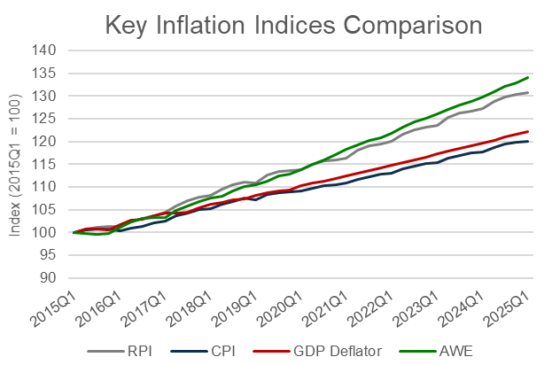
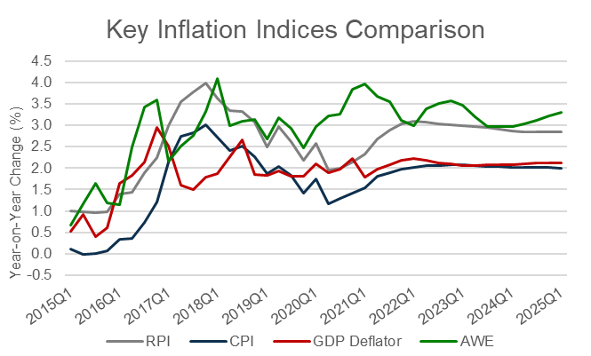
Indexation: Comparisons
Key Takeaways:
AWE and RPI(X) trend higher than CPI and GDP Deflators;
CPI and GDP Deflators trend very closely, although CPI is expected to increase at a slightly lower rate;
The impact of inflation is significant. £100 in 2015, inflated to 2025, would be worth:
£130, if inflated by RPI; but
£120, if inflated by CPI
In the context of contractual costs, worth £ms, this impact is notable.
During periods of economic uncertainty (e.g. recessions), this trends may not hold true.
Note: there are subsets of each index which separate the impact of different products’ impact on inflation.

Slide 7
Indexation: Recommendations
Standard Indices:
CPI: general price inflation
AWE: wage price inflation, for all staff-related wage/salary costs
BMI: price inflation, for all costs relating to building maintenance (e.g. materials, cleaning…)
GDP Deflators: not recommended for contractual inflation, as it will not reflect the prices paid by suppliers.
RPI(X): not recommended. Since 2013, the ONS does not recognise it as a UK National Statistic.
For a detailed list of recommendations, please see the accompanying Indexation Guidance document.
Specific Subset Indices:
There are several subsets of each index which may be more appropriate to use that the standard/general indices. A full list can be found on the ONS’ website.
Key Subsets:
CPIH: CPI, housing costs only;
CPI (D7BU): CPI, food (and non-alcoholic beverages) only;
CPI (D7CQ): CPI, transport only;
CPI (D7C3): CPI, communication only;
AWE: (K54V): AWE, private sector only;
AWE (K54X): AWE, services only.
Note: there are indexation may not always be appropriate, so please think carefully before making a decision.

Slide 8
Indexation Tool
Direct Link to App
Notes:
https://defcalc.apps.alpha.mojanalytics.xyz/

Slide 9
Indexation Tool: Overview
What Can It Do?
Provide up-to-date information on the latest official inflation forecasts;
Allow users to add their own indices (locally);
Inflate financial costs from one time period to another;
Deflate financial costs from one time period to another, in line with HMT Green Book guidance;
Calculate Net Present Costs (NPC);
How Can It Help?
Provide an easy-to-access – and share – source of inflation statistics;
Help users understand and apply appropriate indices to different cost profiles;
Help users understand the impact of (different rates of) inflation on ongoing and future projects.
For more information, please see the in-app guidance

Slide 10
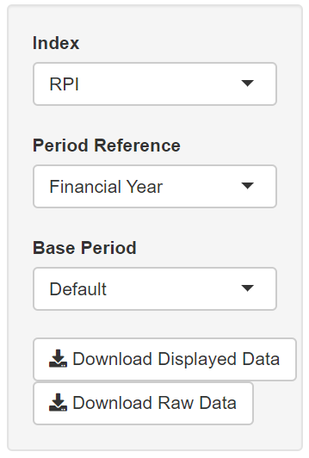
Indexation Tool: Indices
A drop down list of all available indices, including any user-added indices.
A drop down list of all time periods, currently limited to: Financial Year, Calendar Year, and Quarterly.
A drop down list of all time periods that can be used as a base year, generated from the selected period references. Note that ‘Default’ is the original index (i.e. has not been rebased).
Download buttons for downloading the displayed index only, or all the indices.
For more information, please see the in-app guidance

Slide 11
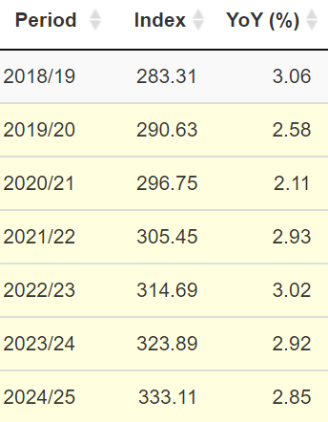
Indexation Tool: Indices
All periods generated by the selected period reference will be shown. Note that:
Any row highlighted YELLOW is a forecast, and likely subject to change;
A row highlighted BLUE is the base period;
A row highlighted GREEN is both a forecast, and the base year.
Interpretation:
The ‘INDEX’ column is the price level, in any given year, relative to the base year.
The ‘Year-on-Year (%)’ column is the price change compared to the same period a year prior.
For more information, please see the in-app guidance

Slide 12
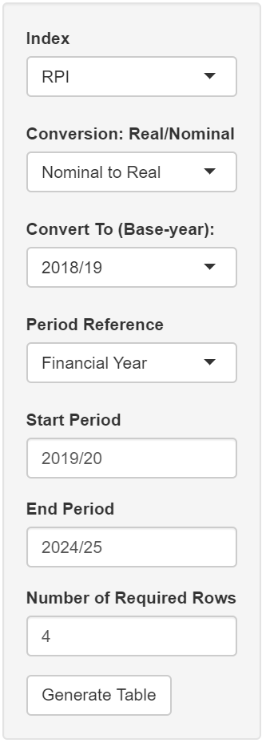
Indexation Tool: Deflator Calculator
A drop down list of all available indices, including any user-added indices.
Selection between nominal-to-real, or vice versa. Note that nominal-to-real is for deflating, and real-to-nominal is for inflating. Understanding whether input data in/excludes inflation is crucial to correct use of the tool.
A drop-down list generated based on the selected period reference. Varies based on prior conversion. For nominal-to-real, choose the base year you wish to convert the costs to; and for real-to-nominal, choose the year you are converting real costs from.
A drop down list of all time periods, currently limited to: Financial Year, Calendar Year, and Quarterly.
Required to generate the correct table dimensions and ensure inflation/deflating is done correctly.
How many rows are required (allows for multiple costs to be inflated at once).
Button that updates the displayed table based on selected parameters.
For more information, please see the in-app guidance

Slide 13
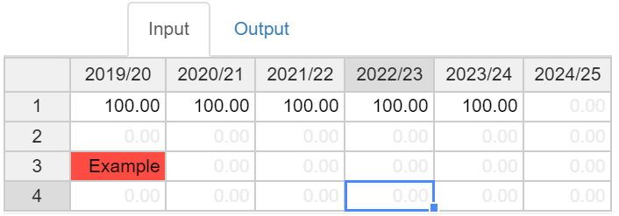
Indexation Tool: Deflator Calculator
An example of an invalid data entry, automatically detected, which will be ignored by subsequent calculations.
Entering data must be done in each year.
Knowledge of whether input data is in nominal or real terms (i.e. in/excludes inflation) is necessary.
Entering this data in the correct column is crucial.
Many Excel shortcuts can be used (e.g. Ctrl+C or Ctrl+V from other applications, Ctrl+Shift+Arrow). Formulae are not supported.
For more information, please see the in-app guidance

Slide 14
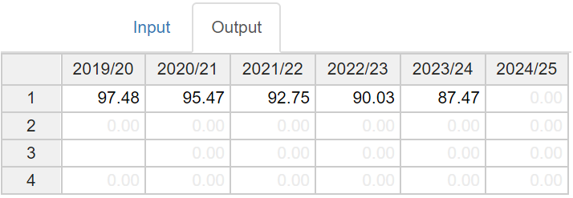
Indexation Tool: Deflator Calculator
Previous error has been ignored and generates a blank cell.
Output data will be automatically calculated based on the inputs and the user parameters selected. Note that:
Parameters can also be edited on the Output tab to allow for quick comparisons/changes;
A download option is available to save the inputs, outputs, and to record the conversion factors used.
For more information, please see the in-app guidance

Slide 15
Indexation Tool: Deflator Calculator
Interpretation is based on the user parameters, such that:
Conversion:
Real-to-Nominal: input will be assumed to be in real terms (i.e. exclude inflation); such that output will be in nominal terms (i.e. include inflation).
Nominal-to-Real: input will be assumed to be in nominal terms; such that output will be in real terms. Note that this is the example.
For more information, please see the in-app guidance

Slide 16
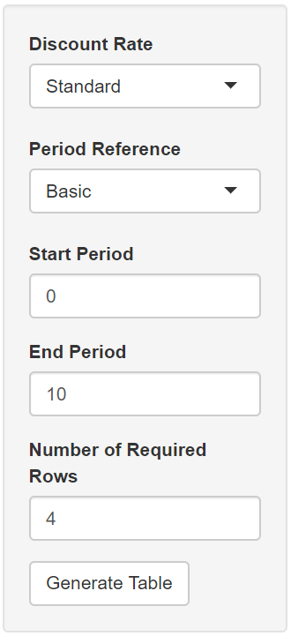
Indexation Tool: Discounting
A choice between the two HMT recognised discount rates (Standard, and Health).
A dropdown list of available period references. It does not impact the outputs, it is for visual purposes only. Note that ‘Basic’ is the default.
Required to generate the correct table dimensions. Note that the start period is equivalent to the ‘base period’, as it will not be discounted.
How many rows are required (allows for multiple costs to be discounted at once).
Button that updates the displayed table based on selected parameters.
For more information, please see the in-app guidance

Slide 17
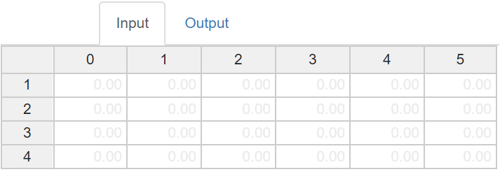
Indexation Tool: Discounting
Operates similarly to the Deflator Calculator. Note that all data input in this tool must be in real terms or the outputs (Net Present Costs) will not be correct.
For more information, please see the in-app guidance

Slide 18
Daniel White
daniel.white@justice.gov.uk

