Slide 1
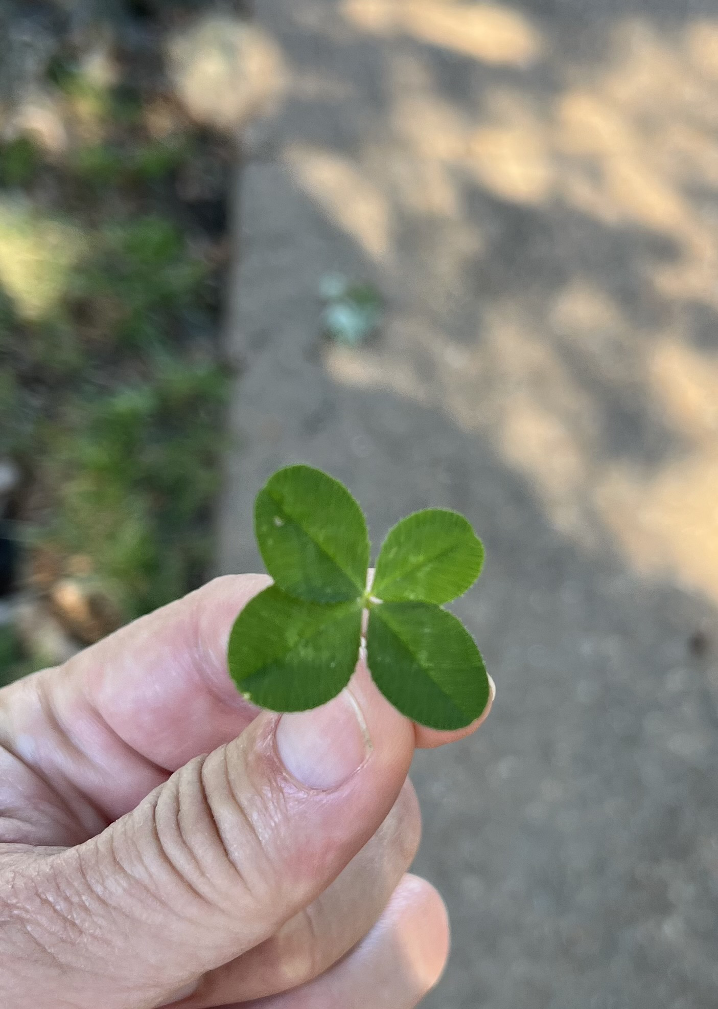
Genetic Fortune Decoded: Using LLMs to Discover Four-Leaf Clover Secrets
A Journey into the Genetics of Luck with AI

Slide 2
Introduction
Brief overview of the significance of four-leaf clovers.
Mention the role of genetics in determining the four-leaf trait.
Introduce the use of AI and LLMs in genetic research.

Slide 3
Four-Leaf Clover and Genetics

Slide 4
The Role of AI and LLMs

Slide 5
Identifying Candidate Genes
- **Gene 1**: Description, location
- **Gene 2**: Description, location
- **Gene 3**: Description, location

Slide 6
Python Code Snippets
# Sample code to fetch gene sequences
from Bio import Entrez, SeqIO
def fetch_sequence(gene_id):
Entrez.email = 'your.email@example.com'
handle = Entrez.efetch(db='nucleotide', id=gene_id, rettype='fasta', retmode='text')
return SeqIO.read(handle, 'fasta')

Slide 7
Data Analysis with AI

Slide 8
Results and Findings

Slide 9
Conclusion
Summarize findings with infographics.
Visual representation of the genetic analysis process.

Slide 10
Questions and Discussion
Open floor for questions.
Engage with the audience.

