Slide 1
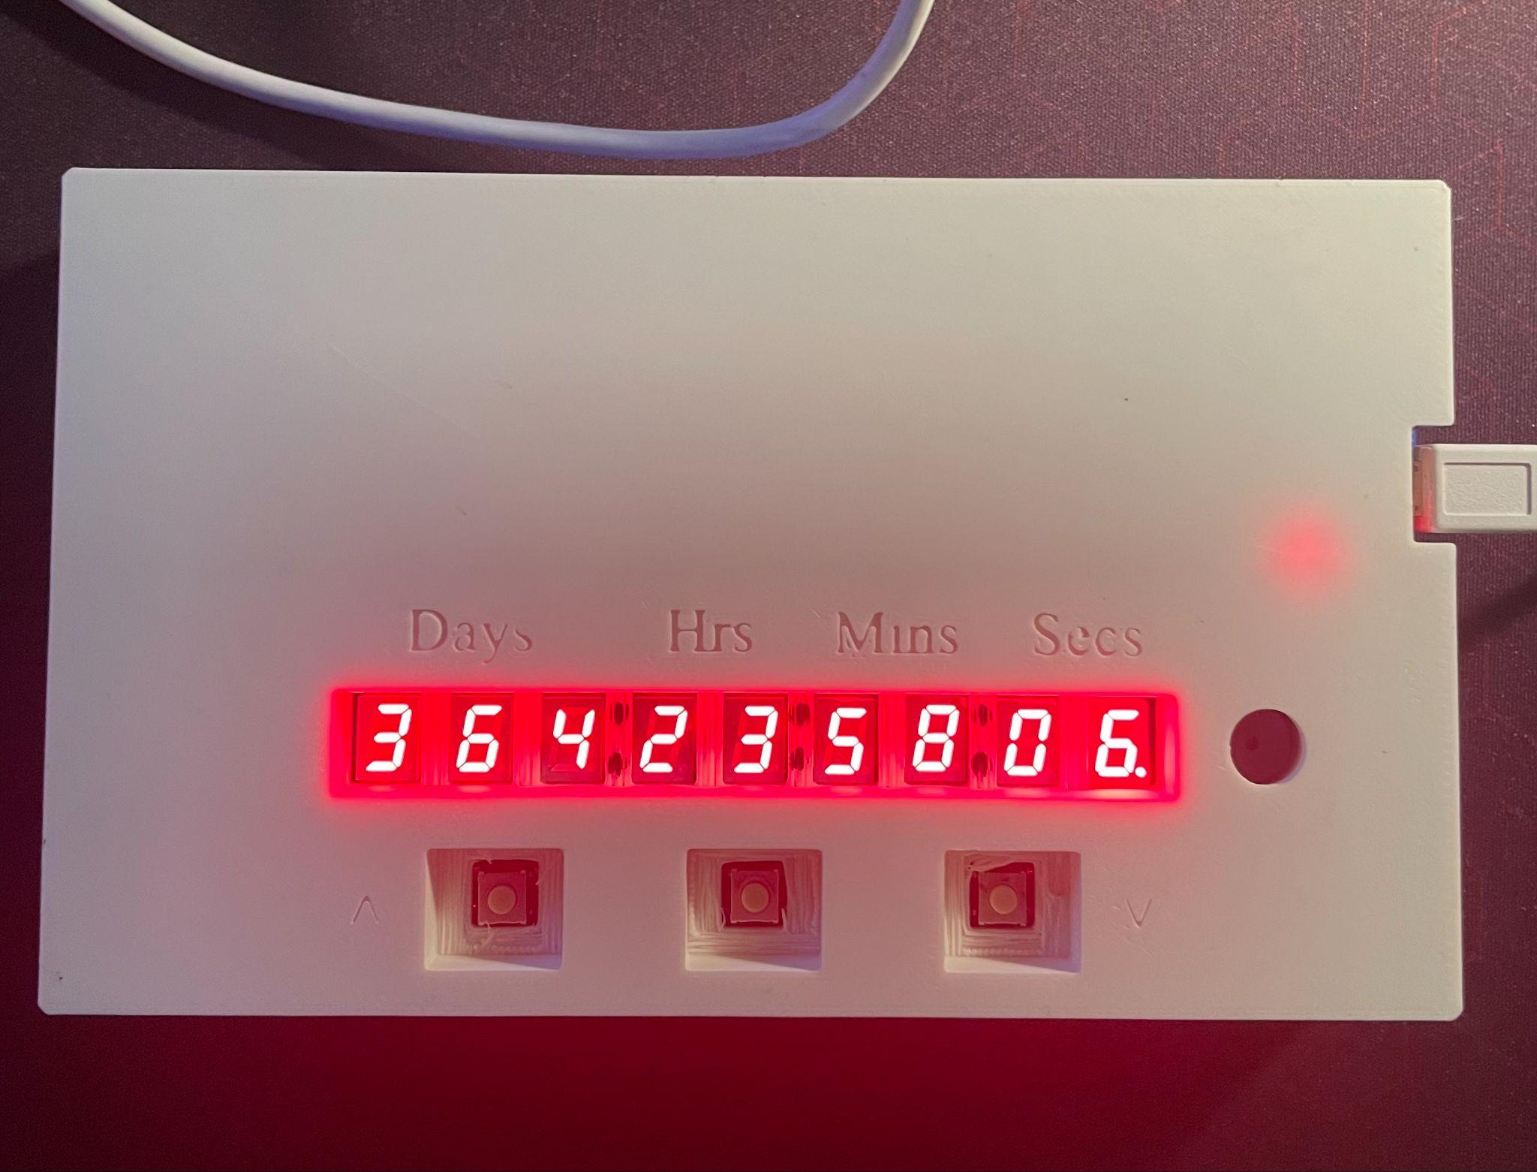
Birthday Countdown Timer
By Joseph Cabrera

Slide 2
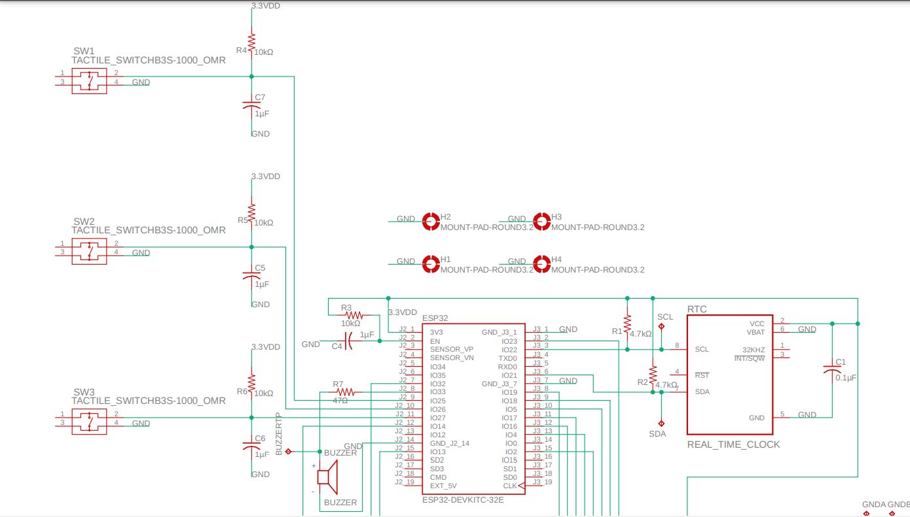
Schematic Diagram Pt. 1
ESP32-Devkit
3 Pushbuttons
Buzzer
Real-Time Clock
Grounded Mounting Holes

Slide 3
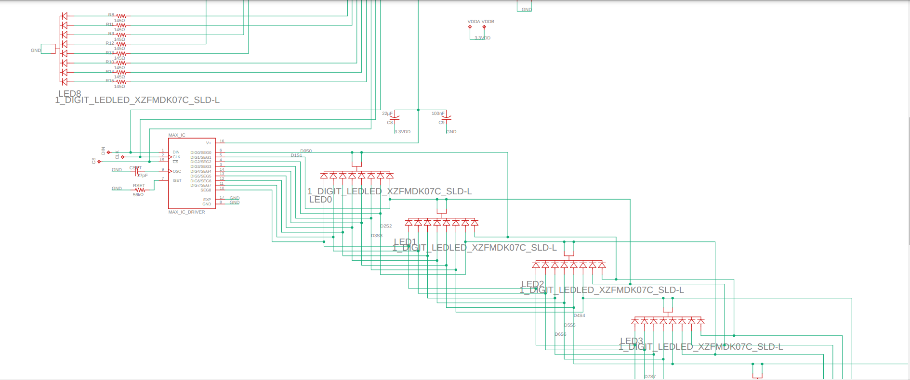
Schematic Diagram Pt.2
…
7-segment LED connected directly to ESP32-Devkit
Display Driver
Eight 7-segment LEDs driven by display driver

Slide 4
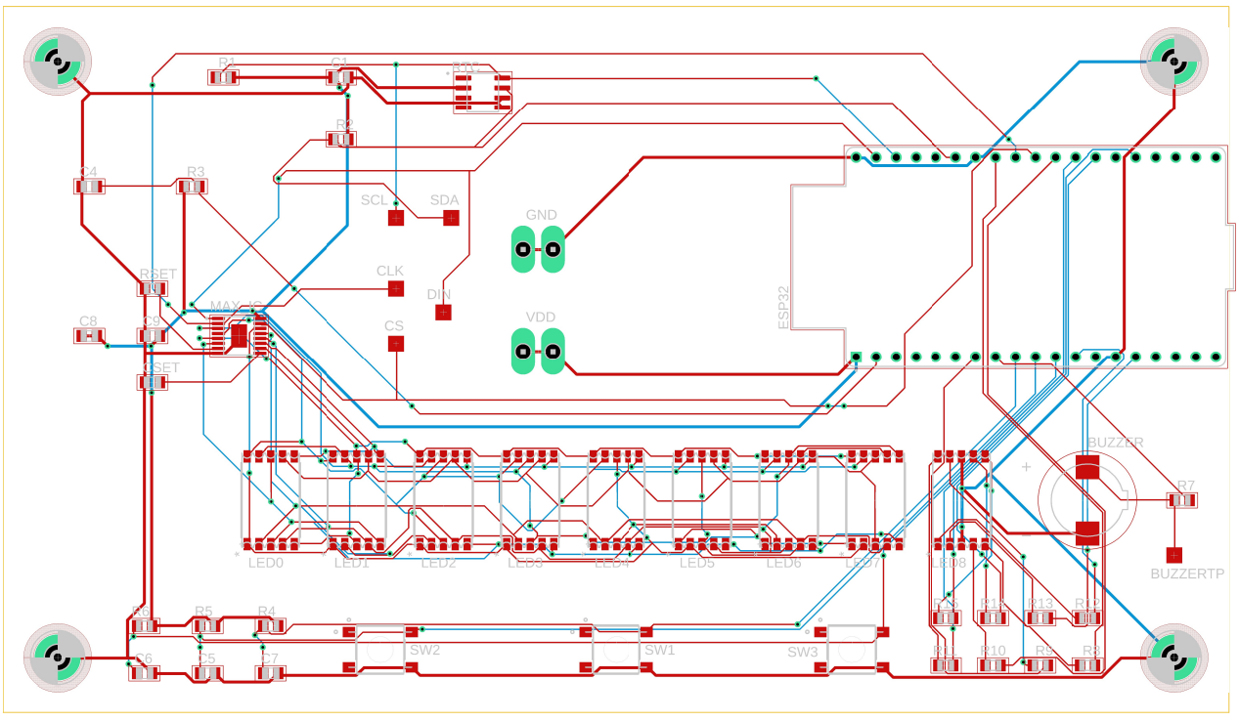
Board Layout
ESP32-Devkit
Real-Time Clock
Display Driver
Nine 7-segment LEDs
Three Pushbuttons
Buzzer
Test Points

Slide 5
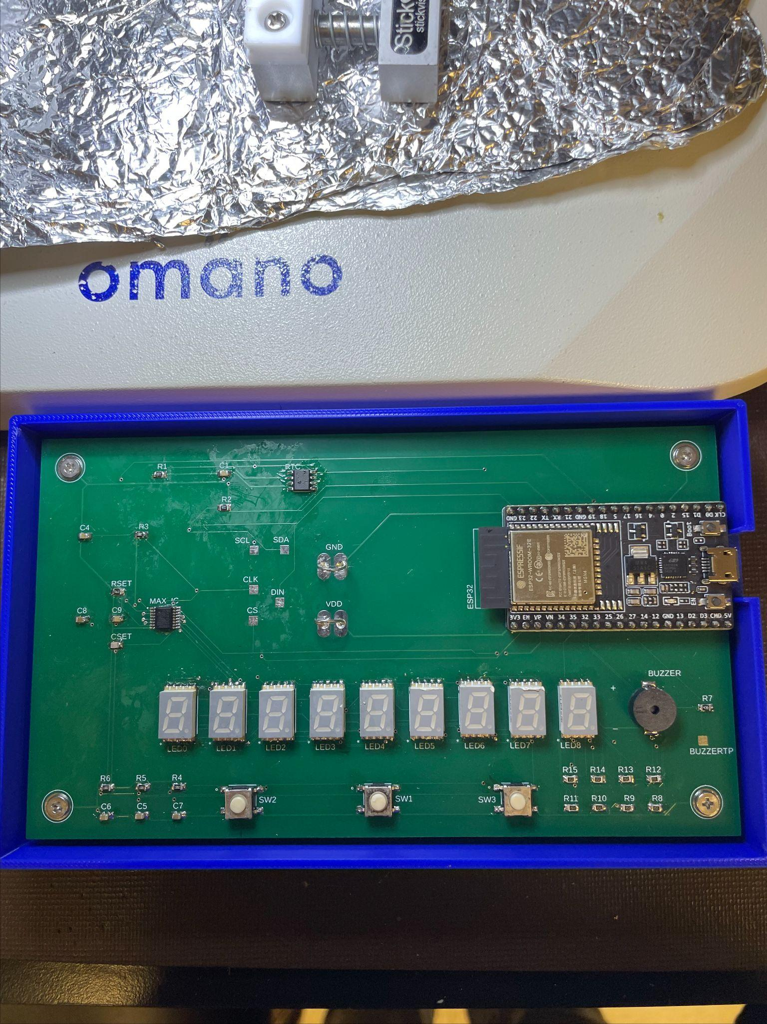
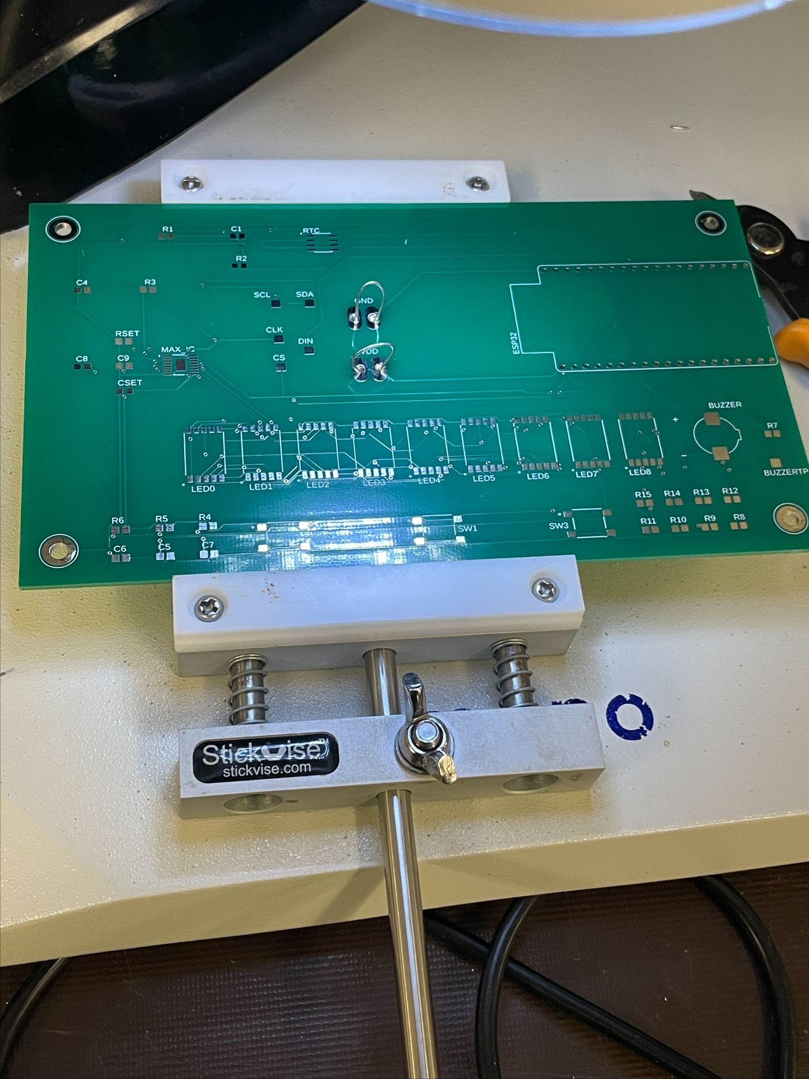
Board Photos

Slide 6
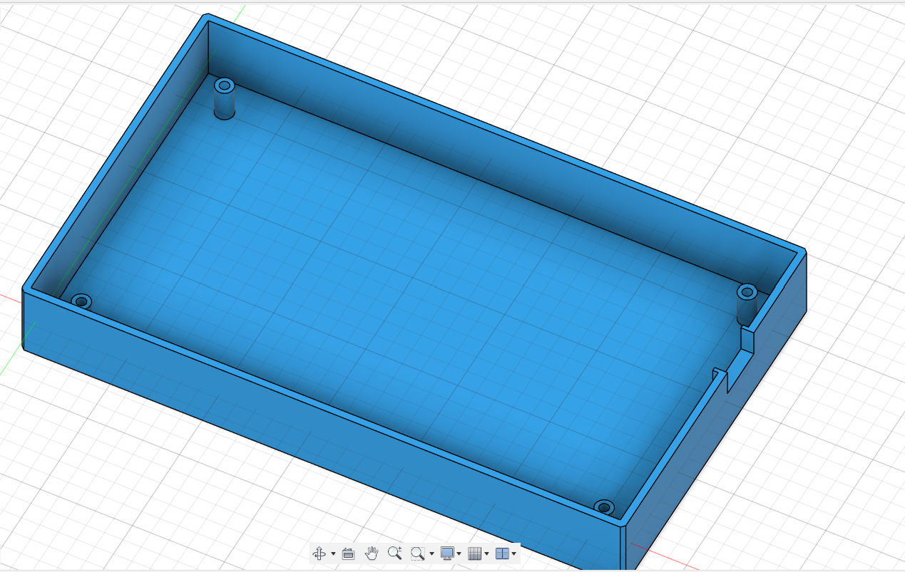
Case Design (Bottom)
Four screw holes diameter of 2.6mm
Micro USB insert hole

Slide 7
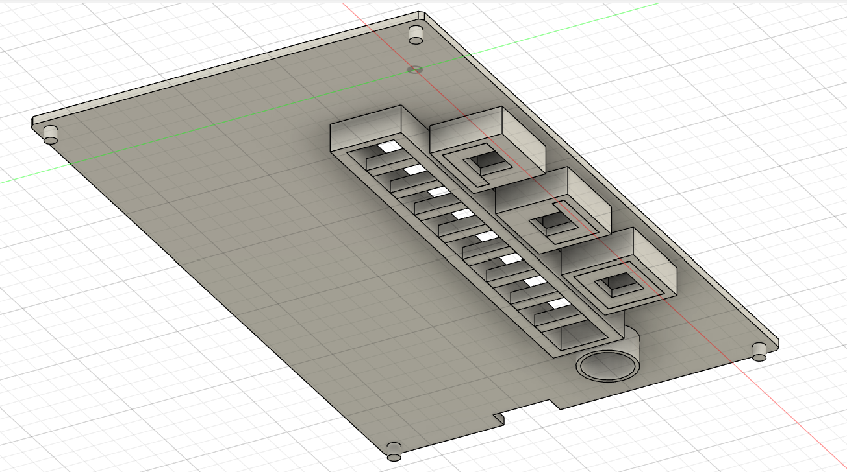
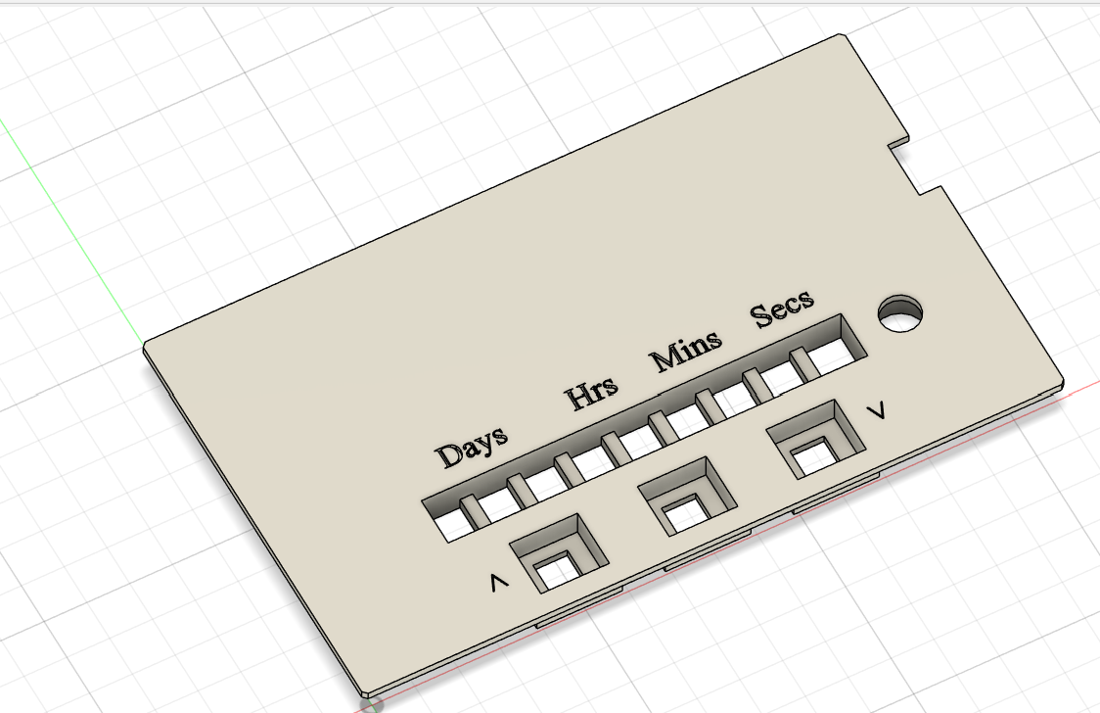
Case Design (Top)
Four tangential pins for connecting to the bottom
Holes for 7-segment LEDs
Holes for pushbuttons
Hole for the buzzer
Some text
Indent for micro USB

Slide 8
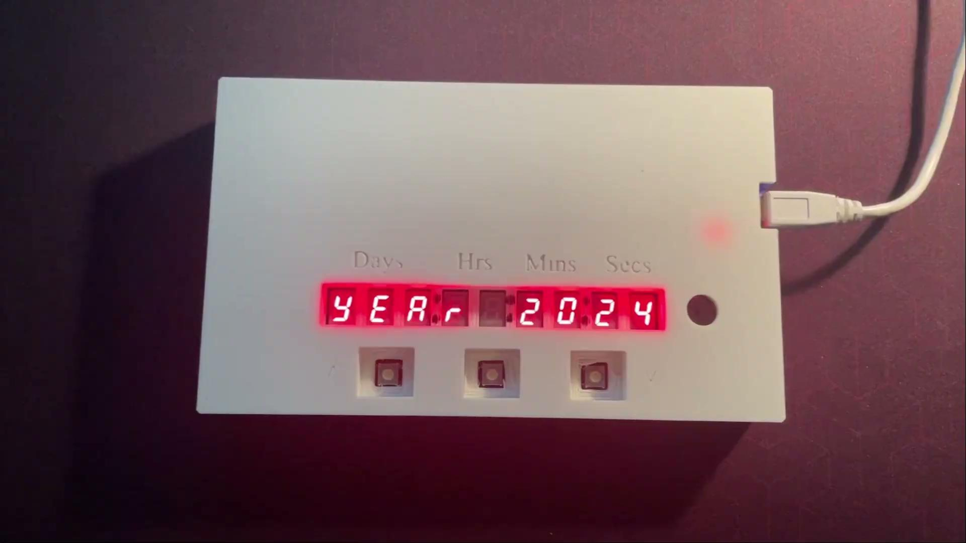
Results

