Slide 1
Classifying Luxury Homes Using Random Forest Based on Housing and Neighborhood Features
Presented by Joseph Emmanuel Cayetano
D606 Data Science Capstone Task 3 Presentation
May 1, 2025

Slide 2
Introduction
My name is Joseph Emmanuel Cayetano.
Data science student at WGU.
Capstone Project Goal: To build a machine learning model that predicts whether a home is classified as luxury based on housing and neighborhood features.
Why: Accurate classification helps real estate professionals make faster, better decisions.

Slide 3
Problem and Hypothesis
Problem Statement: Real estate agencies need a faster and more reliable way to classify luxury homes. Manual classification is inconsistent and time-consuming.
Research Question: To what extent do housing features and neighborhood characteristics influence whether a home is classified as luxury, based on a Random Forest model?
Hypothesis:
Null Hypothesis: Housing features and neighborhood details do not allow the model to classify homes as luxury with an accuracy of 70% or higher (model accuracy < 70%).
Alternate Hypothesis: Housing features and neighborhood details allow the model to classify homes as luxury with an accuracy of 70% or higher (model accuracy ≥ 70%), and some features contribute more than others to the classification.

Slide 4
Data Analysis Process
Loaded and reviewed the housing dataset (7,000 homes, 22 features).
Checked for missing values and removed unnecessary columns.
Encoded categorical features using label encoding.
Split the data into training, validation, and test sets (60%, 20%, 20%).
Trained an initial Random Forest model.
Tuned hyperparameters using GridSearchCV with 5-fold cross-validation.
Evaluated the optimized model on the test dataset.
Analyzed feature importance to identify key housing and neighborhood factors.

Slide 5

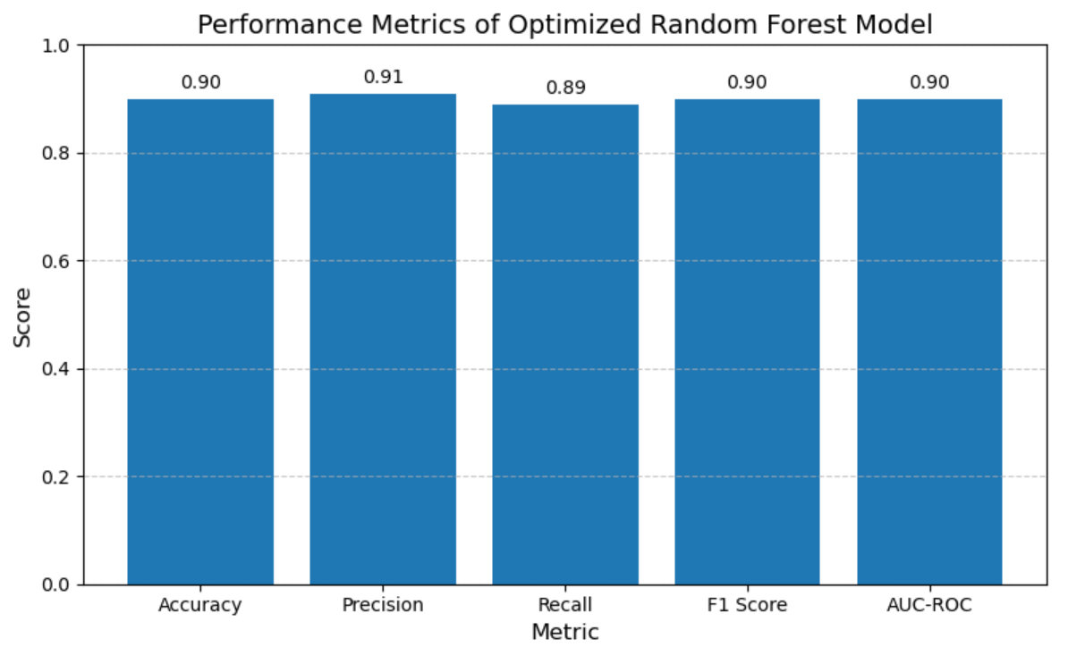
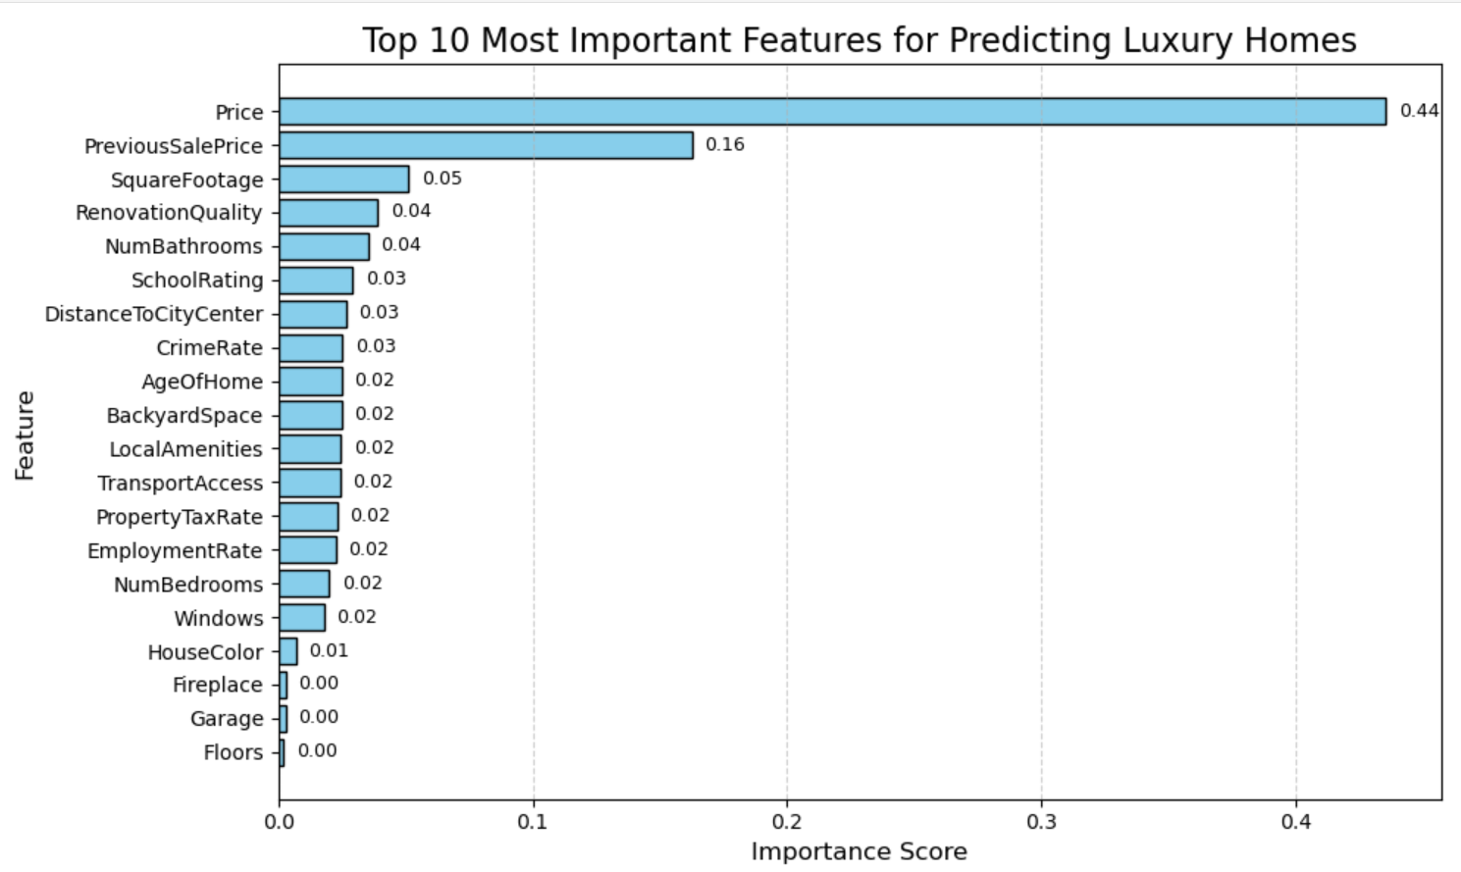
Findings
The optimized Random Forest model achieved 90% accuracy on the test dataset.
Precision: 91%, Recall: 89%, F1 Score: 90%, AUC-ROC: 90%.
The results support the alternate hypothesis (accuracy ≥ 70%).
Price, Previous Sale Price, Square Footage, and Renovation Quality were the most important features.
Features like Fireplace, Garage, and Floors had very little impact.
The model generalizes well with no signs of overfitting.

Slide 6
Limitations of Techniques and Tools
The Random Forest model can be “challenging to interpret compared to simpler models” (Easily, 2024, para. 41).
Hyperparameter tuning with GridSearchCV can be time consuming because it “evaluates all possible combinations of hyperparameters” (Soni, 2025, para. 19).
Feature importance does not capture interactions between features.
Label encoding can oversimplify categorical variables with many unique categories (like HouseColor).

Slide 7
Proposed Actions
Use the Random forest model to automatically classify homes as luxury or not based on housing and neighborhood features.
Save time and improve consistency by reducing manual home classification.
Focus marketing and pricing strategies on key features like price, square footage, renovation quality, and previous sale price.
Builders and developers should prioritize features that increase luxury classification, such as large square footage and high-quality renovations.

Slide 8
Expected Benefits
Reduce manual home classification time by up to 90% using the Random Forest model
Improve consistency and reliability in luxury home classification decisions
Help real estate agencies market and price homes more effectively by focusing on key features
Enable builders and developers to design homes that better meet luxury buyer expectations
Support faster property listing and decision-making processes on real estate platforms

Slide 9
References
Soni, P. (2025, March 4). Tuning Random Forest with Grid Search. Train in Data. https://www.blog.trainindata.com/random-forest-with-grid-search/
Easily, L. S. (2024, March 29). Random Forest in Practice: An Essential Guide. LEARN STATISTICS EASILY. https://statisticseasily.com/random-forest/

