Slide 1
Cryptographic Schemes under Quantum Supremacy and IoT
National Taipei University
Assistant Professor
Shiu, Hung-Jr (許宏誌)

Slide 2
Outline
Threats
Solutions

Slide 3
Threats
Quantum Supremacy
  Shor’s Algorithm
    Threats to public-key crypto-systems
  Grover’s Algorithm
    Security-level shrinkage of private-key crypto-systems
Internet Of Things
  Side-Channel Attack for private-key crypto-systems

Slide 4
Shor’s Algorithm
  Input: an odd composite number N with n bits
  Output: a non-trivial factorization of N with some probability
  quantum parallelism
  Reduce to order-finding problem
Big number N
Order-finding
solution
Factor of N
Quantum
Computer
Classical
Computer

Slide 5
Complexity
Modular exponential: 𝚹(n³)
Quantum Fourier Transform (QFT):𝚹(n²)
Succeed probability: 𝛀(1/log n)
Total time complexity is O(n³log n).
Need 3n qubits in total.

Slide 6
Q. Threats
algorithm\security | 2⁸⁰ | 2¹¹² | 2¹²⁸ | 2¹⁹² | 2²⁵⁶
RSA key length (bits) | 1024 | 2048 | 3072 | 7680 | 15360
ECC key length (bits) | 160 | 224 | 256 | 384 | 512
Key length ratio | 6:1 | 9:1 | 12:1 | 20:1 | 30:1
RSA signature length (bytes) | X | X | 384 | 960 | 1920
ECDSA length (bytes) | X | X | 64 | 96 | 132
qubits to break (RSA) | 3072 | 6144 | 9216 | 23040 | 46080
qubits to break (ECC) | 480 | 672 | 768 | 1152 | 1536
Google and IBM now have 50~70 qubits

Slide 7
Standards
NIST Crypto standards
Public key based
Symmetric key based
Guidelines
Signature (FIPS 186)
AES (FIPS 197 )
TDEA (800-67)
Hash usage/security (800-107)
Modes of operations (800 38A-38G)
Transition (800-131A)
Key establishment (800-56A/B/C)
Key generation (800-133)
SHA-1/2 (FIPS 180) and SHA-3 (FIPS 202)
Key management (800-57)
Tools
Randomized hash (800-106)
RNG (800-90A/B/C)
HMAC (FIPS 198)
KDF (800-108, 800-135)
SHA3 derived functions (parallel hashing, KMAC, etc. (800-185)
Hung-Jr, Shiu Ph. D

Slide 8
The impact
NIST Crypto standards
Public key based
Symmetric key based
Guidelines
Signature (FIPS 186)
AES (FIPS 197 )
TDEA (800-67)
Hash usage/security (800-107)
Modes of operations (800 38A-38G)
Transition (800-131A)
Key establishment (800-56A/B/C)
Key generation (800-133)
SHA-1/2 (FIPS 180) and SHA-3 (FIPS 202)
Key management (800-57)
Tools
Randomized hash (800-106)
RNG (800-90A/B/C)
HMAC (FIPS 198)
KDF (800-108, 800-135)
SHA3 derived functions (parallel hashing, KMAC, etc. (800-185)
Hung-Jr, Shiu Ph. D

Slide 9
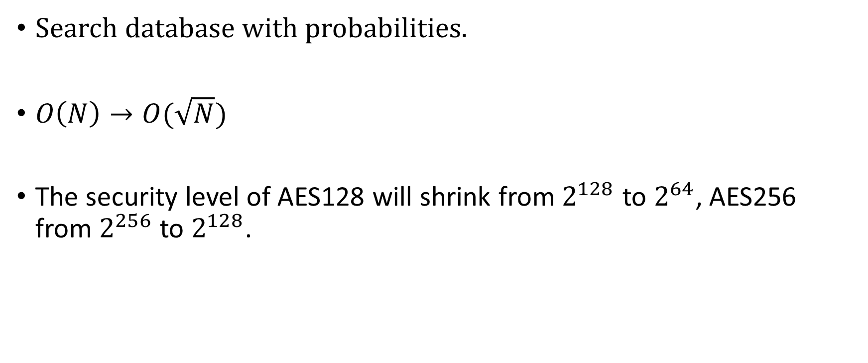
Grover’s Algorithm
Search database with probabilities.
$O\left(N\right)→O(\sqrt{N})$
The security level of AES128 will shrink from $2^{128}$ to $2^{64}$, AES256 from $2^{256}$ to $2^{128}$.

Slide 10
Security Level
Level | Security Description
I | At least as hard to break as AES128 (exhaustive key search)
II | At least as hard to break as SHA256 (collision search)
III | At least as hard to break as AES192 (exhaustive key search)
IV | At least as hard to break as SHA384 (collision search)
V | At least as hard to break as AES256 (exhaustive key search)
Only level I still survive under Grover’s algorithm.
Hung-Jr, Shiu Ph. D

Slide 11
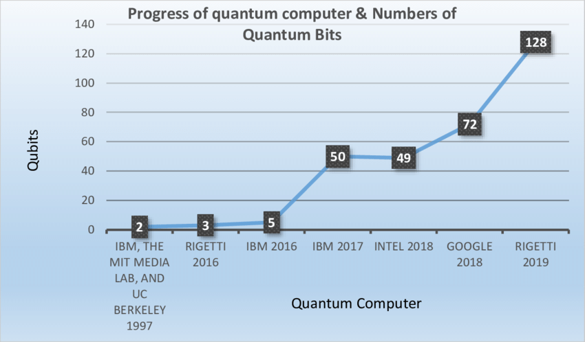
Qbits trend.

Slide 12
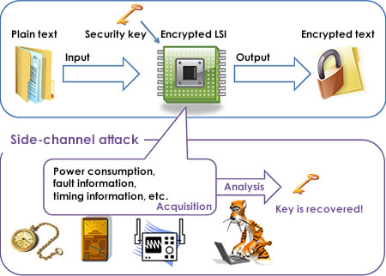
Side-channel attacks

Slide 13
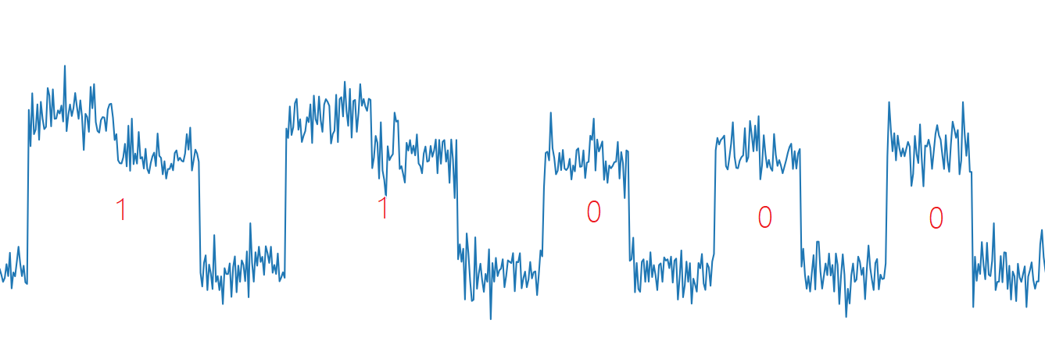
A RSA SCA example
Observing the multiplication

Slide 14
Solutions
For quantum computing:
  public-key crypto-systems:
    Post Quantum Cryptography
  private-key crypto-systems:
    AES 384/512 (extending the key length)
For side-channel attack in IoT:
  Customized AES
  Signal masking
  Pipeline

Slide 15
PQC Timeline
Aug 2016 – Draft submission requirements & evaluation criteria
Dec 2016 – Final requirements and criteria
Nov 2017 – Deadline for submissions
Apr 2018 – NIST PQC Workshop – submitters’ presentations
2018/2019 – 2nd Round begins (smaller number of submissions)
- minor changes allowed
Aug 2019 – 2nd NIST PQC Workshop
2020/2021 - Select algorithms or start a 3rd Round
2022-2024 - Draft standards available
NIST will release reports on progress and selection rationale

Slide 16
Submissions
 | Signatures | KEM/Encryption | Overall
Lattice-based | 5 | 21 | 26
Code-based | 2 | 17 | 19
Multi-variate | 7 | 2 | 9
Symmetric/Hash-based | 3 |  | 3
Other | 2 | 5 | 7
Total | 19 | 45 | 64

Slide 17
Round 3
Candidate: (7)
Key establishment
  Classic McEllece
  CRYSTALS-KYBER
  NTRU
  SABER
Digital signature
  CRYSTALS-DILITHIUM
  FALCON
  Rainbow
Alternative candidate: (8)
Key establishment
  BIKE
  FrodoKEM
  HQC
  NTRU Prime
  SIKE
Digital signature
  GeMSS
  Picnic
  SPHINCS+

Slide 18
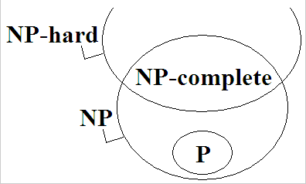
Hardness of problems
Hung-Jr, Shiu Ph. D

Slide 19
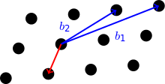
Lattice
Shortest Vector Problem (NP hard)
  Given basis of a vector space V and a lattice L with a norm N, find the shortest non-zero vector in V.
Hung-Jr, Shiu Ph. D

Slide 20
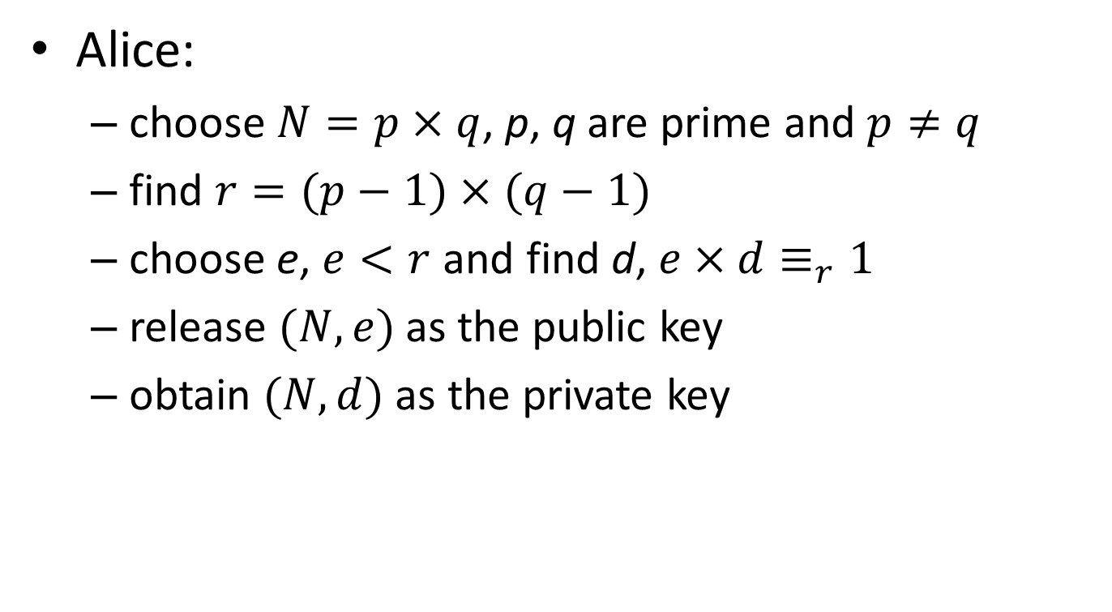
Recall RSA: Key Generation
Alice:
  choose $N=p×q$, p, q are prime and $p≠q$
  find $r=(p−1)×(q−1)$
  choose e, $e<r$ and find d, $e×d≡_{r}1$
  release $(N,e)$ as the public key
  obtain $(N,d)$ as the private key
Hung-Jr, Shiu Ph. D

Slide 21
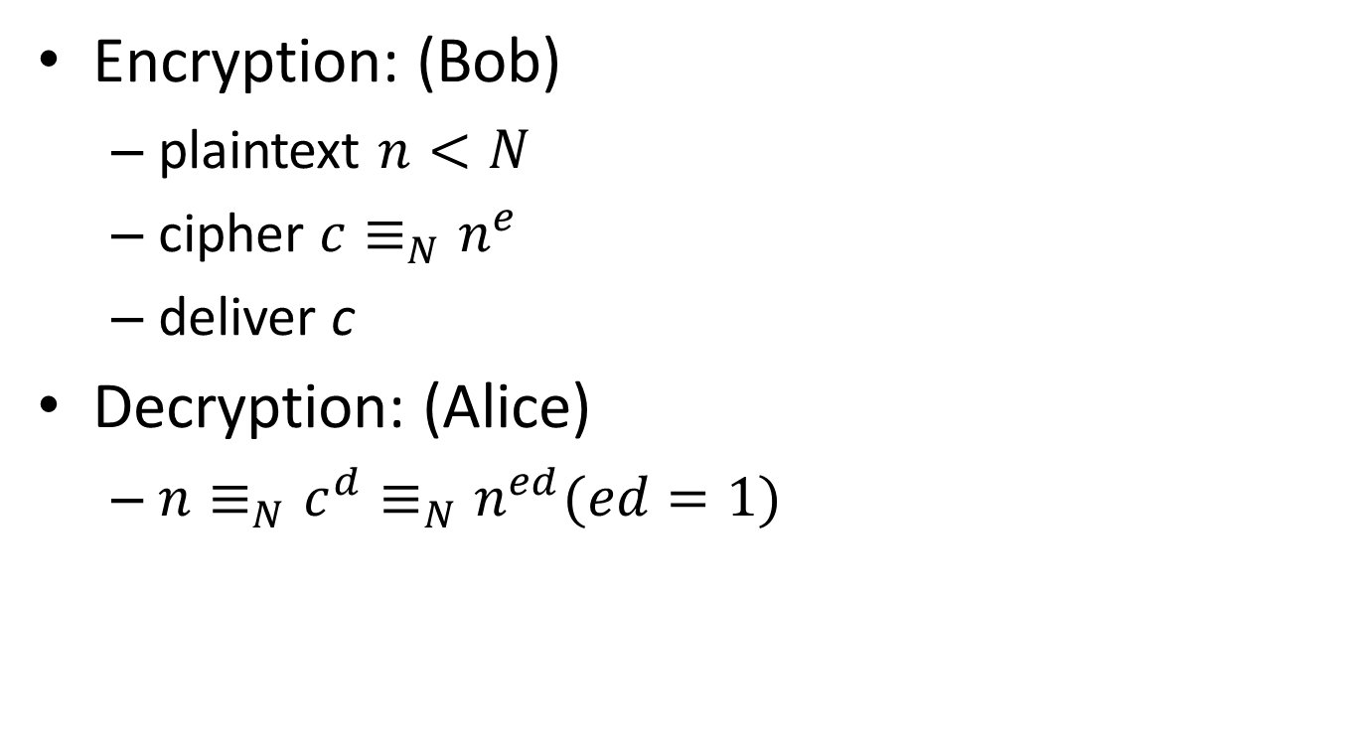
Recall RSA: Encryption/Decryption
Encryption: (Bob)
  plaintext $n<N$
  cipher $c≡_{N}n^{e}$
  deliver c
Decryption: (Alice)
  $n≡_{N}c^{d}≡_{N}n^{ed}(ed=1)$
Hung-Jr, Shiu Ph. D

Slide 22
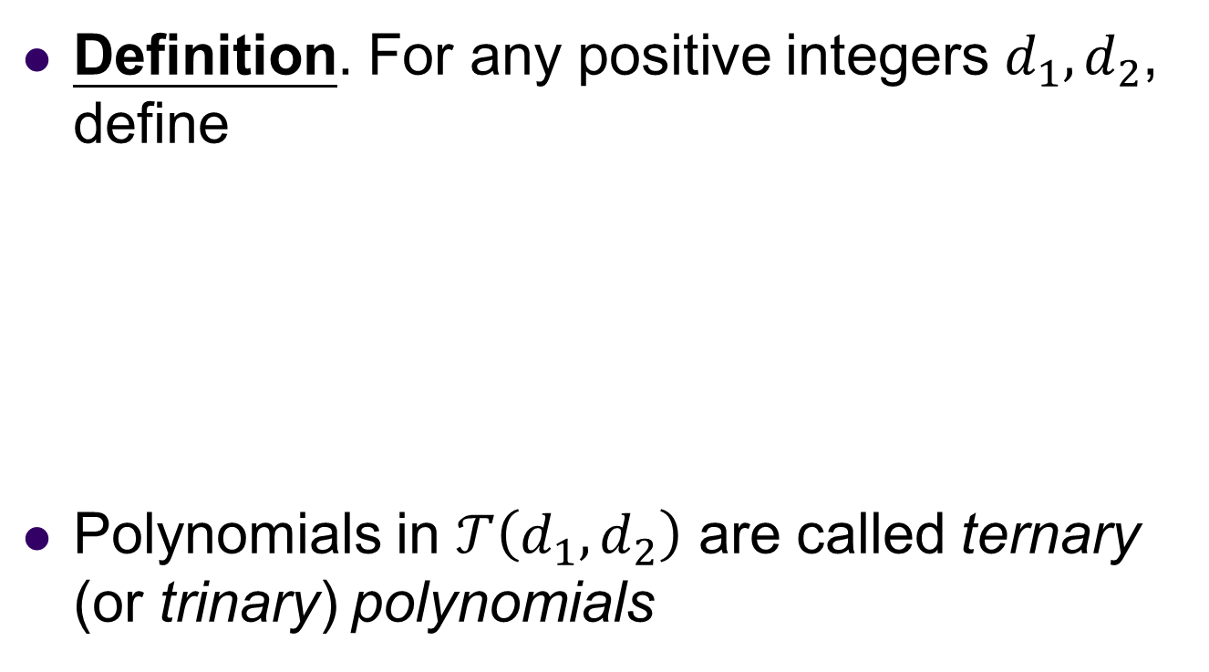
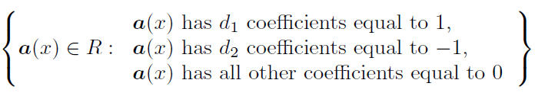
NTRUEncryption (1/9)
Hung-Jr, Shiu Ph. D

Slide 23
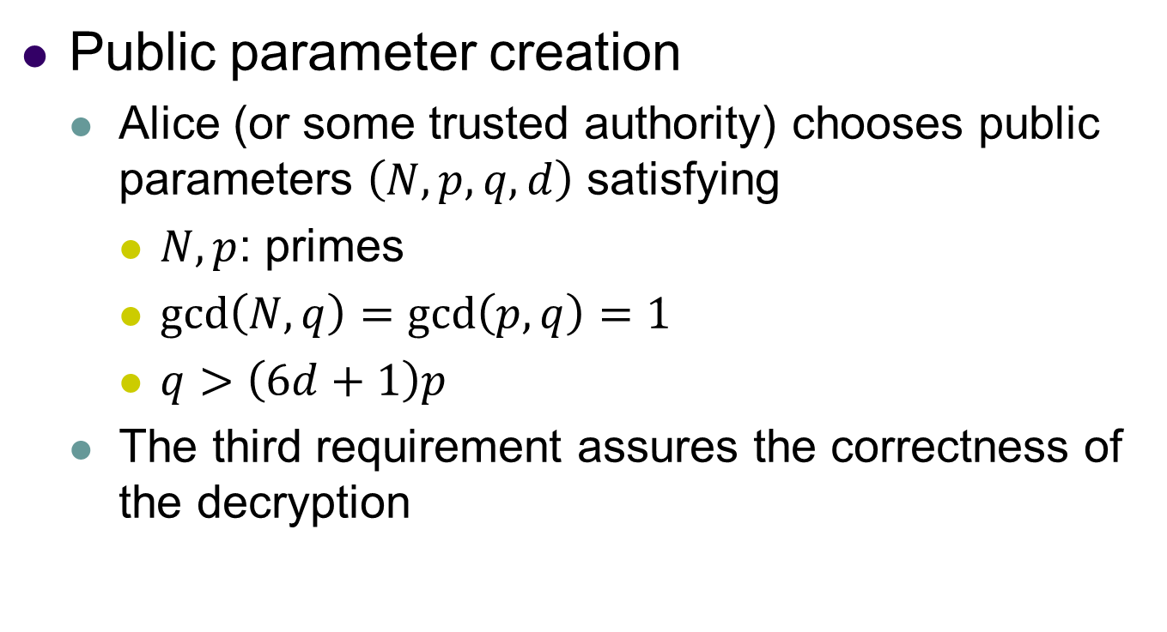
NTRUEncryption (2/9)
Hung-Jr, Shiu Ph. D

Slide 24
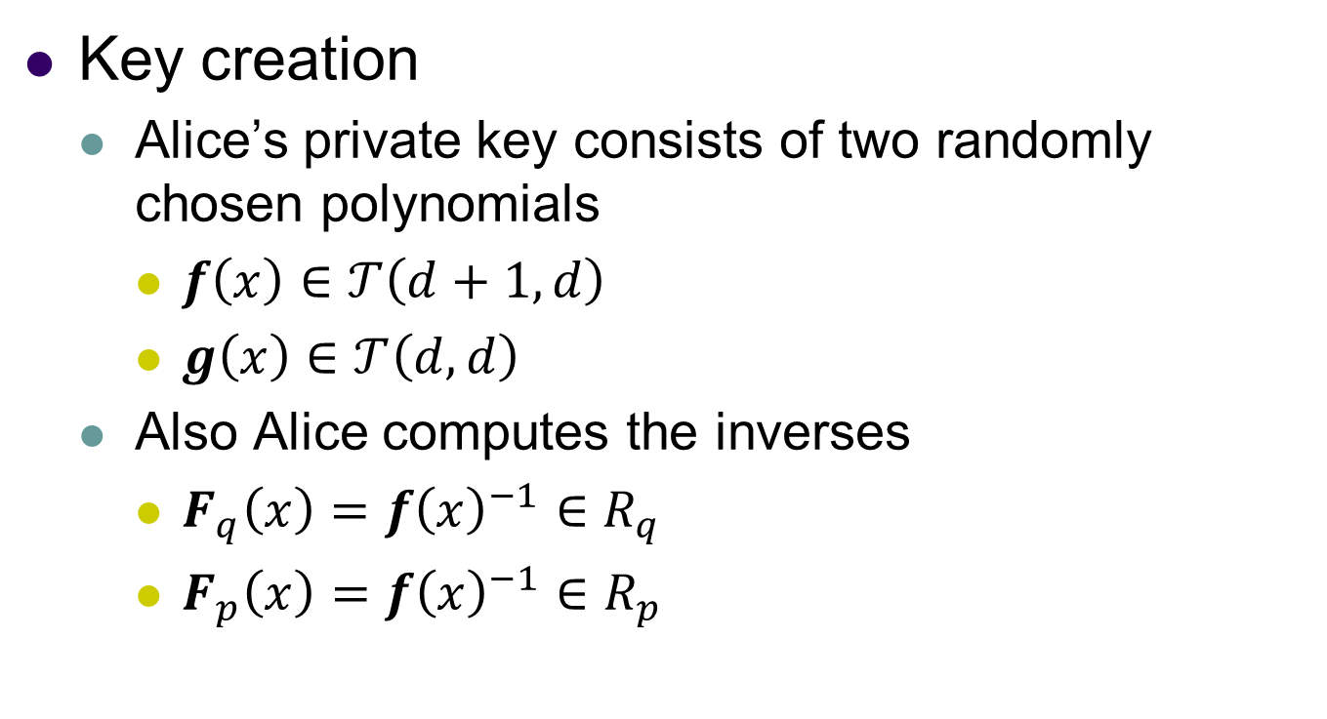
NTRUEncryption (3/9)
Hung-Jr, Shiu Ph. D

Slide 25
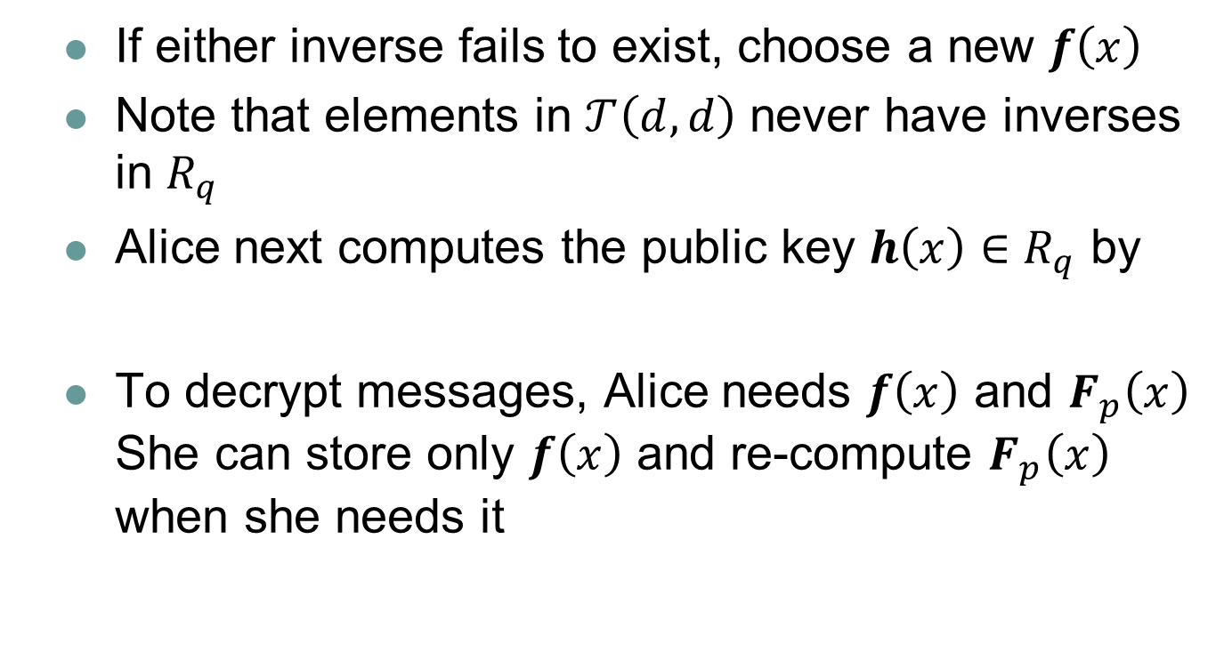

NTRUEncryption (4/9)
Hung-Jr, Shiu Ph. D

Slide 26
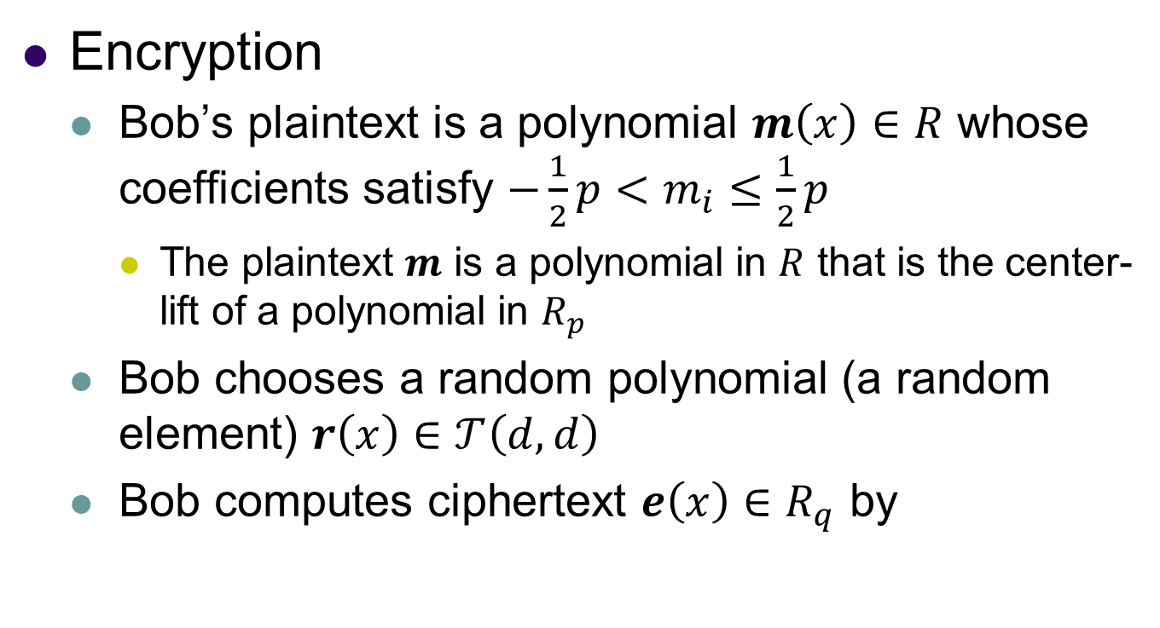
NTRUEncryption (5/9)
Hung-Jr, Shiu Ph. D

Slide 27
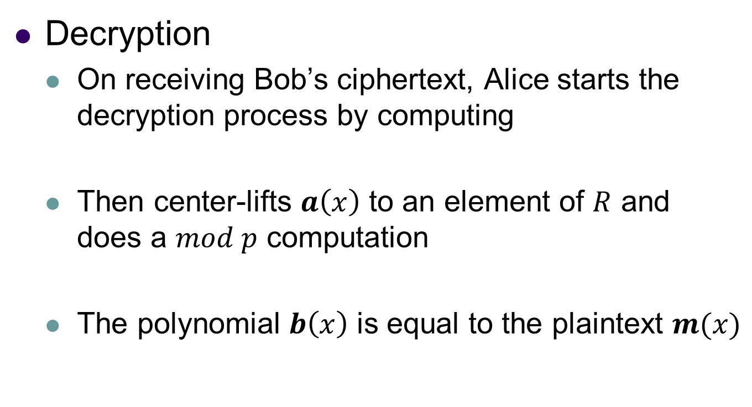


NTRUEncryption (6/9)
Hung-Jr, Shiu Ph. D

Slide 28
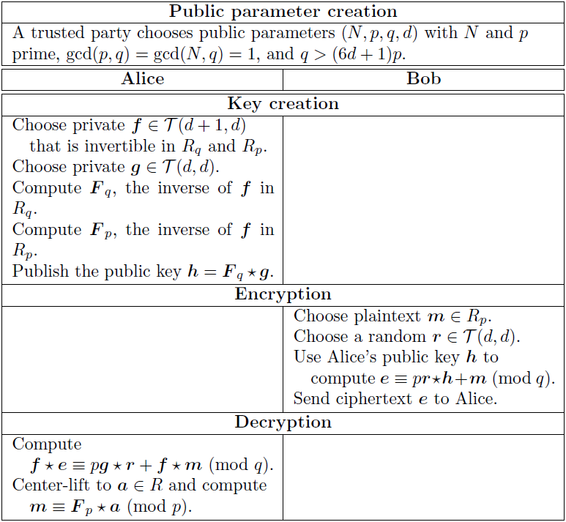
NTRUEncryption (7/9)
Hung-Jr, Shiu Ph. D

Slide 29

NTRUEncryption (8/9)
Even if the largest coefficient of g(x)∗r(x) happens to coincide with the largest coefficient of f(x) ∗ m(x), the largest coefficient of has magnitude at most
Hung-Jr, Shiu Ph. D

Slide 30
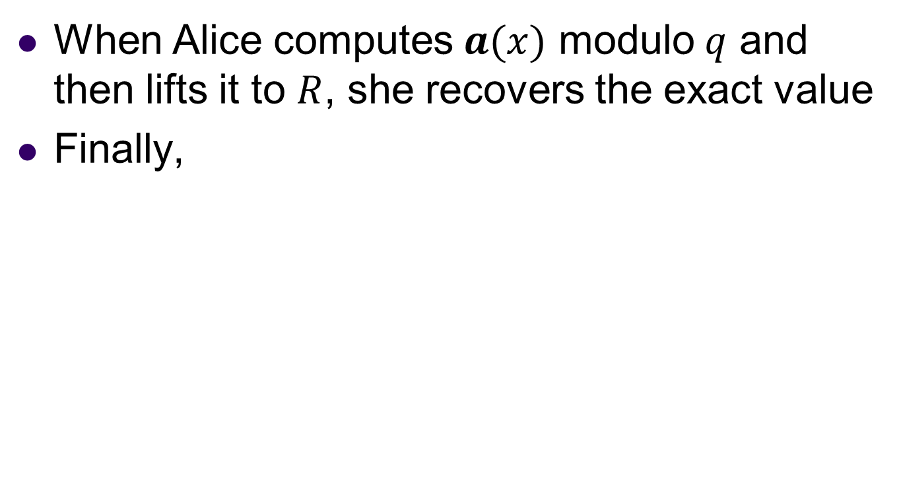
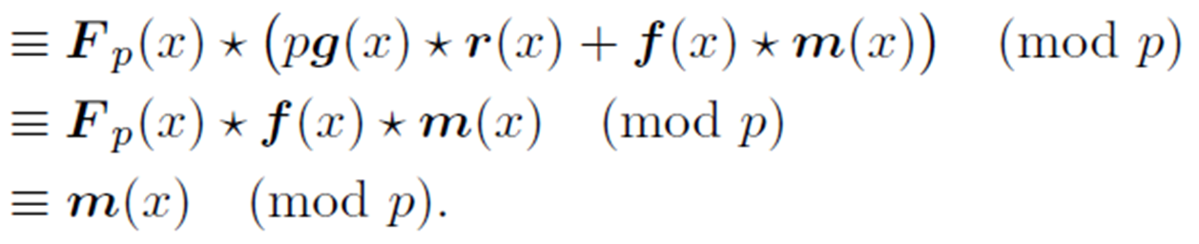
NTRUEncryption (9/9)
Hung-Jr, Shiu Ph. D

Slide 31
Lattice and NTRUEncryption
Finding g(x) and f(x) from h(x) is hard
h(x) can be seen as given basis, g(x) and f(x) can be seen as shortest vectors.

Slide 32
Code based
Coding problem is NP hard:
Input: A binary matrix H, a binary vector s and a nonnegative integer w.
Question: Is there a vector x of Hamming weight <= w such that Hx=s?
Hung-Jr, Shiu Ph. D

Slide 33
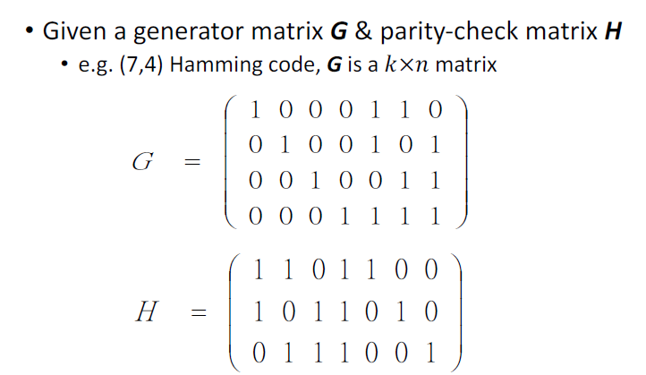
McEliece (1/13)
Hung-Jr, Shiu Ph. D

Slide 34
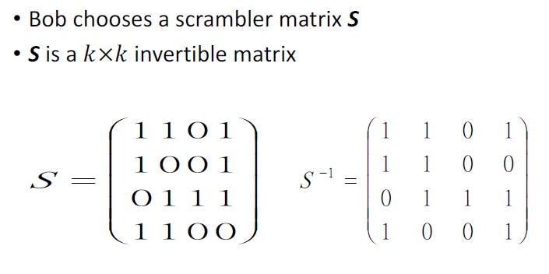
McEliece (2/13)
Hung-Jr, Shiu Ph. D

Slide 35
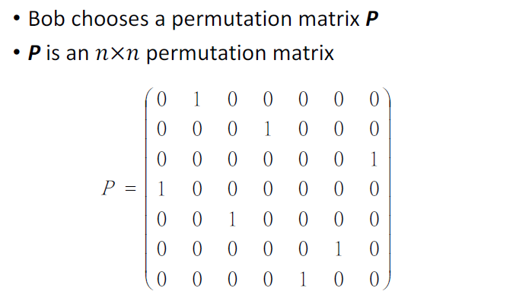
McEliece (3/13)
Hung-Jr, Shiu Ph. D

Slide 36
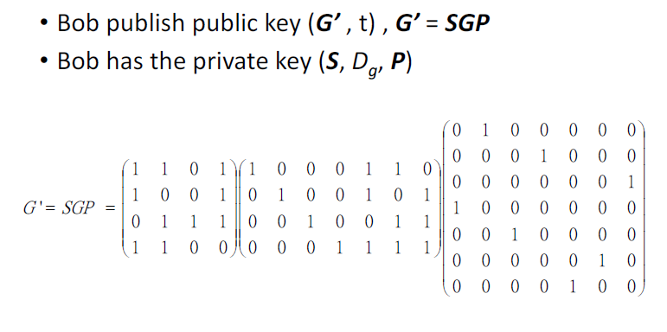
McEliece (4/13)
Hung-Jr, Shiu Ph. D

Slide 37
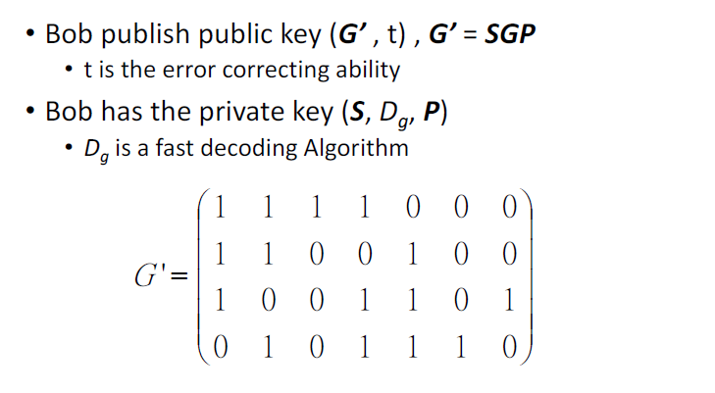
McEliece (5/13)
Hung-Jr, Shiu Ph. D

Slide 38
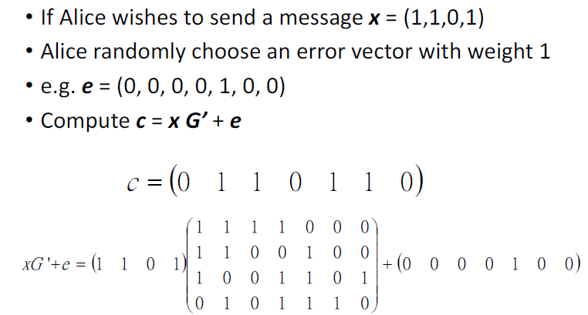
McEliece (6/13)
Hung-Jr, Shiu Ph. D

Slide 39
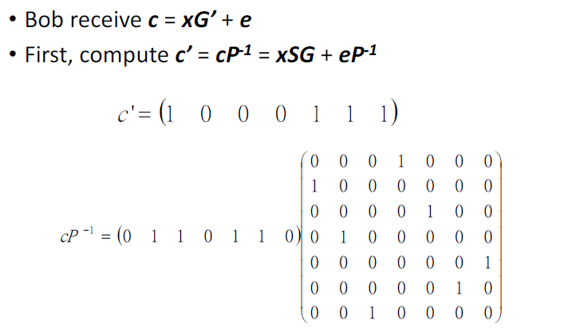
McEliece (7/13)
Hung-Jr, Shiu Ph. D

Slide 40
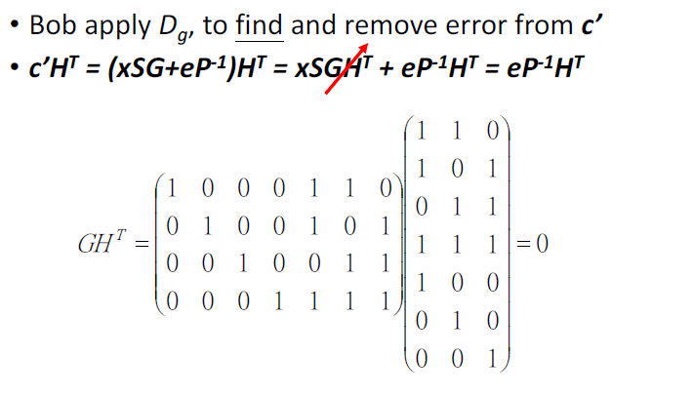
McEliece (8/13)
Hung-Jr, Shiu Ph. D

Slide 41
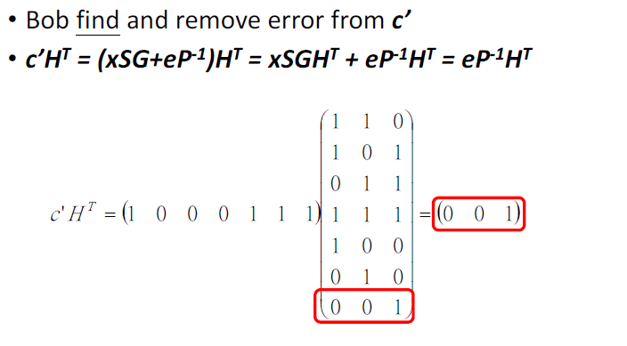
McEliece (9/13)
Hung-Jr, Shiu Ph. D

Slide 42
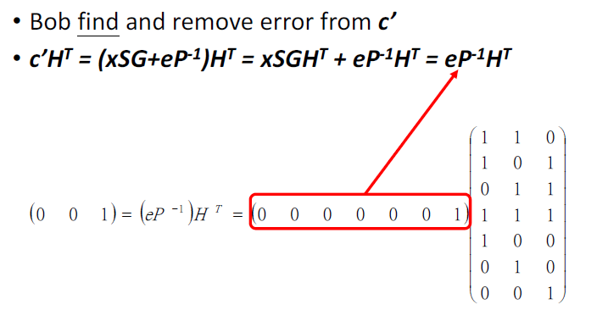
McEliece (10/13)
Hung-Jr, Shiu Ph. D

Slide 43
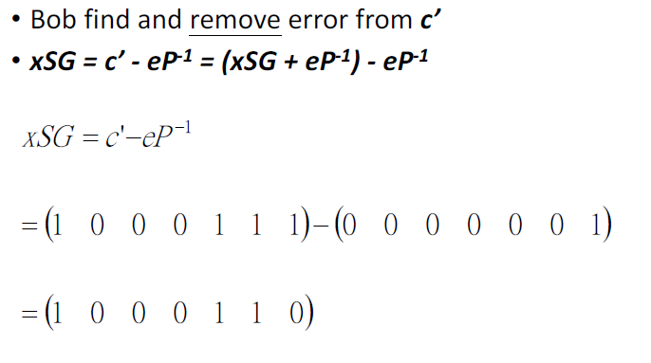
McEliece (11/13)
Hung-Jr, Shiu Ph. D

Slide 44
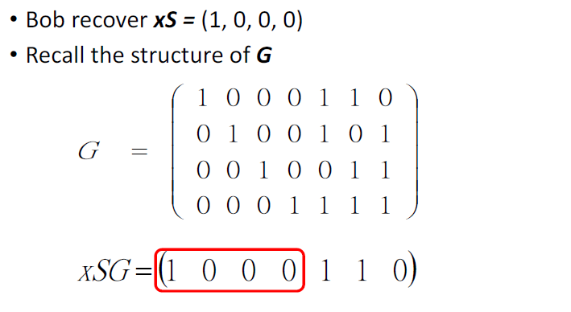
McEliece (12/13)
Hung-Jr, Shiu Ph. D

Slide 45
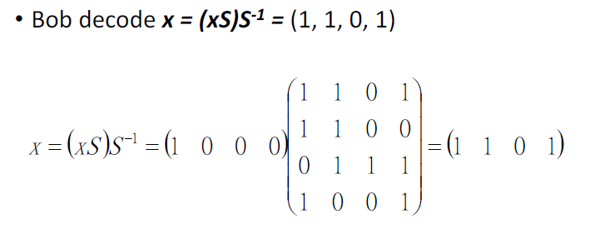
McEliece (13/13)
Hung-Jr, Shiu Ph. D

Slide 46
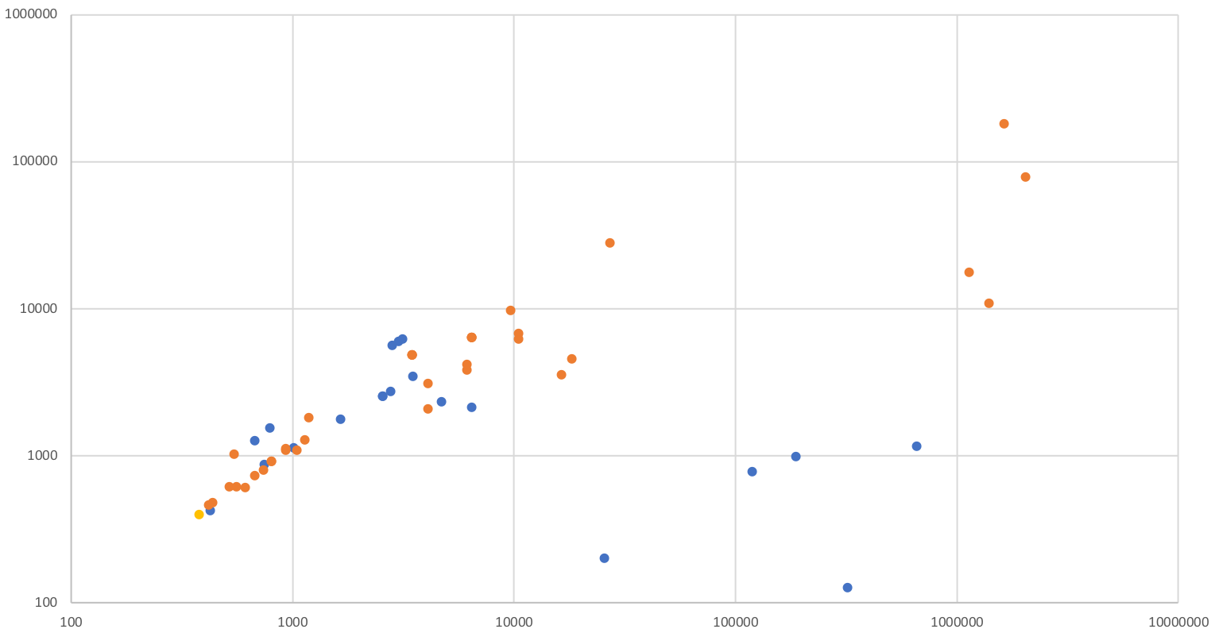
KEM/Encryption (Category 1)
Ciphertext Size (bytes)
Lattice Codes Other
Public Key Size (bytes)
Hung-Jr, Shiu Ph. D

Slide 47
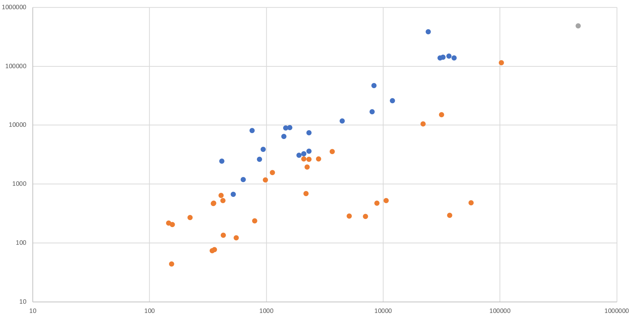
KEM/Encryption (Category 3) Performance
Dec Time (1000s of cycles)
Lattice Codes Other
Enc Time (1000s of cycles)
Hung-Jr, Shiu Ph. D

Slide 48
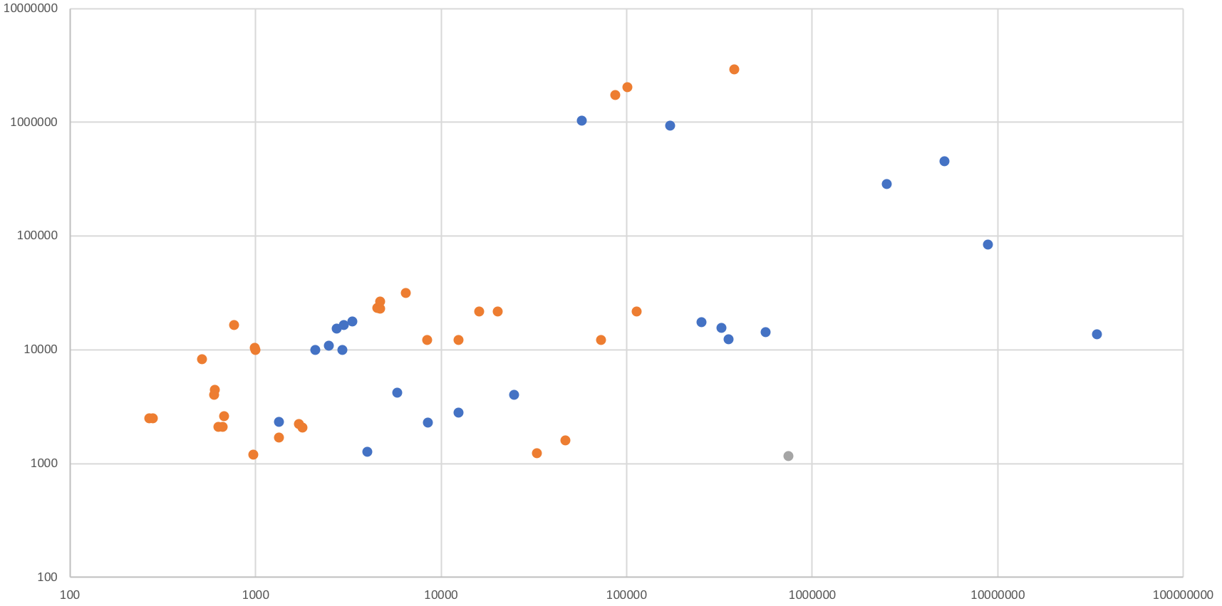
KEM/Encryption (Category 3) Performance by Size
Public Key + Ciphertext Size (bytes)
Lattice Codes Other
KeyGen + Enc Time (1000s of cycles)
Hung-Jr, Shiu Ph. D

Slide 49
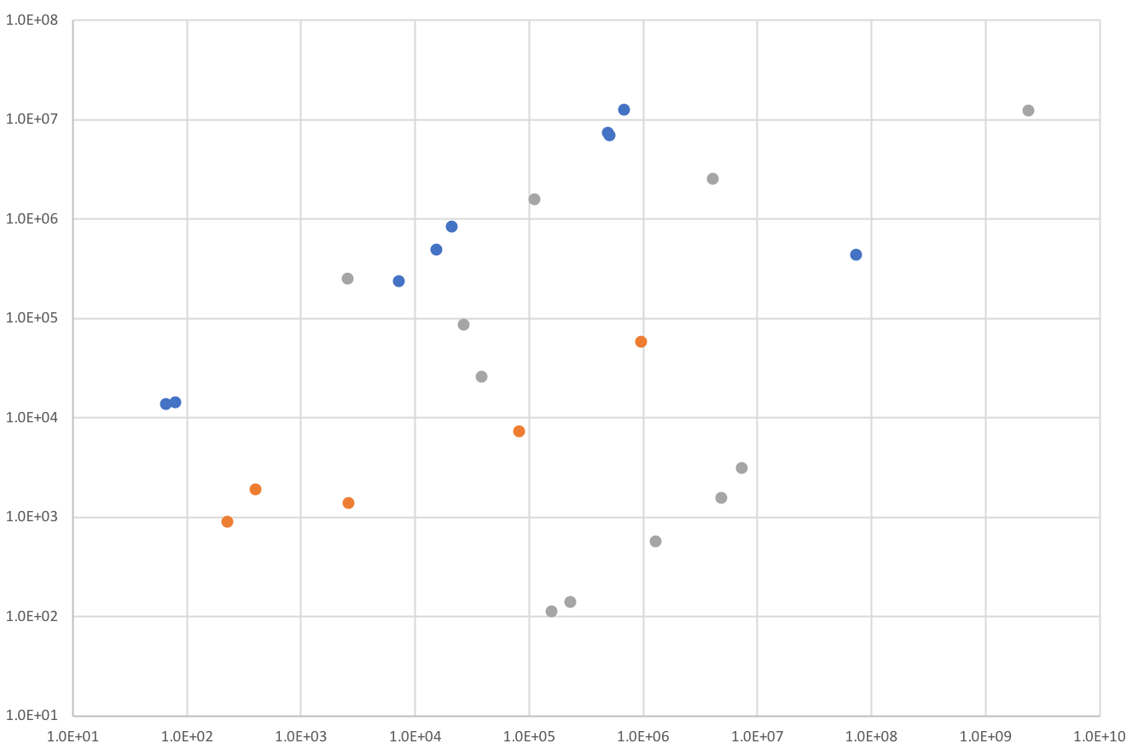
Signatures (Category 1) Performance
Signing Time (1000s of cycles)
Lattice Hash/Symmetric Multivariate
KeyGen Time (1000s of cycles)
Hung-Jr, Shiu Ph. D

Slide 50
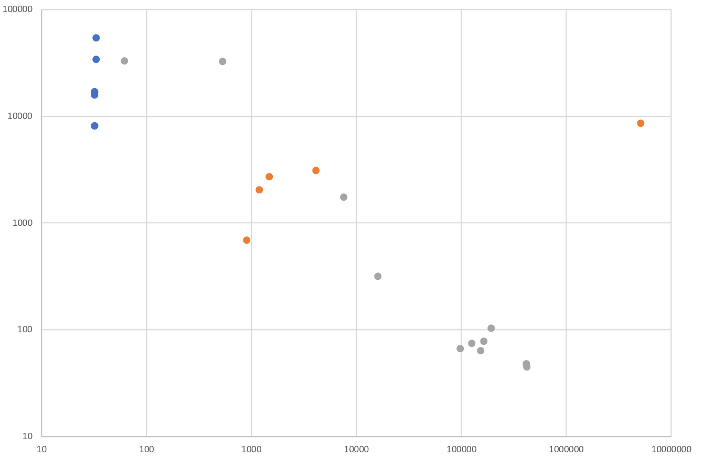
Signature (Category 1) Sizes
Signature Size (bytes)
Lattice Hash/Symmetric Multivariate
Public Key Size (bytes)
Hung-Jr, Shiu Ph. D

Slide 51
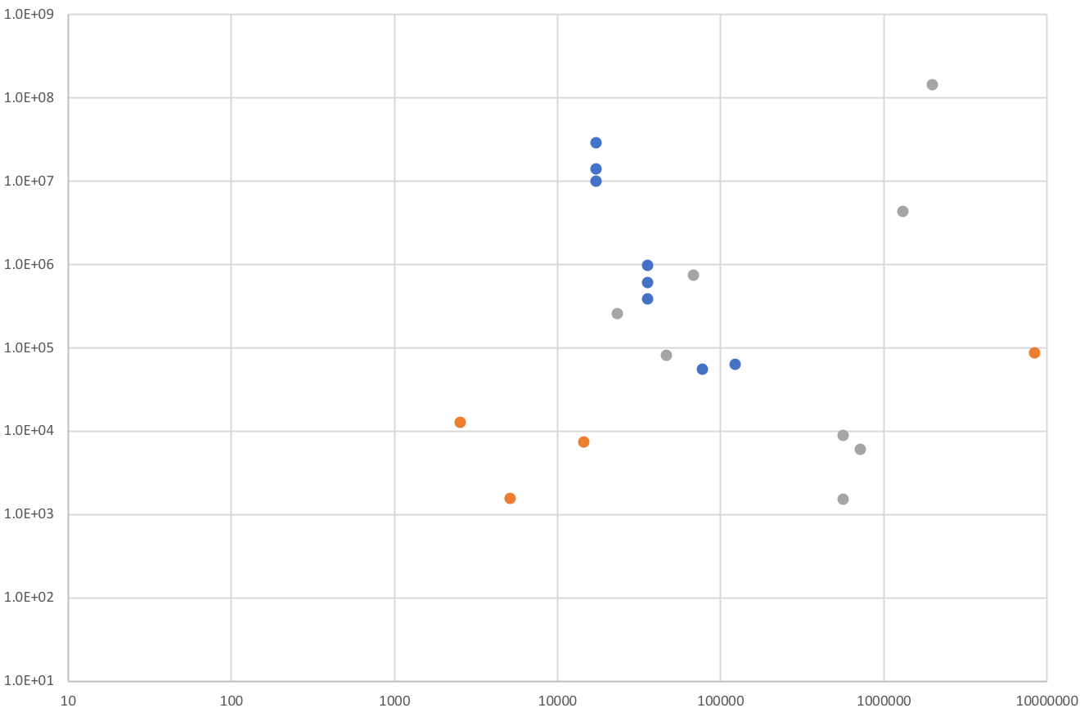
Signatures (Category 3) Performance by Size
Lattice Hash/Symmetric Multivariate
Signing Time (1000s of cycles)
Public Key + Signature Size (bytes)
Hung-Jr, Shiu Ph. D

Slide 52
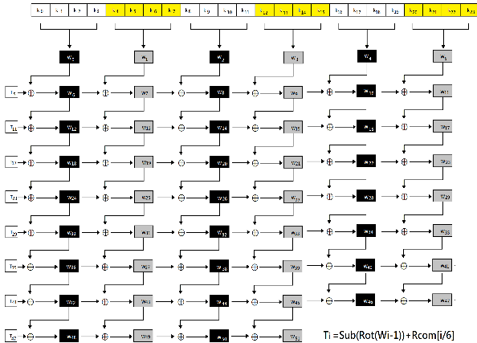
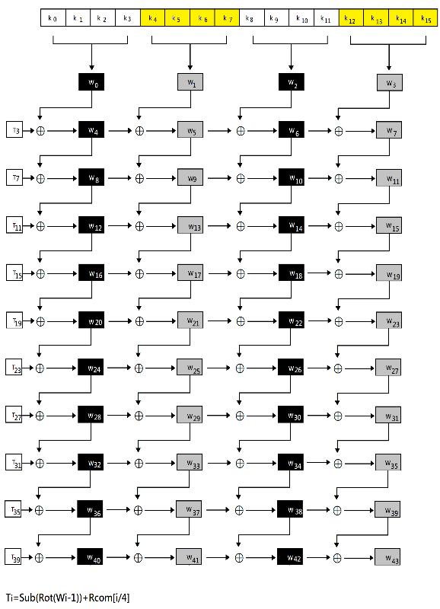
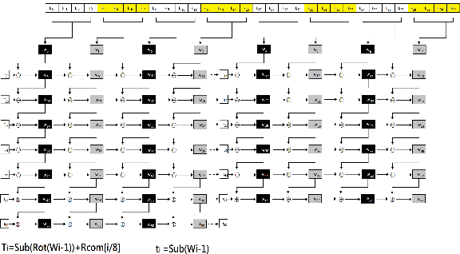
Recall AES key scheduling

Slide 53
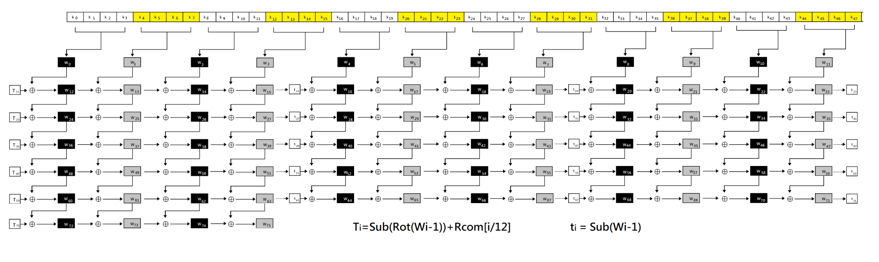
AES 384

Slide 54
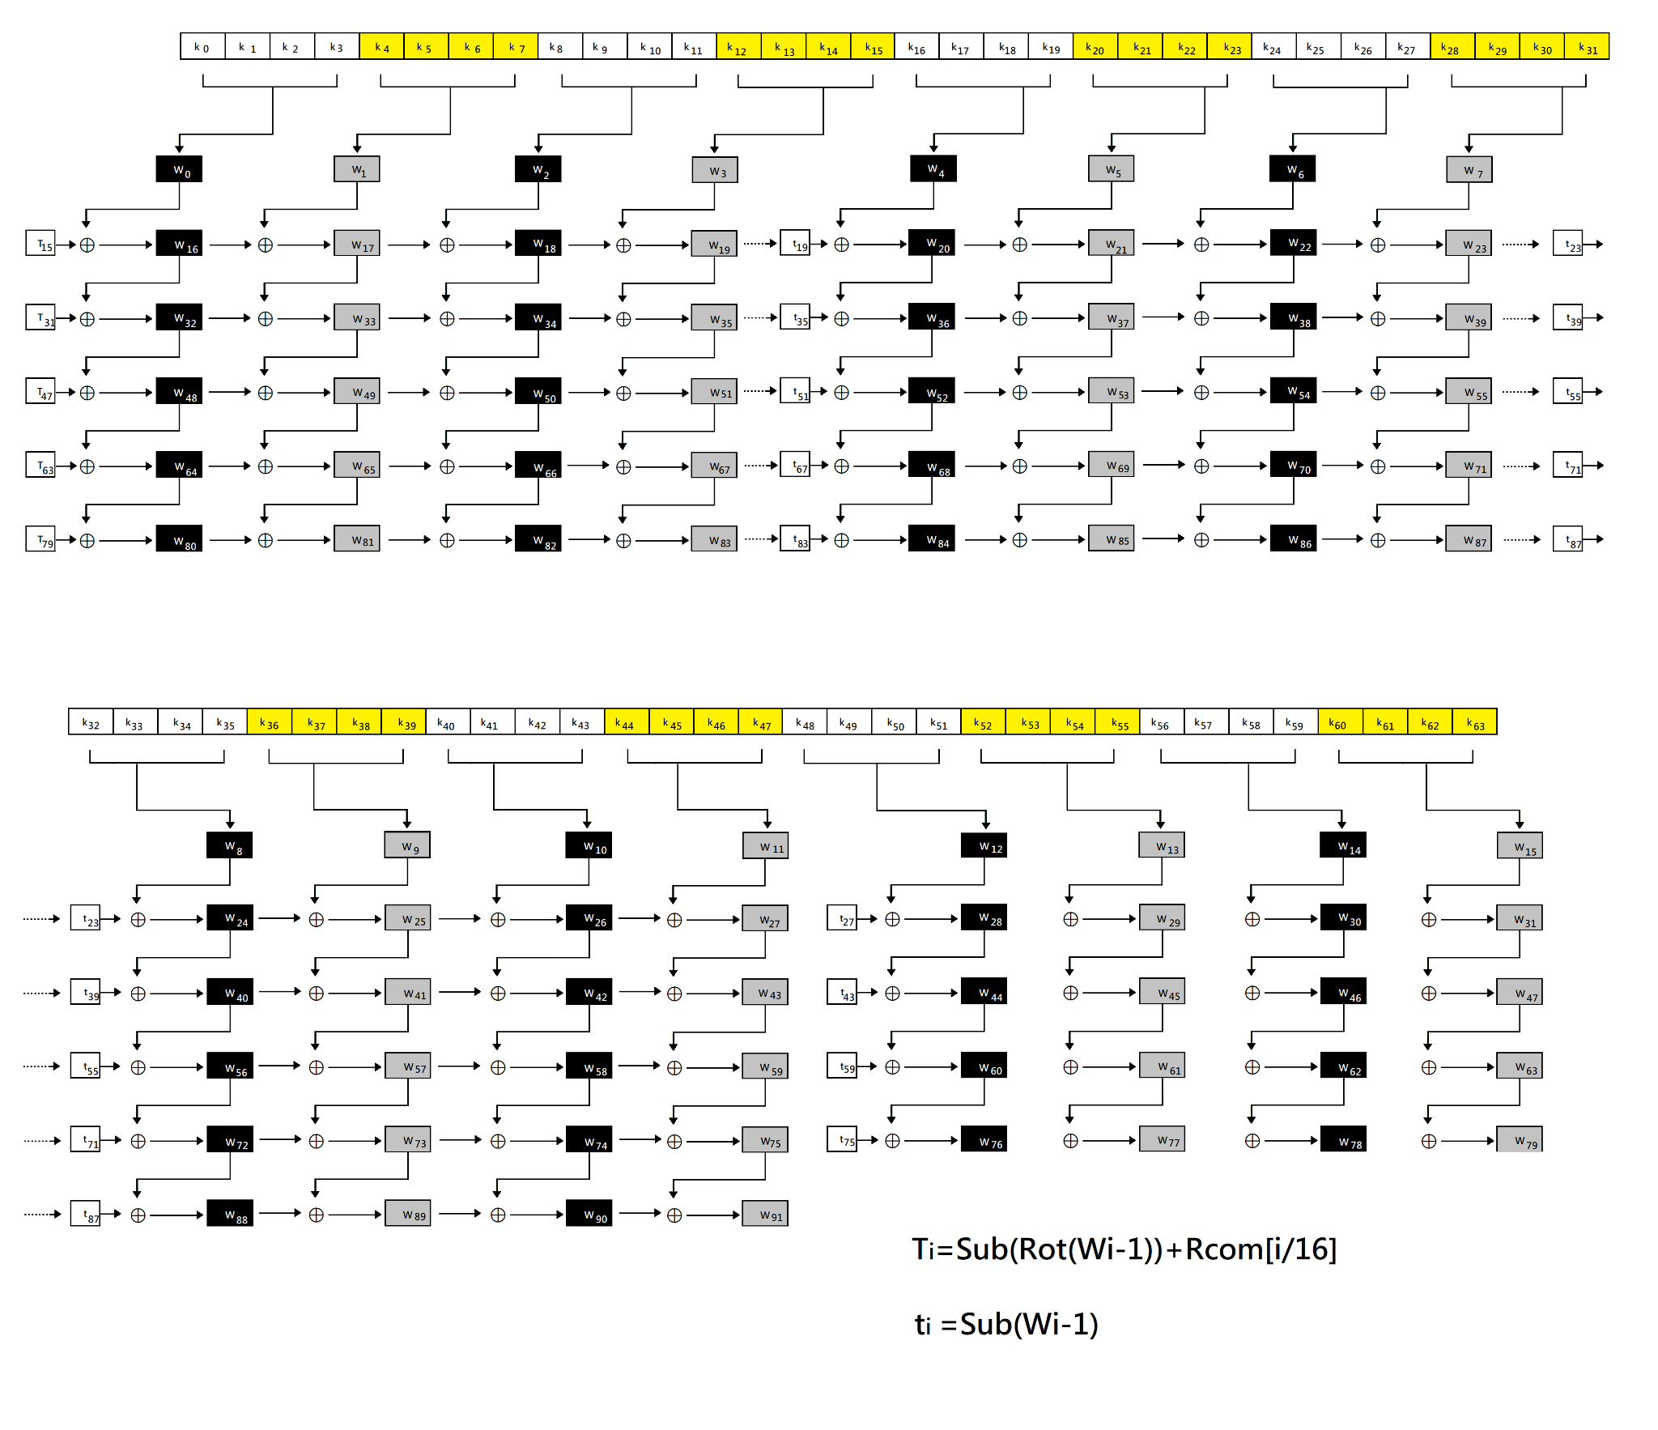
AES 512

Slide 55

Under Grover’s algortihm
AES 384 -> level III ($2^{192}$)
AES 512 -> level V ($2^{256}$)

Slide 56
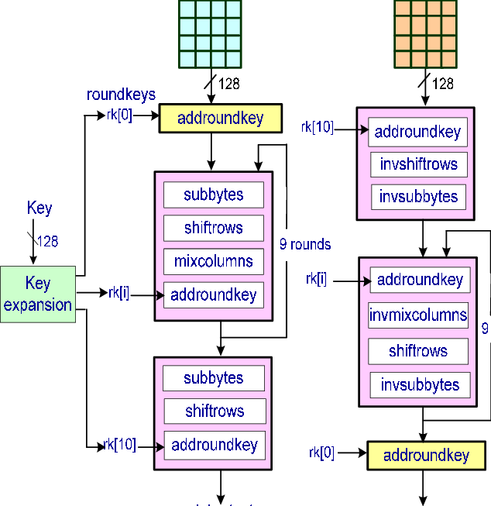
Customized AES
Recall parameters:
  Mixcolumns
  Sbox

Slide 57
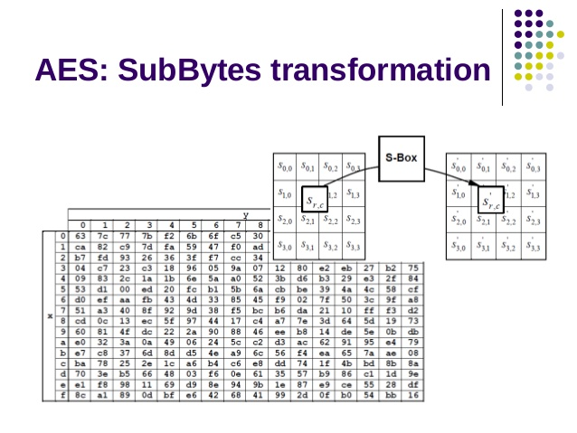
Subbytes
Hung-Jr, Shiu Ph. D

Slide 58
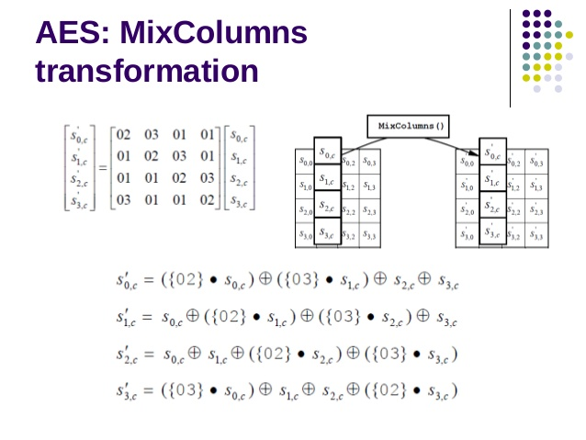
Mixcolumns
Hung-Jr, Shiu Ph. D

Slide 59
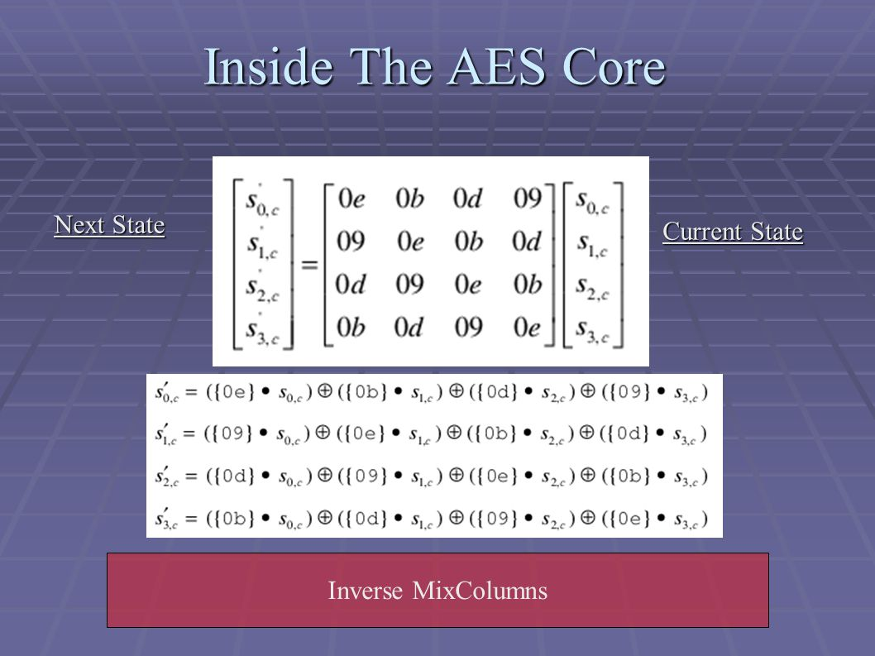
Inverse Mixcolumns
Hung-Jr, Shiu Ph. D

Slide 60
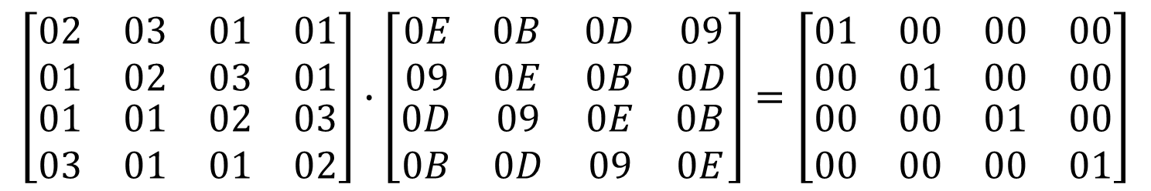
Mixcolumns and Inverse Mixcolumns
All the addition and multiplication are done under a Finite Field (GF(2⁸)).
$$\left[\begin{matrix}\begin{matrix}02 & 03 \\ 01 & 02\end{matrix} & \begin{matrix}01 & 01 \\ 03 & 01\end{matrix} \\ \begin{matrix}01 & 01 \\ 03 & 01\end{matrix} & \begin{matrix}02 & 03 \\ 01 & 02\end{matrix}\end{matrix}\right]∙\left[\begin{matrix}\begin{matrix}0E & 0B \\ 09 & 0E\end{matrix} & \begin{matrix}0D & 09 \\ 0B & 0D\end{matrix} \\ \begin{matrix}0D & 09 \\ 0B & 0D\end{matrix} & \begin{matrix}0E & 0B \\ 09 & 0E\end{matrix}\end{matrix}\right]=\left[\begin{matrix}\begin{matrix}01 & 00 \\ 00 & 01\end{matrix} & \begin{matrix}00 & 00 \\ 00 & 00\end{matrix} \\ \begin{matrix}00 & 00 \\ 00 & 00\end{matrix} & \begin{matrix}01 & 00 \\ 00 & 01\end{matrix}\end{matrix}\right]$$
Hung-Jr, Shiu Ph. D

Slide 61
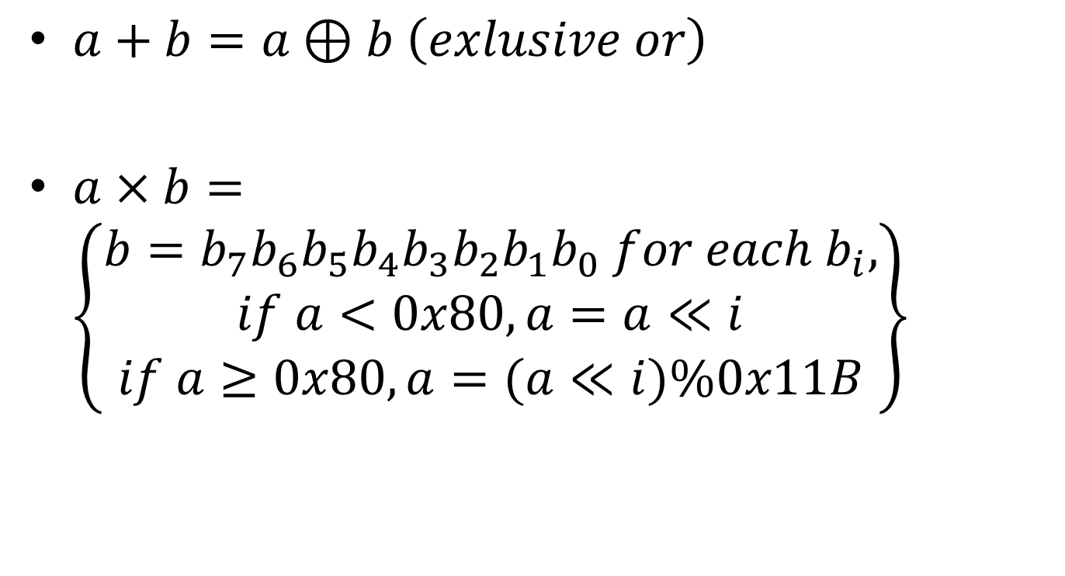
Operations under GF(2⁸)
$a+b=a⊕b \left(exlusive or\right)$
$a×b=\left\{\begin{matrix}\begin{aligned}b=b_{7}b_{6}b_{5}b_{4}b_{3}b_{2}b_{1}b_{0} for each b_{i}, \\ if a<0x80, a=a≪i\end{aligned} \\ if a≥0x80, a=(a≪i)\%0x11B\end{matrix}\right\}$
Hung-Jr, Shiu Ph. D

Slide 62
Variant AES (1/2)
Replace the Mixcolumns and find the Inverse Mixcolumns.
Use Gaussian-Jordan Elimination to find the inverse matrix of Mixcolumns. (Linear Algebra)
Notice that should be under GF(2⁸).
Hung-Jr, Shiu Ph. D

Slide 63
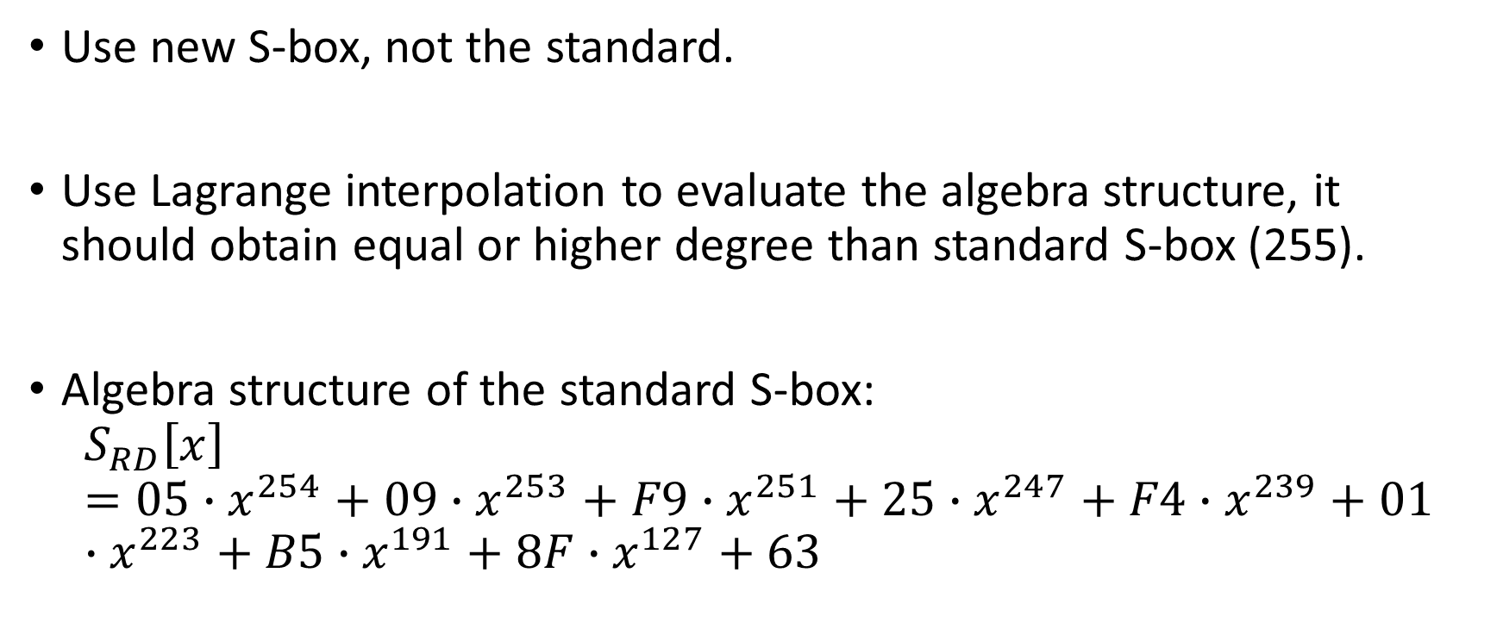
Variant AES (2/2)
Use new S-box, not the standard.
Use Lagrange interpolation to evaluate the algebra structure, it should obtain equal or higher degree than standard S-box (255).
Algebra structure of the standard S-box:
$$S_{RD}\left[x\right]=05∙x^{254}+09∙x^{253}+F9∙x^{251}+25∙x^{247}+F4∙x^{239}+01∙x^{223}+B5∙x^{191}+8F∙x^{127}+63$$
Hung-Jr, Shiu Ph. D

Slide 64


Lagrange Interpolation
Given $x_{0}=1, f\left(x_{0}\right)=1; x_{1}=2, f\left(x_{1}\right)=8; x_{2}=3, f\left(x_{2}\right)=27$
$$L\left(x\right)=1∙\frac{x−2}{1−2}∙\frac{x−3}{1−3}+8∙\frac{x−1}{2−1}∙\frac{x−3}{2−3}+27∙\frac{x−1}{3−1}∙\frac{x−2}{3−2}=6x^{2}−11x+6$$
Hung-Jr, Shiu Ph. D

Slide 65


Signal Masking -Information Hiding (Steganography)
Use a core to run high frequency operations, it will generate higher temperature or noise to mask real encryptions.
Run high frequency
operations
Run AES
Hung-Jr, Shiu Ph. D

Slide 66

Hardware pipeline

Slide 67
Conclusions
For symmetric encryption, to against SCA,
  IoT is a big threats of crypto-module, a slight modification of standard.
  Use multicore hardware and steganography strategy.
For asymmetric encryption, adopt PQC and implement on FPGA to speed up.
Hung-Jr, Shiu Ph. D

Slide 68
Thanks for your attention
Q

