Slide 1
Algorithmic Game Theory
Introduction
Joseph Chuang-Chieh Lin
Dept. CSIE, Tamkang University

Slide 2
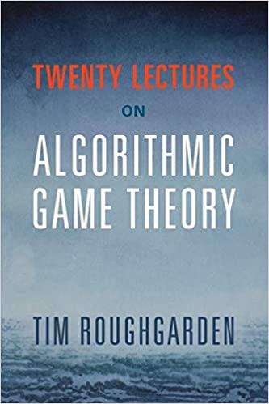
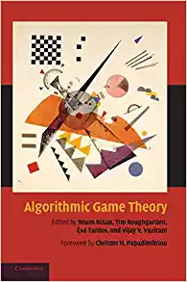
Textbooks and Materials
Textbooks/Lectures:
  Twenty Lectures on Algorithmic Game Theory. Tim Roughgarden. Cambridge University Press. 2016.
  Algorithmic Game Theory. Noam Nisan, Tim Roughgarden, Eva Tardos, and Vijav V. Vazirani. Cambridge University Press. 2011.
Other materials:
  Essentials of Game Theory: A Concise, Multidisciplinary Introduction (Synthesis Lectures on Artificial Intelligence and Machine Learning). Leyton- Brown and Kevin, Shoham. Cambridge University Press. 2008.

Slide 3
Prerequisites
Basic CS undergraduate courses in
  Algorithms
  Probability theory
  Discrete mathematics
  Coding
Motivation.
Curiosity.

Slide 4
Topics (adjusted accordingly)
Examples for Warm-Up
Basic Solution Concepts
Matrix Form and Extensive Form (Dynamic Games)
Equilibria
Inefficiency of Equilibria
Network Formation Games
Social Choice + Easy Project

Slide 5
Grading Policy
Attendance (10%)
Course-interaction (20%)
Assignments x 4–5 (20%)
Project* x 1 (20%)
Final Presentation (30%)
* Project demo: in TKU’s midterm week.
Final Presentation: in TKU’s final exam week.

Slide 6
Grading Policy
Attendance (10%)
Course-interaction (20%)
Assignments x 4–5 (20%)
Project* x 1 (20%)
Final Presentation (30%)
Most of them can be finished in the class.
80% of the source codes will be given.
Find a paper (related to game theory) to study by yourself.
* Project demo: in TKU’s midterm week.
Final Presentation: in TKU’s final exam week.

Slide 7
Where to find the paper? (suggestions)
*Please look for papers in 2015—present.
International conferences:
  EC: Proceedings of the ACM conference on Electronic commerce.
  NeurIPS: Conference on Neural Information Processing Systems.
  AAAI: Association for the Advancement of Artificial Intelligence.
  IJCAI: International Joint Conferences on Artificial Intelligence.
  AAMAS: International Conference on Autonomous Agents and Multiagent Systems.
  SAGT: Symposium on Algorithmic Game Theory.
  WINE: International Conference on Web and Internet Economics.
  ...
Journals:
  Games and Economic Behavior
  International Journal of Game Theory
  ...

Slide 8
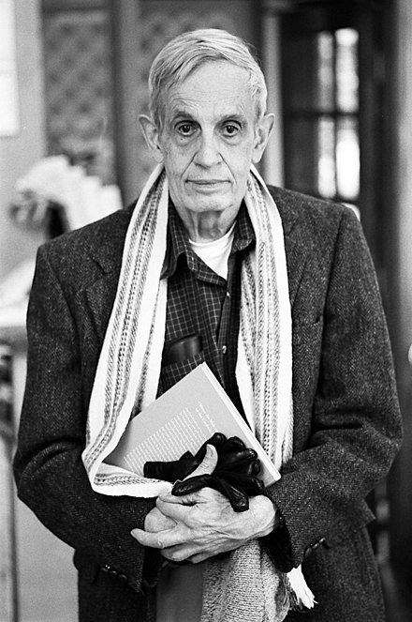
John Forbes Nash Jr. (1928–2015)
American mathematician.
Fundamental contributions to game theory.
Nobel Memorial Prize in Economic Sciences with game theorists Reinhard Selten and John Harsanyi.
Abel Prize with Louis Nirenberg for his work on nonlinear partial differential equations.
Nash in 2006.
Reference: https://en.wikipedia.org/wiki/John_Forbes_Nash_Jr.

Slide 9
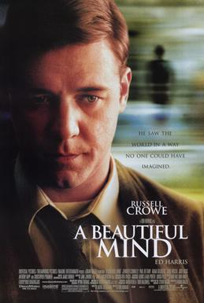
A classic scene of “A Beautiful Mind”
https://www.youtube.com/watch?v=2d_dtTZQyUM
Starring: Russel Crowe

Slide 10
Before introducing Nash Equilibria...
Let’s play around several “games” first.

Slide 11
Number Guessing
Let’s say I have chosen a secret number A in my mind, which is among 1 and 100.
Please guess it by a number B.
If B < A, I will tell you “Larger, please”.
If B > A, I will tell you “Smaller, please”.
How many times do you think you can find out this secret number?
B
A
A
B

Slide 12
Number Guessing
Let’s say I have chosen a secret number A in my mind, which is among 1 and 100.
Please guess it by a number B.
If B < A, I will tell you “Larger, please”.
If B > A, I will tell you “Smaller, please”.
How many times do you think you can find out this secret number? Let’s play to feel the strategic behaviors.
B
A
A
B

Slide 13
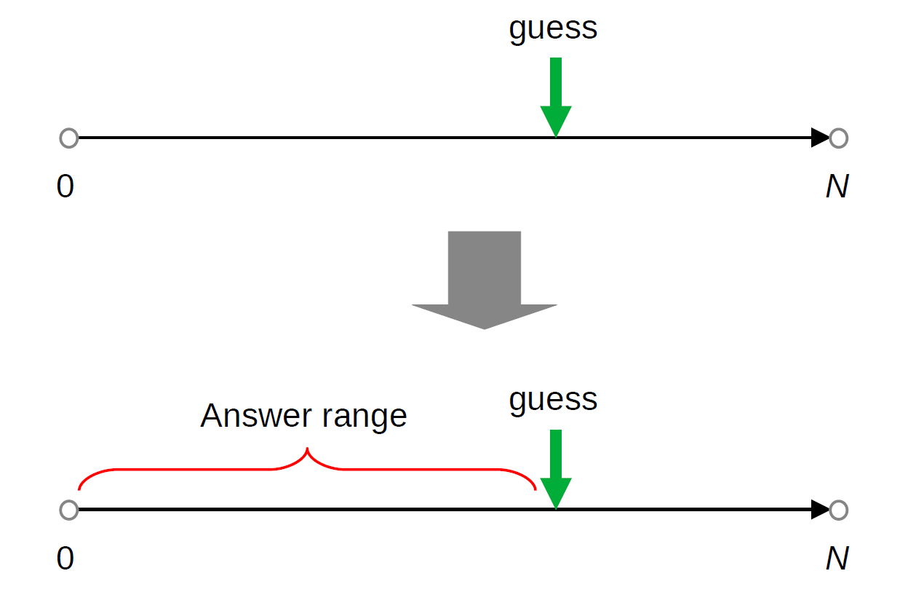
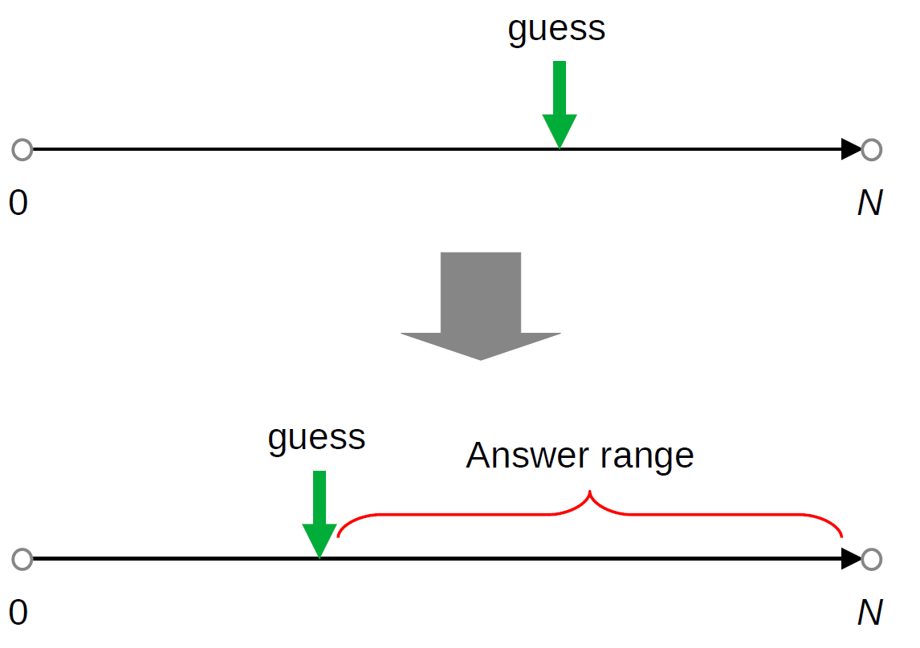
Adversarial Number Guessing
The demo code.

Slide 14
Envy-Free Cake-Cutting
Children wants everything to be FAIR.
Actually, in their world, nothing is FAIR…… lol

Slide 15
Envy-Free Cake-Cutting
Children wants everything to be FAIR.
Actually, in their world, nothing is FAIR…… lol
Let’s say we want two kids to share a cake.

Slide 16
Envy-Free Cake-Cutting
Children wants everything to be FAIR.
Actually, in their world, nothing is FAIR…… lol
Let’s say we want two kids to share a cake.
Can you propose a way of cutting a cake so that two kids share a cake so that no one envies the other?

Slide 17
Prisoners’ Dilemma
It was originally framed by Merrill Flood and Melvin Dresher in 1950.
Let’s say there are two guys, A and B, who broke into a luxury store and stole a treasure.

Slide 18

Prisoners’ Dilemma
It was originally framed by Merrill Flood and Melvin Dresher in 1950.
Let’s say there are two guys, A and B, who broke into a luxury store and stole a treasure.
They had hided the treasure before the police caught them.
source

Slide 19
Prisoners’ Dilemma
It was originally framed by Merrill Flood and Melvin Dresher in 1950.
Let’s say there are two guys, A and B, who broke into a luxury store and stole a treasure.
They had hided the treasure before the police caught them.
They were kept in two separated rooms.
  That means, they cannot communicate with each other…
Each of them was offered two choices: Denial or confession.

Slide 20
Prisoners’ Dilemma
They were told that:

Slide 21
Prisoners’ Dilemma
They were told that:
  If both of them deny the fact of stealing the treasure, they will BOTH be sentenced in prison for one month.
  If one of them confesses while the other one denies, the former will be set FREE while the latter will be sentenced in prison for 9 months.
  If both confess, then they will both get 6 months in prison.
    Because the police officers have got their images from the monitor...

Slide 22
Prisoners’ Dilemma
They were told that:
  If both of them deny the fact of stealing the treasure, they will BOTH be sentenced in prison for one month.
  If one of them confesses while the other one denies, the former will be set FREE while the latter will be sentenced in prison for 9 months.
  If both confess, then they will both get 6 months in prison.
    Because the police officers have got their images from the monitor…
In your opinion, what should they do?
  They cannot communicate, and they must make their decisions simultaneously.

Slide 23
Prisoners’ Dilemma
We can use a “matrix” to formulate this game.
Two players, two actions for each.
If you are criminal A, what will you do?
What’s the solution (outcome)?
Criminal B
Denial
Confess
−1, −1 | −9, 0
0, −9 | −6, −6
Denial
Criminal A
Confess
Notes:
Dominant strategy.

Slide 24
Prisoners’ Dilemma
Dominant strategy?
Socially inefficient.
  Why is it inefficient?
Price of Anarchy (PoA).
Criminal B
Denial
Confess
−1, −1 | −9, 0
0, −9 | −6, −6
Denial
Criminal A
Confess
Notes:
Dominant strategy.

Slide 25
Bach or Stravinsky (BoS)
A historical two-player game.
  The battle of sexes (in Games and Decisions by Luce and Raiffa, 1957).
  Say Amy and Bob want to pick a concert to go to.

Slide 26
Bach or Stravinsky (BoS)
A historical two-player game.
  The battle of sexes (in Games and Decisions by Luce and Raiffa, 1957).
  Say Amy and Bob want to pick a concert to go to.
  Both prefer to go together than to go home.
  However, Amy prefers Bach while Bob prefers Stravinsky.

Slide 27
Bach or Stravinsky (BoS)
What are the SOLUTIONS of the game?
Is there any dominant strategy for either Amy or Bob?
Bob
Bach
Stravinsky
2, 1 | 0, 0
0, 0 | 1, 2
Bach
Amy
Stravinsky
The matrix form

Slide 28
Battle of Sexes (BoS)
What are the SOLUTIONS of the game?
Is there any dominant strategy for either Amy or Bob?
Bob
Baseball
Game
Bach
2, 1 | 0, 0
0, 0 | 1, 2
Movie
Amy
Baseball Game
The matrix form

Slide 29
Matching Pennies
Two players, playing a game by throwing a penny.
Both ‘heads’ or both ‘tails’: player 1 keeps both pennies.
Otherwise, player 2 keeps both pennies.

Slide 30
Matching Pennies
Two players, playing a game by throwing a penny.
Both ‘heads’ or both ‘tails’: player 1 keeps both pennies.
Otherwise, player 2 keeps both pennies.
Player 2
head
tail
1, −1 | −1, 1
−1, 1 | 1, −1
head
The matrix form
Player 1
tail

Slide 31
Matching Pennies
Zero-sum?
Do dominant strategies exist?
What are the solutions?
Player 2
head
tail
1, −1 | −1, 1
−1, 1 | 1, −1
head
Player 1
tail

Slide 32
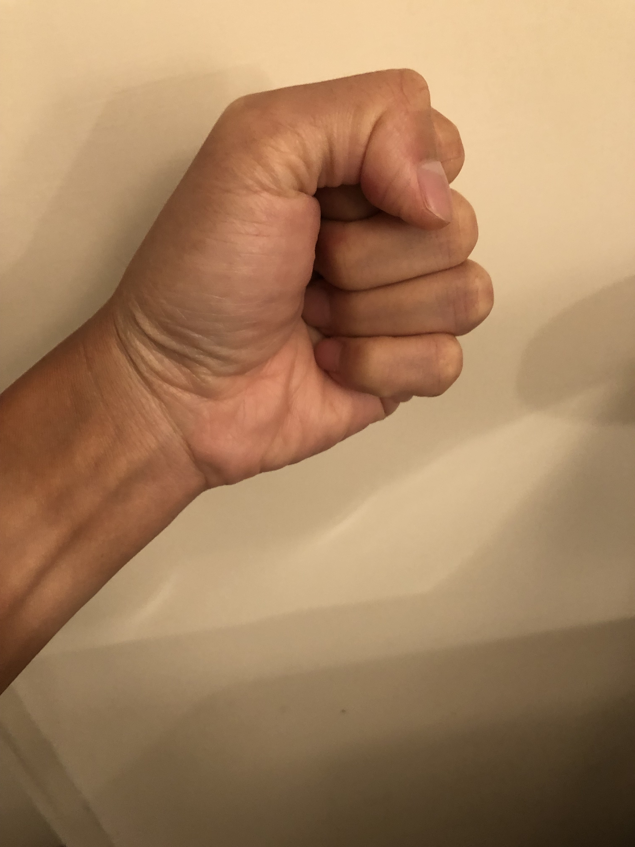

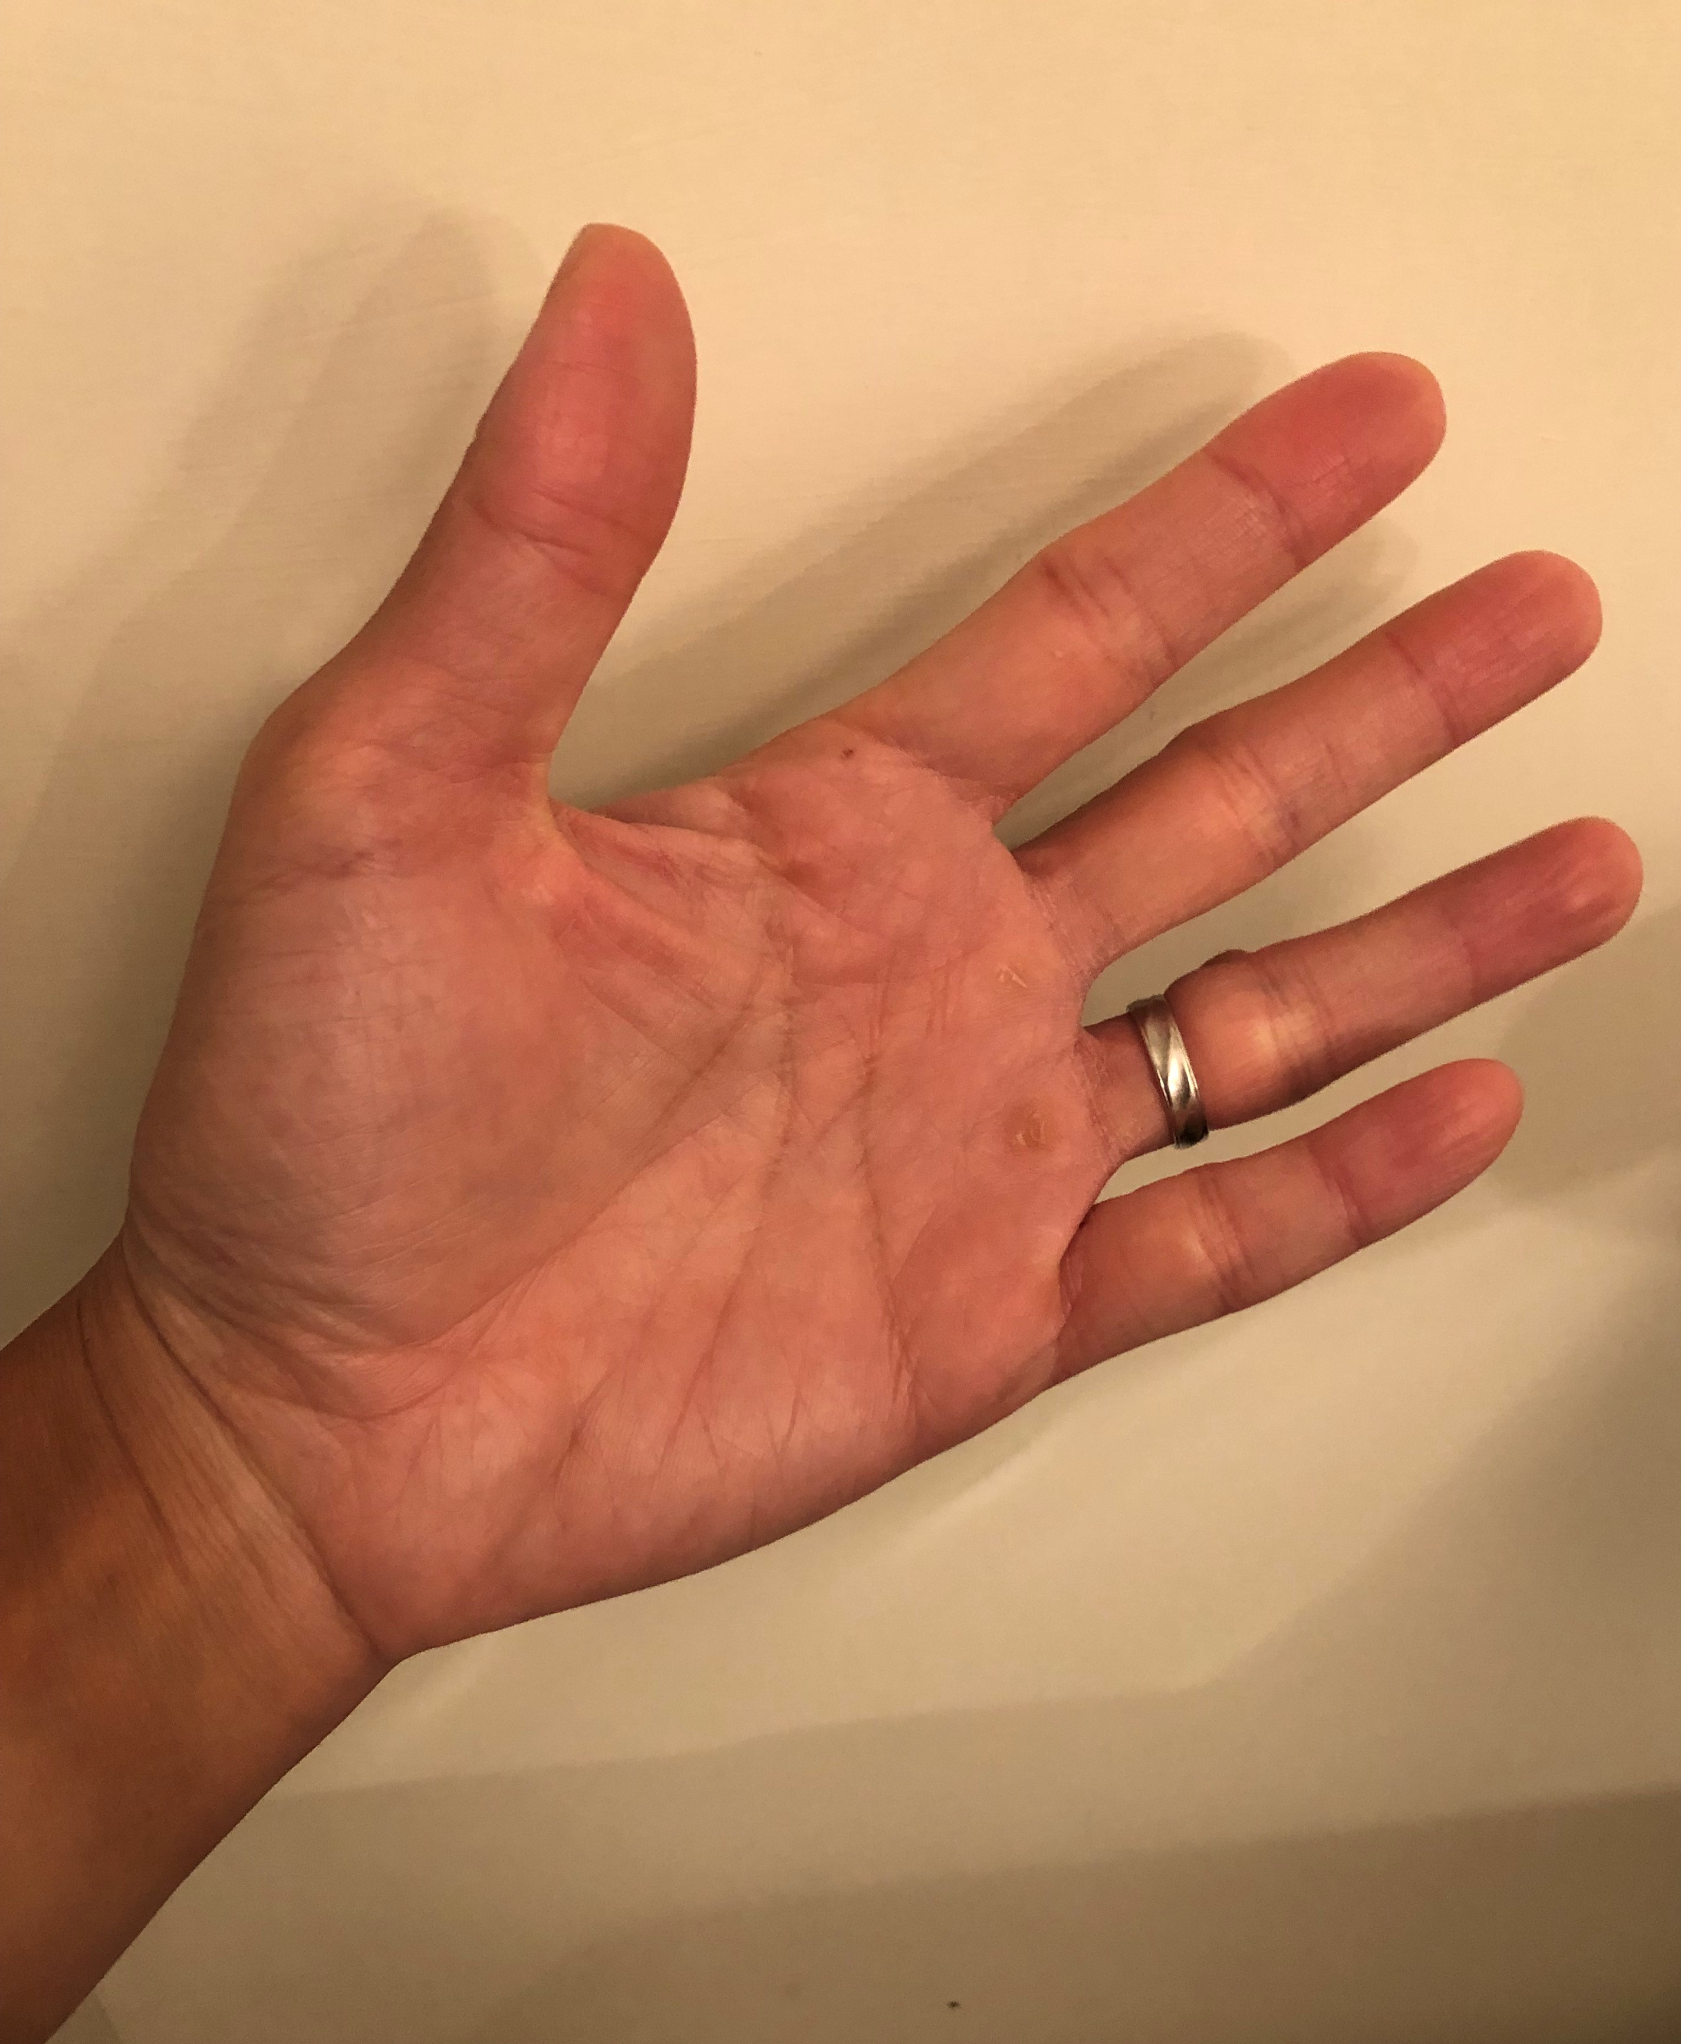
Rock-Scissors-Paper Game
Player 2
rock
scissors
paper
0, 0 | 1, −1 | −1, 1
−1, 1 | 0, 0 | 1, −1
1, −1 | −1, 1 | 0, 0
rock
Player 1
rock
scissors
paper
scissors
paper

Slide 33
Rock-Scissors-Paper Game
Player 2
Zero-sum?
Dominant strategies?
Any solutions?
rock
scissors
paper
0, 0 | 1, −1 | −1, 1
−1, 1 | 0, 0 | 1, −1
1, −1 | −1, 1 | 0, 0
rock
Player 1
scissors
paper

Slide 34
Mixed Strategies
What we have discussed about are all pure strategies.
  A deterministic action.

Slide 35
Mixed Strategies
What we have discussed about are all pure strategies.
  A deterministic action.
What is a mixed strategy?

Slide 36
Mixed Strategies
Like this?
  Nine-headed Dragon Strike.
Or like this?
  Man of many pitches.
For a portfolio manager in a hedge fund:
  Portfolio weighting.

Slide 37
Back to the Game of Matching Pennies
Setting the weights?
Player 2
head
tail
1, −1 | −1, 1
−1, 1 | 1, −1
head
Player 1
tail

Slide 38
Back to the Game of Matching Pennies
Setting the weights?
Player 2
head
tail
1, −1 | −1, 1
−1, 1 | 1, −1
head
Player 1
tail

Slide 39
Back to the Game of Matching Pennies
Setting the weights?
The expected utility of player 1 playing ‘head’:
The expected utility of player 1 playing ‘tail’:
Player 2
head
tail
1, −1 | −1, 1
−1, 1 | 1, −1
head
Player 1
tail

Slide 40
An intuitive definition of a Nash equilibrium
A state such that no player can increase her expected payoff (profit, gain, advantage, money, etc.) by a unilateral deviation.
Nash’s Theorem:
Every finite game (a finite number of players, each has a finite number of pure strategies) has at least one Nash equilibrium.

Slide 41
Back to the Game of Matching Pennies
Setting the weights?
The expected utility of player 1 playing ‘head’:
The expected utility of player 1 playing ‘tail’:
What if
Player 2
head
tail
1, −1 | −1, 1
−1, 1 | 1, −1
head
Player 1
tail

Slide 42
Back to the Game of Matching Pennies
Setting the weights?
The expected utility of player 1 playing ‘head’:
The expected utility of player 1 playing ‘tail’:
What if
Player 2
head
tail
1, −1 | −1, 1
−1, 1 | 1, −1
head
Player 1
tail

Slide 43
Back to the Game of Matching Pennies
Setting the weights?
The expected utility of player 1 playing ‘head’:
The expected utility of player 1 playing ‘tail’:
Solving
Player 2
head
tail
1, −1 | −1, 1
−1, 1 | 1, −1
head
Player 1
tail

Slide 44
Back to the Game of Matching Pennies
Take your time.
So we just proved that the game has a kind of solution:
Player 2
head
tail
1, −1 | −1, 1
−1, 1 | 1, −1
head
“Mixed-Strategy Nash Equilibrium”.
Player 1
tail

Slide 45
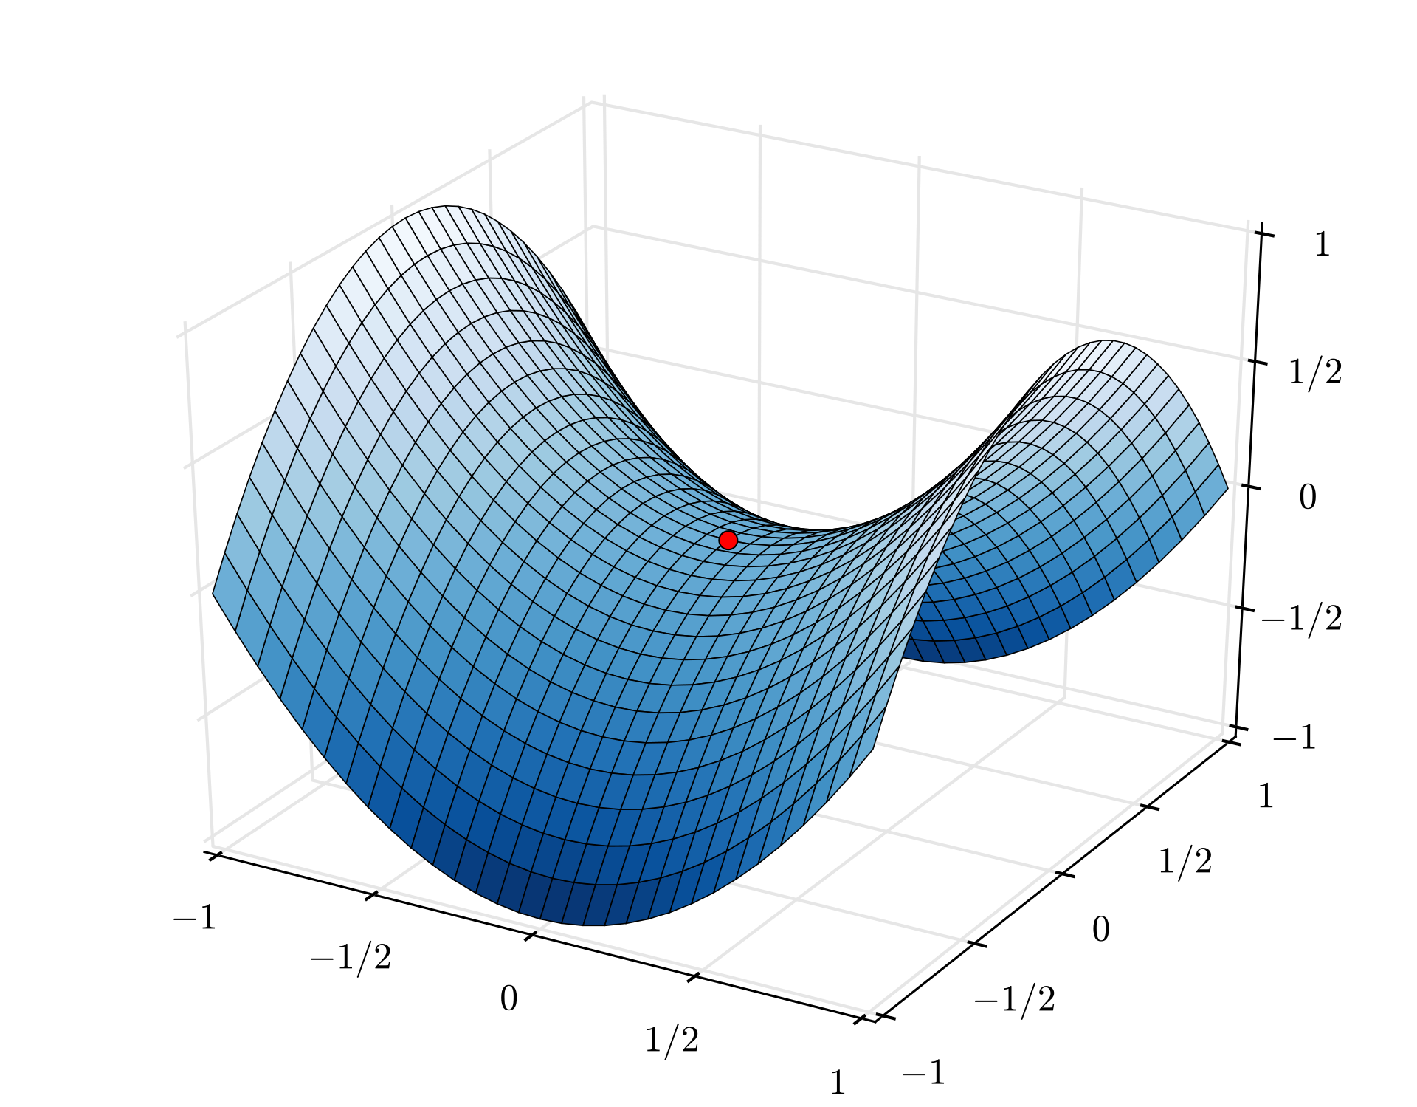

Saddle point illustration

Slide 46
An intuitive definition of a Nash equilibrium
A state such that no player can increase her expected payoff (profit, gain, advantage, money, etc.) by a unilateral deviation.
Nash’s Theorem:
Every finite game (a finite number of players, each has a finite number of pure strategies) has at least one Nash equilibrium.
The concept of best responses & mixed strategies.

Slide 47
Back to the classic scene of “A Beautiful Mind”
https://www.youtube.com/watch?v=2d_dtTZQyUM
Do you observe anything strange or anything wrong?
  https://www.youtube.com/watch?v=DTcmmD_MWas

Slide 48
An Easy Exercise
Please find out a mixed-strategy Nash equilibrium of the rock-scissors-paper game.
Player 2
rock
scissors
paper
0, 0 | 1, −1 | −1, 1
−1, 1 | 0, 0 | 1, −1
1, −1 | −1, 1 | 0, 0
rock
Player 1
scissors
paper

Slide 49
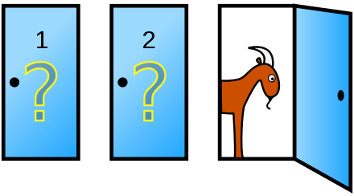
The Monty Hall Problem
From an American TV show Let’s Make a Deal hosted by Monty Hall.
Suppose you're on a game show, and you're given the choice of three doors: Behind one door is a car; behind the others, goats. You pick a door, say No. 1, and the host, who knows what's behind the doors, opens another door, say No. 3, which has a goat. He then says to you, "Do you want to pick door No. 2?" Is it to your advantage to switch your choice?
https://en.wikipedia.org/wiki/Monty_Hall_problem

