Slide 1
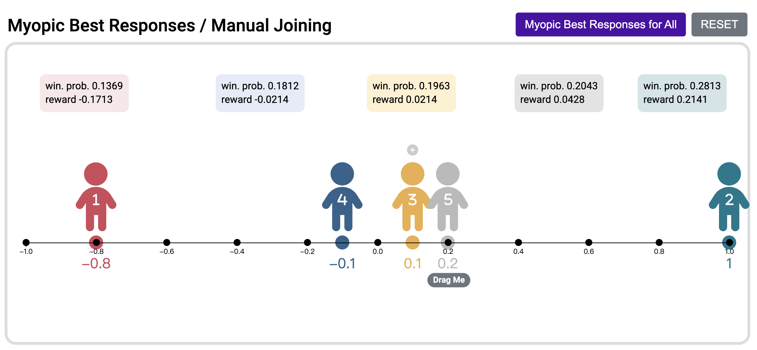
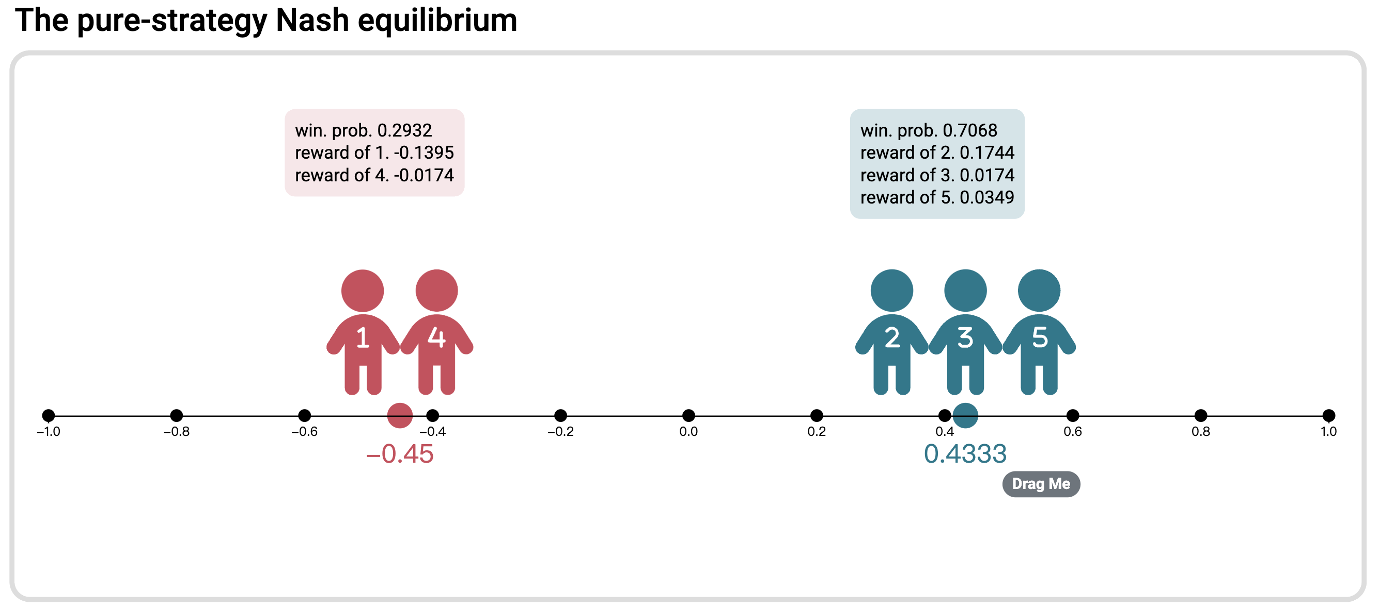
win. prob. 0.1369
reward -0.1713
win. prob. 0.1812
reward -0.0214
win. prob. 0.1963
reward 0.0214
win. prob. 0.2043
reward 0.0428
win. prob. 0.2813
reward 0.2141
win. prob. 0.2932
reward of 1 -0.1395
reward of 4 -0.0174
win. prob. 0.7068
reward of 2 0.1744
reward of 3 0.0174
reward of 5 0.0349

