Slide 1
Randomized Algorithms
Markov Chains and Random Walks
Joseph Chuang-Chieh Lin
Dept. CSIE, Tamkang University
6th May 2021
Notes:
e^x := \sum_{k=0}^{\infty} \frac{x^k}{k!}

Slide 2
Outline
Markov Chains: definitions and representations
Application: Random Walk
Classification of States
Stationary Distribution

Slide 3

Stochastic Process
A stochastic process is a collection of random variables.
  t: time
  X(t): state of the process at time t.
If T is a countably infinite set, we say X is a discrete time process.

Slide 4
Markov Chain
A discrete time stochastic process X₀, X₁, X₂, … is a Markov chain if
  Markov property.
states

Slide 5
Markov Chain
A discrete time stochastic process X₀, X₁, X₂, … is a Markov chain if
  Markov property.
  This does NOT imply that X_{t} is independent of X₀, X₁, …, X_{t-2},
    The dependency of X_{t} on the past is captured in X_{t-1}.

Slide 6
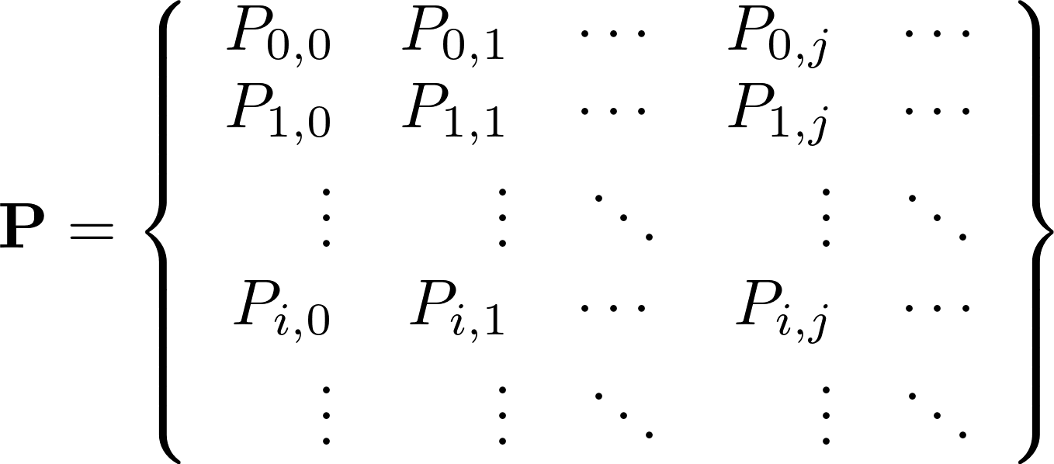
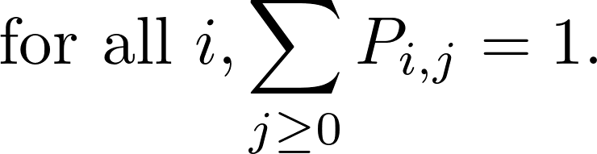
Markov Chain
Markov property implies:
  The Markov chain is uniquely defined by the one-step transition matrix.

Slide 7
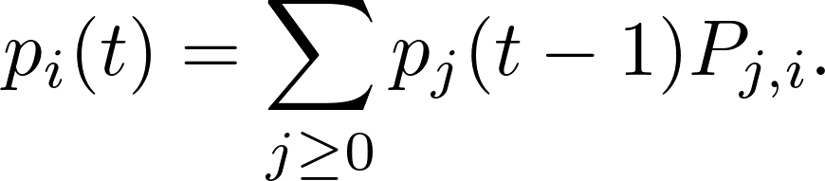

Transition Probabilities
  p_{i}(t): the probability that the process is at state i at time t.

Slide 8
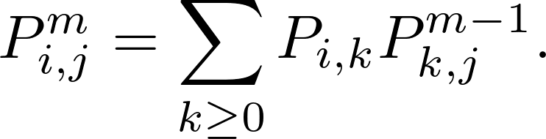
Transition Probabilities
  p_{i}(t): the probability that the process is at state i at time t.
m step transition probability:

Slide 9


Transition Probabilities
  p_{i}(t): the probability that the process is at state i at time t.
m step transition probability:

Slide 10


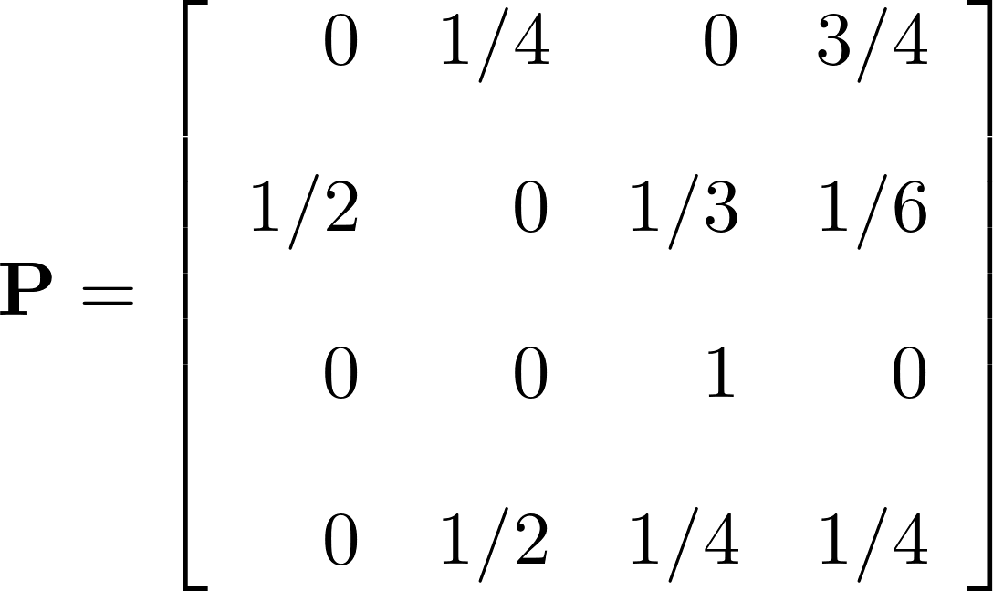



Transition Probabilities
1
0
1
2
3

Slide 11
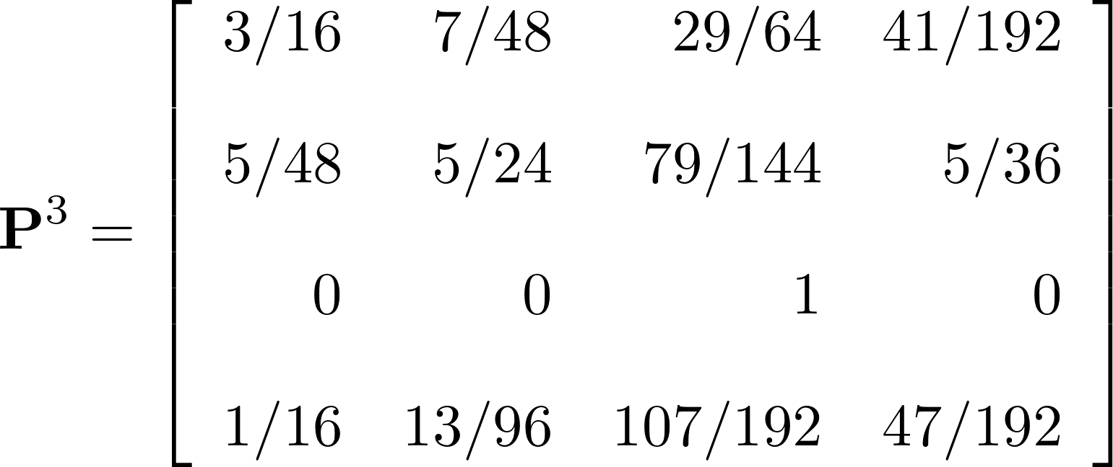
Transition Probabilities
1
0
1
2
3

Slide 12
Transition Probabilities
If we begin in a state chosen uniformly at random: (¼, ¼, ¼, ¼), what is the probability distribution after three steps?

Slide 13
Transition Probabilities
If we begin in a state chosen uniformly at random: (¼, ¼, ¼, ¼), what is the probability distribution after three steps?

Slide 14

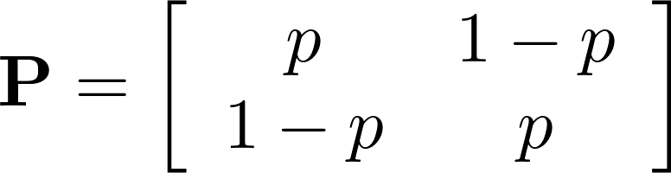
Assignment 06
Consider the two-state Markov chain with the following transition matrix. Find a simple expression for .

Slide 15

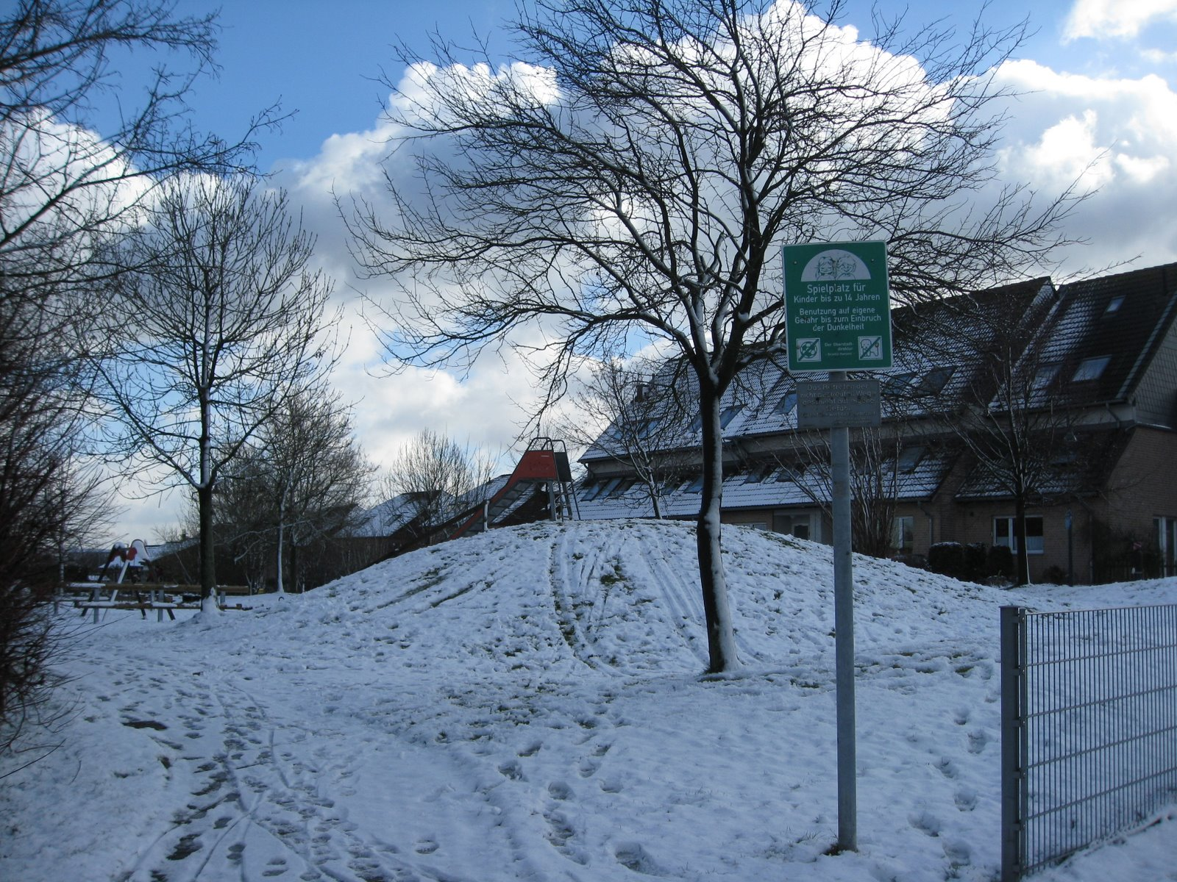
Application: Random Walks
Steppenbergallee Aachen
Aachener Dom
. . . . . .
0
1
2
3
n−1
n

Slide 16
Application: Random Walks
Steppenbergallee Aachen
Aachener Dom
. . . . . .
0
1
2
3
n−1
n
X_{i} : the position after the ith step you’ve walked.

Slide 17
Application: Random Walks
Steppenbergallee Aachen
Aachener Dom
. . . . . .
0
1
2
3
n−1
n
Only at the position 0 (my home) we know how to make a right step towards the destination (cathedral).

Slide 18
Application: Random Walks
Steppenbergallee Aachen
Aachener Dom
. . . . . .
0
1
2
3
n−1
n
Only at the position 0 (my home) we know how to make a right step towards the destination (cathedral).

Slide 19
Application: Random Walks
Steppenbergallee Aachen
Aachener Dom
0
1
2
3
j−1
j
j+1
n−1
n
If we are at positions 1, 2, …, n−1, we have no idea about the direction to go.
Suppose then we have chance of 50% to get one step closer to the destination and 50% to get one step backward…
How many steps we expect to walk…?

Slide 20
Application: Random Walks
Steppenbergallee Aachen
Aachener Dom
0
1
2
3
j−1
j
j+1
n−1
n
Markov chain X₀, X₁, X₂, …
Z_{j}: random variable; the number of steps to reach n from j.
h_{j} : the expected steps to reach n when starting from j.
  E[Z_{j}] = h_{j}.
h_{n} = 0, h₀= h₁ + 1.

Slide 21
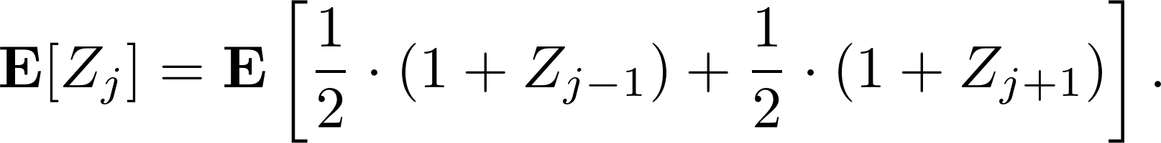
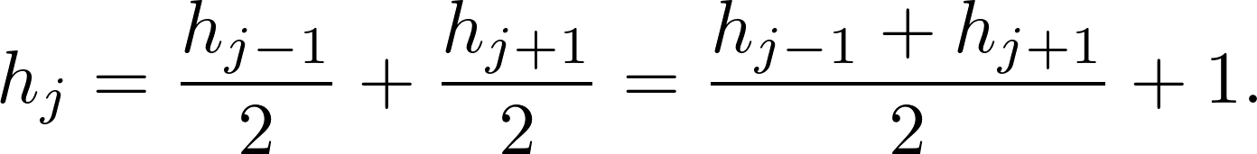

Application: Random Walks
Steppenbergallee Aachen
Aachener Dom
0
1
2
3
j−1
j
j+1
n−1
n

Slide 22
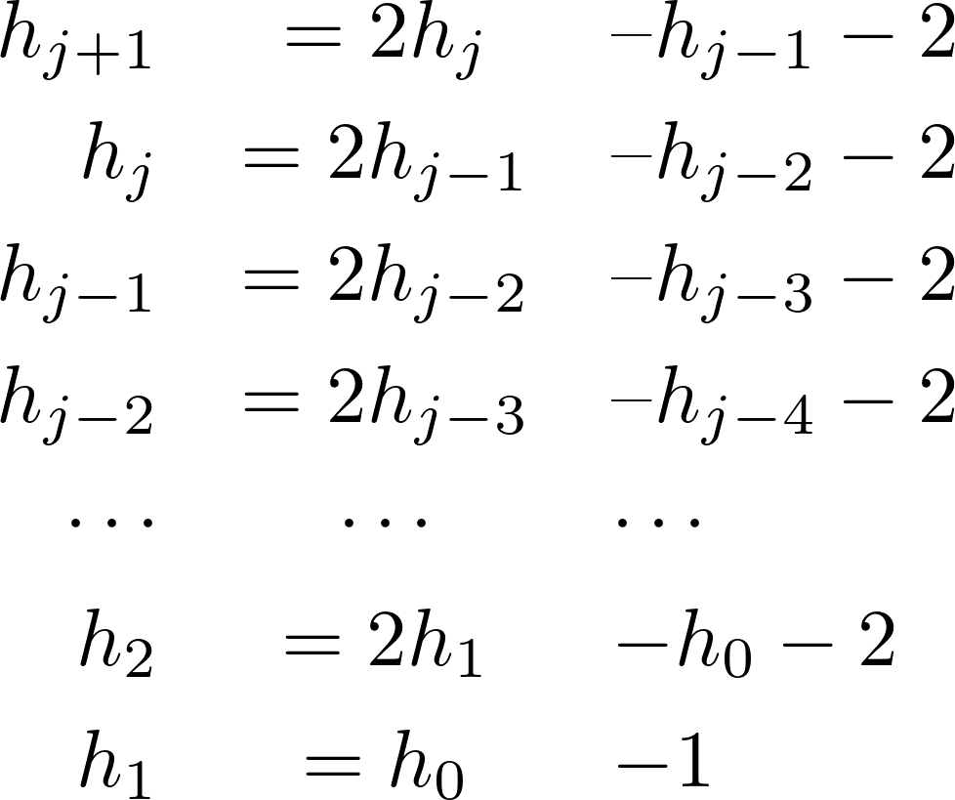
Application: Random Walks

Slide 23

Application: Random Walks

Slide 24
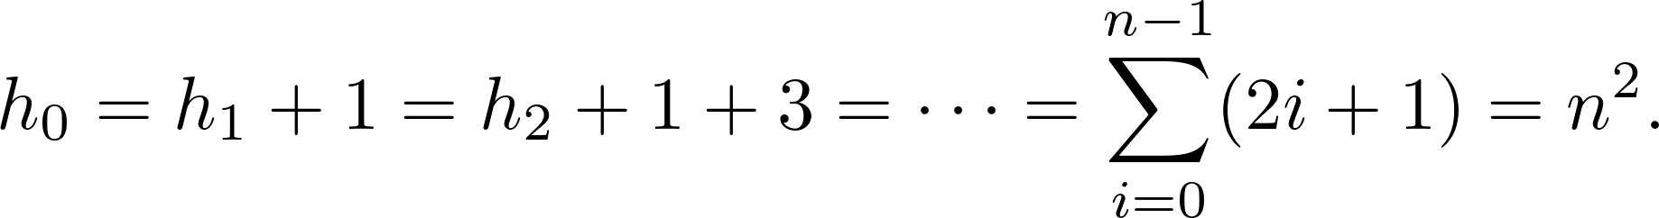
Application: Random Walks

Slide 25
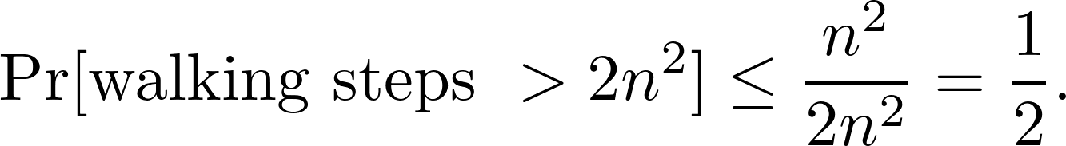
Application: Random Walks

Slide 26
Assignment 07
Consider the random walk we just discussed. Now we assume that whenever position 0 is reached, with probability ½ the walk moves to position 1 and with probability ½ the walk stays at 0. What is the expected number of steps to reach n starting from position 0?

Slide 27
Classification of States
i → j accessible:
  How about 2→0? 2 →1?
1
0
1
2
3

Slide 28
Classification of States
i → j accessible:
  How about 2→0? 2 →1?
i ↔ j: i and j communicate.
1
0
1
2
3

Slide 29
Classification of States
i → j accessible:
  How about 2→0? 2 →1?
i ↔ j: i and j communicate.
0
1
3
The Markov chain is irreducible.
Any two states communicate.

Slide 30
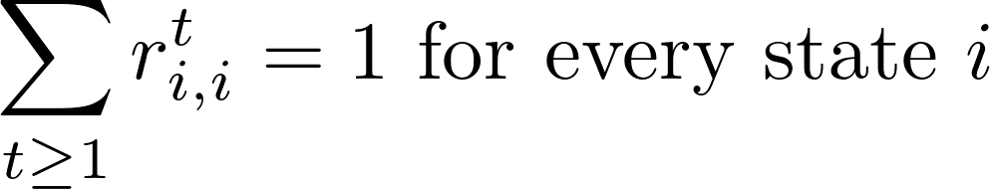
Classification of States
r^{t}_{i,j}: the probability that starting at state i, the first transition to state j occurs at time t.
0
1
3
The Markov chain is recurrent.

Slide 31
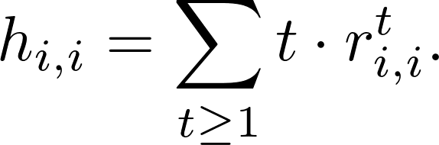

Classification of States
r^{t}_{i,j}: the probability that starting at state i, the first transition to state j occurs at time t.
h_{i,i} : the expected time to return state i when starting from state i.
0
1
3
The Markov chain is recurrent.
Each state i is positive recurrent.

Slide 32
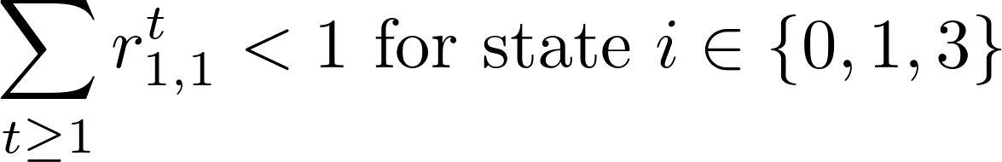
Classification of States
r^{t}_{i,j}: the probability that starting at state i, the first transition to state j occurs at time t.
1
0
1
2
3
State 0, 1, 3 are transient.

Slide 33
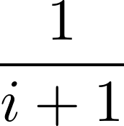
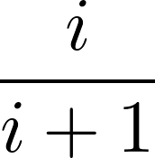
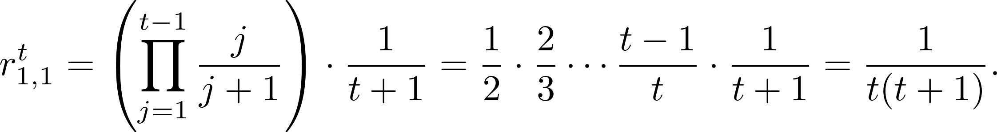
Classification of States
An example of null recurrent:
1
2
3
i−1
i
i+1
n−1
n

Slide 34
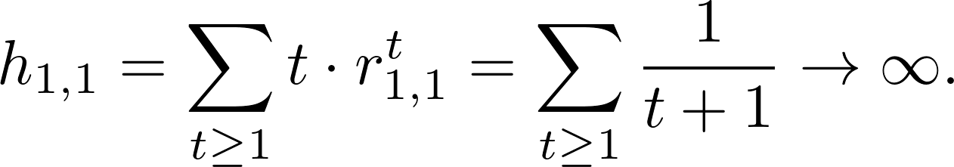
Classification of States
An example of null recurrent:
1
2
3
i−1
i
i+1
n−1
n

Slide 35
Classification of States
periodic states.
aperiodic = not periodic
Suppose the chain starts at 2.
It can be at even number states only after even number steps.
1
2
3
i−1
i
i+1
n−1
n

Slide 36
Classification of States
An aperiodic, positive recurrent state is an ergodic state.
Ergodic Markov chain: every state is ergodic.
1
0
1
2
3

Slide 37


Stationary Distributions
Recall that
Consider

Slide 38
Stationary Distributions
Recall that
Consider
We call it a stationary distribution of the Markov chain.

Slide 39
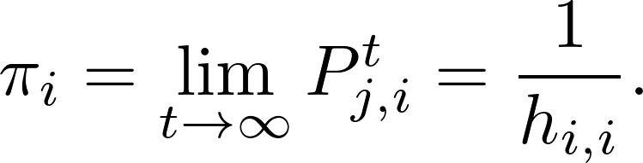
Stationary Distributions
Theorem. Any finite, irreducible, and ergodic Markov chain has the following properties:
  The chain has a unique stationary distribution
  for all j and i,

Slide 40
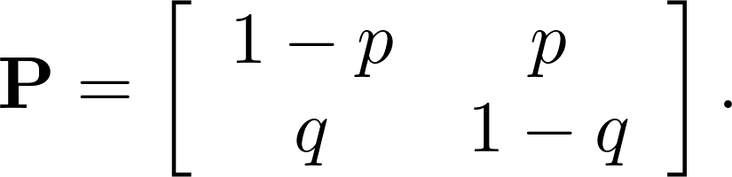
Computing the Stationary Distribution
Method 1: Solve the system of linear equations.
Example:
p
1−p
1−q
0
1
q

Slide 41
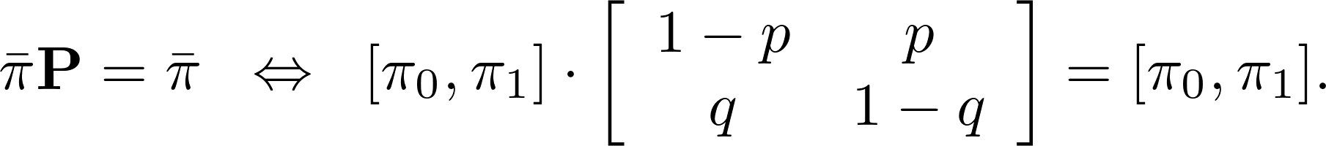
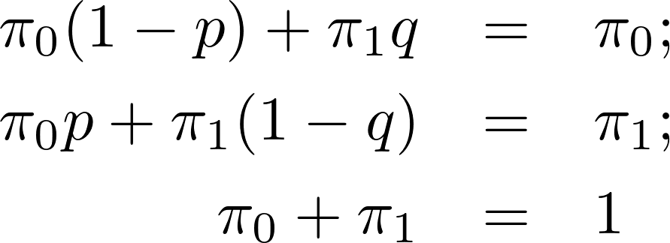
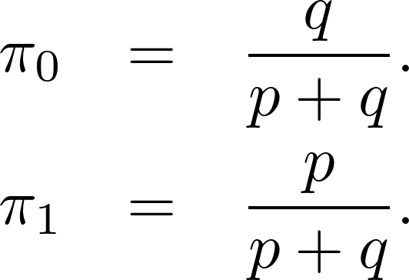
Computing the Stationary Distribution
Method 1: Solve the system of linear equations.
Example:
p
1−p
1−q
0
1
q

Slide 42
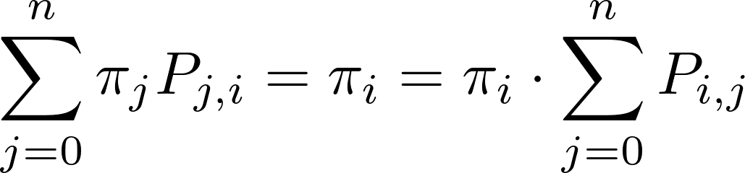
Computing the Stationary Distribution
Method 2: Cut-sets of the Markov chain.
The idea:
  For any state i of the chain,
i

Slide 43

Computing the Stationary Distribution
Method 2: Cut-sets of the Markov chain.
Example:
The probability of leaving state 0 must equal the probability of entering state 0
p
1−p
1−q
0
1
q

Slide 44
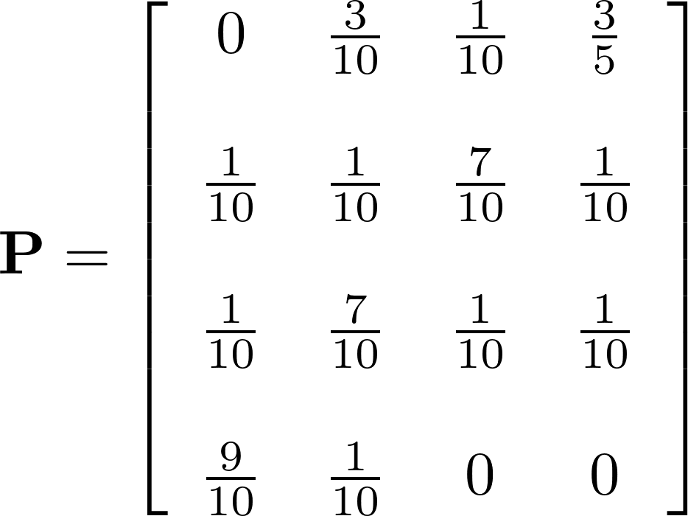
Assignment 08
Consider a Markov chain with state space {0, 1, 2, 3} and a transition matrix
Find the stationary distribution of the Markov chain.

