Slide 1
Economics and Computation
Preliminaries in Game Theory
Joseph Chuang-Chieh Lin
Dept. Computer Science and Engineering
National Taiwan Ocean University
Taiwan

Slide 2
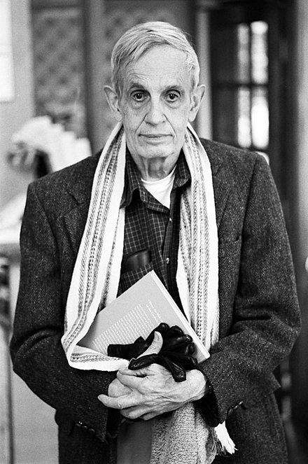
John Forbes Nash Jr. (1928–2015)
American mathematician.
Fundamental contributions to game theory.
1994 Nobel Memorial Prize in Economic Sciences, shared with John Harsanyi and Reinhard Selten, for pioneering analysis of equilibria in non-cooperative games.
2015 Abel Prize, shared with Louis Nirenberg, for fundamental contributions to nonlinear partial differential equations.
Nash in 2006.
Reference: https://en.wikipedia.org/wiki/John_Forbes_Nash_Jr.

Slide 3
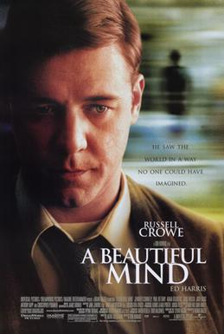
A classic scene of “A Beautiful Mind”
https://youtu.be/LJS7Igvk6ZM?si=lQr2OQqGxW4zFRK0
Starring: Russel Crowe

Slide 4
Before introducing Nash Equilibria...
Let’s play around several “games” first.

Slide 5
Number Guessing
Let’s say I have chosen a secret number A in my mind, which is among 1 and 100.
Please guess it by a number B.
If B < A, I will tell you “Larger, please”.
If B > A, I will tell you “Smaller, please”.
How many times do you think you can find out this secret number?
B
A
A
B

Slide 6
Number Guessing
Let’s say I have chosen a secret number A in my mind, which is among 1 and 100.
Please guess it by a number B.
If B < A, I will tell you “Larger, please”.
If B > A, I will tell you “Smaller, please”.
How many times do you think you can find out this secret number? Let’s play to feel the strategic behaviors.
B
A
A
B

Slide 7
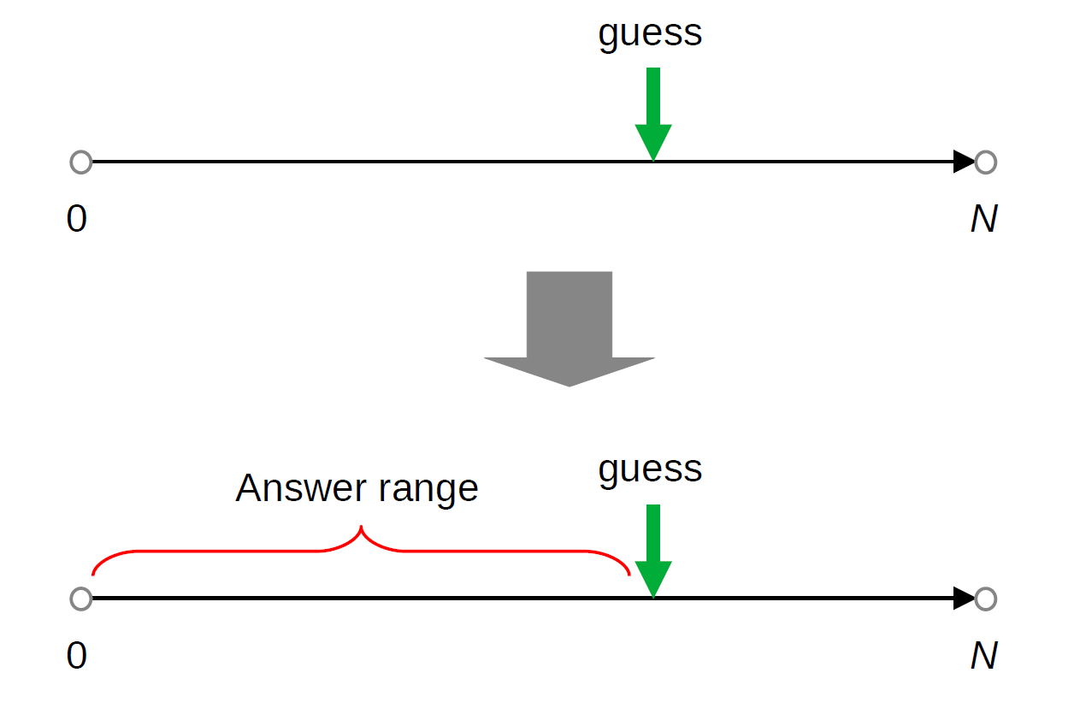
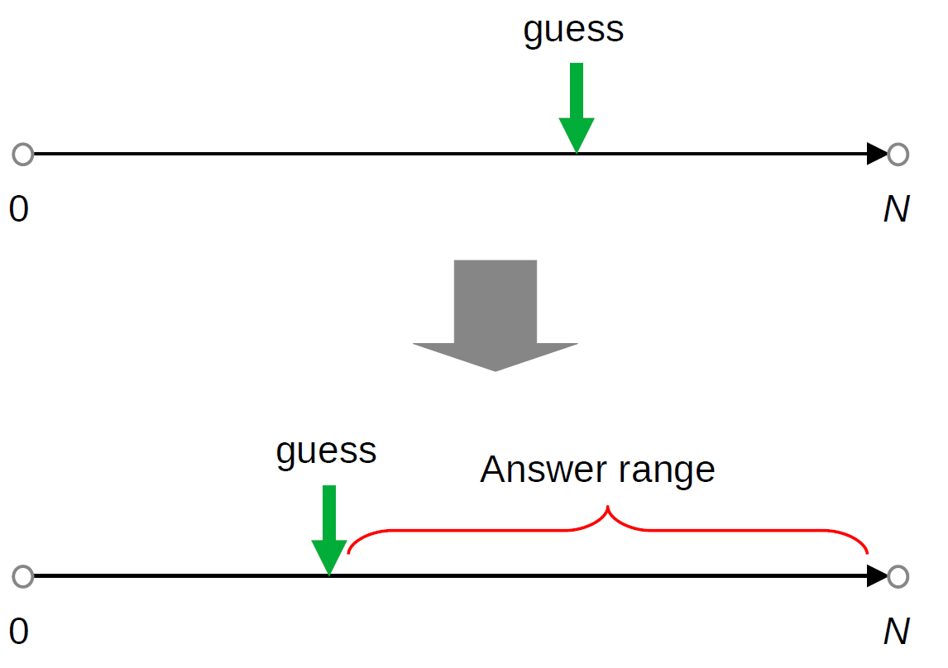
Adversarial Number Guessing
The demo code.
guess

Slide 8
Envy-Free Cake-Cutting
Children wants everything to be FAIR.
Actually, in their world, nothing is FAIR…… lol

Slide 9
Envy-Free Cake-Cutting
Children wants everything to be FAIR.
Actually, in their world, nothing is FAIR…… lol
Let’s say we want two kids to share a cake.

Slide 10
Envy-Free Cake-Cutting
Children wants everything to be FAIR.
Actually, in their world, nothing is FAIR…… lol
Let’s say we want two kids to share a cake.
Can you propose a way of cutting a cake so that two kids share a cake so that no one envies the other?

Slide 11
Prisoners’ Dilemma
It was originally framed by Merrill Flood and Melvin Dresher in 1950.
Let’s say there are two guys, A and B, who broke into a luxury store and stole a treasure.

Slide 12

Prisoners’ Dilemma
It was originally framed by Merrill Flood and Melvin Dresher in 1950.
Let’s say there are two guys, A and B, who broke into a luxury store and stole a treasure.
They had hided the treasure before the police caught them.
source

Slide 13
Prisoners’ Dilemma
It was originally framed by Merrill Flood and Melvin Dresher in 1950.
Let’s say there are two guys, A and B, who broke into a luxury store and stole a treasure.
They had hided the treasure before the police caught them.
They were kept in two separated rooms.
  That means, they cannot communicate with each other…
Each of them was offered two choices: Denial or confession.

Slide 14
Prisoners’ Dilemma
They were told that:

Slide 15
Prisoners’ Dilemma
They were told that:
  If both of them deny the fact of stealing the treasure, they will BOTH be sentenced in prison for one month.
  If one of them confesses while the other one denies, the former will be set FREE while the latter will be sentenced in prison for 9 months.
  If both confess, then they will both get 6 months in prison.
    Because the police officers have got their images from the monitor...

Slide 16
Prisoners’ Dilemma
They were told that:
  If both of them deny the fact of stealing the treasure, they will BOTH be sentenced in prison for one month.
  If one of them confesses while the other one denies, the former will be set FREE while the latter will be sentenced in prison for 9 months.
  If both confess, then they will both get 6 months in prison.
    Because the police officers have got their images from the monitor…
In your opinion, what should they do?
  They cannot communicate, and they must make their decisions simultaneously.

Slide 17
Prisoners’ Dilemma
We can use a “matrix” to formulate this game.
Two players, two actions for each.
If you are criminal A, what will you do?
What’s the solution (outcome)?
Criminal B
Denial
Confess
−1, −1 | −9, 0
0, −9 | −6, −6
Denial
Criminal A
Confess
Notes:
Dominant strategy.

Slide 18
Prisoners’ Dilemma
Dominant strategy?
Socially inefficient.
  Why is it inefficient?
Price of Anarchy (PoA).
Criminal B
Denial
Confess
−1, −1 | −9, 0
0, −9 | −6, −6
Denial
Criminal A
Confess
Notes:
Dominant strategy.

Slide 19
Bach or Stravinsky (BoS)
A historical two-player game.
  The battle of sexes (in Games and Decisions by Luce and Raiffa, 1957).
  Say Amy and Bob want to pick a concert to go to.

Slide 20
Bach or Stravinsky (BoS)
A historical two-player game.
  The battle of sexes (in Games and Decisions by Luce and Raiffa, 1957).
  Say Amy and Bob want to pick a concert to go to.
  Both prefer to go together than to go home.
  However, Amy prefers Bach while Bob prefers Stravinsky.

Slide 21
Bach or Stravinsky (BoS)
What are the SOLUTIONS of the game?
Is there any dominant strategy for either Amy or Bob?
Bob
Bach
Stravinsky
2, 1 | 0, 0
0, 0 | 1, 2
Bach
Amy
Stravinsky
The matrix form

Slide 22
Battle of Sexes (BoS)
What are the SOLUTIONS of the game?
Is there any dominant strategy for either Amy or Bob?
Bob
Baseball
Game
Movie
2, 1 | 0, 0
0, 0 | 1, 2
Movie
Amy
Baseball Game
The matrix form

Slide 23
Matching Pennies
Two players, playing a game by throwing a penny.
Both ‘heads’ or both ‘tails’: player 1 keeps both pennies.
Otherwise, player 2 keeps both pennies.

Slide 24
Matching Pennies
Two players, playing a game by throwing a penny.
Both ‘heads’ or both ‘tails’: player 1 keeps both pennies.
Otherwise, player 2 keeps both pennies.
Player 2
head
tail
1, −1 | −1, 1
−1, 1 | 1, −1
head
The matrix form
Player 1
tail

Slide 25
Matching Pennies
Zero-sum?
Do dominant strategies exist?
What are the solutions?
Player 2
head
tail
1, −1 | −1, 1
−1, 1 | 1, −1
head
Player 1
tail

Slide 26
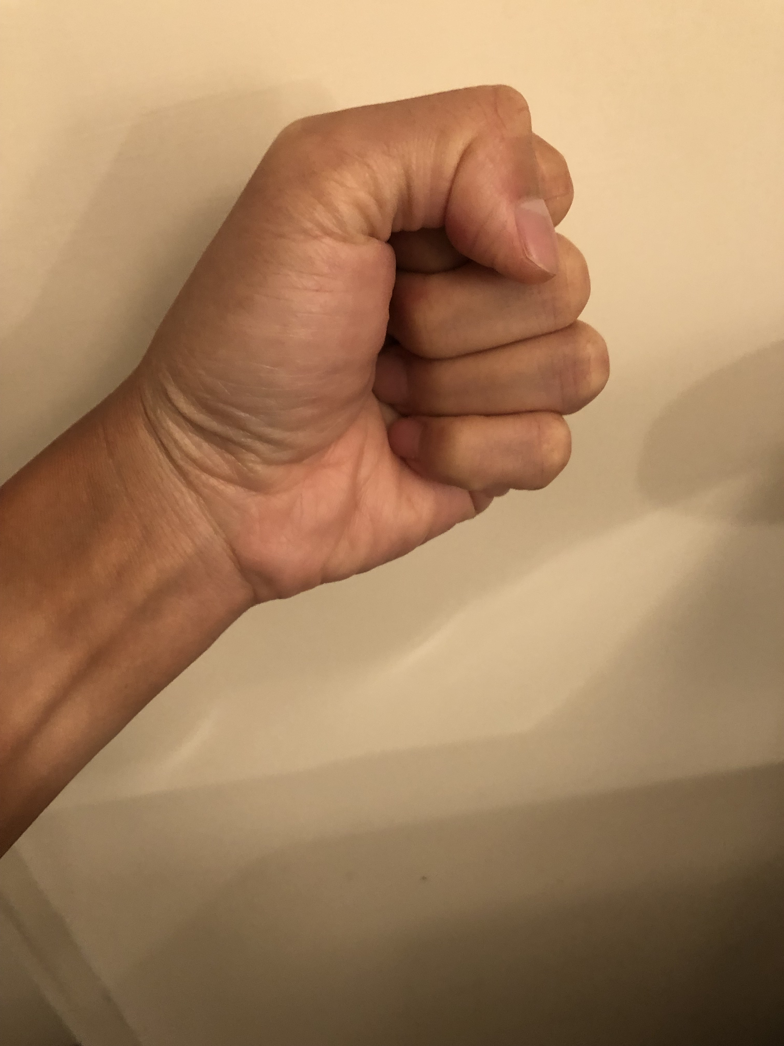

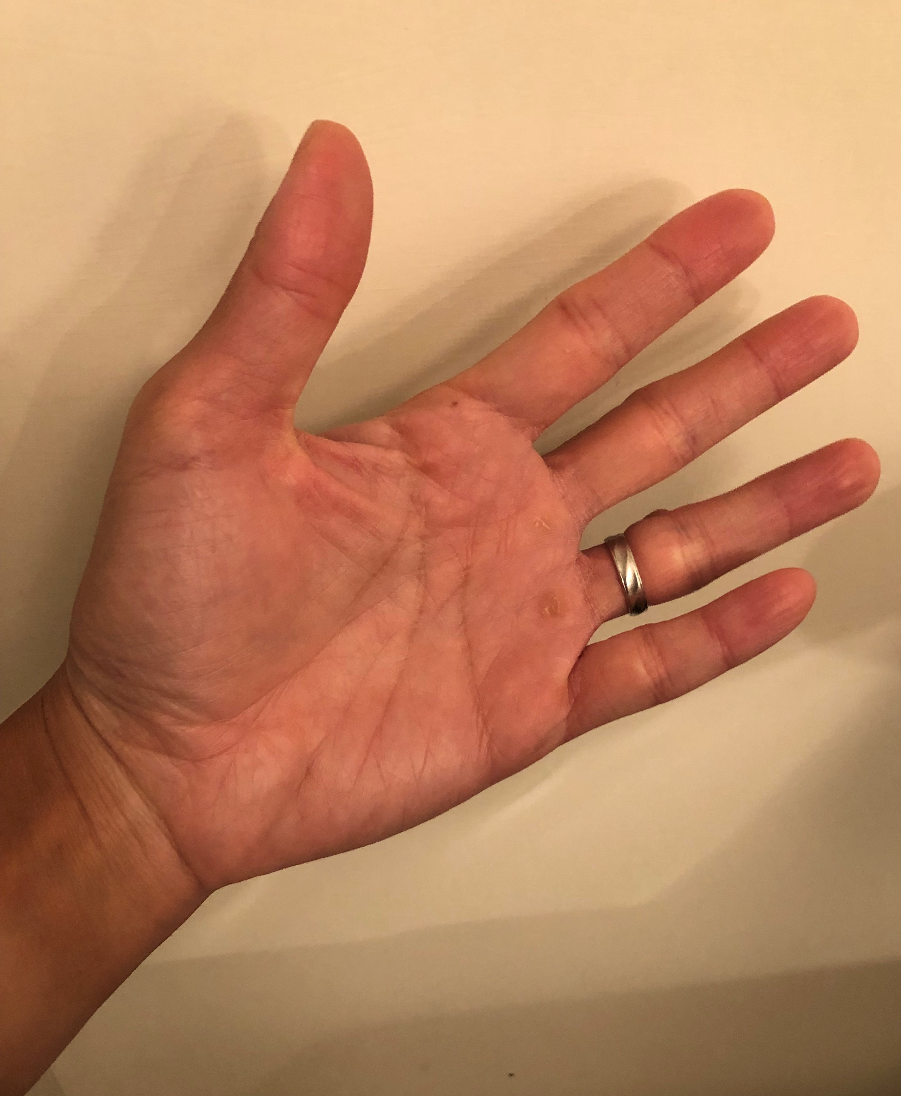
Rock-Scissors-Paper Game
Player 2
rock
scissors
paper
0, 0 | 1, −1 | −1, 1
−1, 1 | 0, 0 | 1, −1
1, −1 | −1, 1 | 0, 0
rock
Player 1
rock
scissors
paper
scissors
paper

Slide 27
Rock-Scissors-Paper Game
Player 2
Zero-sum?
Dominant strategies?
Any solutions?
rock
scissors
paper
0, 0 | 1, −1 | −1, 1
−1, 1 | 0, 0 | 1, −1
1, −1 | −1, 1 | 0, 0
rock
Player 1
scissors
paper

Slide 28
Pareto Optimality (1/3)
We have seen games from the player’s perspective.
From the point of view of an outside observer, we would like to know if there is some outcome(s) of a game which can be said to be better than others.

Slide 29
Pareto Optimality (2/3)
One outcome o is at least as good for every player as another
outcome o', and there is some player who strictly prefers
o to o'. In this case, we say o Pareto-dominates o'.
Definition
An outcome o* is Pareto-optimal if there is no other outcome that Pareto-dominates it.

Slide 30
Example
Presents of three types X, Y, Z will be assigned to three kids Alice, Bob, Chloé. Say the happiness is measured by numbers.
  Everyone gets X: (Alice: 2, Bob: 3, Cholé: 4)
  Everyone gets Y: (Alice: 1, Bob: 4, Cholé: 3)
  Everyone gets Z: (Alice: 2, Bob: 4, Cholé: 4)

Slide 31
Example
Presents of three types X, Y, Z will be assigned to three kids Alice, Bob, Chloé. Say the happiness is measured by numbers.
  Everyone gets X: (Alice: 2, Bob: 3, Cholé: 4)
  Everyone gets Y: (Alice: 1, Bob: 4, Cholé: 3)
  Everyone gets Z: (Alice: 2, Bob: 4, Cholé: 4)
Z Pareto dominates X and Y.

Slide 32
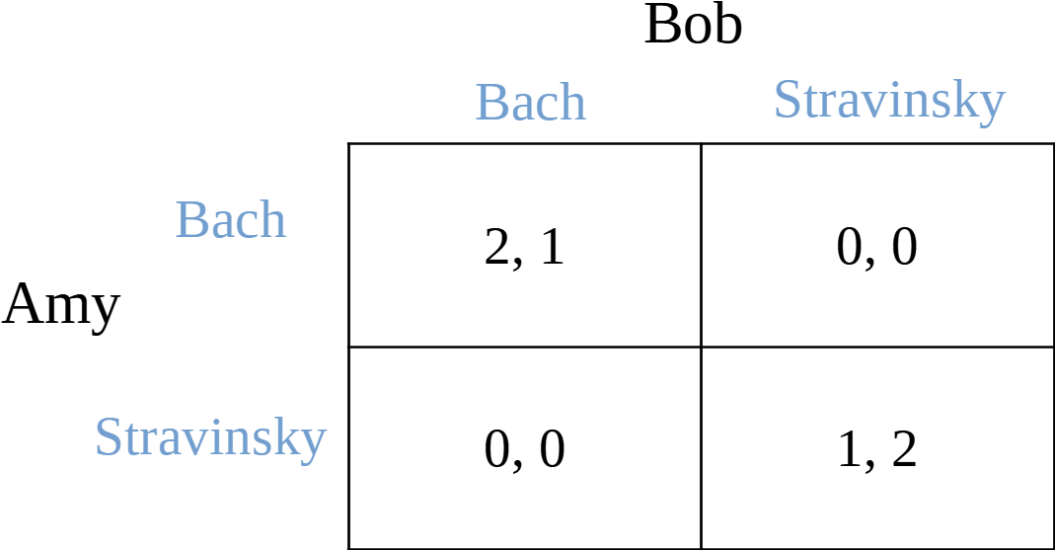
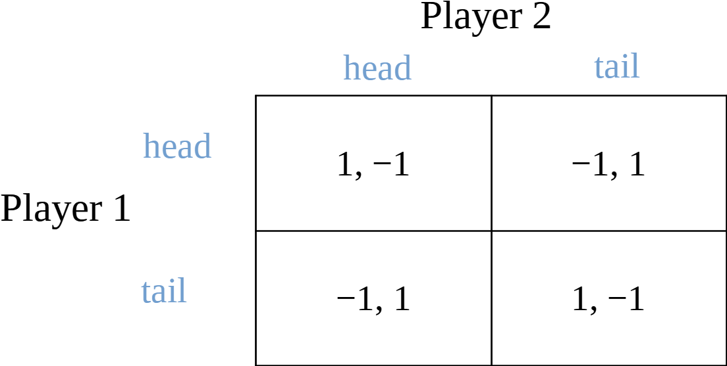
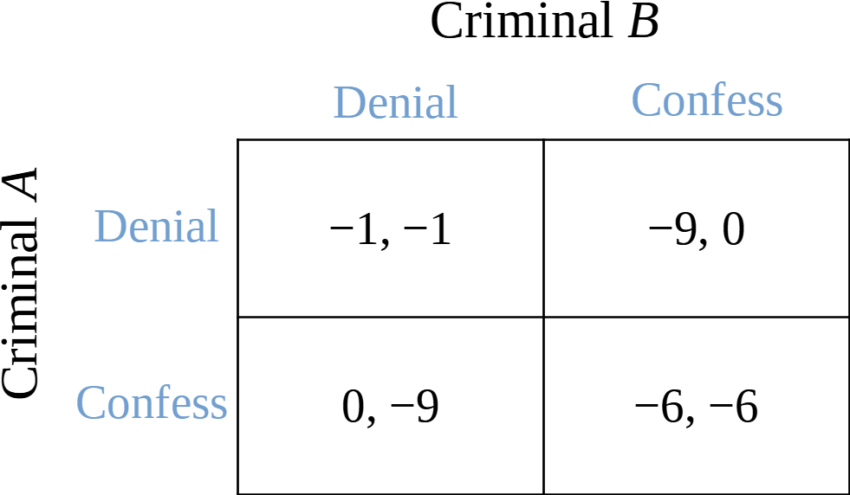
Pareto Optimality (3/3)

Slide 33
Pareto Optimality (3/3)
The pure-strategy NE is the only non-Pareto-optimal outcome!

Slide 34
Mixed Strategies
What we have discussed about are all pure strategies.
  A deterministic action.

Slide 35
Mixed Strategies
What we have discussed about are all pure strategies.
  A deterministic action.
What is a mixed strategy?

Slide 36
Mixed Strategies
Like this?
  Nine-headed Dragon Strike.
Or like this?
  Man of many pitches.
For a portfolio manager in a hedge fund:
  Portfolio weighting

Slide 37
Back to the Game of Matching Pennies
Setting the weights?
Player 2
head
tail
1, −1 | −1, 1
−1, 1 | 1, −1
head
Player 1
tail

Slide 38
Back to the Game of Matching Pennies
Setting the weights?
Player 2
head
tail
1, −1 | −1, 1
−1, 1 | 1, −1
head
Player 1
tail

Slide 39
Back to the Game of Matching Pennies
Setting the weights?
The expected utility of player 1 playing ‘head’:
The expected utility of player 1 playing ‘tail’:
Player 2
head
tail
1, −1 | −1, 1
−1, 1 | 1, −1
head
Player 1
tail

Slide 40
An intuitive definition of a Nash equilibrium
A state such that no player can increase her expected payoff (profit, gain, advantage, money, etc.) by a unilateral deviation.
Nash’s Theorem:
Every finite game (a finite number of players, each has a finite number of pure strategies) has at least one Nash equilibrium.

Slide 41
Back to the Game of Matching Pennies
Setting the weights?
The expected utility of player 1 playing ‘head’:
The expected utility of player 1 playing ‘tail’:
What if
Player 2
head
tail
1, −1 | −1, 1
−1, 1 | 1, −1
head
Player 1
tail

Slide 42
Back to the Game of Matching Pennies
Setting the weights?
The expected utility of player 1 playing ‘head’:
The expected utility of player 1 playing ‘tail’:
What if
Player 2
head
tail
1, −1 | −1, 1
−1, 1 | 1, −1
head
Player 1
tail

Slide 43
Back to the Game of Matching Pennies
Setting the weights?
The expected utility of player 1 playing ‘head’:
The expected utility of player 1 playing ‘tail’:
Solving
Player 2
head
tail
1, −1 | −1, 1
−1, 1 | 1, −1
head
Player 1
tail

Slide 44
Back to the Game of Matching Pennies
Take your time.
So we just proved that the game has a kind of solution:
Player 2
head
tail
1, −1 | −1, 1
−1, 1 | 1, −1
head
“Mixed-Strategy Nash Equilibrium”.
Player 1
tail

Slide 45
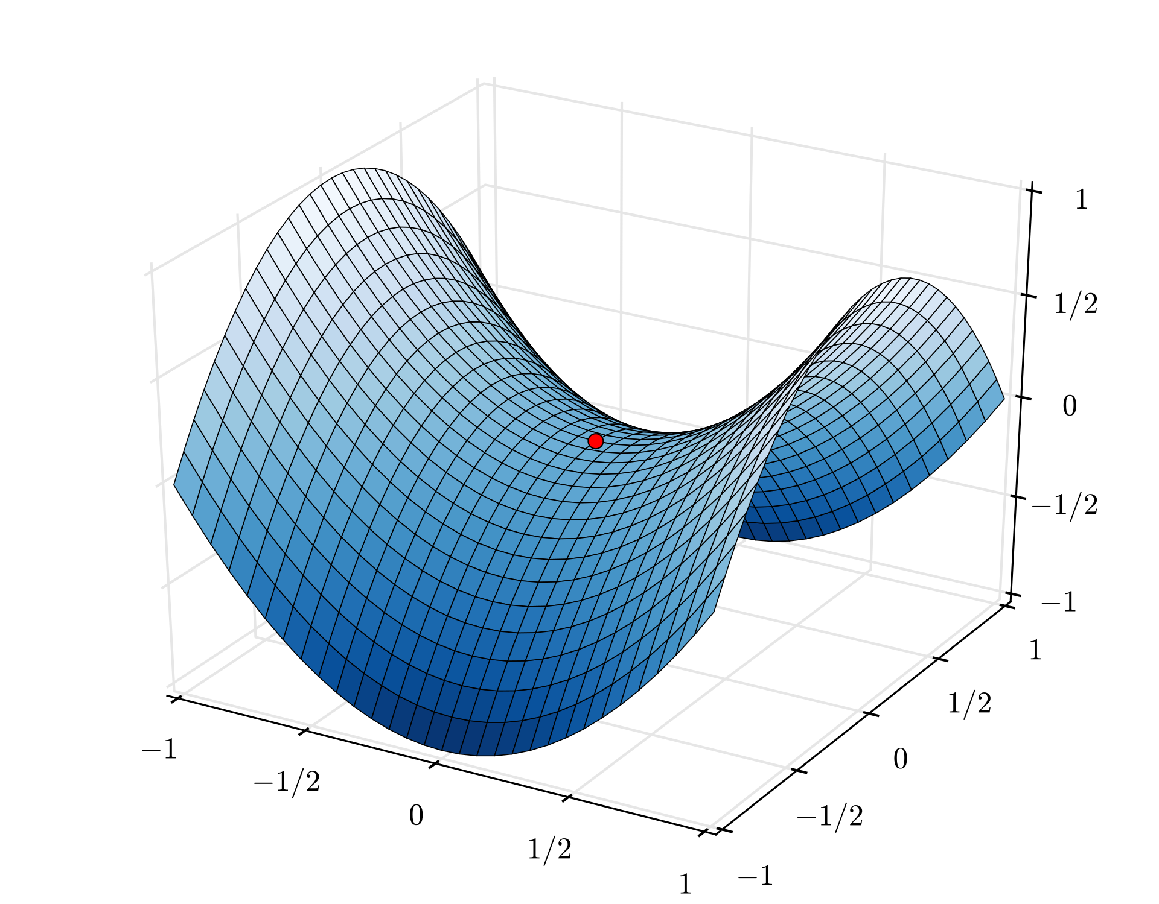

Saddle point illustration

Slide 46
An intuitive definition of a Nash equilibrium
A state such that no player can increase her expected payoff (profit, gain, advantage, money, etc.) by a unilateral deviation.
Nash’s Theorem:
Every finite game (a finite number of players, each has a finite number of pure strategies) has at least one Nash equilibrium.
The concept of best responses & mixed strategies.

Slide 47
Back to the classic scene of “A Beautiful Mind”
https://www.youtube.com/watch?v=2d_dtTZQyUM
Do you observe anything strange or anything wrong?
  https://www.youtube.com/watch?v=DTcmmD_MWas

Slide 48
An Easy Exercise
Please find out a mixed-strategy Nash equilibrium of the rock-scissors-paper game.
Player 2
rock
scissors
paper
0, 0 | 1, −1 | −1, 1
−1, 1 | 0, 0 | 1, −1
1, −1 | −1, 1 | 0, 0
rock
Player 1
scissors
paper

