Slide 1
Randomized Algorithms
Introduction
Joseph Chuang-Chieh Lin
Dept. CSIE, Tamkang University

Slide 2
Self Introduction
Ph.D.: CSIE, National Chung Cheng University, 2011.
  DAAD-NSC Sandwich Program (2007−2008).
  Dissertation supervisors: Maw-Shang Chang & Peter Rossmanith (RWTH Aachen)
Postdoc in Genomics Research Center, Academia Sinica (2011−2014).
Postdoc in Institute of Information Science, Academia Sinica (2014−2018).
Quantitative Analyst (intern) of Point72/Cubist Systematic Strategies (2018−2019).
Quantitative Analyst of Seth Technologies Inc. (2020−2021/01).

Slide 3
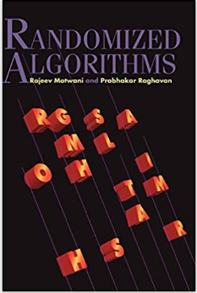
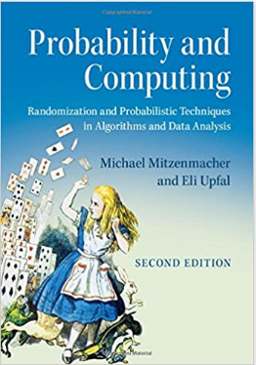
Textbooks and Materials
Textbooks:
  Randomized Algorithms. Motwani, R. and Raghavan, P., 1995. Cambridge University Press.
  Probability and Computing: Randomization and Probabilistic Techniques in Algorithms and Data Analysis. Second Edition. M. Mitzenmacher and E. Upfal, Cambridge University Press, 2017.
Other materials:
  Prepared slides.

Slide 4
Prerequisites
Basic undergraduate courses in
  Algorithms
  Data structures
  Probability theory
  Discrete mathematics
  Linear Algebra
Motivation.
Curiosity.

Slide 5
Topics
Introduction & the Min-Cut Problem
Examples of Probability Paradoxes
Probability Prerequisites
Coupon Collector’s Problem
The Secretary Problem
Randomized Quicksort
Moments and Deviations
Chernoff Bounds and Hoeffding Bounds
Balls and Bins
Continuous Distributions and the Poisson Process
Markov Chains and Random Walks
Monte Chains Monte Carlo (MCMC)

Slide 6
Grading Policy
Attendance (10%)
Assignments (x 6, 30%)
Midterm Presentation (30%)
Final Presentation (30%)

Slide 7
Traditional deterministic algorithms
ALGORITHM
input
output

Slide 8

Randomized algorithms
random bits
ALGORITHM
input
output
figure freely downloaded from https://pixabay.com/illustrations/coin-flipping-coin-hand-flip-flick-5822271/

Slide 9
Why?
Randomized algorithms are
  often much simpler than the best known deterministic ones.
  often much more efficient (faster or using less space) than the best known deterministic ones.
Sometimes ideas from the randomized algorithms lead to good deterministic algorithms.

Slide 10
Comparisons
It’s different from the average-case analysis of deterministic algorithms.
  e.g., expected running time of a deterministic algorithm on input sampled from a distribution.
In most scenarios, it’s NOT a heuristic algorithm.
  The accuracy is guaranteed, or
  The running time is guaranteed.

Slide 11
An illustrating example:
Problem: find a grade-‘A’ student in a class of n students where half of them get ‘A’.
What is the time complexity for the best deterministic algorithm?
  I mean, in the “worst case”.

Slide 12
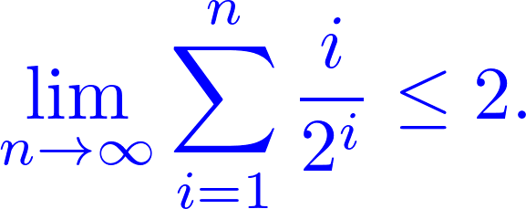
A randomized algorithm (from Wikipedia)
findingA_LV(array L, n)
begin
repeat
Randomly select one element out of n elements.
until 'A' is found
end
Assignment: Prove that the expected number of iterations is

Slide 13

A randomized algorithm (from Wikipedia)
  findingA_MC(array L, n, k)
  begin
  i ← 0
  repeat
  Randomly select one element out of n elements.
            i ← i + 1
  until i = k or 'A' is found
  end
After k iterations,

Slide 14
Birthday problem (paradox)
There are n randomly chosen people in a room.
How large should n be such that there is at least one pair of them having the same birthday (mm/dd)?
By the pigeonhole principle, n = 367? or 366?
Let us consider this problem in the other way around.
How large should n be such that there is at least one pair of them having the same birthday (mm/dd) with probability ≥ 0.5?

Slide 15
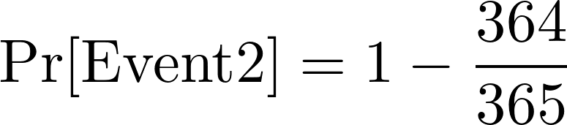
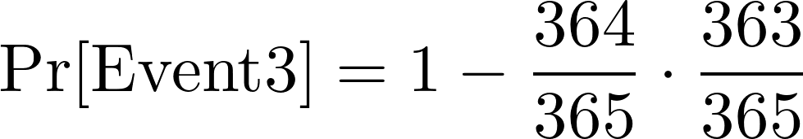
Birthday problem (paradox)
n people: x₁, x₂, ..., x_{n}
Event i: some pair of x₁, x₂, ..., x_{i} have the same birthday.
...
23 is much less than 366 or 367.

Slide 16
Birthday problem (paradox)
Assignment: Compute n such that there is at least one pair of them having the same birthday with probability ≥ 0.9.

Slide 17
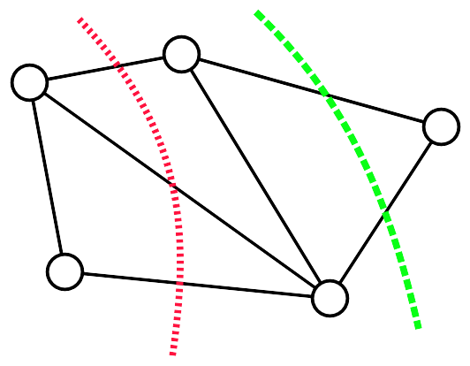


Min-Cut
A graph G = (V, E) and its two “cuts”.
  Cut: a partition of the vertices in V into two non-empty, disjoint sets S and T such that
The cutset of a cut:
The size of the cut:
  the cardinality of its cutset.

Slide 18
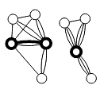
Edge contraction
e = (u, v)
G → G/e
u
v
u, v
By Thore Husfeldt - Python, networkx, neato and TikZ, CC BY-SA 3.0, https://commons.wikimedia.org/w/index.php?curid=21117500

Slide 19

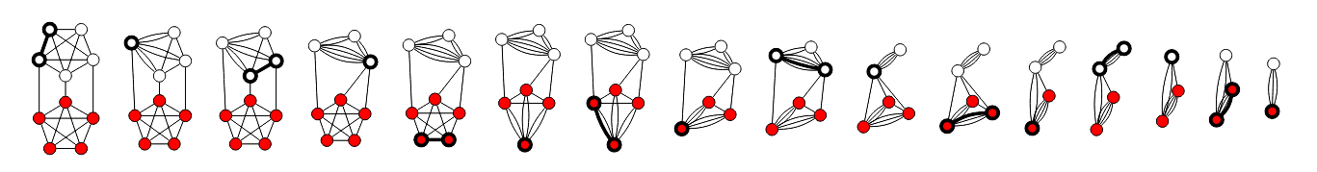
Karger’s edge-contraction algorithm (1993)
Procedure contract (G = (V, E)):
while |V| > 2:
  choose uniformly at random
  G ← G/e
return the only cut in G
Time complexity: O(m) or O(n²).
By Thore Husfeldt - Created in python using the networkx library for graph manipulation, neato for layout, and TikZ for drawing.,
CC BY-SA 3.0, https://commons.wikimedia.org/w/index.php?curid=21103489

Slide 20
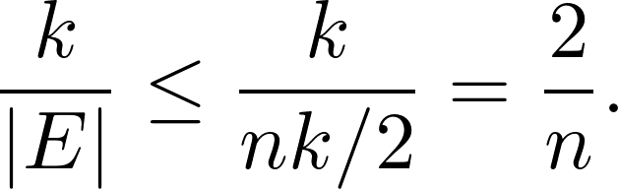
Analysis
C: a specific cut of G.
k: the size of the cut C.
The minimum degree of G must be ≥ k. (WHY?)
  So, |E| ≥ nk/2.
The probability that the algorithm picks an edge from C to contract is

Slide 21
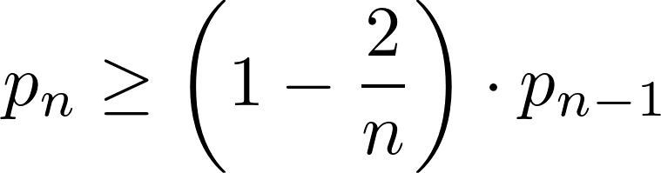
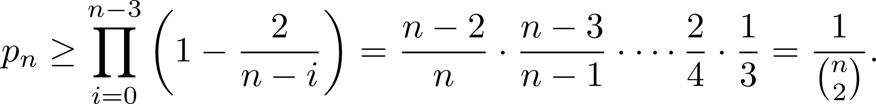
Analysis (contd.)
Let p_{n} be the probability that the algorithm on an n-vertex graph avoids C.
Then,
The recurrence can be expanded as

Slide 22
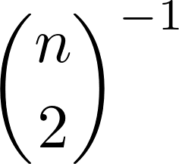
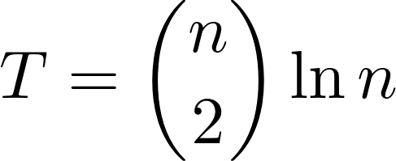
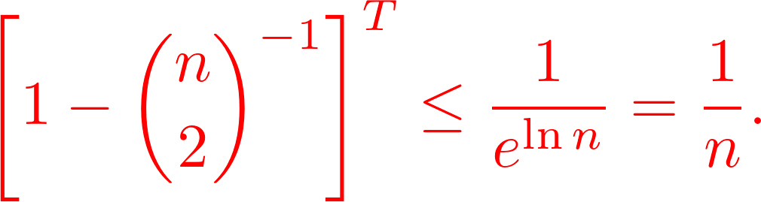
Analysis (contd.)
The probability of “success” is
  A bit too low, isn’t it?
How about repeating it for times, and then choose the minimum of them?
The probability of NOT finding a min-cut is
Total running time: O(Tm) or O(Tn²).

Slide 23
A bonus project (5%)
Implement Karger’s edge-contraction algorithm.

Slide 24
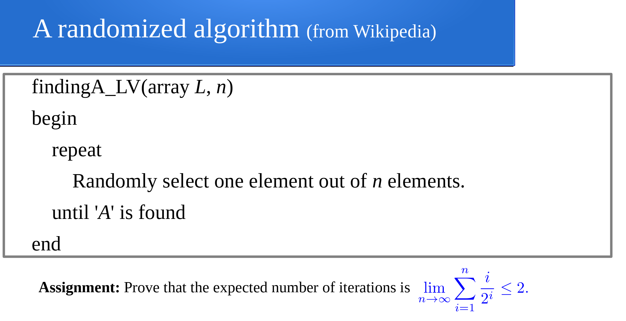
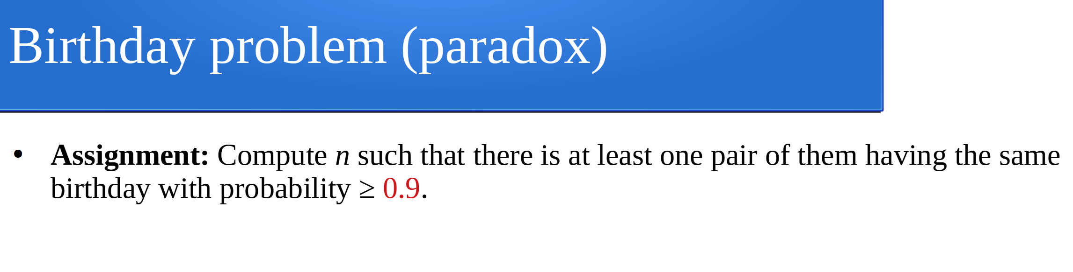
Assignment 1 (5%)
(3%)
(2%)

