Slide 1
Economics and Computation
Introduction
Joseph Chuang-Chieh Lin
Dept. Computer Science and Engineering
National Taiwan Ocean University
Taiwan

Slide 2
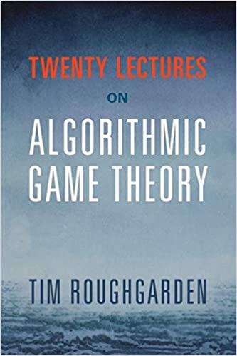

Textbooks and Materials
Textbooks/Lectures:
  Twenty Lectures on Algorithmic Game Theory. Tim Roughgarden. Cambridge University Press. 2016.
  Algorithmic Game Theory. Noam Nisan, Tim Roughgarden, Eva Tardos, and Vijav V. Vazirani. Cambridge University Press. 2011.
  Handbook of Computational Social Choice. F. Brandt, Vincent Conitzer, U. Endriss, Jérôme Lang, Ariel D. Procaccia. Cambridge University Press. 2016.
Other materials:
  Essentials of Game Theory: A Concise, Multidisciplinary Introduction (Synthesis Lectures on Artificial Intelligence and Machine Learning). Leyton- Brown and Kevin, Shoham. Cambridge University Press. 2008.
Course website:
  https://josephcclin.github.io/courses/ec_and_agt.htm

Slide 3
Prerequisites
Basic CS undergraduate courses in
  Algorithms
  Calculus
  Probability theory
  Programming
Motivation.
Curiosity.

Slide 4
Major Topics
Game Theory
Equilibrium Concepts
Computational Social Choice
Mechanism Design
Auctions
No-Regret Dynamics

Slide 5
Grading Policy
Attendance (10%)
Three quizzes on assignments (60%)
  Assignments announced first, then a quiz will be held in one week.
  Oct. 5, Nov. 9, Dec. 7
Final presentation (30%)
  Research conference papers
  About December 14 & 21, 2026.

Slide 6
Grading policy for the presentations
1~3 people in each group (depending on the number of enrolled students).
Complete the presentation: 65 point
  Duration for each presentation: 30~45 minutes.
    2-person group: 30-35 minutes.
    3-person group: 40-45 minutes.
Raising questions: +2 point for each one, maximum +10 point.
  Check the count at the end of the class.
Responses to instructor questions: +5 point for each one, maximum +15 point.
  One individual will be designated to answer.
(Intra-Group) Peer Assessment: maximum +10 point.

Slide 7
Source of the papers
International conferences:
  EC: Proceedings of the ACM conference on Electronic commerce.
  NeurIPS: Conference on Neural Information Processing Systems.
  AAAI: Association for the Advancement of Artificial Intelligence.
  IJCAI: International Joint Conferences on Artificial Intelligence.
  AAMAS: International Conference on Autonomous Agents and Multiagent Systems.
  SAGT: Symposium on Algorithmic Game Theory.
  WINE: International Conference on Web and Internet Economics.
  Workshops such as GAIW, CFD, ...

Slide 8
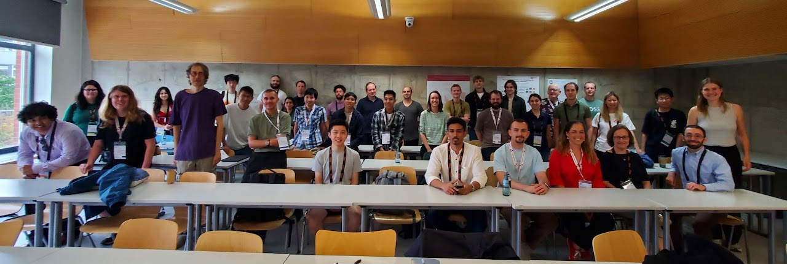
CFD 2026 (Bremen, 17 Aug 2026)

