Slide 1

Introduction to Probability Theory ‧2-1‧
- Preliminaries for Randomized Algorithms
Speaker: Chuang-Chieh Lin
Advisor: Professor Maw-Shang Chang
National Chung Cheng University
Dept. CSIE, Computation Theory Laboratory
January 11, 2006

Slide 2
Outline
Chapter 2: Random variables
  Discrete random variables
  Discrete uniform probability law
  Cumulative distribution function (cdf)
  Probability density function (pdf)
  Expected values

Slide 3
Random variables (隨機變數)
A random variable, usually written X, is a variable whose possible values are numerical outcomes of a random phenomenon. There are two types of random variables, discrete and continuous.
The abbreviation “r.v.” is sometimes used to denote a random variable.

Slide 4
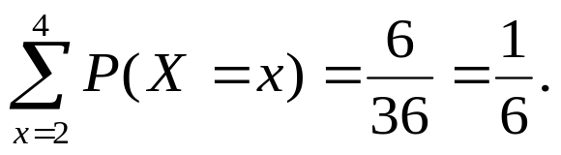
令隨機變數 X 表示兩顆骰子的點數和，則 X 的觀測值(Observed value)，就是代表觀測結果的有序二元組中兩個數字之和。
值域 (range) R_{X} = {2, 3,..., 12}。則 P(X = x) 表示 X = x 發生的機率。
P(X ≤ 4) =
這是離散型隨機變數(discrete random variable)。
x | 2 | 3 | 4 | 5 | 6 | 7 | 8 | 9 | 10 | 11 | 12
P(X = x) | 1/36 | 2/36 | 3/36 | 4/36 | 5/36 | 6/36 | 5/36 | 4/36 | 3/36 | 2/36 | 1/36

Slide 5
Discrete random variables
If X is a discrete random variable with range R_{X}, the probability function for X is p_{X}(x) = P(X = x), which gives the probability of occurrence for each x ∈ R_{X}.
Requirements for the probability function for a discrete random variable X.
  p_{X}(x) ≥ 0 for all real values of x.
  ∑_{x∈RX} p_{X}(x) = 1 for discrete R_{X}.

Slide 6
Discrete uniform probability
A random variable X has the discrete uniform probability law with integer parameter n if
  The range for X is R_{X} = {1,2,…, n}, where n is any positive integer.
  The probability function for X is constant for x∈R_{X} ; thus p_{X}(x) = 1/n.

Slide 7
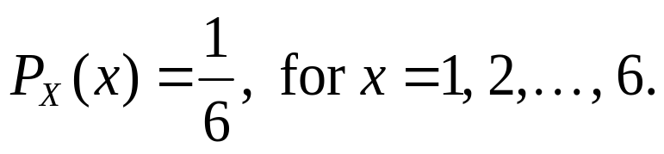
例如：令 X 代表擲一顆均勻骰子出現時的點數，則 X 具有discrete uniform with parameter n = 6.
X 的機率函數(probability function)為

Slide 8
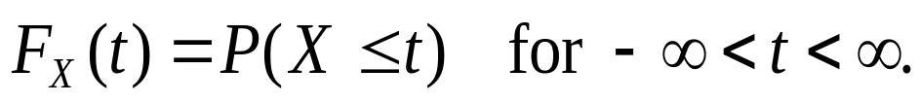
Cumulative distribution function (cdf) (累積機率分佈函數)
Let X be a random variable and let t be any real number; the cumulative distribution function (cdf) for X is F_{X}(t), which gives the probability that the observed value for X will be less than or equal to t, for all real t :

Slide 9
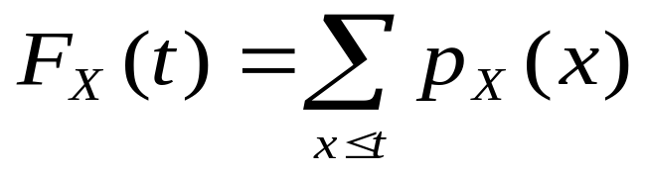
Cumulative distribution function (cdf) (contd.)
If X is a discrete random variable, then its cdf can be written
for all real t.

Slide 10
令隨機變數 X 表示兩顆骰子的點數和，則 X 的觀測值(Observed value)，就是代表觀測結果的有序二元組中兩個數字之和。
值域 (range) R_{X} = {2, 3,..., 12}。則 P(X = x) 表示 X = x 發生的機率。
F_{X} (4) = P(X ≤ 4) =
x | 2 | 3 | 4 | 5 | 6 | 7 | 8 | 9 | 10 | 11 | 12
P(X = x) | 1/36 | 2/36 | 3/36 | 4/36 | 5/36 | 6/36 | 5/36 | 4/36 | 3/36 | 2/36 | 1/36

Slide 11
Requirement for F_{X}(t)
0 ≤ F_{X}(t) ≤ 1 for all real values of t.
lim F_{X}(t) = 0 and lim F_{X}(t) = 1.
If c < d, then F_{X}(c) ≤ F_{X}(d).
F_{X}(t) must be right continuous (右連續).
t → – ∞
t → + ∞
p_{X}(x)
x

Slide 12
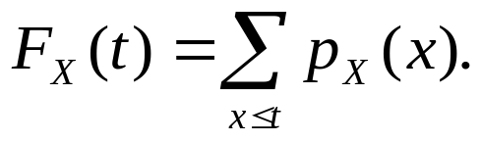
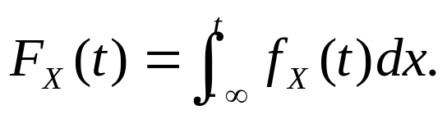
Probability density function (pdf)
(機率密度函數)
For discrete r.v. X,
For continuous r.v. X,
(actually, p_{X} is called the pdf of X)
(actually, f_{X} is called the pdf of X)

Slide 13
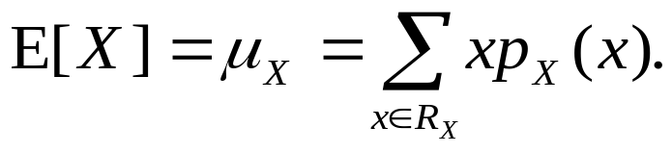
Expected values (期望值)
Expected values are also called the average values or means.
The expected value for a discrete r.v. X is

Slide 14
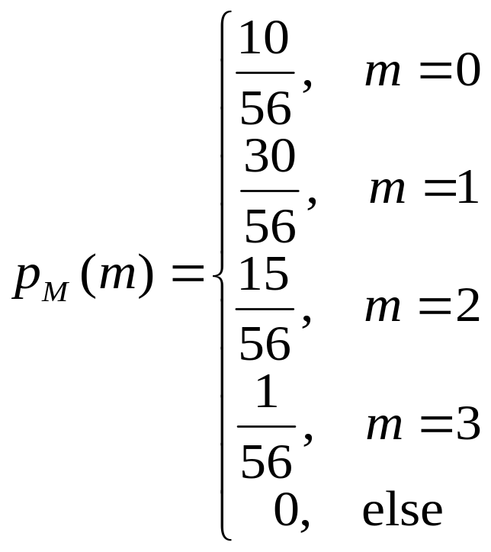
一家小公司有三個職位出缺，三個職位的要求相同，負責的工作也一樣；現在共有 8 個人， 包括 5 位女性，來應徵這些職位。如果用隨機的方式從 8 人中選出 3 人來錄用。問錄用的男性人數期望值為多少？
令 M 代表錄用的男性人數，則
故所求 E[M] = 63/56 = 9/8.
Notes:
P_{M}(1) = C(3,1) * C(5, 2) / C(8, 3)

Slide 15
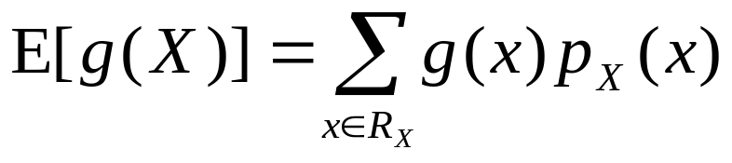
Expected value for a real-valued function
Let g(·) be any real-valued function whose domain includes R_{X} , the range for a discrete r.v. X. Then the expected value of g(X) is defined to be:

Slide 16
令隨機變數 X 表示兩顆骰子的點數和，則 X 的觀測值(Observed value)，就是代表觀測結果的有序二元組中兩個數字之和。
值域 (range) R_{X} = {2, 3,..., 12}。則 P(X = x) 表示 X = x 發生的機率。
某日小明要請小朱吃大餐，小明說：「骰子出現的點數和乘以 100 為多少，我就請你吃多少錢的大餐。」
試問這期望值怎麼算？
令g(x) = 100x
x | 2 | 3 | 4 | 5 | 6 | 7 | 8 | 9 | 10 | 11 | 12
P(X = x) | 1/36 | 2/36 | 3/36 | 4/36 | 5/36 | 6/36 | 5/36 | 4/36 | 3/36 | 2/36 | 1/36

Slide 17
E[g(X)] = 200 · 1/36 + 300 · 2/36 + 400 · 3/36 + 500 · 4/36 + 600 · 5/36
+ 700 · 6/36 + 800 · 5/36 + 900 · 4/36 + 1000 · 3/36 + 1100 · 2/36
+ 1200 · 1/36
= 700.
看來小朱可以吃到鬥牛士喔。

Slide 18
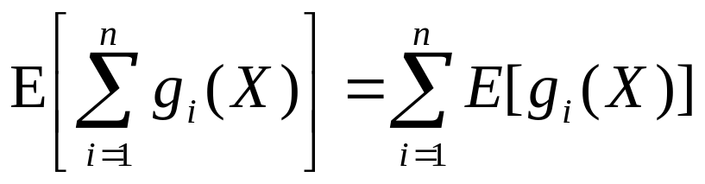
Theorem
If X is any random variable, then
  E[c] = c, where c is any constant.
  E[b · g(X)] = b · E[g(X)], where b is any constant.

Slide 19

Thank you.

Slide 20
References
[H01] 黃文典教授, 機率導論講義, 成大數學系, 2001.
[L94] H. J. Larson, Introduction to Probability, Addison-Wesley Advanced Series in Statistics, 1994; 機率學的世界, 鄭惟厚譯, 天下文化出版.
[MR95] R. Motwani and P. Raghavan, Randomized Algorithms, Cambridge University Press, 1995.

