Slide 1

Introduction to Probability Theory ‧2-2‧
- Preliminaries for Randomized Algorithms
Speaker: Chuang-Chieh Lin
Advisor: Professor Maw-Shang Chang
National Chung Cheng University
Dept. CSIE, Computation Theory Laboratory
January 25, 2006

Slide 2
Outline
Chapter 2: Random variables
  Variances and Standard deviation
  Chebyshev’s Inequality

Slide 3
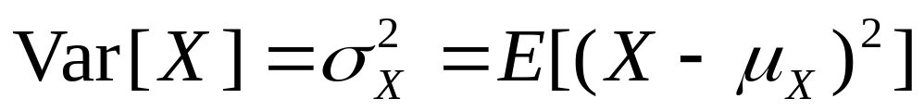
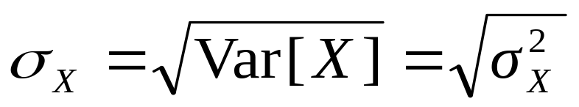
Variances and Standard deviation
(變異數與標準差)
The variance of a random variable X is the average squared distance between X and its mean μ_{X}:
The standard deviation of X is

Slide 4
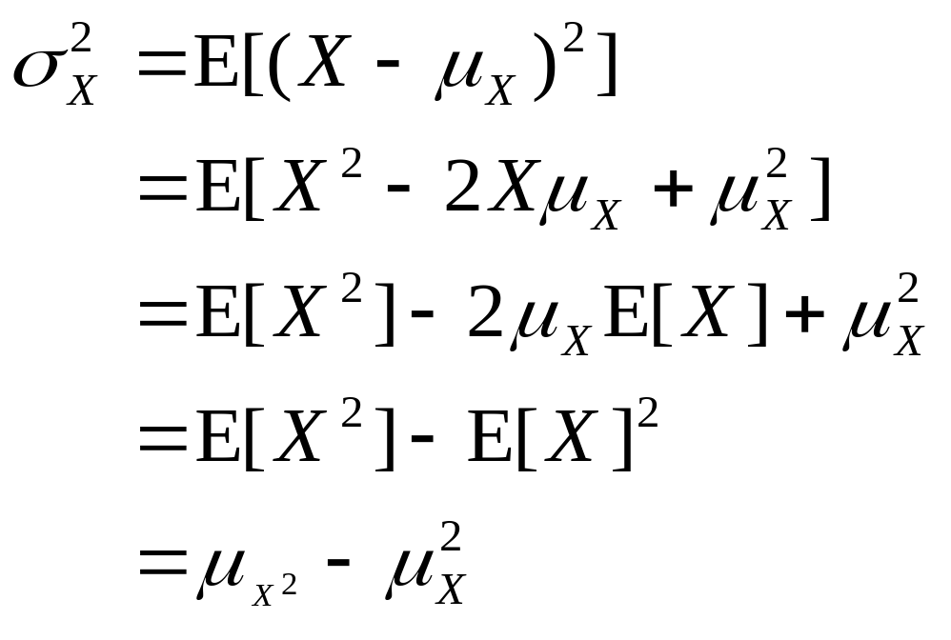
Actually, we can derive that
It is quite useful for computing the variances.

Slide 5
Suppose that X is discrete uniform with parameter n.
Its mean is (n + 1)/2.
Its variance is (n² – 1)/12.
1(1/n)+2(1/n)+…+n(1/n)
[1²(1/n)+2²(1/n)+…+n²(1/n)] – [(n + 1)/2]²

Slide 6
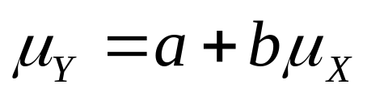
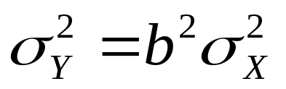
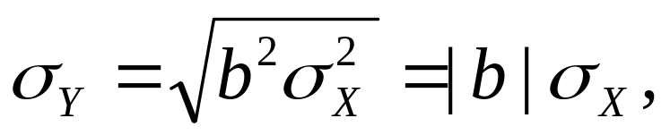
Theorem
If a and b are any real constants and Y = a + bX, then
  ♣
  ♣
  ♣
  as long as the expected values exist.

Slide 7
Standard form
The standard form of a random variable is used for several purposes. We introduce the standard form as follows.
The standard form for a random variable X is the linear function Y = a + bX where a, b ≥ 0 are chosen so that μ_{Y} = 0 and σ_{Y} = 1.

Slide 8
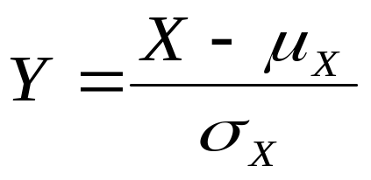
Standard form (contd.)
The standard form for any random variable X with mean μ_{X} and variance σ_{X}² is

Slide 9
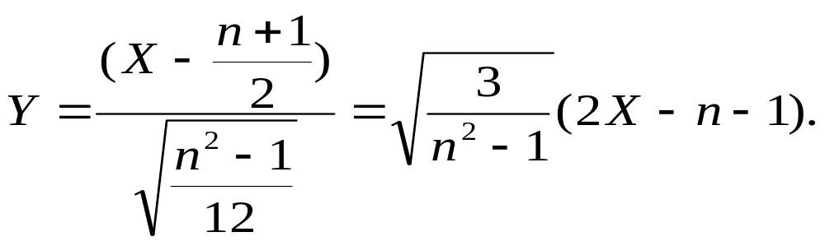
If X is discrete uniform with parameter n, then its mean is (n + 1)/2 and its variance is (n² – 1)/12.
Let Y be the standard form for X. Then Y is
You can verify that μ_{Y} = 0 and σ_{Y} = 1.

Slide 10
The expected value for a random variable locates the place at which its probability function or pdf with balance.
The standard deviation provides a measure of the spread of the distribution and a natural scale factor in measuring how much probability a distribution has in the vicinity of its mean.
This is the meaning of Chebyshev’s inequality.
Notes:
vicinity: 鄰近地區

Slide 11
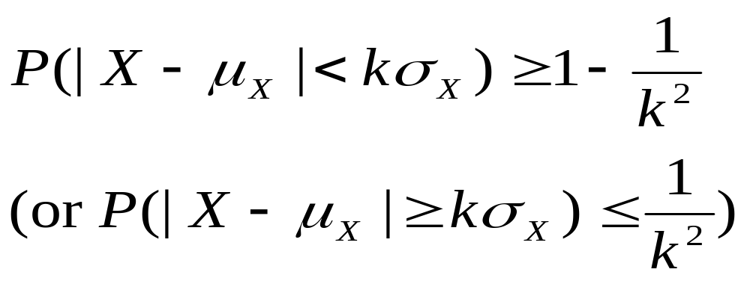
Chebyshev’s inequality
Let X be a random variable with expected value μ_{X} and standard deviation σ_{X}, and let k > 1 be any constant. Then
no matter what the distribution of X.

Slide 12
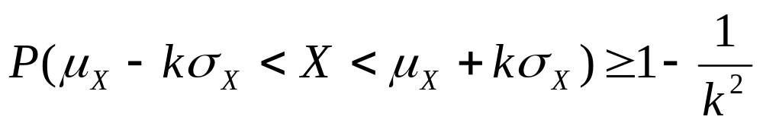
Illustration of Chebyshev’s inequality
μ_{X} – kσ_{X}
μ_{X}
μ_{X} + kσ_{X}
It is quite remarkable that such a lower bound can be found, independent of the particular form of the probability distribution.

Slide 13
Exercise
Let X be the number to occur on one roll of a fair die. Within what interval does the Chebyshev’s inequality say that X must lie within a probability at least ¾ ? What is the exact probability of finding X in this interval?

Slide 14

Thank you.

Slide 15
References
[H01] 黃文典教授, 機率導論講義, 成大數學系, 2001.
[L94] H. J. Larson, Introduction to Probability, Addison-Wesley Advanced Series in Statistics, 1994; 機率學的世界， 鄭惟厚譯， 天下文化出版。
[M97] Statistics: Concepts and Controversies, David S. Moore, 1997; 統計，讓數字說話， 鄭惟厚譯, 天下文化出版。
[MR95] R. Motwani and P. Raghavan, Randomized Algorithms, Cambridge University Press, 1995.

