Slide 1

Introduction to Probability Theory ‧3-1‧
- Preliminaries for Randomized Algorithms
Speaker: Chuang-Chieh Lin
Advisor: Professor Maw-Shang Chang
National Chung Cheng University
Dept. CSIE, Computation Theory Laboratory
January 25, 2006

Slide 2
Outline
Chapter 3: Discrete random variables
  Bernoulli and binomial distributions
  Geometric distribution
  Negative binomial distribution

Slide 3
Bernoulli trials (伯努利試驗)
A Bernoulli trial is an experiment with two different possible outcomes, labeled success and failure. The sample space for a single Bernoulli trial is defined as T = {s, f}, where s represents the outcome success and f represents the outcome failure.

Slide 4
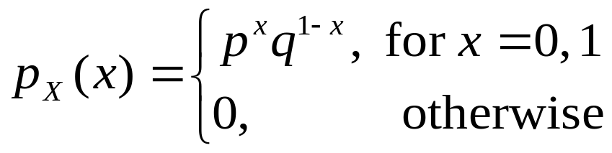
Bernoulli random variable
If an experiment consists of a single Bernoulli trial with parameter p (so that P({s}) = p, and we denote q = 1 – p) and we let X be the number of successes to occur, then X is called a Bernoulli random variable with parameter p.
Its probability function is very simple:

Slide 5
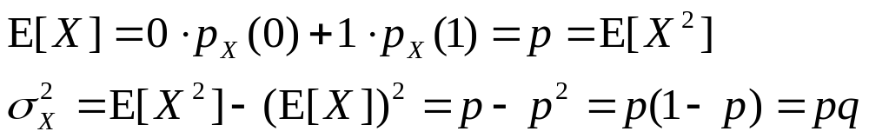
Bernoulli random variable (contd.)
Mean and variance for a Bernoulli random variable X with parameter p:

Slide 6
Many experiments can be modeled as a sequence of independent Bernoulli trials.
For example,
  Ten scratch-off lottery tickets are purchased; each ticket either will or will not win some prize, where p is the probability of a success occurring for each.
  Each of 100 patients with the same affliction is given medication A ; each patient will either be cured or not, with the same success probability p.

Slide 7
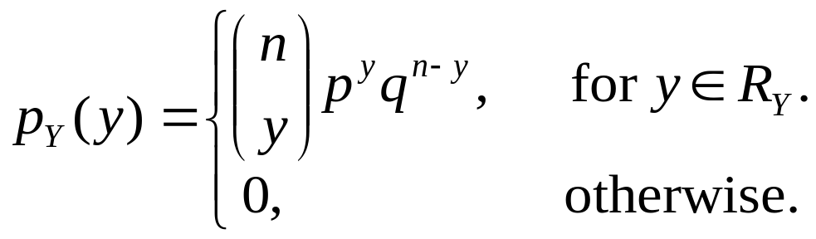
Binomial random variable
(二項隨機變數)
If Y is the number of success to occur in n repeated, independent Bernoulli trials, each with probability of success p, then Y is a binomial random variable with parameter n and p. The range for Y is R_{Y} = {0, 1, 2,…, n}, and its probability function is
where q = 1 – p

Slide 8
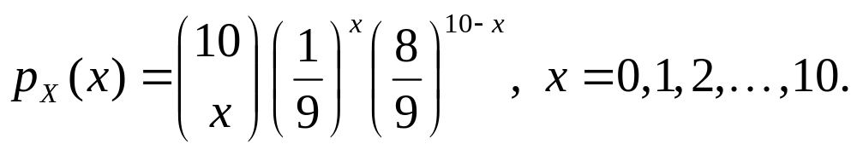
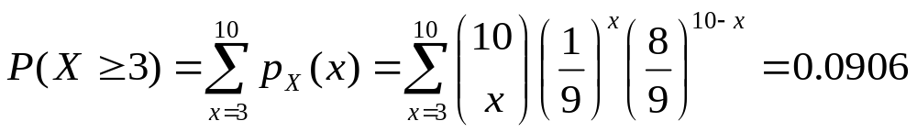
假設老王買了 10 張刮刮樂彩券。假設每張彩券贏得某個獎項的機會是1/9，而彩券彼此互相獨立。因此每張彩券可視為一次Bernoulli trial；若令 X 代表會中獎的彩券張數，則 X 具有 n = 10, p = 1/9 的binomial distribution。
則
老王的彩券至少有三張會中獎的機率，便是

Slide 9
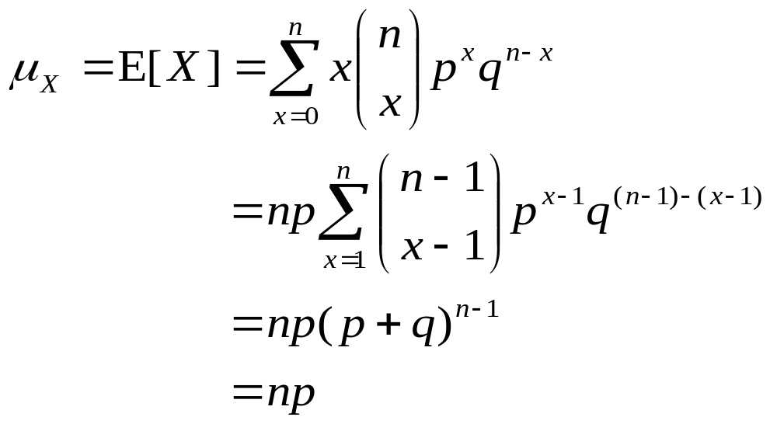
Means and variances for binomial random variables

Slide 10
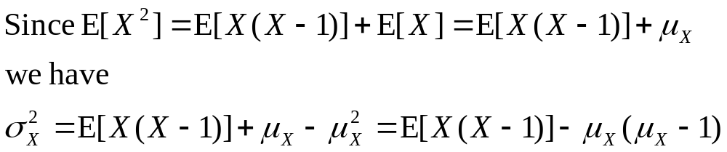
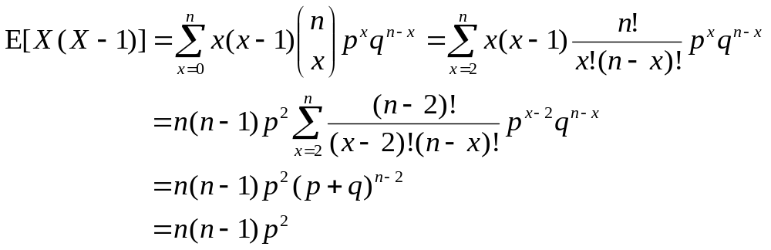
Means and variances for binomial random variables (contd.)

Slide 11
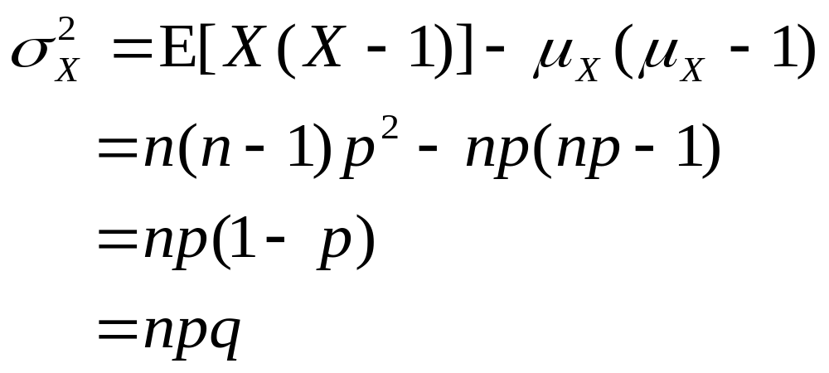
Means and variances for binomial random variables (contd.)
Thus

Slide 12
Before introducing the other probability distribution, we have to be familiar to infinite geometric series first.

Slide 13
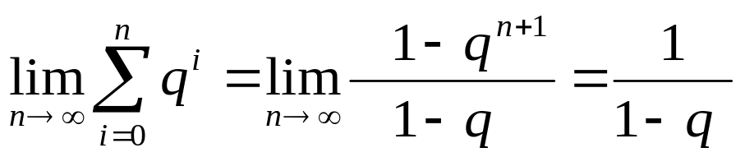
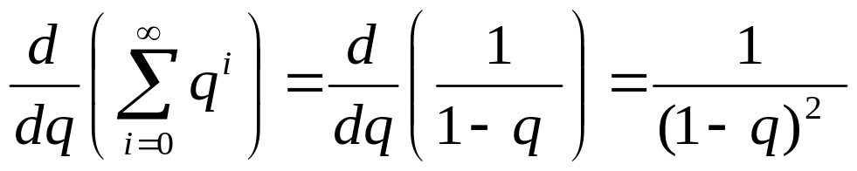
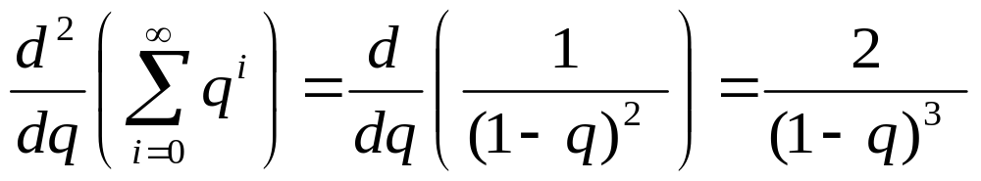
Infinite geometric series
When | q | < 1,

Slide 14
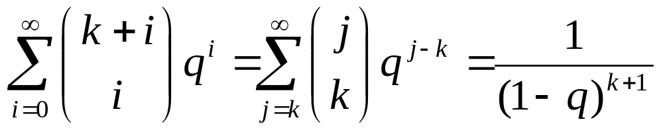
Infinite geometric series (contd.)
Then we will obtain that
An exercise.

Slide 15
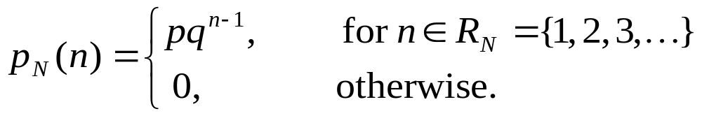
Geometric distribution (幾何分佈)
Let N be the trial number of the first success in a sequence of independent Bernoulli trials, each with parameter p. The probability function for N is
N is called a geometric random variable with parameter p.

Slide 16

Memoryless property (失憶性)
If N is a geometric random variable with parameter p, then
where a and b are any positive integers. This is the only discrete probability law to have this memoryless property.

Slide 17
舉例來說：
假設我們現在要搜尋一個得SARS的病患，而當我們找到第一個病患就停止搜尋。不同的人之間為互相獨立的Bernoulli trials，p = 0.1。
假設我們已經檢查了 8 個人，都還沒出現成功的試驗 (找到一個得SARS的病患)，則下一個人是SARS病患的機率並不會因此改變。這即為失憶性(memoryless property)。

Slide 18
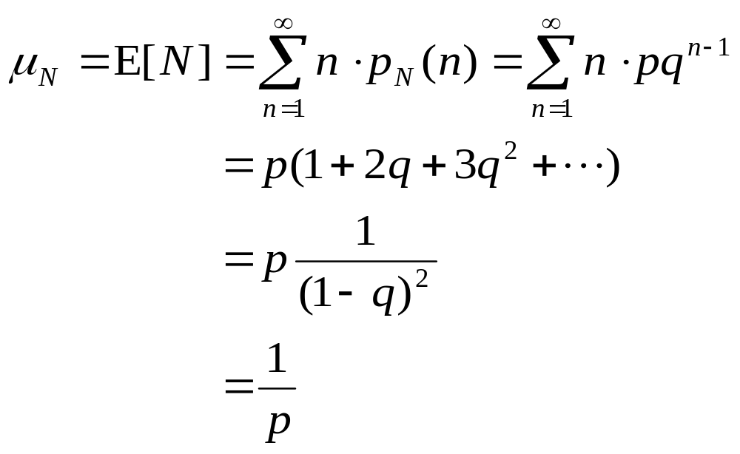
Means and variances for geometric random variables

Slide 19
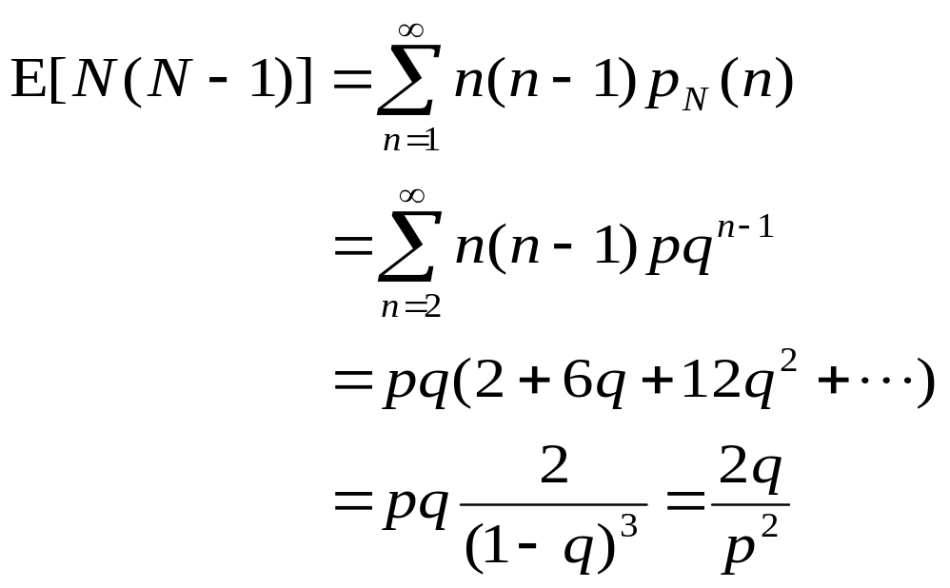
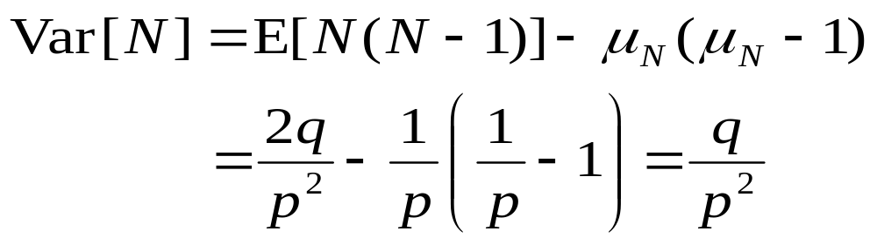
Means and variances for geometric random variables (contd.)
Since
We have

Slide 20
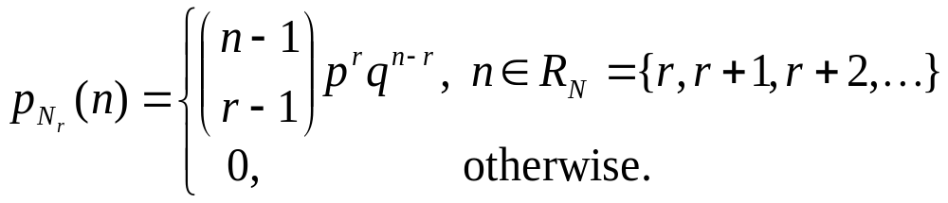
Negative binomial distribution
(負二項分佈)
Independent Bernoulli trials, each with probability of success p, are performed until the rth success occurs. The number of trials required, N_{r} , is called a negative binomial random variable with parameter r, p; its probability function is as follows:

Slide 21
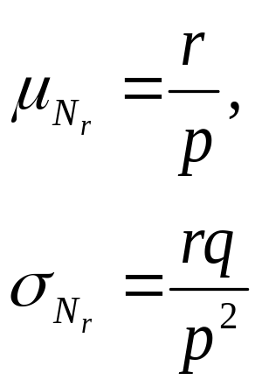
Means and variances for negative binomial random variables

Slide 22
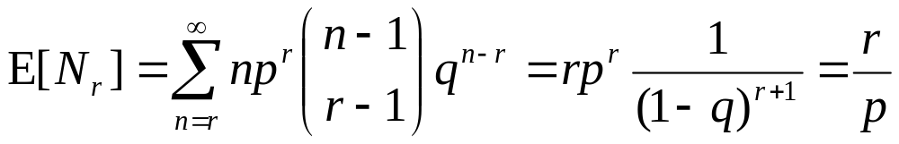
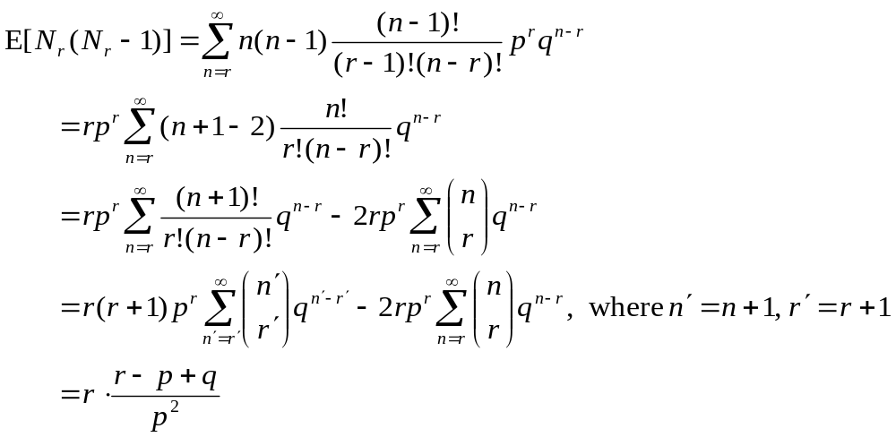
Means and variances for negative binomial random variables (contd.)

Slide 23
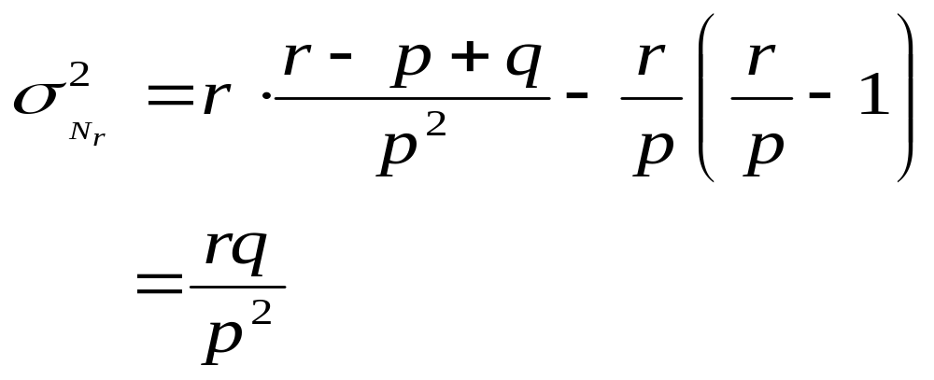
Means and variances for negative binomial random variables (contd.)
Thus

Slide 24

Thank you.

Slide 25
References
[H01] 黃文典教授, 機率導論講義, 成大數學系, 2001.
[L94] H. J. Larson, Introduction to Probability, Addison-Wesley Advanced Series in Statistics, 1994; 機率學的世界， 鄭惟厚譯， 天下文化出版。
[M97] Statistics: Concepts and Controversies, David S. Moore, 1997; 統計，讓數字說話， 鄭惟厚譯, 天下文化出版。
[MR95] R. Motwani and P. Raghavan, Randomized Algorithms, Cambridge University Press, 1995.

