Slide 1

Introduction to Probability Theory ‧3-2‧
- Preliminaries for Randomized Algorithms
Speaker: Chuang-Chieh Lin
Advisor: Professor Maw-Shang Chang
National Chung Cheng University
Dept. CSIE, Computation Theory Laboratory
February 24, 2006

Slide 2
Outline
Chapter 3: Discrete random variables
  The Poisson distribution
  The hypergeometric distribution

Slide 3
1. The Poisson Distribution (卜瓦松分布)

Slide 4
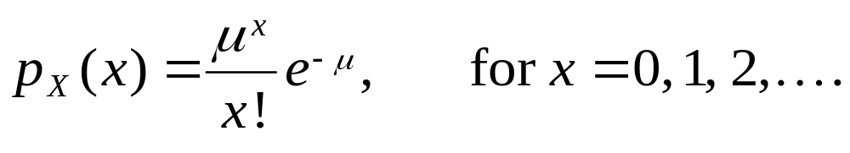
The Poisson Distribution (卜瓦松分布)
X is called a Poisson random variable with parameter μ if its probability function is

Slide 5
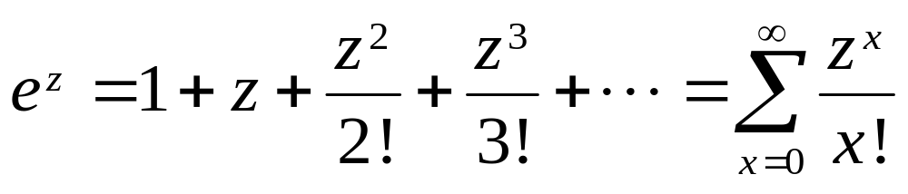
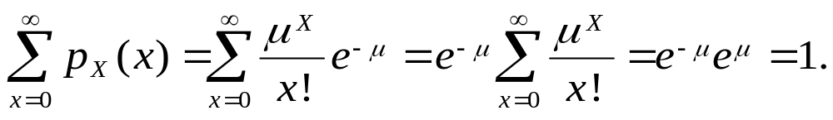
Note that
Thus

Slide 6
Mean and variance
If X is a Poisson random variable with parameter μ, then the mean (expected value) of X is μ, and the variance of X is also μ.

Slide 7
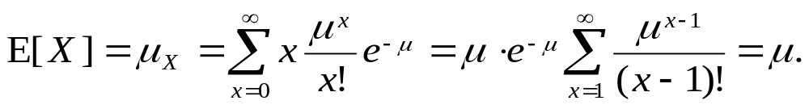
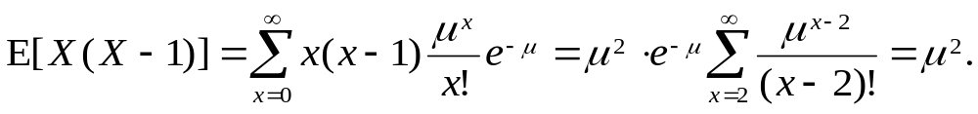
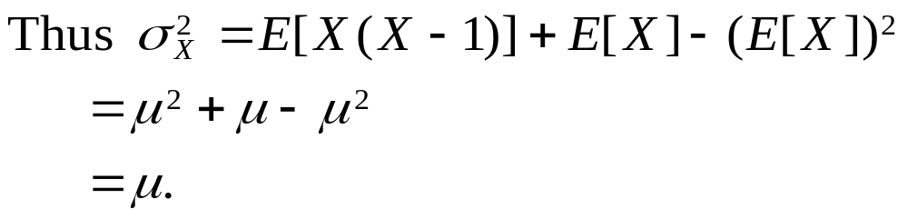
Mean:
Variance:

Slide 8
Why should we learn the Poisson distribution?
The basic assumption is that the phenomena being counted occur independently, at random, and at constant rate over the period of observation.
If Y is a binomial random variable with parameter n, and p, when n → ∞ and p → 0 such that np = μ remains constant, then the Poisson distribution with parameter μ occurs as the limit of P(Y = y).
Notes:
Poisson distribution背後的基本假設是，正在計數的這件事情，於我們的觀察時限內，是獨立、隨機且依固定速率發生的。

Slide 9
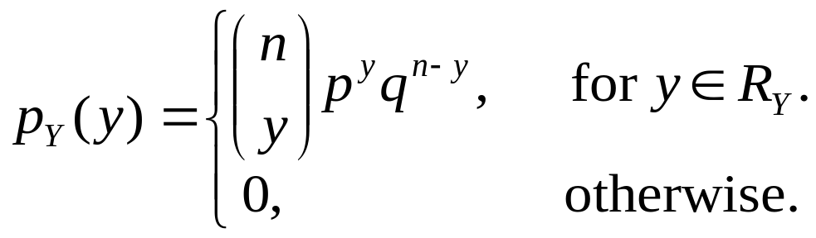
Binomial random variable
(二項隨機變數) - 複習
If Y is the number of success to occur in n repeated, independent Bernoulli trials, each with probability of success p, then Y is a binomial random variable with parameter n and p. The range for Y is R_{Y} = {0, 1, 2,…, n}, and its probability function is
where q = 1 – p

Slide 10
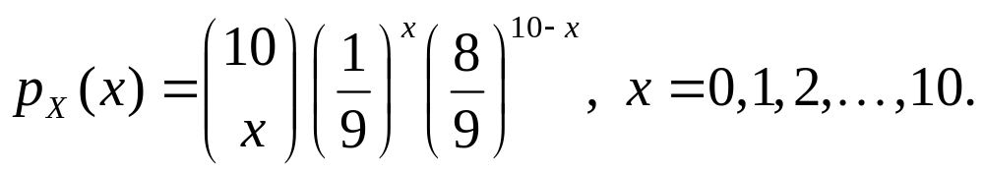
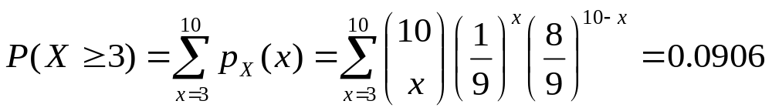
假設老王買了 10 張刮刮樂彩券。假設每張彩券贏得某個獎項的機會是1/9，而彩券彼此互相獨立。因此每張彩券可視為一次Bernoulli trial；若令 X 代表會中獎的彩券張數，則 X 具有 n = 10, p = 1/9 的binomial distribution。
則
老王的彩券至少有三張會中獎的機率，便是

Slide 11
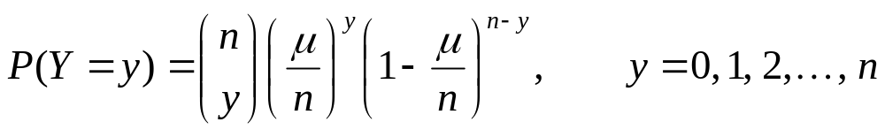
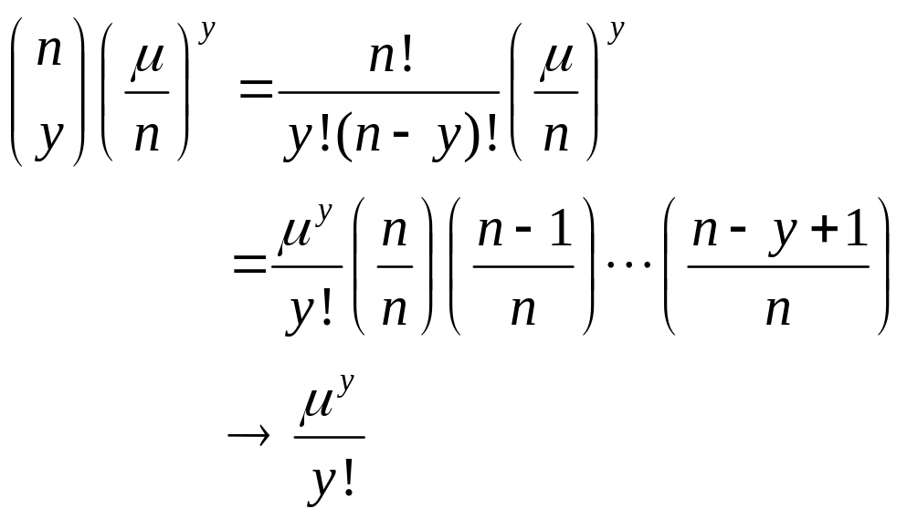
Why should we learn the Poisson distribution? (contd.)
That is,
When n →∞, for any fixed y, we have

Slide 12
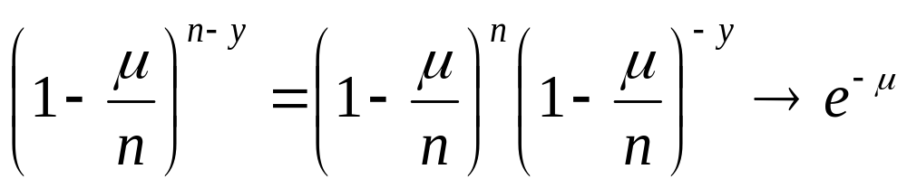
Why should we learn the Poisson distribution? (contd.)
The remain term in P(Y = y) is
as n →∞ and y is fixed.
Then we have the following theorem.

Slide 13
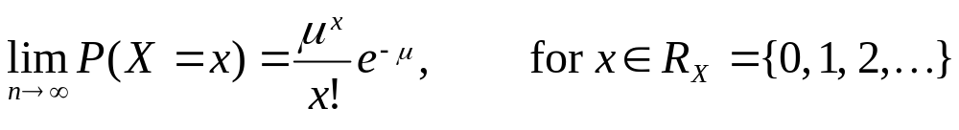
Theorem
If X is a binomial random variable with parameter n and μ / n, then

Slide 14
Why should we learn the Poisson distribution? (contd.)
If X is binomial with “large” n and “small” p, this theorem suggests that the distribution for X should be well approximated by the Poisson probability law, where μ = np.

Slide 15
Why should we learn the Poisson distribution? (contd.)
A Poisson process is a simple mechanism that may govern the time instants at which occurrences are observed as time passes.
In a Poisson process with parameter λ, the occurrences are assumed to be independent and to happen at random at a constant rate λ.
Notes:
Poisson process 是一種簡單機制，當我們隨著時間的進行，觀察某件事的發生情況時， Poisson process 可能可以用來描述該件事發生在哪些時間點。

Slide 16
Why should we learn the Poisson distribution? (contd.)
The “at random with constant rate λ” assumption means that we can convert any fixed period of time (of length t > 0) into n nonoverlapping equal-length increments, each of length ∆t = t / n.
For sufficiently large n, they can be regarded as independent Bernoulli trials.
Furthermore, the probability of one occurrence in each increment (of a success) is p = λ ∆t = λ t / n.
Notes:
每個∆t 的時段中，事情發生的次數不是0就是1

Slide 17
Why should we learn the Poisson distribution? (contd.)
Let X be the number of occurrences to be observed in the time interval (0, t], where t > 0 is some fixed constant.
From these assumptions, X is approximately binomial with parameters n and p = λt / n; as n → ∞, the probability law for X becomes Poisson with parameter μ = np = n (λ t / n) = λt.
Let us see the following example.

Slide 18
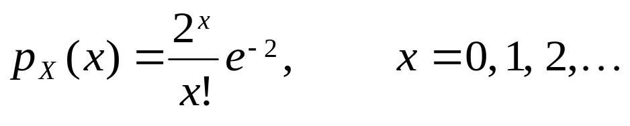
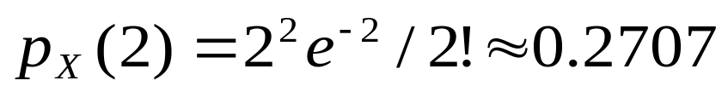
假設在一家大工廠發生受傷意外事件的頻率是每週 λ = ½ 件。
我們令 X 代表隔年的頭四週，在該工廠發生意外的事件數。則 X 為 Poisson random variable with parameter μ = ½ (4) = 2
而 X 的機率密度函數為
在這段期間恰好發生兩件意外事故的機率為

Slide 19
2. The hypergeometric distribution (超幾何分布)

Slide 20
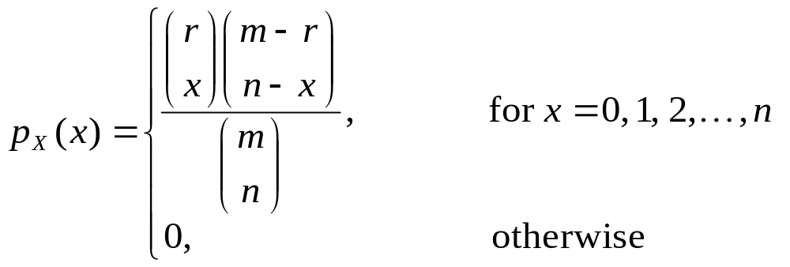
The hypergeometric distribution
(超幾何分布)
If a box contains m balls, of which r are red, and X is the number of red balls to occur in a random sample of n balls removed from the box without replacement (取出不放回), the probability function of X is

Slide 21
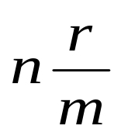
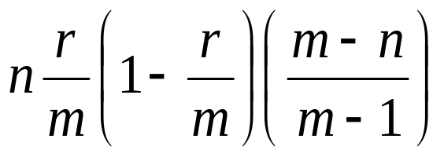
Mean and variance
Mean:
Variance:
Proofs are omitted here.

Slide 22

Thank you.

Slide 23
References
[H01] 黃文典教授, 機率導論講義, 成大數學系, 2001.
[L94] H. J. Larson, Introduction to Probability, Addison-Wesley Advanced Series in Statistics, 1994; 機率學的世界， 鄭惟厚譯， 天下文化出版。
[M97] Statistics: Concepts and Controversies, David S. Moore, 1997; 統計，讓數字說話， 鄭惟厚譯, 天下文化出版。
[MR95] R. Motwani and P. Raghavan, Randomized Algorithms, Cambridge University Press, 1995.

