Slide 1
大數據分析技法
Course Syllabus
Joseph Chuang-Chieh Lin
Dept. CSIE, Tamkang University
22nd February, 2021

Slide 2
Textbooks and Materials
Textbooks:
  大數據基礎與實務 (Big Data Fundamentals and Practices). 胡嘉璽著。普林斯頓國際，2018.
  Python Data Science Handbook: Essential Tools for Working with Data. Jake VanderPlas. O'Reilly. 2016.
    https://jakevdp.github.io/PythonDataScienceHandbook/
Other materials:
  7天學會大數據資料處理—NoSQL (第三版): MongoDB入門與活用。
  黃士嘉,林敬傑。2019.
  Online materials.

Slide 3
Topics (I) Big Data System
Introduction to Big Data Concept
Basic Data Processing Techniques
  Hands-on Practices
Big Data Platform
Hadoop Framework
  A Hands-on Project (bonus)
mongoDB (NoSQL)
  A Hands-on Project (bonus)

Slide 4
Topics (II) Data Science and Analysis
Data Smoothing and Cleaning
Principal Component Analysis
Feature Importance
  Hands-on Practices
Visualization
  Hands-on Practices
Classification
Prediction
Clustering
Final Team Project Presentation

Slide 5
Grading Policy
Assignments (50%)
Final Team Report (50%)

Slide 6
Programming and tools
Programming Languages:
  Python, Linux shell script + AWK, C/C++
Tools/IDE:
  Anaconda, Spyder.
    For python development
  VirtualBox
    For building several virtual machines

Slide 7


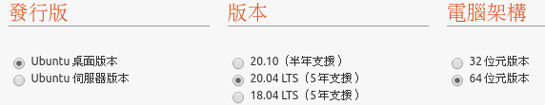
Project Implementation resources
Build virtual machines using VirtualBox: https://www.virtualbox.org/
Download and install Ubuntu Linux: https://www.ubuntu-tw.org/modules/tinyd0/
  Suggestions:

Slide 8
Project implementation resources
How to install Ubuntu 20.04?
  https://tinyurl.com/a8d3hthe
Parallel Distributed Shell (PDSH):
  同時平行對遠端 shell 傳達指令與接受資料的工具。
  參考 ‘sudo apt install pdsh’

Slide 9
Project implementation resources
SSH connection to a VirtualBox virtual machine: https://tinyurl.com/2etet3va
  Check the IP address in the VM: 10.0.2.15
  Using port forwarding (連接埠轉送).
  Set the ip address you want to use, e.g., 192.168.56.1
  Check the ssh status by ‘sudo service ssh status’
    Install OpenSSH if necessary (by ’sudo apt-get install openssh-server’
  In your Host (Windows) OS, install PuTTY or PieTTY. Use it to connect to your guest Ubuntu OS.

Slide 10

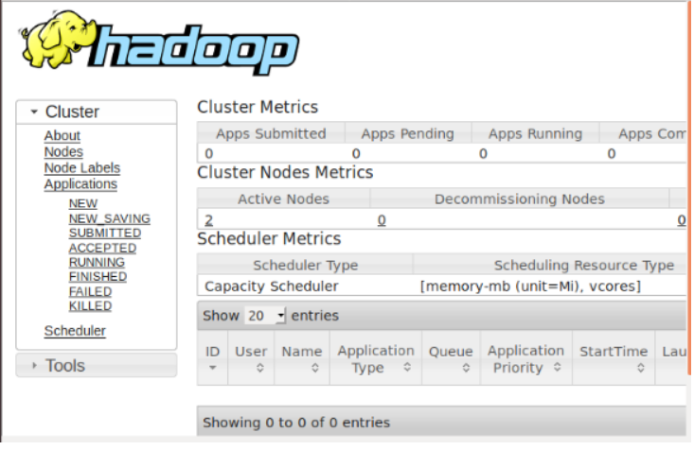
Project implementation resources
How To Set Up a Hadoop 3.2.1 Multi-Node Cluster on Ubuntu 18.04 (2 or More Nodes)? https://tinyurl.com/ycaj4vhs
  Create an SSH key (ssh-keyen -t rsa -P "") and then copy the public key to the authorized_keys in ~/.ssh/
  Install Java 8 (‘sudo apt install openjdk-8-jdk’)
  Get the version of Hadoop you like. https://mirrors.sonic.net/apache/hadoop/common/
  Several settings (e.g., export PATH, add users, add hosts and edit hostname, etc.)
  Make Full Clones for slaves.
  Create an SSH key by ‘ssh-keygen -t rsa’ and copy it to all the nodes.
  Edit configurations for each node.
  Open browser to see if ‘http://hadoop-master:8088/cluster’ works well.

Slide 11
Project implementation resources
Brief introduction for MongoDB: https://noob.tw/mongodb/
  key-value pair for storing data.
    BSON format (an extension of JSON; like dictionary of Python)
    Do not require previous defined schema.
    Distributed storage (flexible)
  A simple way of Installation: sudo apt-get install mongodb.
  Configuration and sharding:
    Concept introduction https://tinyurl.com/ysmz9wee
    Implementation reference: https://tinyurl.com/54zxhaya

Slide 12
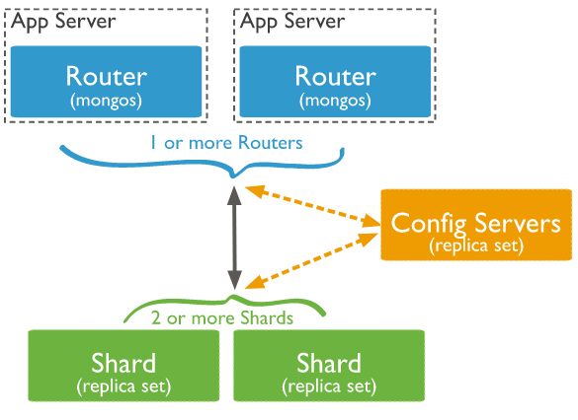
Project implementation resources
Refer to https://docs.mongodb.com/manual/sharding/

Slide 13
Project implementation resources
How To Install MongoDB on Ubuntu 20.04?
  https://tinyurl.com/yztxsrrw
Import CSV file to a mongoDB database:
  https://tinyurl.com/3mrs7bvs

