Slide 1
大數據分析技法
Introduction
Joseph Chuang-Chieh Lin
Dept. CSIE, Tamkang University
22nd February, 2021

Slide 2
What is BIG DATA?
Lower bound of data size:
  1 Gigabyte (GB)? 1 Terabyte (TB)? 1 Petabyte (PB)? …
    1 GB = 1024 MB, 1 TB = 1024 GB, 1PB = 1024 TB, ...

Slide 3
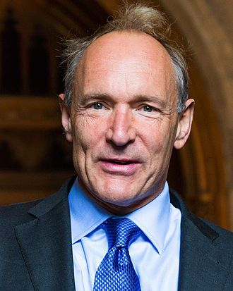
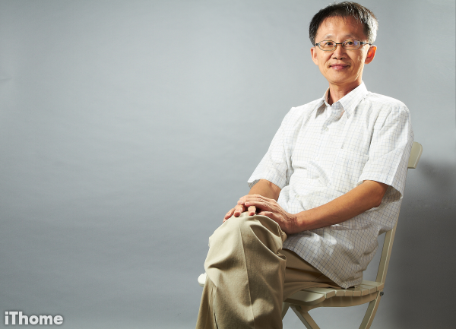
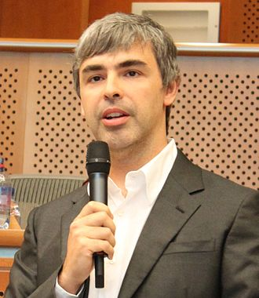
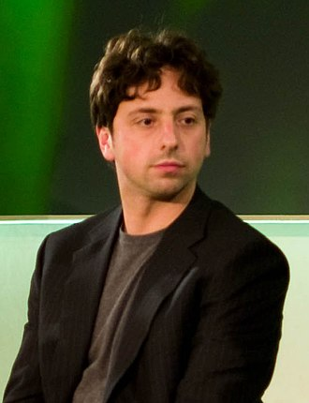
The birth of big data
WWW (World Wide Web) + TCP/IP + HTML, ...
  Sir Timothy Berners-Lee, 1989.
Search Engines
  Yahoo!
  GAIS project → Openfind
    Global Area Information Server
  Google
    Larry Page & Sergie Brin
吳昇 中正資工系副教授
台灣發展出搜尋引擎的第一人
https://tinyurl.com/5gl73yxf

Slide 4
Concept of Google’s search engine
Google crawlers:
  IP 0.0.0.0 ~ 255.255.255.255
    Focus data of servers of normal IP’s.
Problem:
  The storage?
  Processing (e.g., Sorting)?
How to make a lot of computers get involved in the parallel computation?

Slide 5
What is BIG DATA?
Lower bound of data size:
  1 Gigabyte (GB)? 1 Terabyte (TB)? 1 Petabyte (PB)? …
    1 GB = 1024 MB, 1 TB = 1024 GB, 1PB = 1024 TB, ...

Slide 6
What is BIG DATA?
Lower bound of data size:
  1 Gigabyte (GB)? 1 Terabyte (TB)? 1 Petabyte (PB)? …
    1 GB = 1024 MB, 1 TB = 1024 GB, 1PB = 1024 TB, ...
「手頭上的資源無法處理所需要處理的資料量。」

Slide 7
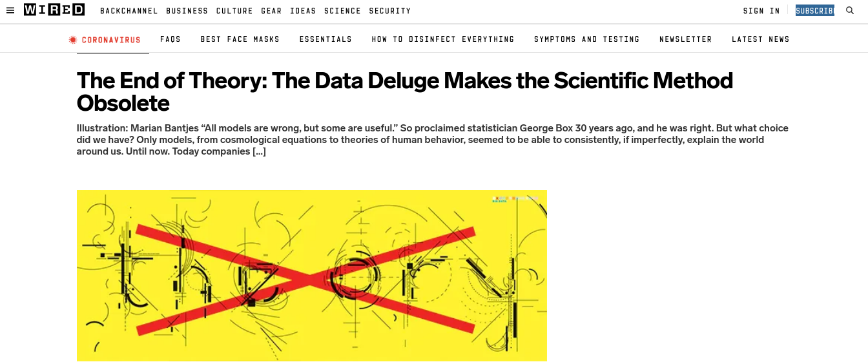
The controversial article
理論的末日：巨量資料讓科學方法式微 [Chris Anderson, 2008]

Slide 8
Correlation/Causation
X ↔ Y 有關聯性
  統計
  機器學習訓練得到的模型
但 X → Y 或 Y → X 的「理論」模型？

Slide 9
Data Growth
Year | 人類總人口 | 數位資料總量
1940 | 25億 | 300 bytes
2017 | 75億 | 30 ZB
3倍
10²⁰倍
Note: 1 ZB = 2³⁰ GB

Slide 10
Data Growth (contd.)
In 2017:
  100 EB of data is generated per day.
    1 EB = 2²⁰ GB
    相當於一億顆容量1TB 的硬碟。
  1.16 PB of data is generated per second.
    相當於 1,160 顆萬容量1TB的硬碟。

Slide 11
Data source
Websites.
Social Networks
  Facebook, LinkedIn, Twitter, Instagram, ResearchGate, …
Wikipedia
Devices
  mobile phones, PDAs, watches, all kinds of sensors, ..
  Logs
Large Hadron Collider (強子對撞機 x 4)
  Data of 25 PB is generated per year.

Slide 12
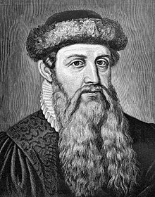
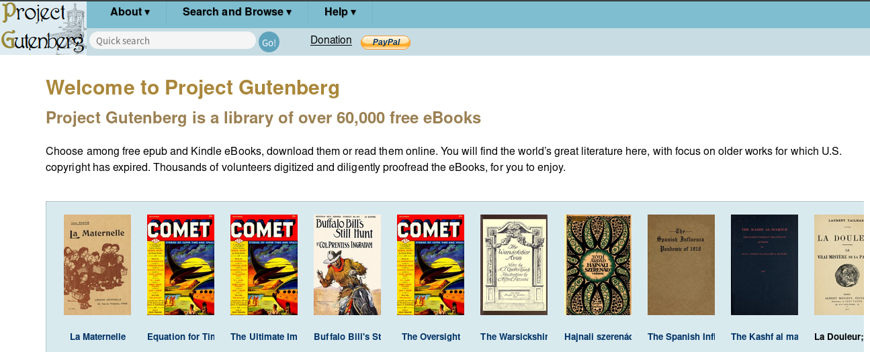
Analog to digital
Not only digitalization, but also making data be able to be read, processed, and analyzed by computers.
典藏書籍數位化並數據化
  Project Gutenberg (https://www.gutenberg.org/)
Johannes Gutenberg
(from wikipedia)

Slide 13
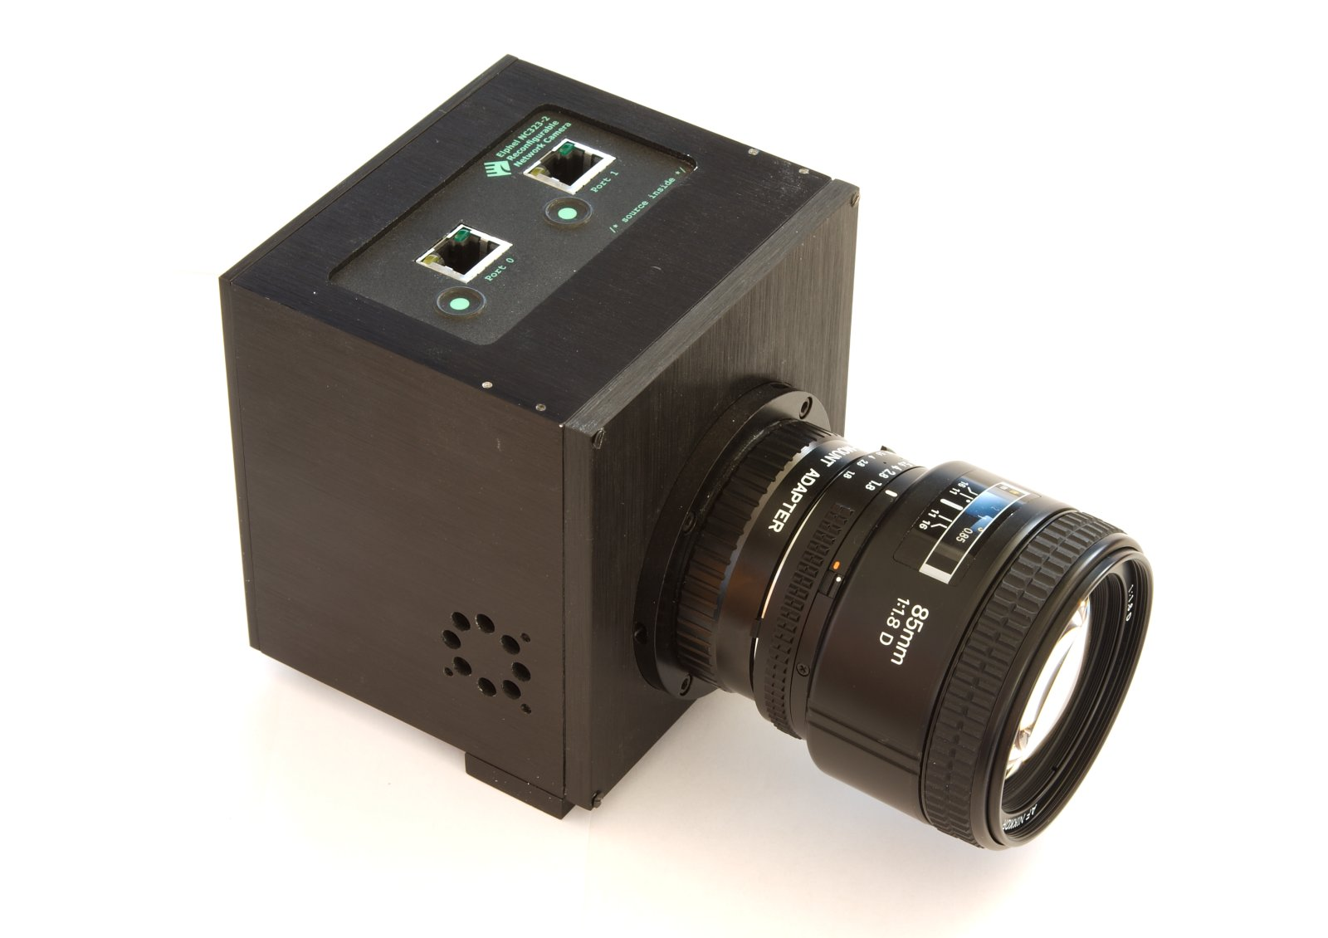
Google books
Google Books: started since 2004.
Using Elphel Model 323 camera.
  1,000 pages in one minute.
  11 Megapixel resolution (4008 x 2672)
refer to https://www.elphel.com/www3/323

Slide 14
Issues
Pure pictures/sounds/videos.
Pictures/sounds/videos with captions.
Machine learning for the rescue?

Slide 15
Structured data
The most convenient data is ‘structured’.
  RDBM (relational database management).
  Tables with schema.
  Yet, only 5~20% of the data is structured.
  Some data is neither tagged nor having a caption or any label.
    You have been asked to give labels by the social networks.

Slide 16
In this era of big data
We must and are able to deal with the unstructured data.
Data might contain errors or incompatible parts.

Slide 17
High speed internet
We can regard all the computers on the earth as a big united computer.
  That transmissions/transactions can be completed in 1ms or 0.01ms doesn’t make any difference to human beings.
IP address is running out.
  IPv6 comes to the rescue.
    128 bits
    compatible with IPv4
    Everyone can share 4.86 x 10²⁸ IPs.

Slide 18
Difference between 1~4G to 5G
The focus of 1~4G:
  Communication protocol.
  ‘Phones’.
5G
  Sensors.
  IoT.

Slide 19
Data to profit
Relationship between data.
Providing services.
  Arbitrage
  Prediction
    Buy-and-also-buy
R & D
  DeepMind (acquired by Google in 2014).
The most successful company: Google.
  The biggest advertisement platform in the world.

