Slide 1
大數據分析技法
Data Cleaning
Joseph Chuang-Chieh Lin
Dept. CSIE, Tamkang University
22th March, 2021

Slide 2
Data Processing
Basic script techniques
  Shell
  awk
Data cleaning
  Error
  Scaling
  Imputation
Data transform
  Fourier transform
  Wavelet transform

Slide 3
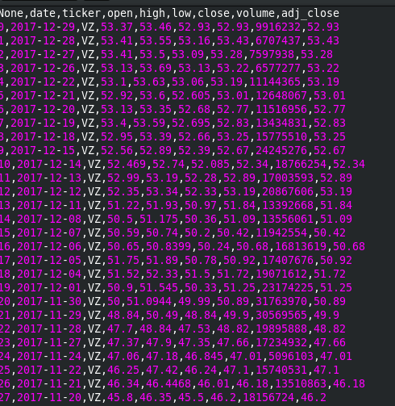

Basic scripts
Example data set
  from quandl
  register an account then fetch the OHLCV data.

Slide 4
Basic scripts
cat <file1> <file2>...
  concatenate file1, file2, ...
sed ‘s/<target>/<replaced>/g’
  replace ‘target’ with ‘replaced’
sort
  -V: natural sort of (version) numbers within text
wc
  counts of bytes, words, lines
less (or more)
  show data by pages (less: allow backward and forward moves)

Slide 5
Basic scripts
grep:
  searching for lines in data that match a regular expression.
  -v <text>: searching except <text>
  ^$: stands for empty line
agrep:
  approximate grep
uniq:
  report or omit repeated lines

Slide 6
Basic scripts (awk)
Scripting language developed by Alfred Aho, Peter J. Weinberger, and Brian Kernighan.
A standard feature in Unix-like operating systems.
Cope with streams of textual data, either can be run directly or used as a part of a pipeline.
C language syntax is consistent.
Refer to https://en.wikipedia.org/wiki/AWK for more details.

Slide 7
Basic scripts (awk)
FS: field separator
RS: record separator
NF: number of fields in one record
NR: number of records
$0: the record
$1: the first field in the record
BEGIN {}: executes before the main body
END {}: executes after the main body.

Slide 8
awk scripts -> program file
Example:
cat file | awk -f some_awk.awk > output.log
awk '
BEGIN {
FS = "[\t,]";
count = 0;
...
}
{ # program main body
…
count += 1;
}
END {
for (i=0; i<count; i++) printf("xxxxx");
}' $*
some_awk.awk

Slide 9
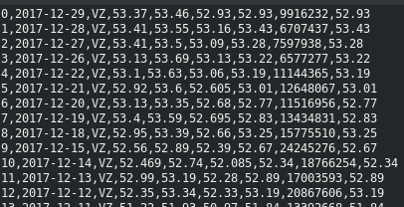
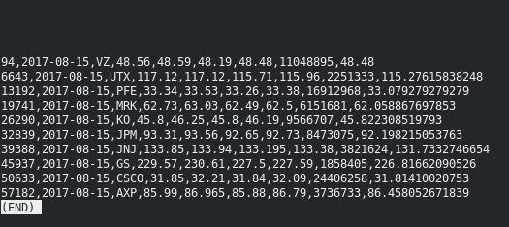
awk example
Remove the header:
  cat data | awk ‘NR != 1 { print $0}’ | less
Then extract all records in 2017-08-15:
  cat data | awk ‘NR != 1 { print $0}’ | grep 2017-08-15 | less

Slide 10
awk example
Example program:
  Calculate word frequencies (from Wikipedia)
  Example text file:
    The Adventures of Sherlock Holmes, by Arthur Conan Doyle
    http://www.gutenberg.org/files/1661/1661-0.txt
    From the Project Gutenberg.
BEGIN {
FS="[^a-zA-Z]+"
}
{
for (i=1; i<=NF; i++)
words[tolower($i)]++
}
END {
for (i in words)
print i, words[i]
}

Slide 11
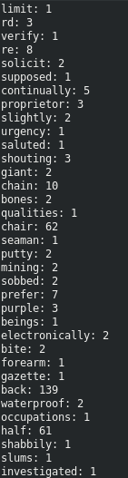
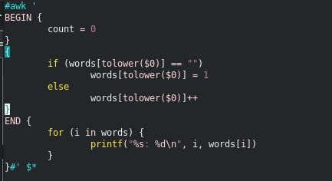
awk example (my try)
cat sherlock.txt | tr -sc ‘[A-Za-z]’ ‘\n’ | grep -v “^$” | awk -f countExample.awk

Slide 12
Data cleaning
Fix or remove incorrect, corrupted, incorrectly formatted, duplicated, or incomplete data within a dataset.
Should be done before further data transformation.
After data cleaning, the data is called raw-data, as it sometimes requires further transformation before analyzing tasks or model construction.

Slide 13
Steps of data cleaning
Remove duplicates or irrelevant stuffs.
Fixed structured errors
Filter outliers
Deal with missing data
Check the data over again
    Does it make sense?
    Does it fit the underground theory?
    Find expertises/colleagues for the double check.

Slide 14
Characteristics of quality data
Validity
Accuracy
Completeness
Consistency
Uniformity

Slide 15
Validity
Check consistency with the schema
  data type
  missing value
  uniqueness of fields
  data range

Slide 16
Accuracy
Check if the values are ‘correct’ or make sense.
  For example, the there are fields of addresses, check if each address really exists (via another dataset)
  Another example, if the temperature of some day is 27 Celsius degree but -10 Celsius degree on the next day. It doesn’t make sense at the first sight. Check the other dataset or source to find out if it is correct.

Slide 17
Completeness
Check if the data is complete.
  For example, the data consists of daily prices of two years. Check if prices exist in every week-day or trading day.
    Check the calendar and fetch the holidays and weekends.
  Another example, if the data consists of heights and weights of students in a school, check if every student’s data is included.
  Duplicated records can be dropped as long as you are confident of doing so.

Slide 18
Consistency
Check if values of related fields are consistent.
  For example, if there are two fields such as address and local-area code. We can check if the address is consistent with the code.
  Another example, if the data consists of individual genomes (i.e., DNA sequences) as well as id and sex. Check if the last pair of chromosomes are consistent with the sex.

Slide 19
Uniformity
Check if the unit is consistent in the fields.
  For example, the temperature should be all in Celsius or Fahrenheit.
  For example, the prices can be in USD or TWD but have to be unified.

Slide 20
Example datasets for data cleaning practices
Reference: https://tinyurl.com/ry3nzwmh
Hourly Weather Surface – Brazil (Southeast region) (click to get the data)
Hotel Booking Demand (click to get the data)
Temperature Readings: IoT Devices (click to get the data)
Trending YouTube Video Statistics (click to get the data)

Slide 21
Hourly Weather Surface – Brazil
Hourly weather data from 122 weathers stations of southeast region of Brazil.
17 climate parameters.
sudeste.csv (1.72GB)
wsid | wsnm | elvt | lat | lon | inme | city | prov | mdct | date
Weather station id | Name station (city location or nickname) | Elevation | Latitude | Longitude | Station number for the location | City | State (Province) | Observation Datetime (complete date: date + time) | Date of observation

Slide 22
Hotel Booking Demand
This dataset contains booking information for a city hotel and a resort hotel.
It includes information such as
  when the booking was made,
  length of stay,
  the number of adults, children, and/or babies,
  and the number of available parking spaces,
  ...
All personally identifying information has been removed from the data.

Slide 23
Temperature Readings: IoT Devices
This dataset contains the temperature readings from IoT devices.
  Time period: 28-07-2018 to 08-12-2018
  The devices are installed outside and inside of an anonymous Room (say - admin room).
  The device was in the alpha testing phase.
    It was uninstalled or shut off several times during the entire reading period.
    It contains random interval recordings and few mis-readings (outliers).
      It’s challanging to perform analysis on this data.
id : unique IDs for each reading
room_id/id : room id in which device was installed (inside and/or outside) -> currently 'admin room' only for example purpose.
noted_date : date and time of reading
temp : temperature readings
out/in : whether reading was taken from device installed inside or outside of room?

Slide 24
Assignment 02
Pick one of the four suggested datasets and try to ‘observe’ it.
Apply data cleaning steps to ensure the data to be of good quality.

Slide 25
Tips (Python)
Remove duplicates
Example:
import pandas as pd
data = pd.read_csv(‘some_data.csv’)
data.drop_duplicates(keep=False, inplace=True)

Slide 26
Tips (Python)
Check if there is nan
Example:
import pandas as pd
data = pd.read_csv(‘some_data.csv’)
data[‘some_column’].isnull().values.any() # check for any ‘NaN’ in a single column
data[‘some_column’].isnull().sum() # count the ‘NaN’ values in a single column

Slide 27
Tips (Python)
Fill the nan with some value or drop records containing nan’s.
Example:
import pandas as pd
data = pd.read_csv(‘some_data.csv’)
data[‘some_column’].fillna(value=0, inplace=True) # fill the nan’s with 0
data[‘some_column’].fillna(value=data[‘some_column’].mean() # fill the nan’s with column’s mean
data[‘some_column’].fillna(method=’ffill’, inplace=True) # forward fill the values
data[‘some_column’].fillna(method=’bfill’, inplace=True) # backward fill the values
data.dropna(subset=[‘some_column’, ‘another_column’], inplace=True) # drop nan’s for certain columns instead of the whole dataframe

