Slide 1
Data Science Theory and Practices
Foundations on Principal Component Analysis
Joseph Chuang-Chieh Lin
Dept. CSIE, Tamkang University
19th April, 2021

Slide 2
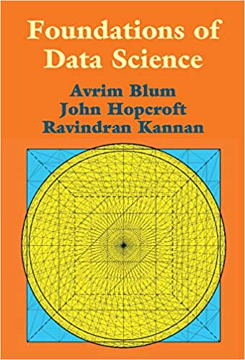
Outline
Matrices & Overview
Projection
Singular Vectors
Singular Value Decomposition (SVD)
Best Rank-k Approximation
Principal Component Analysis (PCA)
Refer to https://tinyurl.com/3rnuvb7e

Slide 3

Inner Products and Projection
Low of Cosines:
And,

Slide 4
Inner Products and Projection
Low of Cosines:
And,

Slide 5

Inner Products and Projection
Low of Cosines:
And,

Slide 6

Matrices
Eigenvalues and eigenvectors.

Slide 7
Matrices
Eigenvalues and eigenvectors.
eigenvector
or
other vectors
rotations

Slide 8
Data: d-dimensional n points
 | feature 1 | feature 2 | ...... | feature d-1 | feature d
record 1 | a_{1,1} | a_{1,2} | ...... | a_{1,d-1} | a_{1,d-1}
record 2 | a_{2,1} | a_{2,2} | ...... | a_{2,d-1} | a_{2,d-1}
⁞ | ⁞ | ⁞ | ...... | ⁞ | ⁞
record n-1 | a_{n-1, 1} | a_{n-1,2} | ...... | a_{n-1,d-1} | a_{n-1,d-1}
record n | a_{n, 1} | a_{n,2} | ...... | a_{n,d-1} | a_{n,d-1}

Slide 9

Eigenvalue Decomposition (Overview)
A: square matrix
If A is symmetric,
  D: diagonal
A
n x n
V
n x n
D
n x n
V^{T}
n x n
=

Slide 10


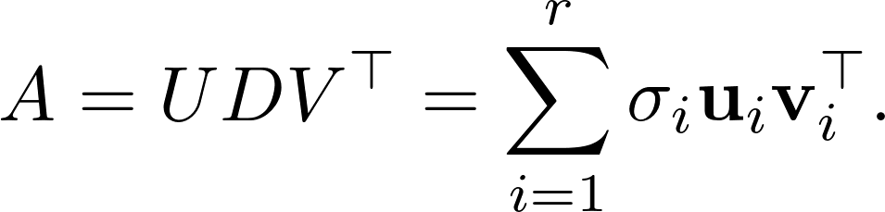
Singular Value Decomposition (Overview)
A
n x d
U
n x r
D
r x r
V^{T}
r x d
=
D : diagonal matrix, d_{ii} > 0
columns of U and V: orthonomal

Slide 11

Singular Value Decomposition (Overview)
A
n x d
U
n x r
D
r x r
V^{T}
r x d
=
D : diagonal matrix, d_{ii} > 0
columns of U and V: orthonomal

Slide 12

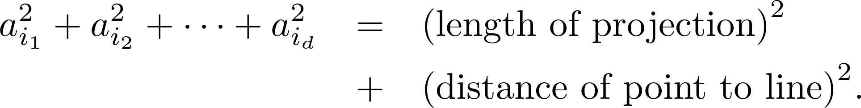
Projection
Project a point (vector)
a_{i}
dist_{i}
v
onto a line (vector) v.
projection
Pythagorean Theorem:

Slide 13
Projection
Project a point (vector)
a_{i}
dist_{i}
v
onto a line (vector) v.
projection
Pythagorean Theorem:
Minimize this!

Slide 14
Projection
Project a point (vector)
a_{i}
dist_{i}
v
onto a line (vector) v.
projection
Pythagorean Theorem:
Maximize this!

Slide 15
Projection
Project a point (vector)
a_{i}
dist_{i}
v
onto a line (vector) v.
projection
Pythagorean Theorem:
Maximize this!
Find a v such that the sum of the projection lengths is maximum!

Slide 16

Projection
Project a point (vector)
a_{i}
dist_{i}
v
onto a line (vector) v.
projection
Pythagorean Theorem:
Maximize this!
Find a v such that the sum of the projection lengths is maximum!

Slide 17
Projection
A
n x d
a₁
v_{i}

Slide 18
Projection
A
n x d
v_{i}
a₂

Slide 19
Projection
A
n x d
v_{i}
…...

Slide 20
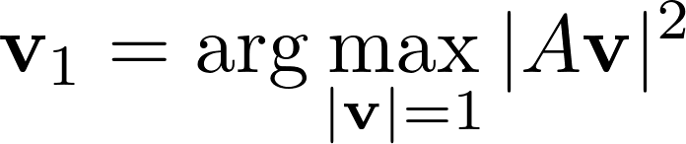
Singular Vectors
The first singular vector v₁ of A:

Slide 21
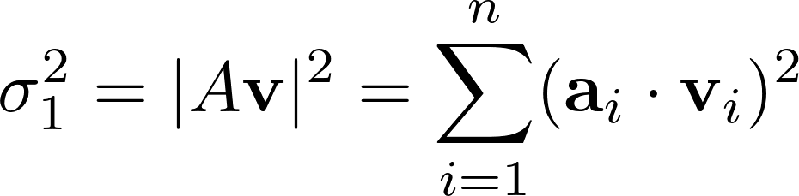
Singular Vectors
The first singular vector v₁ of A:
a_{i}’s
v₁

Slide 22
Singular Vectors
The first singular vector v₁ of A:
Sometimes we are not lucky enough so that data points are not close to “one lineˮ, but close to a k-dimension space.
a_{i}’s
v₁

Slide 23
Singular Vectors
The first singular vector v₁ of A:
How about the second, the third, ..., the kth singular vectors?
a_{i}’s
v₁

Slide 24
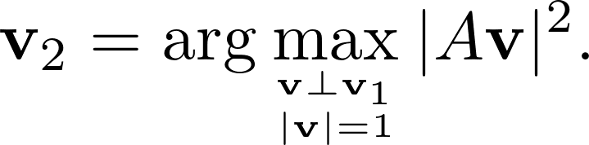
Singular Vectors
The second singular vector: the best-fit line perpendicular to v₁.

Slide 25
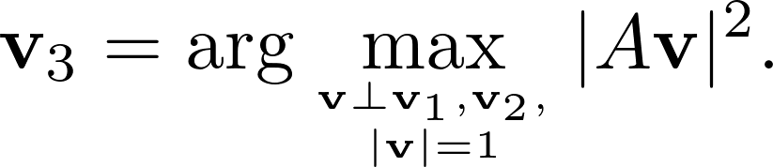
Singular Vectors
The second singular vector: the best-fit line perpendicular to v₁.
The third singular vector: the best-fit line perpendicular to v₁ and v₂.

Slide 26

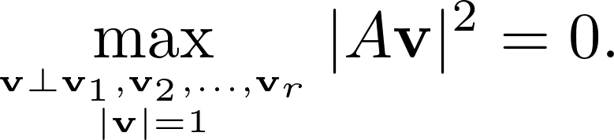
Singular Vectors
The second singular vector: the best-fit line perpendicular to v₁.
The third singular vector: the best-fit line perpendicular to v₁ and v₂.
Find singular vectors v₁, v₂, ... , v_{r} and singular values
⁞

Slide 27
The Greedy Algorithm Find the Best-Fit Subspace!
Theorem. Let A be an n x d matrix with singular vectors v₁, v₂, ... , v_{r}. For 1 ≤ k ≤ r, let V_{k} be the subspace spanned by v₁, v₂, ... , v_{k}. For each k, V_{k} is the best-fit k-dimensional subspace for A.

Slide 28
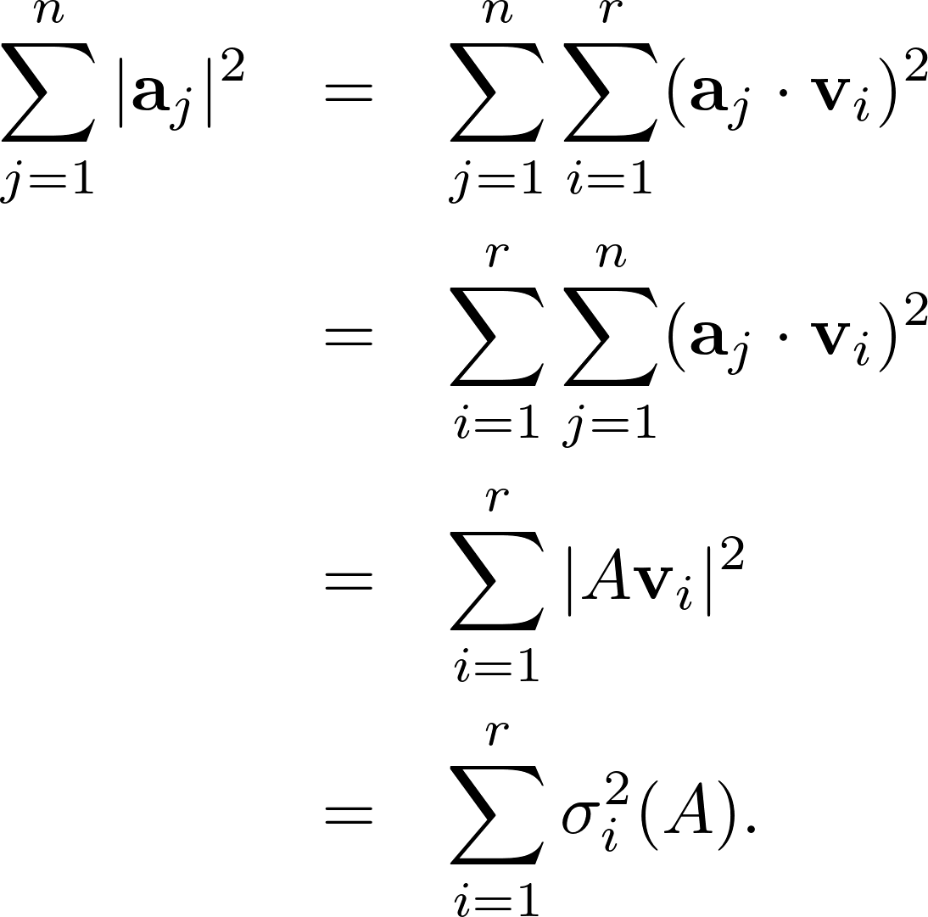
Sum of squares of singular values

Slide 29
Sum of squares of singular values
linear combination of a_{j} w.r.t. v_{i}’s

Slide 30
Sum of squares of singular values

Slide 31
Sum of squares of singular values
The sum of squares of all the entries of A.
=
The sum of squares of singular values of A.

Slide 32
Sum of squares of singular values
The sum of squares of all the entries of A.
=
The sum of squares of singular values of A.
The singular values summarizes the whole matrix in some sense.

Slide 33
Left and Right-Singular Vectors
v₁, v₂, ... , v_{r} : right-singular vectors.
To find the left-singular vectors:

Slide 34
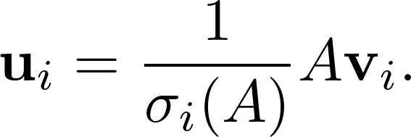
Left and Right-Singular Vectors
v₁, v₂, ... , v_{r} : right-singular vectors.
To find the left-singular vectors:

Slide 35
Left and Right-Singular Vectors
v₁, v₂, ... , v_{r} : right-singular vectors.
To find the left-singular vectors:
Concept of normalization

Slide 36
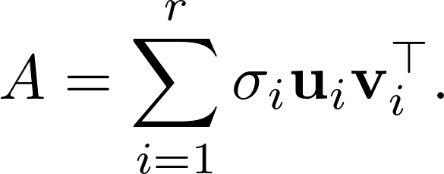
Singular Value Decomposition
Theorem. Let A be an n x d matrix with right-singular vectors v₁, v₂, ... , v_{r}, left-singular vectors u₁, u₂, ... , u_{r} and corresponding singular values σ₁, σ₂, ... , σ_{r}. Then

Slide 37
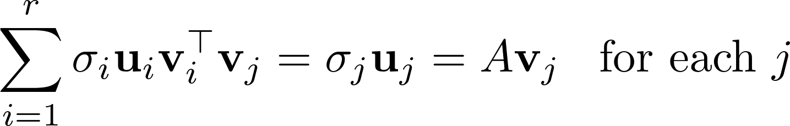
Singular Value Decomposition
Theorem. Let A be an n x d matrix with right-singular vectors v₁, v₂, ... , v_{r}, left-singular vectors u₁, u₂, ... , u_{r} and corresponding singular values σ₁, σ₂, ... , σ_{r}. Then
Proof:

Slide 38
Singular Value Decomposition
Theorem. Let A be an n x d matrix with right-singular vectors v₁, v₂, ... , v_{r}, left-singular vectors u₁, u₂, ... , u_{r} and corresponding singular values σ₁, σ₂, ... , σ_{r}. Then
Proof:

Slide 39
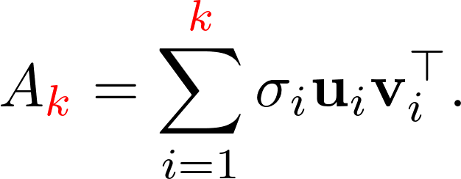
Best Rank-k Approximations
The sum truncated after k terms.
The rows of A_{k} are the projections of the rows of A onto the subspace V_{k} spanned by the first k singular vectors of A.

Slide 40
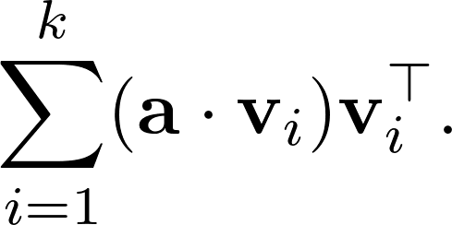
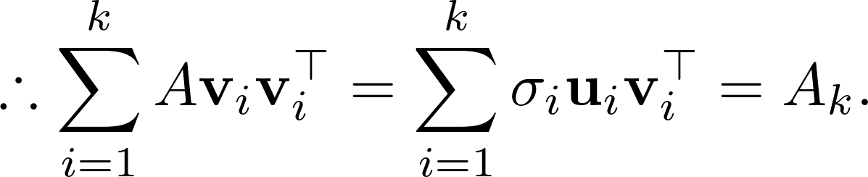
Best Rank-k Approximations
The sum truncated after k terms.
The rows of A_{k} are the projections of the rows of A onto the subspace V_{k} spanned by the first k singular vectors of A.

Slide 41
On Left Singular Vectors
The left singular vectors are pairwise orthogonal.

Slide 42
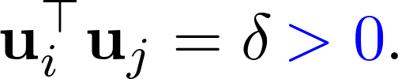
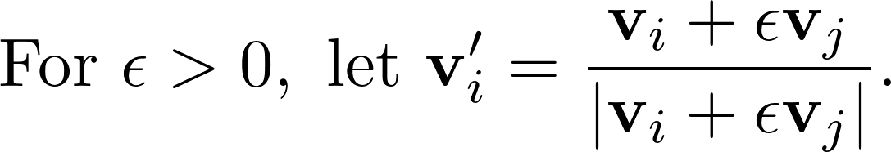
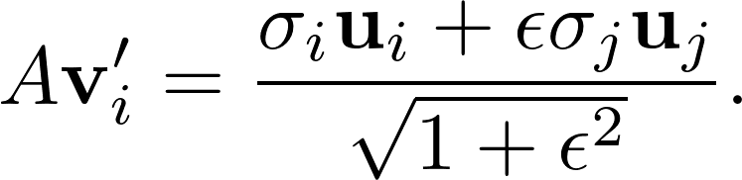
On Left Singular Vectors
The left singular vectors are pairwise orthogonal.
  i : the smallest integer such that u_{i} is not orthogonal to some other u_{j}.
  Assume that

Slide 43

On Left Singular Vectors
The left singular vectors are pairwise orthogonal.
  i : the smallest integer such that u_{i} is not orthogonal to some other u_{j}.
  Assume that

Slide 44
On Left Singular Vectors
The left singular vectors are pairwise orthogonal.
  i : the smallest integer such that u_{i} is not orthogonal to some other u_{j}.
  Assume that

Slide 45

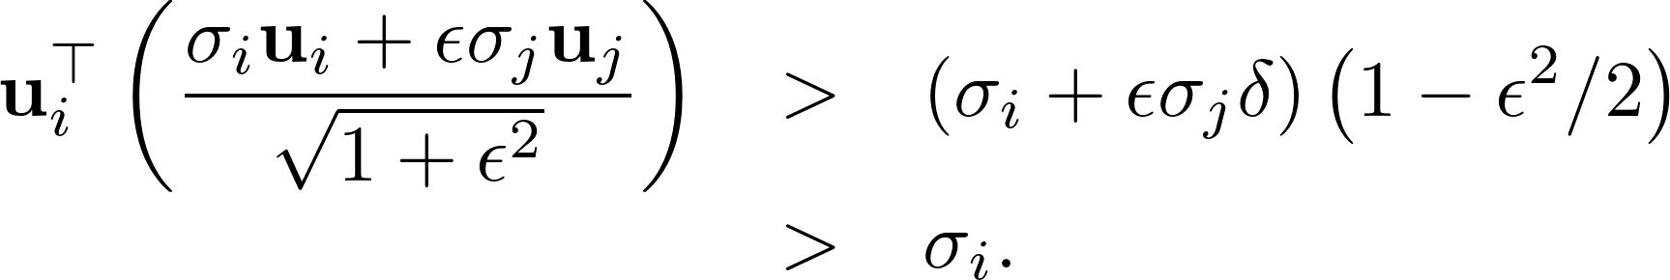
On Left Singular Vectors
The left singular vectors are pairwise orthogonal.
  i : the smallest integer such that u_{i} is not orthogonal to some other u_{j}.
  Assume that

Slide 46
Analog of eigenvalues and eigenvectors

Slide 47
Analog of eigenvalues and eigenvectors
Proof for the second:
From the SVD, we have

Slide 48

Analog of eigenvalues and eigenvectors
Proof for the second:
From the SVD, we have

Slide 49
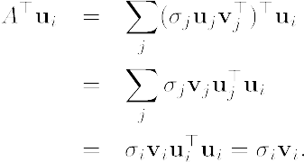
Analog of eigenvalues and eigenvectors
Proof for the second:
From the SVD, we have

Slide 50
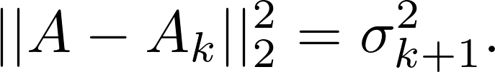

Ak: best rank-k 2-norm approximation

Slide 51
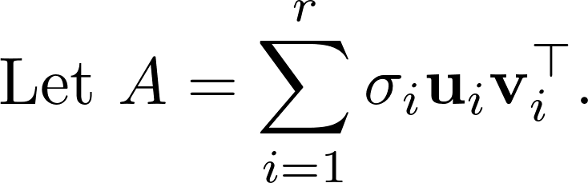
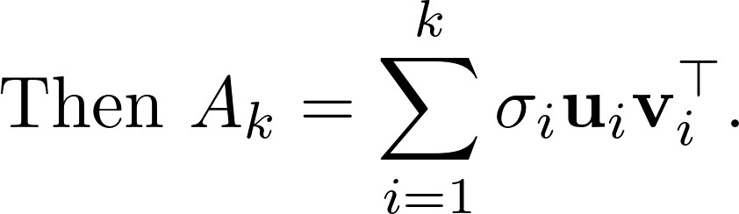
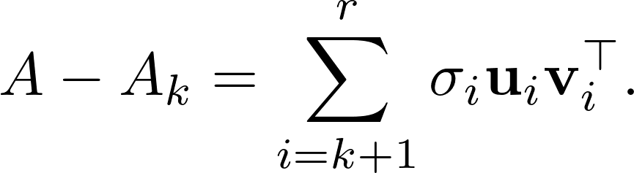
Ak: best rank-k 2-norm approximation

Slide 52
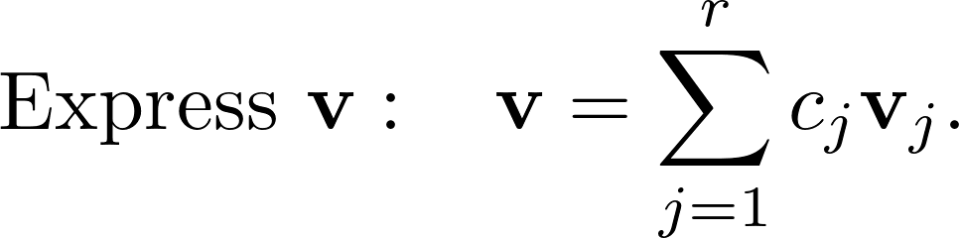
Ak: best rank-k 2-norm approximation

Slide 53
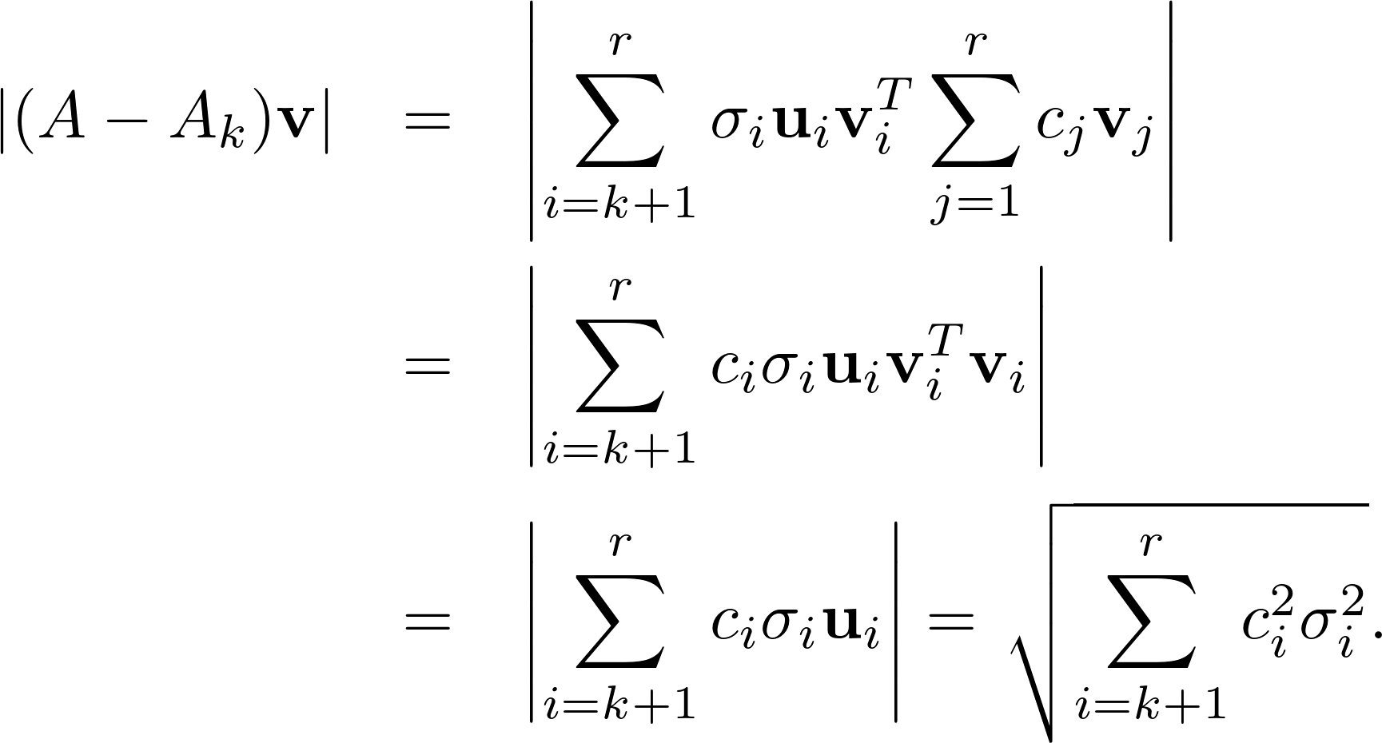
Ak: best rank-k 2-norm approximation

Slide 54

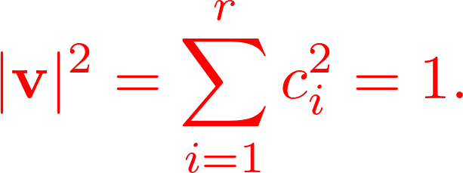
Ak: best rank-k 2-norm approximation
Try to maximize it!

Slide 55
Ak: best rank-k 2-norm approximation
Theorem. Let A be an n x d matrix. For any matrix B of rank ≤ k,

Slide 56
Ak: best rank-k 2-norm approximation
Theorem. Let A be an n x d matrix. For any matrix B of rank ≤ k,
  Assume A is of rank > k.

Slide 57

Ak: best rank-k 2-norm approximation
Theorem. Let A be an n x d matrix. For any matrix B of rank ≤ k,
  Assume A is of rank > k.

Slide 58

Ak: best rank-k 2-norm approximation
Theorem. Let A be an n x d matrix. For any matrix B of rank ≤ k,
  Assume A is of rank > k.

Slide 59
Ak: best rank-k 2-norm approximation
Theorem. Let A be an n x d matrix. For any matrix B of rank ≤ k,
  Assume A is of rank > k.

Slide 60
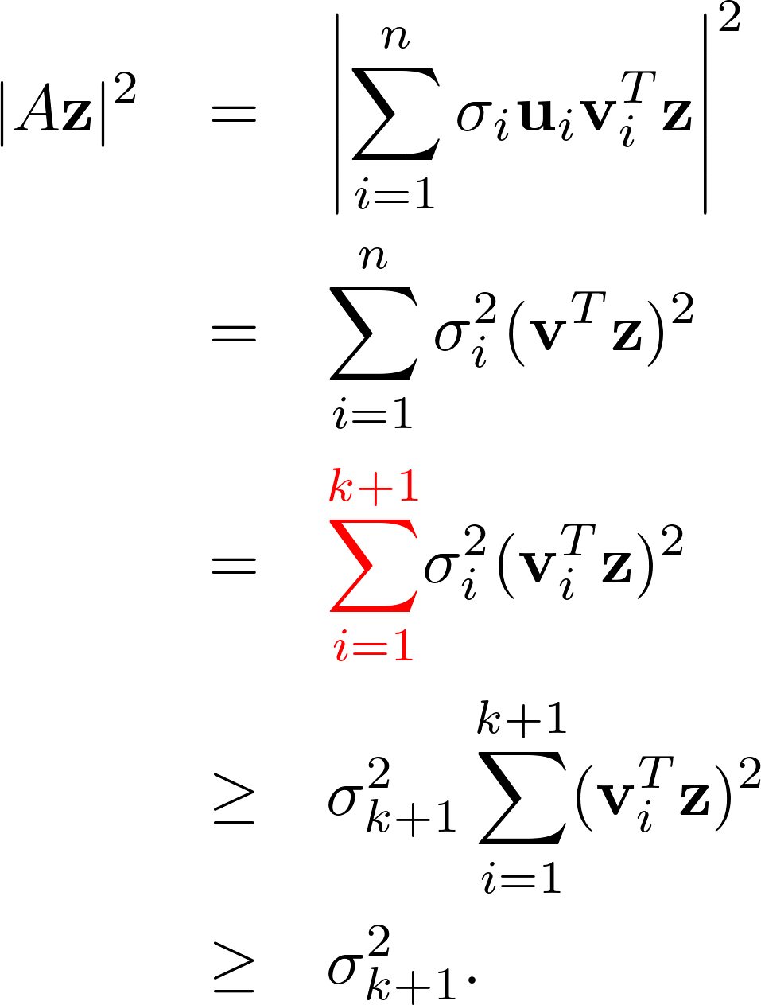
Ak: best rank-k 2-norm approximation
1 x d
vi^{T}
z
Theorem. Let A be an n x d matrix. For any matrix B of rank ≤ k,
  Assume A is of rank > k.
d x 1

Slide 61
Remark
Singular Value Decomposition (SVD) is used as core routine in the Principal Component Analysis (PCA).
  Unsupervised learning paradigm.
  A dimensionality reduction algorithm.

Slide 62
Application: Principle Component Analysis
Movie recommendation:
  n customers and d movies.
  a_{i,j} : the amount how customer i likes movie j.

Slide 63
Application: Principle Component Analysis
Movie recommendation:
  n customers and d movies.
  a_{i,j} : the amount how customer i likes movie j.
Hypothesis:
  Only k underlying factors that determine a customer likes a movie.
  k << n, d.

Slide 64
Application: Principle Component Analysis
Movie recommendation:
  n customers and d movies.
  a_{i,j} : the amount how customer i likes movie j.
Hypothesis:
  Only k underlying factors that determine a customer likes a movie.
  k << n, d.
U: n x k describing the customers.
V^{T}: d x k matrix, describing the movies.

Slide 65
Application: Principle Component Analysis
Movie recommendation:
  n customers and d movies.
  a_{i,j} : the amount how customer i likes movie j.
Hypothesis:
  Only k underlying factors that determine a customer likes a movie.
  k << n, d.
U: n x k describing the customers.
V^{T}: d x k matrix, describing the movies.
Goal: Find the best rank-k approximation A_{k}.

Slide 66
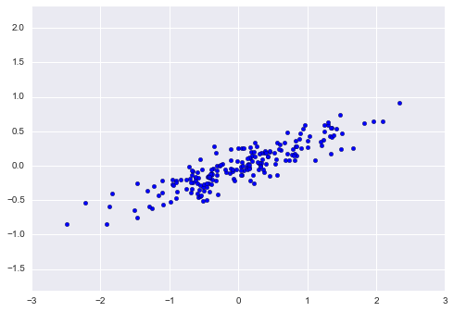
In scikit-learn
Suppose we have a dataset X of two-dimension.
A set of 200 randomly generated 2-D points

Slide 67
In scikit-learn
Suppose we have a dataset X of two-dimension.
Import PCA as below:
from sklearn.decomposition import PCA
pca = PCA(n_components=2)
pca.fit(X)
n_component=2 k = 2
A set of 200 randomly generated 2-D points

Slide 68
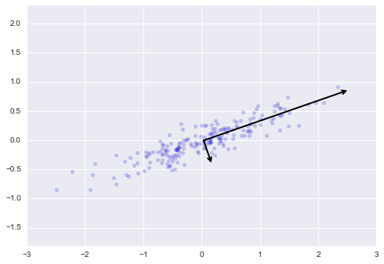
In scikit-learn
Suppose we have a dataset X of two-dimension.
Import PCA as below:
from sklearn.decomposition import PCA
pca = PCA(n_components=2)
pca.fit(X)
n_component=2 k = 2
print(pca.components_)
print(pca.explained_variance_)
[[ 0.94446029 0.32862557]
[ 0.32862557 -0.94446029]]
[ 0.75871884 0.01838551]
A set of 200 randomly generated 2-D points + components as axis

Slide 69
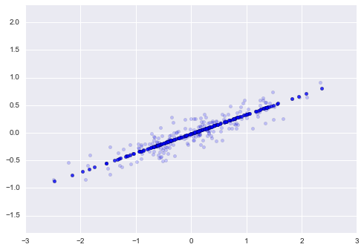
In scikit-learn
Dimension reduction:
pca = PCA(n_components=1)
pca.fit(X)
X_pca = pca.transform(X)
X_new = pca.inverse_transform(X_pca)
plt.scatter(X[:, 0], X[:, 1], alpha=0.2)
plt.scatter(X_new[:, 0], X_new[:, 1], alpha=0.8)

Slide 70
In scikit-learn
Refer to the webpage for more detail.

