Slide 1
Data Science Theory and Practices
Deviations and Fundamental Tail Probabilities
Joseph Chuang-Chieh Lin
Dept. CSIE, Tamkang University
17th May 2021
Notes:
e^x := \sum_{k=0}^{\infty} \frac{x^k}{k!}

Slide 2
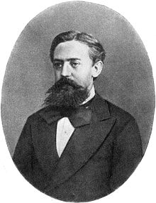

Markov’s Inequality
Let X be a random variable that assumes only non-negative values. Then, for all a > 0,
Andrei Andreyevich Markov (Wikipedia)
1856–1922

Slide 3



Markov’s Inequality
Let X be a random variable that assumes only non-negative values. Then, for all a > 0,
Proof:
Let . Since X ≥ 0,
Andrei Andreyevich Markov (Wikipedia)
1856–1922

Slide 4
Example: 75% heads in fair coin flips
What’s the probability of obtaining > 3n/4 heads in a sequence of n fair coin flips?

Slide 5



Example: 75% heads in fair coin flips
What’s the probability of obtaining > 3n/4 heads in a sequence of n fair coin flips?
Applying Markov’s inequality,

Slide 6

Example: 75% heads in fair coin flips
What’s the probability of obtaining > 3n/4 heads in a sequence of n fair coin flips?
Applying Markov’s inequality,

Slide 7
Scenarios of applying Markov’s inequality
Markov’s inequality gives the best tail bound when:
  All we know is the expectation of the random variable
  The random variable is non-negative.

Slide 8
The kth moment
Definition. The kth of a random variable X is E[X^{k}].
  So, the expectation is the first moment of X.

Slide 9
The variance
Definition. The variance of a random variable X is defined as
    Var[X] = E[(X−E[X])²] = E[X²] − (E[X])².

Slide 10
The variance
Definition. The variance of a random variable X is
    Var[X] = E[(X−E[X])²] = E[X²] − (E[X])².
Definition. The standard deviation of a random variable X is
        σ[X] = (Var[X])^{1/2}.
Definition. The covariance of two random variables X and Y is
    Cov(X, Y) = E[(X−E[X])(Y−E[Y])].

Slide 11
Variance of the sum of two random variables
Theorem. For any two random variables X and Y,
    Var[X+Y] = Var[X] + Var[Y] + 2 Cov(X, Y).

Slide 12
Variance of the sum of two random variables
Theorem. For any two random variables X and Y,
    Var[X+Y] = Var[X] + Var[Y] + 2 Cov(X, Y).
Not as nice as the linearity of expectation!

Slide 13
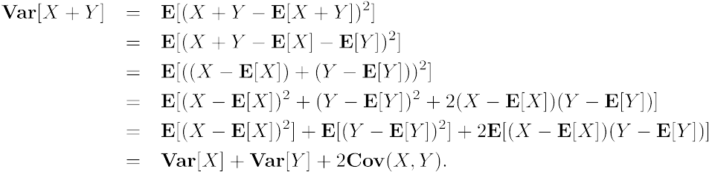
Variance of the sum of two random variables
Theorem. For any two random variables X and Y,
    Var[X+Y] = Var[X] + Var[Y] + 2 Cov(X, Y).
Proof:

Slide 14
Expectation of product of two random variables
Theorem. If X and Y are two independent random variables, then

Slide 15
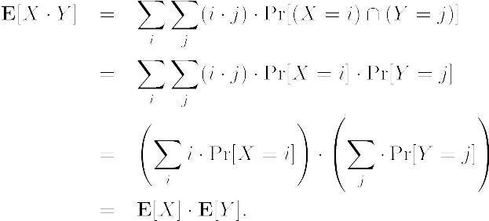
Expectation of product of two random variables
Theorem. If X and Y are two independent random variables, then
Proof:

Slide 16
Independence → Linearity of Variance
Corollary. If X and Y are independent random variables, then
Cov(X, Y) = 0
and
Var[X+Y] = Var[X] + Var[Y].

Slide 17
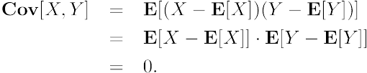
Independence → Linearity of Variance
Corollary. If X and Y are independent random variables, then
Cov(X, Y) = 0
and
Var[X+Y] = Var[X] + Var[Y].
Proof:

Slide 18

Remark
Theorem. For mutually independent random variables X1, X2, …, Xn

Slide 19
Example: Variance of a binomial random variable
Recall: a binomial random variable X can be regarded as the sum of n independent Bernoulli trials (Y’s), each with success probability p.

Slide 20
Example: Variance of a binomial random variable
Recall: a binomial random variable X can be regarded as the sum of n independent Bernoulli trials (Y’s), each with success probability p.

Slide 21
Example: Variance of a binomial random variable
A binomial random variable X can be regarded as the sum of n independent Bernoulli trials (Y’s), each with success probability p.
By the theorem in p.19,

Slide 22

Chebyshev’s Inequality
A stronger tail bound if you have the expectation and the variance.
Theorem [Chebyshev’s Inequality]. For any a > 0,

Slide 23
Chebyshev’s Inequality
Theorem [Chebyshev’s Inequality]. For any a > 0,
Proof:
Apply Markov’s inequality,

Slide 24


Chebyshev’s Inequality
Corollary. For any t > 1,

Slide 25
Example: 75% heads in fair coin flips

Slide 26



Example: 75% heads in fair coin flips
Actually,

Slide 27
Example: 75% heads in fair coin flips
Actually,

Slide 28
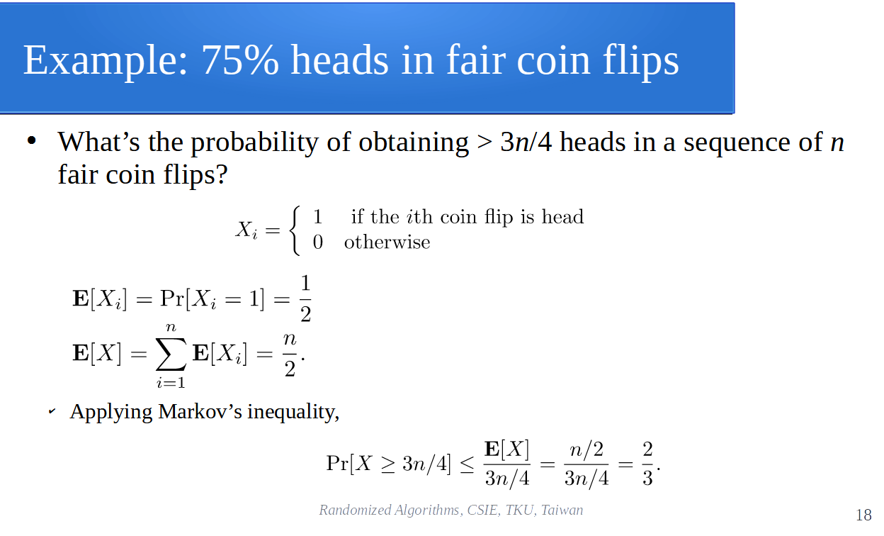
Example: 75% heads in fair coin flips
Actually,

Slide 29
Assignment 03
Let X be a number chosen uniformly at random from [1, n]. Find Var[X].
Suppose that we roll a standard fair die 100 times. Let X be the sum of the numbers that appear over the 100 rolls. Use Chebyshev’s inequality to bound

