Slide 1
Data Science Theory and Practices
Chernoff and Hoeffding Bounds
Joseph Chuang-Chieh Lin
Dept. CSIE, Tamkang University
24th May 2021
Notes:
e^x := \sum_{k=0}^{\infty} \frac{x^k}{k!}

Slide 2
Moment Generating Functions
Definition. The moment generating function of a random variable X is

Slide 3

Moment Generating Functions
Definition. The moment generating function of a random variable X is
The nth derivative of M_{X}(t) at t = 0.

Slide 4
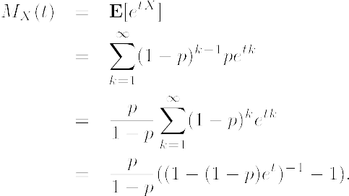
Example
Consider a geometric random variable X with parameter p.
For t < − ln(1−p),

Slide 5

Example
Consider a geometric random variable X with parameter p.
For t < − ln(1−p),

Slide 6

Example
Consider a geometric random variable X with parameter p.
For t < − ln(1−p),

Slide 7
MGF for sum of independent r.v.’s
Theorem. If X and Y are independent random variables, then

Slide 8
MGF for sum of independent r.v.’s
Theorem. If X and Y are independent random variables, then
Proof.

Slide 9
MGF for sum of independent r.v.’s
Theorem. If X and Y are independent random variables, then
Generalization:

Slide 10
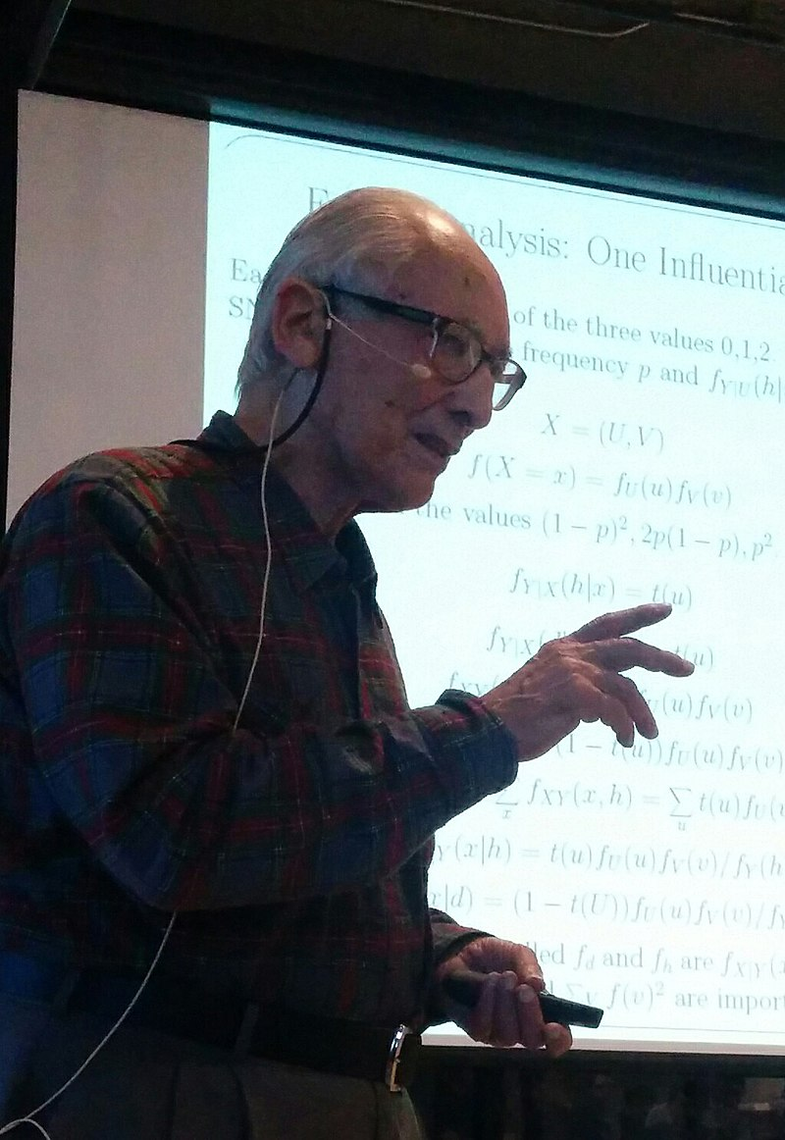




Chernoff bounds:
Applying Markov’s inequality to e^{tX}
From Markov’s inequality,
Herman Chernoff
https://en.wikipedia.org/wiki/Herman_Chernoff
For any t > 0,
For any t < 0,

Slide 11
Chernoff bounds:
Applying Markov’s inequality to e^{tX}
From Markov’s inequality,
Choose appropriate values for t for specific distributions.
Herman Chernoff
https://en.wikipedia.org/wiki/Herman_Chernoff
For any t > 0,
For any t < 0,

Slide 12

Chernoff bounds for sum of Poisson trials
Poisson trials:
  ≈ Bernoulli trials
  while the trials are not necessarily identical.
X1, …, X_{n}: independent Poisson trials with Pr[X_{i} = 1] = p_{i}.
Let

Slide 13

Chernoff bounds for sum of Poisson trials
Poisson trials:
  ≈ Bernoulli trials
  while the trials are not necessarily identical.
X1, …, Xn: independent Poisson trials with Pr[X_{i} = 1] = p_{i}.
Let

Slide 14
Chernoff bounds for sum of Poisson trials
For δ > 0, we want to analyze the tail probabilities

Slide 15
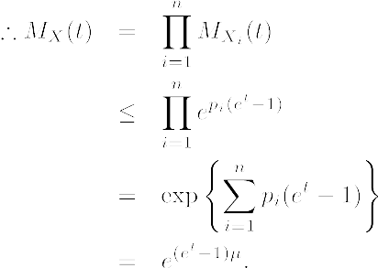
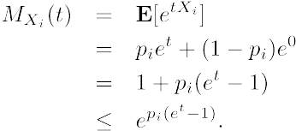
Chernoff bounds for sum of Poisson trials
For δ > 0, we want to analyze the tail probabilities

Slide 16



Chernoff bounds for sum of Poisson trials
Theorem. Let X1, …, X_{n} be independent Poisson trials with Pr[X_{i} = 1] = p_{i}.
              Then the following Chernoff bounds hold:
  For δ > 0,
  For 0 < δ ≤ 1,
  For R ≥ 6μ,

Slide 17
Chernoff bounds for sum of Poisson trials
Theorem. Let X1, …, X_{n} be independent Poisson trials with Pr[X_{i} = 1] = p_{i}.
              Then the following Chernoff bounds hold:
  For δ > 0,
  For 0 < δ ≤ 1,
  For R ≥ 6μ,

Slide 18
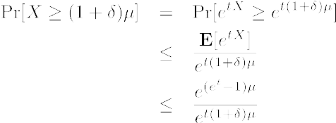
Chernoff bounds for sum of Poisson trials
Applying Markov’s inequality for t > 0,

Slide 19

Chernoff bounds for sum of Poisson trials
Applying Markov’s inequality for t > 0,
For any δ > 0, set t = ln(1+δ) > 0:

Slide 20


Chernoff bounds for sum of Poisson trials
Applying Markov’s inequality for t > 0,
For any δ > 0, set t = ln(1+δ) > 0:
For 0 < δ ≤ 1,
Taking logarithm of both sides:

Slide 21


Chernoff bounds for sum of Poisson trials
Applying Markov’s inequality for t > 0,
For any δ > 0, set t = ln(1+δ) > 0:
For 0 < δ ≤ 1,
Taking logarithm of both sides:

Slide 22
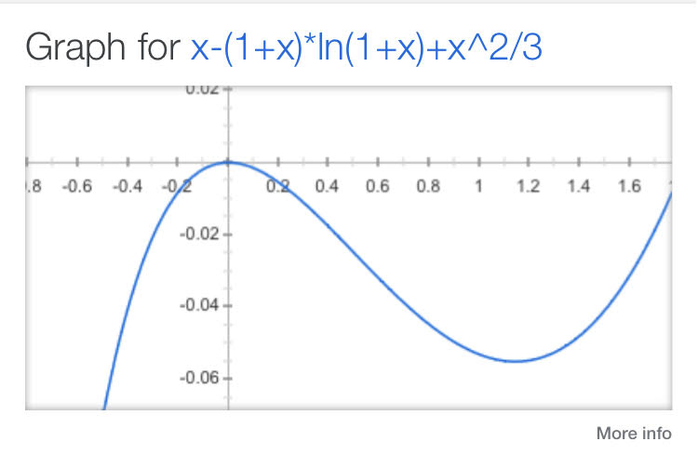
Proof sketch
Applying Markov’s inequality for t > 0,
For any δ > 0, set t = ln(1+δ) > 0:
For 0 < δ ≤ 1,
Taking logarithm of both sides:

Slide 23



Chernoff bounds for sum of Poisson trials
Theorem. Let X1, …, X_{n} be independent Poisson trials with Pr[X_{i} = 1] = p_{i}.
              Then the following Chernoff bounds hold:
  For 0 < δ < 1,
  Therefore we have:

Slide 24



Example: 75% heads in fair coin flips

Slide 25
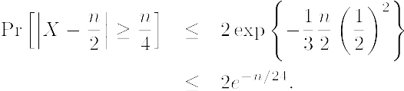
Example: 75% heads in fair coin flips
Try to use Chernoff bound!

Slide 26
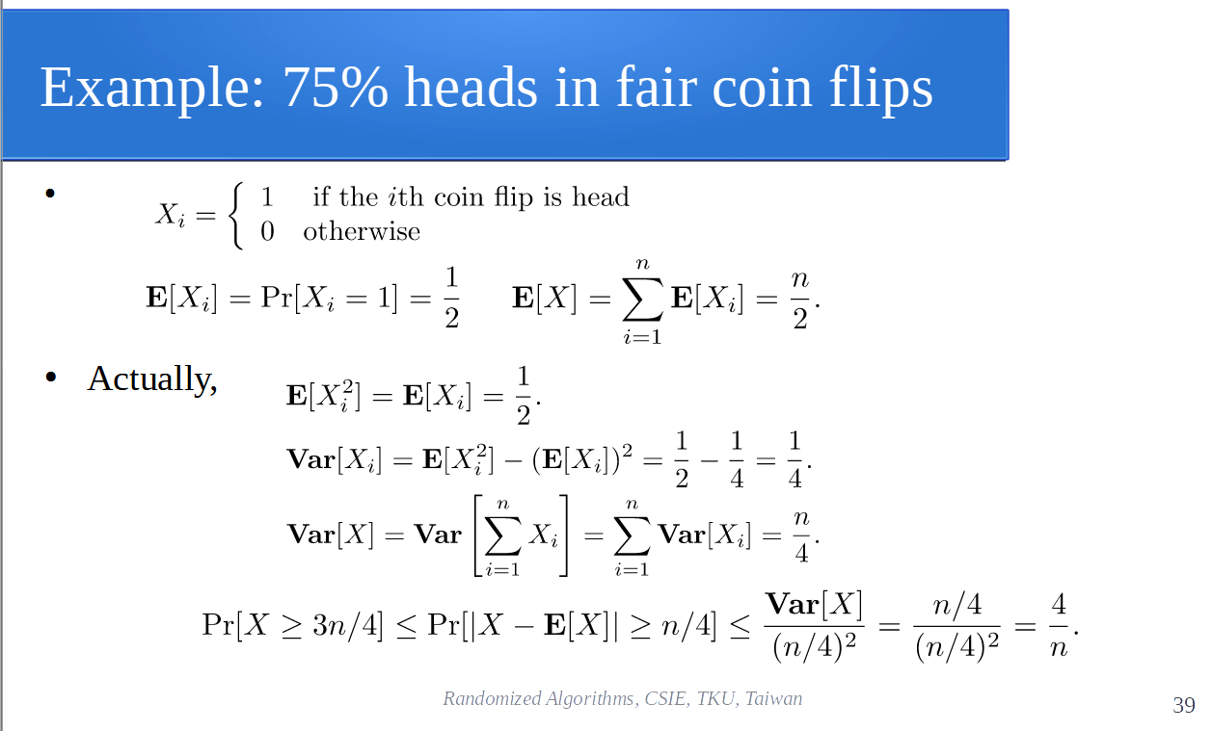
Example: 75% heads in fair coin flips
Try to use Chernoff bound!
Previous bound using Chebyshev’s inequality:

Slide 27
Example: 75% heads in fair coin flips
Try to use Chernoff bound!
Previous bound using Chebyshev’s inequality:
 | n=50 | n=100 | n=200
2/n | 0.2 | 0.02 | 0.01
 | 0.125 | 0.016 | 0.00025

Slide 28
Strengthen a weak classifier
Suppose we have designed a device which can check in a very short time if a diamond is real or fake and the accuracy is around 66% for each examination.
Such a device is somehow too weak to be used in practical.

Slide 29
Strengthen a weak classifier
Suppose we have designed a device which can check in a very short time if a diamond is real or fake and the accuracy is around 66% for each examination.
Such a device is somehow too weak to be used in practical.
Let say we run the device for n = 201 times for each examination and output “True” if more than 101 of the results reveal that the diamond is real and output “False” otherwise.

Slide 30
Strengthen a weak classifier
Suppose we have designed a device which can check in a very short time if a diamond is real or fake and the accuracy is around 66% for each examination.
Such a device is somehow too weak to be used in practical.
Let say we run the device for n = 201 times for each examination and output “True” if more than 101 of the results reveal that the diamond is real and output “False” otherwise. (majority vote)

Slide 31

An application: Parameter Estimation
Goal: evaluating the probability that a particular gene mutation occurs in the population.
A lab test can determine if a DNA sample carries the mutation.
However, the test is very expensive, so we want to obtain a relatively reliable estimate from a small number of samples.
https://tinyurl.com/8fwxsnab

Slide 32
An application: Parameter Estimation
p: be the unknown value we try to estimate.
n: the number of samples we have
: number of samples having the mutation
Large number of samples

Slide 33
An application: Parameter Estimation
p: be the unknown value we try to estimate.
n: the number of samples we have
: number of samples having the mutation
Large number of samples
We expect the value p to be close to the sampled value

Slide 34
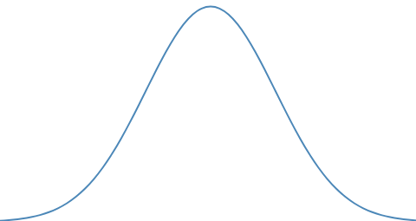
An application: Parameter Estimation
Definition. A 1−γ confidence interval for a parameter p is an interval
such that
We need to find values of δ and γ such that

Slide 35
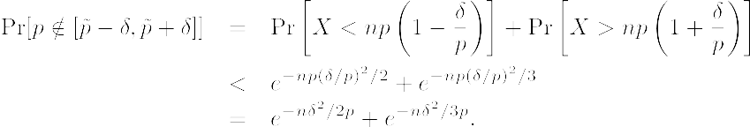
An application: Parameter Estimation
Apply the Chernoff bound:

Slide 36
An application: Parameter Estimation
Apply the Chernoff bound:
But we do not know the value of p, so it’s not useful…
Take p ≤ 1,

Slide 37
An application: Parameter Estimation
Apply the Chernoff bound:
But we do not know the value of p, so it’s not useful…
Take p ≤ 1,

Slide 38
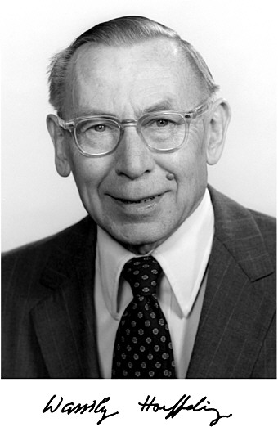
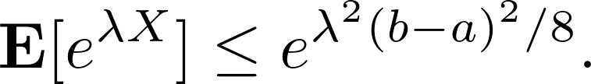
The Hoeffding Bound
Wassily Hoeffding (1914−1991)
refer to https://tinyurl.com/mzz7x8pb
Extending the Chernoff bound to general random variables with a bounded range.
Hoeffding’s Lemma: Let X be a random such that
Then for every λ > 0,

Slide 39
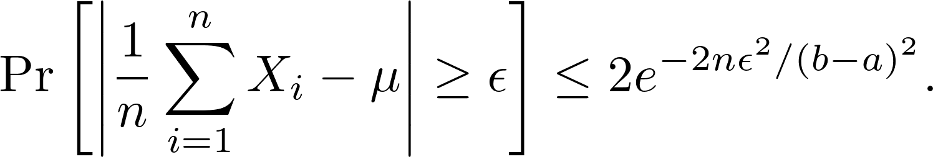
The Hoeffding Bound
Wassily Hoeffding (1914−1991)
refer to https://tinyurl.com/mzz7x8pb
Extending the Chernoff bound to general random variables with a bounded range.
Hoeffding’s Lemma: Let X be a random such that
Then for every λ > 0,
Hoeffding’s Bound: Let X₁, ..., X_{n} be independent random variables such that
for all 1 ≤ i ≤ n, Then for every λ > 0,

Slide 40
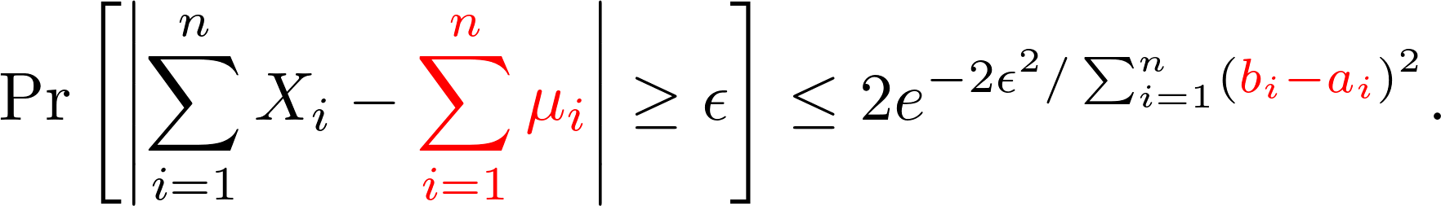
The Hoeffding Bound
Wassily Hoeffding (1914−1991)
refer to https://tinyurl.com/mzz7x8pb
Extending the Chernoff bound to general random variables with a bounded range.
Theorem: Let X₁, ..., X_{n} be independent random variables such that

Slide 41
Proofs

Slide 42
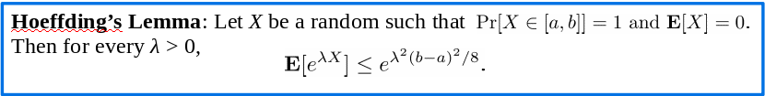
Proof of Hoeffding’s Lemma
We assume a < 0 and b > 0. (Why?)
f(x) = e^{λx} is a convex function.

Slide 43

Proof of Hoeffding’s Lemma
We assume a < 0 and b > 0. (Why?)
f(x) = e^{λx} is a convex function.

Slide 44
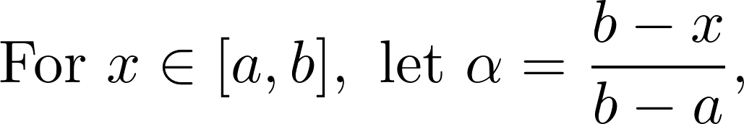
Proof of Hoeffding’s Lemma
We assume a < 0 and b > 0. (Why?)
f(x) = e^{λx} is a convex function.

Slide 45
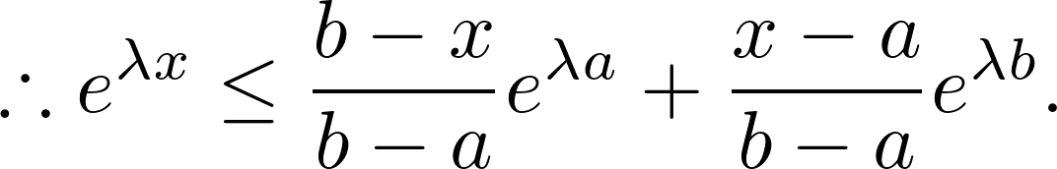
Proof of Hoeffding’s Lemma
We assume a < 0 and b > 0. (Why?)
f(x) = e^{λx} is a convex function.

Slide 46
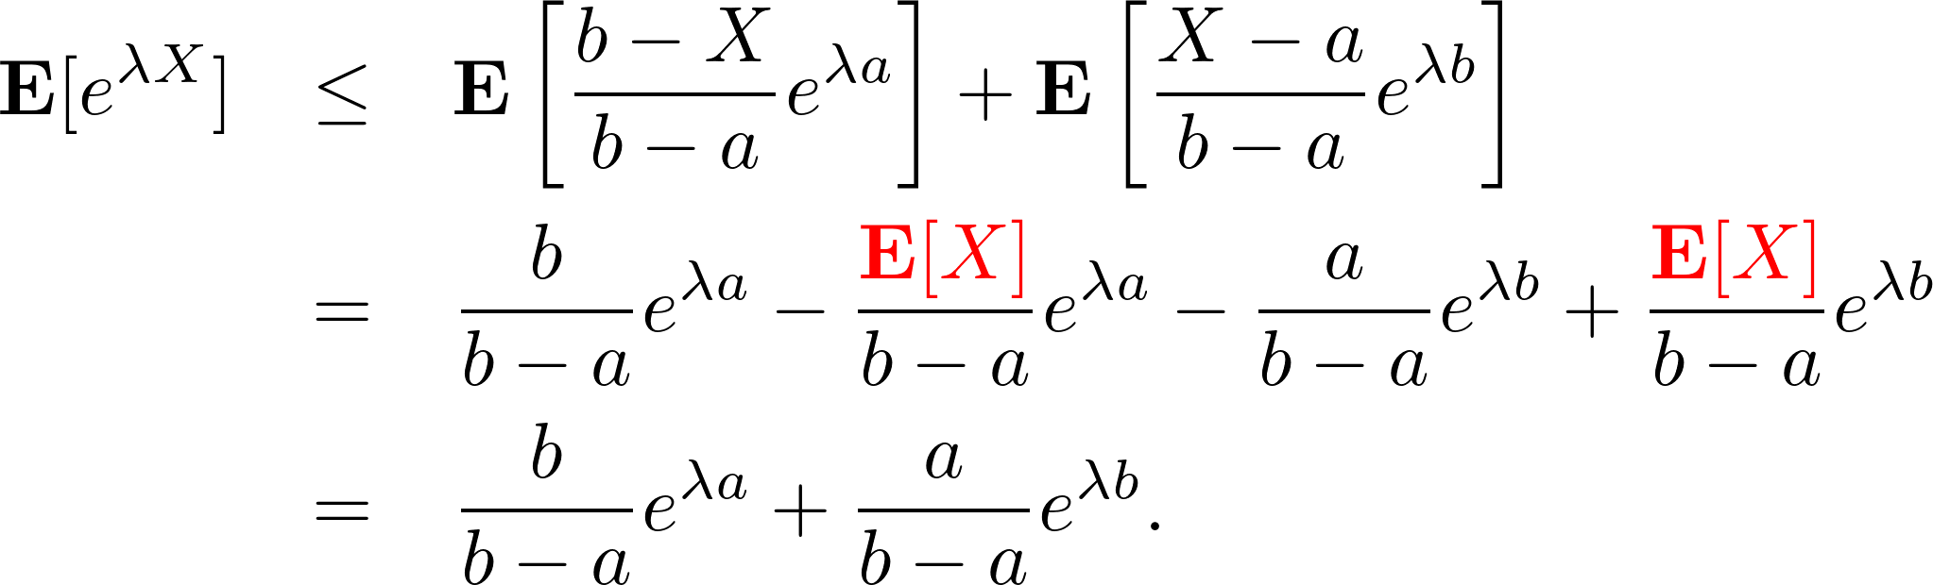
Proof of Hoeffding’s Lemma

Slide 47
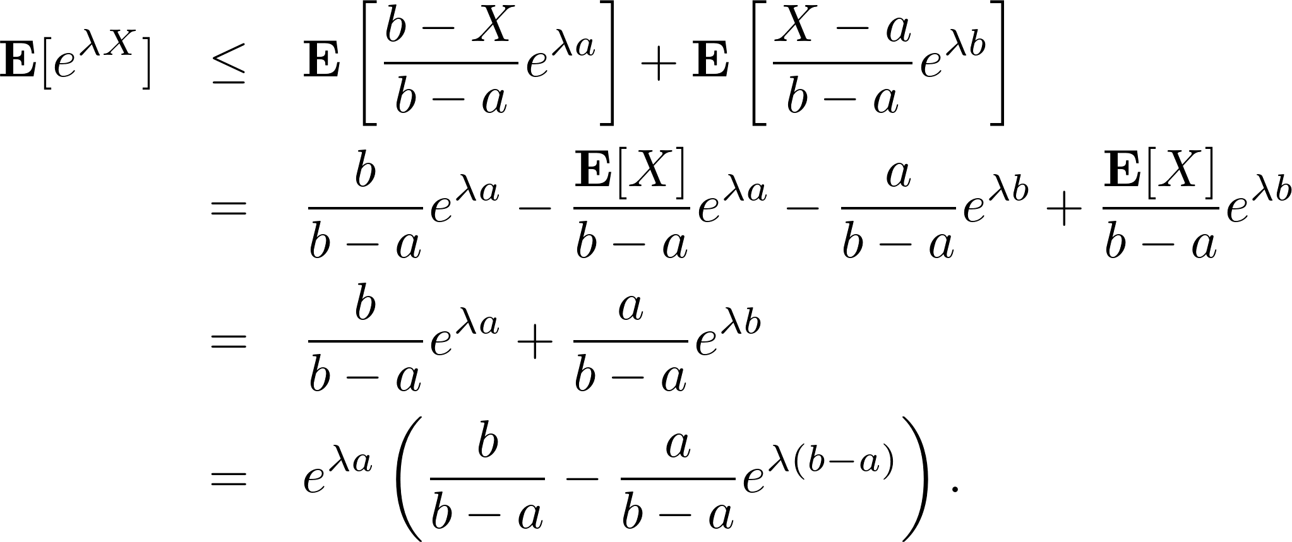
Proof of Hoeffding’s Lemma

Slide 48
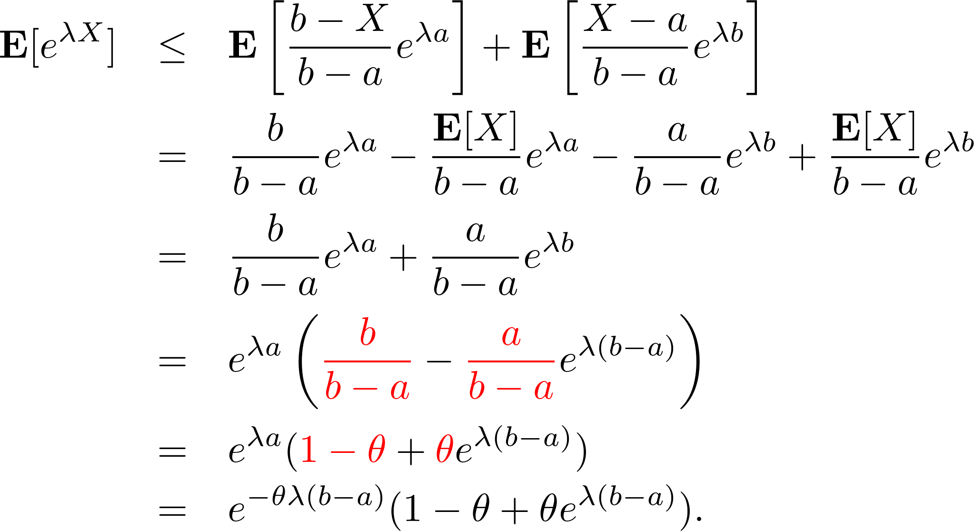
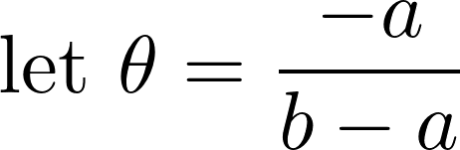
Proof of Hoeffding’s Lemma

Slide 49
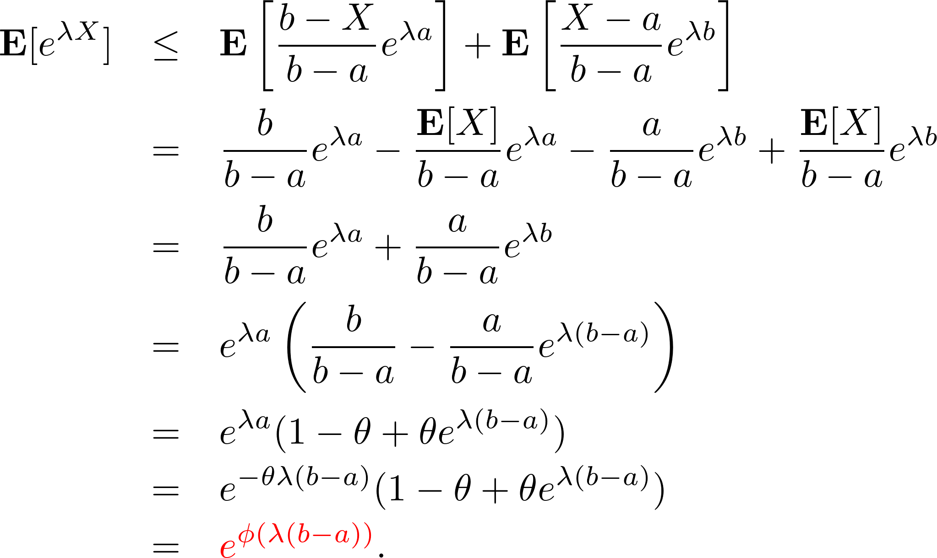
Proof of Hoeffding’s Lemma

Slide 50

Proof of Hoeffding’s Lemma

Slide 51
Proof of Hoeffding’s Lemma

Slide 52
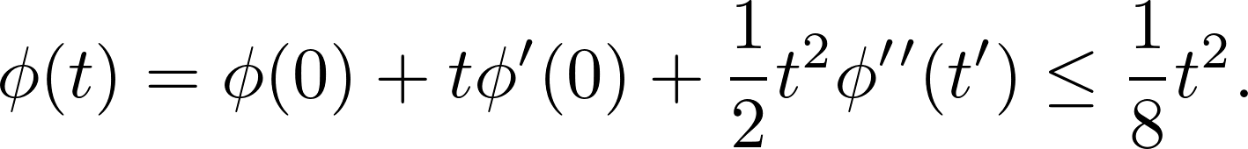
Proof of Hoeffding’s Lemma

Slide 53

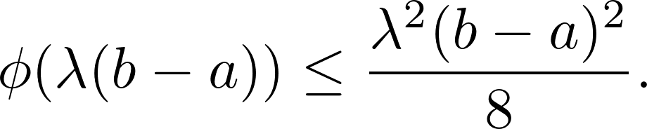
Proof of Hoeffding’s Lemma

Slide 54
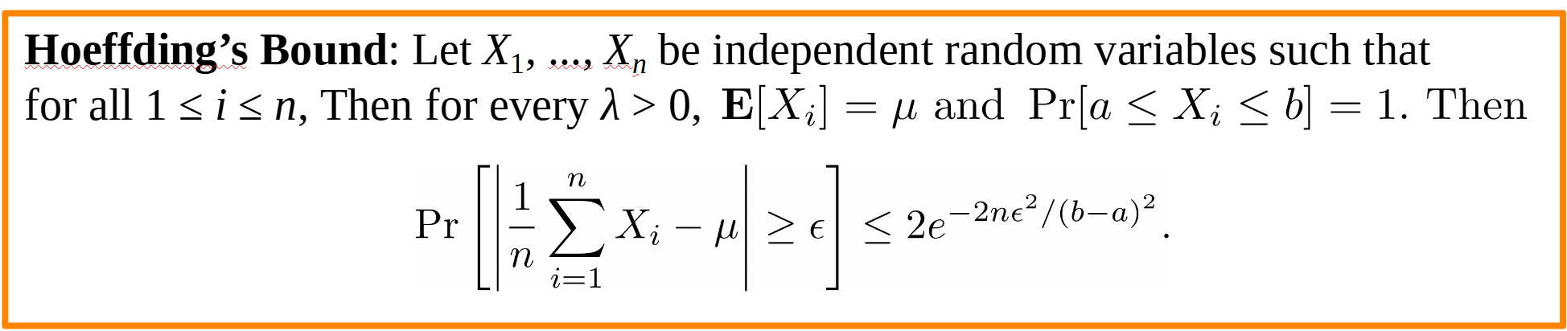
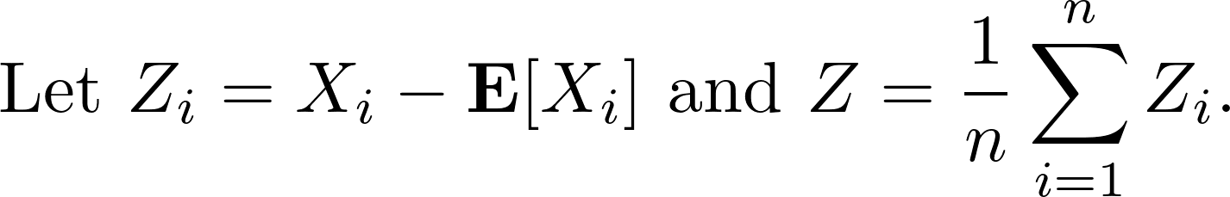
Proof of The Hoeffding’s Bound

Slide 55
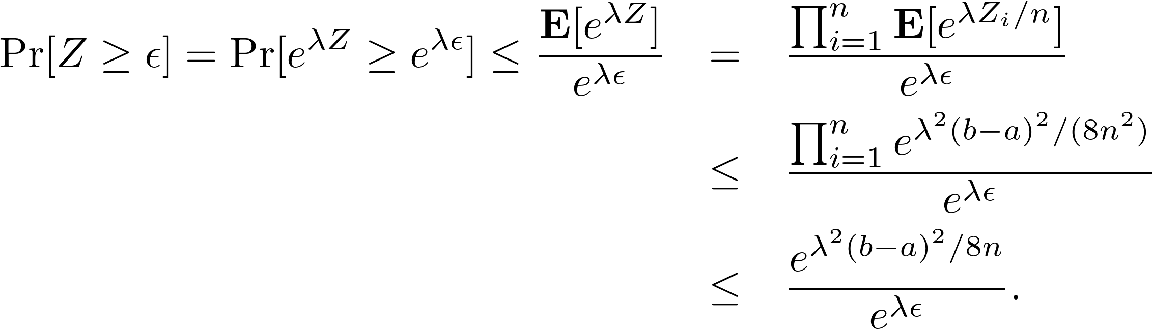
Proof of The Hoeffding’s Bound

Slide 56
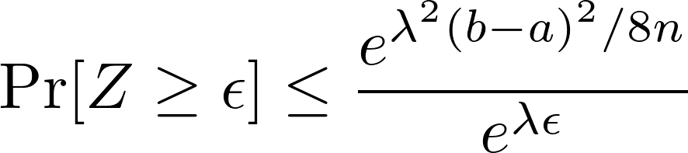
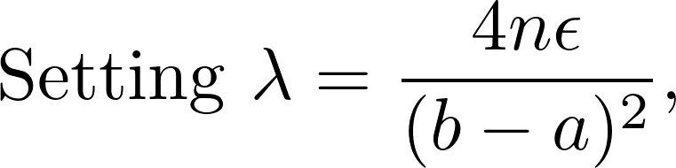
Proof of The Hoeffding’s Bound

Slide 57
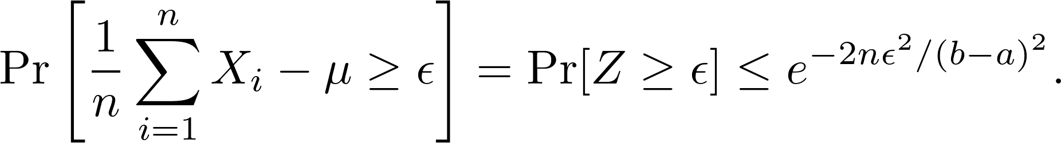
Proof of The Hoeffding’s Bound

Slide 58
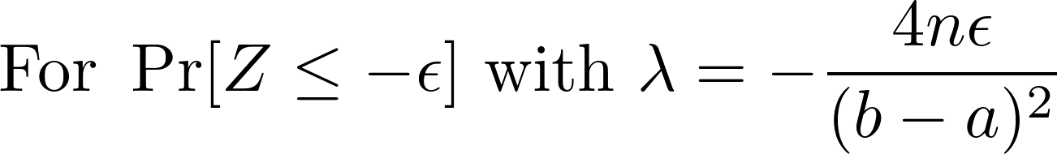
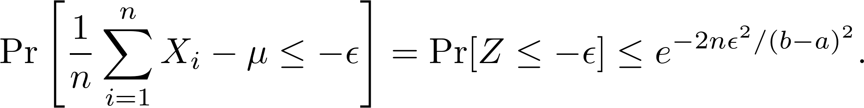
Proof of The Hoeffding’s Bound

