Slide 1
Data Science Theory and Practices
Generalization and Regularization
Joseph Chuang-Chieh Lin
Dept. CSIE, Tamkang University
7th June 2021
Notes:
e^x := \sum_{k=0}^{\infty} \frac{x^k}{k!}

Slide 2
Outline
Formalization of learning
Overfitting and uniform convergence
Occam’s razor
Regularization

Slide 3
Formalization
Instance space
  Data described by d features.
    Email messages with presence or absence of various types of words.
    Patient records with the results of various medical tests.
Learning task:
  Given
    Could be labeled.
      Email messages: each is labeled ‘spam’ nor ‘not spam’.
      Patient records: each is labeled whether or not they respond well to the treatment.

Slide 4
Formalization (contd.)
Goal: An algorithm using the training examples to produce a classification rule (or regression) that will perform well over new data.
  The key feature of machine learning: generalization.
How?

Slide 5
Formalization (contd.)
Goal: An algorithm using the training examples to produce a classification rule (or regression) that will perform well over new data.
  The key feature of machine learning: generalization.
How?
  In general, find a “simple” rule with good performance on the training data.
    e.g., find highly indicative words or weighting of words such that weighted sum can be used to classify spam and non-spam emails.
  Argue that the training data is representative of the future data.

Slide 6
Formalization (contd.)
Assume that
Training set S:
    drawn uniformly at random from D.
c*: target concept
  denote the subset of X corresponding to the positive class
    E.g, all spam emails, all patients who respond well to the treatment.
  Hence, each training data point is labeled according to whether it belongs to c* or not.

Slide 7

Formalization (contd.)
Our goal: produce
True error of h:
  The probability that h incorrectly classifies a data point drawn randomly from D.
Training error of h:

Slide 8
Formalization (contd.)
What if we obtain an h for which err_{S}(h) is pretty low while err_{D}(h) is high?

Slide 9
Formalization (contd.)
What if we obtain an h for which err_{S}(h) is pretty low while err_{D}(h) is high?
  For example, memorizing all the training examples and predicting positive for each example if and only if it already appeared positively in the training set.

Slide 10
Formalization (contd.)
What if we obtain an h for which err_{S}(h) is pretty low while err_{D}(h) is high?
  For example, memorizing all the training examples and predicting positive for each example if and only if it already appeared positively in the training set.
  We call it overfitting.

Slide 11
Formalization (contd.)
What if we obtain an h for which err_{S}(h) is pretty low while err_{D}(h) is high?
  For example, memorizing all the training examples and predicting positive for each example if and only if it already appeared positively in the training set.
  We call it overfitting.
Algorithms will typically optimize over the data (training data).

Slide 12
Formalization (contd.)
Hypothesis class H over X : a collection of subsets of X. (assume it finite)
  Example: the class of linear separators over X = R^{d}.

Slide 13
Formalization (contd.)
Hypothesis class H over X : a collection of subsets of X (assume it finite)
  Example: the class of linear separators over X = R^{d}.
…...

Slide 14
Formalization (contd.)
Hypothesis class H over X : a collection of subsets of X. (assume it finite)
  Example: the class of linear separators over X = R^{d}.
?
…...
?

Slide 15

Formalization (contd.)
To facilitate our discussion, let

Slide 16

Overfitting and uniform convergence
Theorem [PAC-learning guarantee (Probably Approximately Correct)].
Let H be a hypothesis class and let ε, δ > 0.
If a training set S of size
is drawn from distribution D, then with probability ≥ 1−δ, every h ∈ H
with true error err_{D}(h) ≥ ε has training error err_{S}(h) > 0.

Slide 17
Overfitting and uniform convergence
Theorem [PAC-learning guarantee (Probably Approximately Correct)].
Let H be a hypothesis class and let ε, δ > 0.
If a training set S of size
is drawn from distribution D, then with probability ≥ 1−δ, every h ∈ H
with training error err_{S}(h) = 0 has true error err_{D}(h) < ε.

Slide 18
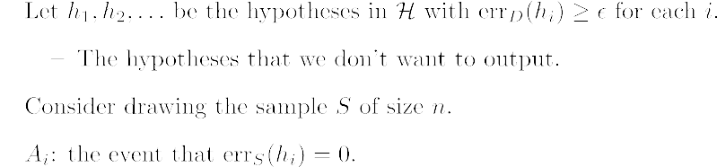

Slide 19
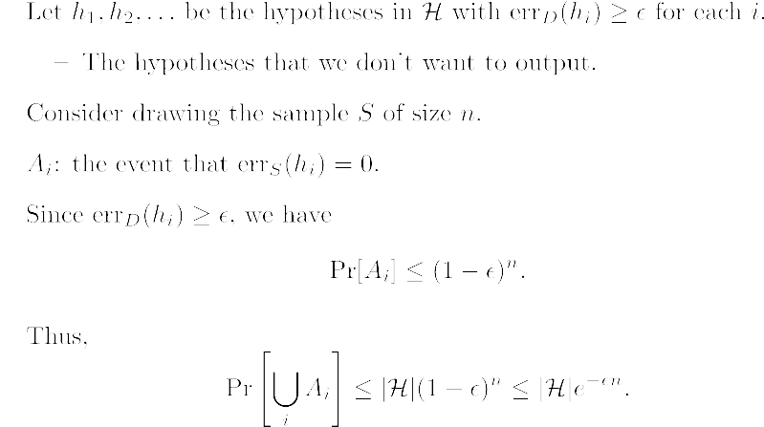

Slide 20


Slide 21
Remark on PAC Theorem
What if the best h_{i} in H has > 0% error (say 5%) on S?
  Can we still be confident that its true error is low? (say 10%?)

Slide 22
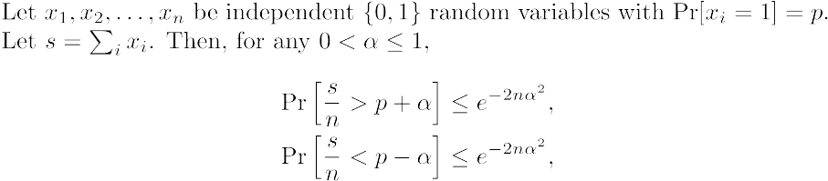
Theorem (Hoeffding bounds; reformulate)

Slide 23
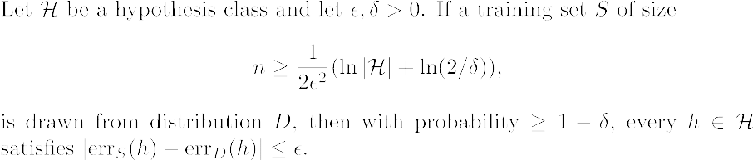
Theorem (Uniform convergence)

Slide 24
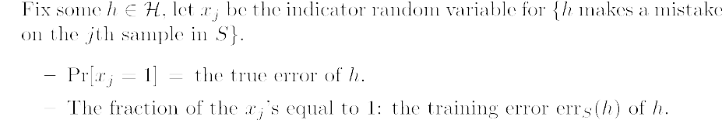

Slide 25
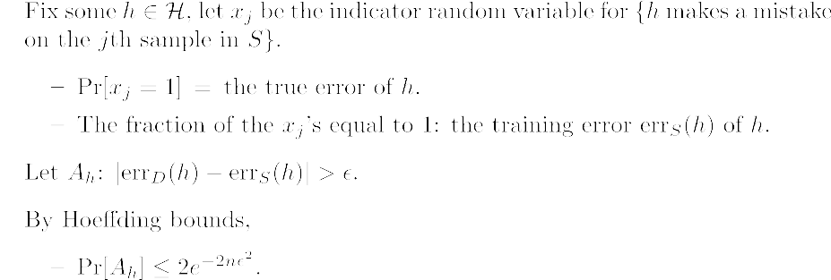

Slide 26
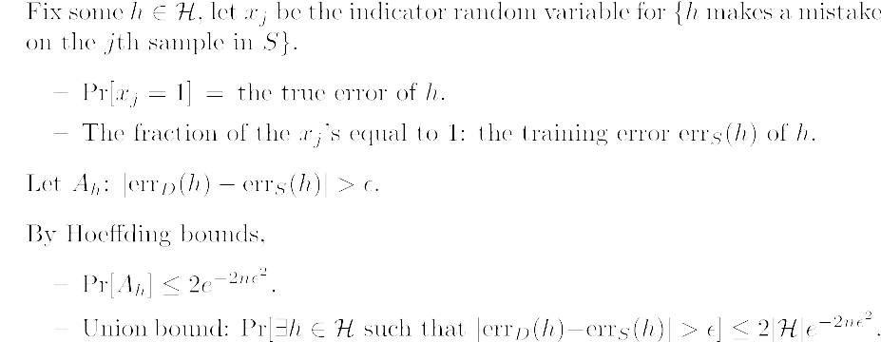

Slide 27
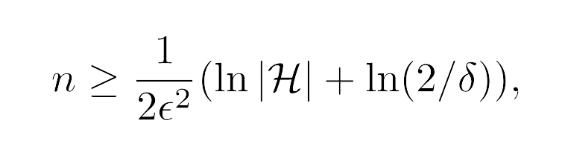

Slide 28
Description language
Suppose that the target concept can be represented by a disjunction (OR) over d features.

Slide 29
Description language
Suppose that the target concept can be represented by a disjunction (OR) over d features.
features for non-spam
features for spam
spam
spam
non-spam
spam

Slide 30
Description language
Suppose that the target concept can be represented by a disjunction (OR) over d features.
features for non-spam
features for spam
spam
spam
non-spam
spam

Slide 31
Description language
Suppose that the target concept can be represented by a disjunction (OR) over d features.
features for non-spam
features for spam
spam
spam
non-spam
spam

Slide 32
Occam’s razor
William of Occam (1287–1347)
a.k.a. Law of Parsimony.
In general, one should prefer simpler explanations over more complicated ones.
Use < b bits for the description language.
  1 + 2 + 4 + … + 2^{b-1} < 2^{b}.

Slide 33
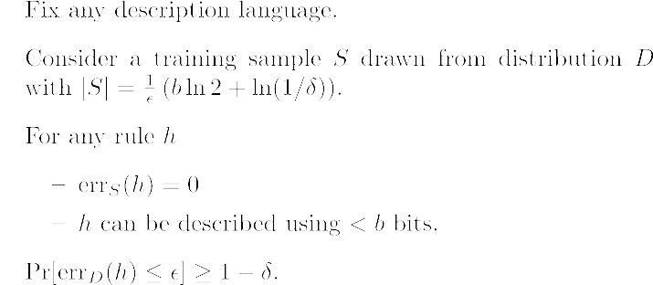
Mathematical statement of Occam’s razor
Theorem (Occam’s razor)

Slide 34
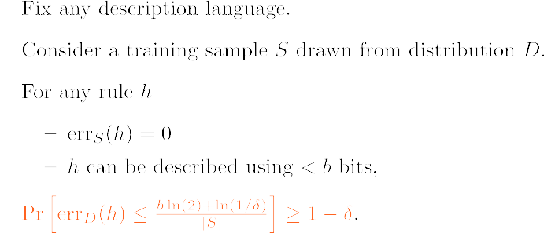
Mathematical statement of Occam’s razor
Theorem (Occam’s razor)

Slide 35
Application: Learning decision trees
Find the smallest decision tree to fit the training sample S: NP-hard.
Suppose we run a heuristic h on S and it outputs a tree with k nodes.
x2
0
1
x1
x3
0
1
0
1
+
−
+
x1
0
1
−
+

Slide 36
Application: Learning decision trees
Find the smallest decision tree to fit the training sample S: NP-hard.
Suppose we run a heuristic h on S and it outputs a tree with k nodes.
Such a tree can be described using O(k log d) bits.
x2
0
1
x1
x3
0
1
0
1
+
−
+
x1
0
1
−
+

Slide 37
Application: Learning decision trees
Find the smallest decision tree to fit the training sample S: NP-hard.
Suppose we run a heuristic h on S and it outputs a tree with k nodes.
Such a tree can be described using O(k log d) bits.
By the theorem of Occam’s razor, we can be confident that err_{D}(h) is low if we can produce a consistent tree with
x2
0
1
x1
x3
0
1
0
1
+
−
+
x1
0
1
−
+

Slide 38
Simple rules? Complex rules?
Suppose that there is NO simple rule that is perfectly consistent with the training data.

Slide 39
Simple rules? Complex rules?
Suppose that there is NO simple rule that is perfectly consistent with the training data.
But,
  We have a VERY simple rule with training error 20%.
  We have also a complex rule with training error 10%.
  …

Slide 40
Simple rules? Complex rules?
Suppose that there is NO simple rule that is perfectly consistent with the training data.
But,
  We have a VERY simple rule with training error 20%.
  We have also a complex rule with training error 10%.
  …
Optimize some combination of training error and simplicity?

Slide 41
Simple rules? Complex rules?
Suppose that there is NO simple rule that is perfectly consistent with the training data.
But,
  We have a VERY simple rule with training error 20%.
  We have also a complex rule with training error 10%.
  …
Optimize some combination of training error and simplicity?
  The notion of regularization (complexity penalization).

Slide 42
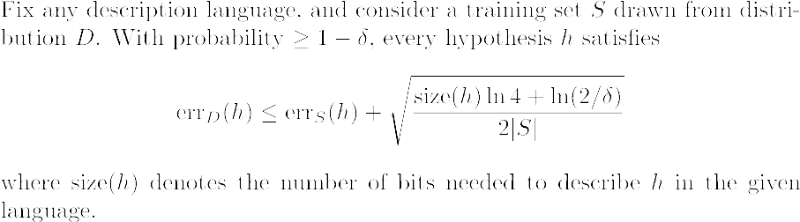
Regularization (penalizing complexity)
Corollary.

Slide 43
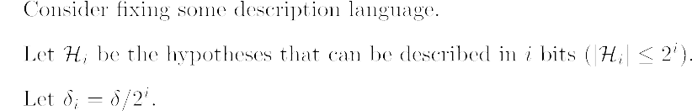
The idea

Slide 44
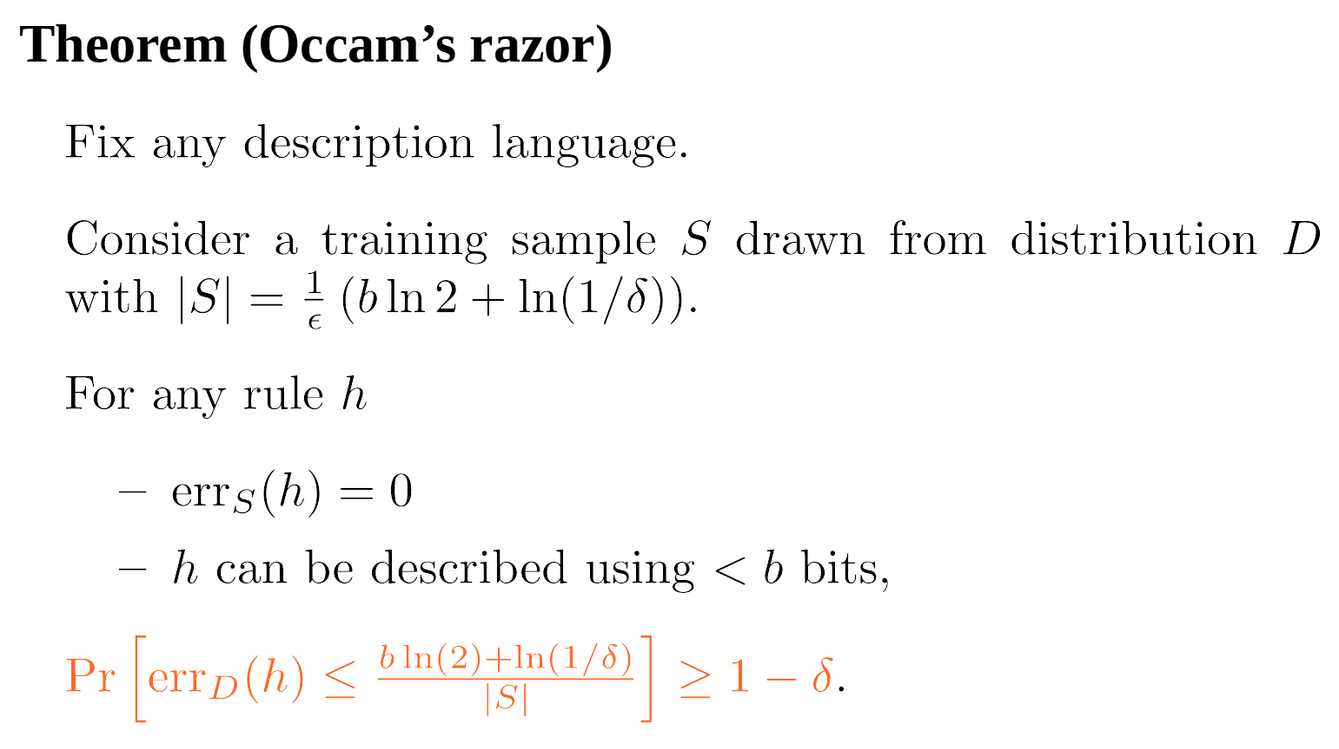
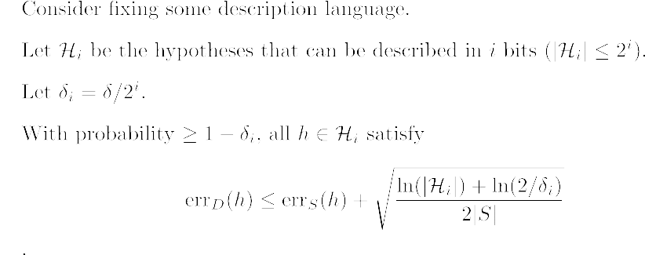
The idea

Slide 45
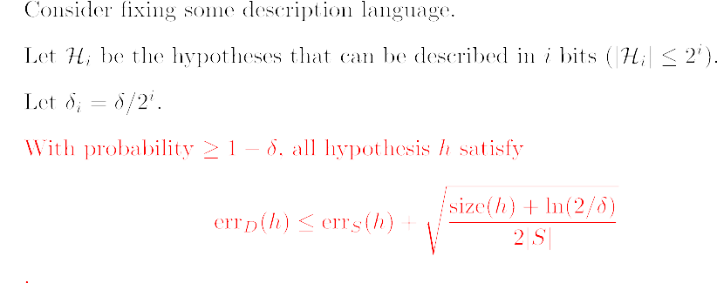
The idea

Slide 46
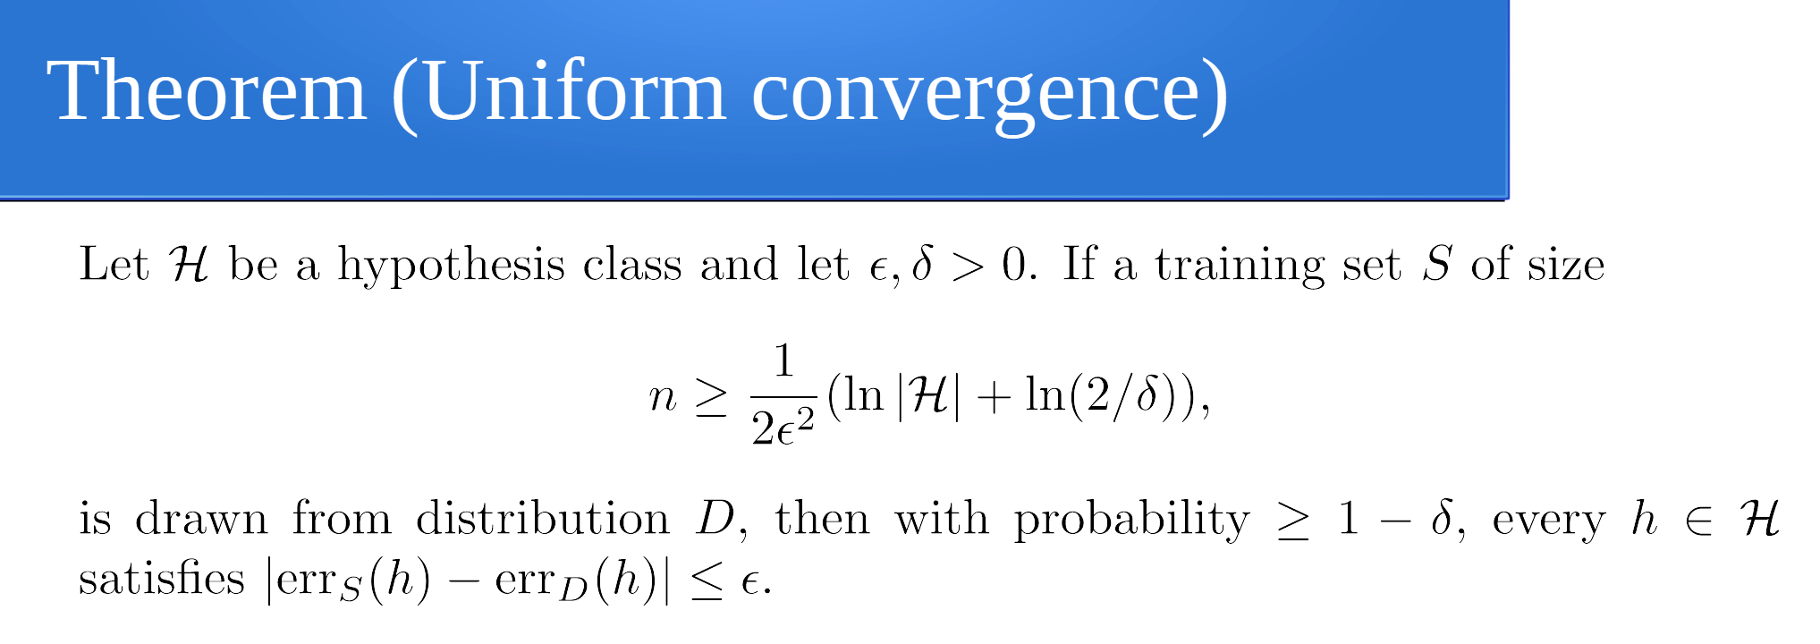
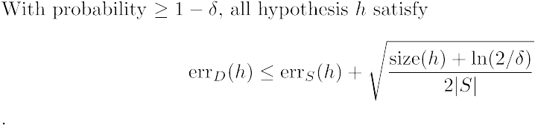
The idea
Don’t want the model to be too complex
Minimize the right-hand size hopefully
Try to minimize the training error

