Slide 1
Randomized Algorithms
Discrete Random Variables and Expectation
Joseph Chuang-Chieh Lin
Dept. CSIE, Tamkang University
4th March 2021
Notes:
e^x := \sum_{k=0}^{\infty} \frac{x^k}{k!}

Slide 2
Review
Why randomized algorithms?
Types of randomized algorithms.
Hints for Homework 1

Slide 3

Randomized algorithms
random bits
ALGORITHM
input
output
figure freely downloaded from https://pixabay.com/illustrations/coin-flipping-coin-hand-flip-flick-5822271/

Slide 4
Why?
Randomized algorithms are
  often much simpler than the best known deterministic ones.
  often much more efficient (faster or using less space) than the best known deterministic ones.

Slide 5


Two types of randomized algorithms
The accuracy is guaranteed.
  Las Vegas algorithms.
The running time is guaranteed.
  Monte Carlo algorithms.
Mike Boening@mbphotography
Pasquale Iovino@pask_07

Slide 6
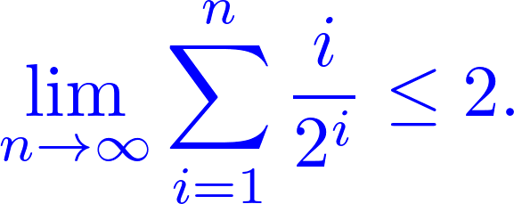
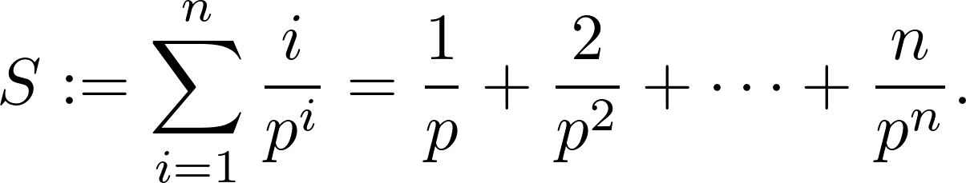
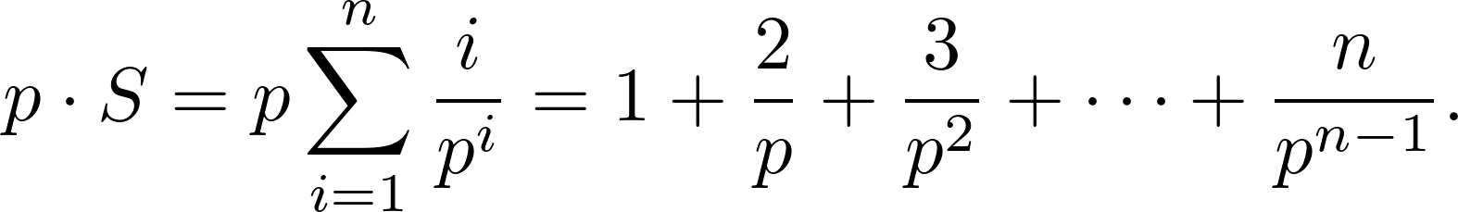
A hint

Slide 7
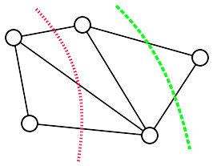


Min-Cut
A graph G = (V, E) and its two “cuts”.
  Cut: a partition of the vertices in V into two non-empty, disjoint sets S and T such that
The cutset of a cut:
The size of the cut:
  the cardinality of its cutset.

Slide 8

Edge contraction
e = (u, v)
G → G/e
u
v
u, v
By Thore Husfeldt - Python, networkx, neato and TikZ, CC BY-SA 3.0, https://commons.wikimedia.org/w/index.php?curid=21117500

Slide 9


Karger’s edge-contraction algorithm (1993)
Procedure contract (G = (V, E)):
while |V| > 2:
  choose uniformly at random
  G ← G/e
return the only cut in G
Time complexity: O(m) or O(n²).
By Thore Husfeldt - Created in python using the networkx library for graph manipulation, neato for layout, and TikZ for drawing.,
CC BY-SA 3.0, https://commons.wikimedia.org/w/index.php?curid=21103489

Slide 10
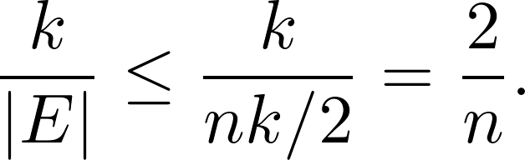
Analysis
C: a specific cut of G.
k: the size of the cut C.
The minimum degree of G must be ≥ k. (WHY?)
  So, |E| ≥ nk/2.
The probability that the algorithm picks an edge from C to contract is

Slide 11
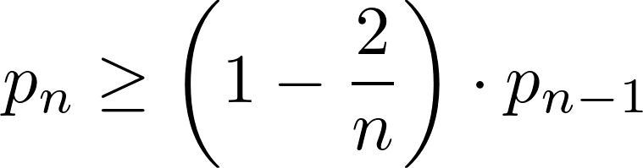
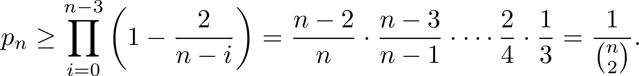
Analysis (contd.)
Let p_{n} be the probability that the algorithm on an n-vertex graph avoids C.
Then,
The recurrence can be expanded as

Slide 12
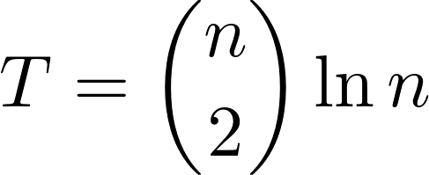
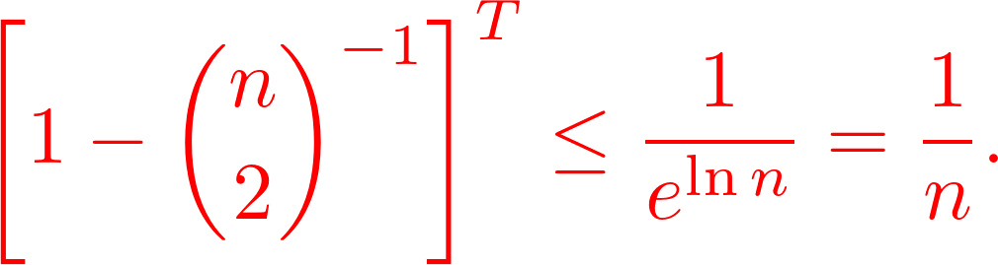
Analysis (contd.)
Repeat the contract algorithm for times, and then choose the minimum of them.
The probability of NOT finding a min-cut is
Let’s take a look at the exponential function e^{x}.

Slide 13
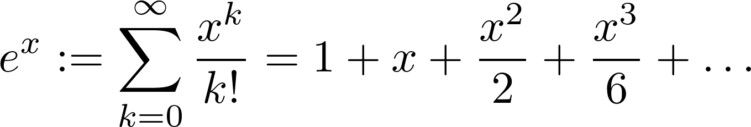
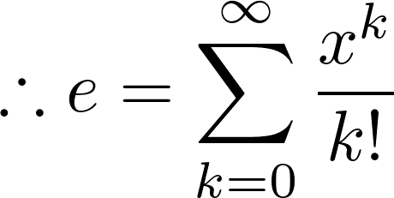

Facts on e^{x}

Slide 14

Probability basics
A random variable X on a sample space Ω is a real-valued function. That is,
A discrete random variable is a random variable that takes on only a finite or countably infinite number of values.

Slide 15
Kolmogorov axioms
1. For any event A ⊂ S, P(A) ≥ 0.
2. Pr[S] = 1.
3. If A₁, A₂, … are mutually exclusive events, then
  Pr[A₁∪A₂ ∪…] = Pr[A₁]+ Pr[A₂] + …

Slide 16
Useful theorems
Pr[∅] = 0 for any experiment.
For any event A ⊆ S, Pr[A] = 1 − Pr[A].
If A ⊆ S, B ⊆ S are any two events, then
  Pr[A∪B] = Pr[A] + Pr[B] − Pr[A∩B].
If A ⊂ B, then Pr[A] ≤ Pr[B].

Slide 17
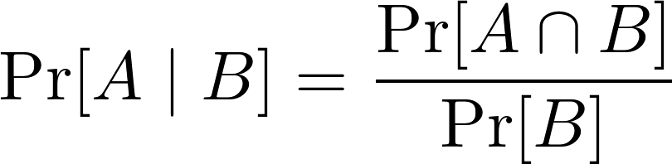
Conditional probability
In an experiment with sample space S,
let B be any event such that Pr[B] > 0.
Then the conditional probability of A occurring,
given that B has occurred, is
for any A ⊂ S.

Slide 18
Example
Suppose you are going to buy milk in a supermarket.
  There are a total of 40 boxes for you to choose from.
  10 of them are corrupted (not visible on the outside).
  Then, you are asked to buy two boxes of milk.
  What is the probability that both boxes are good?

Slide 19
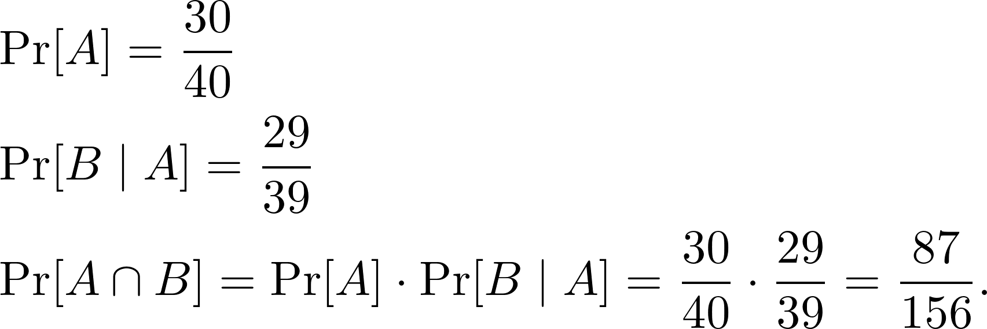
Example (contd.)
A: the event that the first box you choose is good.
B: the event that the second box you choose is good.
Then

Slide 20
Theorem of total probability
If A₁, A₂,…, A_{n} is a partition of S, and B is any event, then
A₁
A₃
B
A₇
A₄
A₂
A₆
A₅

Slide 21
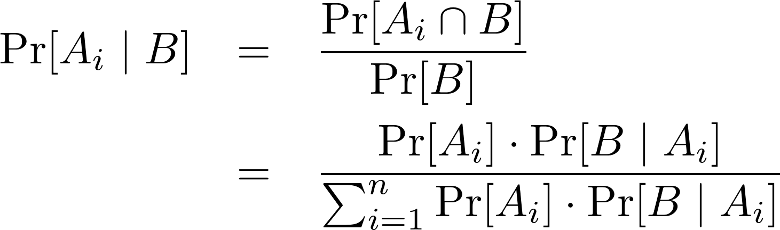
Bayes’ theorem
From the theorem of total probability, and granted that A₁, A₂,…, A_{n} is a partition of S, we have
This result is known as Bayes’ theorem.

Slide 22
Example
Assuming a jury selected to participate in a criminal trial.
Whether the defendant is guilty or not, there is a 95% chance
of making the correct verdict.
It is also assumed that the local police law enforcement is very strict,
such that 99% of the people being tried are actually guilty.
If a jury is known to sentence a defendant not guilty, what is the
probability that the defendant is really not guilty?

Slide 23

Example (contd.)
A_{1:} the defendant is guilty
: the defendant is not guilty.
Let B be the event that the defendant is sentenced to unguilty.
We want to know Pr[A₂ | B].

Slide 24
Example (contd.)
Before the sentence, this defendant is supposed to be unguilty with
probability 1%.
After the sentence of unguilty, the probability is increased to
be 16.1%.

Slide 25
Independent events
If A ⊂ S and B ⊂ S are any two events with nonzero probabilities,
A and B are called independent if and only if Pr[A ∩ B] = Pr[A]∙Pr[B]
That is, Pr[A] = Pr[A | B] and Pr[B] = Pr[B | A].

Slide 26
Independent trials
An experiment is said to consist of n independent trials if and only if
  S = T₁ × T₂ × … × T_{n}.
  For every (x₁, x₂, …, x_{n}) ∈ S,
  Pr[{(x₁, x₂, …, x_{n})}] = Pr[{x₁}]∙Pr[{x₂}] … Pr[{x_{n}}],
  where Pr[{x_{i}}] is the probability of x_{i} ∈ T_{i} occurring on trial i.

Slide 27
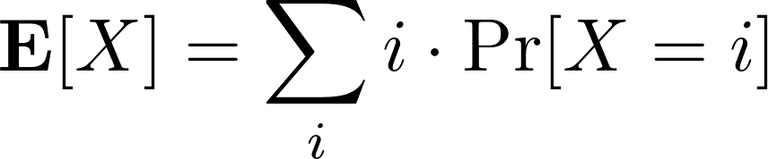

Expectation
The expectation of a discrete random variable X, denoted by E[X], is
Example: Let X denote the sum of of dices:
Adam Fejes@adamfjs

Slide 28
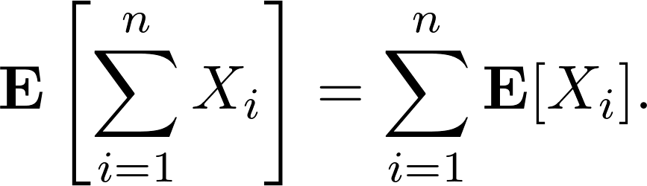

Linearity of Expectation
For any finite collection of discrete random variables X₁, X₂, ..., X_{n} with finite expectations,
For any constant c and discrete random variable X,
Why is it useful?

Slide 29
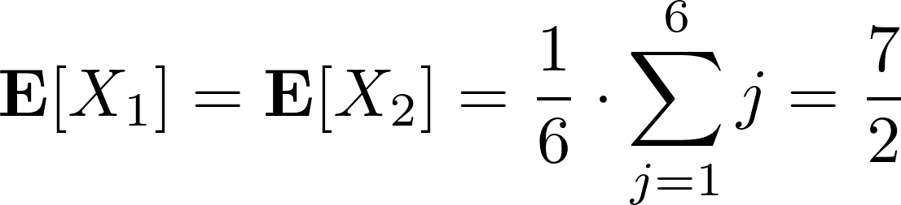
Example
Consider the dice-throwing example again.
  X₁ : the outcome of die 1
  X₂ : the outcome of die 2
Adam Fejes@adamfjs

Slide 30
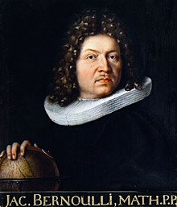
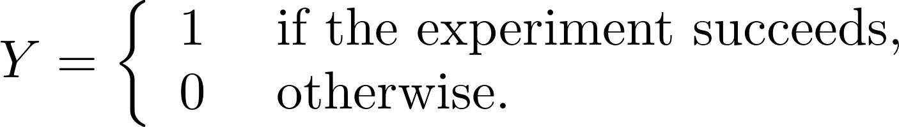
Bernoulli random variable
Suppose we run an experiment that succeeds with probability p and fails with probability 1−p.
Y: Bernoulli random variable.
  or indicator random variable.
Wikipedia

Slide 31
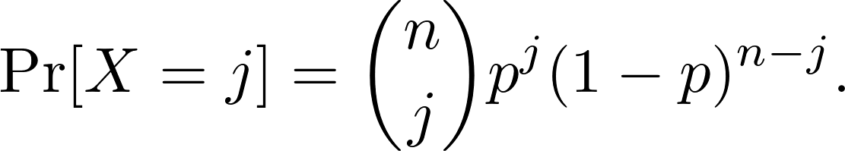
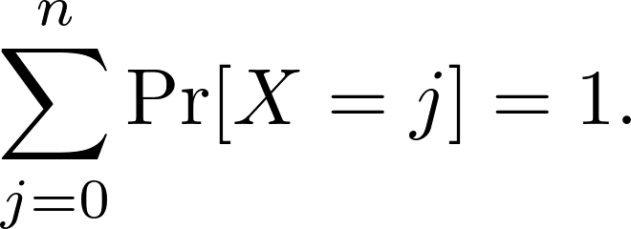
Binomial random variable
A binomial random variable X with parameters n and p, denoted by B(n, p), is defined as
for j = 0, 1, 2, ..., n.
Exercise: Show that

Slide 32
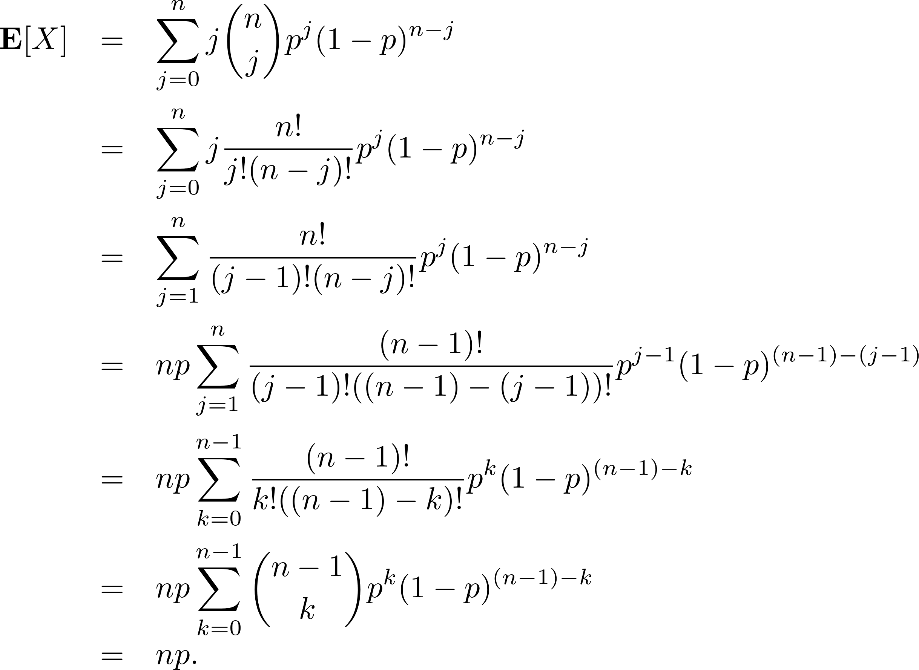
Binomial random variable (contd.)

Slide 33
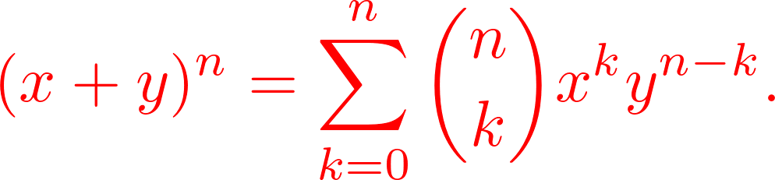
Binomial random variable (contd.)

Slide 34
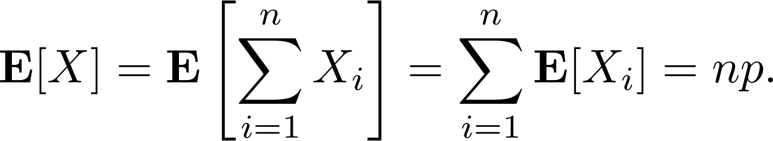
Let’s make it simpler!
Denote a set of n Bernoulli random variables X₁, X₂, ..., X_{n}.
  X_{i} = 1 if the ith trial is successful and 0 otherwise.

