Slide 1
Randomized Algorithms
Coupon Collector’s Problem
Joseph Chuang-Chieh Lin
Dept. CSIE, Tamkang University
11th March 2021
Notes:
e^x := \sum_{k=0}^{\infty} \frac{x^k}{k!}

Slide 2
Review
Expectation of discrete random variables
Linearity of expectation.
Bernoulli and Binomial random variable

Slide 3
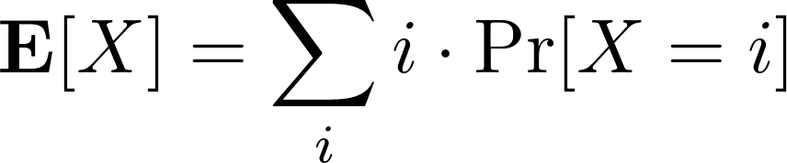

Expectation
The expectation of a discrete random variable X, denoted by E[X], is
Example: Let X denote the sum of of dices:
Adam Fejes@adamfjs

Slide 4
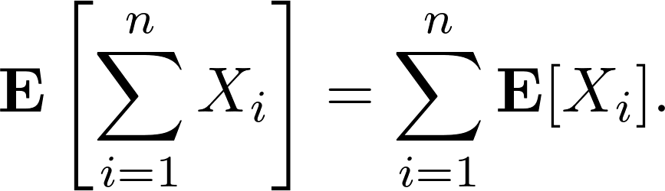

Linearity of Expectation
For any finite collection of discrete random variables X₁, X₂, ..., X_{n} with finite expectations,
For any constant c and discrete random variable X,
Why is it useful?

Slide 5
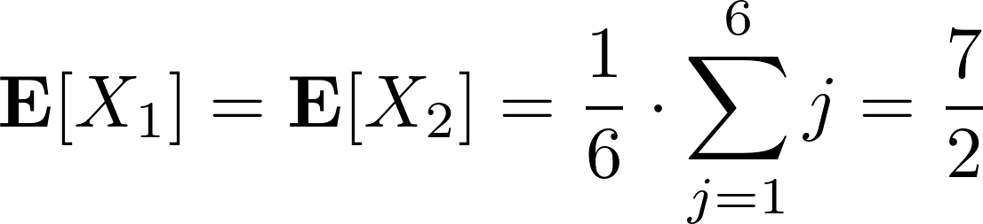
Example
Consider the dice-throwing example again.
  X₁ : the outcome of die 1
  X₂ : the outcome of die 2
Adam Fejes@adamfjs

Slide 6
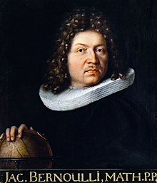
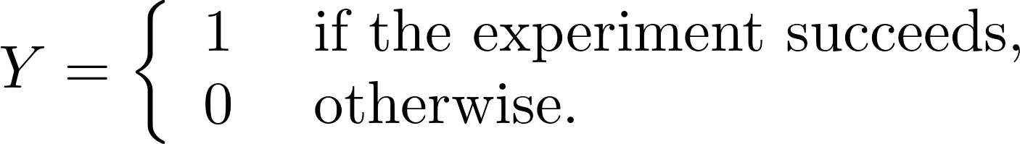
Bernoulli random variable
Suppose we run an experiment that succeeds with probability p and fails with probability 1−p.
Y: Bernoulli random variable.
  or indicator random variable.
Wikipedia

Slide 7
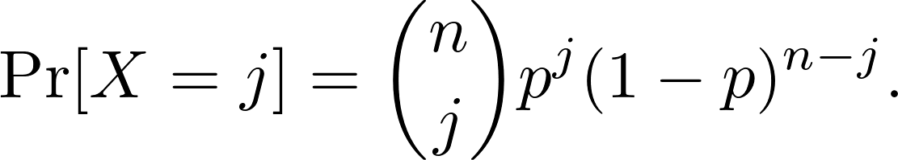
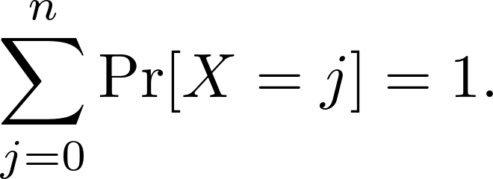
Binomial random variable
A binomial random variable X with parameters n and p, denoted by B(n, p), is defined as
for j = 0, 1, 2, ..., n.
Exercise: Show that

Slide 8
Binomial random variable
A binomial random variable X with parameters n and p, denoted by B(n, p), is defined as
for j = 0, 1, 2, ..., n.
Exercise: Show that
X: the number of successful trials in the n experiments.

Slide 9
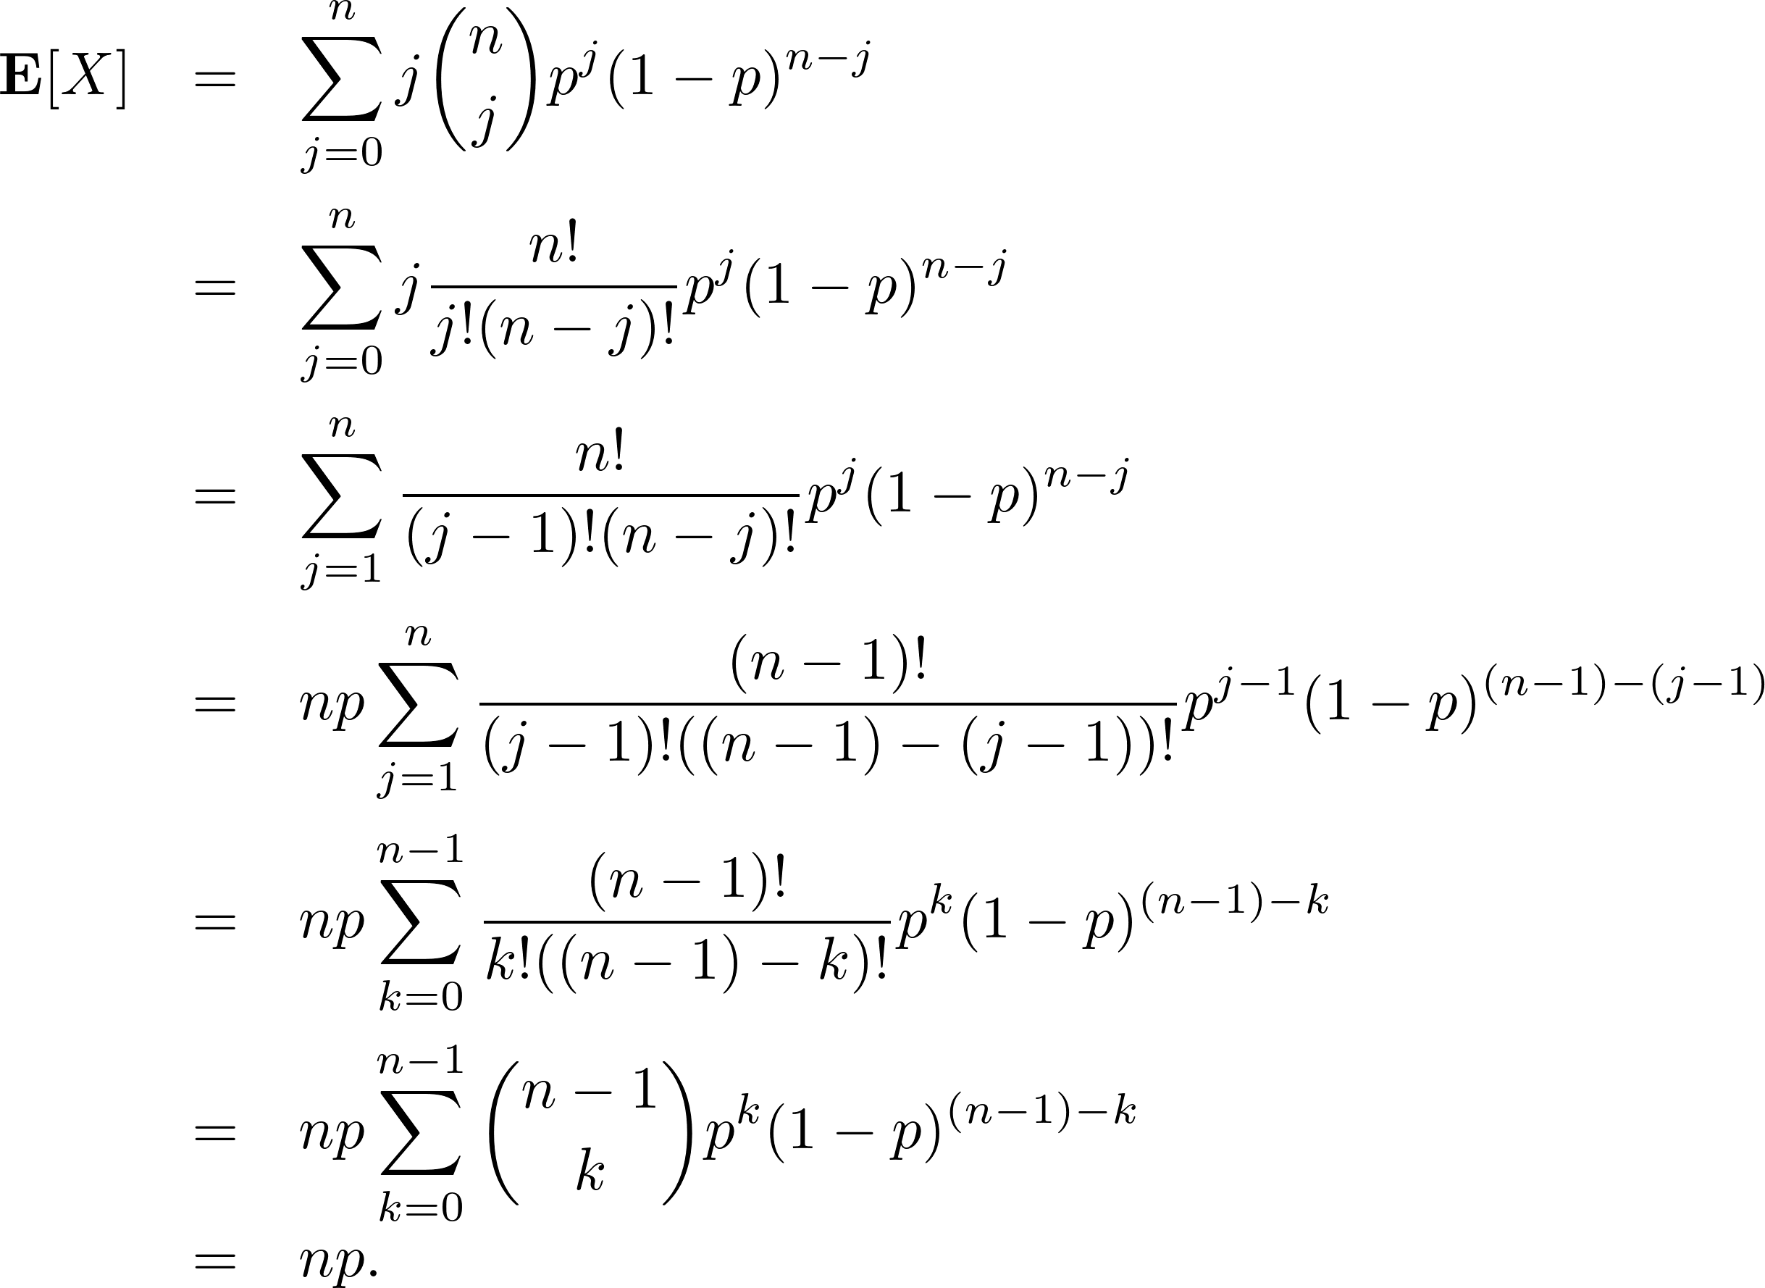
Binomial random variable (expectation)

Slide 10
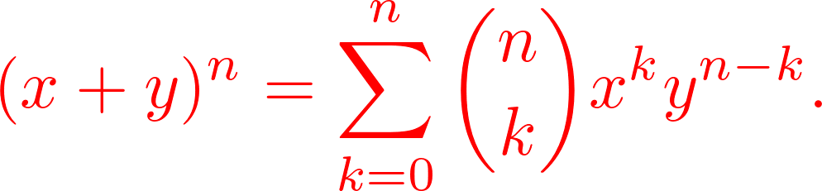
Binomial random variable (expectation)

Slide 11
Let’s make it simpler!
Denote a set of n Bernoulli random variables X₁, X₂, ..., X_{n}.
  X_{i} = 1 if the ith trial is successful and 0 otherwise.
  X = X₁+ X₂ + … + X_{n}

Slide 12
Let’s make it simpler!
Denote a set of n Bernoulli random variables X₁, X₂, ..., X_{n}.
  X_{i} = 1 if the ith trial is successful and 0 otherwise.
  X = X₁+ X₂ + … + X_{n}
  Compute E[X] using linearity of expectation:

Slide 13
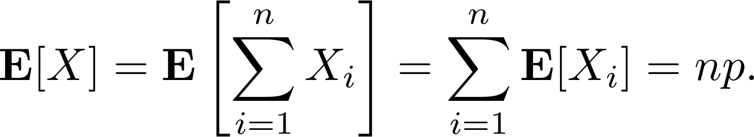
Let’s make it simpler!
Denote a set of n Bernoulli random variables X₁, X₂, ..., X_{n}.
  X_{i} = 1 if the ith trial is successful and 0 otherwise.
  X = X₁+ X₂ + … + X_{n}
  Compute E[X] using linearity of expectation:

Slide 14
Geometric Distribution
Imagine: flip a coin until it lands on a head.
  What’s the distribution of the number of flips?

Slide 15

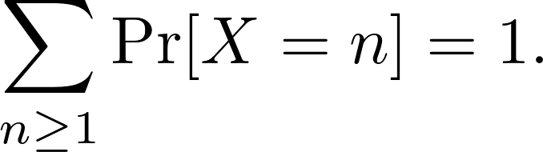
Geometric Distribution
Imagine: flip a coin until it lands on a head.
  What’s the distribution of the number of flips?
Definition. A geometric random variable X with parameter p is
for n = 1, 2, …
Exercise. Show that

Slide 16
Memoryless
Let X be a geometric random variable X with parameter p > 0.
For any n, k > 0,

Slide 17
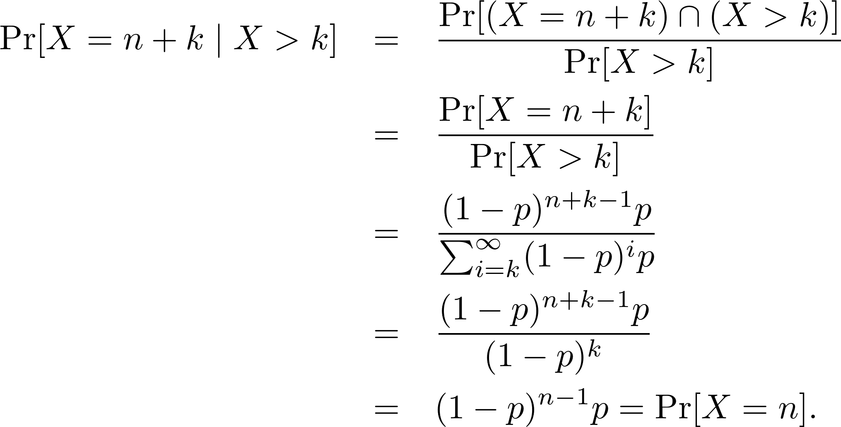
Memoryless
Let X be a geometric random variable X with parameter p > 0.
For any n, k > 0,
Proof.

Slide 18
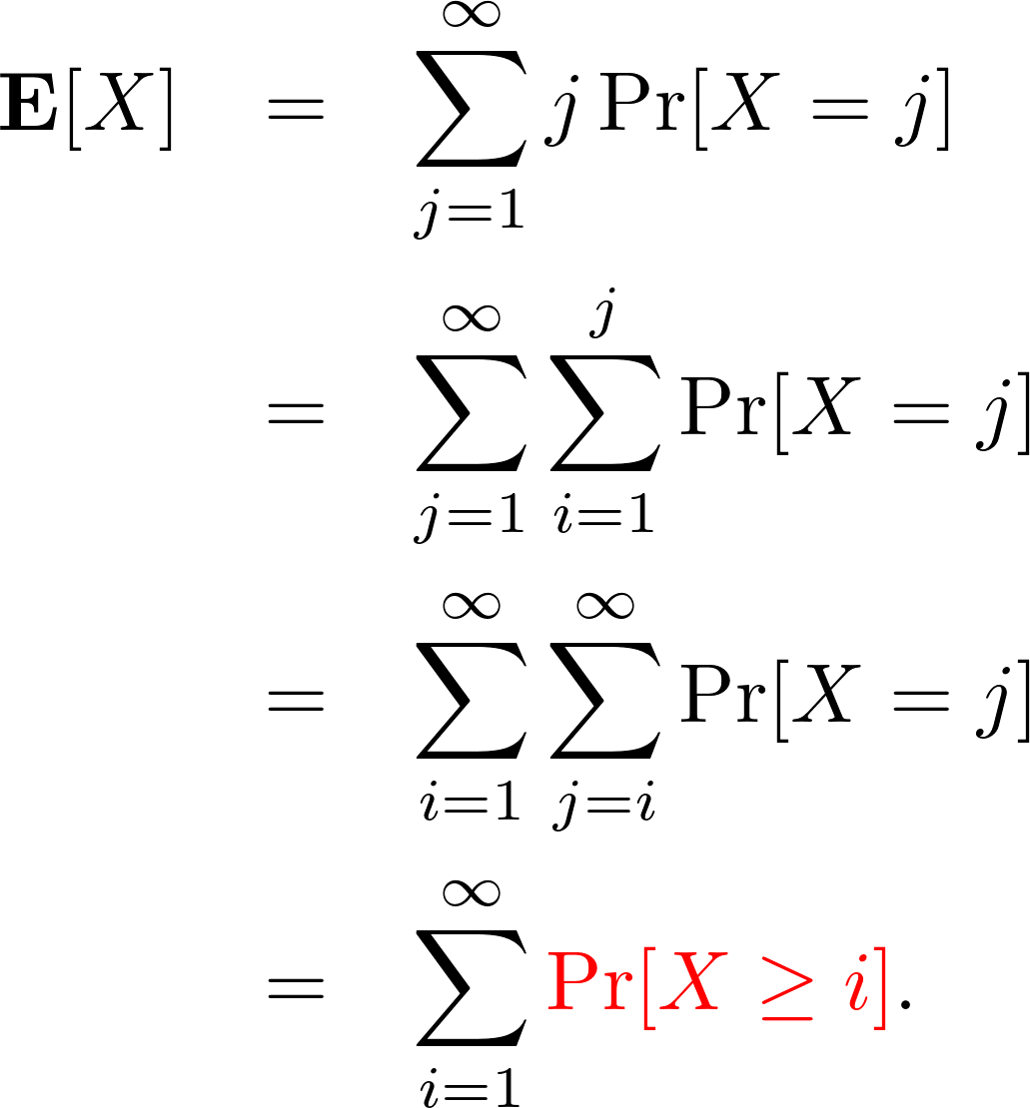
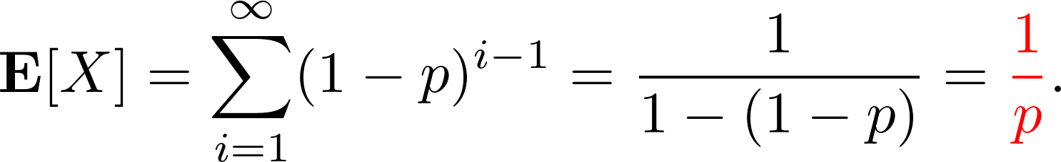
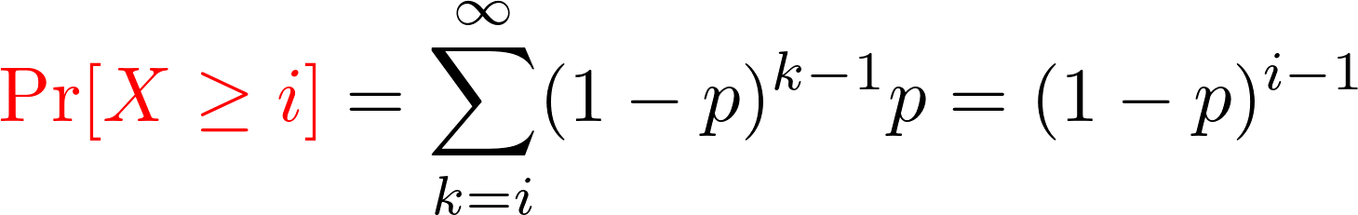
The mean of a geometric r.v. X(p)

Slide 19
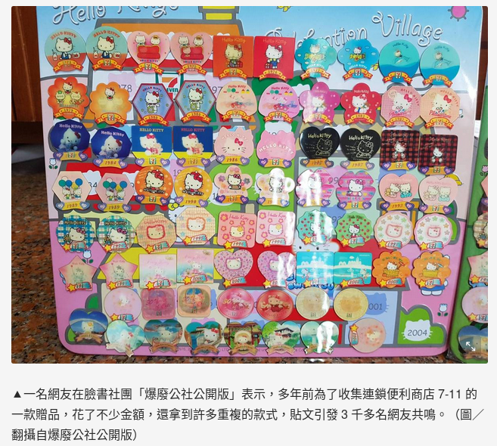
Coupon Collector’s Problem

Slide 20
Coupon Collector’s Problem
Have you already got all of them (totally n types)?
Have you ever thought about how much you should pay for them?
Concealed
bag
Concealed
bag
Concealed
bag
Concealed
bag
Concealed
bag
Each bag is chosen independently and uniformly at random from the n possibilities.

Slide 21
Coupon Collector’s Problem
Let X be the number of bags bought until every type of coupon is obtained.
Let X_{i} be the number of bags bought while you had already got exactly i−1 different coupons.
X₃
X

Slide 22
Coupon Collector’s Problem
Let X be the number of bags bought until every type of coupon is obtained.
Let X_{i} be the number of bags bought while you had already got exactly i−1 different coupons.
  Geometric random variables?!

Slide 23
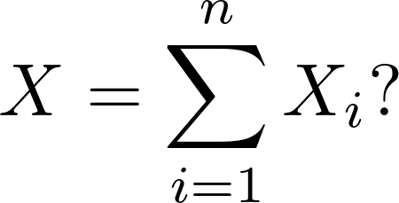
Coupon Collector’s Problem
Let X be the number of bags bought until every type of coupon is obtained.
Let X_{i} be the number of bags bought while you had already got exactly i−1 different coupons.
  Geometric random variables?!
  What about

Slide 24
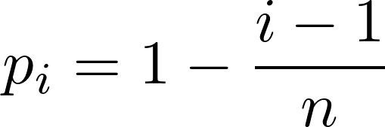
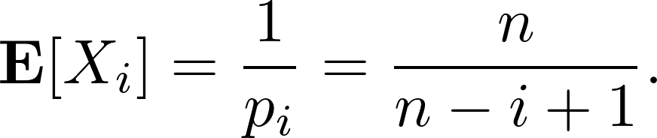
Coupon Collector’s Problem
When exactly i−1 coupons have been collected, the probability of obtaining a new one is
X_{i} is a geometric random variable, so

Slide 25
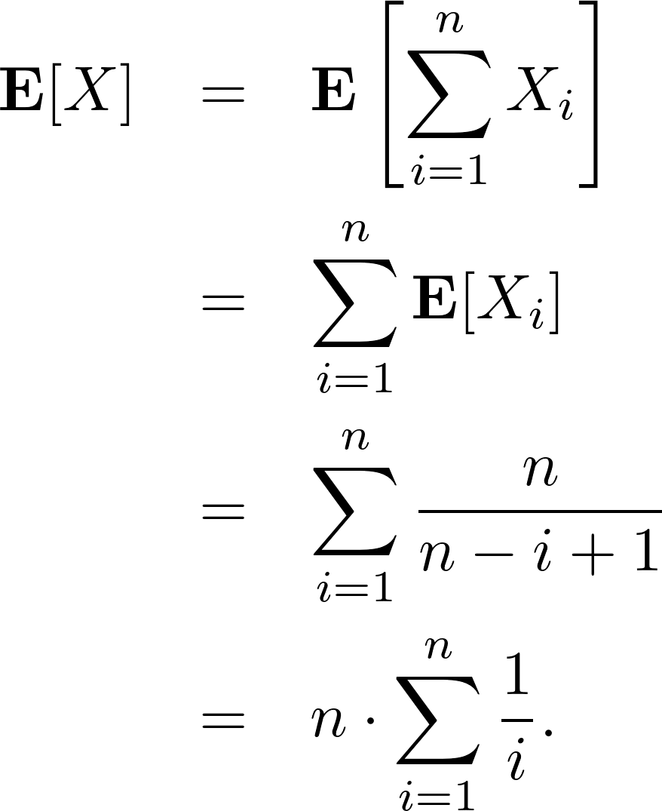
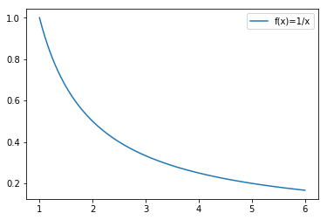
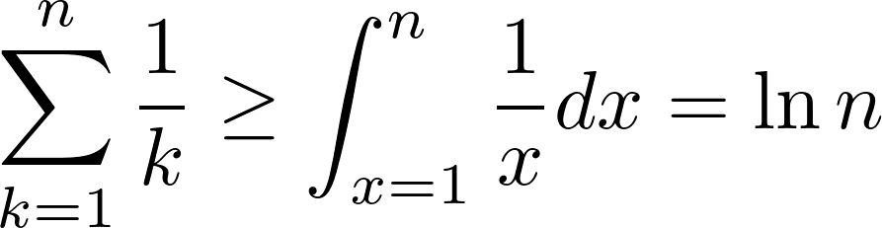
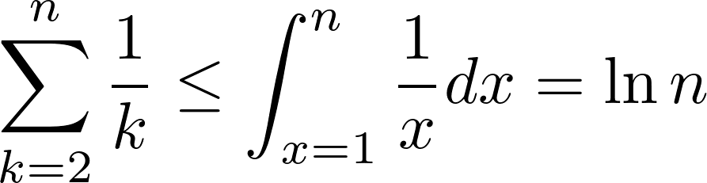
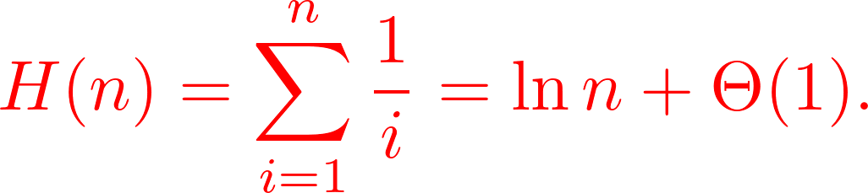
Coupon Collector’s Problem (contd.)

Slide 26

Coupon Collector’s Problem (contd.)
So, you are about to buy bags for collecting all the coupons (stickers)!

Slide 27
On conditional expectation
There are terminologies which may confusing you.

Slide 28
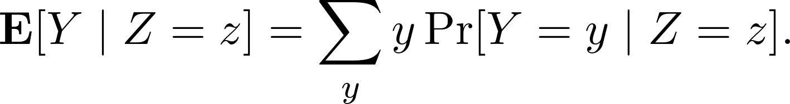
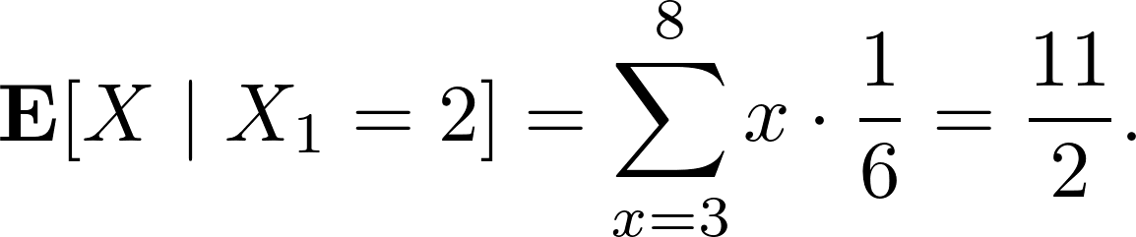
Conditional Expectation
Definition.
Example of two dices.
  X₁: the number showing on the first die
  X₂: the number showing on the second die
  X = X₁+ X₂

Slide 29
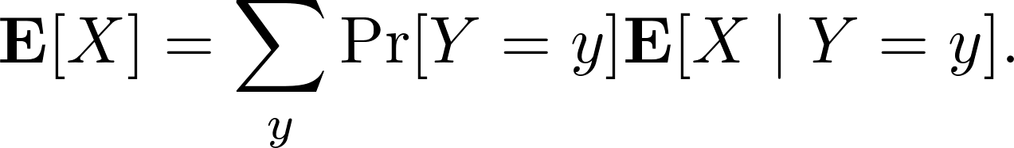
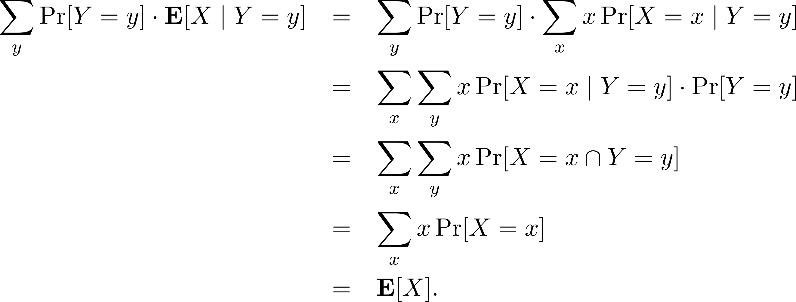
Conditional Expectation (contd.)
Lemma. For any random variables X and Y,
Proof.

Slide 30
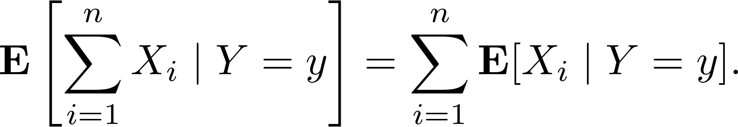
Conditional Expectation
Lemma. For any finite collection of discrete random variables X₁, X₂, ..., X_{n} with finite expectations and for any random variable Y,

Slide 31


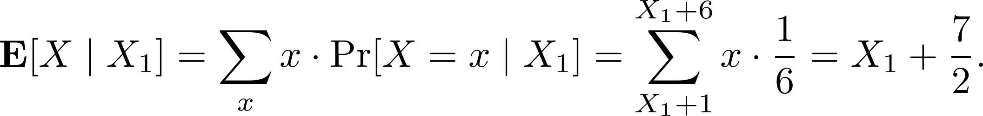
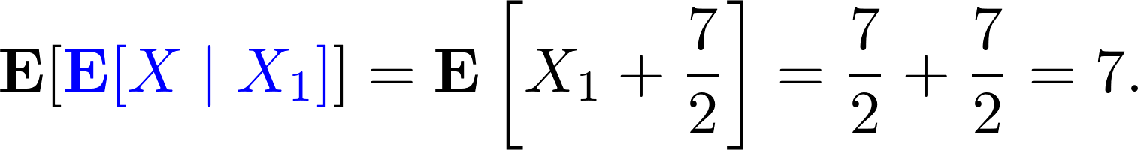
Conditional Expectation (contd.)
A weird definition.
: regarded as a random variable f(Z).
  It takes on the value when Z = z.
In the previous example,
So it makes sense that

Slide 32

Conditional Expectation (contd.)
Theorem.
Proof.

Slide 33
Assignment 02
Let X ~ binomial distribution B(n, p) be a random variable. Show that
Let X ~ geometric distribution G(p) be a random variable. Show that
Give a practical example of coupon collector’s problem and provide your analysis.

