Slide 1
Randomized Algorithms
The Secretary Problem
Joseph Chuang-Chieh Lin
Dept. CSIE, Tamkang University
25th March 2021
Notes:
e^x := \sum_{k=0}^{\infty} \frac{x^k}{k!}

Slide 2
Review
Geometry random variable.
Coupon Collector’s Problem

Slide 3

Geometric Distribution
Imagine: flip a coin until it lands on a head.
  What’s the distribution of the number of flips?
Definition. A geometric random variable X with parameter p is
for n = 1, 2, …

Slide 4
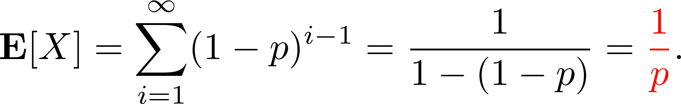
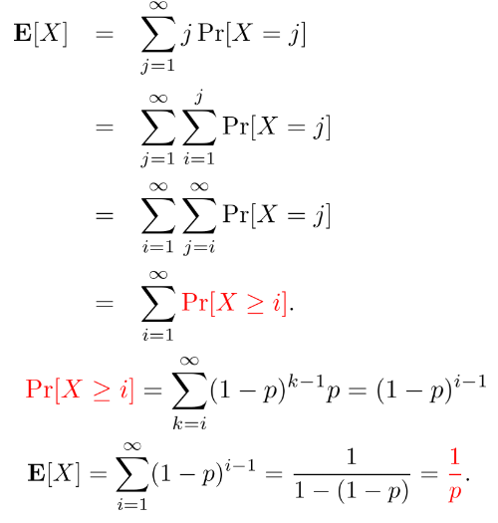
The mean of a geometric r.v. X(p)

Slide 5
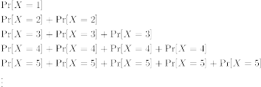
The mean of a geometric r.v. X(p)

Slide 6
Other methods (1)

Slide 7
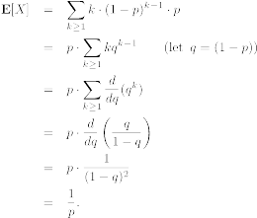
Other methods (2)

Slide 8
Memoryless
Let X be a geometric random variable X with parameter p > 0.
For any n, k > 0,

Slide 9

Coupon Collector’s Problem

Slide 10
Coupon Collector’s Problem
Have you already got all of them (totally n types)?
Have you ever thought about how much you should pay for them?
Concealed
bag
Concealed
bag
Concealed
bag
Concealed
bag
Concealed
bag
Each bag is chosen independently and uniformly at random from the n possibilities.

Slide 11
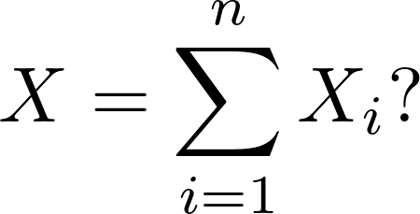
Coupon Collector’s Problem
Let X be the number of bags bought until every type of coupon is obtained.
Let X_{i} be the number of bags bought while you had already got exactly i−1 different coupons.
  Geometric random variables.
  What about

Slide 12
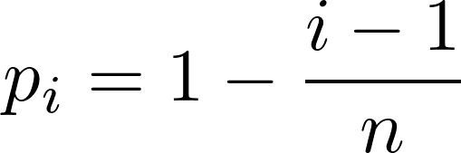
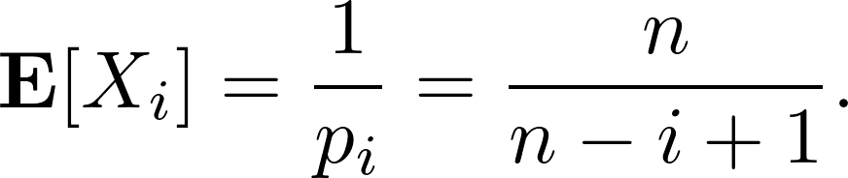
Coupon Collector’s Problem
When exactly i−1 coupons have been collected, the probability of obtaining a new one is
X_{i} is a geometric random variable, so

Slide 13
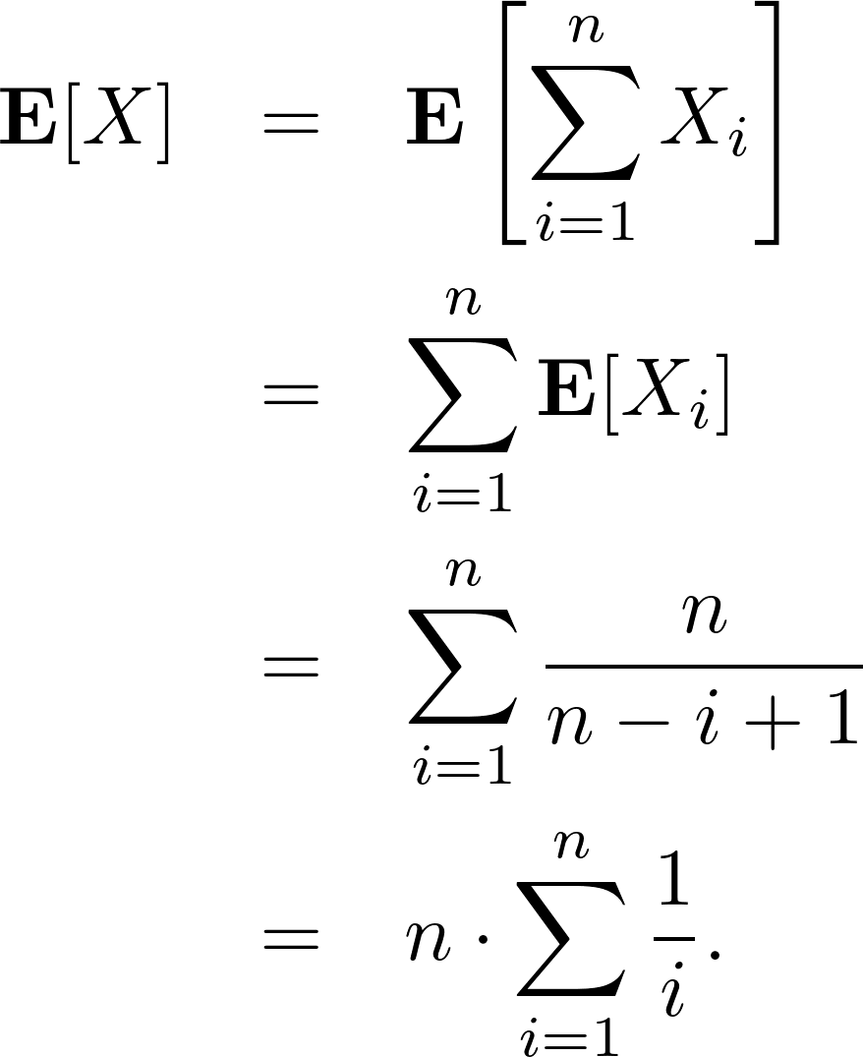
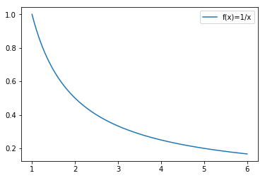
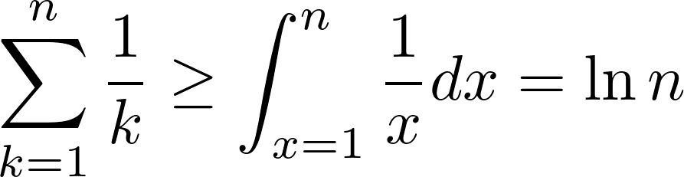
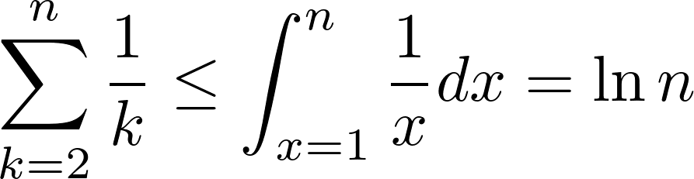
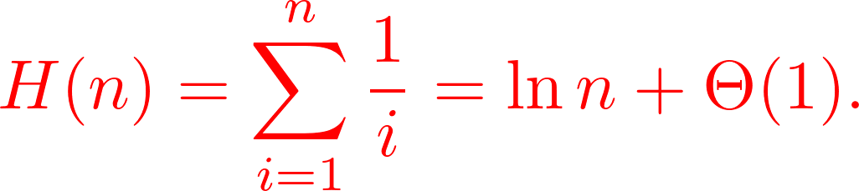
Coupon Collector’s Problem (contd.)

Slide 14

Coupon Collector’s Problem (contd.)
Expected bags to buy for collecting all the coupons (stickers)!

Slide 15
The Secretary Problem
Or, we call it the ‘Girlfriend/Boy friend Choosing Problem’.
Consider the problem of hiring an office secretary.
  We interview candidates, coming one by one, on a rolling basis.
  Let’s say the ith candidate has a value which stands for how much we like her.
  At some time point, we would like to hire the best candidate we have seen so far.
  Suppose we can fire the old one and hire a new better candidate.
  Assume that we only want to interview at most n candidates.

Slide 16
The Secretary Problem (contd.)
The whole hiring process will be just like:
  Randomly shuffle the n candidates.
  Set TheOne ← 0
  for i ← 1 to n do:
    interview candidate i
    if vi > vTheOne then:
      TheOne ← i
      Hire candidate i
Isn't it very simple?

Slide 17
The cost
No pain, no gain. We cannot reap without sowing.
Let cI be the cost associated with interviewing a candidate.
Let cH be the cost associated with hiring a candidate.
So, if totally we have ever hired m people (m−1 was fired though…), what is the total cost of the algorithm?

Slide 18
The cost
No pain, no gain. We cannot reap without sowing.
Let cI be the cost associated with interviewing a candidate.
Let cH be the cost associated with hiring a candidate.
So, if totally we have ever hired m people (m−1 was fired though…), what is the total cost of the algorithm?

Slide 19
The cost
In the worst scenario,
The cost in the worst case:
…...

Slide 20
The cost
In the worst scenario,
The cost in the worst case:
What’s about the EXPECTED cost?
…...

Slide 21


The expected cost analysis
Let X_{i} be an indicator random variable such that
: the number of times we hire a new candidate.

Slide 22
The expected cost analysis
Let X_{i} be an indicator random variable such that
: the number of times we hire a new candidate.

Slide 23
The expected cost analysis
Let X_{i} be an indicator random variable such that
: the number of times we hire a new candidate.
  Imagine we have randomly chosen i numbers, what’s the probability that the ith number is the biggest?
  It’s NOT a conditional probability.

Slide 24
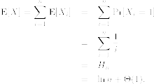
The expected cost analysis
Therefore,
The expected cost is

Slide 25
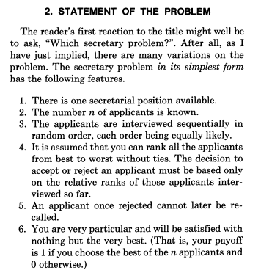

The classic version
Reference:
  Thomas S. Ferguson: Who solved the Secretary Problem? Statistical Science, Vol. 4 (1989), pp. 282−289.

Slide 26

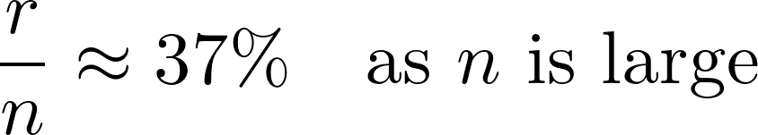
A simple solution
Reject the first r − 1 applicants.
Choose the next applicant who is the best in the relative ranking of the observed applicants.
The famous 37% rule.
Refer to https://www.books.com.tw/products/F014054315

Slide 27
Illustration

Slide 28
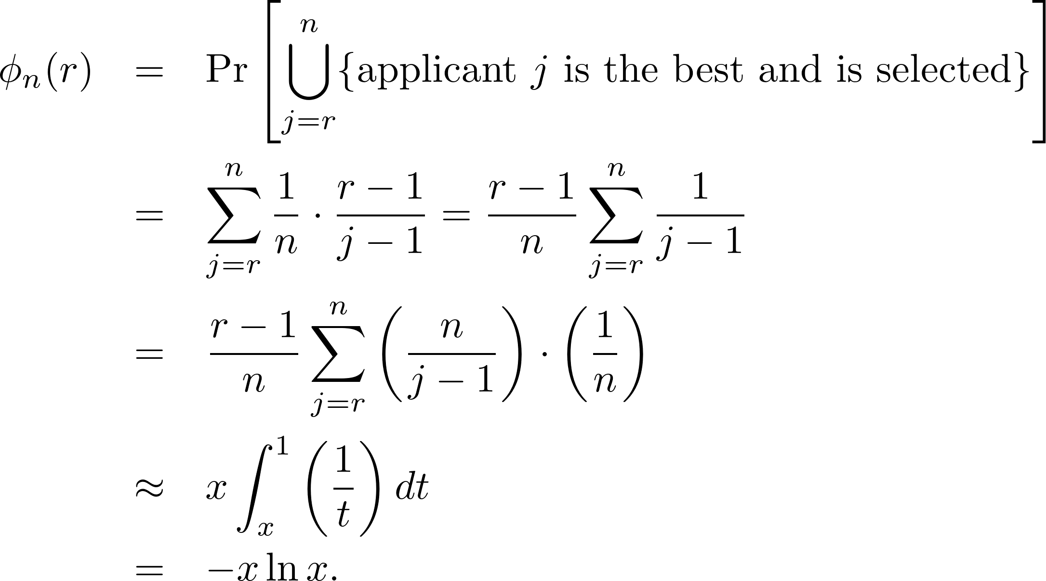
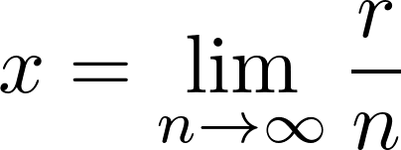
Analysis
ϕ_{n}(r): the probability that the best applicant is selected.
For r = 1, ϕ_{n}(r) = 1/n.
For r > 1,
We want x,

Slide 29
Analysis
ϕ_{n}(r): the probability that the best applicant is selected.
For r = 1, ϕ_{n}(r) = 1/n.
For r > 1,
Each of the j−1 candidates is the
best of them with prob. 1/(j−1),
but we count only the r−1 of them.
We want x,

Slide 30
Analysis (contd.)
Find the value of x which maximizes ϕ_{n}(r).
  Solve d(ϕ_{n}(r))/dx = 0.

Slide 31
Analysis (contd.)
Find the value of x which maximizes ϕ_{n}(r).
  Solve d(ϕ_{n}(r))/dx = 0.

Slide 32
Analysis (contd.)
Find the value of x which maximizes ϕ_{n}(r).
  Solve d(ϕ_{n}(r))/dx = 0.
We can find optimal x = 1/e = 0.367879… ≈ 37%.

Slide 33
Analysis (contd.)
Find the value of x which maximizes ϕ_{n}(r).
  Solve d(ϕ_{n}(r))/dx = 0.
We can find optimal x = 1/e = 0.367879… ≈ 37%.
What about your strategy of finding your wife/husband?
  This lecture assumes that you can never go back to your ex’s...

