Slide 1
Randomized Algorithms
Moments and Deviations
Joseph Chuang-Chieh Lin
Dept. CSIE, Tamkang University
25th March 2021
Notes:
e^x := \sum_{k=0}^{\infty} \frac{x^k}{k!}

Slide 2
Review
The Secretary Problem.

Slide 3
The Secretary Problem
Consider the problem of hiring an office secretary.
  We interview candidates, coming one by one, on a rolling basis.
  Let’s say the ith candidate has a value which stands for how much we like her.
  At some time point, we would like to hire the best candidate we have seen so far.
  Suppose we can fire the old one and hire a new better candidate.
  Assume that we only want to interview at most n candidates.

Slide 4
The Secretary Problem (contd.)
The whole hiring process will be just like:
  Randomly shuffle the n candidates.
  Set TheOne ← 0
  for i ← 1 to n do:
    interview candidate i
    if vi > vTheOne then:
      TheOne ← i
      Hire candidate i
Isn't it very simple?

Slide 5
The cost
No pain, no gain. We cannot reap without sowing.
Let cI be the cost associated with interviewing a candidate.
Let cH be the cost associated with hiring a candidate.
So, if totally we have ever hired m people (m−1 was fired though…), the total cost will be

Slide 6


The expected cost analysis
Let X_{i} be an indicator random variable such that
: the number of times we hire a new candidate.

Slide 7
The expected cost analysis
Let X_{i} be an indicator random variable such that
: the number of times we hire a new candidate.

Slide 8
The expected cost analysis
Let X_{i} be an indicator random variable such that
: the number of times we hire a new candidate.
  For randomly chosen i numbers, the probability that the ith number is the biggest.

Slide 9
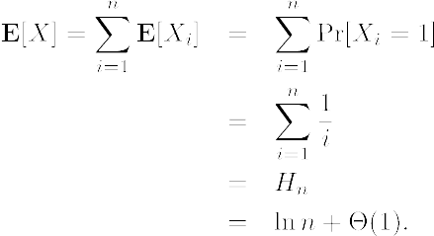
The expected cost analysis
Therefore,
The expected cost is

Slide 10
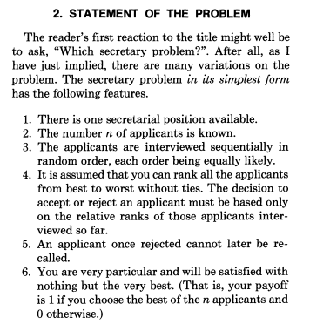

The classic version
Reference:
  Thomas S. Ferguson: Who solved the Secretary Problem? Statistical Science, Vol. 4 (1989), pp. 282−289.

Slide 11

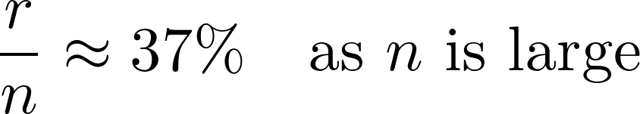
A simple solution
Reject the first r − 1 applicants.
Choose the next applicant who is the best in the relative ranking of the observed applicants.
The famous 37% rule.
Refer to https://www.books.com.tw/products/F014054315

Slide 12
Illustration

Slide 13
Let’s start the mathematics…
Moments and Deviations.
Basic tail bounds.

Slide 14
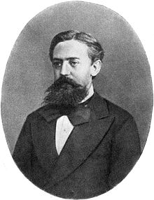

Markov’s Inequality
Let X be a random variable that assumes only non-negative values. Then, for all a > 0,
Andrei Andreyevich Markov (Wikipedia)
1856–1922

Slide 15



Markov’s Inequality
Let X be a random variable that assumes only non-negative values. Then, for all a > 0,
Proof:
Let . Since X ≥ 0,
Andrei Andreyevich Markov (Wikipedia)
1856–1922

Slide 16
Example: 75% heads in fair coin flips
What’s the probability of obtaining > 3n/4 heads in a sequence of n fair coin flips?

Slide 17



Example: 75% heads in fair coin flips
What’s the probability of obtaining > 3n/4 heads in a sequence of n fair coin flips?
Applying Markov’s inequality,

Slide 18

Example: 75% heads in fair coin flips
What’s the probability of obtaining > 3n/4 heads in a sequence of n fair coin flips?
Applying Markov’s inequality,

Slide 19
Scenarios of applying Markov’s inequality
Markov’s inequality gives the best tail bound when:
  All we know is the expectation of the random variable
  The random variable is non-negative.

Slide 20
The kth moment
Definition. The kth of a random variable X is E[X^{k}].
  So, the expectation is the first moment of X.

Slide 21
The variance
Definition. The variance of a random variable X is defined as
    Var[X] = E[(X−E[X])²] = E[X²] − (E[X])².

Slide 22
The variance
Definition. The variance of a random variable X is
    Var[X] = E[(X−E[X])²] = E[X²] − (E[X])².
Definition. The standard deviation of a random variable X is
        σ[X] = (Var[X])^{1/2}.
Definition. The covariance of two random variables X and Y is
    Cov(X, Y) = E[(X−E[X])(Y−E[Y])].

Slide 23
Variance of the sum of two random variables
Theorem. For any two random variables X and Y,
    Var[X+Y] = Var[X] + Var[Y] + 2 Cov(X, Y).

Slide 24
Variance of the sum of two random variables
Theorem. For any two random variables X and Y,
    Var[X+Y] = Var[X] + Var[Y] + 2 Cov(X, Y).
Not as nice as the linearity of expectation!

Slide 25
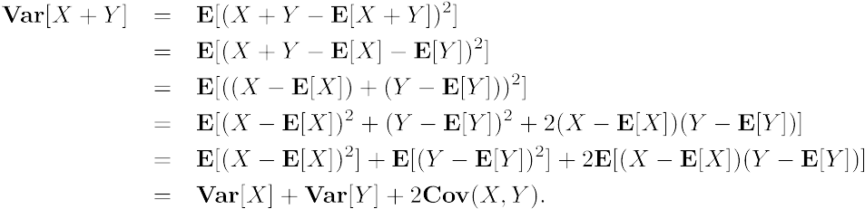
Variance of the sum of two random variables
Theorem. For any two random variables X and Y,
    Var[X+Y] = Var[X] + Var[Y] + 2 Cov(X, Y).
Proof:

Slide 26
Expectation of product of two random variables
Theorem. If X and Y are two independent random variables, then

Slide 27
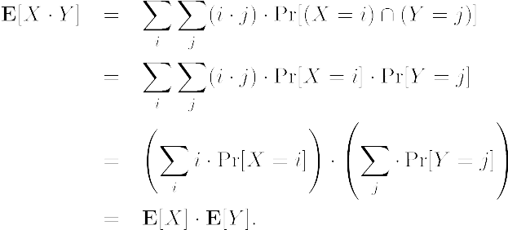
Expectation of product of two random variables
Theorem. If X and Y are two independent random variables, then
Proof:

Slide 28
Independence → Linearity of Variance
Corollary. If X and Y are independent random variables, then
Cov(X, Y) = 0
and
Var[X+Y] = Var[X] + Var[Y].

Slide 29
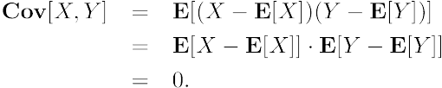
Independence → Linearity of Variance
Corollary. If X and Y are independent random variables, then
Cov(X, Y) = 0
and
Var[X+Y] = Var[X] + Var[Y].
Proof:

Slide 30

Remark
Theorem. For mutually independent random variables X1, X2, …, Xn

Slide 31
Example: Variance of a binomial random variable
Recall: a binomial random variable X can be regarded as the sum of n independent Bernoulli trials (Y’s), each with success probability p.

Slide 32
Example: Variance of a binomial random variable
Recall: a binomial random variable X can be regarded as the sum of n independent Bernoulli trials (Y’s), each with success probability p.

Slide 33
Example: Variance of a binomial random variable
Recall: a binomial random variable X can be regarded as the sum of n independent Bernoulli trials (Y’s), each with success probability p.
By the theorem in p.19,

Slide 34

Chebyshev’s Inequality
A stronger tail bound if you have the expectation and the variance.
Theorem [Chebyshev’s Inequality]. For any a > 0,

Slide 35
Chebyshev’s Inequality
Theorem [Chebyshev’s Inequality]. For any a > 0,
Proof:
Apply Markov’s inequality,

Slide 36


Chebyshev’s Inequality
Corollary. For any t > 1,

Slide 37
Example: 75% heads in fair coin flips

Slide 38



Example: 75% heads in fair coin flips
Actually,

Slide 39
Example: 75% heads in fair coin flips
Actually,

Slide 40
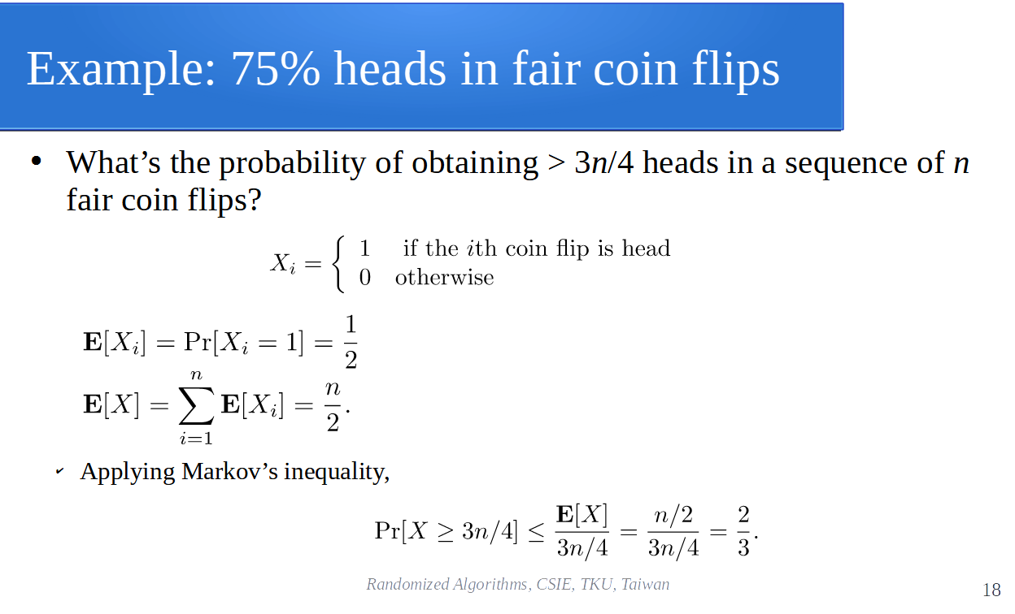
Example: 75% heads in fair coin flips
Actually,

Slide 41

Example: Coupon Collector’s Problem
Recall:
  X: the time to collect n coupons.
  E[X] ≈ nHn.
Using Markov’s inequality,

Slide 42
Example: Coupon Collector’s Problem
Recall:
  X: the time to collect n coupons (sum of geometric random variables).
  E[X] ≈ nHn.
Using Markov’s inequality,
It seems to be weak. Can we get a better bound?

Slide 43
Example: Coupon Collector’s Problem
Consider a geometric random variable Y.
  Y: the number of flips until the first heads (head: appear with prob. p).
E[Y] = 1/p. How about E[Y²]?
  We try to calculate it using conditional expectation.
  Could be easier (?)

Slide 44
Example: Coupon Collector’s Problem
Consider a geometric random variable Y.
  Y: the number of flips until the first heads (head: appear with prob. p).
E[Y] = 1/p. How about E[Y²]?
  We try to calculate it using conditional expectation.
  Could be easier (?)

Slide 45

Example: Coupon Collector’s Problem
Consider a geometric random variable Y.
  Y: the number of flips until the first heads (head: appear with prob. p).
E[Y] = 1/p. How about E[Y²]?
  We try to calculate it using conditional expectation.
  Could be easier (?)
  If X = 1, then Y = 1; if X = 0, then Y > 1. So,
Z: another geometric random variable with parameter p.

Slide 46
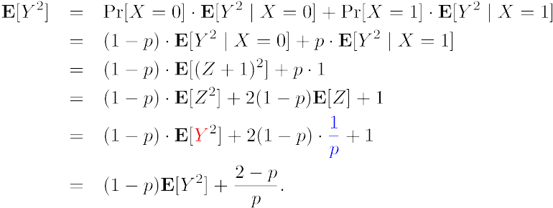


Example: Coupon Collector’s Problem
Hence,

Slide 47
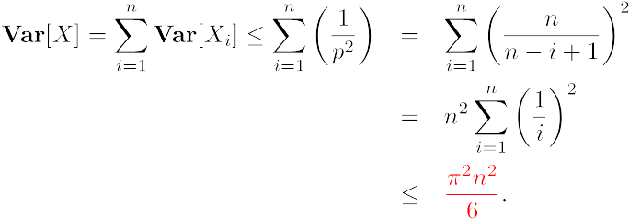
Example: Coupon Collector’s Problem
Let’s go back to the coupons…
Let’s welcome Chebyshev!

Slide 48
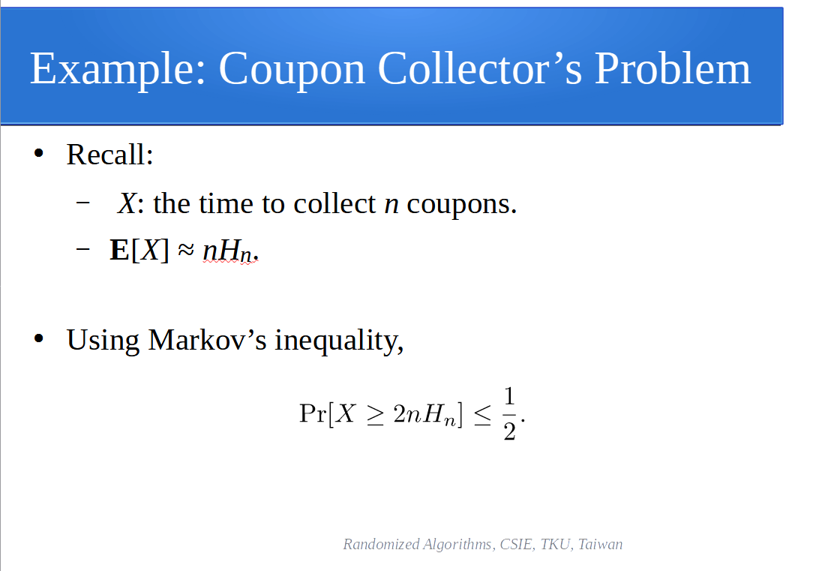
Example: Coupon Collector’s Problem
Let’s go back to the coupons…
Let’s welcome Chebyshev!

Slide 49
Example: Coupon Collector’s Problem
Let’s go back to the coupons…
Let’s welcome Chebyshev!
< 0.22 when n=100
< 0.15 when n=1,000

Slide 50
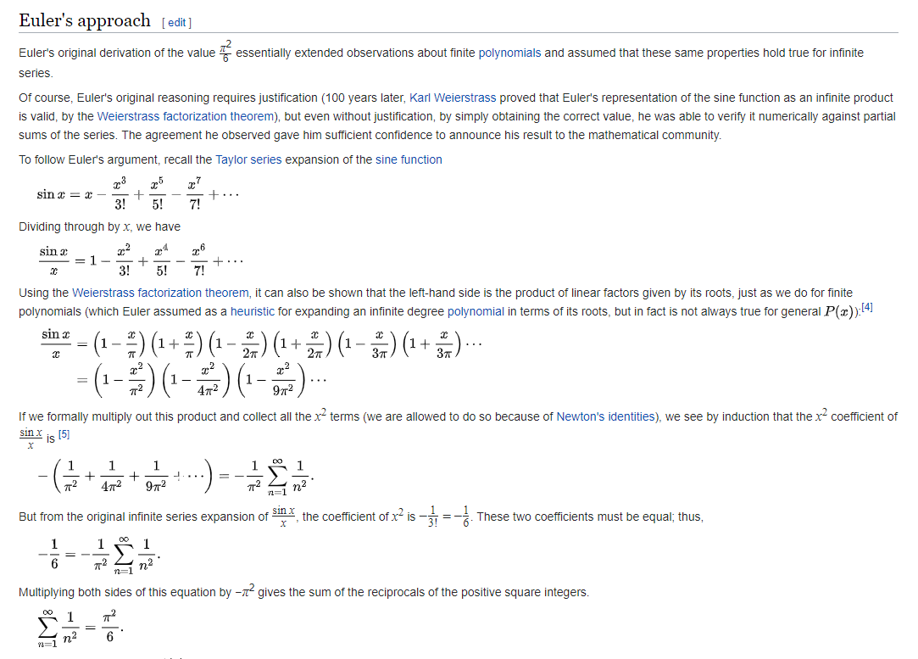
Basel problem
Refer to Wikipedia for more details and more approaches.
https://en.wikipedia.org/wiki/Basel_problem

Slide 51
Assignment 03
Let X be a number chosen uniformly at random from [1, n]. Find Var[X].
Suppose that we roll a standard fair die 100 times. Let X be the sum of the numbers that appear over the 100 rolls. Use Chebyshev’s inequality to bound

