Slide 1
Randomized Algorithms
Balls and Bins: Some basics
Joseph Chuang-Chieh Lin
Dept. CSIE, Tamkang University
29th April 2021
Notes:
e^x := \sum_{k=0}^{\infty} \frac{x^k}{k!}

Slide 2
Outline
The Birthday Paradox – Revisited
Balls into Bins
Poisson Distribution

Slide 3
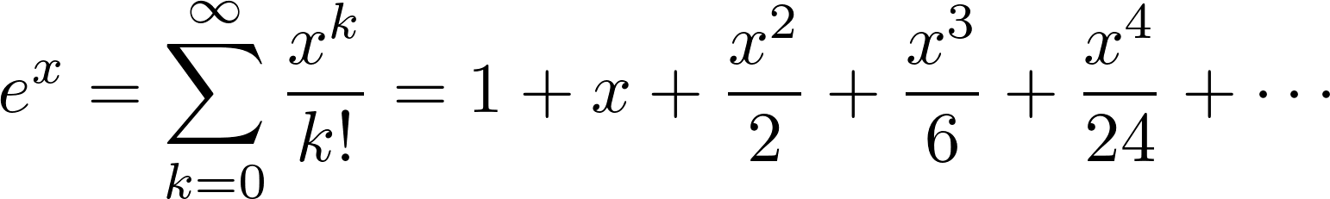
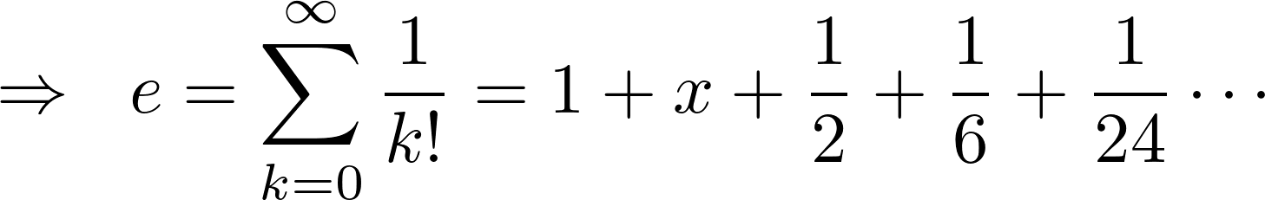
Exponential function - revisited
By definition of e^{x}:

Slide 4
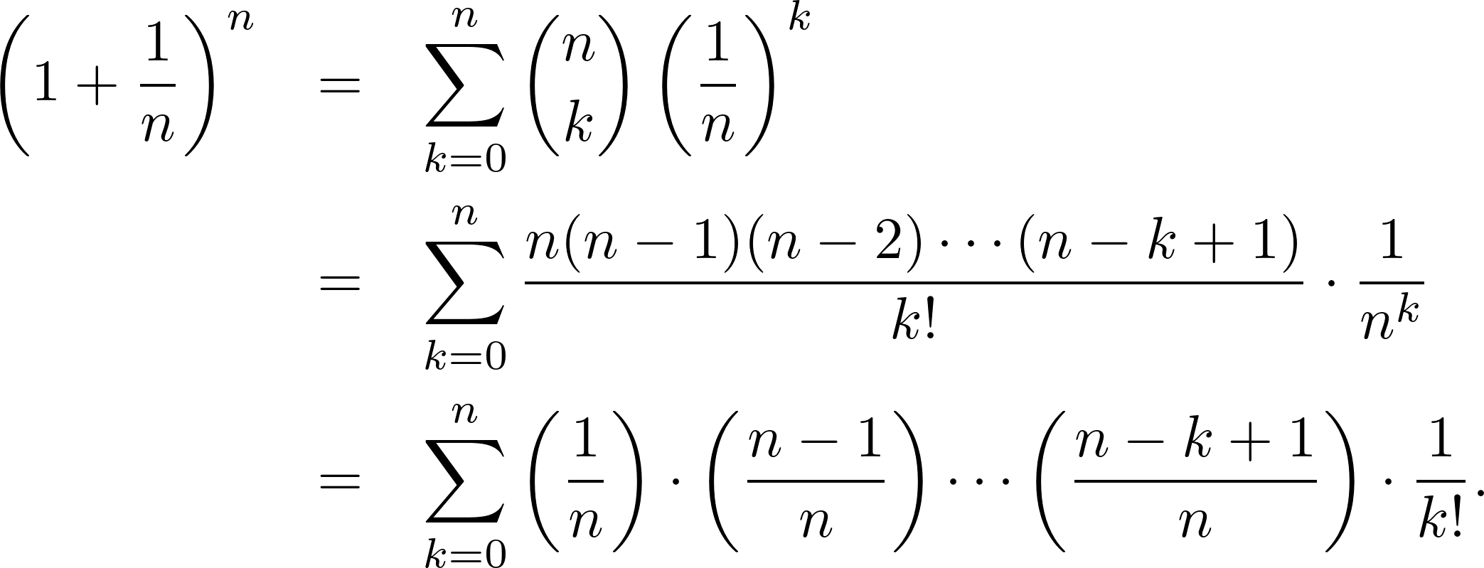
Exponential function - revisited
By the Binomial Theorem:

Slide 5
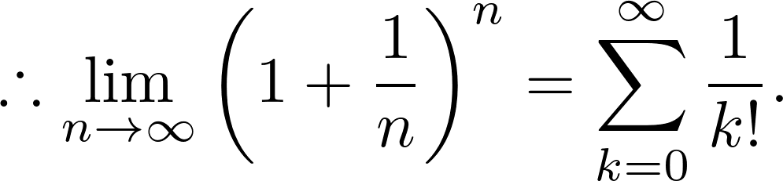
Exponential function - revisited
By the Binomial Theorem:

Slide 6
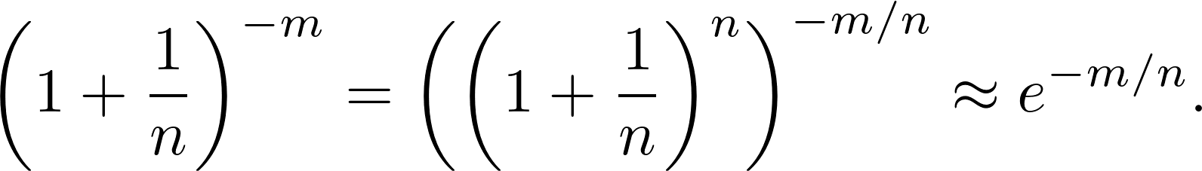
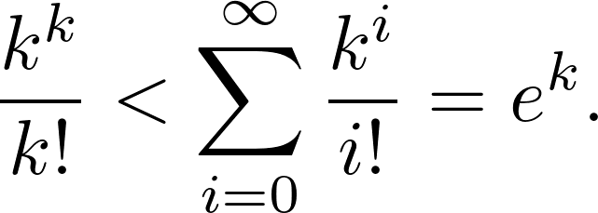
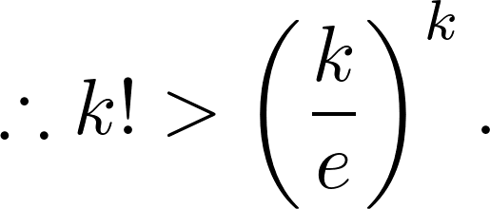
Exponential function - revisited
Useful approaches:

Slide 7

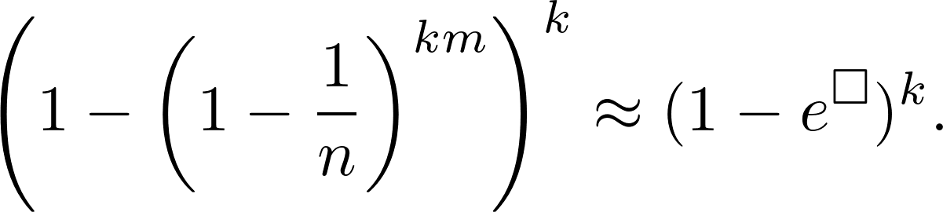
Assignment 04
Show that for |x| ≤ 1,
Let
Find □ = ?

Slide 8
m balls into n bins
…...
…...

Slide 9
m balls into n bins
…...

Slide 10
m balls into n bins
Example. balls: people, bins: birthdays (mm/dd).
…...

Slide 11
m balls into n bins
Example. balls: people, bins: birthdays (mm/dd).
Let’s say there are 30 people in a room. What’s the probability that no two people in the room share the same birthday?
…...

Slide 12
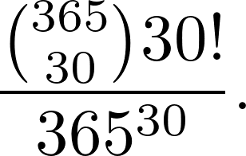
m balls into n bins
Example. balls: people, bins: birthdays (mm/dd).
Let’s say there are 30 people in a room. What’s the probability that no two people in the room share the same birthday?
…...

Slide 13
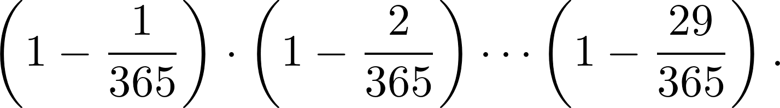
m balls into n bins
Example. balls: people, bins: birthdays (mm/dd).
Let’s say there are 30 people in a room. What’s the probability that no two people in the room share the same birthday?
…...

Slide 14
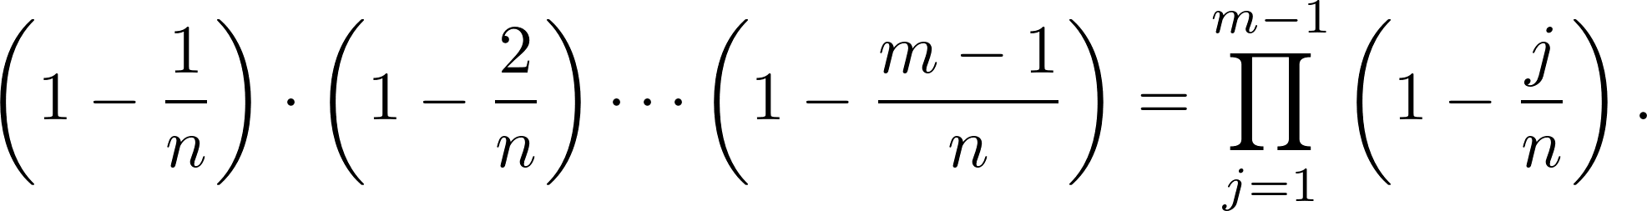
m balls into n bins
Example. balls: people, bins: birthdays (mm/dd).
In general, for m people in a room and n possible birthdays, what’s the probability that no two people in the room share the same birthday?
…...

Slide 15
m balls into n bins
Example. balls: people, bins: birthdays (mm/dd).
In general, for m people in a room and n possible birthdays, what’s the probability that no two people in the room share the same birthday?
…...

Slide 16
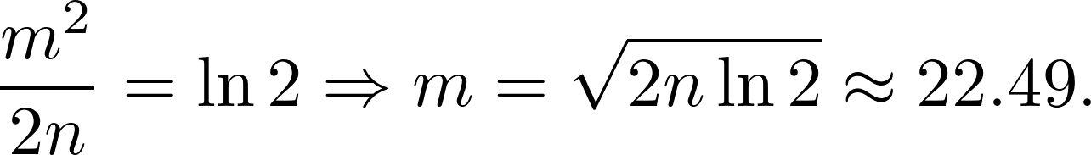
m balls into n bins
Example. balls: people, bins: birthdays (mm/dd).
In general, for m people in a room and n possible birthdays, what’s the probability that no two people in the room share the same birthday?
Set the probability threshold to be ½:
…...

Slide 17
m balls into n bins
Example. balls: people, bins: birthdays (mm/dd).
In general, for m people in a room and n possible birthdays, what’s the probability that no two people in the room share the same birthday?
Set the probability threshold to be ½:
…...
Matching your observation?

Slide 18
n balls into n bins: maximum load
n balls are thrown independently and uniformly at random into n bins.
What’s the probability that the maximum “load” is more than L?
  Maximum number of balls in one bin.

Slide 19
n balls into n bins: maximum load
n balls are thrown independently and uniformly at random into n bins.
What’s the probability that the maximum “load” is more than L?
  Maximum number of balls in one bin.
    The average load is n/n = 1?!

Slide 20
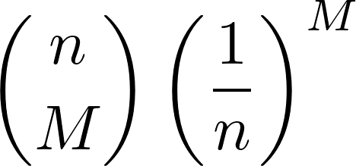
n balls into n bins: maximum load
n balls are thrown independently and uniformly at random into n bins.
What’s the probability that the maximum “load” is more than L?
  Maximum number of balls in one bin.
The probability that bin 1 receives at least M balls is at most

Slide 21
n balls into n bins: maximum load
n balls are thrown independently and uniformly at random into n bins.
What’s the probability that the maximum “load” is more than L?
  Maximum number of balls in one bin.
The probability that bin 1 receives at least M balls is at most
union bound

Slide 22
n balls into n bins: maximum load
n balls are thrown independently and uniformly at random into n bins.
What’s the probability that the maximum “load” is more than L?
  Maximum number of balls in one bin.
The probability that bin 1 receives at least M balls is at most

Slide 23
n balls into n bins: maximum load
The probability that bin 1 receives at least M balls is at most
Applying the union bound again:

Slide 24
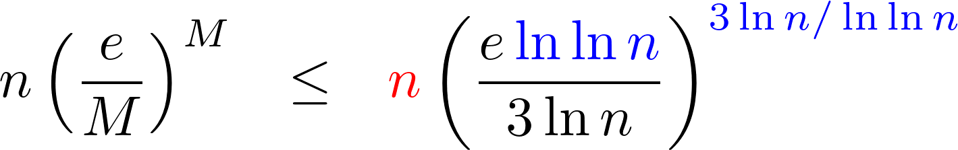
n balls into n bins: maximum load
The probability that bin 1 receives at least M balls is at most
Applying the union bound again:

Slide 25
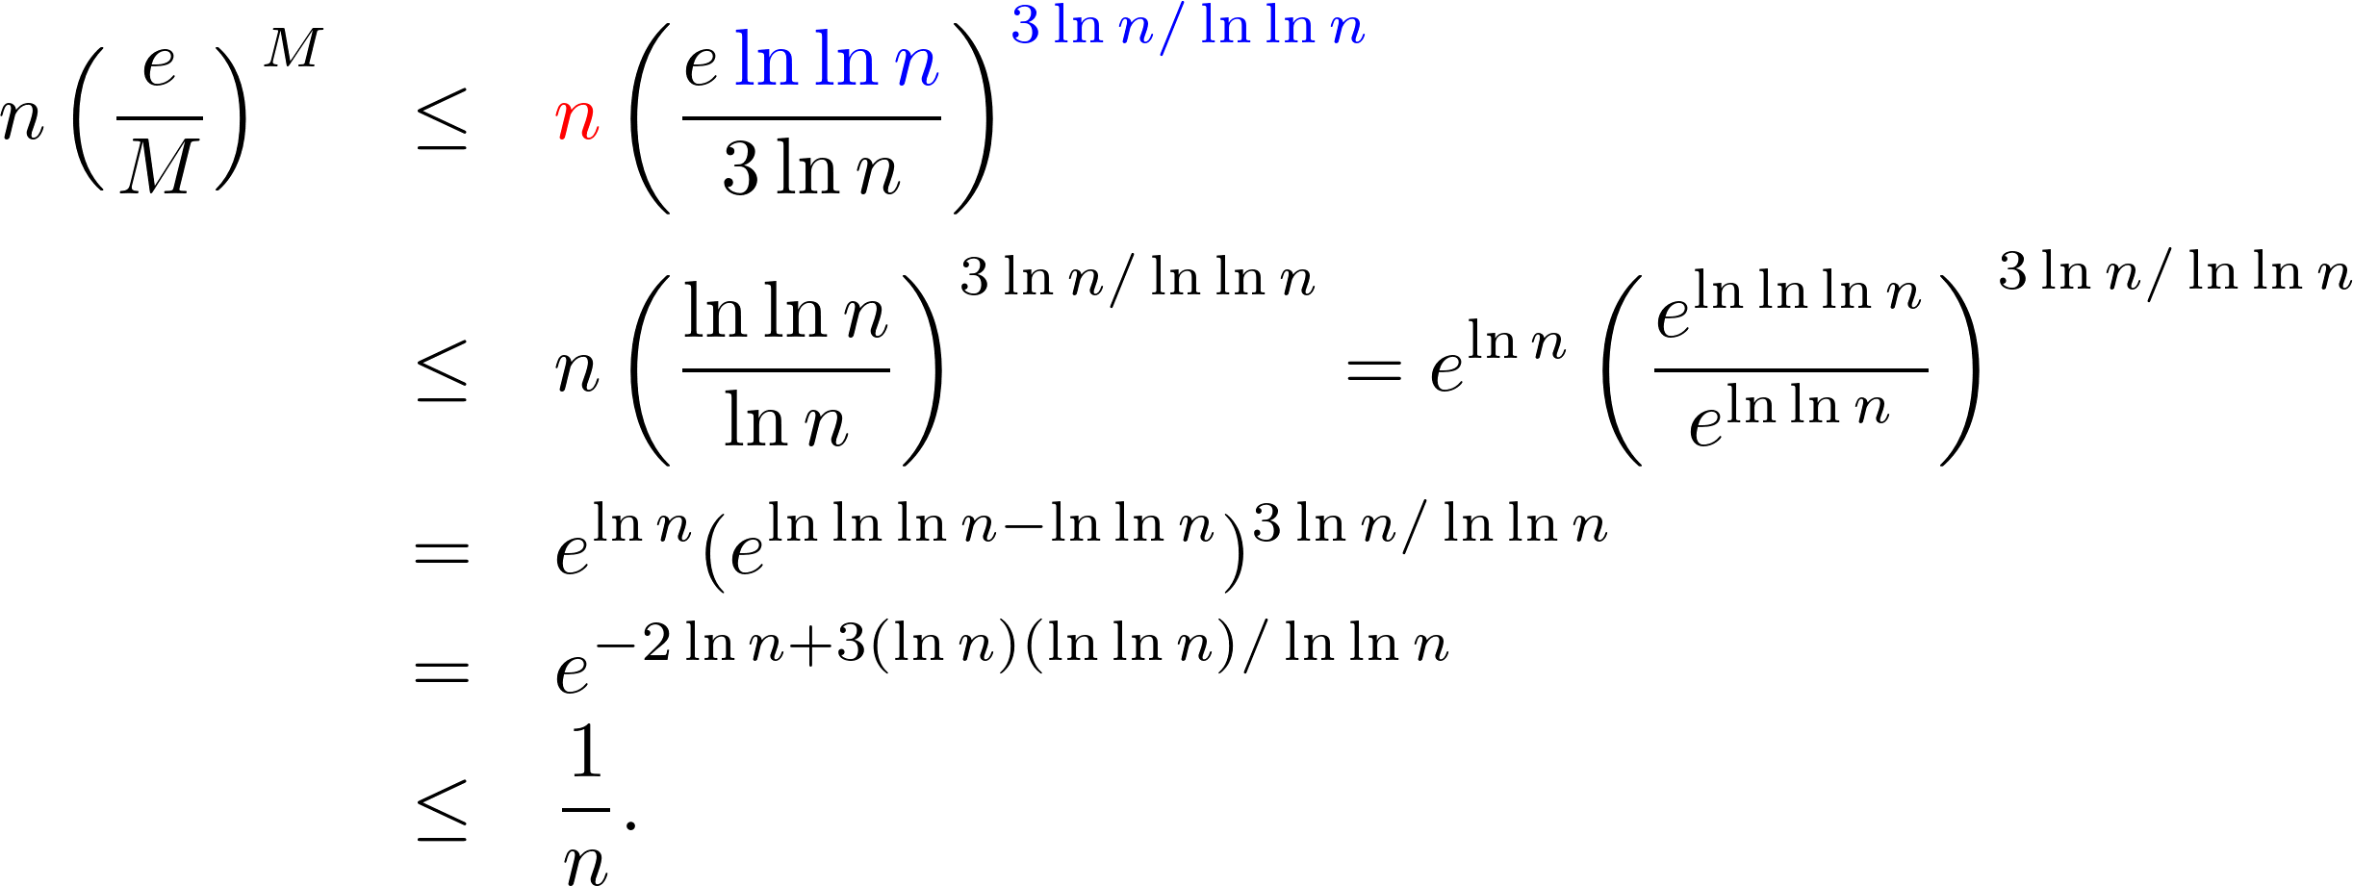
n balls into n bins: maximum load
The probability that bin 1 receives at least M balls is at most
Applying the union bound again:

Slide 26
Application: Bucket Sort
A set of n = 2^{m} numbers chosen uniformly at random in [0, 2^{k}), k ≥ m.
Bucket Sort:
  Stage 1: place the elements into n buckets.
    j^{th} bucket: holds all elements whose first m binary digits corresponds to j.
      e.g., n = 2¹⁰, bucket 3 contains all elements whose first 10 digits are 0000000011.
  Stage 2: sort each bucket using any standard sorting algorithm.

Slide 27
Application: Bucket Sort
A set of n = 2^{m} numbers chosen uniformly at random in [0, 2^{k}), k ≥ m.
Bucket Sort:
  Stage 1: place the elements into n buckets.
    j^{th} bucket: holds all elements whose first m binary digits corresponds to j.
      e.g., n = 2¹⁰, bucket 3 contains all elements whose first 10 digits are 0000000011.
  Stage 2: sort each bucket using any standard sorting algorithm.
Expected O(n) time?!

Slide 28
Application: Bucket Sort
A set of n = 2^{m} numbers chosen uniformly at random in [0, 2^{k}), k ≥ m.
Bucket Sort:
  Stage 1: place the elements into n buckets.
    j^{th} bucket: holds all elements whose first m binary digits corresponds to j.
      e.g., n = 2¹⁰, bucket 3 contains all elements whose first 10 digits are 0000000011.
    The number of elements landing in a specific bucket: Binomial(n, 1/n).
  Stage 2: sort each bucket using any standard sorting algorithm.

Slide 29
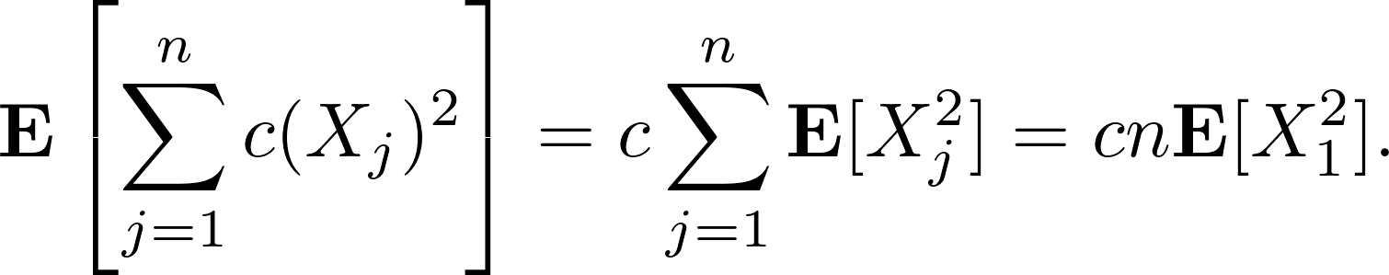
Application: Bucket Sort
X_{j}: the number of elements landing in bucket j.
The time to sort bucket j: c(X_{j})², for some constant c.
The expected time for sorting in Stage 2:

Slide 30
Application: Bucket Sort
X_{j}: the number of elements landing in bucket j.
The time to sort bucket j: c(X_{j})², for some constant c.
The expected time for sorting in Stage 2:
The same for all buckets.

Slide 31

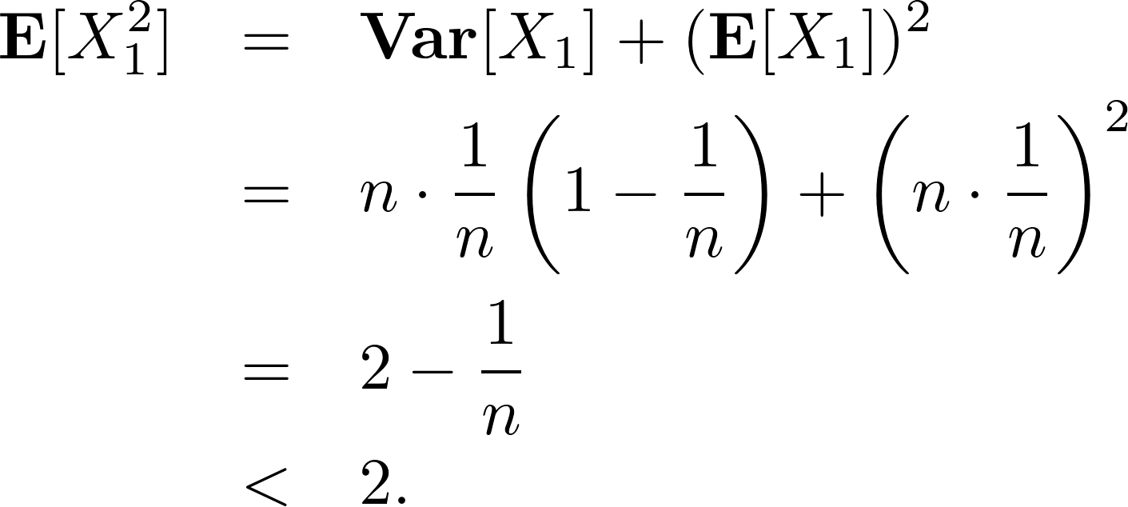
Application: Bucket Sort
X_{j}: the number of elements landing in bucket j.
The time to sort bucket j: c(X_{j})², for some constant c.
The expected time for sorting in Stage 2:

Slide 32
Assignment 05
Suppose that n balls are thrown independently and uniformly at random into n bins.
  Find the conditional probability that bin 1 has one ball given that exactly one ball fell into the first three bins.
  Find the conditional expectation of the number of balls in bin 1 under the condition that bin 2 received no balls.

Slide 33
Questions
What is the probability that a given bin is empty?
What is the expected number of empty bins?

Slide 34

The probability that the ith bin remains empty is

Slide 35

The probability that the ith bin remains empty is
The expected number of empty bins:

Slide 36
The probability that the ith bin remains empty is
The expected number of empty bins:
The expected “fraction”

Slide 37
Generalization:
  The probability that a given bin has r balls is

Slide 38
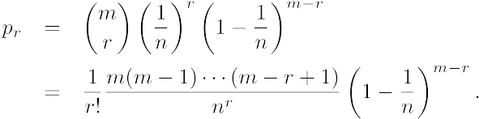

Generalization:
  The probability that a given bin has r balls is
Expected number of bins with exactly r balls ≈ npr.

Slide 39
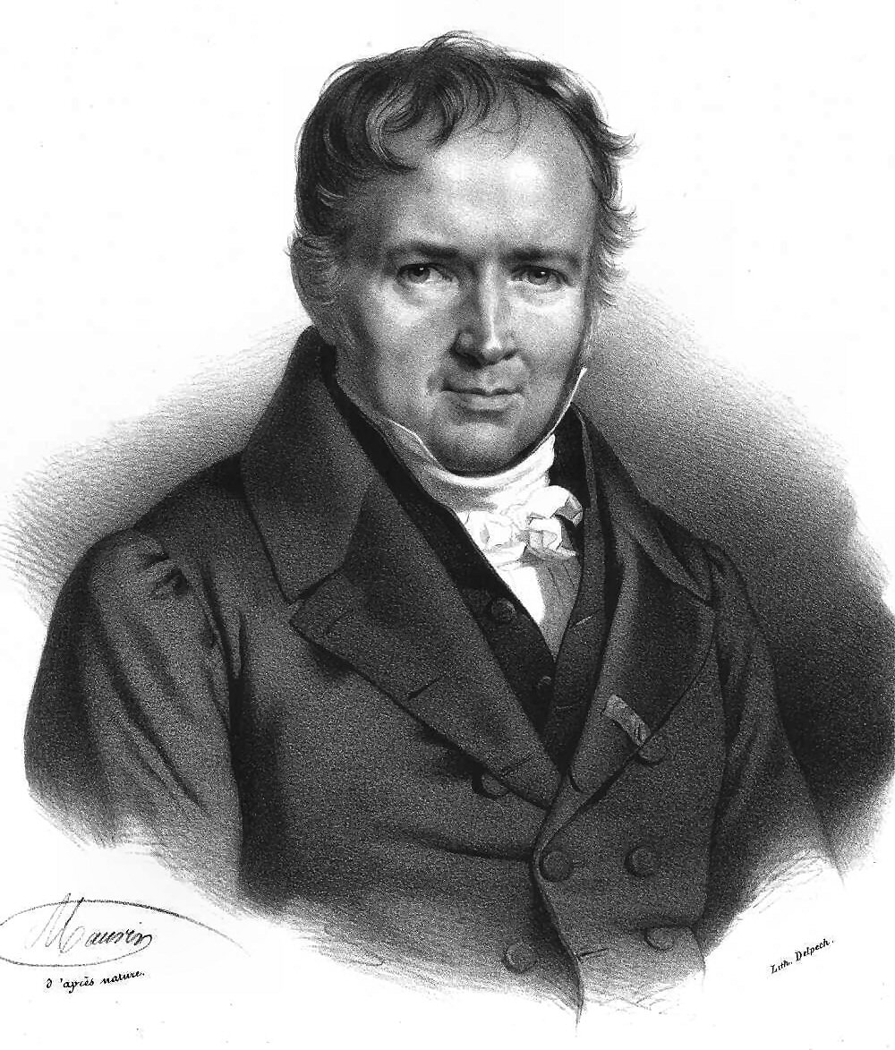

The Poisson Distribution
Siméon Poisson (1781−1840)
Wikipedia
A discrete Poisson random variable X with parameter μ is given by the following probability distribution on j = 0, 1, 2, …:

Slide 40

The Poisson Distribution
Siméon Poisson (1781−1840)
Wikipedia
A discrete Poisson random variable X with parameter μ is given by the following probability distribution on j = 0, 1, 2, …:

Slide 41
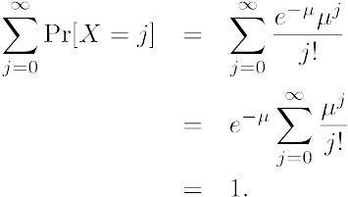
The Poisson Distribution
Siméon Poisson (1781−1840)
Wikipedia
Try to verify if it’s proper:

Slide 42
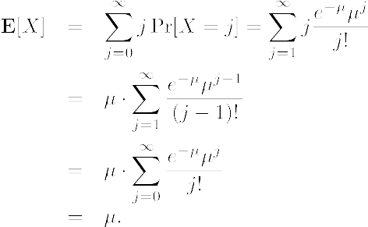
The Poisson Distribution
Siméon Poisson (1781−1840)
Wikipedia
The expectation:

Slide 43
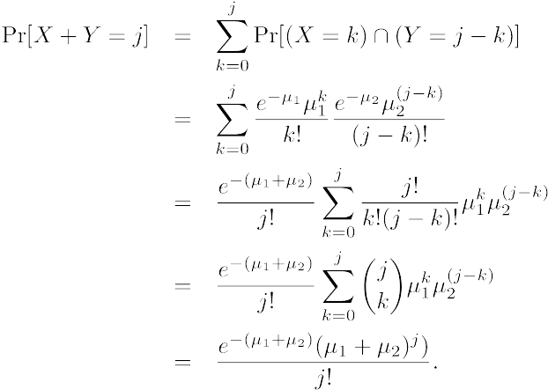
The Poisson Distribution
Siméon Poisson (1781−1840)
Wikipedia
The sum of finite number of independent Poisson random variables is a Poisson random variable.

Slide 44

The Poisson Distribution
Siméon Poisson (1781−1840)
Wikipedia
The moment generating function of a Poisson random variable with parameter μ is

Slide 45
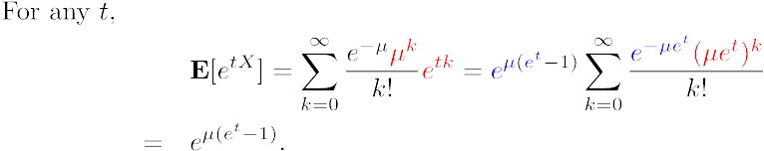
The Poisson Distribution
Siméon Poisson (1781−1840)
Wikipedia
The moment generating function of a Poisson random variable with parameter μ is

Slide 46
The Poisson Distribution
Siméon Poisson (1781−1840)
Wikipedia
The moment generating function of a Poisson random variable with parameter μ is

Slide 47

Limit of the Binomial Distribution
Theorem. Let X_{n} ~ Binomial(n, p) be a binomial random variable
  p: a function of n
  limn→∞ np = λ is a constant, independent of n.
Then for any fixed k,

Slide 48

Scenario
m balls into n bins.
  m = f (n);
  limm→∞ m/n = λ;
  X_{m}: the number of balls in a specific bin.
    Binomial(m, 1/n).
From the theorem:

