Slide 1
Randomized Algorithms
Continuous Distributions and the Poisson Process
Joseph Chuang-Chieh Lin
Dept. CSIE, Tamkang University
27th May 2021
Notes:
e^x := \sum_{k=0}^{\infty} \frac{x^k}{k!}

Slide 2
Outline
Continuous Random Variables
The Uniform Distribution
The Exponential Distribution
The Poisson Process

Slide 3

Recall: Probability function
Pr(Ω) = 1
For any event E, 0 ≤ Pr(E) ≤ 1.
For any finite or enumerable collection B of disjoint events,

Slide 4
k distinct points in [0, 1)
p: the probability of any given point is in [0, 1).
S(k): a set of k distinct points in [0, 1).

Slide 5
k distinct points in [0, 1)
p: the probability of any given point is in [0, 1).
S(k): a set of k distinct points in [0, 1).

Slide 6
k distinct points in [0, 1)
p: the probability of any given point is in [0, 1).
S(k): a set of k distinct points in [0, 1).
k can be any number!

Slide 7
k distinct points in [0, 1)
p: the probability of any given point is in [0, 1).
S(k): a set of k distinct points in [0, 1).
k can be any number!

Slide 8
Continuous distribution
Probabilities are assigned to intervals rather than to individual values.
  X is continuous if F(x) is a continuous function.

Slide 9
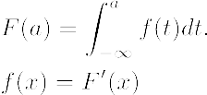
Continuous distribution
Probabilities are assigned to intervals rather than to individual values.
  X is continuous if F(x) is a continuous function.
For all −∞ < a < ∞,

Slide 10

Continuous distribution
Probabilities are assigned to intervals rather than to individual values.
  X is continuous if F(x) is a continuous function.
For all −∞ < a < ∞,

Slide 11

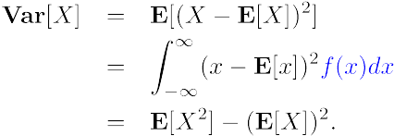


Continuous distribution

Slide 12

Exercise
Lemma. Let X ≥ 0 be a continuous random variable. Then

Slide 13
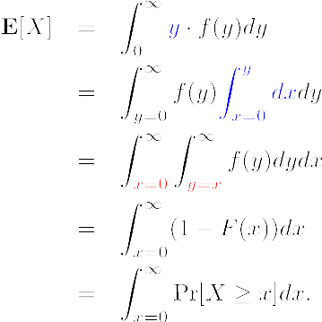
Exercise

Slide 14


Joint Distribution
The joint distribution function of X and Y:
X and Y have joint density function f if for all x, y,

Slide 15
Marginal Distribution Function
Given a joint distribution function F(x, y) over X and Y, we have the marginal distribution functions:
The corresponding marginal density functions:

Slide 16
Independence
The random variables X and Y are independent if, for all x and y,

Slide 17
Example
For a, b > 0, consider the joint distribution function of two random variables X and Y:

Slide 18
Example
For a, b > 0, consider the joint distribution function of two random variables X and Y:

Slide 19

Example
For a, b > 0, consider the joint distribution function of two random variables X and Y:

Slide 20
Example
For a, b > 0, consider the joint distribution function of two random variables X and Y:

Slide 21
Conditional Probability
Why?

Slide 22
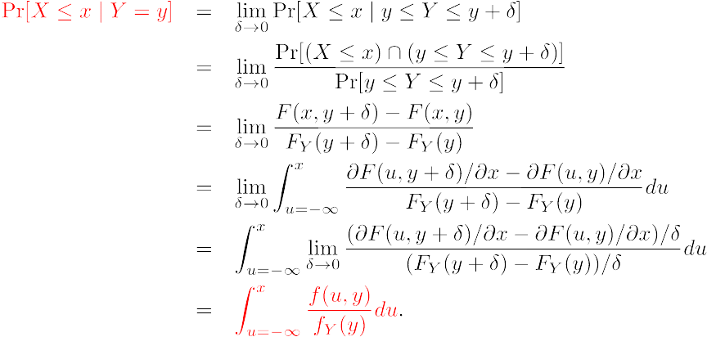
Conditional Probability

Slide 23
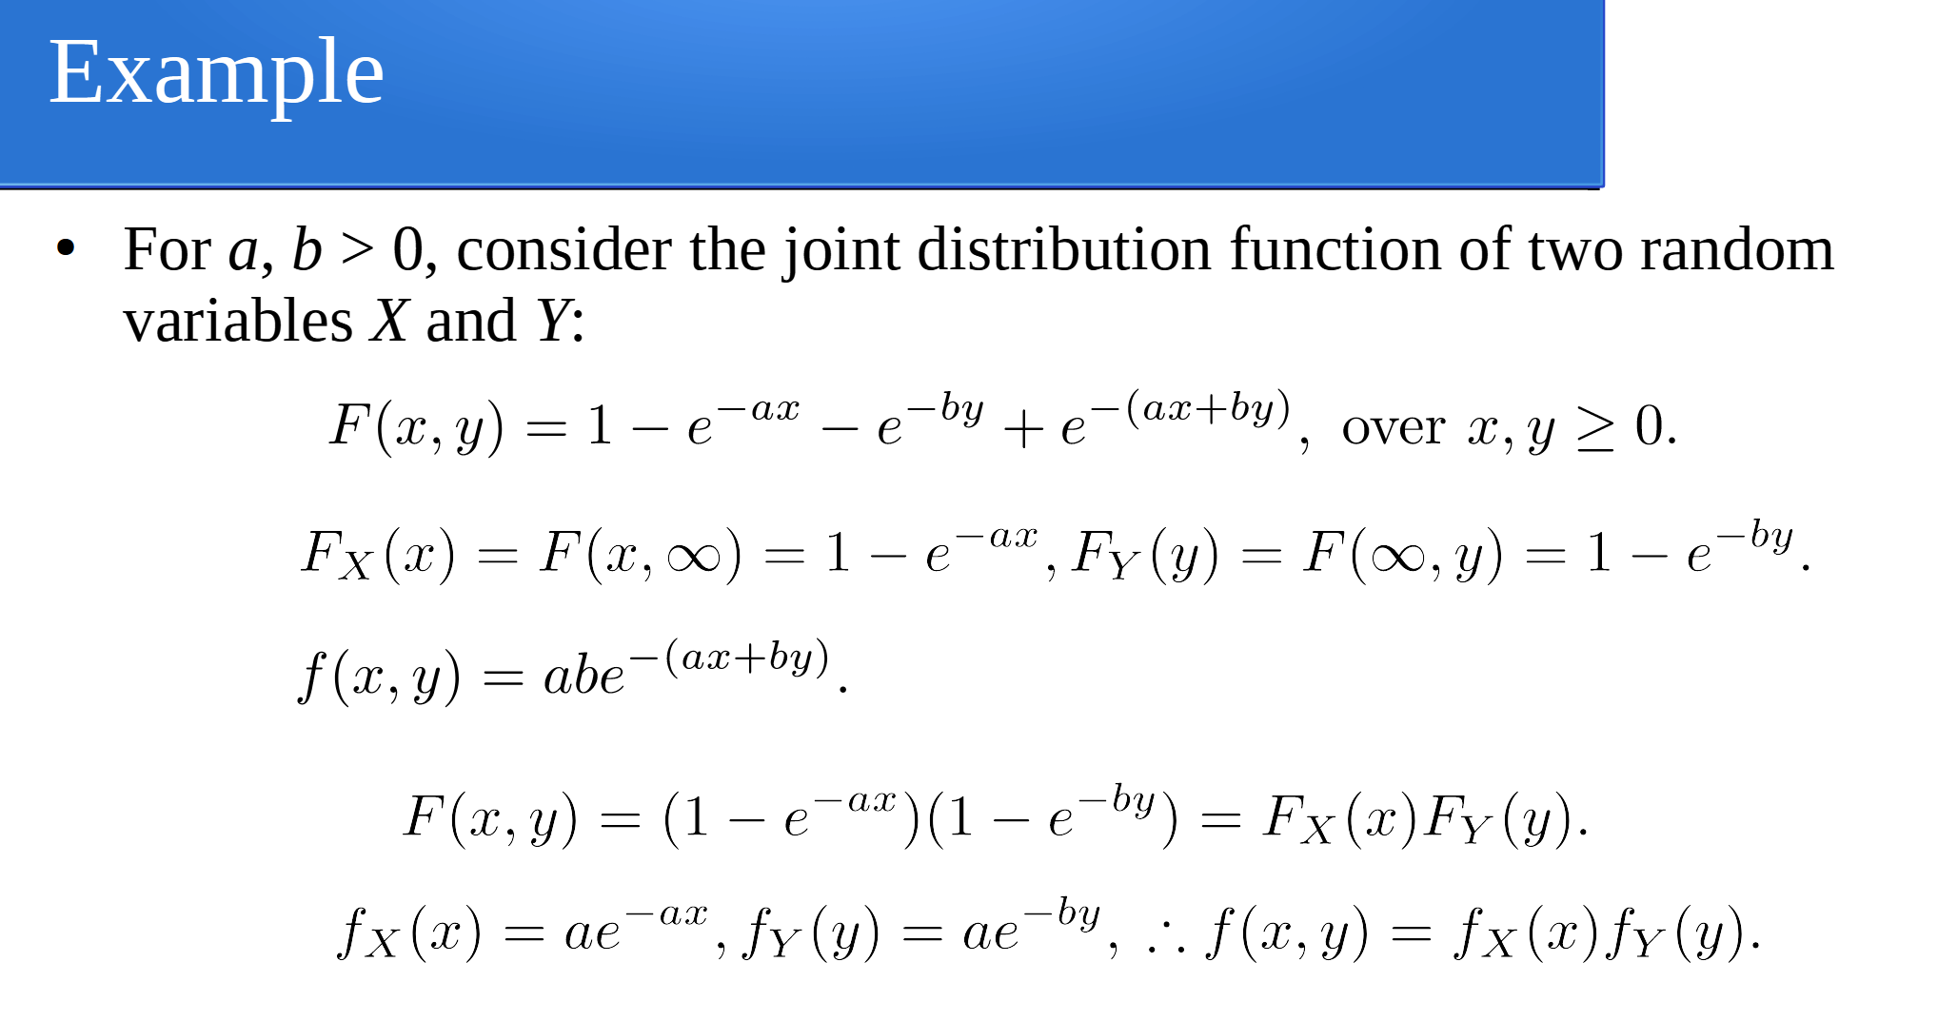
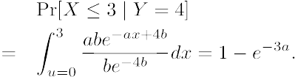
Conditional Probability
For example,

Slide 24
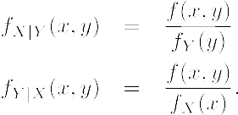

Conditional Density Function
Assume that f_{Y}(y) ≠ 0,

Slide 25






Uniform Distribution

Slide 26

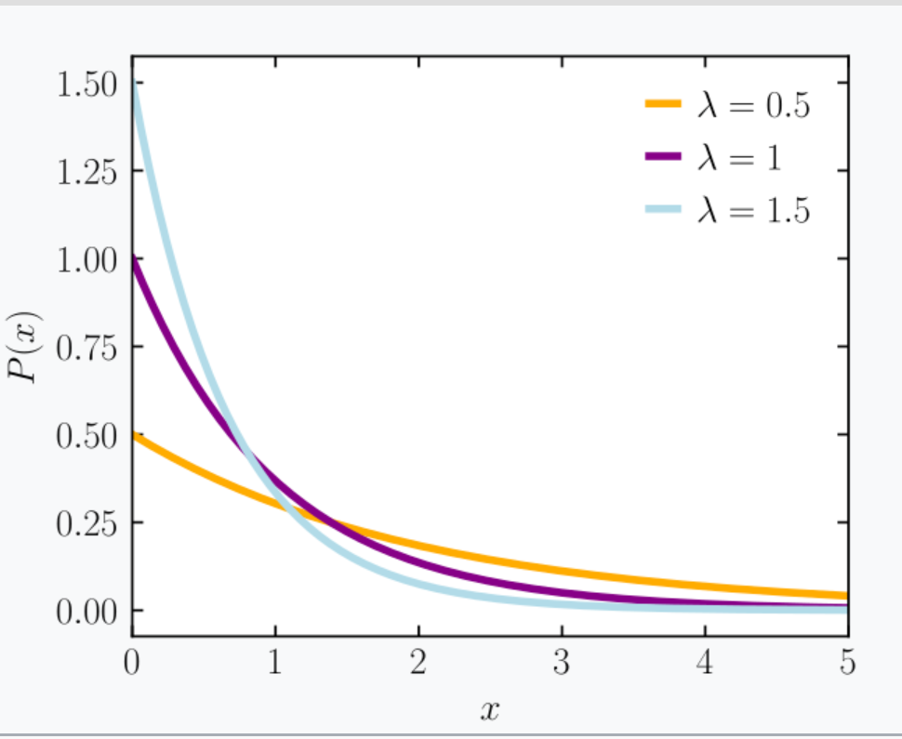
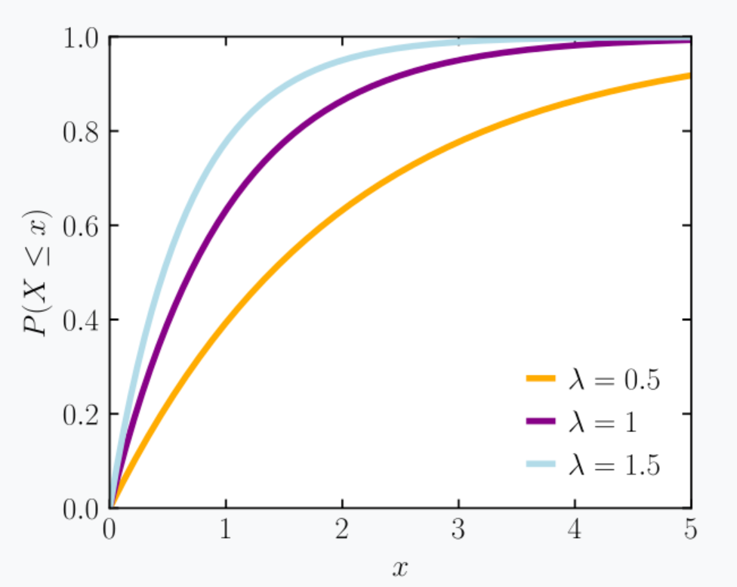


Exponential Distribution
Definition. An exponential distribution with parameter λ is given by the following probability distribution function:
wikipedia

Slide 27



Exponential Distribution
(Integration by parts)

Slide 28
Exponential Distribution (memoryless)
For an exponential random variable X with parameter λ,

Slide 29
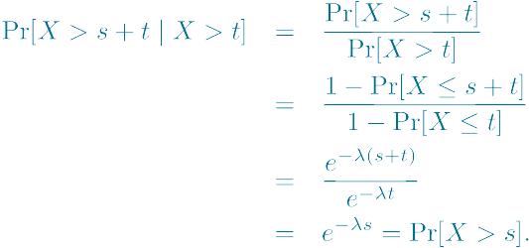
Exponential Distribution (memoryless)
For an exponential random variable X with parameter λ,

Slide 30

Min(exponential random variables)
Lemma. If X₁, X₂, …, X_{n} are independent exponential random variables with parameters λ₁, λ₂, …, λ_{n}, respectively, then min(X₁, X₂, …, X_{n}) is exponential random variable with parameter

Slide 31
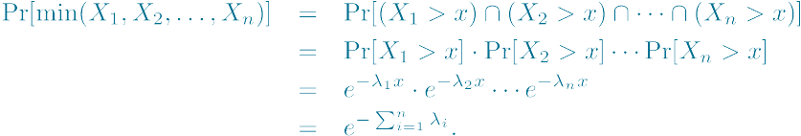
Min(exponential random variables)
Lemma. If X₁, X₂, …, X_{n} are independent exponential random variables with parameters λ₁, λ₂, …, λ_{n}, respectively, then min(X₁, X₂, …, X_{n}) is exponential random variable with parameter

Slide 32
Scenario
An airline ticket counter with n service agents.
The time agent i takes per customer:
  Exponential distribution, parameter λ_{i}
You are at the head of the line and wondering how long, in average, you wait for an agent to serve you...

Slide 33


Scenario
An airline ticket counter with n service agents.
The time agent i takes per customer:
  Exponential distribution, parameter λ_{i}
You are at the head of the line and wondering how long, in average, you wait for an agent to serve you...
The time until the first agent is free
Exponential distribution with parameter
Expected waiting time:

Slide 34
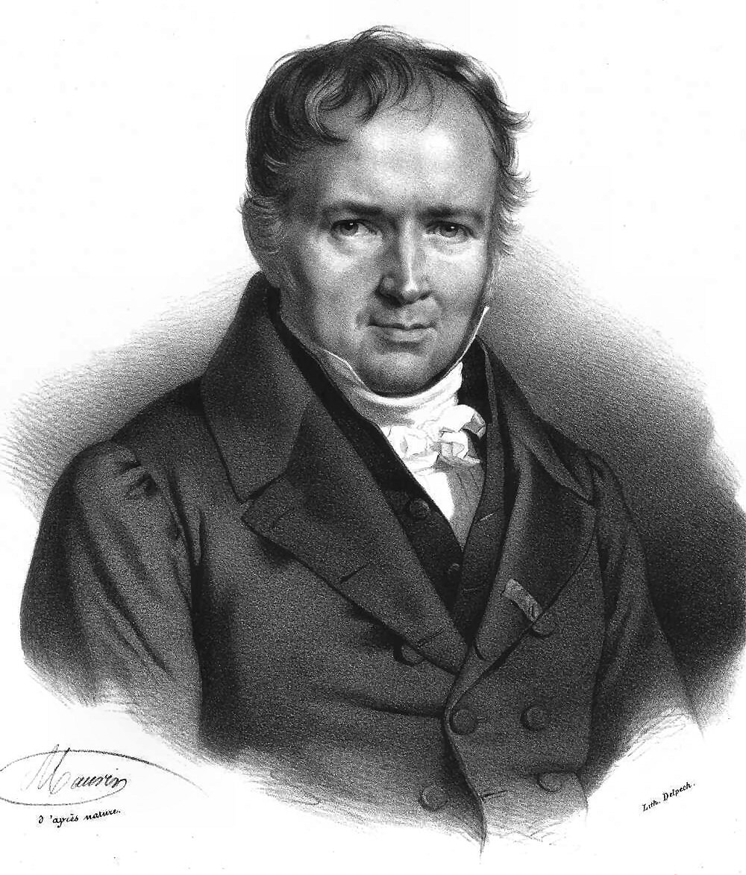
The Poisson Process
Siméon Poisson (1781−1840)
Wikipedia
Counting process.
  E.g., arrivals of customers to a queue, emissions of radioactive particles, price surges in the stock markets, etc.
N(t): the number of events in the interval (say [0, t]).
A stochastic counting process: {N(t): t ≥ 0}

Slide 35


The Poisson Process
Siméon Poisson (1781−1840)
Wikipedia
A Poisson process {N(t): t ≥ 0} with parameter λ is a stochastic counting process such that the following conditions hold.
  N(0) = 0.
  (Independent & stationary increments) For any t, s > 0,
    the distribution of N(t+s) – N(s) is identical to the distribution of N(t);
    for disjoint intervals [t1, t2] and [t3, t4], the distribution of N(t2) – N(t1) is independent of the distribution of N(t4) – N(t3).

Slide 36
The Poisson Process
Siméon Poisson (1781−1840)
Wikipedia
A Poisson process {N(t): t ≥ 0} with parameter λ is a stochastic counting process such that the following conditions hold.
  N(0) = 0.
  (Independent & stationary increments) For any t, s > 0,
    the distribution of N(t+s) – N(s) is identical to the distribution of N(t);
    for disjoint intervals [t1, t2] and [t3, t4], the distribution of N(t2) – N(t1) is independent of the distribution of N(t4) – N(t3).
The number of events in a given time interval follows the Poisson distribution!

Slide 37

Poisson Process → Poisson Distribution
Theorem. Let {N(t): t ≥ 0} be a Poisson process with with parameter λ. For any t, s ≥ 0 and any integer n ≥ 0,

Slide 38
Poisson Process → Poisson Distribution
Theorem. Let {N(t): t ≥ 0} be a Poisson process with with parameter λ. For any t, s ≥ 0 and any integer n ≥ 0,
The probability that n events happen during time interval of length t.

Slide 39
Stochastic Process + Poisson = ?
Theorem. Let {N(t): t ≥ 0} be a stochastic process such that
  N(0) = 0.
  (Independent increments) For disjoint intervals [t1, t2] and [t3, t4], the distribution of N(t2) – N(t1) is independent of the distribution of N(t4) – N(t3).
  For any t, s ≥ 0, N(t+s) – N(s) has a Poisson distribution with mean λt.
Then {N(t): t ≥ 0} is a Poisson process with rate λ.

Slide 40


Stochastic Process + Poisson = ?
Theorem. Let {N(t): t ≥ 0} be a stochastic process such that
  N(0) = 0.
  (Independent increments) For disjoint intervals [t1, t2] and [t3, t4], the distribution of N(t2) – N(t1) is independent of the distribution of N(t4) – N(t3).
  For any t, s ≥ 0, N(t+s) – N(s) has a Poisson distribution with mean λt.
Then {N(t): t ≥ 0} is a Poisson process with rate λ.

Slide 41
An Intuitive Idea
Balls: events, bins: time slots
A lot of balls into a lot of (infinitely small) bins...
…...
…...

Slide 42
Another Viewpoint: Interarrival
Surprising fact: All of the X_{n} have the same distribution and this distribution is exponential!
X_{n}: the interval time
(n – 1)th event
nth event
: events of Poisson process

Slide 43
Interarrival times
Theorem. X₁ has an exponential distribution with parameter λ.

Slide 44
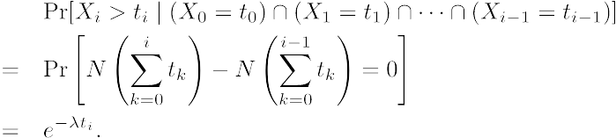
Interarrival times
Theorem. X_{i} , i = 1, 2, …, are i.i.d exponential random variables with parameter parameter λ.

Slide 45
Interarrival times
Theorem. X_{i} , i = 1, 2, …, are i.i.d exponential random variables with parameter parameter λ.

Slide 46
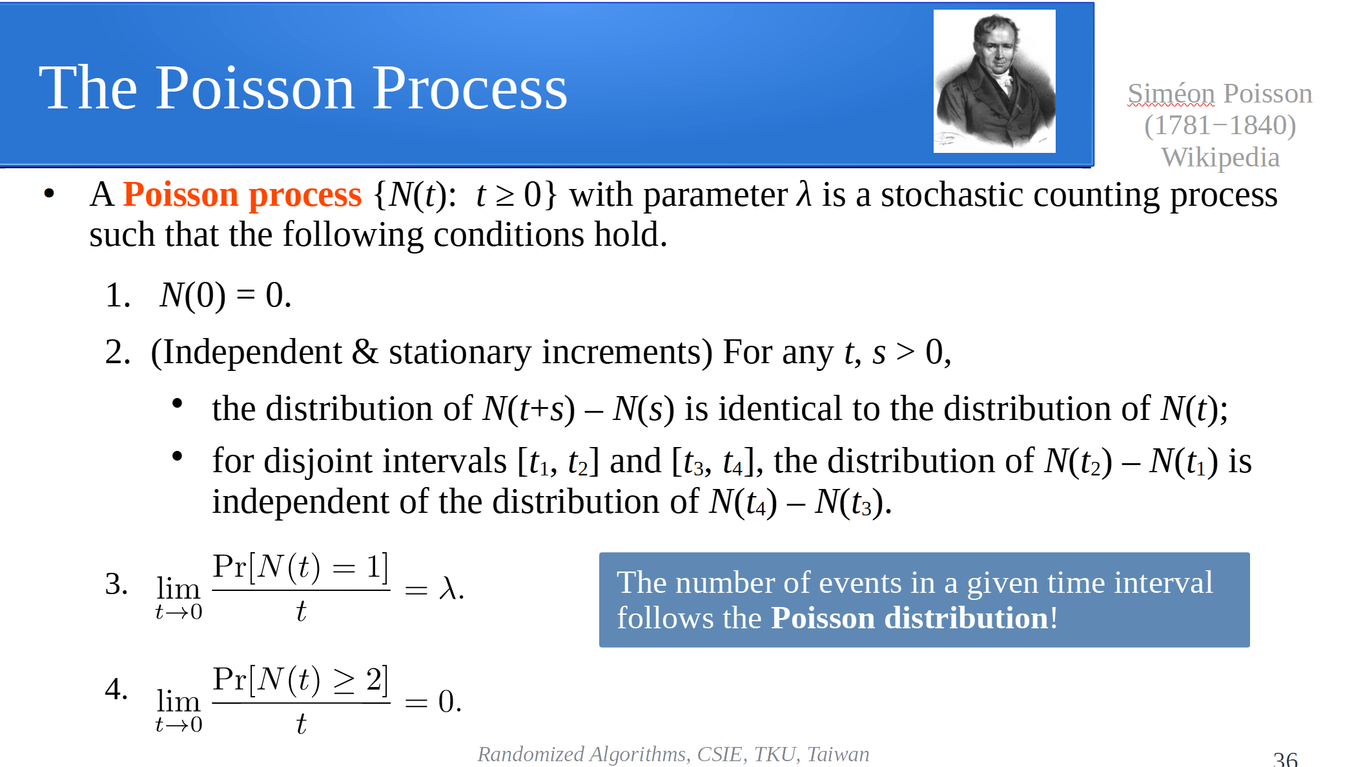
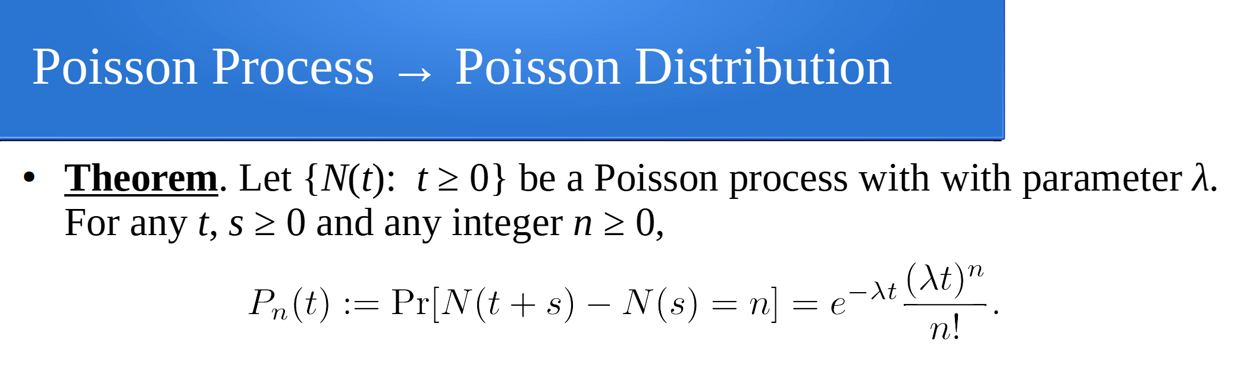
So, why the Poisson process makes P_{n}(t) Poisson distributed?

Slide 47
P₀(t)
The number of events in [0, t] and (t, t+h] are independent.

Slide 48
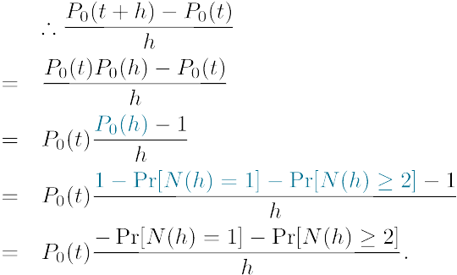
P₀(t)
The number of events in [0, t] and (t, t+h] are independent.

Slide 49
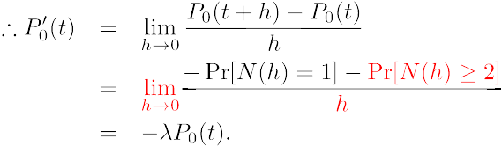
P₀(t)
The number of events in [0, t] and (t, t+h] are independent.

Slide 50

P₀(t)
The number of events in [0, t] and (t, t+h] are independent.

Slide 51
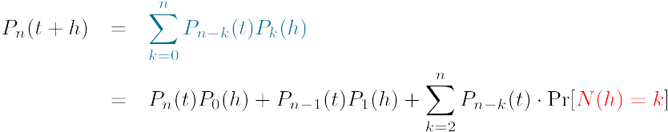
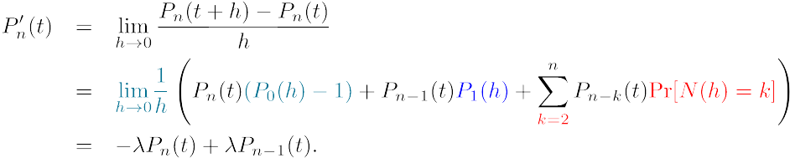
P_{n}(t), n ≥ 1

Slide 52
P_{n}(t), n ≥ 1

Slide 53

P_{n}(t), n ≥ 1

Slide 54
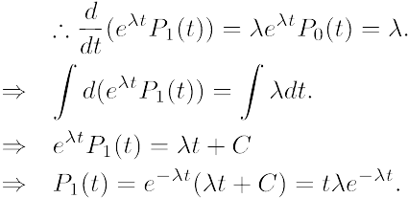
P_{n}(t), n ≥ 1

Slide 55
P_{n}(t), n ≥ 1

Slide 56


P_{n}(t), n ≥ 1
Look back at what we want to have:
We already have P₀(t) and P₁(t).
Induction hypothesis:

Slide 57

P_{n}(t), n ≥ 1
Look back at what we want to have:
We already have P₀(t) and P₁(t).
Induction hypothesis:

Slide 58

P_{n}(t), n ≥ 1
Look back at what we want to have:
We already have P₀(t) and P₁(t).
Induction hypothesis:

Slide 59
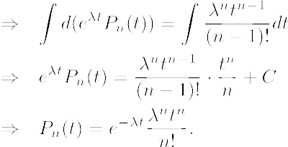
P_{n}(t), n ≥ 1
Look back at what we want to have:
We already have P₀(t) and P₁(t).
Induction hypothesis:

Slide 60
Further related topics
Stochastic counting process: point processes
Hawkes (self-exciting) processes.
  Earthquake modeling, financial analysis.
  A reference: https://arxiv.org/pdf/1507.02822.pdf

