Slide 1
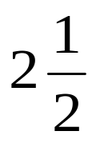
A -Approximation Algorithm for Shortest Superstring
Sweedyk, Z.
SIAM Journal on Computing, Vol. 29, No. 3, 1999, pp. 954-986
Speaker: Chuang-Chieh Lin
Advisor: R. C. T. Lee
National Chi-Nan University

Slide 2
Outline
Introduction
Basic definitions
String functions
The approximation algorithm
The upper bound
The lower bound
Conclusion

Slide 3
Outline
Introduction
Basic definitions
String functions
The approximation algorithm
The upper bound
The lower bound
Conclusion

Slide 4
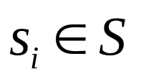
Introduction
Let S = {s₁, s₂, …, s_{n}} be a set of strings. A superstring of S is a string containing each
as a contiguous substring.
The shortest superstring problem is to find a minimum length superstring of the input set S.
This problem has important applications in computational biology and in data compression.

Slide 5
For example,
S = { ab, bcd, de, abc },
then abcde is a superstring of length 5 of S
and
abcabcde is a superstring of length 8 of S.

Slide 6
Outline
Introduction
Basic definitions
String functions
The approximation algorithm
The upper bound
The lower bound
Conclusion

Slide 7
Basic definitions
Let’s introduce some basic definitions.
Notes:
可刪除

Slide 8
Overlap
Let s and t be two strings. Let the suffix f of s and the prefix p of t are the same, then we call f or p the overlap of s with respect to t .
For example,
s = cabab
t = babcba
bab is the overlap of s with respect to t.

Slide 9
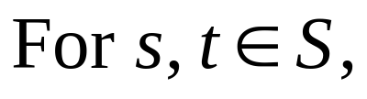
OV (s, t)
OV (s, t) is the set of overlaps of s with respect to t.
For example,
s = cabab, t = bababa
OV (s, t) = {ε, b, bab },
OV (s, s) = {ε},
OV (t, t) = {ε, ba, baba },
OV (t, s) = {ε}.

Slide 10
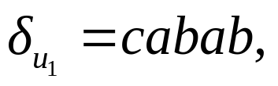
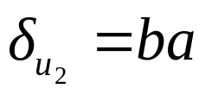
ov (s, t), pref (s, t) and suff (s, t)
We use ov (s, t) to denote the longest string in OV (s, t); pref (s, t) and suff (s, t) denote the prefix of s and suffix of t corresponding to ov (s, t).
Furthermore, we use δ_{S} to denote pref (s, s)
For example,
u₁ = cabab u₁ = cabab u₂ = bababa
u₂ = bababa u₁ = cabab u₂ = bababa
So, pref (u₁, u₂) = ca, suff (u₁, u₂) = aba,

Slide 11
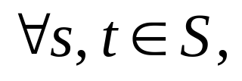
Distance/ overlap graph
Let S be a set of strings. The distance/ overlap graph G_{S} is a complete diagraph with vertex set S; each edge of the graph is assigned a positive length as follows.
the edge e from s to t has length | e | = | pref (s, t) |.

Slide 12
For example,
S = { u₀, u₁, u₂}, where u₀ = ababc, u₁ = cabab, u₂ = bababa .
The following graph is G_{S} .
5
1
5
u₀
4
u₁
u₀ = ababc
3
2
6
u₁ = cabab
5
u₂
u₁ = cabab
u₀ = ababc
2

Slide 13




The distance/ overlap multigraph g_{S}
We define overlap ov (e) = ov (s, t).
The distance/ overlap multigraph g_{S} for S is constructed out of the distance/ overlap graph. Every and every an edge from s to t has length and overlap | v |.

Slide 14
For example, S = {u₀, u₁, u₂}
u₀ = ababc, u₁ = cabab, u₂ = bababa
5, 0
1, 4
5, 0
u₀
4, 1
u₁
3, 3
2, 3
6, 0
5, 0
We use “m, n” to denote the “length and the overlap” of that edge.
u₂
2, 4

Slide 15
Why are the above graph useful?
Consider the Hamiltonian path u₀-u₁-u₂.
Its total overlap is 1 + 3 = 4.
The corresponding superstring is ababcabababa (12)
Consider the Hamiltonian path u₁-u₂-u₀.
Its total overlap is 3 + 3 = 6.
Its corresponding superstring is
cababababc (10) (optimal solution).

Slide 16
Roughly speaking, we are interested in
a cycle which covers all vertices with the largest sum of overlaps, or the smallest sum of lengths.

Slide 17
We have oversimplified the problem,
because there may well be more than one cycle in the cycle cover.
In this case, we have to combine cycles.

Slide 18
Cycle cover
A cycle cover of G_{S} is a set of simple cycles that cover all the vertices of the graph.
Notes:
Note: A minimum-length cycle cover is also a maximum-overlap cover.

Slide 19
The following cycle c = (u₀, u₁, u₂) is a cycle cover of G_{S}
u₀
4, 1
u₁
3, 3
2, 3
u₂
c
where S = { u₀, u₁, u₂ }, u₀ = ababc, u₁ = cabab, u₂ = bababa

Slide 20
S = { u₀, u₁, u₂ }, u₀ = ababc, u₁ = cabab, u₂ = bababa
The following cycles also form a cycle cover of G_{S} .
1, 4
u₀
4, 1
u₁
u₂
2, 4

Slide 21
The following red and blue cycles also form a cycle cover.
4, 1
5, 1
v₁
4, 2
5, 0
5, 0
2, 3
6, 0
v₀
4, 0
5, 0
5, 0
5, 0
v₂
6, 0
5, 1
4, 0
4, 1
5, 0
4, 0
3, 2
3, 2
5, 0
v₄
4, 0
4, 1
v₃
4, 0
4, 1
3, 2

Slide 22
A minimum-length cycle cover C_{S}* is a cycle cover of G_{S} with minimum sum of lengths of edges.
The greedy algorithm can be used to construct C_{S}*.

Slide 23
Since each cycle cover corresponds to several superstrings, the minimum cycle cover somehow corresponds to a rather short superstring.

Slide 24
For example, Let S = {v₁, v₂, v₃, v₄, v₅}
v₀ = aggtt, v₁ = gttaag, v₂ = taagc, v₃ = gcata, v₄ = tacc.
Then g_{S} is as follows:
4, 1
5, 1
v₁
4, 2
5, 0
5, 0
2, 3
6, 0
v₀
4, 0
5, 0
5, 0
5, 0
v₂
6, 0
5, 1
4, 0
4, 1
5, 0
4, 0
3, 2
3, 2
5, 0
v₄
4, 0
4, 1
v₃
4, 0
4, 1
3, 2

Slide 25
And we proceed the greedy algorithm to construct C_{S}* :
v₀ = aggtt, v₁ = gttaag, v₂ = taagc, v₃ = gcata, v₄ = tacc
4, 1
5, 1
v₁
4, 2
5, 0
5, 0
2, 3
6, 0
v₀
4, 0
5, 0
v₂
5, 0
5, 0
6, 0
5, 1
4, 0
4, 1
5, 0
4, 0
3, 2
3, 2
5, 0
v₄
4, 0
4, 1
v₃
4, 0
4, 1
3, 2

Slide 26
4, 1
5, 1
v₁
4, 2
5, 0
5, 0
2, 3
6, 0
v₀
4, 0
5, 0
v₂
5, 0
5, 0
6, 0
5, 1
4, 0
4, 1
5, 0
4, 0
3, 2
3, 2
5, 0
v₄
4, 0
4, 1
v₃
4, 0
4, 1
3, 2

Slide 27
4, 1
5, 1
v₁
4, 2
5, 0
5, 0
2, 3
6, 0
v₀
4, 0
5, 0
v₂
5, 0
5, 0
6, 0
5, 1
4, 0
4, 1
5, 0
4, 0
3, 2
3, 2
5, 0
v₄
4, 0
4, 1
v₃
4, 0
4, 1
3, 2

Slide 28
4, 1
5, 1
v₁
4, 2
5, 0
5, 0
2, 3
6, 0
v₀
4, 0
5, 0
v₂
5, 0
5, 0
6, 0
5, 1
4, 0
4, 1
5, 0
4, 0
3, 2
3, 2
5, 0
v₄
4, 0
4, 1
v₃
4, 0
4, 1
3, 2

Slide 29
4, 1
5, 1
v₁
4, 2
5, 0
5, 0
2, 3
6, 0
v₀
4, 0
5, 0
v₂
5, 0
5, 0
6, 0
5, 1
4, 0
4, 1
5, 0
4, 0
3, 2
3, 2
5, 0
v₄
4, 0
4, 1
v₃
4, 0
4, 1
3, 2

Slide 30
4, 1
5, 1
v₁
4, 2
5, 0
5, 0
2, 3
6, 0
v₀
4, 0
5, 0
v₂
5, 0
5, 0
6, 0
5, 1
4, 0
4, 1
5, 0
4, 0
3, 2
3, 2
5, 0
v₄
4, 0
4, 1
v₃
4, 0
4, 1
3, 2

Slide 31
Now, the following graph is C_{S}*
v₀ = aggtt, v₁ = gttaag, v₂ = taagc, v₃ = gcata, v₄ = tacc
v₁
4, 2
2, 3
c₁
v₀
v₂
c₂
3, 2
3, 2
v₄
c₃
v₃
4, 0

Slide 32
v₀ = aggtt, v₁ = gttaag, v₂ = taagc, v₃ = gcata, v₄ = tacc.
The superstrings corresponding to the cycles of this cycle cover are as follows
v₀ - v₁: aggttaag
v₂ - v₃: taagcata
v₄: tacc
The superstring: aggttaagtaagcatacc
can be obtained by concatenating the three cycles.
Notes:
考慮刪除

Slide 33
Why do we use “cycles”?

Slide 34
Open
Let c = (s₀, s₁,…, s_{j-1}, s₀) be a cycle of G_{S} . For any l , the string
, where the indices are taken modulo j, is called an open of c.

Slide 35
A cycle c may have many opens.
We can regard opens as local superstrings.

Slide 36
For example,
1, 4
4, 1
u₀ = ababc
u₁ = cabab
u₂ = bababa
c₁ = (u₂, u₂)
c₂ = (u₀, u₁, u₀)
u₀
u₁
c₂
u₂
4, 2
c₁
Let x₁ = bababa, x₂₁ = ababcabab, x₂₂ = cababc
x₁ is an open of c₁.
x₂₁ and x₂₂ are opens of c₂.

Slide 37
For any cycle c, an open is a Hamiltonian path of this cycle.

Slide 38
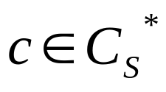
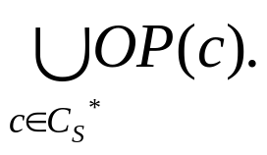
For , we denote OP(c) to be the set of opens of c and U_{S}* =

Slide 39
For example,
1, 4
u₀ = ababc
u₁ = cabab
u₂ = bababa
c₁ = (u₂, u₂)
c₂ = (u₀, u₁, u₀)
OP(c₁) = { bababa }
OP(c₂) = { ababcabab, cababc }
u₀
4, 1
u₁
c₂
u₂
4, 2
c₁

Slide 40
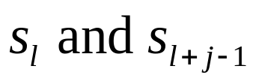
The vertices are called, respectively,
x_{first} and x_{last} and the edge < x_{last} , x_{first} > is called the opening edge of x.
An opening edge of x is an edge whose removal creates the open x.
For example,
<u₂, u₂> is the opening edge of x₁
<u₁, u₀> is the opening edge of x₂₁

Slide 41
Lemma 2.12
Let c be a cycle. We denote sop (c) to be the shortest open of c. If the minimum length cycle cover C_{S}* consists of a single cycle c, sop (c) is a shortest superstring of S.

Slide 42
For example,
Cycle cover c₂ is a minimum length cycle cover and c₂ consists of just one cycle. OP (c₂) = { ababcabab, cababc }. So sop (c₂) = cababc is a shortest superstring of u₀ = ababc and u₁ = cabab.
1, 4
u₀
4, 1
u₁
c₂

Slide 43
Outline
Introduction
Basic definitions
String functions
The approximation algorithm
The upper bound
The lower bound
Conclusion

Slide 44
String functions and lemmas
At first, we should know the meaning of the expansion of a cycle or an edge.

Slide 45




Expansion
e = < s, t, k > and are versions of each other and if , we say that e is an expansion of
For example,
s = bbcabba, t = abbabab
bbcabba bbcabba
abbabab abbabab
Let e = < s, t, 1>, . Therefore, e is an expansion of .

Slide 46


1-expansion
is an expansion of c if every edge of is an expansion of an edge in c.
An edge < s, t, k > is tight if k = |ov (s, t)| and loose otherwise.
We call a cycle of g_{S} a 1-expansion of if is an expansion of c and it has only one loose edge.
Notes:
重點

Slide 47
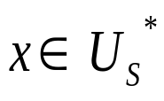
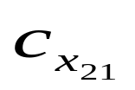
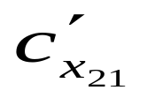
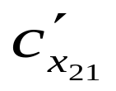
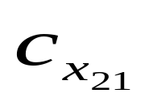
When we refer to a 1-expansion of c_{x} for , we mean that the only possible loose edge is <x_{last}, x_{first}>.
For example,
is a 1-expansion of .
1, 4
3, 2
u₀
4, 1
u₁
u₀
4, 1
u₁
u₁ = cabab u₁ = cabab
u₀ = ababc u₀ = ababc

Slide 48
Let’s take a look at an example here with 3 strings where an expansion of the superstring of two strings should be expanded so that the final superstring covering the three strings is even shorter.

Slide 49
y₁ = abcd, y₂ = cdba, y₃ = cdcdbaba
Case 1: without expansion:
y₁= abcd
y₂ = cdba
y₁₂ = abcdba
y₁₂ = abcdba
y₁₂₃ = cdcdbababcdba
y₃ = cdcdbaba
Case 2: with expansion:
y₁= abcd
y₂ = cdba
y₁₂ = abcdcdba
y₁₂ = abcdcdba
y₃ = cdcdbaba
y₁₂₃ = cdcdbaba

Slide 50
The above example shows we have to consider some string functions to improve our solutions.

Slide 51
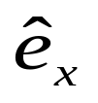

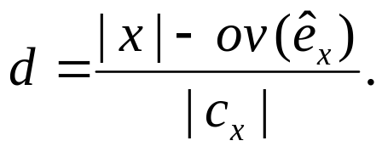
Pseudolength
Let x be a string in U_{S}* and let be an expansion of e_{x}. We denote the 1-expansion of c_{x} corresponding to as , where
The quantity d |c_{x}| is called the pseudolength of the edge and d is called the normalized pseudolength of the edge.

Slide 52
Actually, the pseudolength d |c_{x}| measures the losing length after connecting to the other string y.

Slide 53
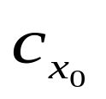
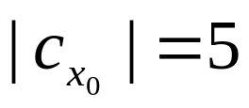

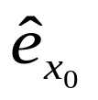
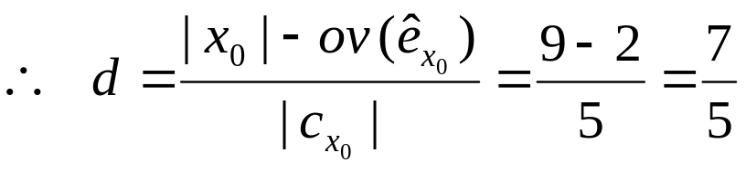
u₁ = cabab u₁ = cabab
u₀ = ababc u₀ = ababc
For example, u₀ = ababc, u₁ = cabab, c₂ = = (u₀, u₁, u₀), so .
Let x₀ = ababcabab an open of c₂ , = < u₁, u₀, 4 > , = < u₁, u₀, 2 >, so | x₀ | = 9 and ov ( ) = 2.

Slide 54
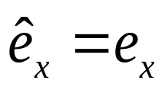
Fact 3.5
Let x be a string in U_{S}*.
The 1-expansion exists for some d if and only if there is an expansion of e_{x} with pseudolength d |c_{x}|.
If is an expansion of e_{x} with pseudolength d |c_{x}|, then d ≥ 1 with equality if and only if .

Slide 55
There exist certain 1-expansions of a cycle c_{x} based on the string functions, lemmas and corollaries.
These string functions allow us to identify the expansions of c_{x}.
The string functions can shows the situations of overlap between any two strings.

Slide 56
We omit the detail of all the string functions and just give an example to describe their function simply.

Slide 57
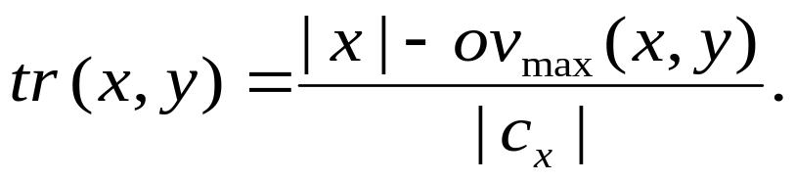
For example, let’s take a look at the string function trade-off :
Let x be a string in U_{S}*, c_{x} ≠ c_{y}. The trade-off of x with respect to y, denoted tr (x, y), is defined as

Slide 58
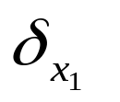
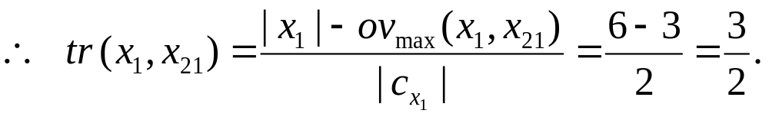
u₀ = ababc, u₁ = cabab, u₂ = bababa
x₁ = bababa x₂₁ = ababcabab
x₂₁ = ababcabab x₁ = bababa
For example, x₂₁ = ababcabab, x₁ = bababa
ov_{max}(x₁, x₂₁) = 3
x₁ = bababa
x₁ = bababa | | = 2, | x₁ | = 6.
x₁
x₂₁
ov_{max}(x₁, x₂₁)

Slide 59

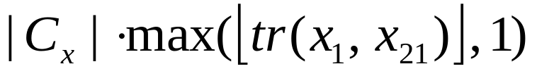

From a lemma, a 1-expansion of c_{x} corresponding to ) with pseudolength = exists.
For example,
x₁ = bababa
x₁ = bababa

Slide 60
Outline
Introduction
Basic definitions
String functions and lemmas
The approximation algorithm
The upper bound
The lower bound
Conclusion

Slide 61
The approximation algorithm
Before proceeding to the algorithm, we should understand the important idea: edge exchange.
Notes:
省略 algorithm of construction for W

Slide 62

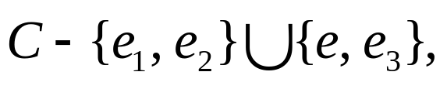
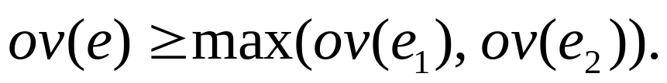
Edge exchange and winning edge
Let C be a cycle cover and let e = < s, t > be an edge of G_{S} . Assume e₁ = < s, u > and e₂ = < v, t >, are respectively, the out-edge of s and in-edge of t in C.
The edge exchange of e is denoted , is the cycle cover where e₃ = <v, u>.
And e is a winning edge if
Notes:
這一篇比較難講，要搞好。

Slide 63

For example,
The cycle length is 9
winning edge
The cycle length is 7
1, 4
u₀
4, 1
u₁
4, 1
u₀
u₁
C
3, 3
2, 3
u₂
u₂
u₂ = bababa
u₂ = bababa
2, 4

Slide 64
v₀ = aggtt, v₁ = gttaag, v₂ = taagc, v₃ = gcata, v₄ = tacc
Another example,
4, 1
5, 1
v₁
4, 2
5, 0
5, 0
2, 3
6, 0
v₀
4, 0
5, 0
5, 0
5, 0
v₂
6, 0
5, 1
4, 0
4, 1
5, 0
4, 0
3, 2
3, 2
5, 0
v₄
4, 0
4, 1
v₃
4, 0
4, 1
3, 2

Slide 65
The cycle length is 20.
v₁
2, 3
6, 0
v₀
5, 0
v₂
v₄
4, 0
v₃
3, 2

Slide 66
v₁
2, 3
6, 0
v₀
5, 0
v₂
3, 2
v₄
4, 0
v₃
3, 2

Slide 67
v₁
2, 3
6, 0
v₀
5, 0
v₂
3, 2
v₄
4, 0
v₃
3, 2

Slide 68
v₁
2, 3
6, 0
v₀
5, 0
v₂
4, 0
3, 2
v₄
4, 0
v₃
3, 2

Slide 69
The cycle length before edge exchange: 20
The cycle length after edge exchange: 18
Therefore, we reduced the cycle length.
v₁
2, 3
6, 0
v₀
v₂
4, 0
3, 2
v₄
v₃
3, 2

Slide 70


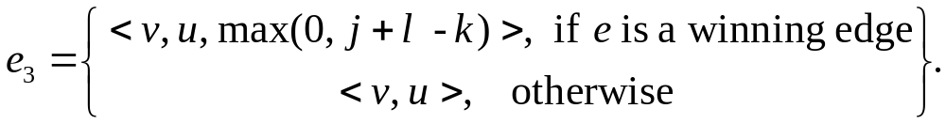
Parsimonious edge exchange and losing edge
Let C be a cycle cover and let e = < s, t, k > be an edge of G_{S} . Assume e₁ = < s, u, j > and e₂ = < v, t l >, are respectively, the out-edge of s and in-edge of t in C.
The parsimonious edge exchange of e in C, denoted , is the cycle cover
where
And e₃ is called a losing edge.
Notes:
這一篇要努力要搞懂。

Slide 71

For example,
S = { u₀, u₁, u₂ }, u₀ = ababc, u₁ = cabab, u₂ = bababa
The cycle length is 9
winning edge
The cycle length is 9
1, 4
u₀
4, 1
u₁
u₀
4, 1
u₁
C
3, 3
2, 3
u₂
u₂
losing edge
u₂ = bababa
u₂ = bababa
4, 2
Notes:
Compare

Slide 72
v₁
2, 3
6, 0
v₀
5, 0
v₂
4, 0
3, 2
winning edge
losing edge
v₄
4, 0
v₃
3, 2

Slide 73
Lemma 2.2
Let s, t, u and v be strings. If ov_{k} (s, t), ov_{l} (s, u), and ov_{j} (v, t) exist for k ≥ max( j, l ), then ov_{m}(v, u) exists for m = max(0, j + l − k).
Let’s go to see an example:
l
j
v
t
s
u
j + l − k
k

Slide 74

The approximation algorithm
1. Construct G_{S} and find C_{S}*. Compute U_{S}* and the string functions.
2. Build the set of merging edges W.
3. Let C = C_{S}*.
  While W is nonempty do
  Let e = < s, t > be a minimum-overlap edge in W. If s and t are in different cycles of C, then C = χ(C, e).
  W = W \ {e}.
4. Set AOPT_{S} to the concatenation of sop (c), .

Slide 75
For example,
S = { u₀, u₁, u₂}, where u₀ = ababc, u₁ = cabab, u₂ = bababa .
The following graph is g_{S} .
5, 0
1, 4
5, 0
u₀
4, 1
u₁
3, 3
2, 3
6, 0
5, 0
u₂
2, 4

Slide 76
u₀ = ababc, u₁ = cabab, u₂ = bababa
C_{S}* is as follows:
c₁ = (u₂, u₂)
c₂ = (u₀, u₁, u₀)
OP(c₁) = { bababa }
OP(c₂) = { ababcabab, cababc }
U_{S}* = {bababa, ababcabab, cababc}
1, 4
u₀
4, 1
u₁
c₂
u₂
Let x₁ = bababa, x₂₁ = ababcabab, x₂₂ = cababc
x₁ is an open of c₁.
x₂₁ and x₂₂ are opens of c₂.
2, 4
c₁

Slide 77
u₀ = ababc, u₁ = cabab, u₂ = bababa
1, 4
c₁ = (u₂, u₂)
c₂ = (u₀, u₁, u₀)
u₀
4, 1
u₁
c₂
u₂
We begin the coloring action from the minimum length cycle.
2, 4
c₁

Slide 78

Now, we choose merging edges to merge the cycles:
1, 4
According to the construction algorithm of W, we choose < u₁, u₂ > to merge c₁ and c₂ .
.
u₀
4, 1
u₁
c₂
u₂
2, 3
2, 4
c₁
u₀ = ababc, u₁ = cabab, u₂ = bababa
c₁ = (u₂, u₂)
c₂ = (u₀, u₁, u₀)
Notes:
若此cycle的minimum length open跟其他cycle產生的opens連接之後所得到的edge最短，就將他們對應的edge加入，即merging edges

Slide 79
1, 4
u₀
4, 1
u₁
c₂
u₂
2, 3
2, 4
c₁

Slide 80
1, 4
u₀
4, 1
u₁
u₂
2, 3
2, 4

Slide 81
1, 4
u₀
4, 1
u₁
3, 3
u₂
2, 3
2, 4

Slide 82
u₀
4, 1
u₁
3, 3
u₂
2, 3
Let this cycle be c_{final} .

Slide 83
u₀ = ababc, u₁ = cabab, u₂ = bababa
c₁ = (u₂, u₂), c₂ = (u₀, u₁, u₀)
At last, We try to find out sop (c_{final} ) .
OP (c_{final} ) = {ababcabababa(12), cababababc(10), babababcabab(12)}.
Therefore, sop (c_{final} ) = cababababc.
u₀
4, 1
u₁
3, 3
u₂
2, 3

Slide 84
However, the optimal solution is right cababababc with length 10.
This approximation algorithm finds out the optimal solution at this case.

Slide 85
Outline
Introduction
Basic definitions
String functions and lemmas
The approximation algorithm
The upper bound
The lower bound
Conclusion

Slide 86
Since the formal analyses of lower bound and the upper bound for the optimal solution is too complicated and difficult for us to understand, now we’re going to describe general strategy relative to simpler examples.

Slide 87
The upper bound
Let S = { u₀, u₁, u₂ }, where u₀ = ababc, u₁ = cabab, u₂ = baba.
5, 0
1, 4
5, 0
u₀
4, 1
u₁
1, 3
2, 3
4, 0
5, 0
u₂
2, 2

Slide 88
Note: u₀ = ababc, u₁ = cabab, u₂ = baba.
C_{S}* = {c₁, c₂}, where c₁ = (u₂, u₂), c₂ = (u₀, u₁, u₀)
1, 4
c₂
u₀
4, 1
u₁
u₂
c₁
2, 2
Let x₀ = ababcabab, x₁ = cababc, x₂ = baba
x₂ is an open of c₁ ; x₀ and x₁ are opens of c₂.
| C_{S}* | = 1 + 4 + 2 = 7

Slide 89
Note: u₀ = ababc, u₁ = cabab, u₂ = baba.
From the algorithm, we obtain AOPT_{S} = ababcabab ∙baba =ababcababa, so | AOPT_{S} | = 10
1, 4
c₂
u₀
4, 1
u₁
u₂
c₁
2, 2
However, the optimal solution is OPT_{S} = cabababc
|OPT_{S}| = 8.

Slide 90
Note: u₀ = ababc, u₁ = cabab, u₂ = baba.
Now, we make an expansion C_{U} of C_{S}*:
u₁ = cabab
u₀ = ababc
3, 2
u₀ = ababc
u₁ = cabab
u₀
5, 0
u₁
C_{U}
u₂
u₁ = baba
u₀ = baba
4, 0

Slide 91


And we make an parsimonious edge exchange for C_{U} .
3, 2
5, 0
u₀
5, 0
u₁
u₀
u₁
2, 3
4, 0
2, 3
u₂
u₂
4, 0

Slide 92


Note: u₀ = ababc, u₁ = cabab, u₂ = baba.
u₀
5, 0
u₁
4, 0
2, 3
u₂
c₁
{ ababccababa(11), cababaababc(11), babaababccabab(14) }
ababccababa or cababaababc

Slide 93
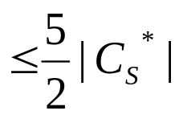
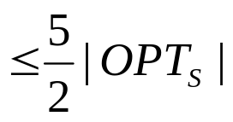

So we obtain that:
|C_{S}*| ≤ | AOPT_{S} | ≤
7
10
11
17.5
20

Slide 94
Outline
Introduction
Basic definitions
String functions and lemmas
The approximation algorithm
The upper bound
The lower bound
Conclusion

Slide 95
The lower bound
Let S = { u₀, u₁, u₂ }, where u₀ = abc, u₁ = cab, u₂ = bababa, then g_{S} is constructed as follows:
3, 0
1, 2
3, 0
u₀
2, 1
u₁
5, 1
2, 1
6, 0
3, 0
u₂
2, 4

Slide 96
Then we find a Hamiltonian cycle c = u₀-u₁-u₂ of g_{S}.
Clearly, c doesn’t contain < u₂, u₂ >.
u₀
2, 1
u₁
5, 1
2, 1
u₂

Slide 97

We find that < u₂, u₂, 2 > is a winning edge for c.
Let e = < u₂, u₂, 2 >. We can make a cycle cover by a parsimonious edge exchange :
u₀
2, 1
u₁
5, 1
2, 1
u₂
4, 2

Slide 98
We find that < u₂, u₂, 2 > is a winning edge for c.
Let e = < u₂, u₂, 2 >. We can make a cycle cover by a parsimonious edge exchange :
u₀
2, 1
u₁
c₁
3, 0
u₂
c₂
4, 2

Slide 99
The length of the local superstring of u₁ to u₀ is 2 + 3 + ov (u₁, u₀). Thus the cycle length = 2 + 3 = 5 is a lower bound of the local superstring of u₁ to u₀.
The global superstring has to consider the connection between u₀ and u₂. We may ignore this when we calculate the lower bound.

Slide 100
Therefore, |C_{L}| = 2 + 3 + 4 = 9.
u₀
2, 1
u₁
c₁
3, 0
u₂
c₂
4, 2

Slide 101
However, the optimal solution is cababababc, which has length 10, so | C_{L} | = |OPT_{S}| − 1.

Slide 102
Outline
Introduction
Basic definitions
String functions and lemmas
The approximation algorithm
The upper bound
The lower bound
Conclusion

Slide 103
Conclusion
Probably the most interesting open question in superstring study is whether the greedy method yields a 2-approximation.
Of course, the other important question in this area is whether OPT_{S} can be approximated within a factor of 2 by any algorithm.

Slide 104
We conjecture that our algorithm can be modified slightly and the analysis improved to prove a 2 1/3 bound.
Unfortunately, the analysis is even more complicated, perhaps worse, the algorithm becomes extremely complex.

Slide 105

Actually, as I looked up for the relative research, I found that the ratio has not been improved since this paper was born.

Slide 106
Thank you.

Slide 107
Happy Teacher’s Day

Slide 108
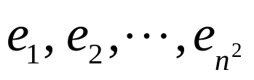
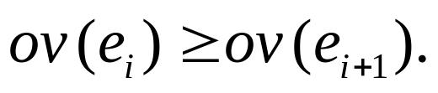
Greedy-cover algorithm
Let C_{S}* = φ . Order the edges of G_{S} as
, so that
For i = 1,…, n²
Add e_{i} = < s, t > to C_{S}* if s doesn’t have an out-edge and t doesn’t have an in- edge in C_{S}*.

