Slide 1
African Populations and the Evolution of Human Mitochondrial DNA
Vigilant L., Stoneking M., Harpending H., Hawkers K. and Wilson A. C.
Science, New Series, Volume 253, Issue 5027(Sep. 27, 1991), 1503-1507.
Speaker : Chuang-Chieh Lin
Advisor : Prof. R. C. T. Lee
National Chi-Nan University

Slide 2
Outline
Introduction
The human mtDNA control region
Tree Analysis
Winning Sites Method
Geographic States Method
Rate of Evolution
Modern Human Origins
Conclusion

Slide 3
Introduction
This paper describes the use of female mitochondrial DNA (mtDNA) as a tool for unraveling the genealogical history of human species.
Why do we use female mtDNA?
When an ovum cell from mother is fecundated, the mitochondria of this ovum cell isn’t influenced by the sperm cell from father.

Slide 4
Where and When did our common ancestor occur?
From Molecular Study of Genes.

Slide 5
Common ancestor?
If human beings have many ancestors, there should be many mtDNAs.
We have already found that the female mtDNAs of all human races in the present world are the same.
Therefore we have only one common ancestor.

Slide 6
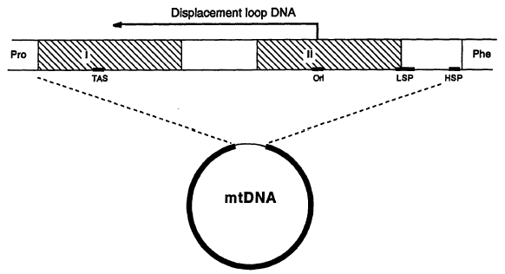
The human mtDNA control region
Let see the figure below :
Enzymes!
Sequences associated with premature termination of replication
HSP, LSP means heavy and light strand promoters, respectively.
The two shaded areas in this figure are the hypervariable segments.
Origin of replication that initiate the Displacement-loop
(16,17, 20, 21)

Slide 7
We find 189 individuals to study :
121 native Africans:
25 !Kung
27 Herero
1 Naron
17 Hadza
14 Yorubans
20 Eastern Pygmies
17 Western Pygmies
68 additional individuals:
20 Papua New Guineans
1 Native Australian
15 Europeans
24 Asians
8 African Americans

Slide 8
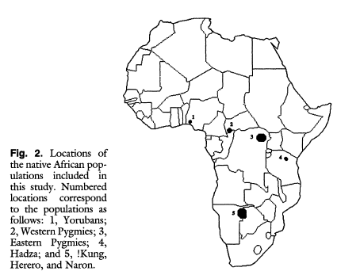
Locations of native African Population

Slide 9
Result in Enzymatic amplification and direct sequencing
Compare approximately 610 nucleotides from each individual:
Substitution : at 179 sites
length changes : at 22 sites.
So there are 201 polymorphic sites.
Each unique sequence is termed an mtDNA type.
135 mtDNA types are defined!

Slide 10
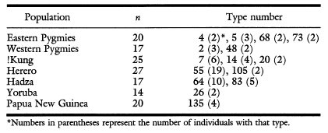
16 mtDNA types occurred more than once:
Type 63 was in one Yoruban and one African American

Slide 11
So we find that:
People with identical mtDNA types were not found in Europeans and Asians. Only within African or Papua New Guinea populations.
There was no sharing of mtDNA types among people from different populations, with one apparent exception :
a Yoruban and an African American
African Americans stem mainly come from West Africa
Strong geographic specificity (7, 16, 20, 25)

Slide 12
Tree Analysis
Genealogical tree relating 135 mtDNA types
Parsimony method: (27, 28)
Branching network is constructed in an effort to minimize the number of mutations required to relate the types.
The parsimony criterion is a philosophical criterion, not a statement of fact.

Slide 13
To convert the resulting network into a tree
The ancestor or root must be found.
We need additional information or assumption.
Midpoint Method? Outgroup Method? (28)

Slide 14
Midpoint Method
A
d (A,D) = 10 + 3 + 5 = 18
Midpoint = 18 / 2 = 9
10
C
3
2
2
5
B
D
Roots the tree at the midway point between the two most distant taxa in the tree, as determined by branch lengths.

Slide 15




Outgroup Method
outgroup
Uses taxa (the “outgroup”) that are known to fall outside of the group of interest (the “ingroup”). Requires some prior knowledge about the relationships among the taxa.

Slide 16
Using the Midpoint Method
Assume that the rate of evolution has been the same in all lineages.
If the evolution rate in African were fast, Rooting by this method wouldn’t indicate an African origin.
The tree might not yield any information regarding the geographic origin of the mtDNA ancestor.
So let’s give up the midpoint method.

Slide 17
Using the Outgroup Method
The outgroup attaches to the position that minimize the total number of mutations.
Problem : High-resolution restriction maps of
African ape mtDNA were not available.
Solution : A control region sequence from a
common chimpanzee sequence was used
to root the tree.

Slide 18
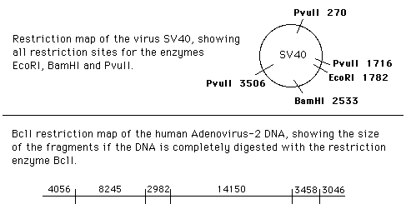
Restriction Map
A stylized depiction of a stretch of DNA which shows the location of the restriction sites for one or several restriction enzymes.
Let’s see the graph below :

Slide 19
Previous result presented by Cann et al.
All contemporary human mtDNAs trace back through maternal lineages to an ancestral mtDNA present in an African population some 200,000 years ago. (7)
But there exists weakness of Cann et al.’s study:
Restriction analysis
Small sample made up largely of African Americans
Using inferior method(midpoint method) to root
No statistical justification is given
Inadequate calibration of rate of human mtDNA evolution
Now, all of the above problems have been solved!

Slide 20
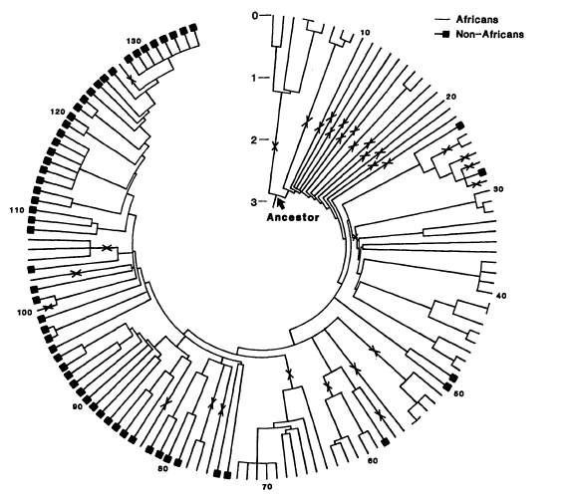
Phylogenetic Tree Relating the 135 mtDNA Types
Markings in the branches indicate the 31 African clusters of mtDNA types

Slide 21
How is the tree constructed?
First: Eliminate uninformative nucleotide positions.
Second: The 119 informative sites were used to determine branching order by program PAUP
Uninformative nucleotide position:
Nonvariable positions and those variable positions that would have the same number of mutations regardless of the branching order of the tree.

Slide 22
Geographic Origin
The outgroup rooting divides the tree into two primary braches.
Ancestor
6 African mtDNA types
All remaining mtDNAs

Slide 23
We can see the 6 African mtDNA types

Slide 24
The 14 deep African branches
These 14 deep African branches provide the strongest support yet for the placement of common human ancestor in Africa.

Slide 25
How do we assess the statistical significance?
Winning Sites Method
Geographic States Method

Slide 26
Winning Sites Method
How many additional mutations would be required to produce a tree whose branching order implies that the ancestor live other than Africa?
Is this number significant more than the number of mutations in the minimum length, African origin tree?
This method does by comparing the number of mutations required by two alternative trees.
A tree is said to win at a nucleotide position if fewer changes are required at the position.
Let’s see type 23 in the Phylogenetic Tree.

Slide 27
The deepest non-African lineage
Type 23
Moving type 23 to the common ancestral stem produce a tree that requires 11 more mutations than the minimum length, African origin tree.
The winning site method determines whether these 11 mutations are significantly more than would expected if both trees are consistent with the data
By applying the test, the African origin tree wins at more sites than the alternative tree

Slide 28
Geographic states method
This method isn’t concerned with the number of mutations, but with the distribution of geographic states for a particular tree.
Focus : The first 14 branches in the tree lead exclusively to African mtDNA types.
This method estimates the probability that this pattern of 14 deepest branches all being African would have arisen by chance along. And the majority of mtDNAs examined were African.

Slide 29
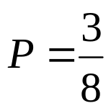
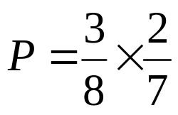
Hypergeometric Distribution
For example:
If there are 3 red balls and 5 green balls in a bag.
What is the probability that the first two balls taken from the bag are red balls?
(Step 1)
(Step 2)

Slide 30

By Hypergeometric Distribution
(35)
The first n branches of the tree: x
Total number of clusters: x + y
For our tree, suppose n = 14, x = 31, y = 24
Therefore P = 0.00006 = 0.006%
There is a 0.006% probability that the observed distribution of geographic states could occur by chance.

Slide 31
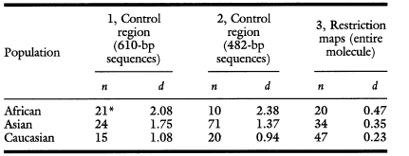
mtDNA sequence difference
An African origin is also suggested by the finding that mtDNA sequence differences are bigger among Africans than among Asians or Europeans.
See the graph below:

Slide 32
The occurrence and accumulation of these mutations is primarily a function of time
We infer that the greater mtDNA sequence differences in sub-Saharan Africa indicate that this population is older. (Because it needs time for mutations.)

Slide 33
Rate of Evolution
An estimate of the rate of sequence divergence of the hypervariable segments of the mtDNA control region was obtained by comparing the average amount of sequence difference between human and chimpanzee.
The apparent difference 15.1% is an underestimate.
Transitions occur much more frequently than transversions in primate mtDNA. (16, 17, 20, 21, 38)

Slide 34
Transitions are likely underrepresented and a multiple hit correction is needed to account for the loss of the record of mutations over time.
Transitions have outnumbered transversions by a ratio of 15 to 1.
For example:
Average transversions = 26.4
Equivalent number of transitions = 26.4 * 15 = 396
Finally we obtain an adjusted estimate of the amount of sequence divergence : 69.2%

Slide 35
To know the rate of mtDNA evolution we need to know :
The amount of sequence divergence
When did the human and chimpanzee mtDNA diverge?
The rate of divergence of the hypervariable segments is roughly 11.5% ~ 17.3%

Slide 36
Age of the common Ancestor
The ancestor corresponds to the deepest node of the tree in Fig.3 and is placed at 2.87% on the scale of accumulated sequence differences.
Accordingly, the ancestor existed about 166000 ~ 249000 years ago.
Derived from the study of restriction maps:
140000 ~ 290000 years ago (7)
From mtDNA sequences of a protein-coding region :
172000 yeas ago (17)
From a maximum likehood analysis of sequences of the control region:
280000 years ago (41)

Slide 37
The above estimates of the age of common human mtDNA ancestor should be regarded as preliminary
Because differences in the pattern of nucleotide substitutions may render the correction for multiple substitutions inaccurate. (17, 41)
There is a need for an intraspecific calibration of the rate of sequence evolution in the human control region. That doesn’t rely on comparing human and chimpanzee sequences. (42)

Slide 38
Modern Human Origins
The present study strongly support :
All the mtDNAs found in contemporary human population stem from a single ancestral mtDNA that was present in an African population approximately 200,000 years ago.
The mtDNA evidence is thus consistent with :
The last 200,000 years, with subsequent migrations out of Africa that established human populations in Eurasia.(7, 44)
Some proponents of fossil view claim :
There has been genetic continuity between modern and archaic Eurasian populations.

Slide 39
Other interpretation of the fossil record :
Support the African origin hypothesis. (49)
The number of informative traits available form the fossil record maybe too small to achieve significance in any statistical test.

Slide 40
Conclusions
Our study strongly supports the placement of our common mtDNA ancestor in Africa some 200,000 years ago.
mtDNA is but a single genetic locus. There are other locuses such as Y chromosome and other DNA markers.
The latest result:
Human ancestor exists in Africa 50,000 years ago.
Therefore, “Evolutionism” of Biology is overturned.

Slide 41

Thank you for attending this seminar.

Slide 42
D-Loop (Displacement loop)
Control site for both replication (copying DNA) and transcription (copying DNA into RNA)
The only non-coding segment of mtDNA that contains the origin of replication
Therefore D-Loop also means mtDNA control region.
Back

Slide 43
Root the tree by Midpoint Method
Real Root
1
1
0.5
Root by Midpoint Method
0.5
1
1
1
1
1
Back

