Slide 1
Algorithms for Identifying Boolean Networks and Related Biological Networks Based on Matrix Multiplication and Fingerprint Function
Tatsuya Akutsu (阿久津 達也), Satoru Miyano (宮野 悟) and Satoru Kuhara (九原 悟)
Journal of Computational Biology, Vol. 7, No. ¾, 2000, pp. 331-343.
Speaker: Chuang-Chieh Lin
Advisor: Professor Maw-Shang Chang
Computation Theory Laboratory
National Chung-Cheng University

Slide 2
Outline
Introduction
Problem Definitions
NP-hardness Result
An Algorithm for Boolean Functions
An Algorithm for Boolean Networks
Conclusions
References

Slide 3
Outline
Introduction
Problem Definitions
NP-hardness Result
An Algorithm for Boolean Functions
An Algorithm for Boolean Networks
Conclusions
References

Slide 4
Introduction
The DNA microarray technology is one of the most important inventions in recent molecular biology.
Many projects using microarray technologies aim at revealing gene regulation mechanisms of gene expression patterns.
Sometimes a gene is expressed if some other genes activate it and is not expressed if some other genes repress it.

Slide 5
Introduction (contd.)
catalyze
phosphorylated protein
catalyze
P
P
transcription factor
protein kinase
protein phosphatase
Protein
transcription factor
DNA
Gene A
Gene B
Gene C
Gene D
Gene E
Through the graph above, we know that each gene’s expression may affect other genes’ expressions. Actually, such affections include activations, repressions, etc.

Slide 6
Introduction (contd.)
Another description: [ss96]
translation
trans A
translation
trans B
trans A
mRNA
mRNA
trans B
cis B
trans B factor gene
cis A
trans A factor gene
Transcription direction
Transcription direction

Slide 7
Introduction (contd.)
To analyze the gene regulation schemes, genetic networks were proposed.
Many studies have been done by using the Boolean network as a model of genetic network.
Each node in a Boolean network represents a gene and it has a value 0 if it is not expressed and a value 1 if it is expressed.

Slide 8
Introduction (contd.)
In this presentation, analysis of qualitative relations and randomized algorithms are omitted.
I will introduce the part of randomized algorithm at next presentation.

Slide 9
Outline
Introduction
Problem Definitions
NP-hardness Result
An Algorithm for Boolean Functions
An Algorithm for Boolean Networks
Conclusions
References

Slide 10
Problem Definitions
Let us see the following gene expression data:
Can you figure out the regulation relations among A, B and C?
 | A | B
1 | 1 | 0
0 | 0 | 1
regulator
regulator
target C
0 : not expressed
1 : expressed
: activation
: repression
A
?
B
?
?
+
C
–
target

Slide 11
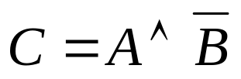
Problem Definitions (contd.)
We can easily find that C = A and are consistent with the given data, where “C = A” means C can be activated if and only if A is activated while means C can be activated if and only if A is activated and B is not activated (repressed).
regulator
A
B
A
B
 | A | B
1 | 1 | 0
0 | 0 | 1
target C
AND
+
+
–
C
C
C = A

Slide 12

Problem Definitions (contd.)
Note that a Boolean network is consistent with the experiment data if for each target gene y_{j} , its regulators x_{i1}, x_{i2},…, x_{iD} , and the corresponding Boolean function f : x_{i1}, x_{i2} ,…, x_{iD}→ y_{j} , the expressions (0’s or 1’s) of x_{i1}, x_{i2},…, x_{iD} and y_{j} satisfy the Boolean function f.
For example,
regulator
A
B
 | A | B
1 | 1 | 0
0 | 0 | 1
target C
AND
+
–
C

Slide 13
Problem Definitions (contd.)
However, is there any other Boolean function consistent with the given data?
 | A | B
1 | 1 | 0
0 | 0 | 1
regulator
target C
A
?
B
?
?
C

Slide 14


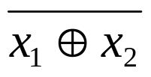

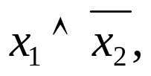
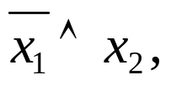
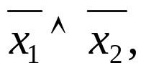


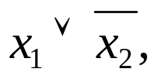

Problem Definitions (contd.)
Claim: For a gene y with indegree D, there are 2^{2D} possible Boolean functions for y. [SS96]
For example, consider D = 2 and let x₁ and x₂ be the genes which regulate y, we have the following Boolean functions:
  0, 1, x₁, x₂, , , x₁⊕x₂, ,

Slide 15
Problem Definitions (contd.)
The reason is as follows. Suppose that genes x₁, x₂,…, x_{D} are regulators to gene y.
  Each x_{i} can be expressed or not expressed (1 or 0) for i=1, 2,…, D. Thus the D-tuple (x₁, x₂,…, x_{D}) has 2^{D} possible values.
  Each possible D-tuple (x₁, x₂,…x_{D}) can be mapped to expressed or not expressed (1 or 0), so we have 2^{2D} possible Boolean functions.

Slide 16





Problem Definitions (contd.)
Note that we say and are the same.
This can be achieved by considering a total order and counting only ’s such that , where x₁,…, x_{n} are the whole given genes.

Slide 17
Problem Definitions (contd.)
An example denotes a set of values of x_{i} ’s and y_{j}’s where each y_{j} is regulated by some x_{i}’s.
For example,
regulator
 | A | B
1 | 1 | 0
0 | 0 | 1
target C
examples

Slide 18
Problem Definitions (contd.)
The following data are also examples.
y₁ | y₂ | x₁ | x₂
0 | 1 | 1 | 0
0 | 0 | 1 | 1
1 | 0 | 0 | 1
0 | 0 | 0 | 0
0 | 1 | 1 | 0
examples

Slide 19
Problem Definitions (contd.)
The consistency problem:
  Decide whether or not there exists a Boolean network (function) consistent with the given examples, and output it if it exists.
The counting problem:
  Count the number of Boolean networks (functions) consistent with the given examples.
The identification problem:
  Decide whether or not there exists a unique Boolean network (function) with the given examples and output it if it exists.

Slide 20
Problem Definitions (contd.)
We shall only discuss algorithms for solving the counting problem because they can be converted for the identification problem and the consistency problem without increasing the order of the time complexity.
Let us define the counting problem as follows.

Slide 21
Problem Definitions (contd.)
< The counting problem >
Input:
  y_{j}(k) (j =1,…,l, k =1,…,m), x_{i} (k) (i =1,…,n, k =1,…,m) and integer D, where x_{i} (k) and y_{j} (k) are Boolean values (i.e., 0 or 1) respectively.
Output:
  For each j, the number of Boolean functions f_{j} (x_{i1},…, x_{iD})’s such that y_{j} (k) = f_{j} (x_{i1} (k),…,x_{iD} (k)) holds for all k =1,…,m.
Actually, k is the number of experiments, and we can view y_{j} as a gene regulated by x_{i}’s.

Slide 22
Problem Definitions (contd.)
Note that, if the number of Boolean functions y_{j} (k) = f_{j} (x_{i1},…, x_{iD})’s can be determined, the number of Boolean networks consistent with the given examples can be also determined by counting each f_{j} .

Slide 23
Problem Definitions (contd.)
However, the consistency problem is NP-complete.
Thus the identification problem and the counting problem are NP-hard.
We shall give to show that the consistency problem is NP-complete.

Slide 24
Outline
Introduction
Problem Definitions
NP-hardness Result
An Algorithm for Boolean Functions
An Algorithm for Boolean Networks
Conclusions
References

Slide 25

NP-hardness Result (contd.)
We will reduce the set cover problem to the consistency problem to show that the consistency problem is NP-complete, then the counting problem and the identification problem are NP-hard.
The set cover problem:
  Given a set of m elements U = {u₁, u₂,…, u_{m}}, a set of subsets S = {S₁, S₂,…,S_{n}} of U and a constant number D, Does there exist D sets S_{i1},…,S_{iD} in S such that
Let us see an instance of the set cover problem first.

Slide 26
NP-hardness Result (contd.)
For example,
A set cover

Slide 27
NP-hardness Result (contd.)
The set cover problem:
  Input:
    a set of m elements U = {u₁, u₂ ,…, u_{m}},
    a set of subsets S = {S₁, S₂ ,…, S_{n}} of U,
    and a constant number D.
  Output:
    Does there exist D sets S_{i1},…, S_{iD} in S such that
  (yes or no)
We shall show the polynomial time reduction from the set cover problem to the counting problem as follows.

Slide 28
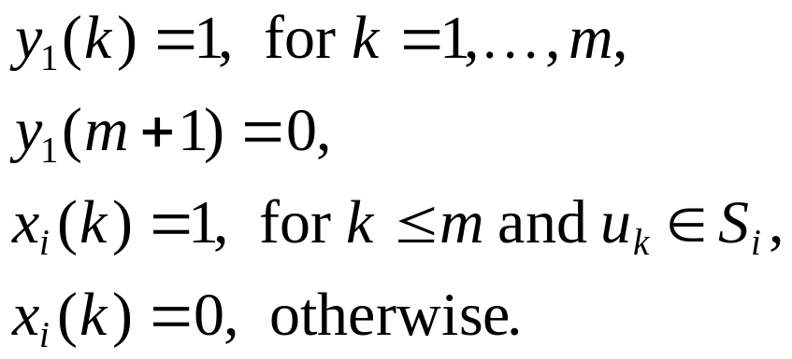


NP-hardness Result (contd.)
From S, D, we construct m + 1 examples as follows:
Then there exists a Boolean function such that if and only if

Slide 29
NP-hardness Result (contd.)
For example,
k | x₁ | x₂ | x₃ | y₁
1 | 1 | 1 | 0 | 1
2 | 1 | 0 | 1 | 1
3 | 0 | 0 | 1 | 1
4 | 0 | 1 | 0 | 1
5 | 0 | 1 | 1 | 1
6 | 0 | 0 | 1 | 1
7 | 0 | 0 | 0 | 0
1
2
3
4
5
6
: u₁,…,u₆ (m=6)
: S₁
(n=3)
: S₂
: S₃

Slide 30
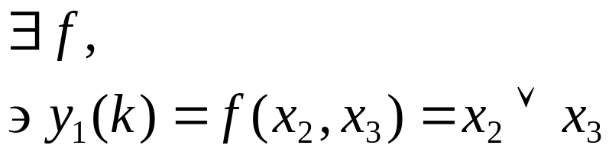
NP-hardness Result (contd.)
k | x₁ | x₂ | x₃ | y₁
1 | 1 | 1 | 0 | 1
2 | 1 | 0 | 1 | 1
3 | 0 | 0 | 1 | 1
4 | 0 | 1 | 0 | 1
5 | 0 | 1 | 1 | 1
6 | 0 | 0 | 1 | 1
7 | 0 | 0 | 0 | 0
1
2
3
4
5
6
: u₁,…,u₆ (m=6)
: S₁
(n=3)
: S₂
: S₃

Slide 31
NP-hardness Result (contd.)
Therefore, the consistency problem is NP-complete.
We should note that the reduction was made just for the case of l = 1. However, the case of l = n is just a generalization of the case of l =1, so it is also NP-complete.
Note that the case of l = n is right for Boolean networks.

Slide 32
Outline
Introduction
Problem Definitions
NP-hardness Result
An Algorithm for Boolean Functions
An Algorithm for Boolean Networks
Conclusions
References

Slide 33
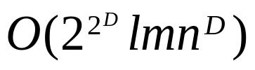
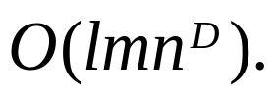
An Algorithm for Boolean Functions
For the counting problem, there is a brute-force algorithm:
  For each y_{j} , for all types of 2^{2D} Boolean functions, for all combinations of D variables x_{i1},…, x_{iD}, examine whether or not y_{j} (k) = f_{j} (x_{i1}(k),…, x_{iD}(k)) holds for k =1,…, m.
It takes time.
If the indegree D is bounded, the time complexity can be reduced to be

Slide 34

An Algorithm for Boolean Functions (contd.)
If we consider only AND, OR and XOR functions, and give restrictions that l = 1and D = 2, we have a time algorithm. However, different types of Boolean functions are counted separately.
ω is the exponent of matrix multiplication (currently, ω < 2.376) [CW90]

Slide 35
An Algorithm for Boolean Functions (contd.)
Multiplication of two n × n matrices can be done in O(n^{ω}) time.
For n × m matrices X and Y, matrix product X ⋅ Y ^{t} can be computed in O(mn^{ω−1}) time if m ≥ n, otherwise it can be computed in O(m^{ω−2}n²) time.
O(m^{ω−2}n² + mn^{ω−1}) time.

Slide 36



An Algorithm for Boolean Functions (contd.)
Note that constant functions (ex: 0, 1) and unary functions (ex: x_{i} , ) are easy to be counted, so we can only consider AND, OR, XOR functions.
AND and OR functions are treated in a similar way based on the fact that
Let us see the algorithm for counting functions first.

Slide 37




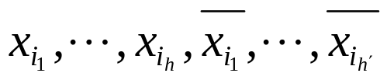


An Algorithm for Boolean Functions (contd.)
<for functions>
Step 1: Make a conjunction of all literals as
Step 2: Process examples one by one (from k = 1 to m). If y₁(k) = 0, nothing is done, else all x_{i}’s such that x_{i} (k) = 0 and all ’s such that (i.e., ) are deleted from the conjunction respectively.
Step 3: Let be the variables remaining in the conjunction after testing all examples, then let be the indices such that y₁(k_{i}) = 0 for
y₁(k) = 1

Slide 38



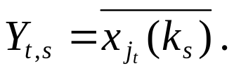


An Algorithm for Boolean Functions (contd.)
Step 4: Make two matrices X and Y, where X is the integer matrix defined by and Y is the integer matrix defined by
Step 5: Compute matrix product
Step 6: Count the number of elements Z_{i, j}’s such that Z_{i, j}= 0.
Since holds if and only if Z_{s, t}= 0, the number in Step 6 is correct and it is the output.

Slide 39
An Algorithm for Boolean Functions (contd.)
For example, assume that the following examples are given as an input data set:
y₁ | x₁ | x₂ | x₃ | x₄ | x₅ | x₆
1 | 1 | 1 | 1 | 0 | 1 | 0
0 | 0 | 1 | 0 | 0 | 1 | 1
0 | 1 | 0 | 1 | 1 | 1 | 1
0 | 1 | 1 | 0 | 1 | 1 | 0
1 | 1 | 1 | 1 | 0 | 0 | 0
0 | 0 | 1 | 0 | 0 | 1 | 1
Table 1

Slide 40


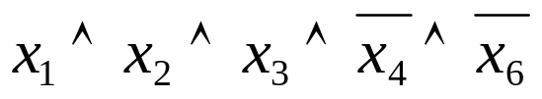
An Algorithm for Boolean Functions (contd.)
After proceeding Step 1, Step 2, Step 3 and Step 4, we have Table 2:
y₁ | x₁ | x₂ | x₃ | x₄ | x₅ | x₆
1 | 1 | 1 | 1 | 0 | 1 | 0
0 | 0 | 1 | 0 | 0 | 1 | 1
0 | 1 | 0 | 1 | 1 | 1 | 1
0 | 1 | 1 | 0 | 1 | 1 | 0
1 | 1 | 1 | 1 | 0 | 0 | 0
0 | 0 | 1 | 0 | 0 | 1 | 1
y₁ | x₁ | x₂ | x₃
0 | 0 | 1 | 0 | 1 | 0
0 | 1 | 0 | 1 | 0 | 0
0 | 1 | 1 | 0 | 0 | 1
0 | 0 | 1 | 0 | 1 | 0
Table 2
Table 1

Slide 41
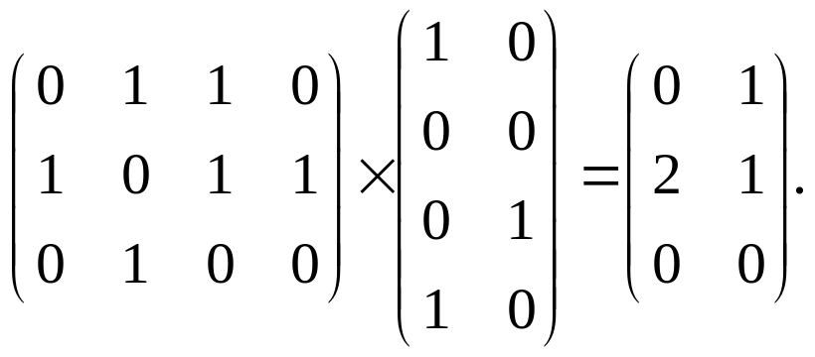


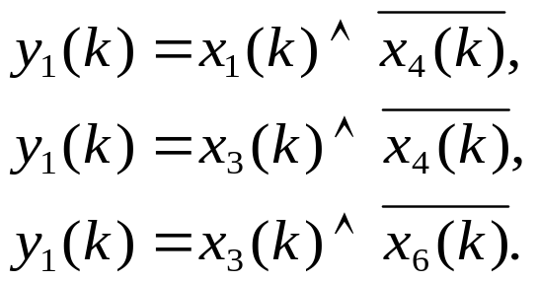
An Algorithm for Boolean Functions (contd.)
By performing Step 5 and Step 6, we have:
Finally, we have the following Boolean functions consistent with the given examples:
x₁
x₂
x₃

Slide 42
An Algorithm for Boolean Functions (contd.)
Thus the time complexity of counting AND functions would be O(m^{ω−2}n² + mn^{ω−1}) time.
Matrices multiplication in Step 5 dominates the time complexity.

Slide 43

An Algorithm for Boolean Functions (contd.)
Now let us proceed on counting functions.

Slide 44

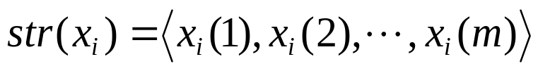
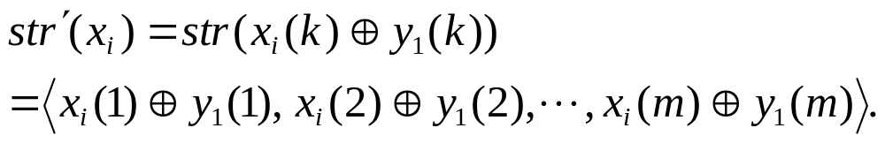



An Algorithm for Boolean Functions (contd.)
<for functions>
Step 1: Let
      Let
Step 2: Count the number of pairs (x_{i} , x_{j}) such that
Note: This algorithm is based on the fact that
iff

Slide 45


An Algorithm for Boolean Functions (contd.)
The time complexity for counting functions would take time if we used a naïve algorithm.
However, we can reduce the time complexity to by constructing a trie. [A90]

Slide 46
An Algorithm for Boolean Functions (contd.)
str(x_{i})’s:
str'(x_{i})’s:
(m = 4 and n = 3)
0
1
str(x₁) = <1,1,0,1>
Construct a trie
str(x₂) = <0,1,0,1>
1
0
1
O(mn)
str(x₃) = <1,0,0,0>
0
0
0
1
0
1
traversing the trie
str'(x₁) = <0,0,0,1>
str'(x₂) = <0,1,0,1>
O(mn)
str'(x₃) = <1,1,0,0>

Slide 47

An Algorithm for Boolean Functions (contd.)
Theorem 1. The counting problem for Boolean functions of two inputs can be solved in time.
We can extend the mentioned algorithms to develop an time algorithm for cases of D ≥ 2.

Slide 48
An Algorithm for Boolean Functions (contd.)
For example, consider the case of D = 3.
Note that
holds for any Boolean function f (x, y, z).

Slide 49





An Algorithm for Boolean Functions (contd.)
Thus we can count the number of Boolean functions ’s for fixed x_{h} by multiplying
  the number of ’s such that holds for examples with x_{h}(k) = 1.
  the number of ’s such that holds for examples with x_{h}(k) = 0.
×

Slide 50

An Algorithm for Boolean Functions (contd.)
Thus for general D, we can apply this method recursively and we can obtain the following time complexity:

Slide 51
Outline
Introduction
Problem Definitions
NP-hardness Result
An Algorithm for Boolean Functions
An Algorithm for Boolean Networks
Conclusions
References

Slide 52

An Algorithms for Boolean Networks
This problem can be solved by using a time Monte-Carlo-type randomized algorithm.
We omit this algorithm this time.

Slide 53
Outline
Introduction
Problem Definitions
NP-hardness Result
An Algorithm for Boolean Functions
An Algorithm for Boolean Networks
Conclusions
References

Slide 54
Conclusions
Checking if there exists a O(n²) time algorithm to perform matrix multiplication is an open problem.
If we can develop a more efficient matrix multiplication algorithm, the algorithms proposed in this paper can be improved.
Try to find some other methods to solve these problems?
Dynamic programming?

Slide 55
T
o
u
h
n
y
a
k

Slide 56
Outline
Introduction
Problem Definitions
NP-hardness Result
An Algorithm for Boolean Functions
An Algorithm for Boolean Networks
Conclusions
References

Slide 57
References
[A90] Algorithms for Finding Patterns in Strings, Aho, A. V., In Van Leeuwen, J. ed., Handbook of Theoretical Computer Science, Vol. A, Elsevier Science, Amsterdam, 1990.
[AB96] Approximating Minimum Keys and Optimal Substructure Screens, Akutsu, T. and Bao, F., Proceedings of 2nd International Conference on Computing and Combinatorics, 1996, pp. 290-299.
[AMK99a] Identification of Genetic Networks from a Small Number of Gene Expression Patterns under the Boolean Network Model, Akutsu, T., Miyano, S. and Kuhara, S., Proceedings of Pacific Symposium on Biocomputing, World Scientific, Singapore, 1999, pp. 17-28.
[AMK99b] Fast Identification of Boolean Networks, Akutsu, T., Miyano, S. and Kuhara, S., Technical Report 99-AL-66, Information Processing Society of Japan, 1999, pp. 25-32.
[AMK2000] Algorithms for Inferring Qualitative Models of Biological Networks, Akutsu, T., Miyano, S. and Kuhara, S., Proceedings of Pacific Symposium on Biocomputing, World Scientific, Singapore, 2000, pp. 293-304.

Slide 58
[AF91] Efficient Two-dimensional Approximate Matching of Nonregular Figures, Amir, A. and Farach, M., Proceedings of ACM-SIAM Symposium on Discrete Algorithms, ACM Press, 1991, pp. 212-223.
[ASR97] A Test Case of Correlation Metric Construction of a Reaction Pathway from Measurements, Arkin, A., Shen, P. and Ross, J., Science, Vol. 277, 1997, pp. 275-229.
[CFS99] Identifying Gene Regulatory Networks from Experimental Data, Chen, T., Filkov, V. and Skiena, S. S., Proceedings of 3rd Annual International Conference on Computational Molecular Biology, 1999, pp. 94-103.
[CW90] Matrix Multiplication via Arithmetic Progression, Coppersmith, D. and Winograd, S., Journal of Symbolic Computation, Vol. 9, 1990, pp. 251-280.
[dB84] Qualitative Physics Based on Confluences, de Kleer, J. and Brown, J. S., Artificial Intelligence, Vol. 24, 1984, pp. 7-83.
[DLB97] Exploring the Metabolic and Genetic Control of Gene Expression on a Genomic Scale, DeRisi, J. L., Lyer, V. R. and Brown, P. O., Science, Vol. 278, 1997, pp. 680-686.
[DWFS99] Linear Modeling of mRNA Expression Levels During CNS Development and Injury, D’haeseleer, P. Wen, X., Fuhrman, S. and Somogyi, R., Proceedings of Pacific Symposium on Biocomputing, World Scientific, Singapore, 1999, pp. 41-52.

Slide 59
[FP74] String Matching and Other Products, Fisher, M. J. and Paterson, M. S., Proceedings of SIAM-AMS Conference on Complexity of Computation, 1974, pp. 113-125.
[HP98] Fast Rectangular Matrix Multiplication and Applications, Huang, X. and Pan, V. Y., Journal of Complexity, Vol. 14, 1998, pp. 257-299.
[J74] Approximation Algorithms for Combinatorial Problems, Johnson, D. S., Journal of Computer and System Sciences, Vol. 9, 1974, pp. 256-278.
[KR85] Efficient Randomized Pattern-Matching Algorithms, Karp, R. M. and Rabin, M. O., IBM Journal of Research and Development, Vol. 31, 1985, pp. 249-260.
[KV94] An Introduction to Computational Learning Theory, Kearns, M. J. and Vazirani, U. V., The MIT Press, Cambridge, MA., 1994.
[LFS98] REVEAL, a General Reverse Engineering Algorithm for Inference of Genetic Network Architectures, Liang, S., Fuhrman, S. and Somogyi, R., Proceedings of Pacific Symposium on Biocomputing, World Scientific, Singapore, 1998, pp. 18-29.
[L88] Learning Quickly When Irrelevant Attributes Abound: a New Linear-threshold Algorithm, Littlestone, N., Machine Learning, Vol. 2, 1988, pp. 285-318.
[M97] Studies on Positive and Horn Boolean Functions with Applications to Data Analysis, Makino, K., Ph.D Thesis, Kyoto University, 1997.

Slide 60
[MR87] Dependency Inference, Mannila, H. and Räihä, K., Proceedings of 13th VLDB Conference, 1987, pp. 155-158.
[MR92] On the Complexity of Inferring Functional Dependencies, Mannila, H. and Räihä, K., Discrete Applied Mathematics, Vol. 40, 1992, pp. 237-243.
[MR94] Randomized Algorithms, Motowani, R. and Raghavan, P, Cambridge University Press, New York, 1994.
[SS96] Modeling the Time Complexity of Genetic Networks: Understanding multigene and pleiotropic regulation, Somogyi, R. and Sniegoski, C. A., Complexity, Vol. 1, 1996, pp. 45-63.
[TT98] Qualitative Analysis of Gene Networks, Thieffry, D. and Thomas, R., Proceedings of Pacific Symposium on Biocomputing, World Scientific, Singapore, 1998, pp. 77-88.
[V84] A Theory of the Learnable, Valiant, L. G., Communications of the ACM, Vol. 27, 1984, pp. 1134-1142.

