Slide 1
An Algorithm for the Steiner Problem in Graphs
M. L. Shore, L. R. Foulds, P. B. Gibbons
Networks, Vol. 12, 1982, pp. 323-333.
Speaker: Chuang-Chieh Lin
Advisor: Professor Maw-Shang Chang
Dept. of CSIE, National Chung-Cheng University
December 10, 2004

Slide 2
Outline
Introduction
Related works
Branch-and-bound strategy
  General concept of the algorithm
  The branching method
  The bounding method
Numerical example
Conclusion
References

Slide 3
Outline
Introduction
Related works
Branch-and-bound strategy
  General concept of the algorithm
  The branching method
  The bounding method
Numerical example
Conclusion
References

Slide 4
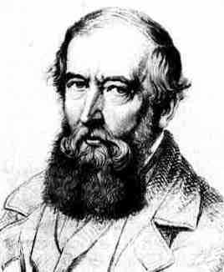
Introduction
Steiner’s problem (SP)
  SP is concerned with connecting a given set of points in an Euclidean plane by lines in the sense that there is a path of lines between every pair in the set.
Steiner problem in graphs (SPG)
  SPG is a graph-theoretic version of the SP.
  Let G be a graph denoted by an ordered pair (V, E), where V is the set of points and E is a set of undirected edges jointing pairs of distinct points of V.
Jakob Steiner

Slide 5
SPG (contd.)
  Let w : E→R be a weight function, such that each edge e in E has a weight w (e), where R is the set of real numbers. For each edge e_{ij} = {v_{i} , v_{j}} in E, we denote its weight w (e_{ij}) by w_{ij} .
  A path between point v_{i} and v_{j} in G is a sequence of the form:
  where v_{αk} , k = 1, 2, …, p, are distinct points in G and the pairs are edges in G.

Slide 6
SPG (contd.)
SPG is then defined as follows:
Given a weighted graph G = (V, E) and a nonempty subset V ' of V, the SPG requires the identification of a subset E* of E such that:
  The edges in E* connect the points in V' in the sense that between every pair of points in V', there exists a path comprising only edges in E*.
  The sum of weights of the edges in E* is a minimum.

Slide 7
SPG (contd.)
To discuss this article more conveniently, we call the vertices in V ' terminals, and vertices in V \ V' Steiner points from now on.
Throughout discussing this article, we assume that all edges of any graph G = (V, E) under consideration have non-negative weight.

Slide 8
This restriction means that among the optimal solutions, there will exist a tree.
Thus we shall solve the SPG by finding a tree containing V ' which is a subgraph of G and is of minimum total weight.
Let us see some examples.

Slide 9
5
A Steiner tree
6
5
2
2
2
3
3
4
2
4
2
13
: E \ E*
: E*
: V'
; terminals
: V / V'
; Steiner points
The sum of weights of this Steiner tree is 2 + 2 + 2 + 2 + 4 = 12.

Slide 10
5
Another Steiner tree
6
5
2
2
2
3
3
4
2
4
2
13
: E \ E*
: E*
: V'
; terminals
: V / V'
; Steiner points
The sum of weights of this Steiner tree is 4 + 2 + 2+ 3 + 4 = 15.

Slide 11
Special cases:
  | V ' | = 1:
  single point
  => The optimal solution has no edges and zero total weight.
  | V ' | = 2:
  SPG can be reduced to finding the shortest path in G between the nodes in V '.
  | V ' | = | V |:
  SPG can be reduced to the minimal spanning tree problem.

Slide 12
Outline
Introduction
Related works
Branch-and-bound strategy
  General concept of the algorithm
  The branching method
  The bounding method
Numerical example
Conclusion
References

Slide 13
Related works
Melzak [M61] and Cockayne [C70] have given exact algorithms for the SP respectively. (Only small SP’s can be handled by these algorithms)
Chang [C72] and Scott [S71] proposed heuristics for larger SP’s.
For the special case of constructing a Steiner tree with a given topology, Hakimi [H71] proposed an algorithm based on the method of Melzak for the SP.

Slide 14
Related works (contd.)
Hakimi [H71] examined the general SPG and provided an algorithm for its solution. Hakimi also showed that a solution to the SPG also yields solutions to the problems of finding a maximum independent set and a minimum dominating set.
Dreyfus and Wagner [DW72] presented an algorithm for the general SPG which is similar in spirit to dynamic programming and requires the calculation of the shortest path between every pair of points in the graph.

Slide 15
Related works (contd.)
According to Christofides [C72a], these algorithms above are not bad in experimental results but they can’t handle problems with much above 10 points in V ' in reasonable computing time.
Takahashi and Matsuyama [TM80] have presented an algorithm based on Dijkstra’s minimal spanning tree algorithm, which finds an approximate solution in Θ(k n²) time, where k = | V ' | and n = | V |. The worse case cost ratio of the obtained solution to the optimal solution is tightly 2(1 − 1/k).

Slide 16
Outline
Introduction
Related works
Branch-and-bound strategy
  General concept of the algorithm
  The branching method
  The bounding method
Numerical example
Conclusion
References

Slide 17
Branch-and-bound strategy
The general ideas:
  Each edge e_{ij} can be temporarily excluded from consideration.
  The set of included edges for a partial solution will form a set of connected components; those components that contain points in V ' are called essential components.
  The criterion for a solution to be feasible is that there is only one essential component. (All points in V ' are connected by the set of includes edges.)
include
exclude
Notes:
Some edges may be temporarily excluded from consideration. => 要加在後面的slides

Slide 18
  As an edge e_{ij} is added to the set of included edges, the components containing v_{i} an v_{j} will be combined to form one component.
  When a further edge is excluded, the component structure remains unaltered.
The algorithm is as follows:

Slide 19
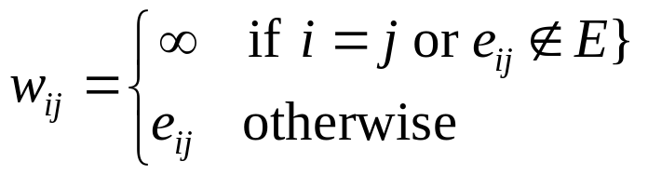
The algorithm:
  <1> Let |V | = n and |V' | = m. Relabel the points in V' as v₁, v₂, … , v_{m} and those in V \ V' as v_{m+1}, v_{m+2}, … , v_{n}.
  <2> Construct a matrix W = [w_{ij}]_{n×n} , where

Slide 20
  <3> Calculate the lower bound and upper bound at this node.
    (Fathomed) If the lower bound is equal to the upper bound, return the feasible solution.
    (Fathomed) If the lower bound is greater than the presently found lowest upper bound, discard this node.
    (Fathomed) If the node itself represents an infeasible solution, discard this node.

Slide 21
    (Unfathomed) Else, branch on each node to two nodes. One node is generated by excluding an edge from consideration and the other one is generated by including it in the partial solution. The latter node is always selected first. (This leads to an initial examination of successive partial solutions of accepted edges.) => < depth-first >
  <4> Backtrack the partial solutions then:
    the optimal solution is uncovered
    or the evidence that no such solution exists is provided.
Next, let us proceed to the branching method.

Slide 22
Outline
Introduction
Related works
Branch-and-bound strategy
  General concept of the algorithm
  The branching method
  The bounding method
Numerical example
Conclusion
References

Slide 23
The branching method
Assume that we are branching on an unfathomed node N.
We associate with each edge a penalty for not adding it to the set of included edges.
The edge with the largest penalty will be selected for branching.
How do we calculate a penalty?
  penalty vector

Slide 24
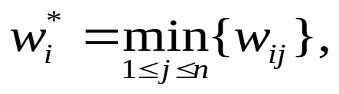
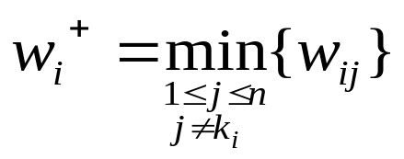
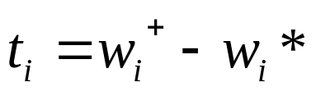
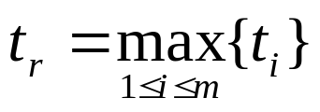
A penalty vector T = {t_{i}: i = 1, 2, … , m} is calculated as follows:
  Compute k_{i} = the value of j producing w_{i}*.
  Compute .
  Compute
  At last,
Then the edge e_{r, kr} is the edge to branch.
Two nodes emanating from N are created.
It is some kind of heuristic idea!
Notes:
每次都選擇terminals來看(since i=1, 2, …m)
後面有例子

Slide 25
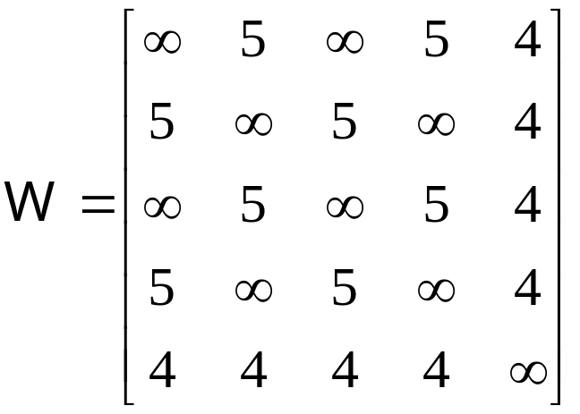
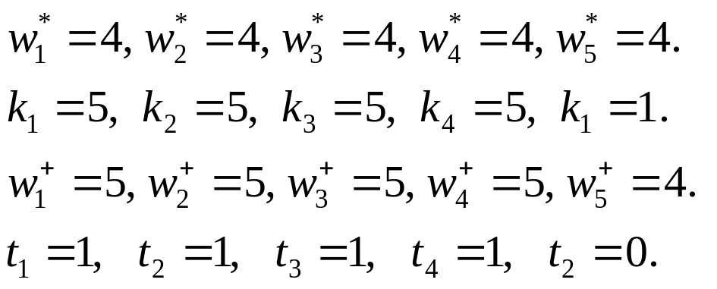
For example, let us see the following graph:
v₁
v₃
(v₁, v₂, v₃, v₄ are terminals and v₅ is a Steiner point.)
5
5
v₂
5
4
5
4
4
v₅
4
v₄
∴t_{r} = 1 and the edge to branch can be e_{1, 5}

Slide 26
v₁
v₃
v₂
Node 0
v₄
v₅
v₁
v₁
v₃
v₃
v₂
v₂
4
or
v₅
v₄
v₅
v₄
Node 1
Node 2

Slide 27
In order to produce a bound for a new partial solution, we must temporarily adjust the weight matrix W.
If the new partial solution was produced by adding e_{xy} to the set of excluded edges, then we temporarily set w_{xy} = w_{yx} = ∞.
If the new partial solution was produced by adding e_{xy} to the set of included edges, then components, c_{x} and c_{y} , where v_{x} and v_{y} belong are combined. W is then transformed to W ' with one less row in each row and one less column in each column.

Slide 28
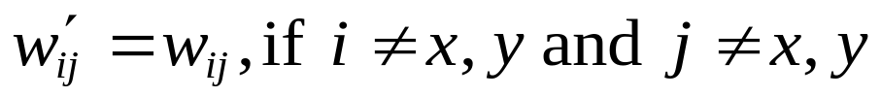
Thus if we let W ' =[w'_{ij}],
  If 1 ≤ x ≤ m,
  Otherwise,
<for included edges>
(x’s are terminals)
(x’s are Steiner points)

Slide 29
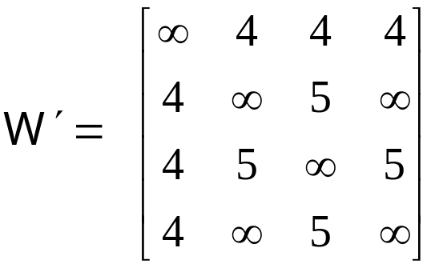
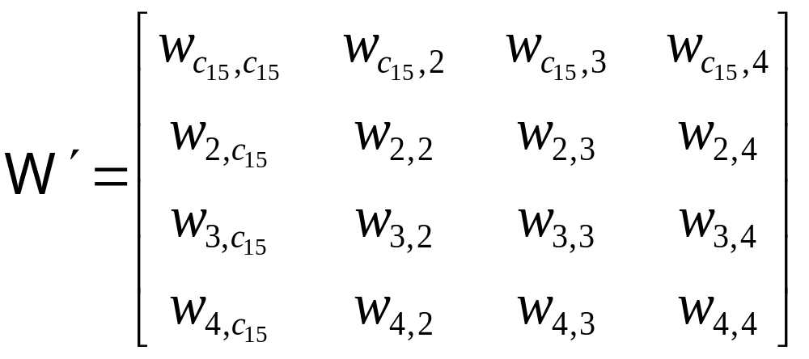
For example, in the previous example,
At node 1, W will be temporarily changed to
v₁ and v₅ are combined

Slide 30
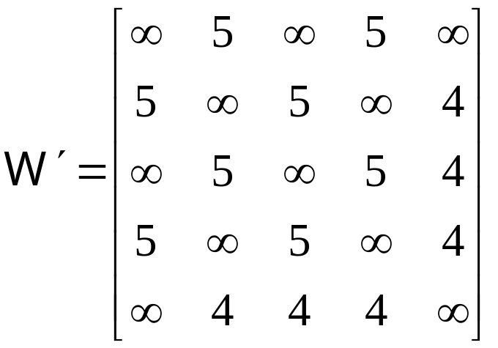
At node 2, W will be temporarily changed to

Slide 31
Outline
Introduction
Related works
Branch-and-bound strategy
  General concept of the algorithm
  The branching method
  The bounding method
Numerical example
Conclusion
References

Slide 32
The bounding method
Upper bound:
  At each branching node N, finding the minimal spanning tree from the current node. Then the sum of weights of this tree is an upper bound for N. (Actually, The authors didn’t calculate the upper bounds, so we omit the proof here.)
Lower bound:
  The Lower bound is calculated for a node with weight matrix W by using the following theorem.

Slide 33
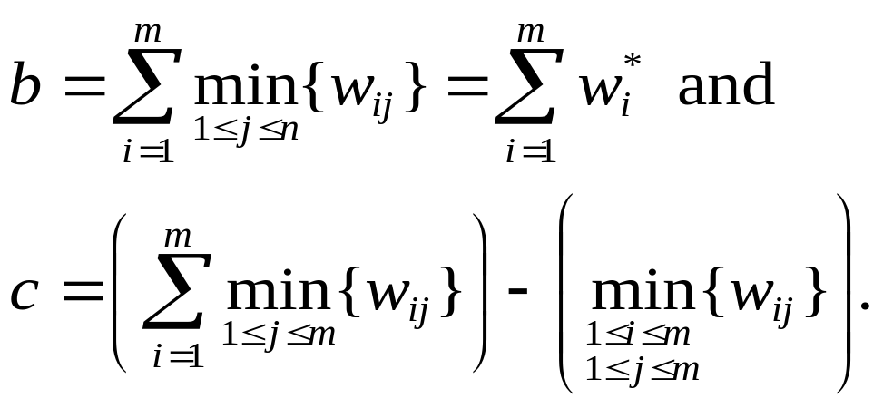
The bounding method (contd.)
Theorem.
Consider an SPG on graph G = (V, E) with the optimal solution z*. Then we have z* ≥ min {b, c}, where

Slide 34
Proof:
Consider a minimal tree T * with length z* spanning V'.
Suppose T * = (V *, E *), where V' ⊆ V *⊆ V and E *⊆ E.
T * can be represented as the ordered triple (V_{t} , E*, v_{t}), where V_{t} ∪ {v_{t}} = V *, and there is a one-to-one correspondence h: V_{t} → E * such that v_{i} is incident with h(v_{i}), for all v_{i}∈V_{t} .
Now, let us discuss about the following two cases:
  Case I: V *\ V ' ≠ φ
  Case II: V *= V '.
⇒ Think about the reason !

Slide 35
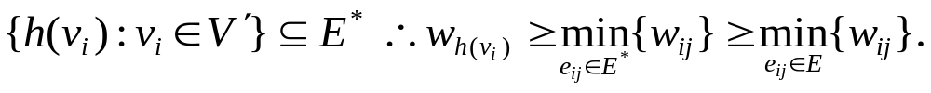
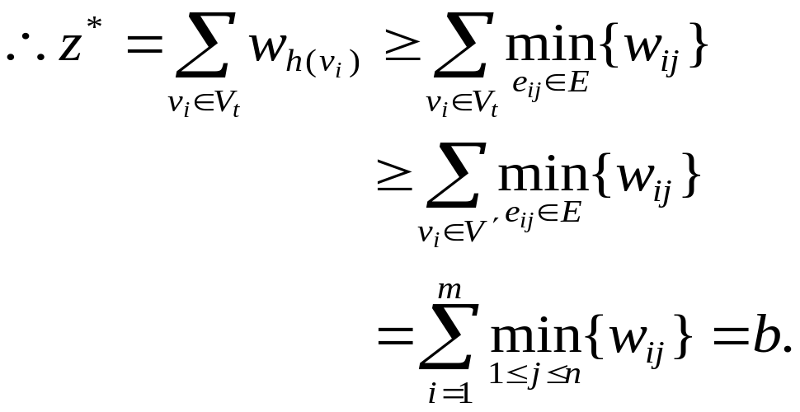
Case I. V *\ V ' ≠ φ, i.e., ∃k, m < k ≤ n s.t. v_{k}∈ V *\ V '.
  Let v_{t} = v_{k} . Therefore V' ⊆ V_{t} as v_{k}∉ V'.
  Thus
since E*⊆ E.

Slide 36
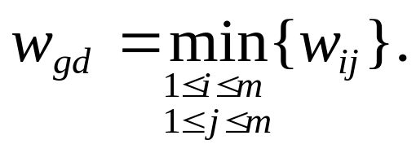
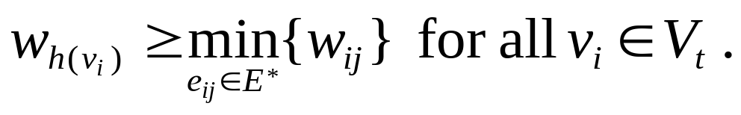
V * contains only terminals, T * becomes the minimal spanning tree of V *, that is, V'.
Case II. V *= V ' .
  Given any v_{t}∈V *, {h(v_{i}): v_{i}∈V_{t}} = E*.
  Let
  Let v_{t} = v_{g} . Now,
v_{d}
v_{g} = v_{t}

Slide 37
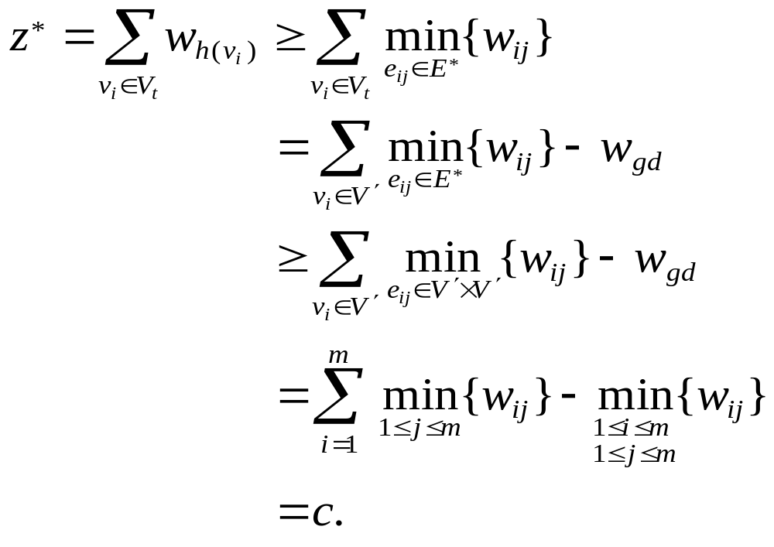
(Note that {h(v_{i}): v_{i}∈V_{t}} = E*.)
since V_{t}∪{v_{t}} = V * = V ' and v_{t} = v_{g}
since E* ⊆ V *×V * = V '× V '
Therefore, we have shown that z* ≥ b or z* ≥ c. ■

Slide 38
Outline
Introduction
Related works
Branch-and-bound strategy
  General concept of the algorithm
  The branching method
  The bounding method
Numerical example
Conclusion
References

Slide 39
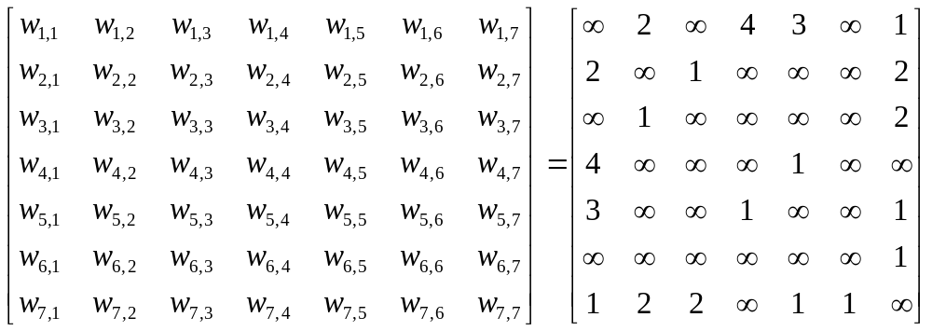
Numerical example
Now, let us see an example.
6
4
1
7
5
m = 4
3
2

Slide 40
Node 1
(4)
~ e_{4, 5}
e_{4, 5}
The authors’ decision tree nodes
Node 17
(7)
Node 2
(4)
~ e_{5, 7}
e_{5, 7}
discard
Node i
(lower bound)
Node16
(7)
Node 3
(5)
~ e_{1, 7}
e_{1, 7}
discard
Node15
(7)
Node 4
(6)
node
~ e_{6, 7}
e_{6, 7}
discard
Node 5
(7)
Node 10
(6)
~ e_{3, 7}
e_{3, 7}
~ e_{2, 3}
Node 9
(7)
Node 6
(7)
Node 14
(7)
e_{2, 3}
discard
~ e_{2, 3}
e_{2, 3}
discard
Node 11
(6)
Node 8
(∞)
Node 7
(7)
~ e_{3, 7}
e_{3, 7}
discard
solution
Node 13
(∞)
Node 12
(6)
discard
solution

Slide 41
Node 1
(4, ∞)
~ e_{4, 5}
e_{4, 5}
My decision tree nodes
Node 7
(7, 6)
Node 2
(4, 7)
Node i
(lower bound, upper bound)
discard
~ e_{5, 7}
e_{5, 7}
Node 6
(7, 6)
Node 3
(5, 6)
node
discard
~ e_{1, 7}
e_{1, 7}
Node 5
(7, 6)
Node 4
(6, 6)
discard
solution
Next, we will concentrate on this bounding procedure.

Slide 42
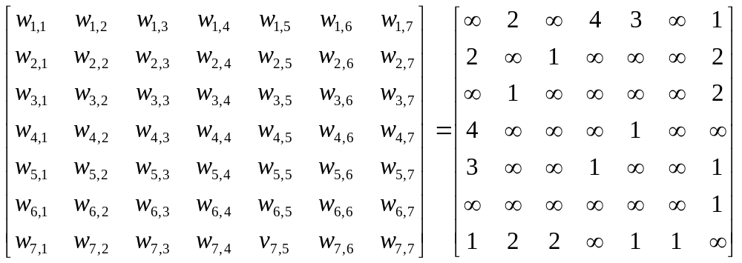
Node 1: < φ >
b = 1 + 1 + 1 + 1 = 4; c = (2 + 1 + 1 + 4) −(1) = 7
lower bound = min {b, c} = 4
upper bound = ∞ ⇒ global upper bound (by finding a minimal spanning tree of v₁, v₂, v₃ and v₄)
pick?

Slide 43
Node 1
(4, ∞)
~ e_{4, 5}
e_{4, 5}
Node 7
(?, ?)
Node 2
(?, ?)

Slide 44
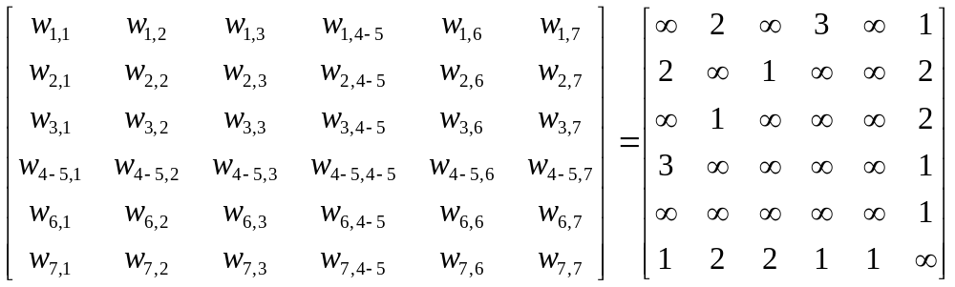
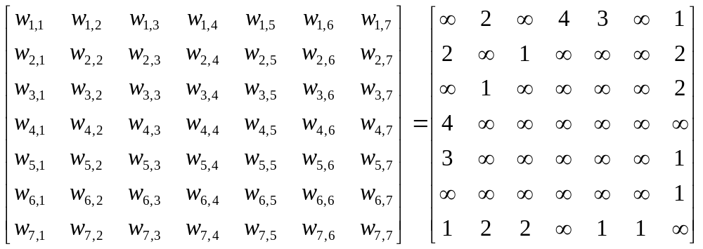
For node 2: (pick e_{4, 5})
For node 7: (don’t pick e_{4, 5})

Slide 45
Node 2: < e_{4, 5} >
b =1 + 1 + 1 + 1 = 4; c = (2+1+1+1) − (1) = 4
lower bound = 1 + min {b, c} = 5
upper bound = |e_{4, 5}| + | e_{5, 1}| + |e_{1, 2}| + |e_{2, 3}| = 1 + 3 + 2 + 1 = 7 ⇒ global upper bound (by finding a minimal spanning tree of v₁, v₂, v₃ and v₄₋₅)
pick?

Slide 46
Node 1
(4, ∞)
~ e_{4, 5}
e_{4, 5}
Node 7
(?, ?)
Node 2
(4, 7)
~ e_{5, 7}
e_{5, 7}
Node 6
(?, ?)
Node 3
(?, ?)

Slide 47
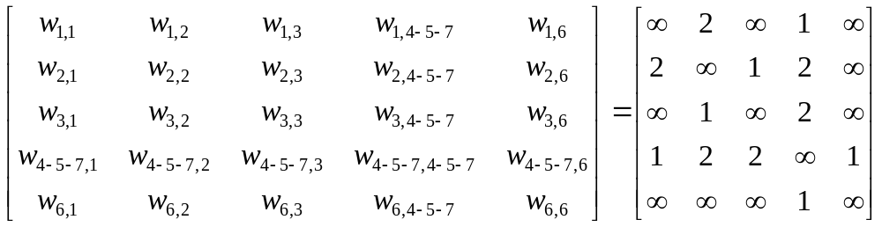
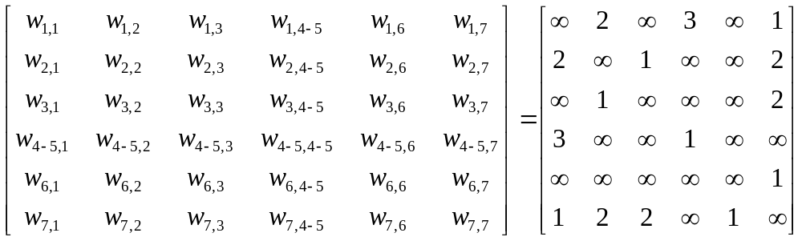
For node 3: (pick e_{5,} ₇)
For node 6: (don’t pick e_{5, 7})

Slide 48
Node 3: < e_{4, 5} , e_{5, 7} >
b =1 + 1 + 1 + 1 = 4; c = (1+1+1+1) − (1) = 3
lower bound = 2 + min {b, c} = 5
upper bound = |e_{4, 5}| + | e_{5, 7}| + |e_{7, 1}| + |e_{1, 2}| + |e_{2, 3}| = 1 + 1 + 1 + 2 + 1 = 6 ⇒ global upper bound (by finding a minimal spanning tree of v₁, v₂, v₃ and v₄₋₅₋₇)
pick?

Slide 49
Node 1
(4, ∞)
~ e_{4, 5}
e_{4, 5}
Node 7
(?, ?)
Node 2
(4, 7)
~ e_{5, 7}
e_{5, 7}
Node 6
(?, ?)
Node 3
(5, 6)
~ e_{1, 7}
e_{1, 7}
Node 5
(?, ?)
Node 4
(?, ?)

Slide 50
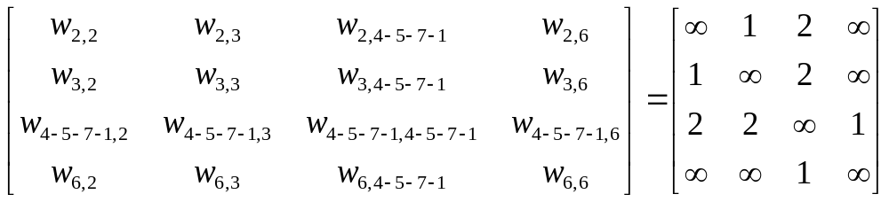
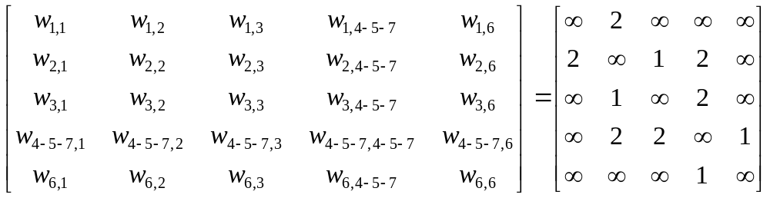
For node 4: (pick e_{1,} ₇)
For node 5: (don’t pick e_{1, 7})

Slide 51
Node 4: < e_{4, 5} , e_{5, 7} , e_{1, 7} >
b =1 + 1 + 1 + 1 = 4; c = (1+1+1+1) − (1) = 3
lower bound = 3 + min {b, c} = 6
upper bound = |e_{4, 5}| + |e_{5, 7}| + |e_{7, 1}| + |e_{1, 2}| + |e_{2, 3}| = 1 + 1 + 1 + 2 + 1 = 6 = global upper bound (by finding a minimal spanning tree of v₂, v₃ and v₄₋₅₋₇₋₁)
A feasible solution is here since its lower bound = its upper bound.

Slide 52
Node 1
(4, ∞)
~ e_{4, 5}
e_{4, 5}
Node 7
(?, ?)
Node 2
(4, 7)
~ e_{5, 7}
e_{5, 7}
Node 6
(?, ?)
Node 3
(5, 6)
~ e_{1, 7}
e_{1, 7}
Node 5
(?, ?)
Node 4
(6, 6)
solution

Slide 53
Node 5: < e_{4, 5} , e_{5, 7} , ~e_{1, 7} >
b =2 + 1 + 1 + 1 = 5; c = (2+1+1+2) − (1) = 5
lower bound = 2 + min {b, c} = 7
upper bound = |e_{4, 5}| + |e_{5, 7}| + |e_{7, 2}| + |e_{2, 3}| + |e_{2, 1}| = 1 + 1 + 2 + 1 + 2 = 7 > global upper bound = 6 (by finding a minimal spanning tree of v₁, v₂, v₃ and v₄₋₅₋₇)
Discard this node since its lower bound is higher than global upper bound

Slide 54
Node 1
(4, ∞)
~ e_{4, 5}
e_{4, 5}
Node 7
(?, ?)
Node 2
(4, 7)
~ e_{5, 7}
e_{5, 7}
Node 6
(?, ?)
Node 3
(5, 6)
~ e_{1, 7}
e_{1, 7}
Node 5
(7, 6)
Node 4
(6, 6)
discard
solution

Slide 55

Node 6: < e_{4, 5} , ~ e_{5, 7} >
b = 1 + 1 + 1 + 3 = 6; c = (2 + 1 + 1 + 3) − (1) = 6
lower bound = 1 + min {b, c} = 7
upper bound = |e_{4, 5}| + |e_{5, 1}| + |e_{1, 2}| + |e_{2, 3}| = 1 + 3 + 2 + 1 = 7 > global upper bound = 6 (by finding a minimal spanning tree of v₁, v₂, v₃ and v₄₋₅)
Discard this node since its lower bound is higher than global upper bound

Slide 56
Node 1
(4, ∞)
~ e_{4, 5}
e_{4, 5}
Node 7
(7, 6)
Node 2
(4, 7)
~ e_{5, 7}
e_{5, 7}
Node 6
(7, 6)
Node 3
(5, 6)
discard
~ e_{1, 7}
e_{1, 7}
Node 5
(7, 6)
Node 4
(6, 6)
discard
solution

Slide 57
Node 7: < ~e_{4, 5} >
b = 1 + 1 + 1 + 4 = 7; c = (2 + 1 + 1 + 4) − (1) = 7
lower bound = min {b, c} = 7
upper bound = |e_{1, 2}| + |e_{2, 3}| + |e_{1, 4}| + |e_{2, 3}| = 2 + 1 + 4 = 7 > global upper bound = 6 (by finding a minimal spanning tree of v₁, v₂, v₃ and v₄)
Discard this node since its lower bound is higher than global upper bound

Slide 58
Node 1
(4, ∞)
~ e_{4, 5}
e_{4, 5}
Node 7
(7, 6)
Node 2
(4, 7)
discard
~ e_{5, 7}
e_{5, 7}
Node 6
(7, 6)
Node 3
(5, 6)
discard
~ e_{1, 7}
e_{1, 7}
Node 5
(7, 6)
Node 4
(6, 6)
discard
solution

Slide 59
Node 1
(4, ∞)
~ e_{4, 5}
e_{4, 5}
Node 7
(7, 6)
Node 2
(4, 7)
discard
~ e_{5, 7}
e_{5, 7}
Node 6
(7, 6)
Node 3
(5, 6)
discard
~ e_{1, 7}
e_{1, 7}
Node 5
(7, 6)
Node 4
(6, 6)
discard
solution
Procedure terminated.

Slide 60
Outline
Introduction
Related works
Branch-and-bound strategy
  General concept of the algorithm
  The branching method
  The bounding method
Numerical example
Conclusion
References

Slide 61
Conclusion
In fact, we don’t have to actually form the matrix W '.
Instead, we can retain one copy of the original weight matrix W and held the component structure in a vector C = [c_{i}]_{1×n} , where c_{i} is the number of the component containing point v_{i}.

Slide 62
This article is related to our project but the Steiner points in our project are much more and unknown.
It is related to constructing phylogeny or phylogenetic trees.
That’s all.

Slide 63
Outline
Introduction
Related works
Branch-and-bound strategy
  General concept of the algorithm
  The branching method
  The bounding method
Numerical example
Conclusion
References

Slide 64
References
[B62] On a Routing Problem, Bellman, R. E., Quarterly of Applied Mathematics, Vol. 16, 1962, pp. 349.
[C72a] The Generation of Minimal Trees with Steiner Topology, Chang, S. K., Journal of the ACM, Vol. 19, 1972, pp. 699.
[C72b] Graph Theory : An Algorithm Approach, Christofides, N., Academic Press, London, 1975, pp. 145.
[C70] On the Efficiency of the Algorithm for Steiner Minimal Trees, Cockayne, E. J., SIAM Journal on Applied Mathematics, Vol. 18, 1970, pp. 150.
[D59] A Note on Two Problems in Connection with Graphs, Dijkstra, E. W., Numerische Mathematik, Vol. 1, 1959, pp. 269.
[DW72] The Steiner Problem in Graphs, Dreyfus, S. E. and Wagner, R. A., Networks, Vol. 1, 1972, pp. 195-207.

Slide 65
[F58] Algorithm 97, Shortest Path, Floyd, R. W., Communications of the ACM, Vol. 16, 1958, pp. 87-90.
[F56] Network Flow Theory, Ford, L. R., The Rand Corporation, July, 1956.
[FG78] A Branch and Bound Approach to the Steiner Problem in Graphs, Ford, L. R. and Gibbons, P. B., 14th Ann. Conf. O.R.S.N.Z., Christchurch, New Zealand, May, 1978.
[FHP78] Solving a Problem Concerning Molecular Evolution Using the O.R. Approach, Foulds, L. R., Hendy, M. D. and Penny E. D., N.Z. Operational Research, Vol. 6, 1978, pp. 21-33.
[H71] Steiner’s Problem in Graphs and Its Implications, Hakimi, S. L., Networks, Vol. 1, 1971, pp. 113-133.
[KW72] Algorithm 422-minimal Spanning Tree, Kevin, V. and Whitney, M., Communications of the ACM, Vol. 15, 1972.

Slide 66
[K56] On the Shortest Spanning Subtree of a Graph and the Traveling Salesman Problem, Kruskal, J. B., Jr., Proceedings of Am. Math Soc., Vol. 7, 1956, pp. 48.
[M61] On the Problem of Steiner, Melzak, Z. A., Canadian Mathematical Bulletin, Vol. 4, 1961, pp. 355.
[M57] The Shortest Path through a Maze, Moore, E. F., Proc. Int. Symp. on the Theory of Switching, Part II, 1957, pp. 285.
[P57] Shortest Connection Networks and Some Generalizatons, Prim, R. C., Bell Syst. Tech. J., Vol. 36, 1957, pp. 1389.
[S71] Combinatorial Programming, Spatial Analysis, and planning, Scott, A., Methuen, London, 1971.
[TM80] An Approximation Solution for the Steiner Problem in Graphs, Takahashi, H. and Matsuyama, A., Math. Japonica, Vol. 24, 1980, pp. 573-577.

Slide 67
This file of slides is available at
http://www.cs.ccu.edu.tw/~lincc/paper/An_Algorithm_for_the_Steiner_Problem_in_Graphs.ppt

Slide 68
Thank you.

Slide 69
v_{t}
V' ⊆ V* ⊆ V
all points : V
: V \ V *
Steiner points
: V *\ V'
: V'
terminals

Slide 70
<Case I>
v_{t}
V' ⊆ V* ⊆ V
all points : V
: V \ V *
Steiner points
: V *\ V'
: V'
terminals

Slide 71
<Case II>
v_{t} = v_{g}
V' = V* ⊆ V
all points : V
: V \ V *
Steiner points
: V *= V'
terminals

Slide 72
Jakob Steiner did not learn to read and write until he was 14 and only went to school at the age of 18, against the wishes of his parents. He then studied at the Universities of Heidelberg and Berlin, supporting himself with a very modest income from tutoring.
He was an early contributor to Crelle's Journal, the first journal devoted entirely to mathematics founded in 1826. He was appointed to a chair at the University of Berlin in 1834, a post he held until his death.
He was one of the greatest contributors to projective geometry.
He discovered the Steiner surface which has a double infinity of conic sections on it. The Steiner theorem states that the two pencils by which a conic is projected from two of its points are projectively related.
Another famous result is the Poncelet-Steiner theorem which shows that only one given circle and a straight edge are required for Euclidean constructions.

Slide 73
He disliked algebra and analysis and believed that calculation replaces thinking while geometry stimulates thinking. He was described by Thomas Hirst as follows:
He is a middle-aged man, of pretty stout proportions, has a long intellectual face, with beard and moustache and a fine prominant forehead, hair dark rather inclining to turn grey. The first thing that strikes you on his face is a dash of care and anxiety, almost pain, as if arising from physical suffering - he has rheumatism. He never prepares his lectures beforehand. He thus often stumbles or fails to prove what he wishes at the moment, and at every such failure he is sure to make some characteristic remark.
Article by: J. J. O'Connor and E. F. Robertson
http://www-gap.dcs.st-and.ac.uk/~history/Mathematicians/Steiner.html

